Slide 1
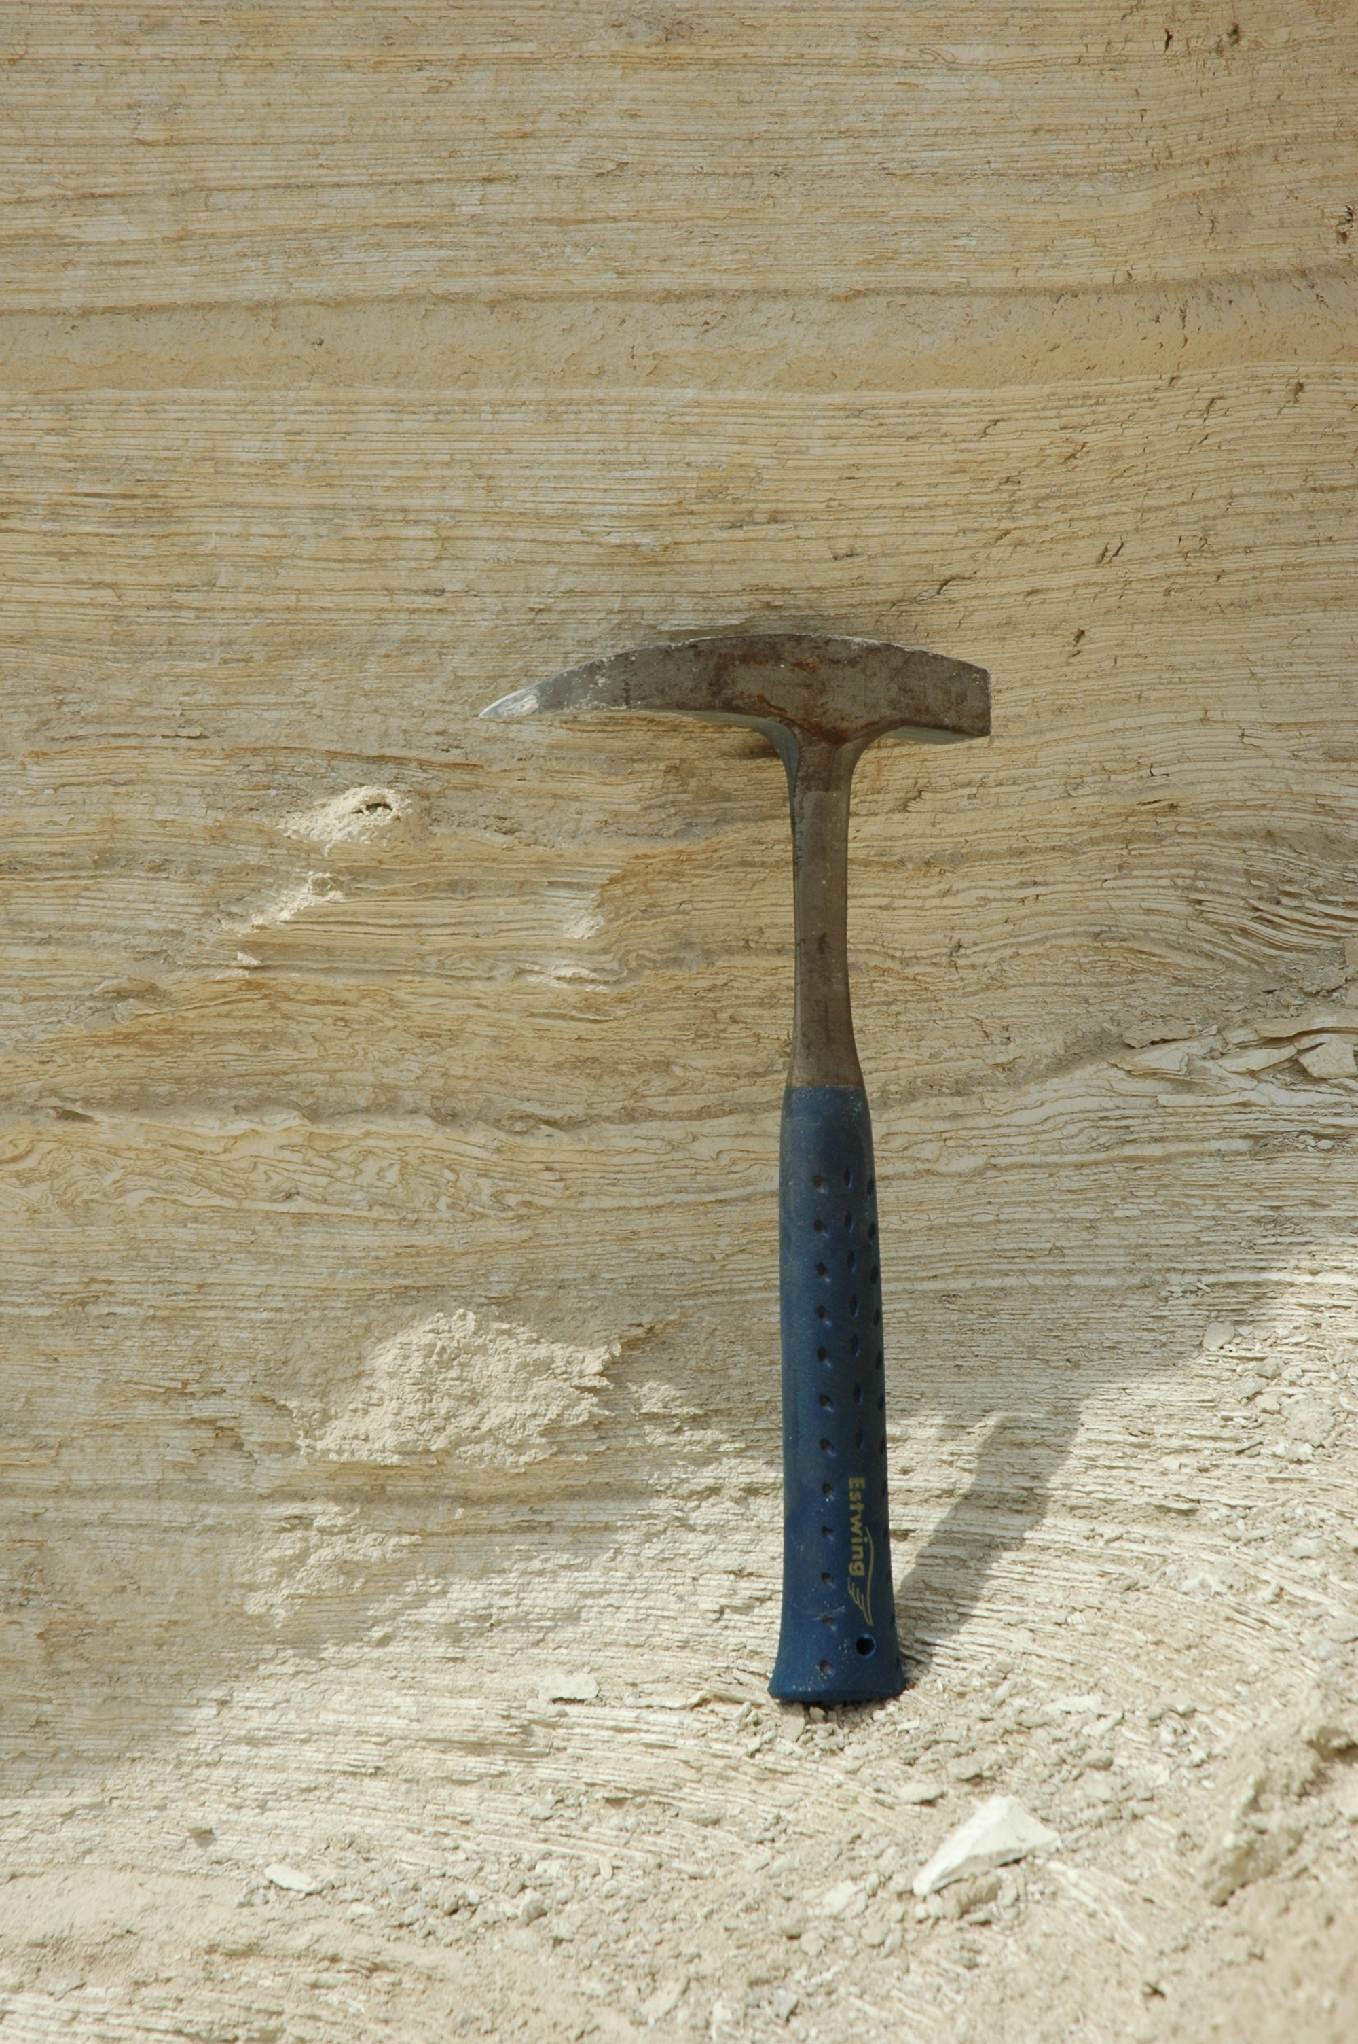
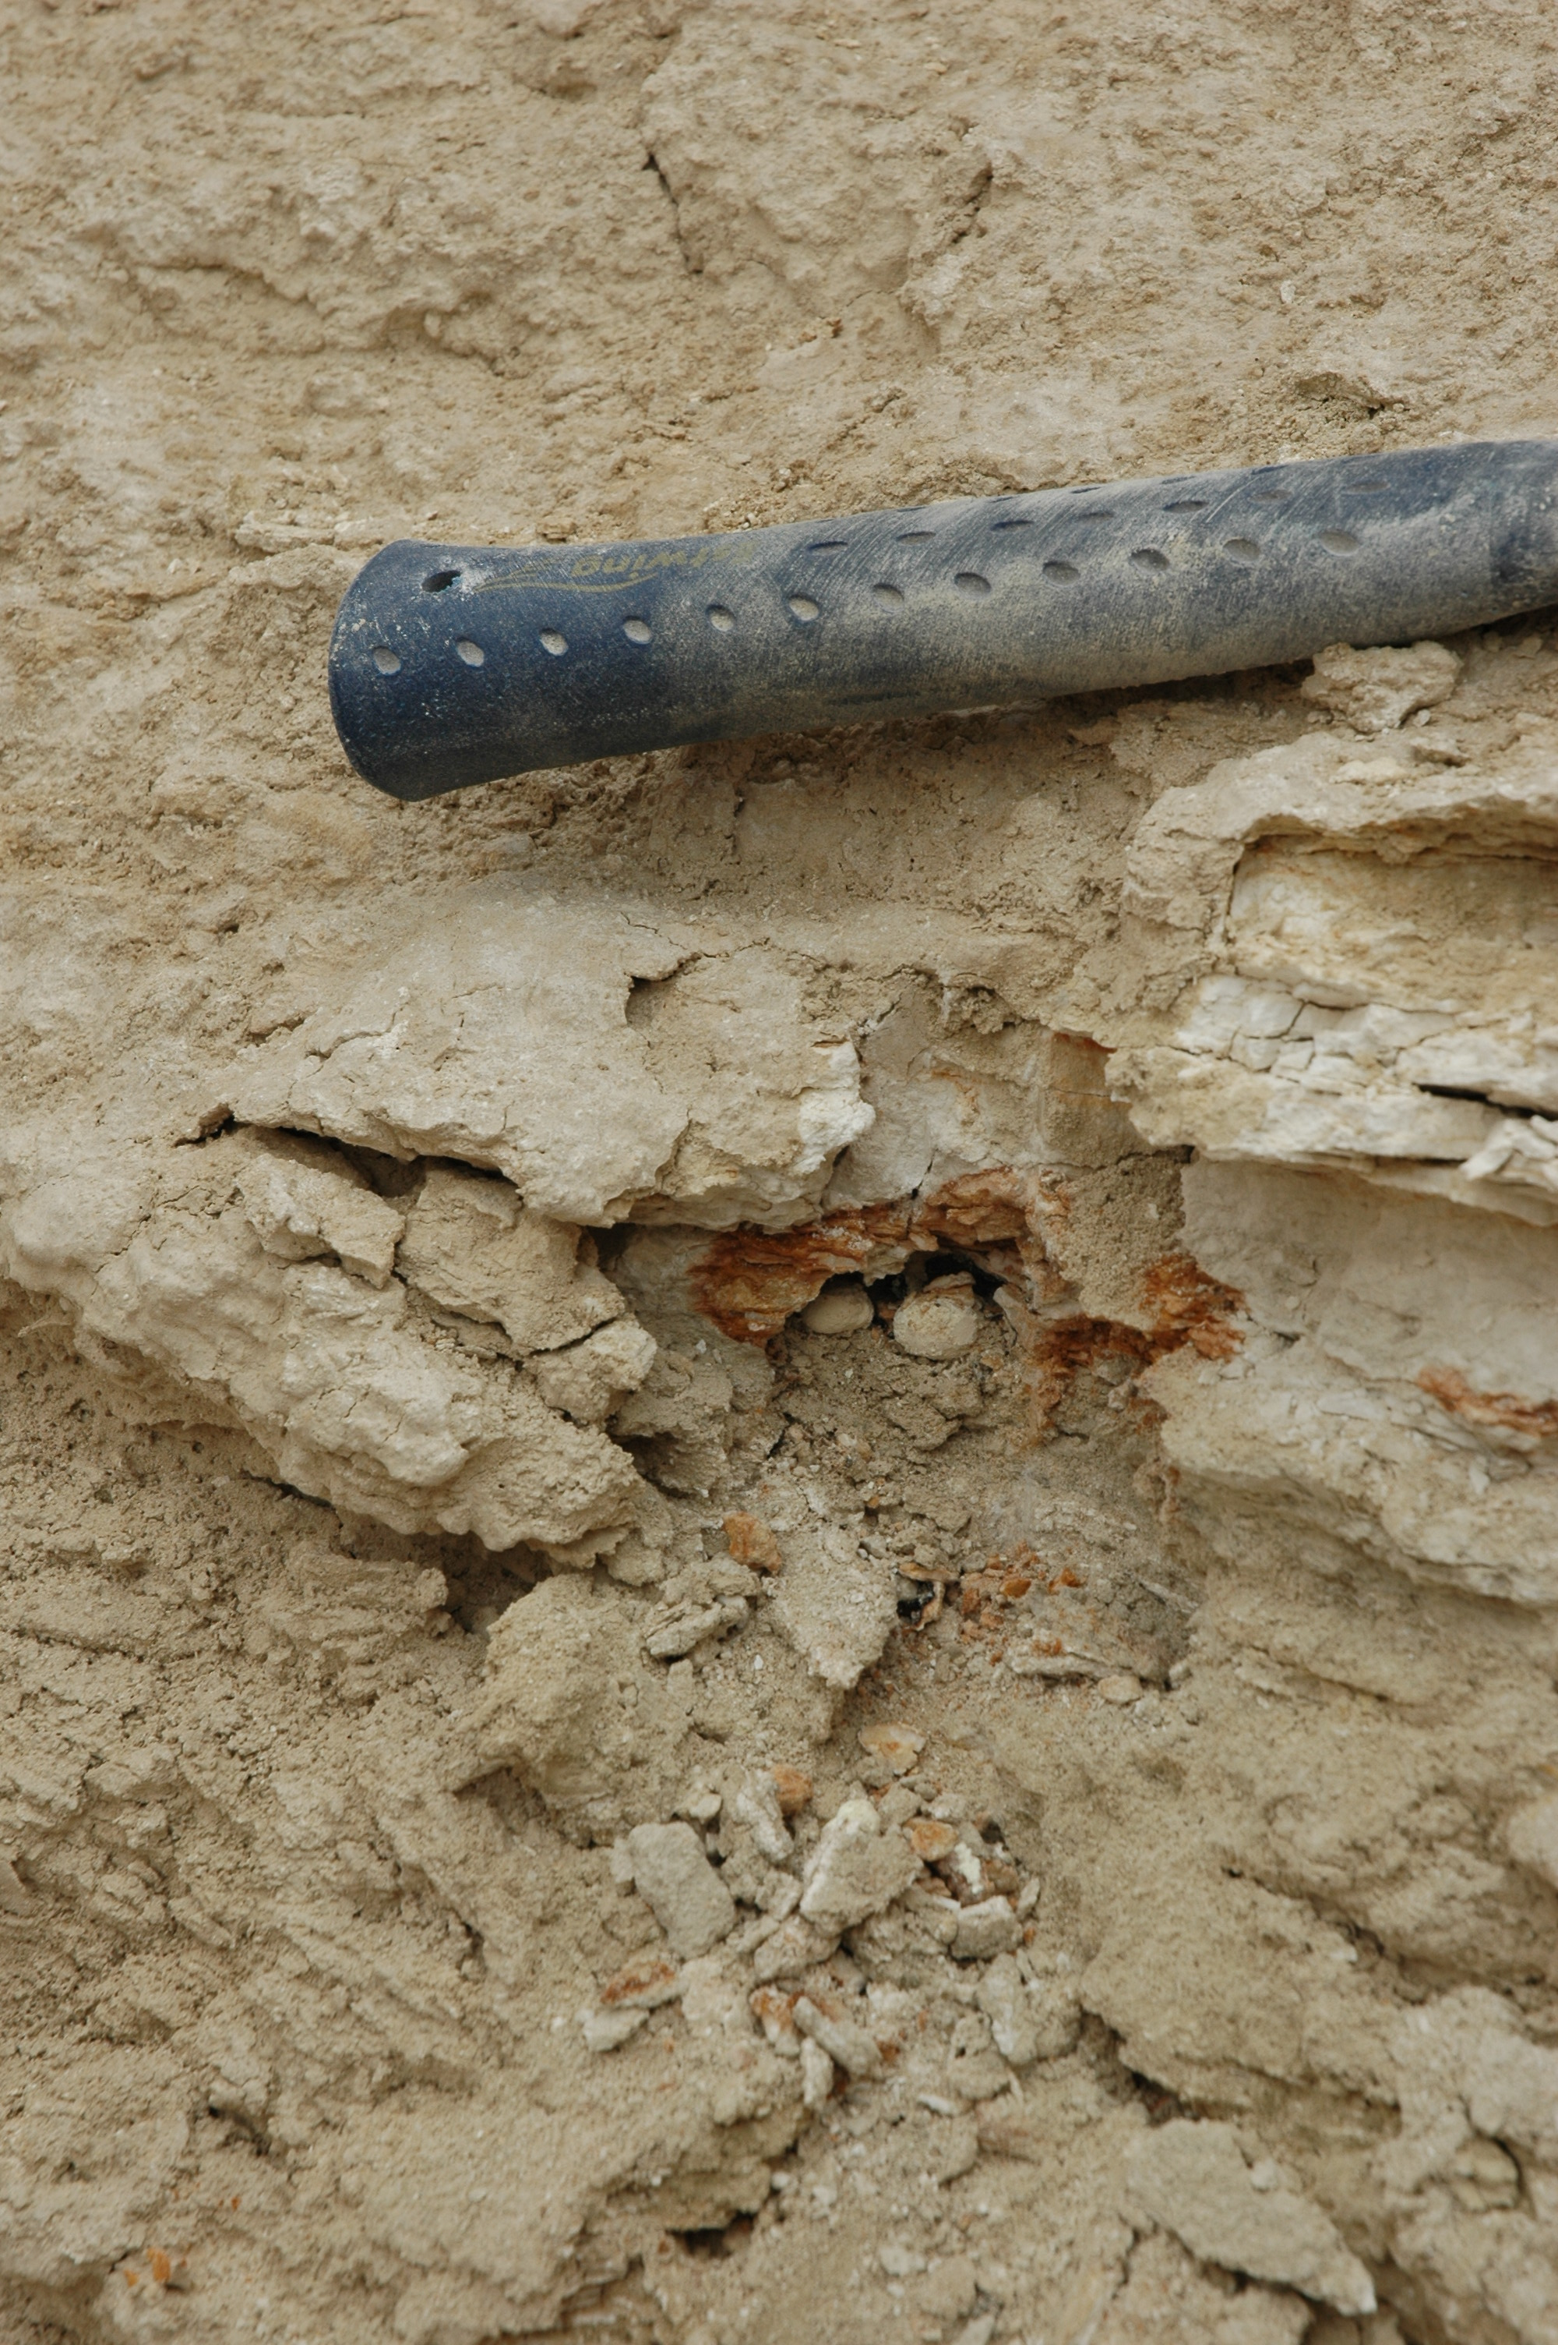
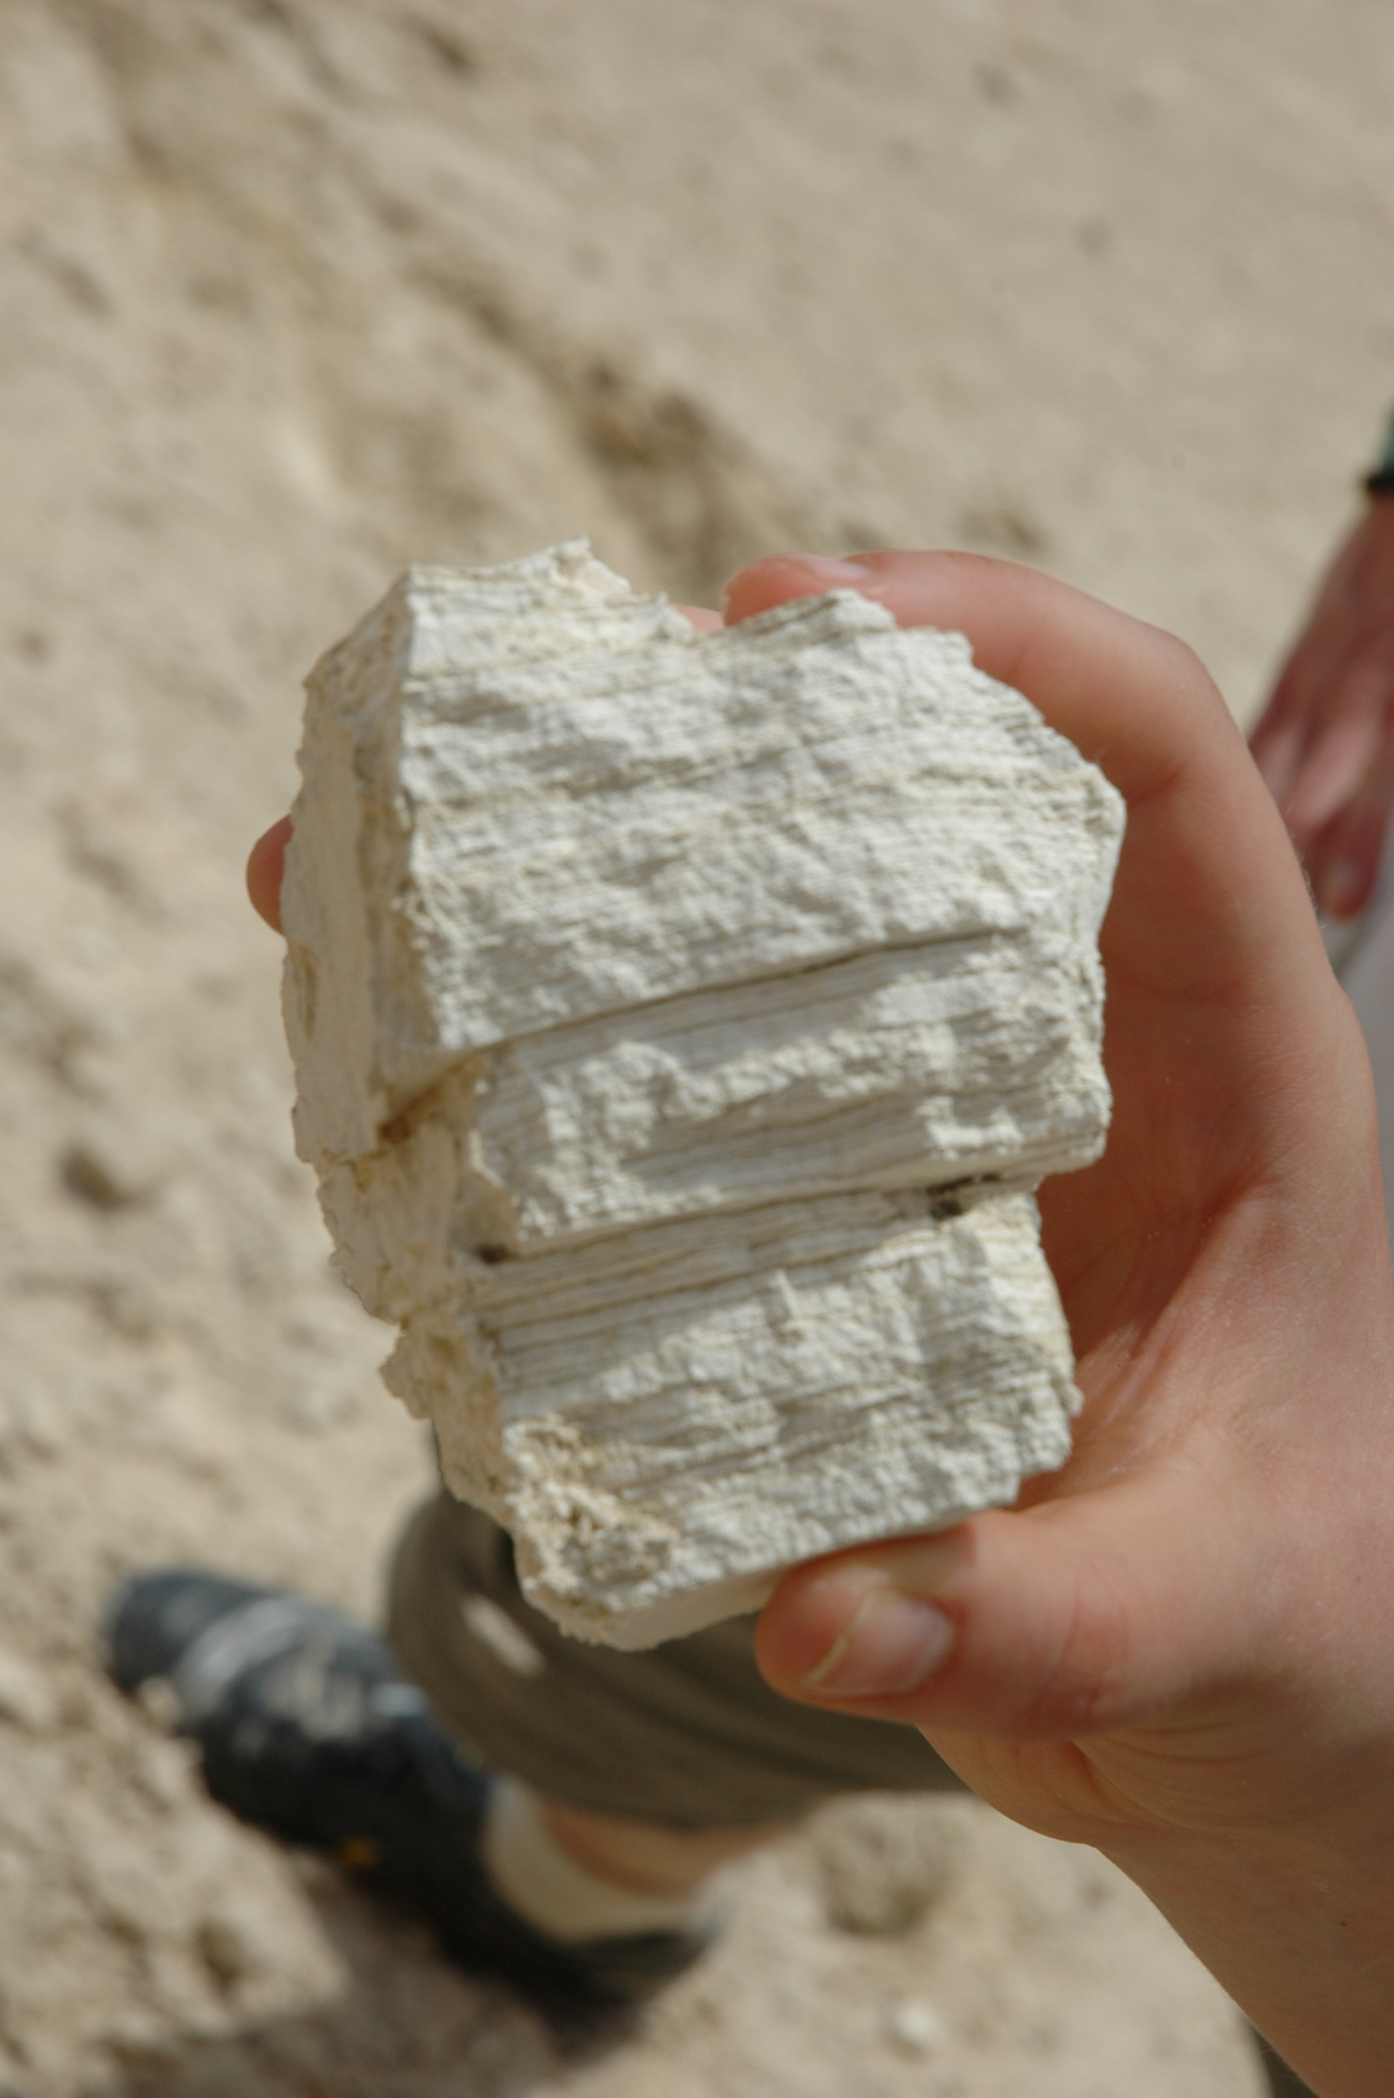
Changes in biogeochemistry recorded in the Lisan formation and the Dead Sea Basin
Alexandra V. Turchyn, Harold J. Bradbury, Adi Torfstein

Slide 2
Lisan Formation: Large freshwater system during the last glacial period, with lake levels 250 meters above where they are today. Annually precipitated aragonite, alternating with detrital material. Occasional overturn led to precipitation of massive gypsum, and in some places there are sulfur nodules within the gypsum.

Slide 3
Annual layers
Sulfur nodules

Slide 4
Local Hydrological Cycle responds to regional climate change and is considered an ‘amplifier lakes’
Bradbury et al., G3 2018

Slide 5
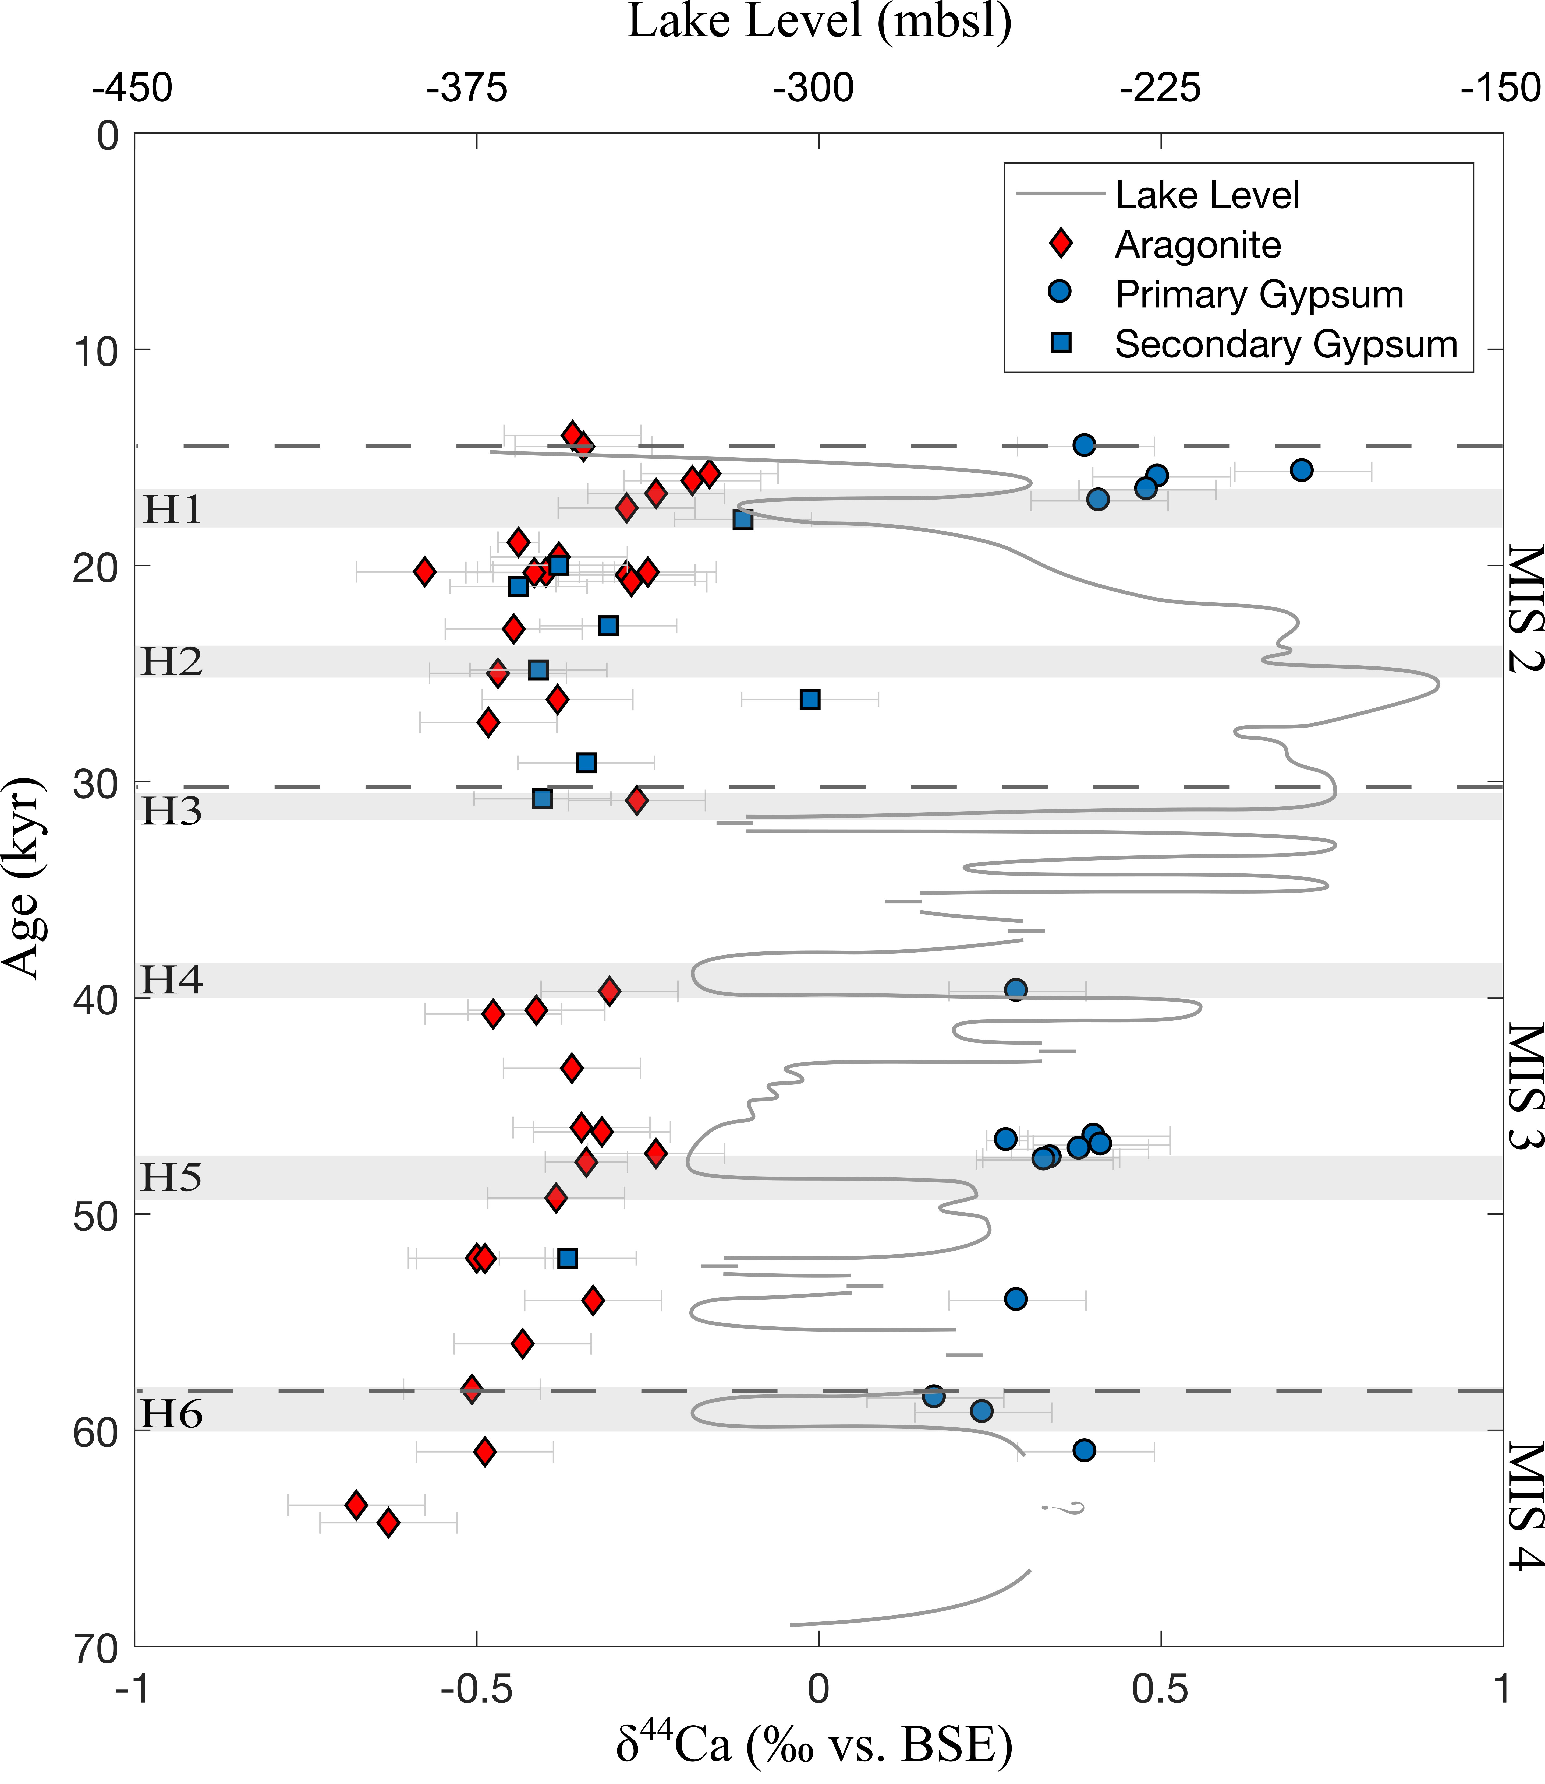
Annual geochemical variability in the Lisan Formation over the last glacial period
δ⁴⁴Ca in aragonite, primary gypsum, secondary gypsum
Bradbury et al., G3 2018

Slide 6
Annual geochemical variability in the Lisan Formation over the last glacial period
δ⁴⁴Ca in aragonite, primary gypsum, secondary gypsum
Observation, the secondary gypsum derives from dissolution of aragonite and reprecipitation
Bradbury et al., G3 2018

Slide 7
Annual geochemical variability in the Lisan Formation over the last glacial period
δ⁴⁴Ca in aragonite, primary gypsum, secondary gypsum
Observation, the secondary gypsum derives from dissolution of aragonite and reprecipitation
Also supported by the sulfur isotopes in the gypsum
Torfstein and Turchyn, Frontiers ES, 2017
Bradbury et al., G3 2018

Slide 8
Annual geochemical variability in the Lisan Formation over the last glacial period
δ⁴⁴Ca in aragonite, primary gypsum, secondary gypsum
Calcium isotopic composition of the aragonite is buffered to changes in lake level, suggesting a calcium-rich brine
Bradbury et al., G3 2018

Slide 9
Conclusion * The Lisan formation with its annual laminae offers a wonderful opportunity to explore the annual hydrological cycle dynamics in this region over the last Glacial Period. *We have (so far) measured the calcium isotopic composition and sulfur and oxygen isotopic composition of the gypsum and nodules to explore diagenesis, the rate of microbial sulfate reduction, and the calcium biogeochemical cycle in this lake over the last Glacial Period. * More can be done to inform our models of the hydrological evolution of the lake and its link to regional climate change in this area.

Slide 10
For more reading

