Slide 1
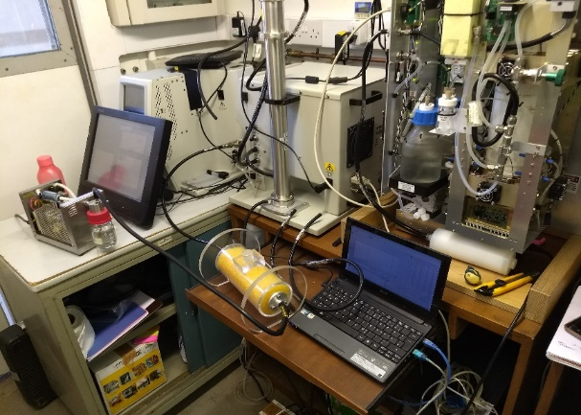
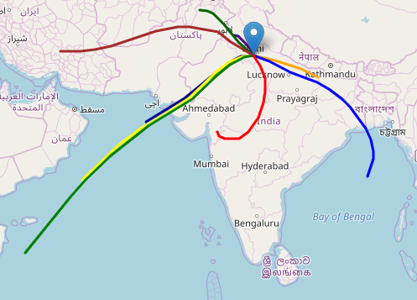
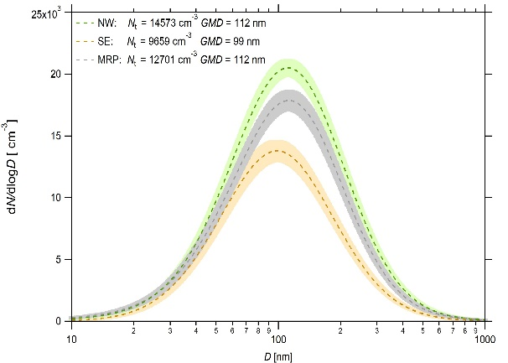
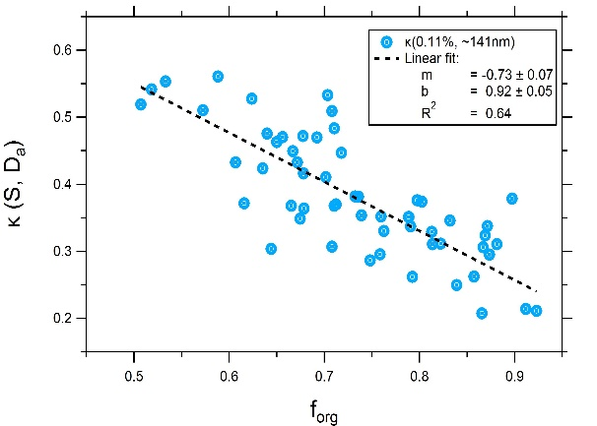
Impact of Long-Range Transport Biomass Burning (BB) Emissions on Cloud Condensation Nuclei (CCN) Activation in Continental Polluted Air of Delhi, India
Subha S. Raj^{1, *}, Mira L. Pӧhlker², Thomas Klimach², Jan-David Förster², David Walter ², Ovid O. Krüger², Christopher Pöhlker², Upasana Panda^{1, 3}, Amit Sharma^{1, a}, Eoghan Derbyshire^{4,b}, James D. Allan^{4, 5}, R. Ravikrishna⁶, V. K. Soni⁷, Siddhartha Singh⁷, Gordon Mcfiggans⁴, Hugh Coe⁴, Ulrich Pӧschl², and Sachin S. Gunthe¹
EXPERIMENTATION
BACK TRAJECTORY (BT) ANALYSIS
AEROSOL PROPERTIES
INTERPRETATIONS
¹EWRE Division, Department of Civil Engineering, Indian Institute of Technology Madras, Chennai, India
²Multiphase Chemistry Department, Max Planck Institute for Chemistry, Mainz, Germany
³Department of Environment and Sustainability, CSIR-Institute of Minerals and Materials Technology, Bhubaneswar, India
⁴Department of Earth and Environmental Sciences, School of Natural Sciences, University of Manchester, Manchester, UK
⁵National Centre for Atmospheric Science, University of Manchester, Manchester, UK
⁶Department of Chemical Engineering, Indian Institute of Technology Madras, Chennai, India
⁷India Meteorological Department, New Delhi, India
ªnow at: Laboratory for Atmospheric Research, Washington State University, Pullman, WA
^{b}now at: The Conflict and Environment Observatory, Hebden Bridge, West Yorkshire, UK
*Correspondence: Subha S. Raj (subhasraj89@gmail.com)

Slide 2
Impact of Long-Range Transport Biomass Burning (BB) Emissions on Cloud Condensation Nuclei (CCN) Activation in Continental Polluted Air of Delhi, India
Cloud Condensation Nuclei (CCN) and other aerosol properties were investigated in Delhi, India, from Feb to Mar. 2018. The high anthropogenic influence on aerosol was studied with size-resolved CCN measurements (supersaturation (S) between 0.13 to 0.66 % and selected diameters from 10 to 300 nm). Furthermore the chemical composition (Aerosol Chemical Speciation Monitor and Aethalometer AE33) of the particles was measured. The aerosol number size distribution was derived by size data inversion of Differential Mobility Particle Sizer (DMPS) from size-resolved CCN measurements. Based on multi-year back trajectory (BT) data, a spatial clustering analysis was done for the actual campaign period and two distinct clusters were identified: northwest- west northwest-long range transport (NW-LRT) and south-southeast-east southeast (SE).
There was preponderant organic mass fraction (f_{org}) in the aerosols throughout the campaign, with prominent diurnal variation except during the SE period. Pronounced diurnal variation was observed also in black carbon (BC) with an average concentration of 16 µg/m³ during NW-LRT, in contrast to a weak diurnal cycle with lower average concentrations of 8 µg/m³ during SE. During the NW-LRT cluster the air masses traversed over agriculture fields with biomass burning (BB) activities identified using the fire radiative power (FRP) observations of Copernicus Atmosphere Monitoring Service (CAMS) Global Fire Assimilation System (GFAS). So it can be speculated that the BB emissions from the fields have contributed to enhanced BC concentrations during this period over Delhi. The remaining period, showing a mixture of local and long-range transported emissions also had a BC concentration higher than SE period where only local/regional emissions were observed. This is an important insight into the air pollution apocalypse in Delhi.
The overall average values of critical dry diameter (D_{a}) for CCN activation varied from 54 ± 8 nm at S = 0.66 % to 139 ± 12 nm at S = 0.13 %.The hygroscopicity parameter derived from CCN data (к_{a}) was in the range from 0.1 to 0.9 with an arithmetic mean of 0.28 ± 0.10, which is close to that of Beijing, another polluted continental region (0.31 ± 0.08, Gunthe et al., 2011). к_{a} also shows good agreement with the hygroscopicity parameter derived from the chemical composition measurements (к_{chem}). A linear fit (Gunthe et al., 2009) applied to the relationship between refractory/non-refractory organic mass fraction and к_{a} at S = 0.13, gives an effective hygroscopicity parameter к_{org} = 0.17 ± 0.09 and к_{inorg} = 0.80 ± 0.09, when extrapolated to f_{org} = 1 and f_{org} = 0, respectively. The presence of externally mixed inactive CCN particles is indicated by an average maximum activated fraction (MAF) of 0.82 ± 0.17 at S = 0.13. The overall average D_{a}, к_{a}, and MAF did not vary much between NW-LRT and SE periods, although the particle number concentration was higher during NW-LRT. Moreover, high CCN efficiency was observed during NW-LRT, in spite of its enhanced BC concentration, indicating the presence of aged internally mixed aerosols. Further details will be presented.
ABSTRACT
Notes:
Nomenclature is updated to match with corresponding research paper under preparation.

Slide 3
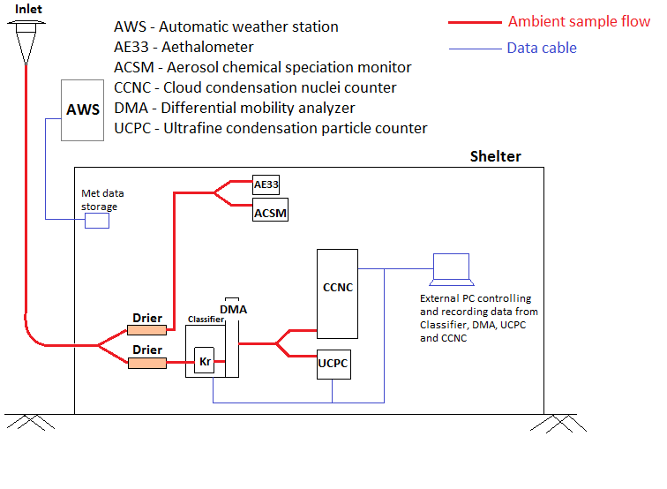
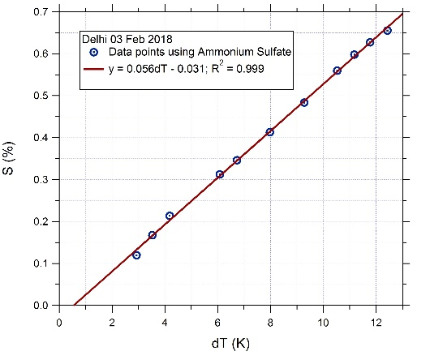
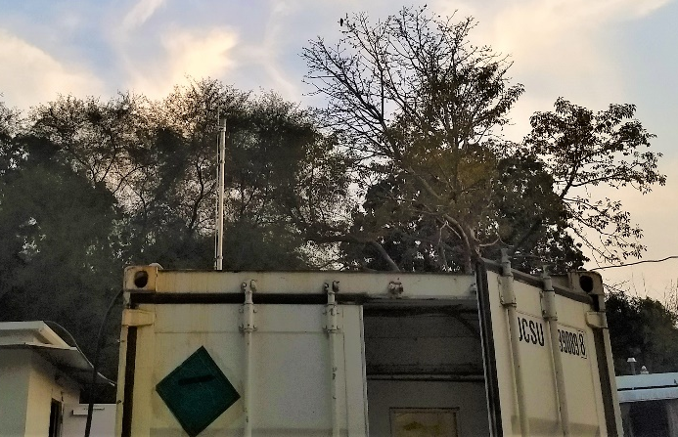
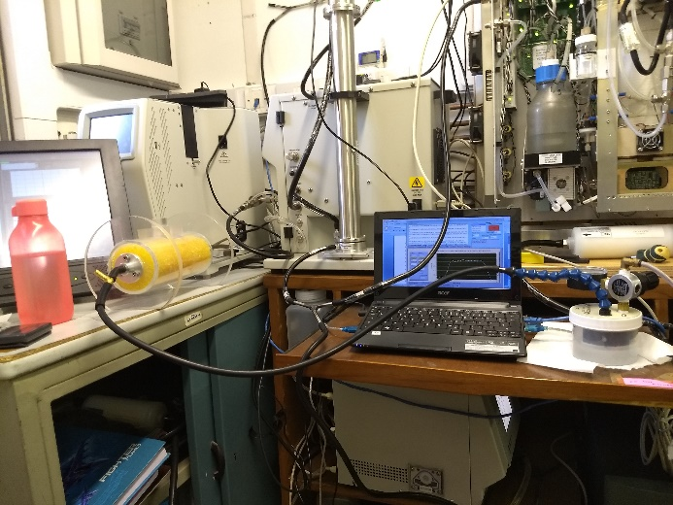
Measurement setup
Experimental setup placed inside air conditioned container
Fig1. CCN calibration line for Ammonium sulfate aerosols
A glimpse of calibration experiments inside container
CCNC calibration based on Rose et al. (2008)
EXPERIMENTATION

Slide 4
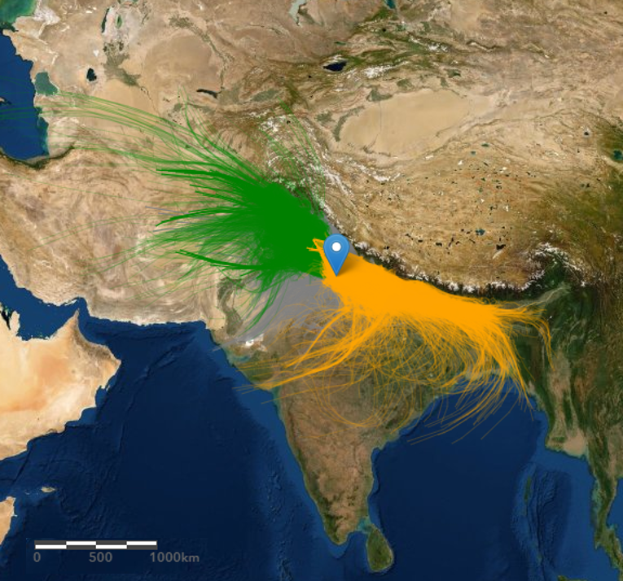
Measurement site and back trajectory clustering
Campaign period: 05 Feb to 02 Mar 2018, 27 days
Location: Inside the campus of India Meteorological Department, Delhi, situated within Indo-Gangetic Plain (IGP)
Average meteorology during campaign: temperature: 10 - 25ºC, relative humidity: 26 – 90%, wind speed: 2.3m/s.
Back trajectory (BT) clustering: Spatial clustering of 1 hr, 3 day BTs of 2016-18 from HYSPLIT yielded 2 distinct air mass during campaign:
North West Long Range Transport (NW-LRT): Air mass travelling long distances mostly over large agricultural fields from NW direction.
South East (SE): Air mass travelling relatively shorter distances from SE direction, passes over smaller agricultural fields and mostly populated built-up area.
Remaining period had mixed regional pollution (MRP) air mass.
Fig2. The blue location marker shows India Meteorological Department, Delhi, India (28.59°N, 77.22°E; 214 m a.s.l.). The 1 hr, 3 day BTs in each cluster are shown: NW-LRT (green), SE (orange), mixed regional (grey)
BT ANALYSIS

Slide 5
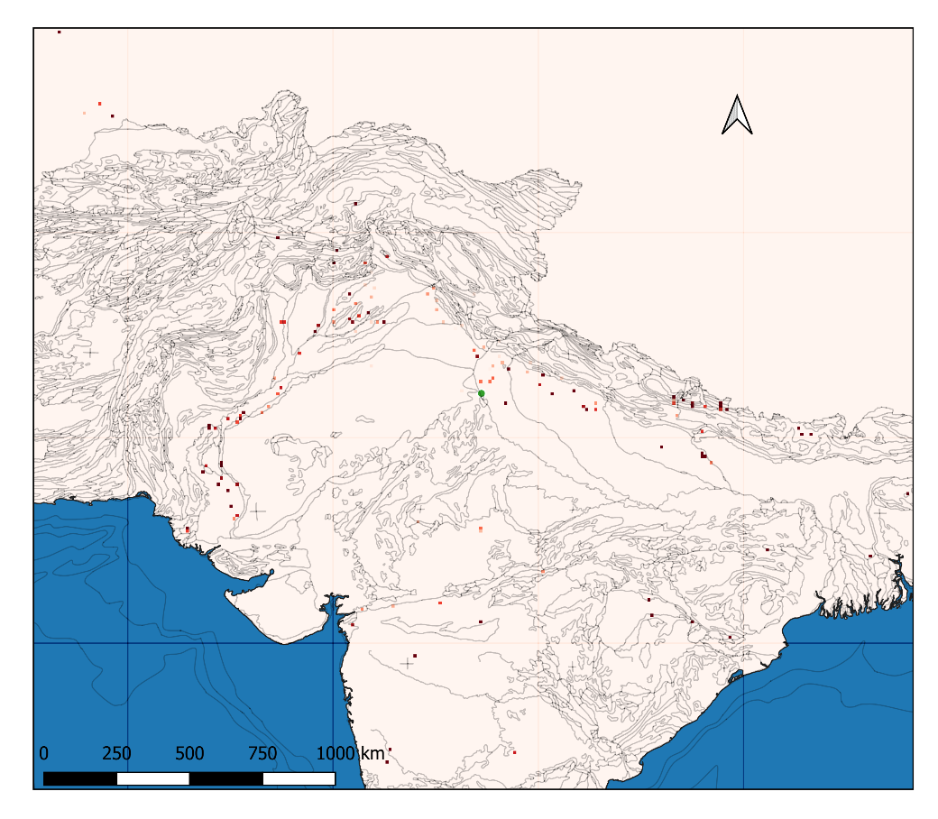
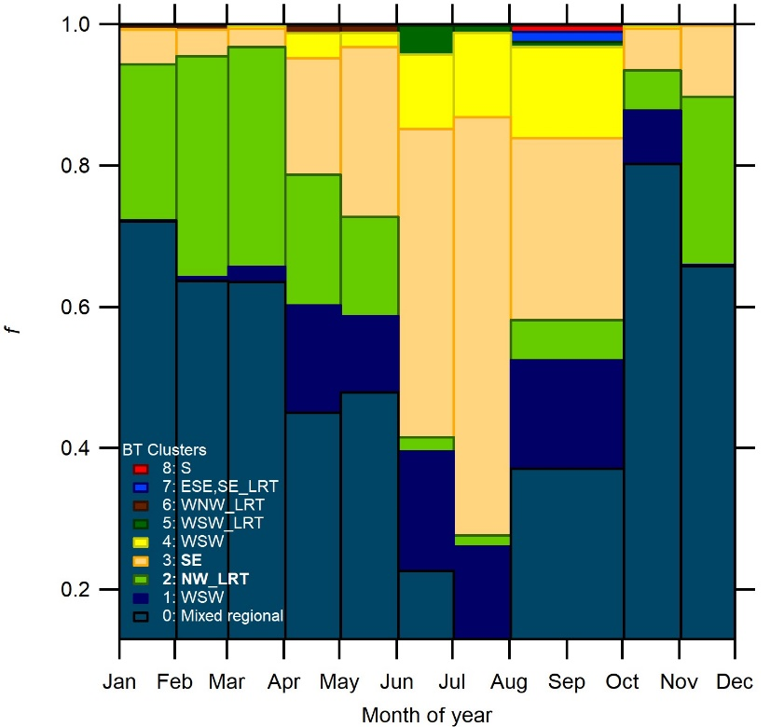
Air masses reaching Delhi and their significance
More number of fire spots observed on the region covered by NW-LRT.
The site is in urban populated region with heavy transportation.
Pronounced diurnal cycle of atmospheric boundary layer
Will there be any difference in the properties of air masses?
Fig4. Average frequency of occurrence of different BT clusters indicating different air masses in Delhi throughout a year calculated from BT data of 2016-18
Fig3. Map showing the wildfire and biomass burning spots from Copernicus Atmosphere Monitoring Service (CAMS) Global Fire Assimilation System (GFAS). Circles indicate the area covered by BT clusters NW-LRT (green) and SE (orange).
Overall 9 different air masses identified in a year.
Mixed regional pollution (MRP) is the most frequent
BT ANALYSIS
Notes:
Delhi winter mixing height is 555m Kumar et al 2017.
The MODIS FRP retrieval is based on the relationship between the emitted fire energy and the middle infrared brightness temperature and is expressed as [Kaufman et al., 1998]

Slide 6
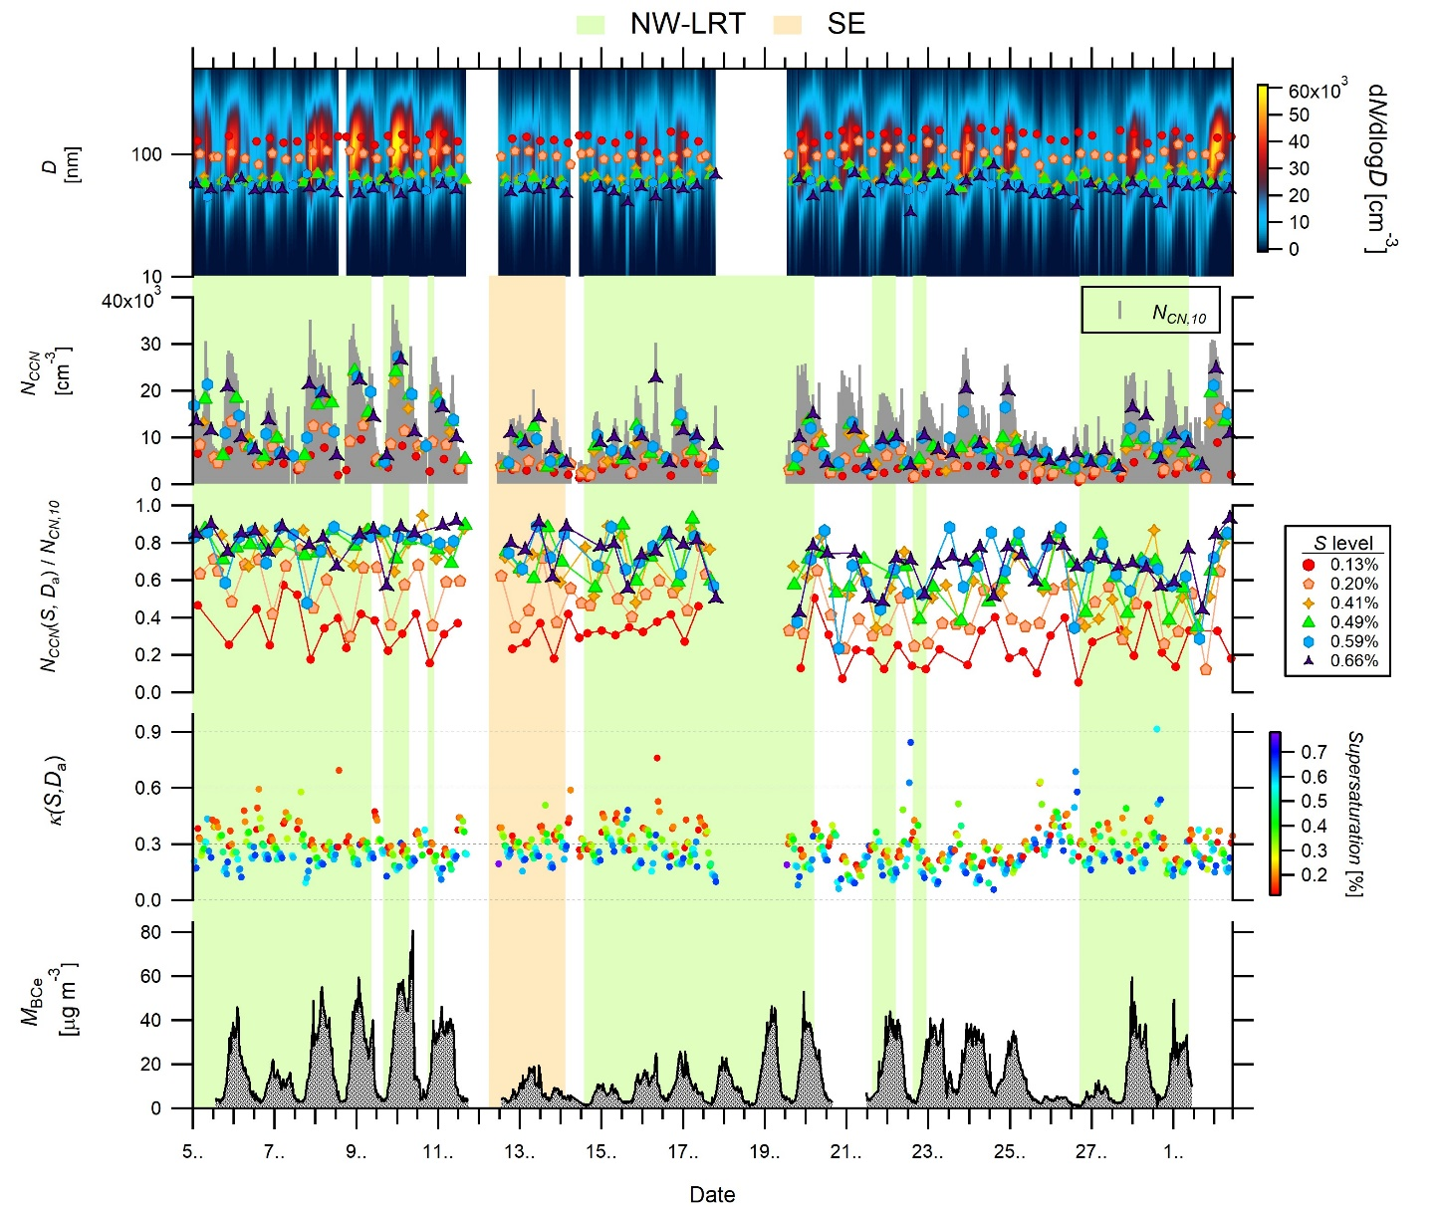
Temporal evolution of aerosols in different air masses
(a)
(b)
(c)
(d)
(e)
Visible reduction in the aerosol number concentration during SE compared to NW-LRT.
Cloud microphysical properties: midpoint activation diameter, and CCN efficiency have similar trends.
CCN number concentration: lower in SE corresponding to a reduction in total particle count.
Hygroscopicity parameter, κ(S,D_{a}) is swinging with supersaturation (S) level and diurnally with an average value close to the global average of 0.3.
Absence of diurnal variation in black carbon (BC) mass concentration during SE. Same observed for organic mass fraction (f_{org}).
Fig5. The time series of (a) size distribution with superimposed midpoint activation diameter colour coded by S level, (b) total particle concentration and CCN number concentration at six S levels, (c) CCN efficiency for six S levels, (d) hygroscopicity parameter κ(S,D_{a}) and (e) mass concentration of black carbon (BC)
AEROSOL PROPERTIES
Notes:
CCN properties exhibit diurnal pattern. The cycling in k_a(S,D_a) is also due to different S levels. This will be more evident in focus period plots.

Slide 7
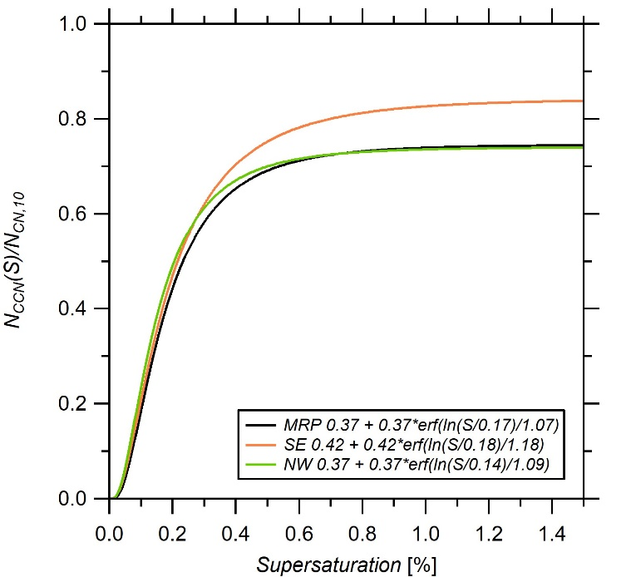
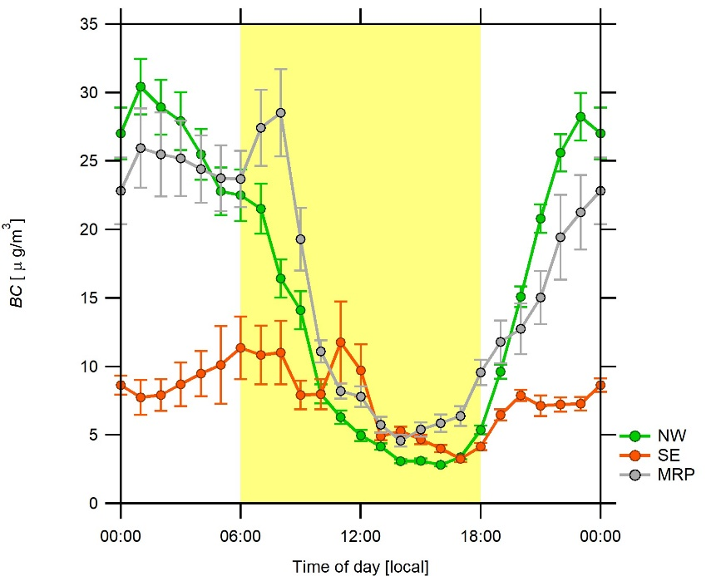
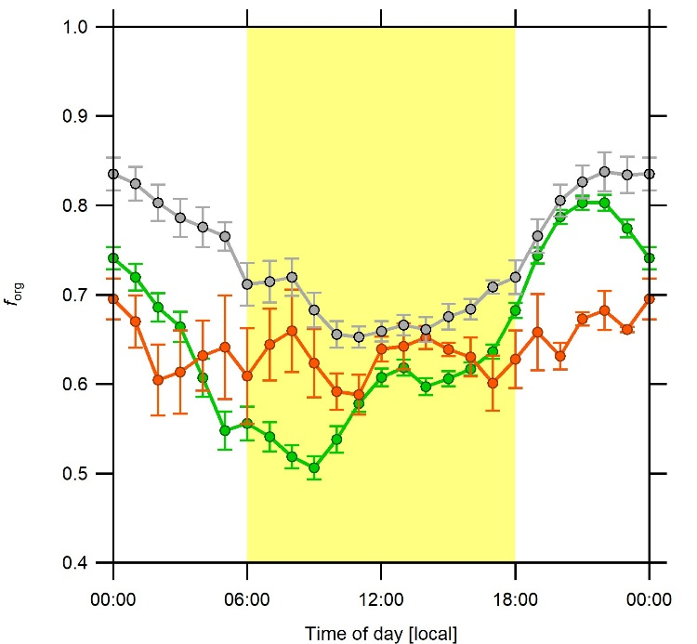
CCN efficiency and Diurnal cycle of predominant aerosol chemicals in different air masses
SE air mass has 12% more CCN.
(a) (b)
Fig6. Error function fitted to CCN efficiency spectra for NW-LRT, SE and MRP
Fig7. Average diurnal variation of (a) black carbon (BC) and (b) organic mass fraction in aerosols during NW-LRT, SE and MRP are shown with standard error bars.
CCN efficiency same for NW-LRT and MRP. No effect of long range transport. High external mixing.
At supersaturations above 0.3% (particles < 75nm) enhanced efficiency in SE. But, why?
Organics and black carbon (BC) predominated the aerosol.
Diurnal variation due to boundary layer dynamics are strong except for SE.
NW-LRT air mass have 65% more organics and 55% more BC than SE air mass. Did this cause more CCN in SE?
Not really. ACSM samples >75nm
AEROSOL PROPERTIES
Notes:
The supersaturation required for 50% activation of aerosol population in NW-LRT is 28% lower than that for SE. But taking into consideration the stdev this difference is not much.

Slide 8
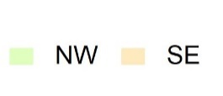
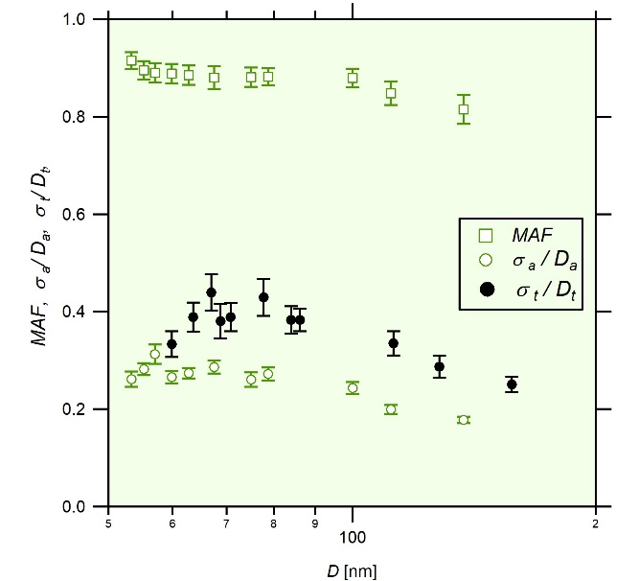
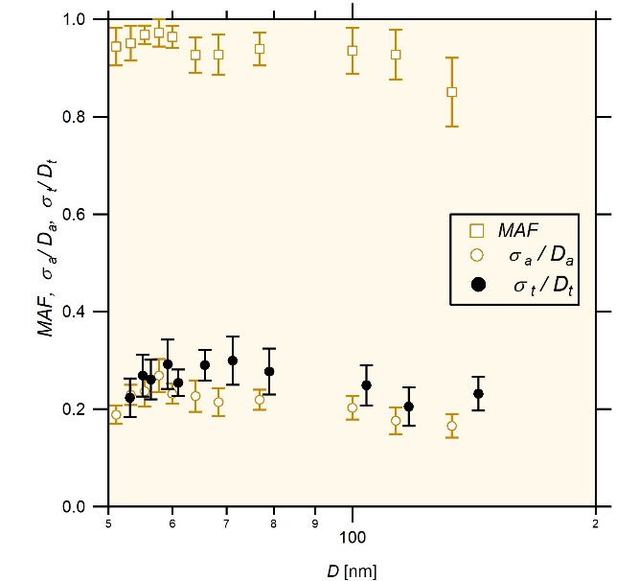
Mixing state of aerosols
(a)
(b)
Aerosols in both air masses are externally mixed and highly heterogeneous.
Heterogeneity of CCN (active + inactive) particles is relatively low in SE indicating less external mixing.
Hence they have 12% more CCN on average.
Fig8. CCN properties derived from measured activation spectra: Maximum activated fraction (MAF), heterogeneity parameter for CCN active particles alone (σ_{a}/D_{a}) and CCN active and inactive particles (σ_{t}/D_{t}) for air masses (a) NW-LRT and (b) SE
Less external mixing- more CCN!
AEROSOL PROPERTIES
Notes:
MAF less than one in both cases so both are externally mixed.
Heterogeneity factor is > 0.03 (ammonium sulfate) so they are heterogeneous mixtures.
For SE particles less than 75nm are less externally mixed with inactive CCN particles ensemble.

Slide 9
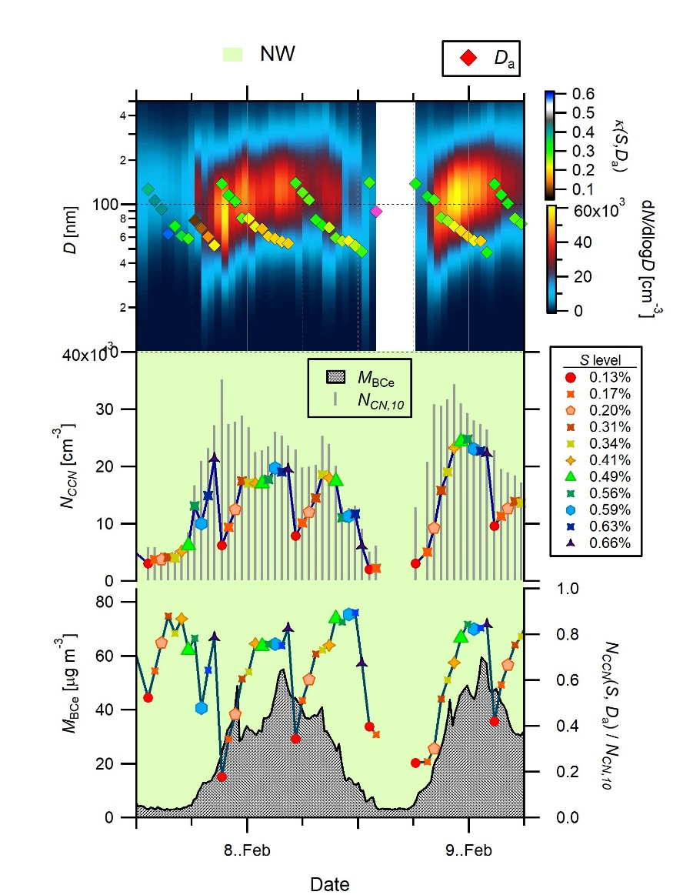
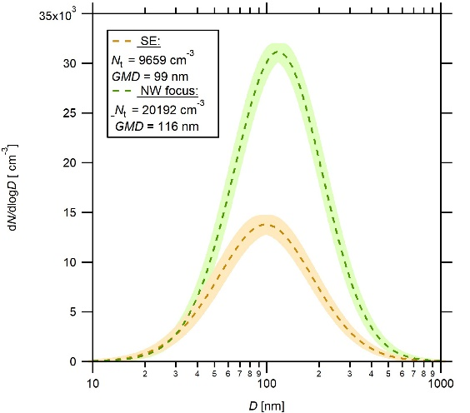
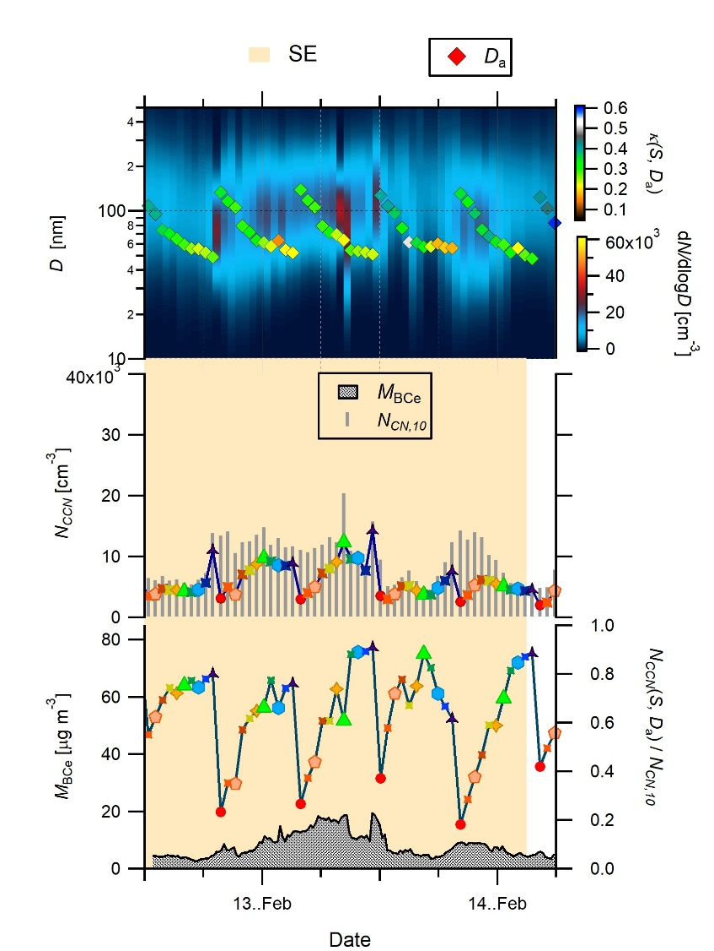
Typical continental cloud microphysical properties
NW-LRT focus period: 1200 07.Feb to 0600 09.Feb
SE focus period: 1200 12.Feb to 0600 14.Feb
(d)
(a)
(b)
(c)
(e)
(f)
(g)
1800 to 1200 hrs characteristic peak in particle number and BC mass
No characteristic peak and low particle number and BC mass
NW-LRT enhances quantity of aged aerosols.
Similar CCN properties
CCN efficiency: 0.2 to 0.8
D_{a}: 140 to 40 nm
К (S, D_{a}): 0.2 to 0.4
SE has aged regional aerosols
Fig9. Time series data during focus period of NW-LRT and SE : (a,e) size distribution with superimposed midpoint activation diameter colour coded by κ(S,D_{a}), (b,f) total particle concentration and CCN number concentration at six S levels, (c,g) ) mass concentration of black carbon (BC) and CCN efficiency for six S levels.
AEROSOL PROPERTIES

Slide 10
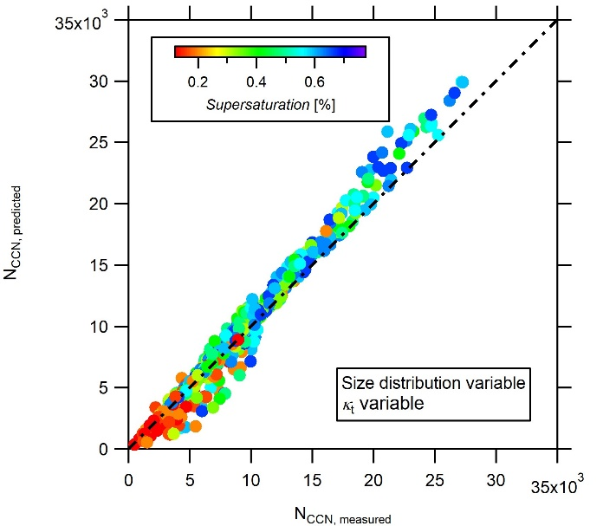
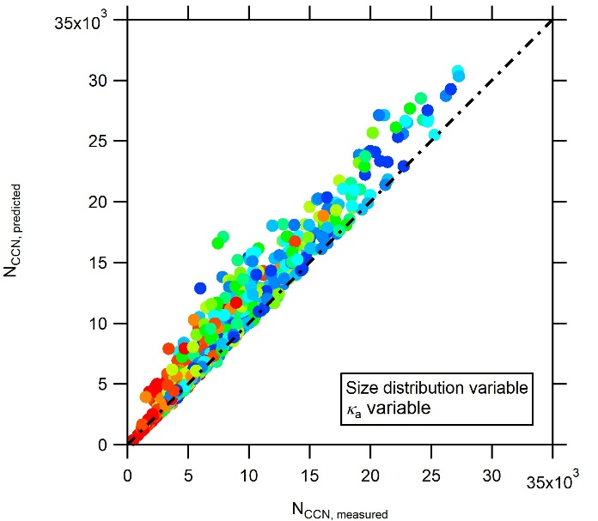
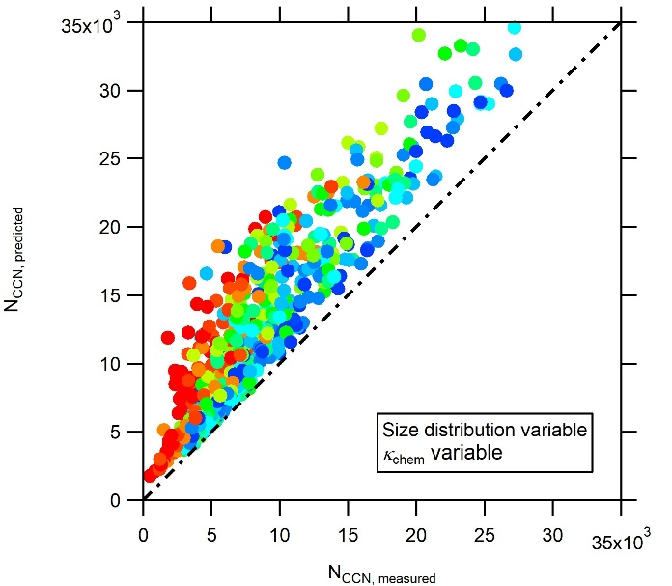
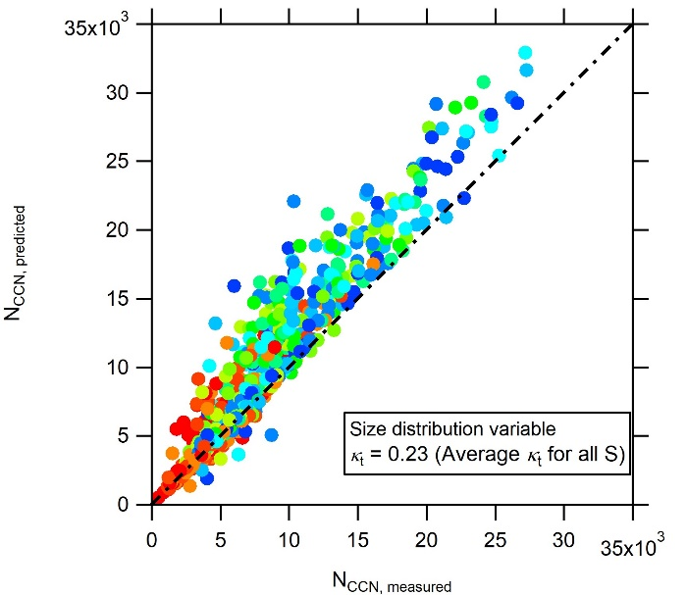
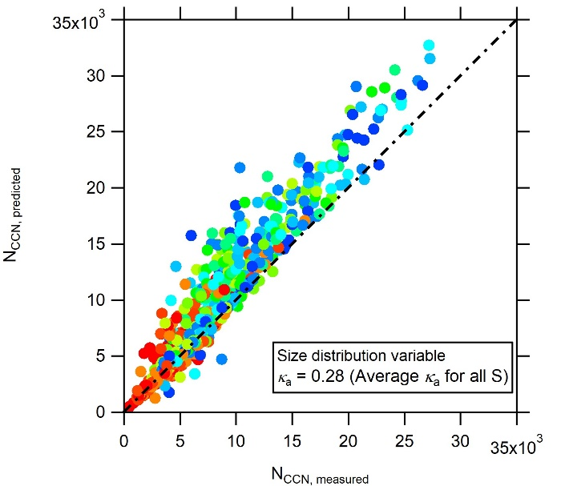
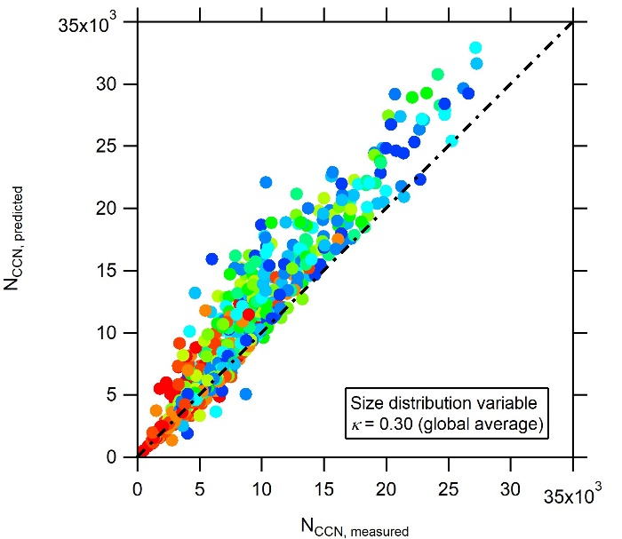
Ramifications of aerosol size over chemistry
(a) (b) (c)
CCN number concentration prediction using Köhler theory on variable size distributions shows :
Variable hygroscopicity, κ_{t} of ensemble of active and inactive particles gives the best prediction since external mixing is high.
Variable hygroscopicity, κ_{a} of active particles also gives good prediction.
Constant κ with variable size distribution does not show much difference in prediction and gives better prediction than variable κ_{chem} (calculated using mixing rule of chemical composition).
Size rules over chemistry in CCN prediction
(d) (e) (f)
Fig10. CCN number concentration predicted by cutting individual size distribution with D_{cut} calculated using (a) individual к_{t} (S,D_{t}), (b) individual к_{a}(S,D_{a}), (c) individual к_{chem} , (d) constant campaign average к_{t} =0.23, (e) constant campaign average к_{a} =0.28, and (f)constant global average к = 0.3 in Köhler theory.
AEROSOL PROPERTIES

Slide 11
Conclusions
Delhi sustains mixed regional polluted air mass all year long.
Infrequent long range transport aerosols from north west contributes only to the quantity of aerosols in mass and number.
The cloud microphysical properties of aerosols are same irrespective of air mass in the month of Feb.2018.
Aerosols are externally mixed and aged.
Better CCN prediction using cloud microphysical properties and size distribution.
CONCLUSIONS

Slide 12
References
Andreae, M.O. and Rosenfeld, D. (2008). Aerosol–cloud–precipitation interactions. Part 1. The nature and sources of cloud-active aerosols. Earth-Science Reviews, 89(1-2), pp.13-41.
Dusek, U., Frank, G.P., Hildebrandt, L., Curtius, J., Schneider, J., Walter, S., Chand, D., Drewnick, F., Hings, S., Jung, D. and Borrmann, S. (2006). Size matters more than chemistry for cloud-nucleating ability of aerosol particles. Science, 312(5778), pp.1375-1378.
Gunthe, S.S., King, S.M., Rose, D., Chen, Q., Roldin, P., Farmer, D.K., Jimenez, J.L., Artaxo, P., Andreae, M.O., Martin, S.T. and Pöschl, U. (2009). Cloud condensation nuclei in pristine tropical rainforest air of Amazonia: size-resolved measurements and modeling of atmospheric aerosol composition and CCN activity. Atmospheric Chemistry and Physics, 9(19), pp.7551-7575.
Gunthe, S.S., Rose, D., Su, H., Garland, R.M., Achtert, P., Nowak, A., Wiedensohler, A., Kuwata, M., Takegawa, N., Kondo, Y. and Hu, M. (2011). Cloud condensation nuclei (CCN) from fresh and aged air pollution in the megacity region of Beijing. Atmospheric Chemistry and Physics, 11(21), pp.11023-11039.
Petters, M.D. and Kreidenweis, S.M. (2007). A single parameter representation of hygroscopic growth and cloud condensation nucleus activity. Atmospheric Chemistry and Physics, 7(8), pp.1961-1971.
Pöhlker, C., Walter, D., Paulsen, H., Könemann, T., Rodríguez-Caballero, E., Moran-Zuloaga, D., Brito, J., Carbone, S., Degrendele, C., Després, V.R., Ditas, F., Holanda, B.A., Kaiser, J.W., Lammel, G., Lavriˇc, J.V., Ming, J., Pickersgill, D., Pöhlker, M.L., Praß, M., Löbs, N., Saturno, J., Sörge, M., Wang, Q., Weber, B., Wolff, S., Artaxo, P., Pöschl, U., and Andreae, M. O. (2019). Land cover and its transformation in the backward trajectory footprint region of the Amazon Tall Tower Observatory. Atmospheric Chemistry and Physics, 19(13), 8425–8470.
Pöhlker, M. L., Ditas, F., Saturno, J., Klimach, T., Hrabě De Angelis, I., Araùjo, A. C., Brito, J., Carbone, S., Cheng, Y., Chi, X., Ditz, R., Gunthe, S.S., Holanda, B.A., Kandler, K., Kesselmeier J., KönemannT., Krüger, O.O., Lavriˇc, J.V., Martin, S.T., Mikhailov, E., Moran-Zuloaga, D., Rizzo, L.V., Rose, D., Su, H., Thalman, R., Walter, D., Wang, J., Wolff, S., Barbosa, H.M.J., Artaxo, P., Andreae, M. O., Pöschl, U., and Pöhlker, C. (2018). Long-term observations of cloud condensation nuclei over the Amazon rain forest - Part 2: Variability and characteristics of biomass burning, long-range transport, and pristine rain forest aerosols. Atmospheric Chemistry and Physics, 18(14), 10289–10331.
Pöhlker, M.L., Pöhlker, C., Ditas, F., Klimach, T., Hrabe de Angelis, I., Araújo, A., Brito, J., Carbone, S., Cheng, Y., Chi, X. and Ditz, R. (2016). Long-term observations of cloud condensation nuclei in the Amazon rain forest–Part 1: Aerosol size distribution, hygroscopicity, and new model parametrizations for CCN prediction. Atmospheric Chemistry and Physics, 16(24), pp.15709-15740.
Rose, D., Gunthe, S. S., Mikhailov, E., Frank, G. P., Dusek, U., Andreae, M. O., and Pöschl, U. (2008). Calibration and measurement uncertainties of a continuous-flow cloud condensation nuclei counter (DMT-CCNC): CCN activation of ammonium sulfate and sodium chloride aerosol particles in theory and experiment. Atmospheric Chemistry and Physics, 8(5), 1153–1179.
Wiedensohler, A. (1988). An approximation of the bipolar charge distribution for particles in the submicron size range. Journal of Aerosol Science, 19(3), pp.387-389.

