Slide 1
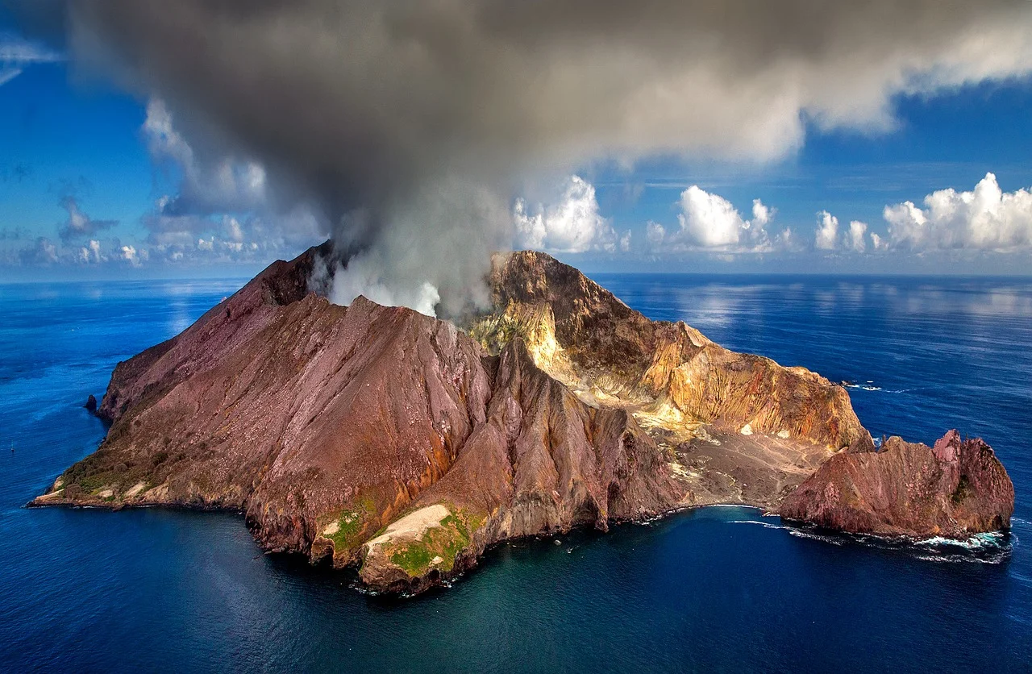
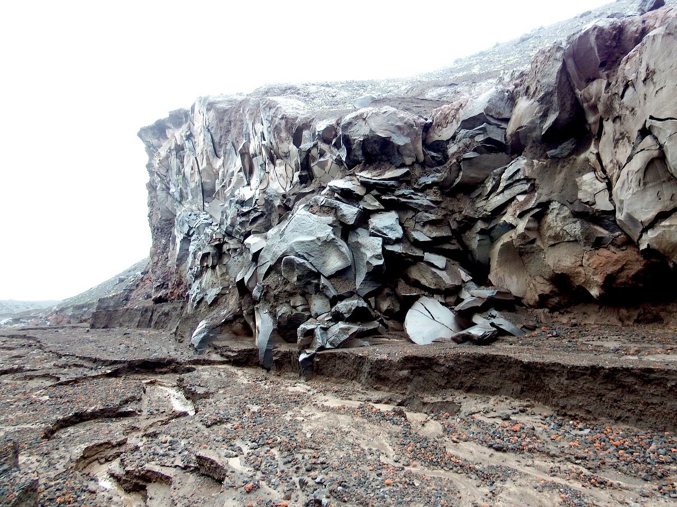
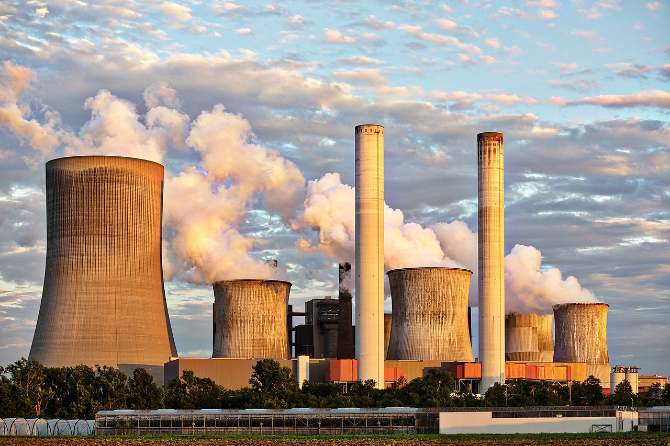
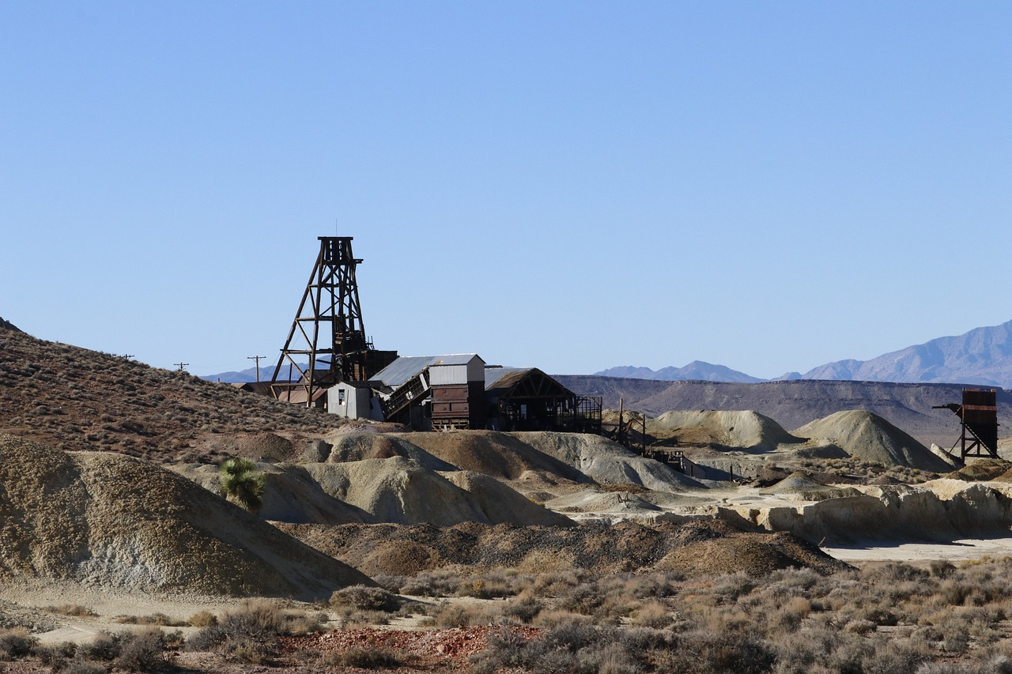
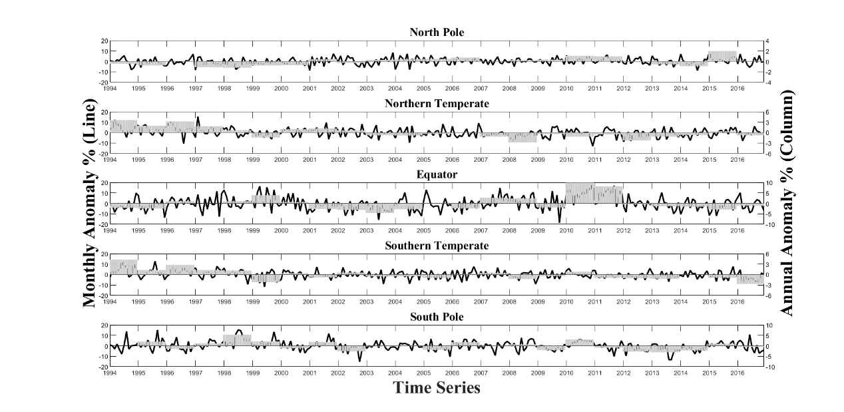
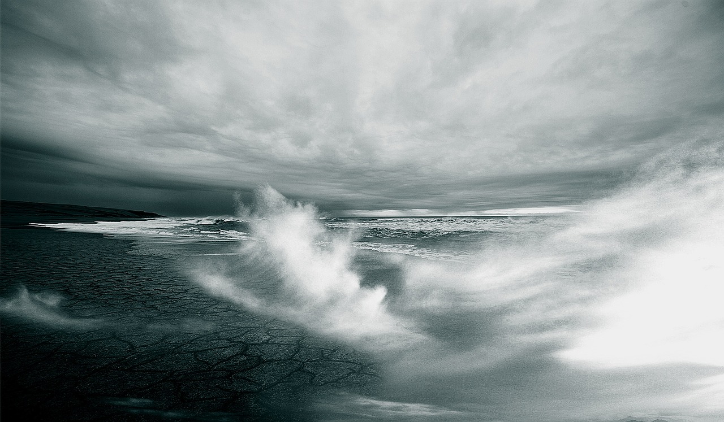
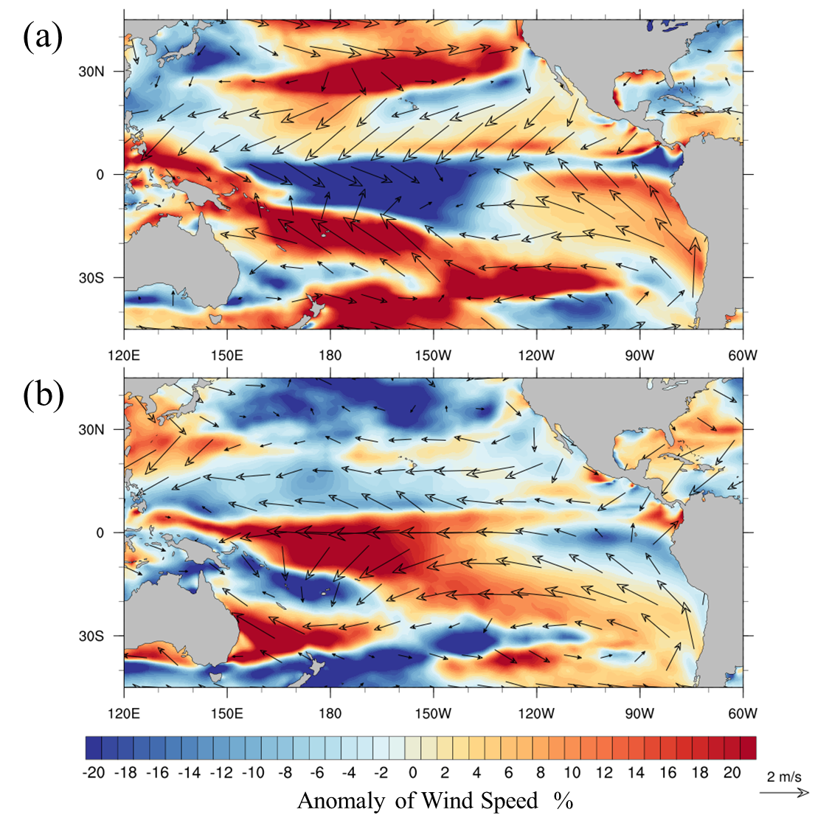
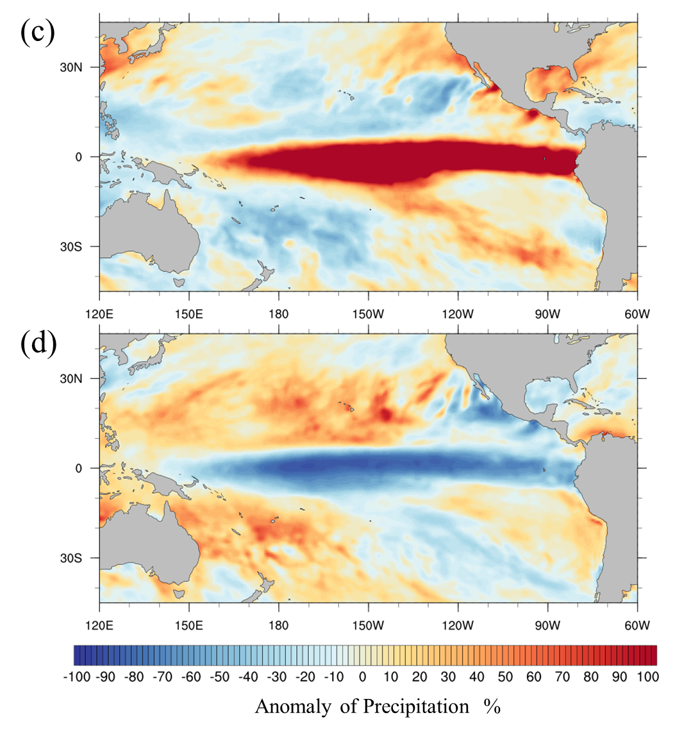
Interannual variability of air-sea exchange of mercury in the global ocean: the “seesaw” effect in the equatorial Pacific
Shaojian Huang¹ and Yanxu Zhang^{1*}
¹Joint International Research Laboratory of Atmospheric and Earth System Sciences, School of Atmospheric Sciences, Nanjing University, Nanjing 210023, P.R. China
*Correspondence to: Yanxu Zhang (zhangyx@nju.edu.cn)
Introduction
Results and Discussion
Results and Discussion
Natural Source
Mercury Emission
Anthropogenic Source
1. Interannual Variability of Hg⁰ Evasion
Volcanic Eruption
Rock Weathering
Fossil fuel combustion
Metal Mining and Smelting
Atmospheric Transmission
Hg⁰
Hg⁰
Br Oxidation
Hg⁰
Hg⁰
Hg⁰ Hg^{II}
Photochemical
Reaction
Photo-reduction
Impact ?
Fig. 4 Schematic diagram for the anomaly of 10 m wind speed and precipitation in tropical Pacific Ocean during EN (a) and LN (b) events and its impact on Hg⁰ evasion. (Warm color represents for positive anomaly of SST while cold color is for negative anomaly. Arrows present the wind vector).
Hg⁰ Evasion
Fig 1. The annual (Column) and monthly anomaly (Line) of Hg⁰ evasion in the North Pole, Northern Temperate, Equator, Southern Temperate, and South Pole.
Deposition
Hg⁰
Wind Speed
Precipitation
The interannual variability of Hg⁰ evasion is relatively small in the mid-latitudes and high-latitudes, with the relative range of annual evasion flux is 3.14% and 8.5% in the Artic Ocean and Southern Ocean, respectively. The ranges are 6.4% and 6.97% in the northern and southern mid-latitudes, respectively.
However, pronounced fluctuations stands for the interannual variability of Hg⁰ evasion in the equatorial regions with a relative range of 14.81%.
In the equator, substantial longitudal variability also exists with relative range of Hg⁰ fluxes as 19.93%, 22.3%, and 9.59% for the Pacific, Atlantic, and Indian Oceans
Temperature
Sea Surface
ENSO
The decreasing anomaly of Hg⁰ evasion in central and eastern equatorial Pacific (90 °W to 170°W illustrated in Fig. 2a) likely relate to the decreasing of wind speed during EN years (Fig.4a) because of significant positive correlation (0.475 to 0.585).
Considering the significant positive correlation (0.429) between Hg⁰ evasion and precipitation, the increasing precipitation probably contributes to the increasing anomaly of Hg⁰ evasion in western equatorial Pacific (150 °E to 170 °W illustrated in Fig. 4b) during EN years.
Similarly, the opposite spatial pattern of Hg⁰ evasion in LN years can also be explained by the increasing wind speed and decreasing precipitation in same regions (Fig. 3b, d).
Interannual Variability
To examine if the variabilities in meteorological conditions would result in interannual variability of Hg⁰ air-sea exchange fluxes.
To examine the connection between Hg⁰ evasion and tropospheric Hg levels.
Materials and Methods
Results and Discussion
2. “Seesaw” effect of Hg⁰ evasion in Equatorial Pacific.
Fig.2 Hg⁰ evasion anomaly compared with the average from 1994 to 2016 in November-January (NDJ) of tropical Pacific during El Nino (EN) and La Nina (LN) years. (a) Average anomaly of all EN events and (b) LN events. (Boxes represent the “Nino boxes”, with Nino 3 in red, Nino 3.4 in black and Nino 4 in green).
MITgcm
The model has a horizontal resolution of 1°×1°and 50 vertical levels.
The resolution is higher over the Arctic (40 km × 40 km) and the equator (~0.5°×1°) to better represent the ocean currents.
The air-sea exchange flux of Hg⁰ are calculated as follow (Andersson et al., 2008; Fu et al., 2010; Wanninkhof, 1992)
$$F_{V}=K_{w}\left(DGM−GEM/{H^{′}}\left(T\right)\right)$$
A prominently “seesaw” pattern for the spatial distribution of evasion anomaly between EN and LN events.
During EN years, the evasion flux is 15-20% lower over Equatorial Pacific (170°W to 120°E) and 5-10% lower over western tropical Pacific (west of 150°E).
The evasion flux is also 15-20% higher over 4°-15°N (Fig. 2a).
The spatial pattern in LN years is exactly opposite to that in EN years (Fig. 2b)
Conclusion
Air-sea exchange
flux of Hg⁰
$$K_{W}={0.31u}_{10}^{2}{\left({{Sc}_{Hg}}/{{Sc}_{CO2}}\right)}^{−0.5}$$
$$H^{′}\left(T\right)=exp\left(−{2403.3}/T+6.92\right)$$
Spotting a pronounced fluctuations standing for the interannual variability of Hg⁰ evasion in the tropical regions with a relative range of 14.81%.
A prominently “seesaw” pattern for the spatial distribution of evasion anomaly between EN and LN events. During EN years, the evasion flux is 15-20% lower over Equatorial Pacific (170°W to 120°E) and 5-10% lower over western tropical Pacific (west of 150°E). Meanwhile, the spatial pattern in LN years is exactly opposite to that in EN years.
Such “seesaw” effect could be explain by the wind speed and precipitation anomaly caused by ENSO in equatorial Pacific.
The increasing anomaly of Hg⁰ evasion from sea surface subsequently transports into the upper atmosphere via geochemical circulation and further results in the interannual variability of tropospheric Hg concentrations
where Fv represents the air-sea exchange flux (ng∙m⁻²∙h⁻¹); Kw is the mass transfer coefficient of water (cm∙h⁻¹); GEM represents the gaseous elemental Hg (ng∙m⁻³) in atmosphere; and DGM is the dissolved gaseous Hg in seawater. H’(T) is the dimensionless partitioning coefficient for Hg⁰ between atmosphere and seawater. The parametrization of Kw follows Soerensen et al (Soerensen et al., 2010) and Nightingale(Nightingale et al., 2000):
Fig.3 The anomaly of wind speed (a, b) and precipitation (c, d) in tropical Pacific during El Niño (a, c) and La Niña (b, d). (Warm and clod color represents for the increasing and decreasing anomaly, respectively. Arrow presents the vector of wind direction)
GEOS-chem
This model is driven by assimilated meteorological data archived from the Goddard Earth Observing System (GEOS) of the NASA Global Modeling and Data Assimilation Office (GMAO), with horizontal resolution of 4° latitude by 5° longitude and 47 vertical levels.
Pronounced “seesaw” patterns are spotted for the wind speed (Fig. 3a, b) and precipitation (Fig. 3c, d) anomaly during the EN and LN event.

