Slide 1

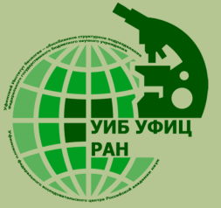


EGU2020-12814:
The joint application of digital modeling and field soil survey data for improvement of the accuracy in soil erosion mapping
Lomonosov Moscow State University
Faculty of Geography
V.V. Dokuchaev
Soil Science Institute
Ufa Institute of Biology UFRC, Russian Academy of Science,
Federal state budgetary institution “Center of agrochemical service “Belgorod”
Zhidkin Andrey, Mikhail Komissarov, Evgeny Zazdravnykh
zhidkin.ap@mail.ru

Slide 2
Chapters
Erosion and soil cover.
The established practice of mapping of eroded soils in Russia.
The proposing of “New” method.
The results in applying of “New” method in different study sites.

Slide 3
I
Erosion and
soil cover

Slide 4
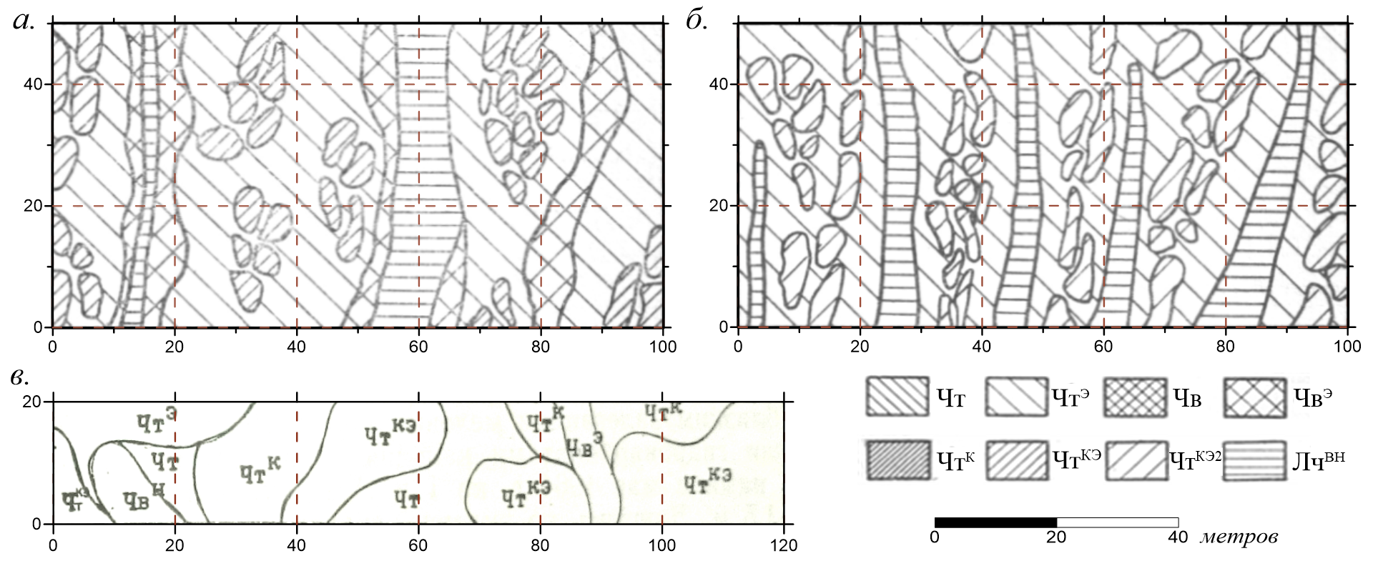
Participation of different soil patterns
I. Erosion and soil cover
Soil degradation as a result of erosion occurs locally in the form of individual small-sized areas

Slide 5
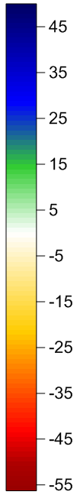
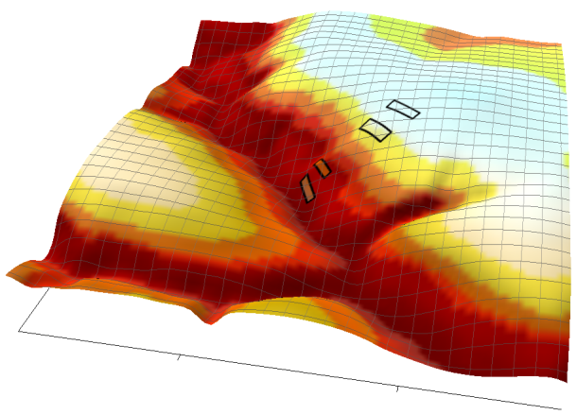
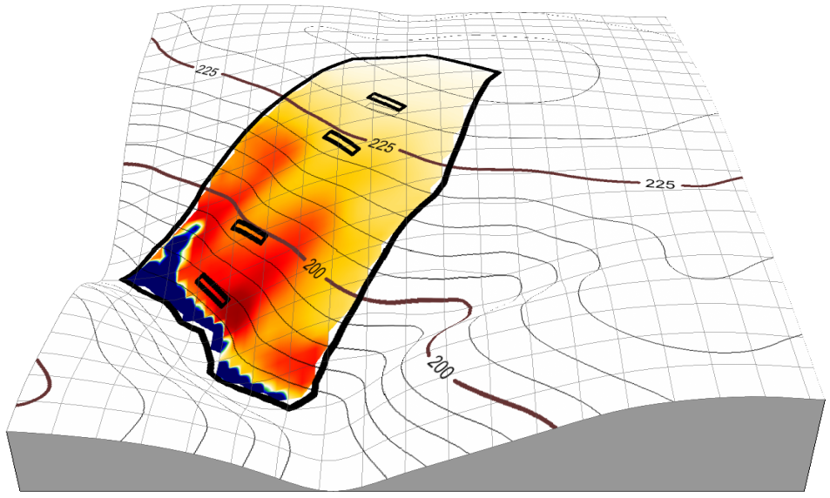
Erosion of soil cover patterns
Plot | slope degree | slope length, m | WaTEM/SEDEM |  | % of eroded soils by field data
 |  |  | t * ha⁻¹ * year⁻¹ | cm/50 years
II | 2 | 280 | -6.4 | 3.2 | non
III | 4 | 430 | -14.4 | 7.2 | 10
IV | 5 | 730 | -29.7 | 14.7 | 59
V | 6 | 880 | -42.4 | 21.0 | 60
<100%
I. Erosion and soil cover
% of eroded soils
Erosion rates
t * ha⁻¹ * year⁻¹

Slide 6
II
The established practice of mapping of eroded soils in Russia

Slide 7
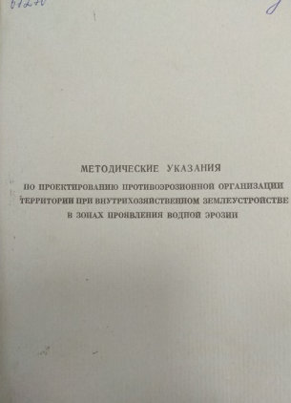
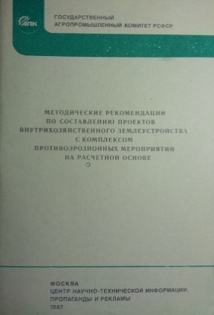
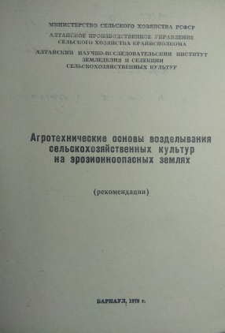
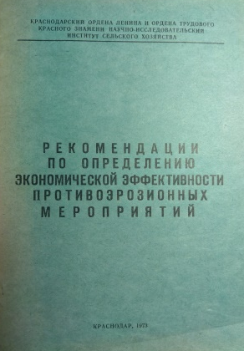
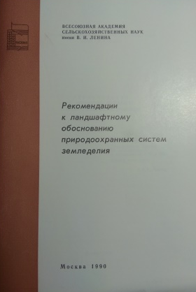
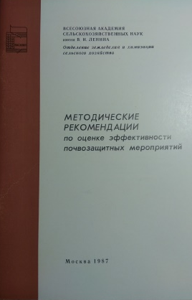
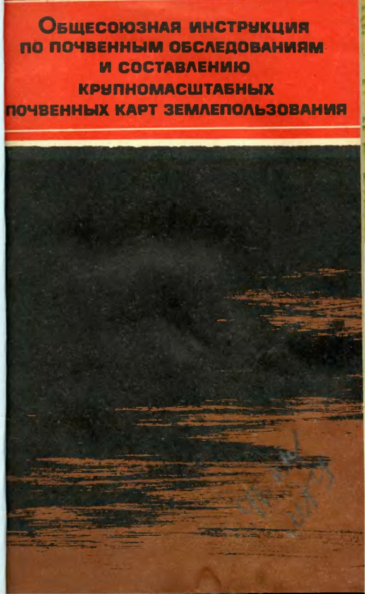
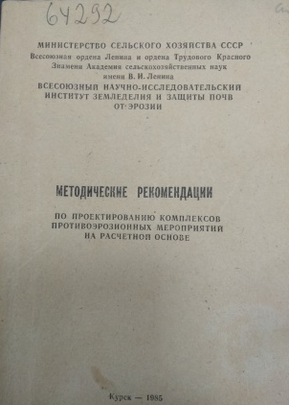
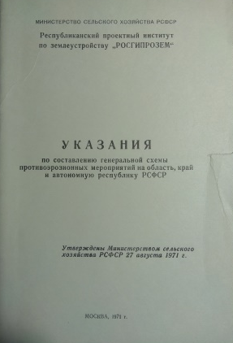
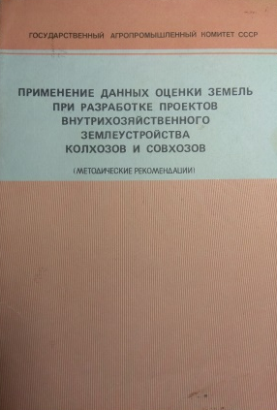
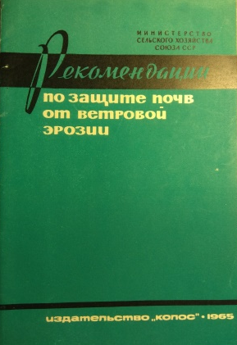
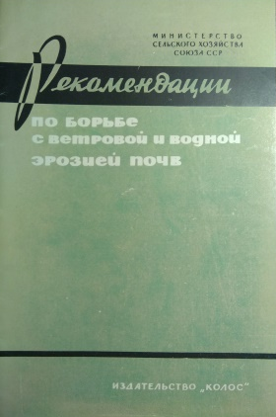
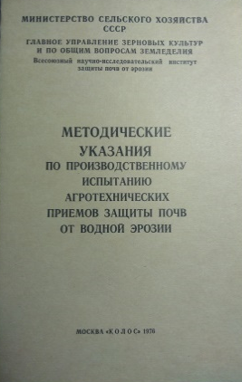
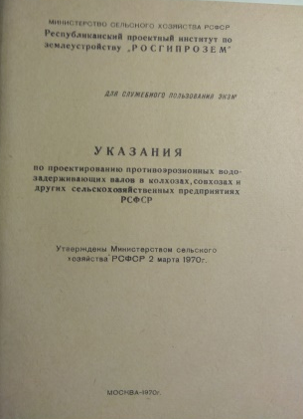
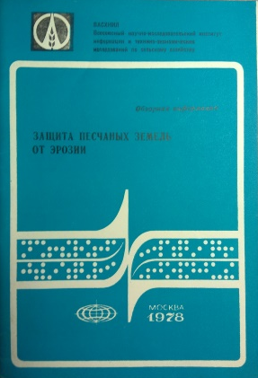
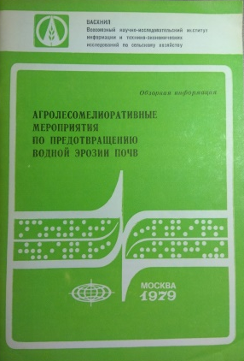
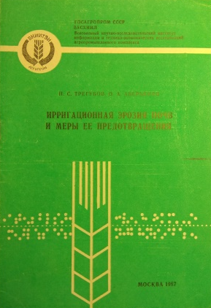
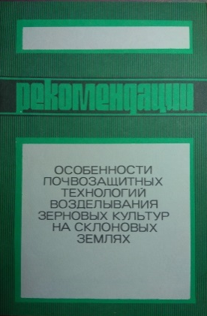
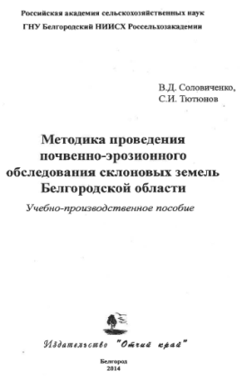
The established practice of mapping of eroded soils in Russia
II. The established practice of mapping of eroded soils in Russia

Slide 8
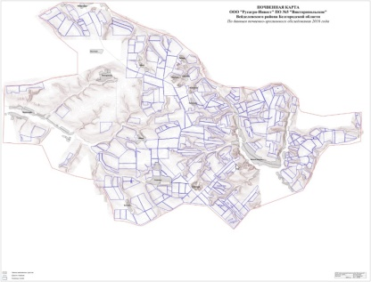
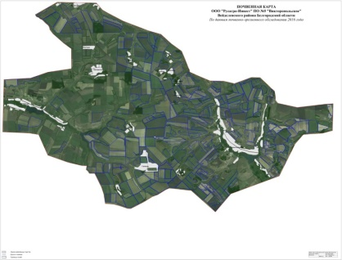
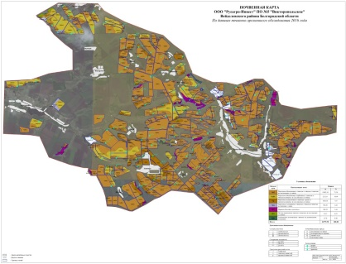
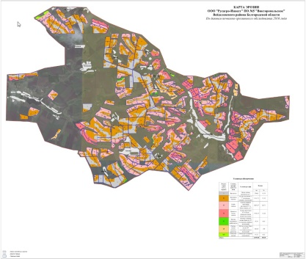

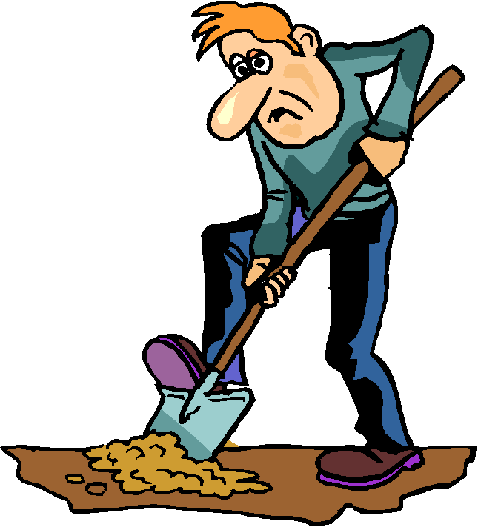
Topographic map
The established practice of mapping of eroded soils
in Russia
Satellite image
Soil map
Map of degree of erosional degradation
Land use and agro-technology
categories
Field work

Slide 9
The determination of a number of soil profiles at the study place
Topographic map
Map scale | The complexity of land
 | I | II | III | IV | V
 | The number of hectares per one soil profile
1 : 2 000 | 3 | 2 | 1.5 | 1 | 0.5
1 : 5 000 | 7 | 5 | 4 | 3 | 2
1 : 10 000 | 25 | 20 | 18 | 15 | 10
1 : 25 000 | 80 | 65 | 50 | 40 | 25
1 : 50 000 | 150 | 130 | 110 | 80 | 50
The established practice of mapping of eroded soils
in Russia
Satellite image
The ratio of full soil profiles, half-profiles and small soil pits
1:2:7 or 1:4:5
Field work

Slide 10
The fragment of soil degradation map due to erosion
Approximate contours. Displays only the dominant categories of soil degradation.
The established practice of mapping of eroded soils
in Russia

Slide 11

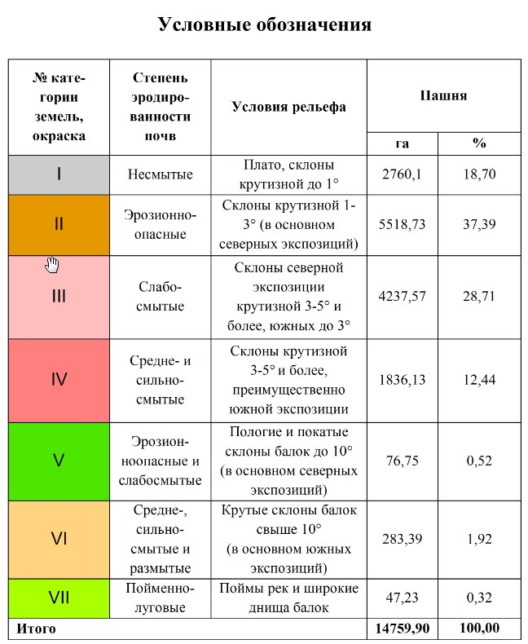
Map of soil degradation due to erosion
The degree of soil degradation
Caused by erosion
The criteria (which are used in the main slopes)
II. The established practice of mapping of eroded soils in Russia

Slide 12
The established criteria in division of soils by the degree of degradation due to erosion
Kozmenko, 1948
Category of soils by degree of erosion | Absence (washed out) of humus horizons А+В, %
Weak | <10
Medium | 10-30
Strong | 30-50
Very strong | >50
Sobolev, 1960, 1961
Category of soils by degree of erosion | Absence (washed out) of horizons
Weak | <0.5 of А horison
Medium | 0.5-1 of А horison
Strong | part of В horison
Very strong | total А + В
Surmach, 1954, 1956
Category of soils by degree of erosion | Absence (washed out) of humus horizons А+В, %
Weak | <30
Medium | 30-60
Strong | 60-80
Very strong | 80-100
Excessively (or completely) washed away | part of В horison (total А + В)
The different classifications were used in various times and regions of Russia.

Slide 13

Disadvantages
The “Expert” principle with a high degree of subjectivity.
Approximate contours. Displays only the dominant categories of soil degradation.
Labor intensity (before the use of GIS, more than 2 people drew maps for several months; and even now using GIS, the drawing of soil contours and the soil erosion map performs manually).
Poorly defined principles of design solutions for reducing soil erosion.
II. The established practice of mapping of eroded soils in Russia

Slide 14
III
The proposing of “New” method

Slide 15
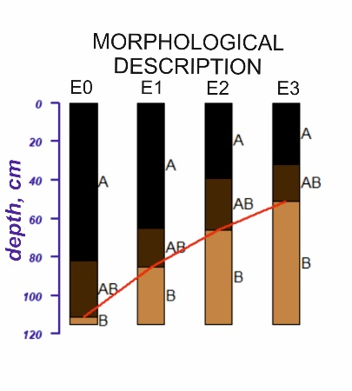
Methods: common review
Field work and creation a database of soil properties (field degree of erosion).
Calculation of soil erosion rates (by WaTEM/SEDEM).
Identification of statistical dependence between share of soils with different degree of erosional degradation and erosion rates.
Creation maps of equity share of soils of different degree of erosional degradation.
Creation map of soil combinations by the degree of erosional degradation.
Verification.
III. The proposing of “New” method

Slide 16
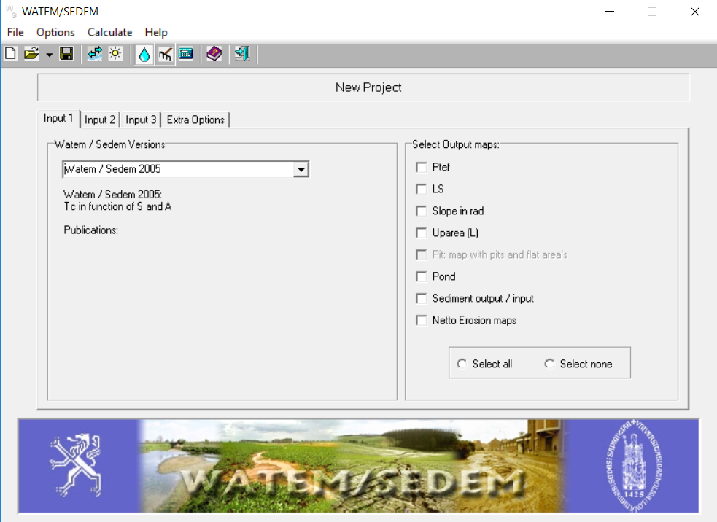
Methods: common review
Field work and creation a database of soil properties (field degree of erosion).
Calculation of soil erosion rates (by WaTEM/SEDEM).
Identification of statistical dependence between share of soils with different degree of erosional degradation and erosion rates.
Creation maps of equity share of soils of different degree of erosional degradation.
Creation map of soil combinations by the degree of erosional degradation.
Verification.
III. The proposing of “New” method

Slide 17
Methods: common review
Field work and creation a database of soil properties (field degree of erosion).
Calculation of soil erosion rates (by WaTEM/SEDEM).
Identification of statistical dependence between share of soils with different degree of erosional degradation and erosion rates.
Creation maps of equity share of soils with different degree of erosion.
Creation map of soil combinations by the degree of erosion.
Verification.
III. The proposing of “New” method

Slide 18
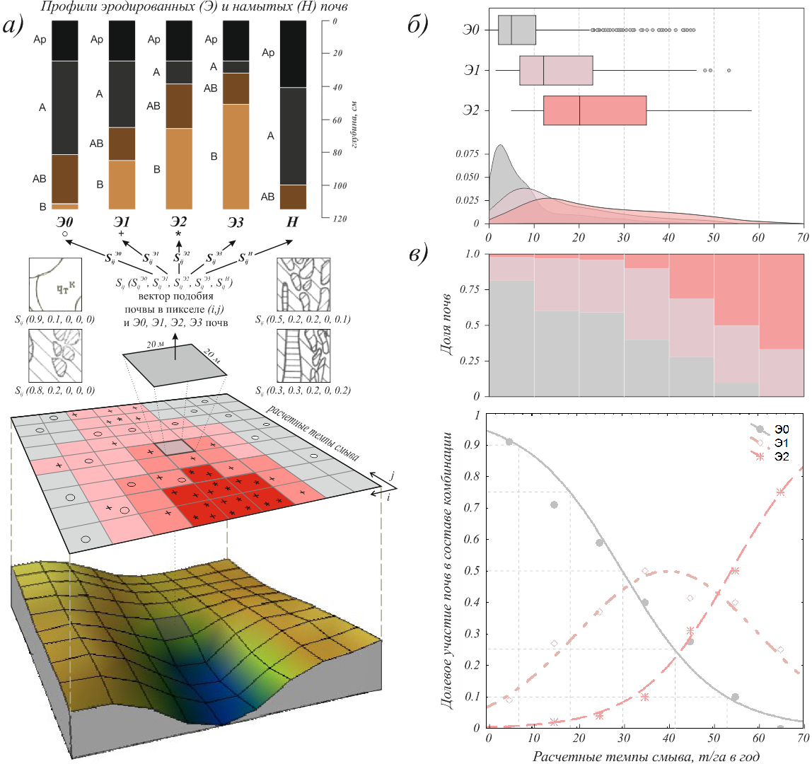
Dependence between share of soils with different degree of erosional degradation and rates of erosion
III. The proposing of “New” method

Slide 19
Methods: common review
Field work and creation a database of soil properties (field degree of erosion).
Calculation of soil erosion rates (by WaTEM/SEDEM).
Identification of statistical dependence between share of soils with different degree of erosional degradation and erosion rates.
Creation maps of equity share of soils with different degree of erosional degradation.
Creation map of soil combinations by the degree of erosional degradation.
Verification.
III. The proposing of “New” method

Slide 20
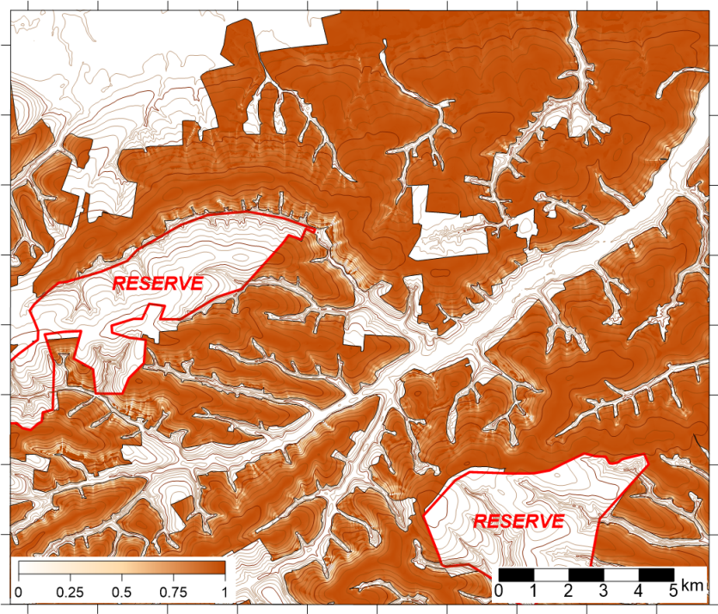
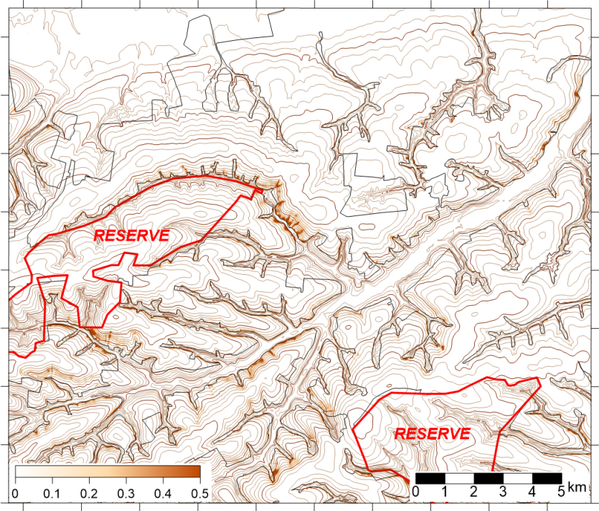
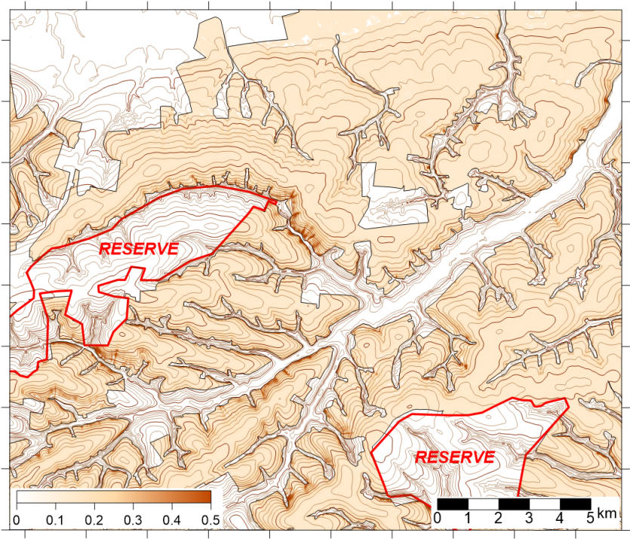
Maps of Equity share of soils of different degree of erosional degradation
III. The proposing of “New” method
Proportion of non eroded soils in pixels
Proportion of medium eroded soils in pixel
Proportion of weakly eroded soils in pixel

Slide 21
Methods: common review
Field work and creation of database of soil properties (field degree of erosion).
Calculation of soil erosion rates (by WaTEM/SEDEM).
Identification of statistical dependence between share of soils with different degree of erosional degradation and erosion rates.
Creation maps of equity share of soils with different degree of erosional degradation.
Creation map of soil combinations by the degree of erosional degradation.
Verification.
III. The proposing of “New” method

Slide 22
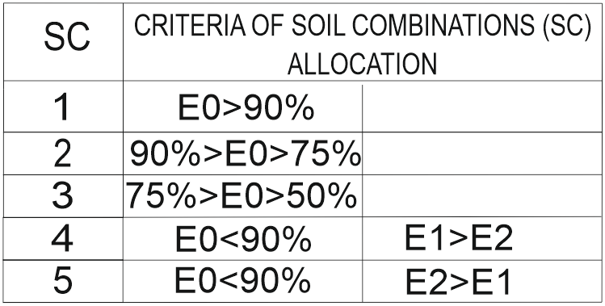
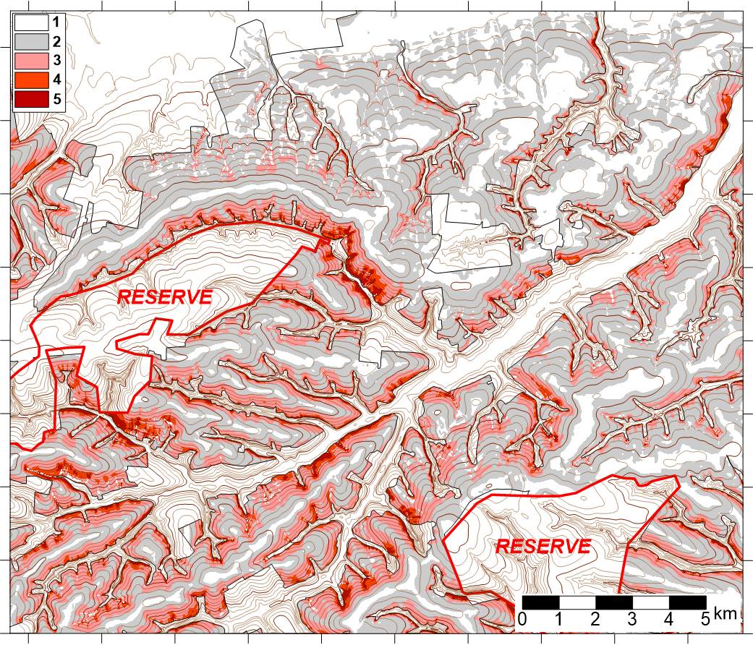
Map of soil combinations
by the degree of erosional degradation
E0 – non eroded soils
E1 – weakly eroded soils
E2 – medium eroded soils
III. The proposing of “New” method

Slide 23
Methods: common review
Field work and creation of database of soil properties (field degree of erosion).
Calculation of soil erosion rates (by WaTEM/SEDEM).
Identification of statistical dependence between share of soils with different degree of erosional degradation and erosion rates.
Creation maps of equity share of soils of different degree of erosional degradation.
Creation map of soil combinations by the degree of erosional degradation.
Verification.
III. The proposing of “New” method

Slide 24

Advantages of this method
Formalized representative principles of mapping.
Low labor and high speed of cartographic works.
The possibilities of studying the territory in different scales of space and time.
Possibilities of detailed design of anti-erosion measures, including the territorial planning of land management.
The joint application of digital modeling and field soil survey data

Slide 25
IV
The results in applying of “New” method in different study sites

Slide 26
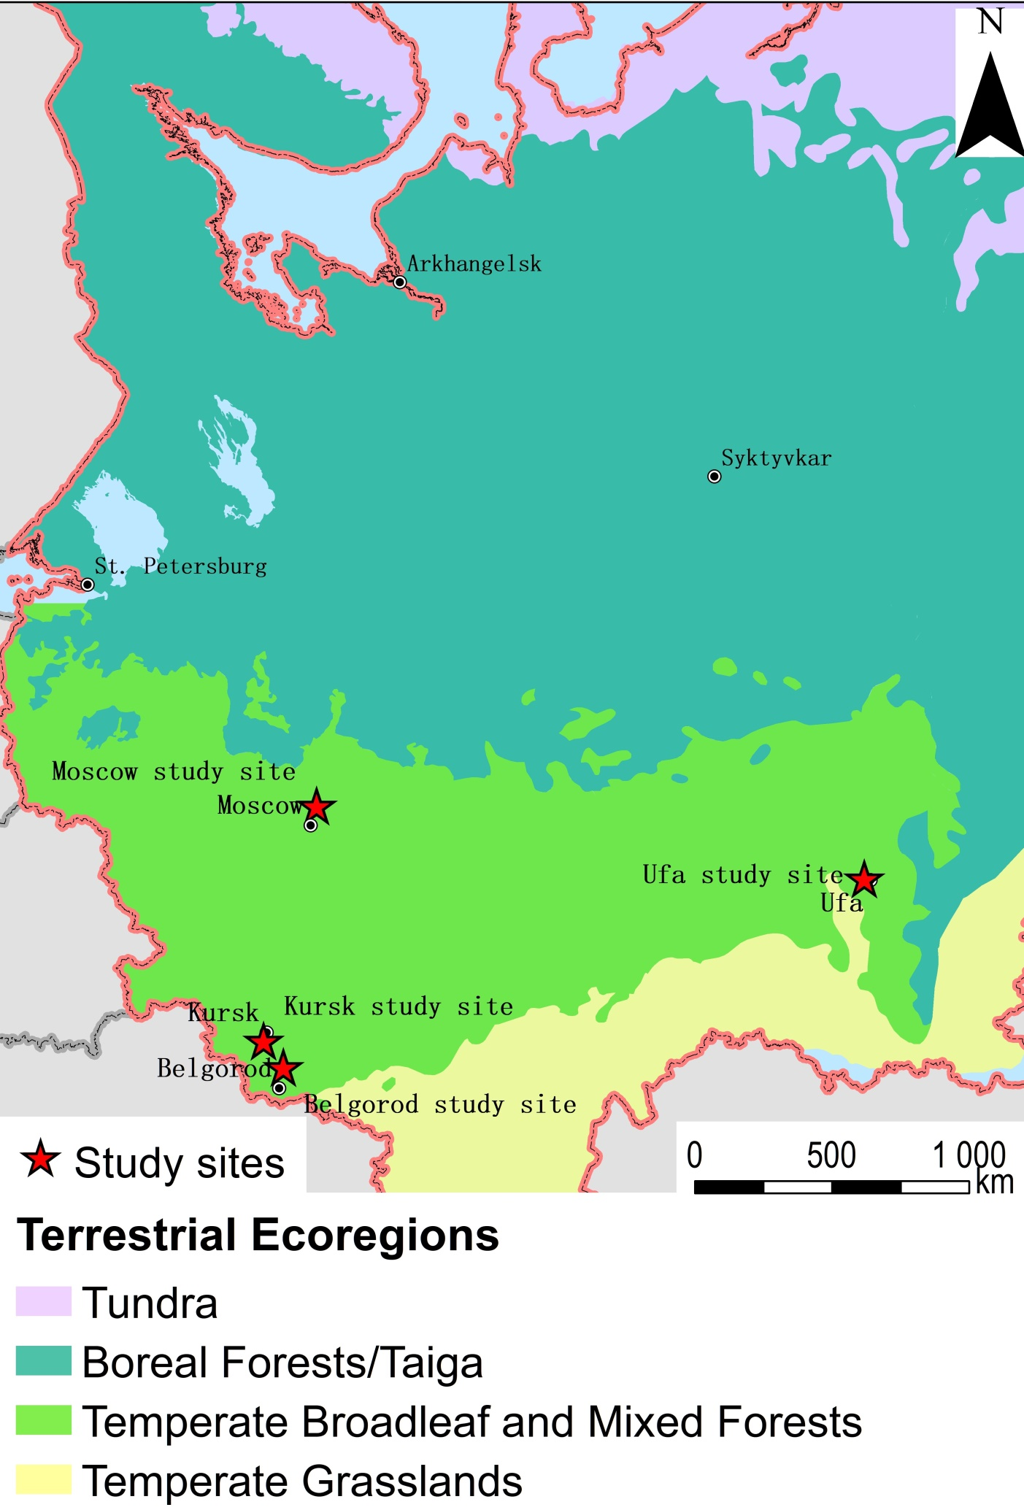
The location of 4 studied sites
IV. The results in applying of “New” method in different study sites

Slide 27
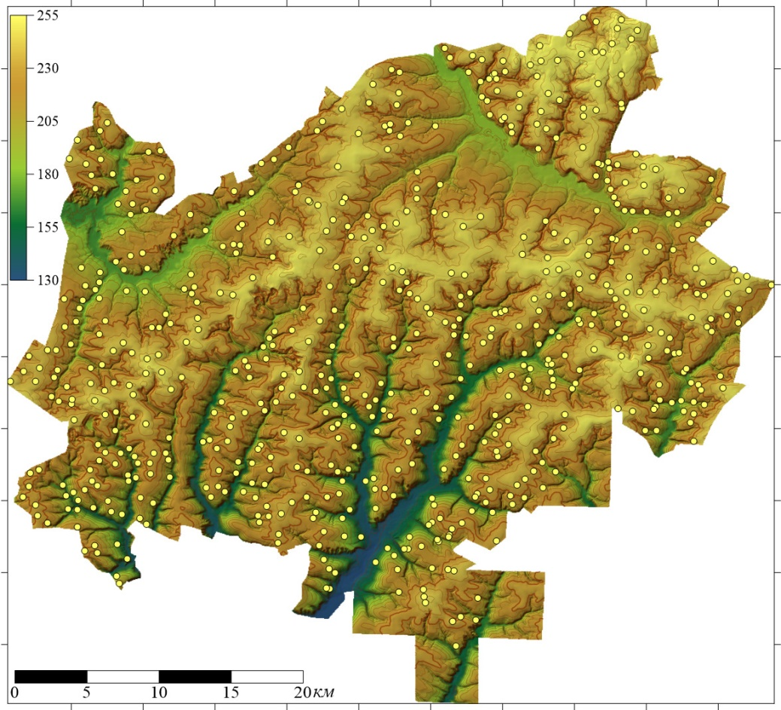
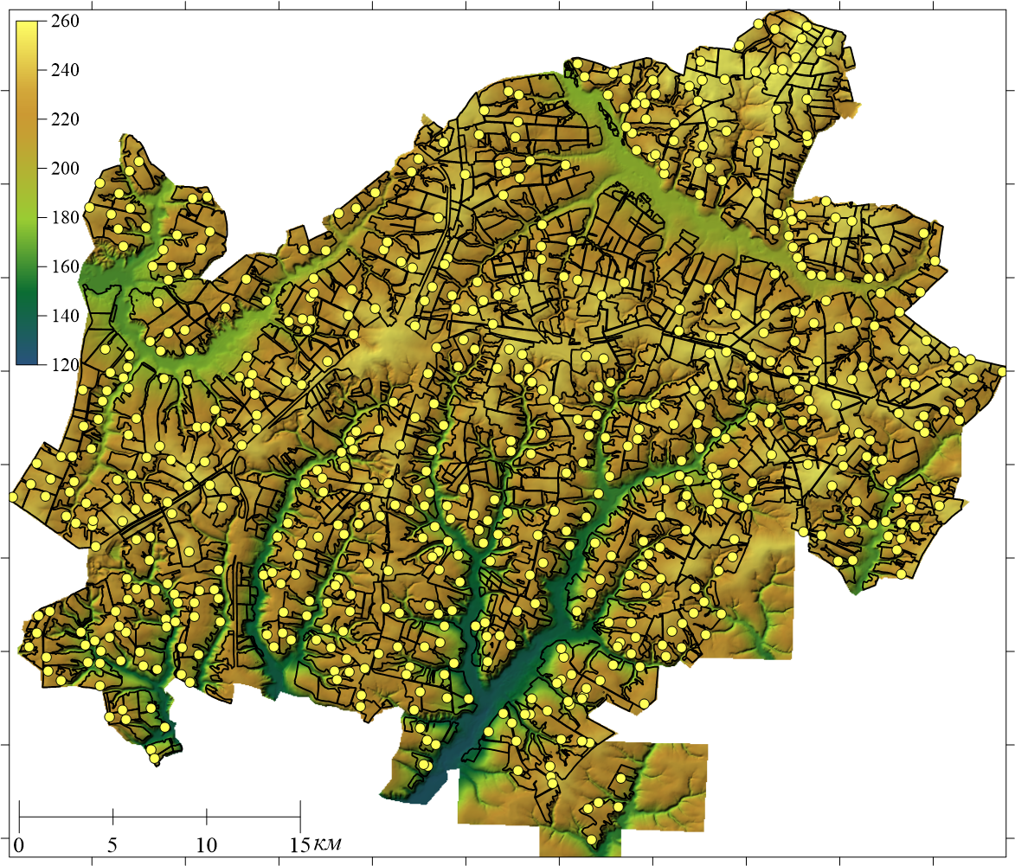
Kursk and Belgorod studied sites
~1000 soil pits
~670 soil pits

Slide 28
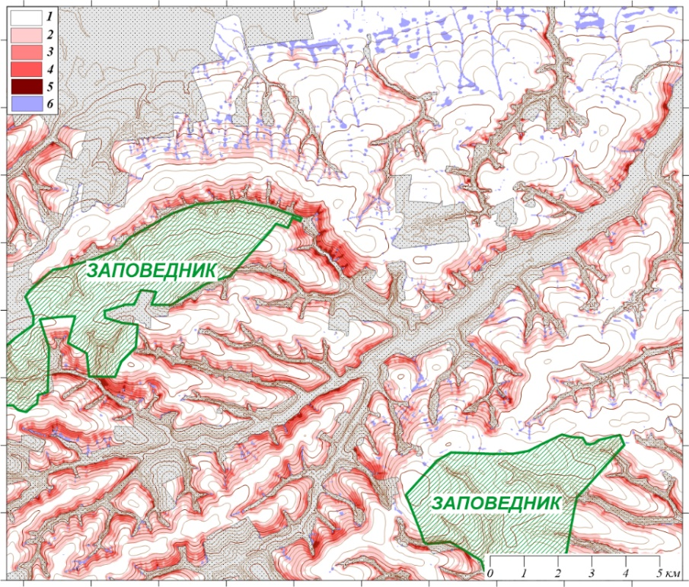
Kursk site
IV. The results in applying of “New” method in different study sites
1) insignificantly-eroded soils (soil losses up to 3 t·ha-1·year-1); 2) slightly-eroded (3–10 t·ha-1·year-1); 3) medium-eroded (10–20 t·ha-1·year-1); 4) highly-eroded (20–40 t·ha-1·year-1); 5) severely-eroded (over 40 t·ha-1·year-1); 6) warpland (accumulation of 3–10 t·ha-1·year-1); 7) virgin lands of the Central Black Earth Re-serve; 8) pastures, hayfields, settlement lands.

Slide 29
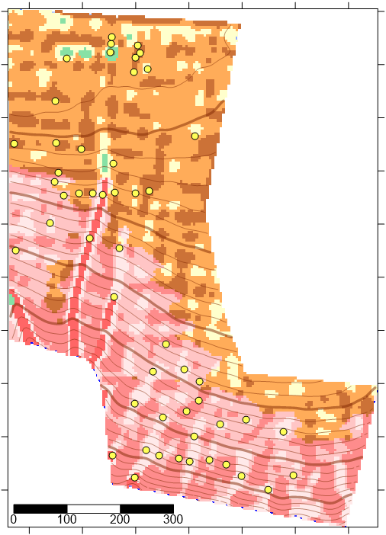
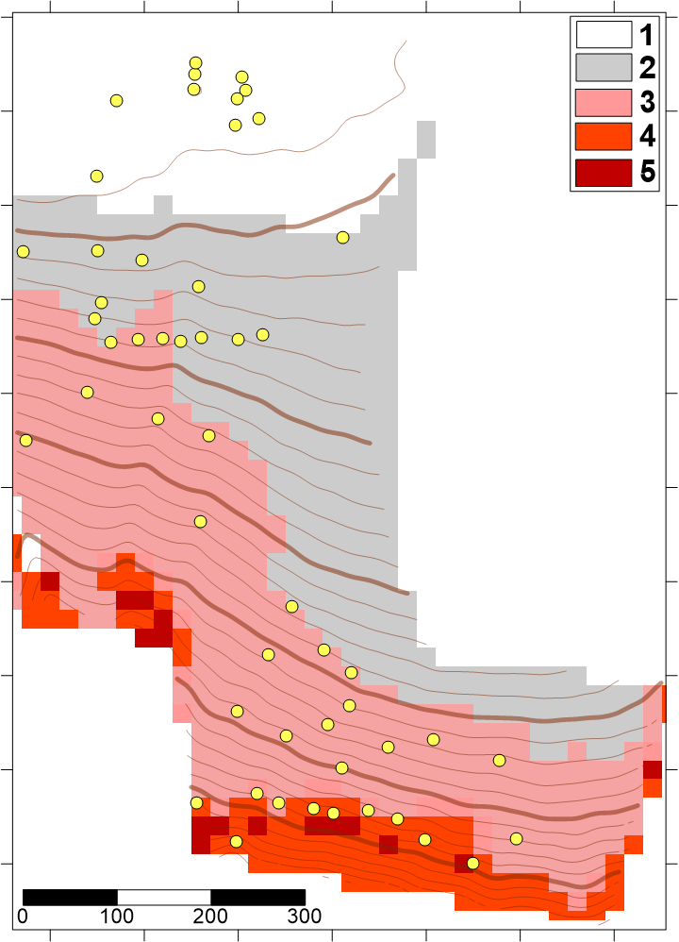
Verification by detailed studies of key small watersheds
Fragment of map of soil combinations by the degree of erosion
Traditional method
IV. The results in applying of “New” method in different study sites
Typical chernozem (TCh)
E0 | 1
 | 2
E0-E1 | 3
E1 | 4
E2 | 5
TChE1
Calcareous chernozem (CCh)
CChE1
Leached chernozem (LCh)
LChE1
Meadow chernozem (MCh)
MChE1

Slide 30
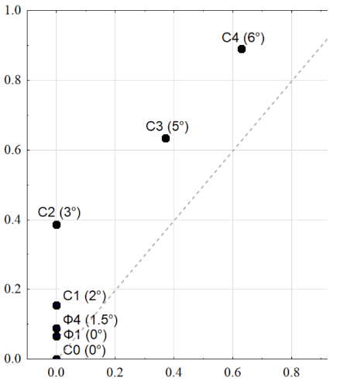
Verification by detailed studies of key small watersheds
The proportion of eroded soils according to modeling data
IV. The results in applying of “New” method in different study sites
The proportion of eroded soils according to detailed field data
*See details in:
Kozlov D. N. , Zhidkin A. P. , Lozbenev N. I. (2019) Digital mapping of soil cover eroded patterns on the bassis of soil erosion simulation model (northern forest-steppe of the Central Russian Upland). Dokuchaev Soil Bulletin.100. 5-35

Slide 31
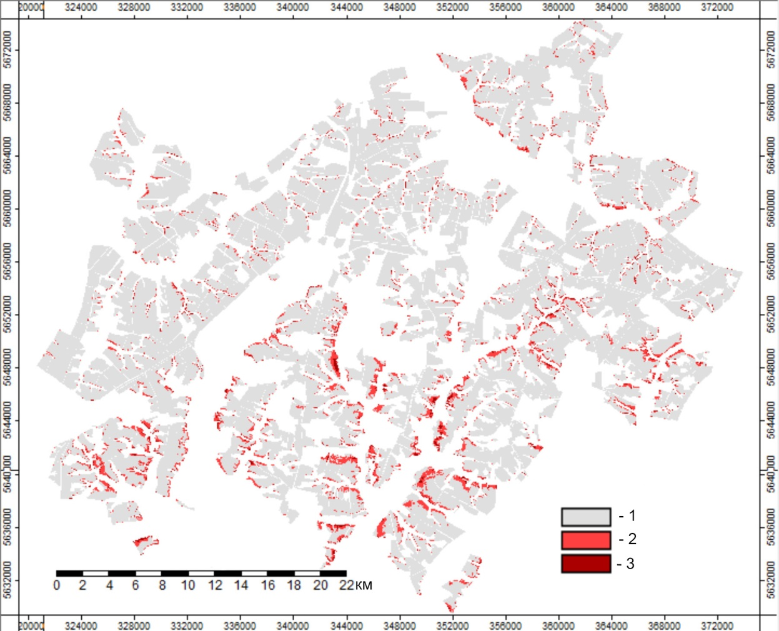
Belgorod site
IV. The results in applying of “New” method in different study sites
1 - non- and slightly eroded with a share> 75%;
2 - medium and strongly eroded> 50%, middle eroded> strongly eroded;
3 - medium and strongly eroded> 50%, strongly eroded> middle eroded.

Slide 32
The total area (in thousand ha) of eroded soils according to different mapping methods
Degree of soil degradation | Traditional visual expert method | Digital mapping
 | Dominant category | Dominant category | Taking into account the proportion of eroded soils in each pixel
Non- and slightly eroded | 65.2 | 62.1 | 55.7
Medium eroded | 2.5 | 4.3 | 11.3
Strongly eroded | 0.0 | 0.9 | 0.3
IV. The results in applying of “New” method in different study sites
*See details in:
Zhidkin A.P., Smirnova M.A. , Gennadiev A.N. , Lukin S.V. , Zazdravnykh E.A. , Lozbenev N.I. (2020) Digital modeling of the structure and erosion degree of soil cover (Prokhorov district of Belgorod region) // Eurasian soil science (on review)

Slide 33
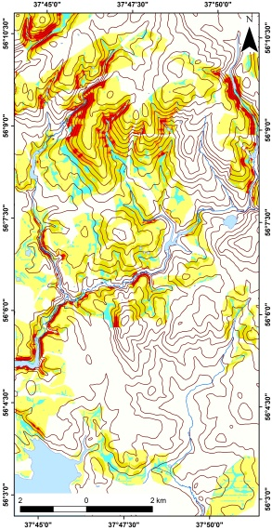
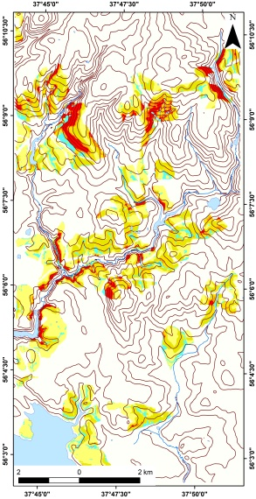
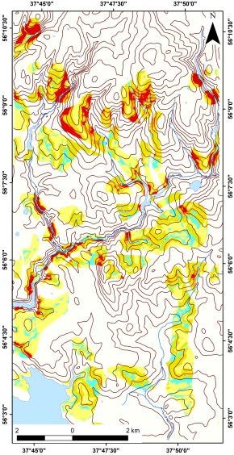
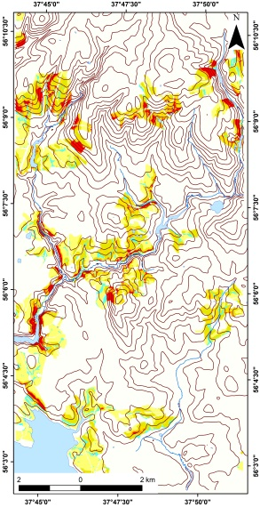




Moscow site
Land Use History - Leading Factor in the Territory
1797 year
1861 year
1871 year
1931 year
IV. The results in applying of “New” method in different study sites
1954 year
1985 year
2000 year
2018 year
*See details in EGU2020-969

Slide 34


Moscow site
Land Use History - Leading Fator in the Territory
~1300 soil pits
IV. The results in applying of “New” method in different study sites
non-eroded
very slightly eroded
slightly eroded
medium and strongly eroded
*See details in EGU2020-969

Slide 35

Ufa site
Soil map
Paleo microrelief greatly reduces the accuracy of digital modeling of soil erosion
Soil erosion rates, calculated by WaTEM/SEDEM with different DEM
IV. The results in applying of “New” method in different study sites
On the basis of topographic map
1:10 000
On the basis of geodetic survey 1:500
SRTM
*See details in:
Zhidkin A., Komissarov M. 2020. Erosion and accumulation microstructures of soil cover in the forest-steppe zone of the Cis-Urals, the republic of Bashkortostan. Vestnik BSAU. № 1. 12-20 (in Russian)

Slide 36
Thank you for your attention!
I regret that currently, we could not see each other. Lets meet in EGU 2021!
I will be glad to answer on any questions.
Dr. Andrey Zhidkin
zhidkin.ap@mail.ru

