Slide 1
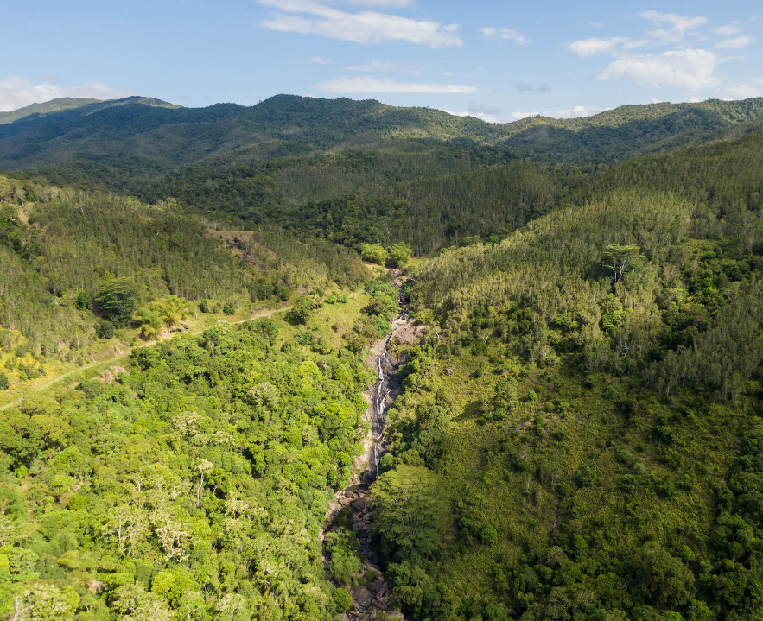



IMPACT OF INVASIVE FAUNA AND WILDFIRES ON HYDROLOGICAL REGIMES IN A TROPICAL VALLEY OF NEW CALEDONIA (SW PACIFIC)
Caroline Tramier Province Nord, Touho : c.tramier@province-nord.nc
Pierre Genthon Insitute for Research for Development, Nouméa : pierre.genthon@ird.fr

Slide 2
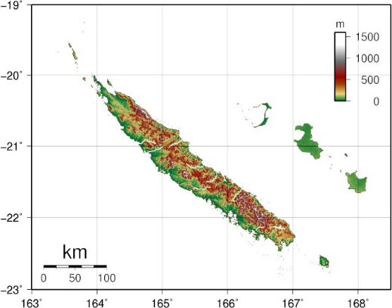
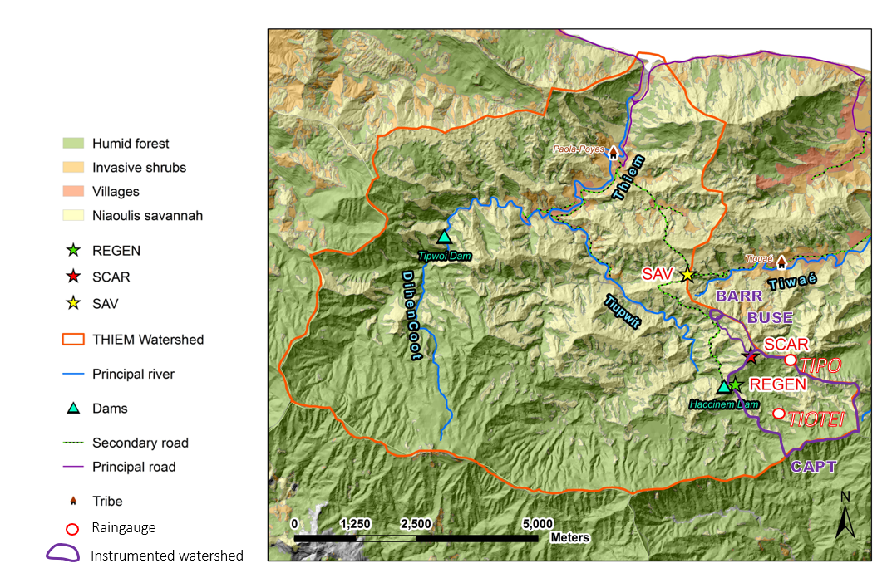
THE HYDROTHIEM HYDROLOGICAL SITE NEAR TOUHO
A mosaic of woody (niaoulis) savannah and humid forest

Slide 3
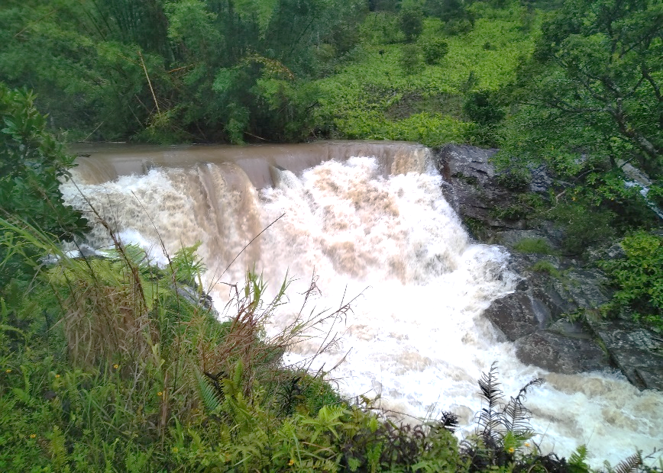
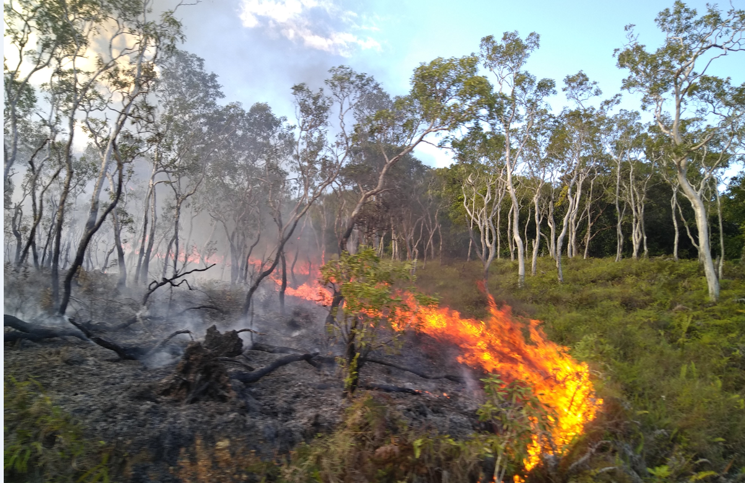
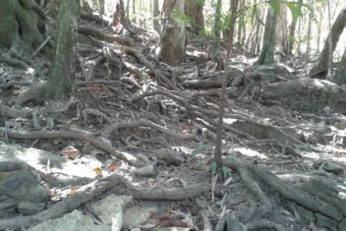
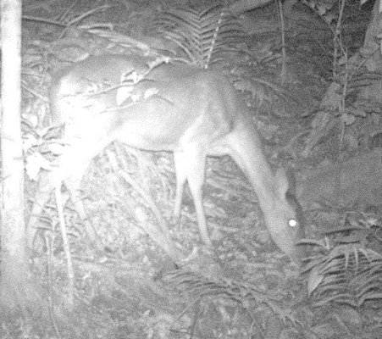
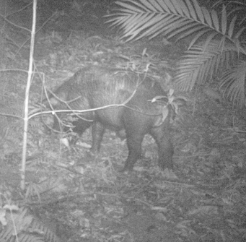
MAJOR ISSUES IN HYDROTHIEM SITE
Land surface degradation and turbid waters
Bad water quality (leptospirosis)
Savannah and forests edges regularly affected by fire
Invasive pigs and deers
Forests regeneration and soil affected by invasive fauna

Slide 4
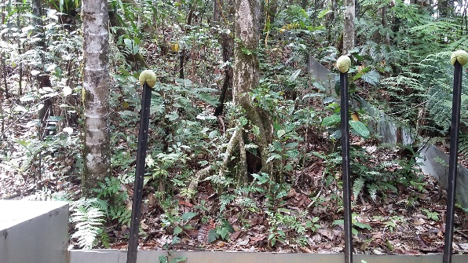
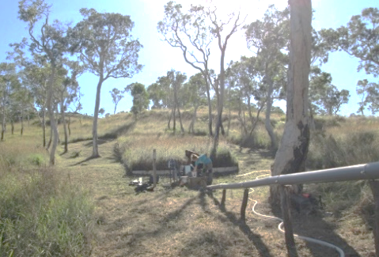
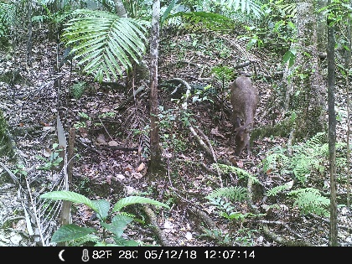
Three Contrasted Experimental Plots
REGEN = healthy forest
SAV = savannah
SCAR =
degraded forest

Slide 5
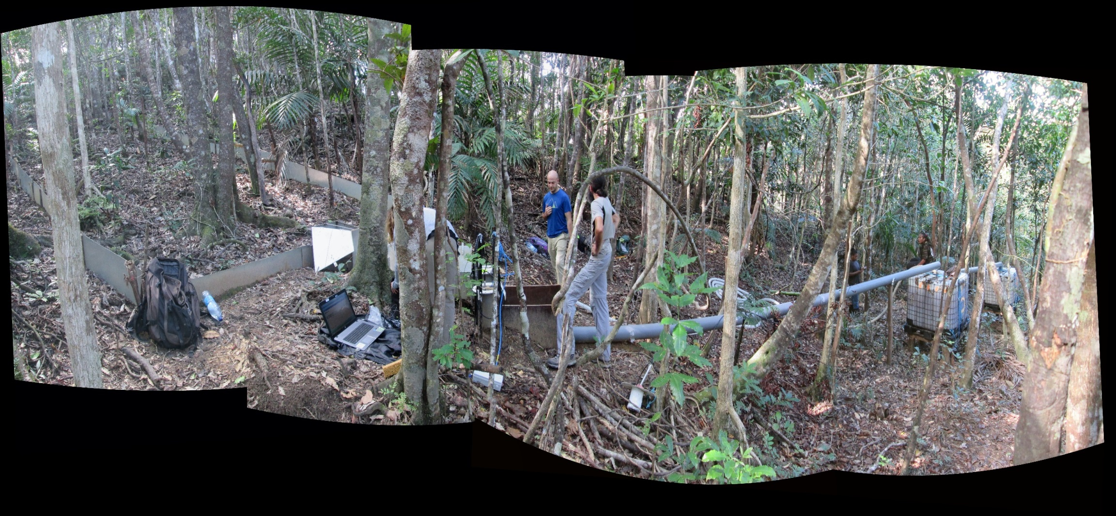
EXPERIMENTAL DESIGN OF THE THREE 100m² PLOTS
2017/05
2 Humidity sensors
Raingauge 50 m
Border down to 10 cm
2 Humidity sensors
Gutter
turbidimeter
HS Flume
= runoff
Gutter
Approach section
Tank 1
Tank 2
6 mins acquisitions of :
Rain
Runoff flow
Runoff turbidity

Slide 6
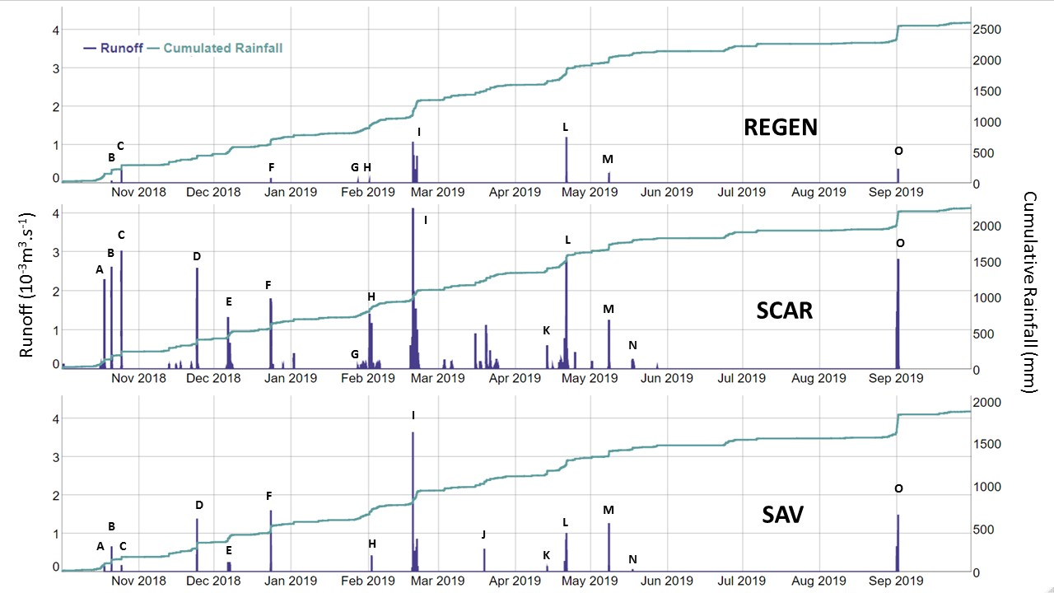
RESULTS : Contrasted runoff behaviors at the three plots

Slide 7
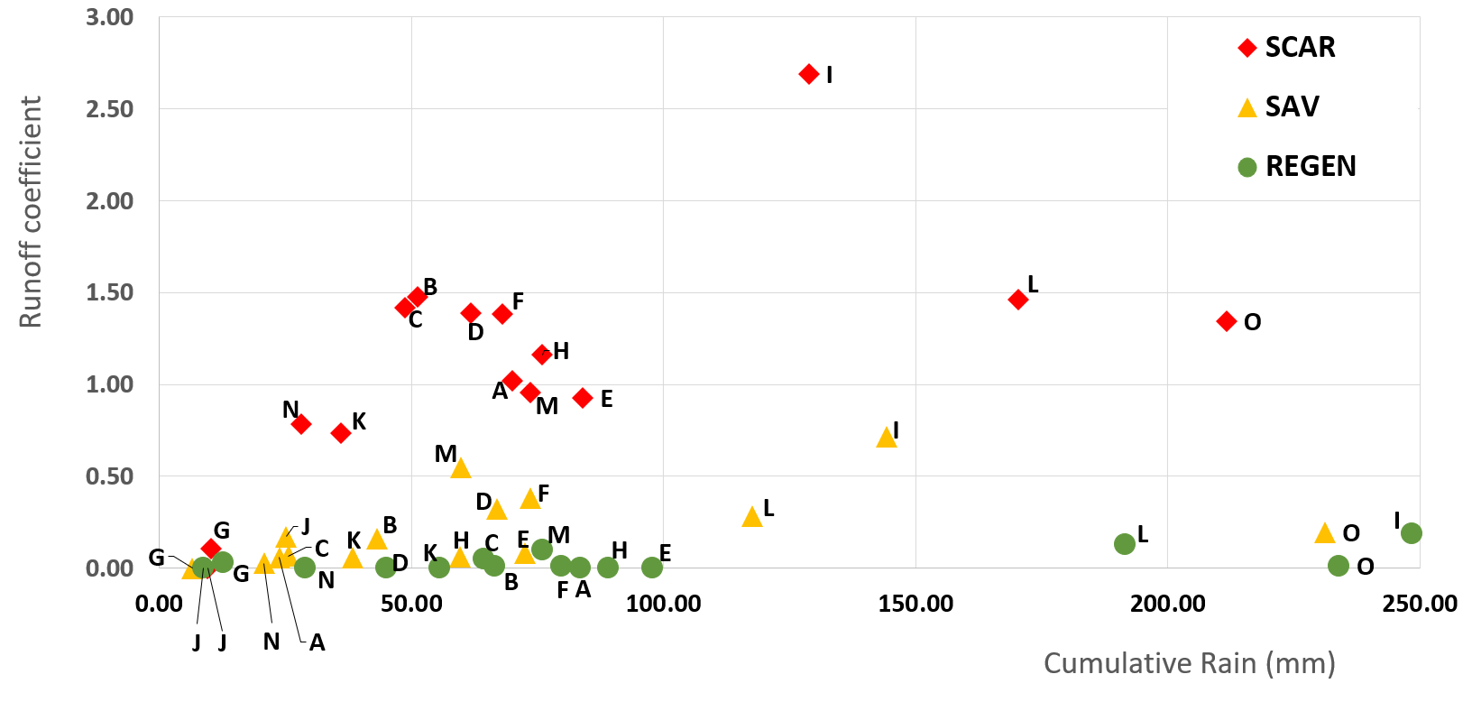
RUNOFF COEFFICIENTS FROM OCTOBER 2018 TO SEPTEMBER 2019
Oma cyclone (March 2019)
RUNOFF : SCAR >> SAV >> REGEN
runoff often > 100 % at SCAR
due to subsurface flow exfiltration inside the plot

Slide 8
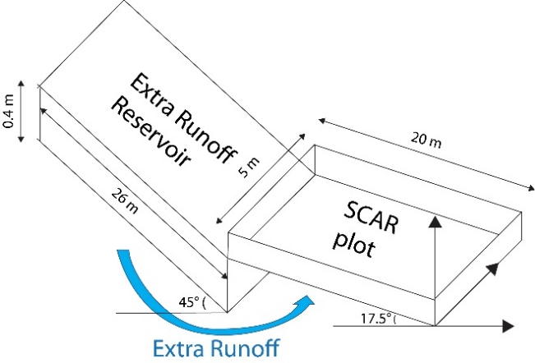
SUBSURFACE FLOW MODEL AT SCAR
Apparent mean runoff at Scar = 0.87
Without subsurface flow = 0.4

Slide 9
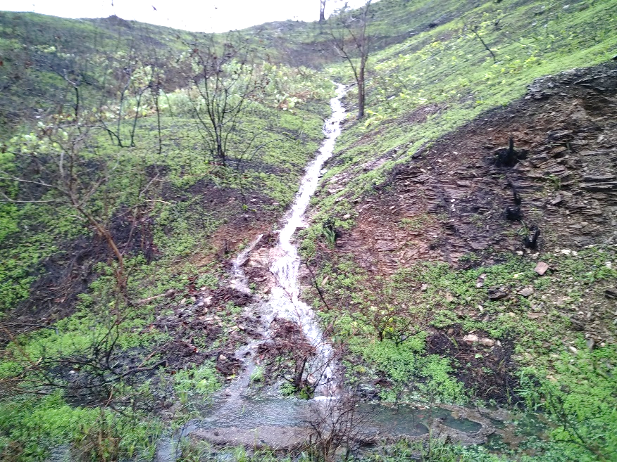
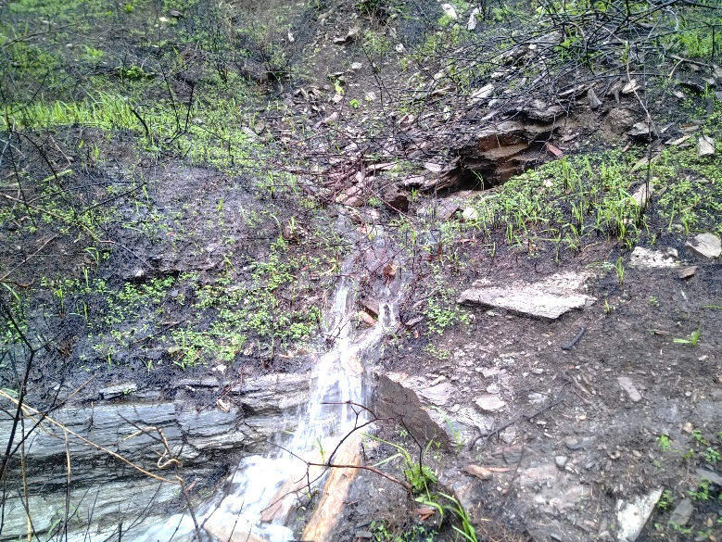
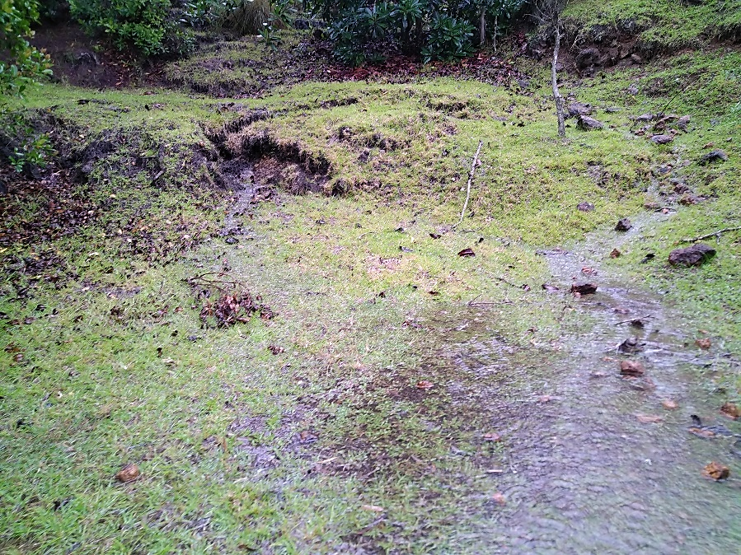
EVIDENCES of SUBSURFACE FLOW (UESI CYCLONE, 02/2020)
Burned savanna
Forest - Savanna

Slide 10
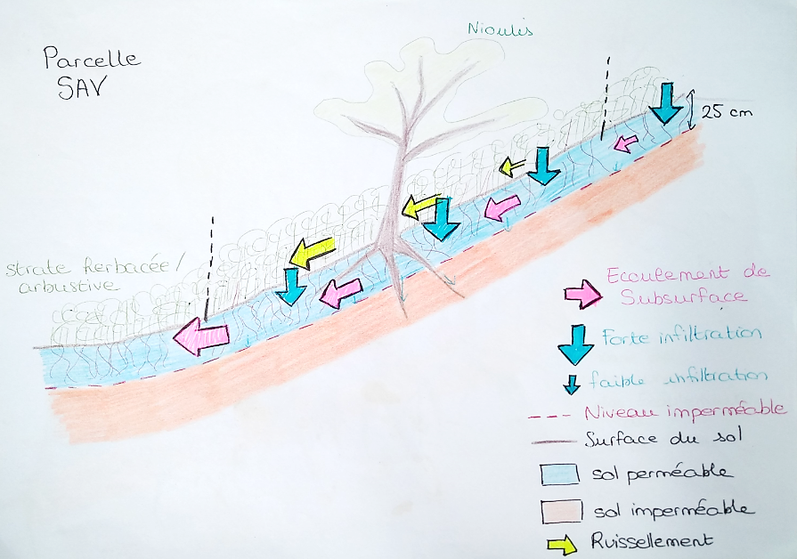
Water budget at the SAV plot (niaoulis savanna)
SAV
plot
Subsurface flow
Large infiltration
Little infiltration
Permeable soil
Impervious soil
Runoff

Slide 11
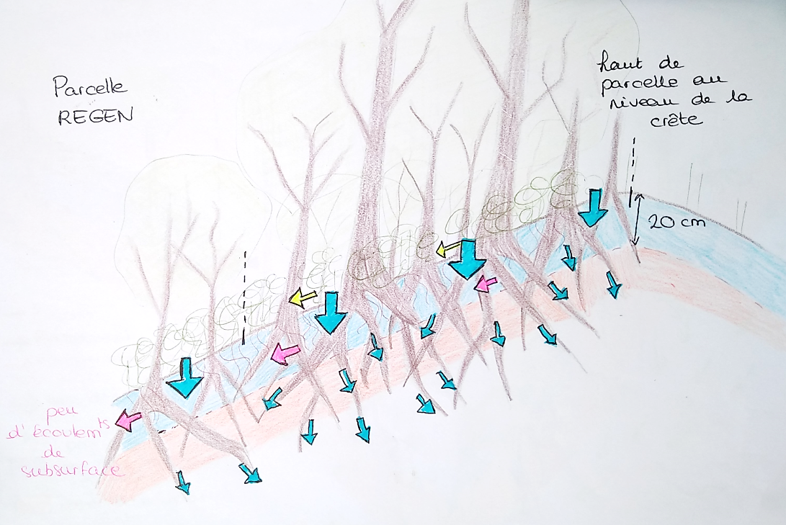
Water budget at the Regen plot (healthy forest)
REGEN
plot
Top of the plot
= Crestline
Little runoff
Little subsurface flow
Large infiltration

Slide 12
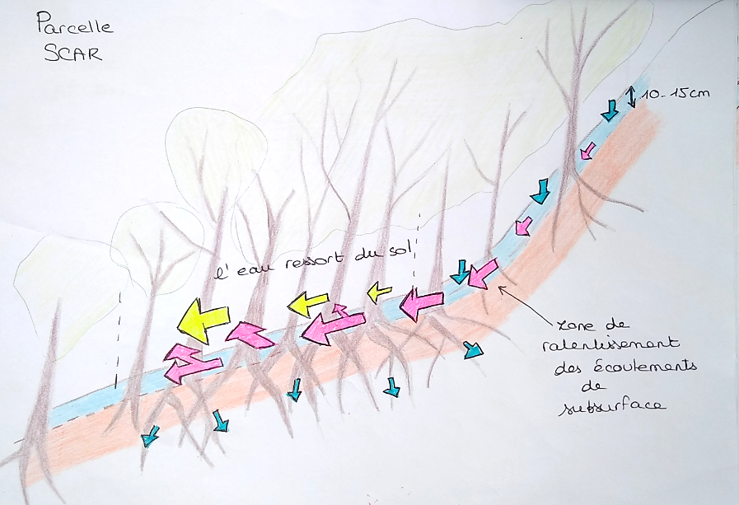
Water budget at the Scar plot (degraded forest)
SCAR
Plot
Plot location
The slope discontinuity induces subsurface water exfiltration

Slide 13
CONCLUSION
Savannahs (with high runoff coefficients due to impervious layer at 25cm) may control floods and runoff at watershed scales as they are often located above the forests
Erosion may come from forest zones highly affected by deers and pigs situated in topographic zones favoring exfiltration of subsurface flow

