Slide 1
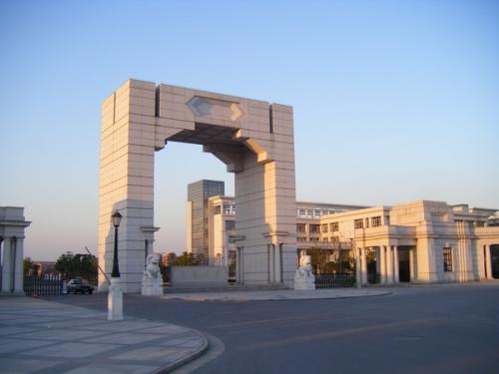
Study on the correction of total suspended particles monitoring results based on machine learning method
Qiaofeng Guo, Zhen Cheng
Shanghai Jiao Tong University

Slide 2
2
CONTENTS
1
Research background
2
Methods and data sources
3
Results of ML models
4
Analysis of influencing factors
5
Conclusion

Slide 3
3
Part 1
Reseach background

Slide 4
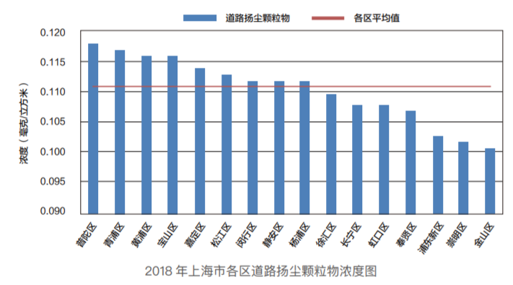
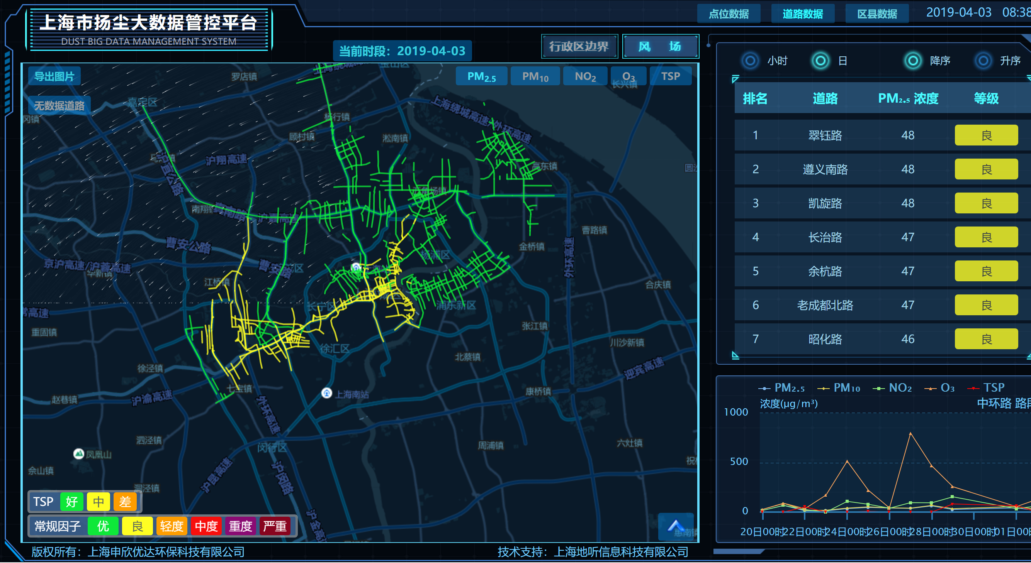
Research background
—Road dust pollution
(Bulletin of Shanghai ecological environment, 2018)
(Dust data online monitoring platform of Shanghai Eureka Environmental Protection Hi-tech., Ltd)
From 2018, Shanghai will no longer carry out conventional manual monitoring of regional dust reduction, but instead carry out online monitoring of road dust.
However, there is a big error between the results of the commonly used on-line measurement of TSP light scattering instrument and the results of the weighing method。

Slide 5
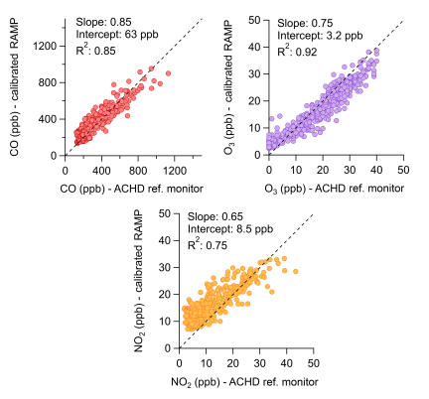
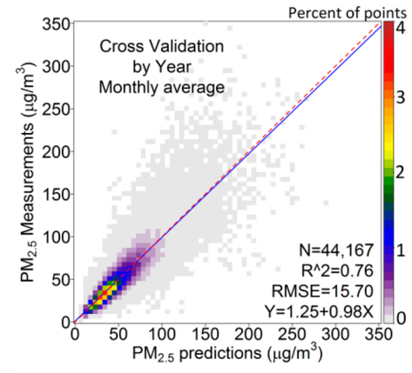
Research background
—Machine Learning correction
(Xiao et al., ES&T, 2018)
(Zimmerman et al., AMT, 2018)
Machine learning correction / prediction models for fine particles and gaseous pollutants have been studied.

Slide 6
Research Contents
Using machine learning model to correct the TSP measurement result of light scattering monitoring instrument
Using the interpretable tools in machine learning, this paper analyzes the influence of various pollutants and environmental temperature and humidity on the instrument monitoring

Slide 7
Part 2
Methods and data sources

Slide 8
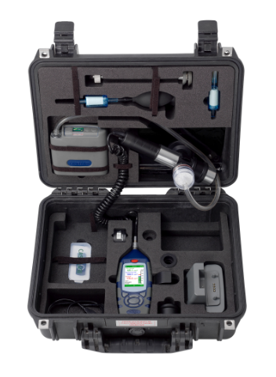
TSP Measurement
—light scattering and gravimetric methods
Parameter | Method | Instrument | Model | Factory number
TSP | GB/T 15432-1995 | Balance | MS105DU | B524045289
TSP | GB/T 15432-1995 | Chamber | LF-3000 | SHNX-2018-B0913
TSP | GB/T 15432-1995 | TSP Sampler | 2030 | M03358884、M03357505
TSP | GB/T 15432-1995 | Flow calibrator | 8040 | 2L01021892
Temperature and humidity | GB/T 18204.1-2013 | Hygrothermograph | 8809 | 9152104
Casella dust monitor
CLE-712
National standard method
GB/T15432-1995

Slide 9
Method
—Machine learning algorithm
ML algorithm | Brief introduction
SVM | Good adaptability to high dimensional space and memory saving
RF | Strong anti over fitting ability
GBRT | Strong ability to handle different types of data
ANN | Good at analyzing large amount of data
INPUT
Casella raw readings
ML Models
SVM
RF
GBRT
ANN
OUTPUT
PM concentrations (PM2.5、PM10)
TSP Gravimetric results
Gaseous pollutants concentrations
(SO₂、NO₂、CO、O₃)
Tem, RH
Monitoring time (hour)

Slide 10
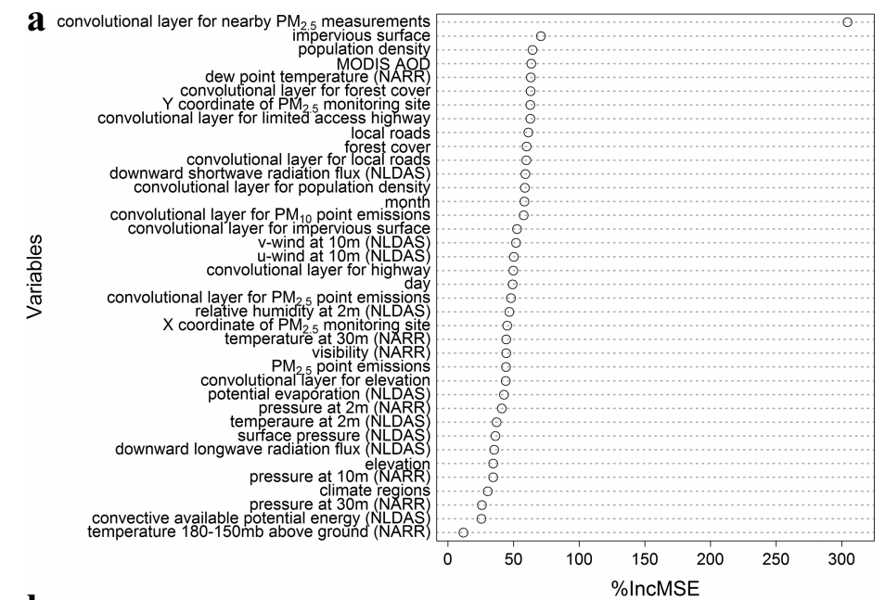
Method
—Interpretable tools (RF importance analysis)
(Hu et al., ES&T, 2017)
Using the importance analysis tool of random forest to rank the importance of each input feature.

Slide 11
Method
—Interpretable tools (Partial dependence plot)
(Sayegh et al., AE, 2016)
Partial dependence plots blurs the influence of other features and shows the marginal effect of target features on the results.

Slide 12
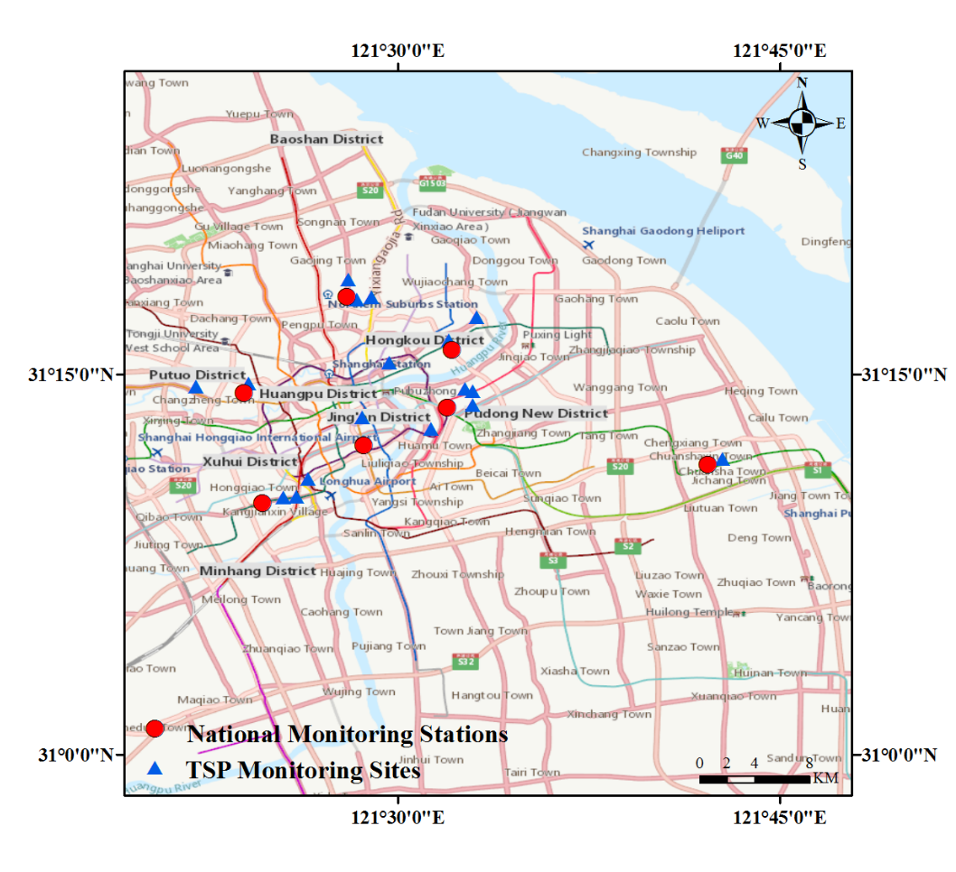
Data source
1114 hourly records were selected in 17 TSP monitoring sites and 7 national monitoring stations in urban Shanghai.

Slide 13
Part 3
Results of ML models

Slide 14
Comparison of original data and training effect
—CaoXi Road site
Notes:
EP1

Slide 15
Comparison of original data and training effect
—CaoXi Road site
Notes:
EP1

Slide 16
Comparison of original data and training effect
—CaoXi Road site
Notes:
EP1

Slide 17
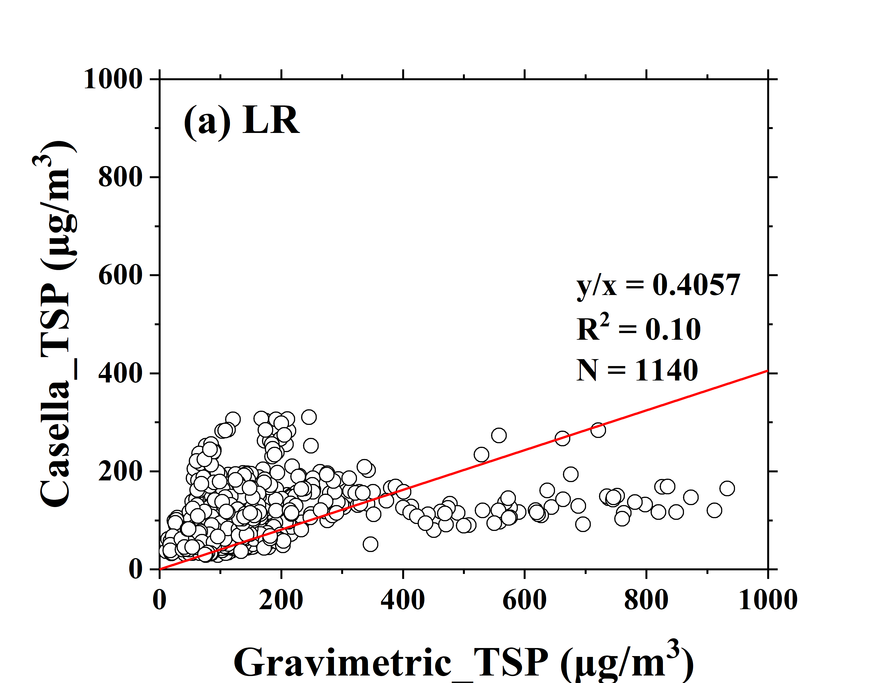
Comparison of model test results

Slide 18
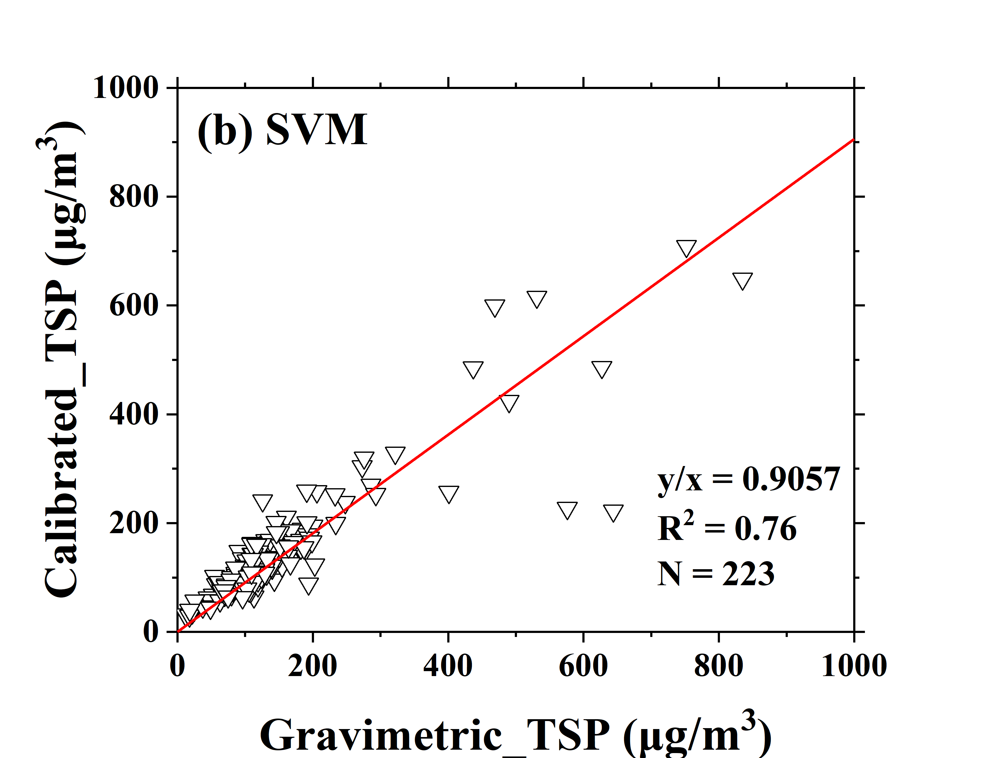
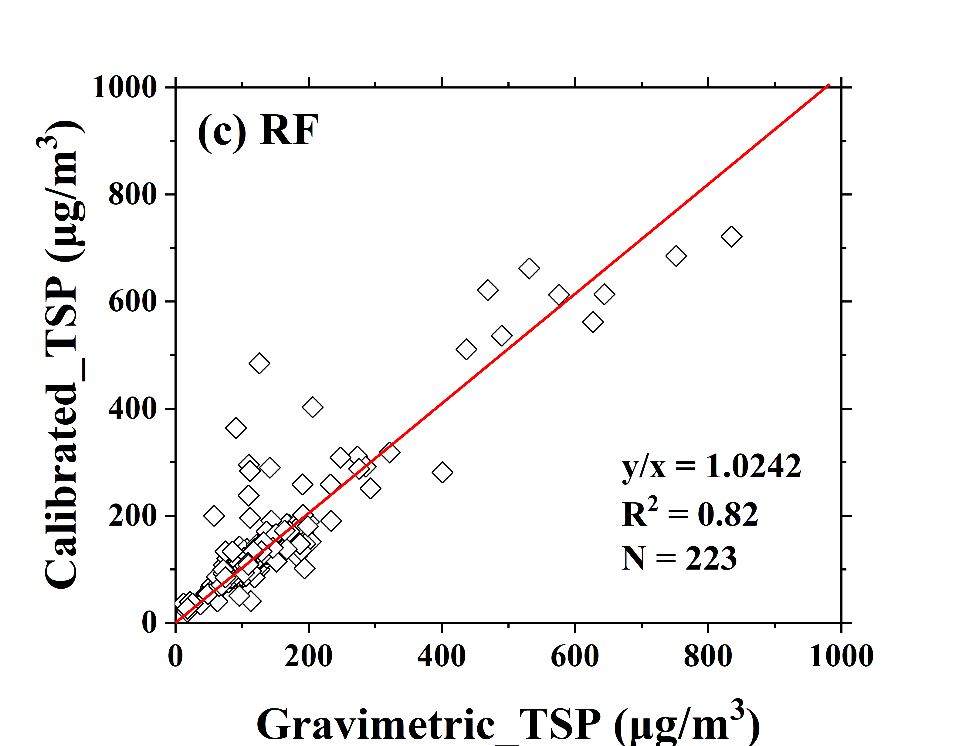
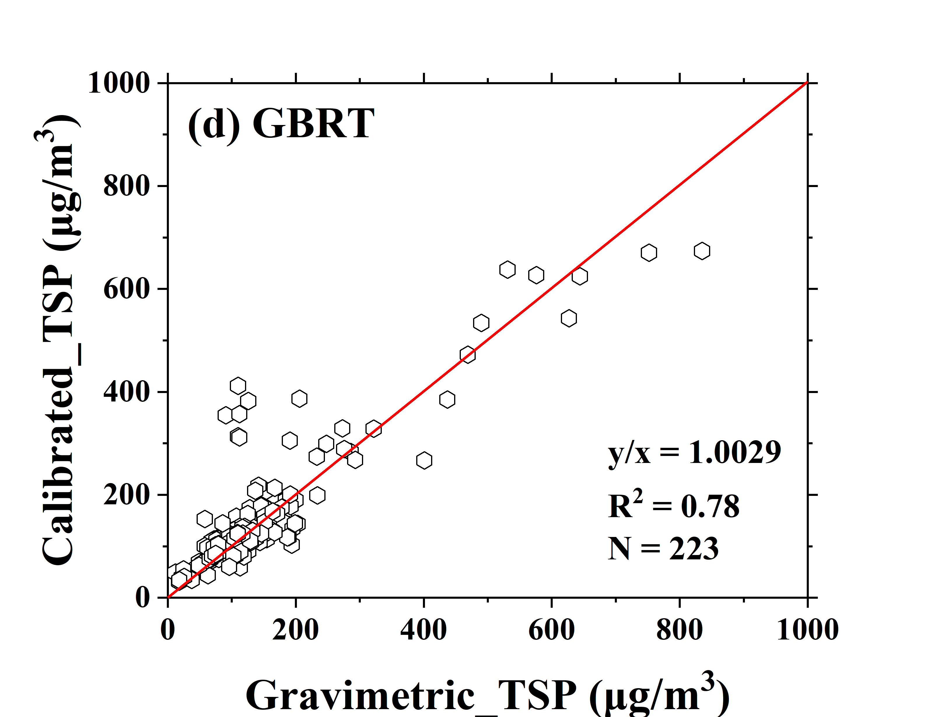
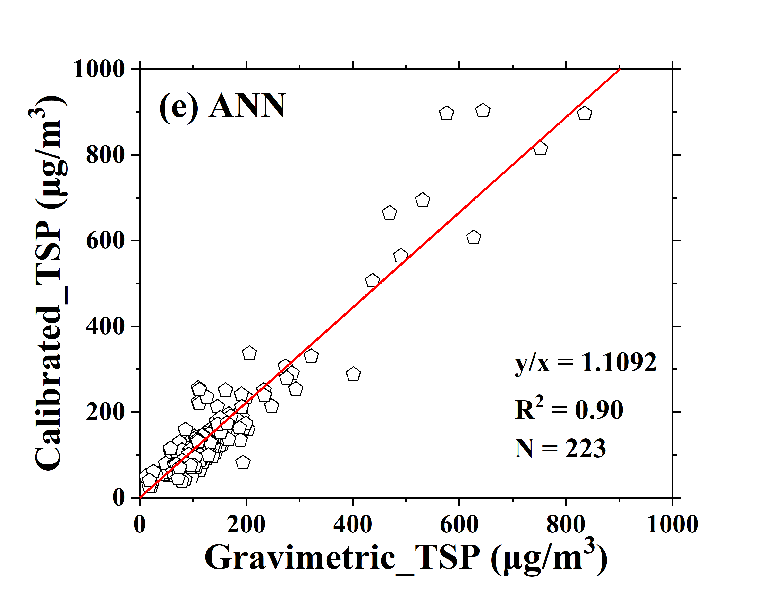
Comparison of model test results
SVM
RF
RMSE=49.01
MAE=24.19
RMSE=49.53
MAE=24.71
GBRT
ANN
RMSE=53.49
MAE=30.15
RMSE=52.19
MAE=29.18
Four models have greatly improved the correlation between the two methods, the slope range is 0.91-1.11, and the correlation coefficient is above 0.75

Slide 19
Part 4
Analysis of influencing factors

Slide 20
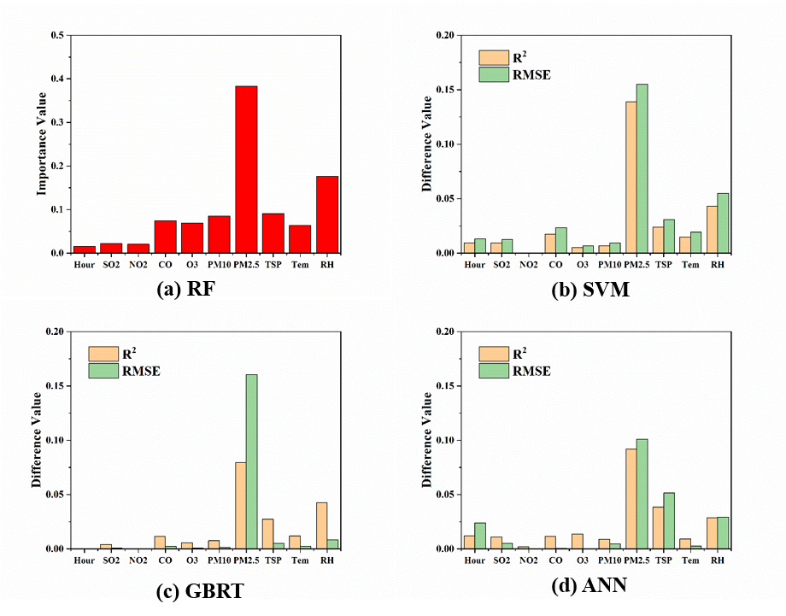
Fearture Importance — RF feature importance and ablation study of three models
PM_{2.5}, RH and TSP are the three features that have the greatest influence on TSP measurement of light scattering instrument

Slide 21
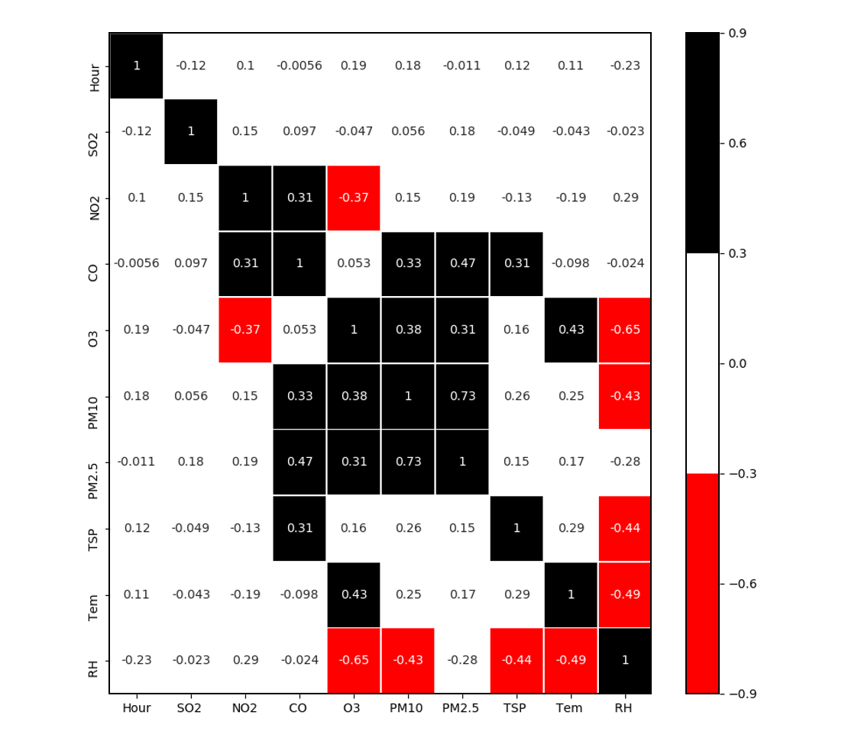
Correlation analysis between features
The result shows that the relationship between PM_{2.5} and PM₁₀ is very close, which has a correlation coefficient of 7.3. RH has a negative correlation with most features (O₃, PM_{2.5}, PM₁₀, TSP, Tem).

Slide 22
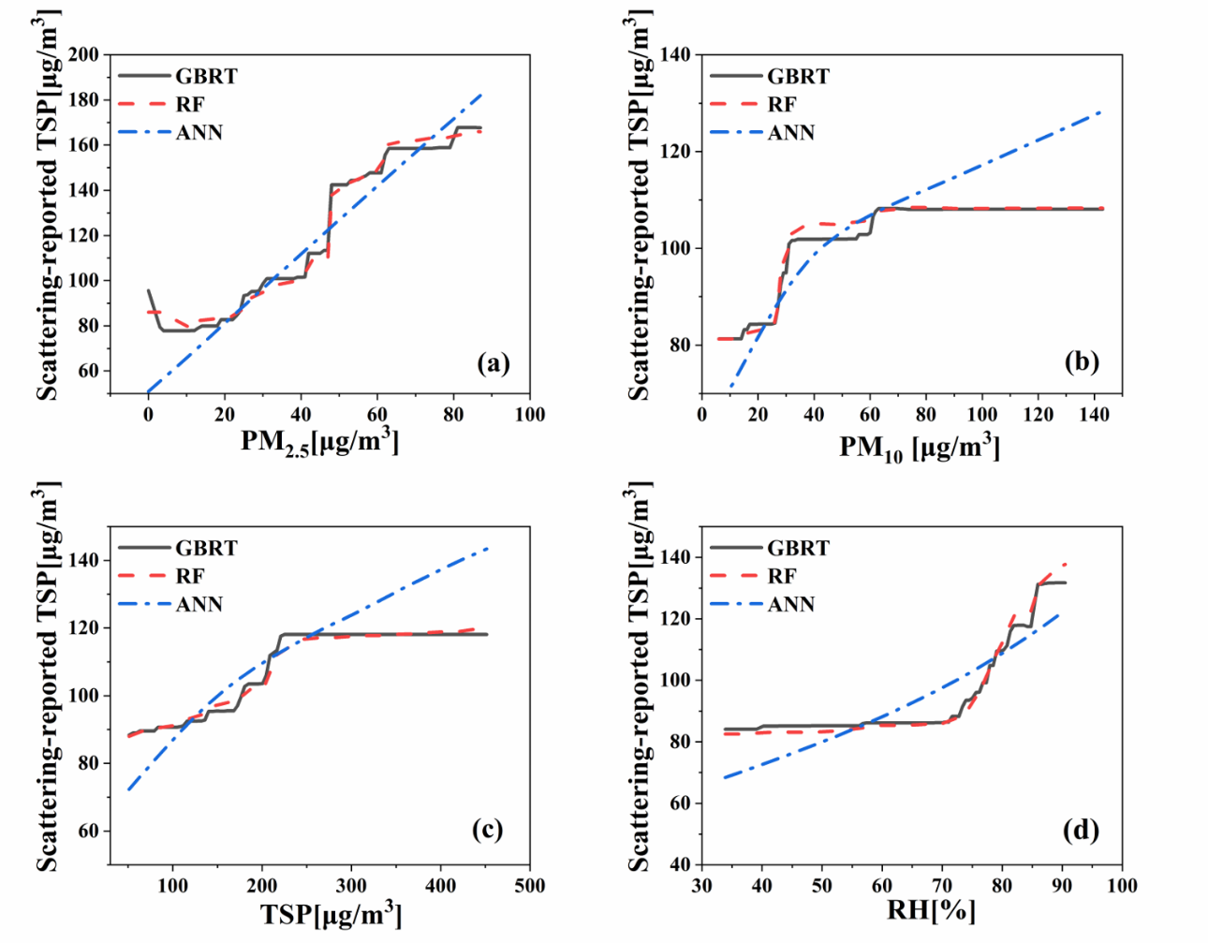
Correlation analysis of feature to target value — PDP

Slide 23
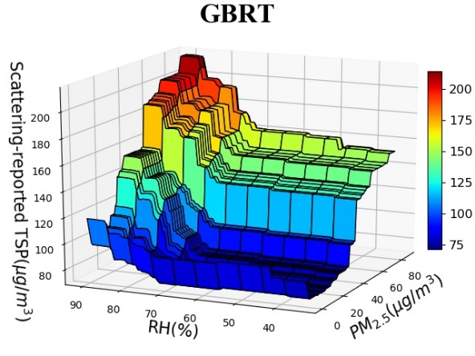
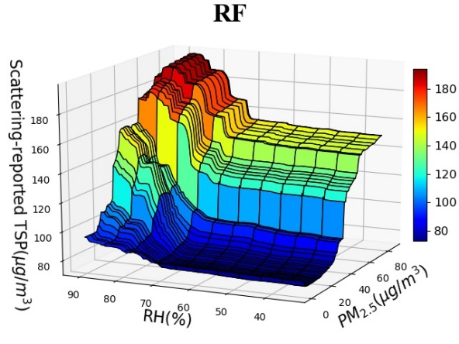
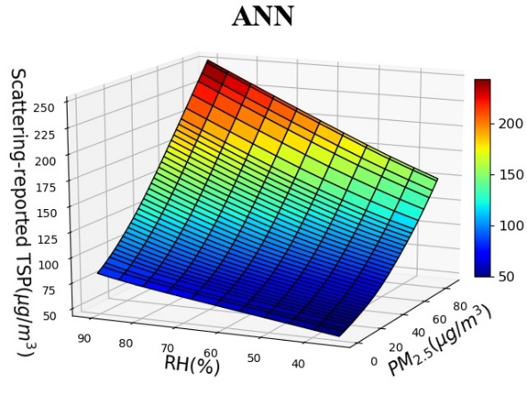
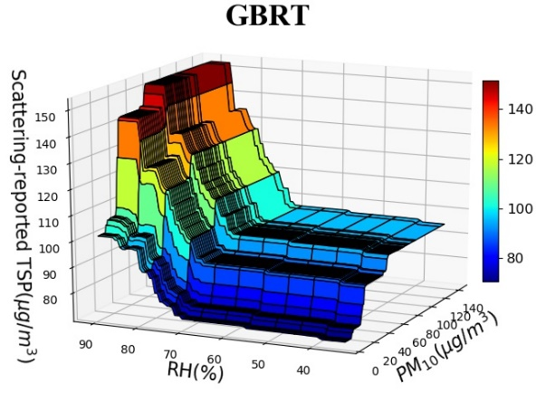
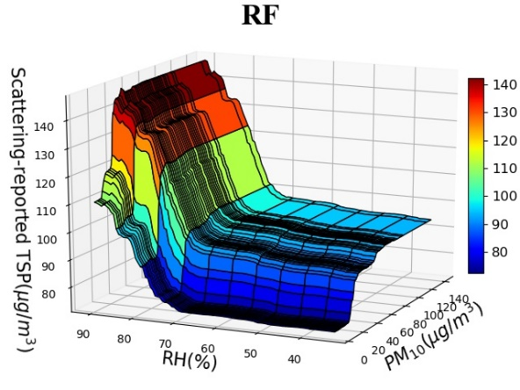
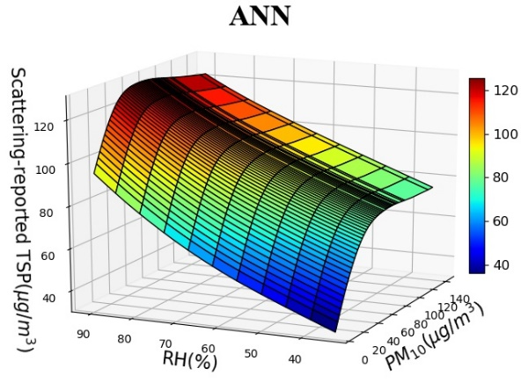
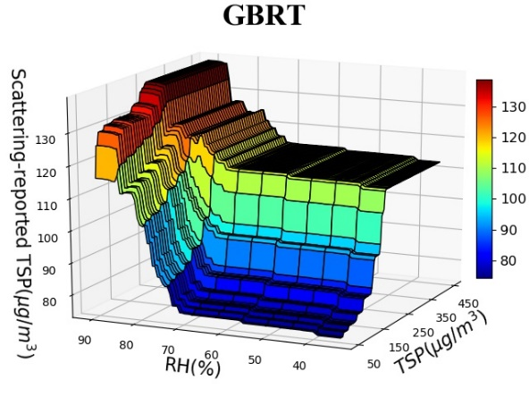
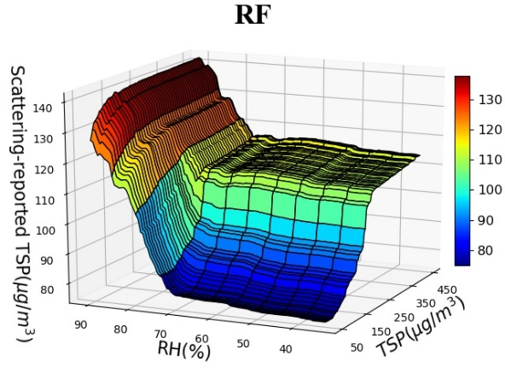
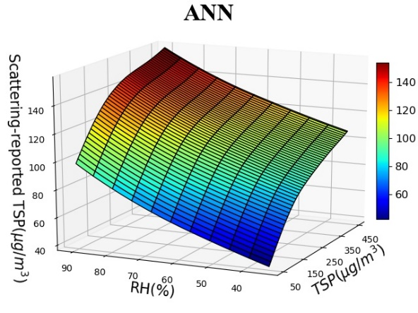
Two-way PDP charts

Slide 24
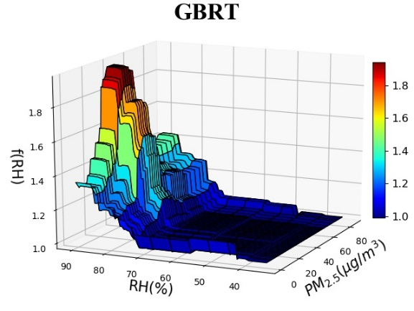
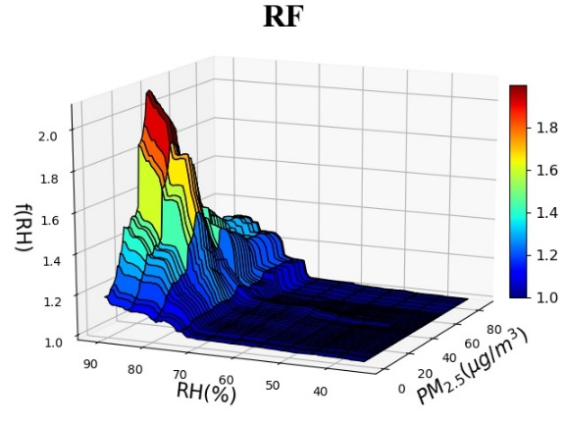
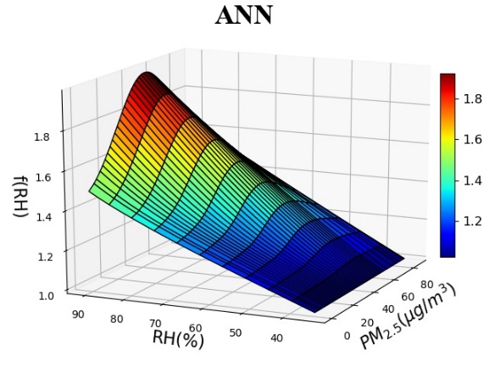
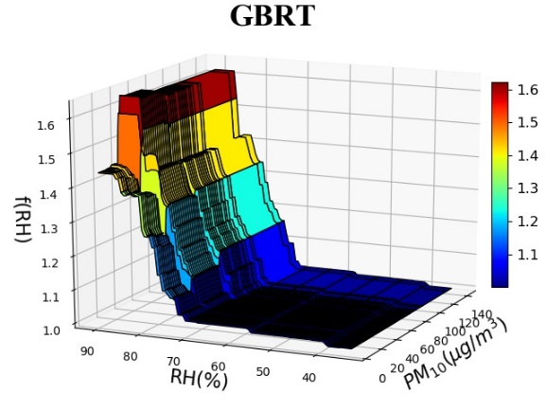
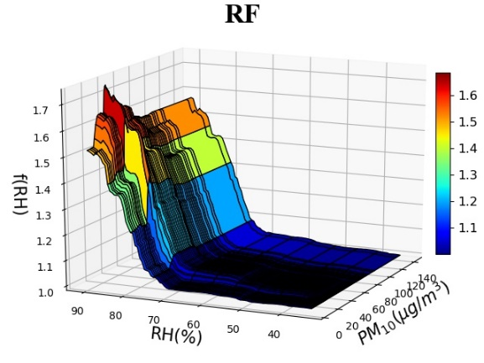
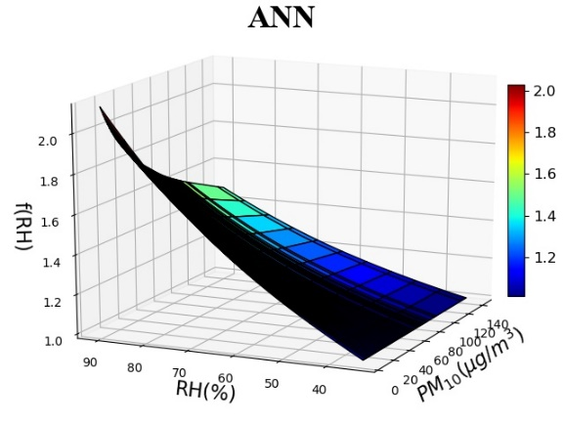
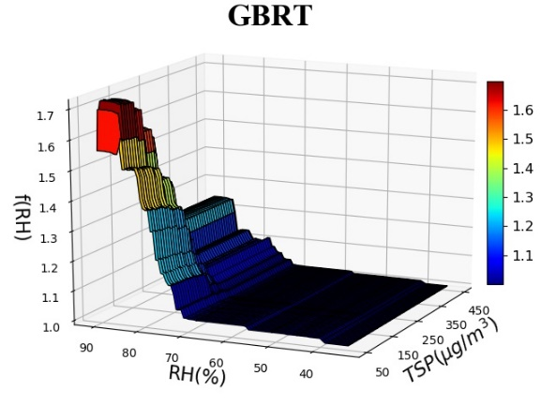
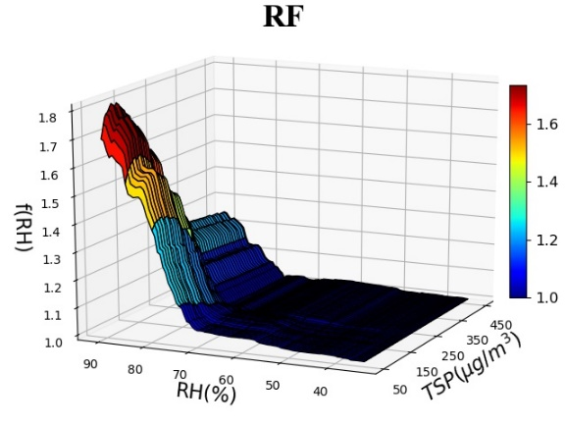
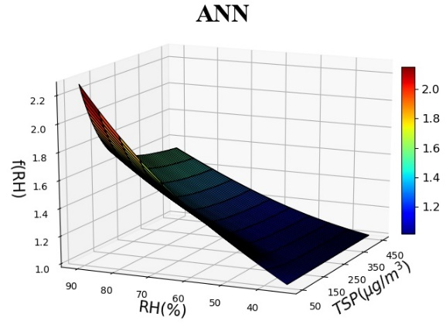
Two-way PDP charts

Slide 25
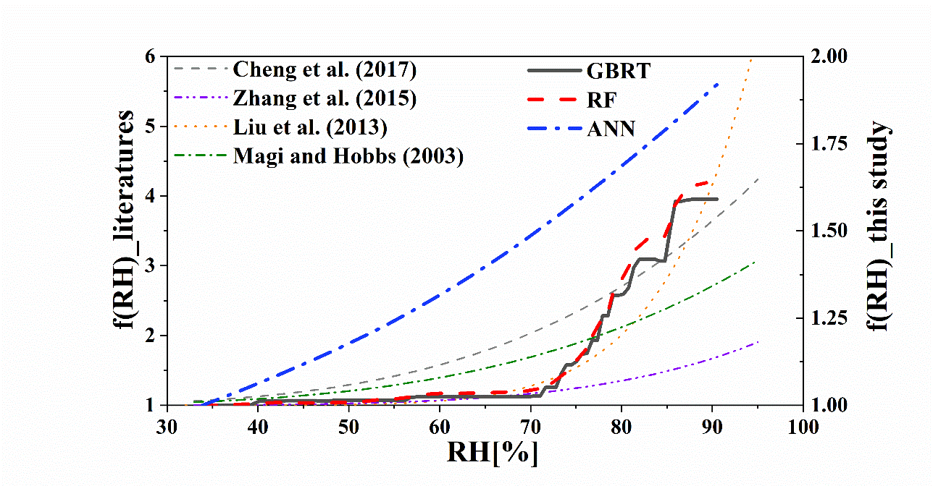
Comparison with previous studies — scattering hygroscopic growth curves
The f(RH) values of PM_{2.5} from previous studies are about 1 to 3 times that of TSP in this study, indicating that the scattering hygroscopic efficiency of PM_{2.5} is much higher than that of TSP.

Slide 26
Part 5
Conclusion

Slide 27
Conclusion
All four machine learning models greatly improved the correlation of the TSP concentrations reported by the Casella with filter-based measurements.
PM_{2.5} has the largest aerosol scattering efficiency, so it has a great influence on the measurement value of light scattering instrument.
Humidity has a significant impact on the monitoring of particulate matter at any concentration, and it is necessary to correct the high humidity data.

Slide 28
Related Publications
应用前景
[1] Qiaofeng Guo, Zhu Zhu, Zhen Cheng*, Shuhong Xu, Xiaoliang Wang, Yusen Duan. Correction of Light Scattering-based Total Suspended Particulate Measurements through Machine Learning[J]. Atmosphere, 2020.

Slide 29
Thanks for data support from Shanghai Eureka Environmental Protection Hi-tech company and Shanghai Environmental Monitoring Center
THANKS!

