Slide 1
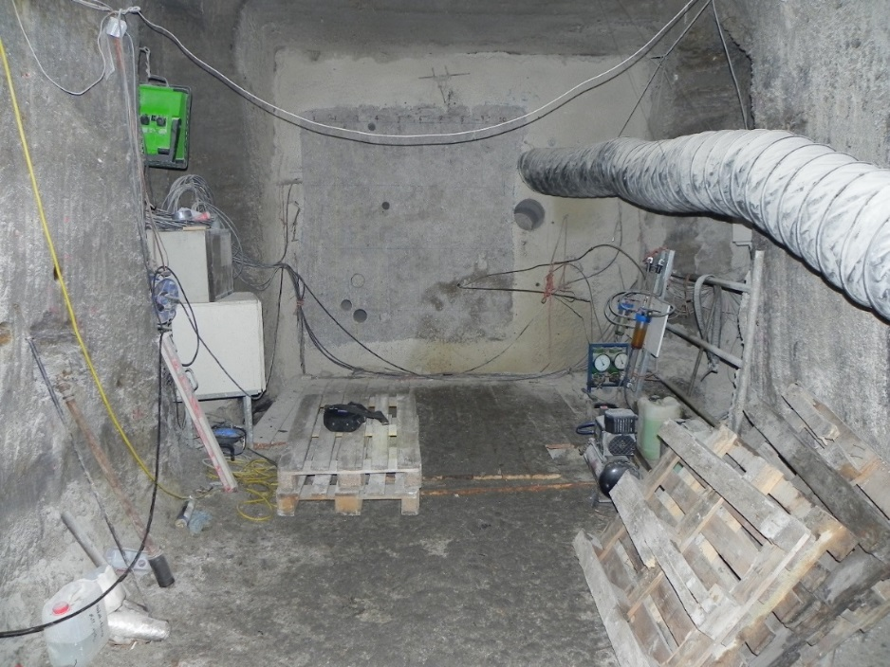
Investigations on the permeability of MgO shotcrete at the GV2-drift-sealing in the Teutschenthal mine
M.Sc. Jennifer Arendt
Prof. Dr.-Ing. Wolfram Kudla
Dr. Daniela Freyer
Dr. Till Popp
Dr. Thomas Wilsnack
EGU
04.05.2020

Slide 2
content
Introduction and background information
Dam building
Material
Investigations on permeability
Summary and forecast

Slide 3
introduction
Long-term safe closure for underground storage facilities and future HAW (“high active waste”) repositories require appropriate building and sealing materials
MgO-concrete is known as possible material for engineered barriers systems for drifts in salt repository environments
For demonstration of its technical feasibility and suitability 2 dams (different construction concepts) were erected as mock-up tests in the Teutschenthal mine (50 km north-west of Leipzig)
Host rock: carnallitite (salt rock with Mg, Ca, K, Na; easily soluble)
3

Slide 4
Concepts of dam construction
GV1
in-situ concrete construction
Length: 9.5 m
Height: 5.6 m internally – 4.4 m (frustoconical)
13 concreting sections (average layer thickness: 0.65 m)
During setting: max. temperature of 120°C in centre of layer and up to 80°C at the stope
GV2
dry-mix shotcrete procedure
Length: 10.25 m
Height/width: 3.55 m; abutment notch near the centre of the dam for mechanical interlock
104 concreting sections (average layer thickness: 0.1 m)
During setting: max. temperature of 43°C in centre of layer and 38°C at the stope
TU Bergakademie Freiberg | Institute of Mining and special civil engineering | Jennifer Arendt | Tel.: 0373139-3868 | EGU 2020
4

Slide 5
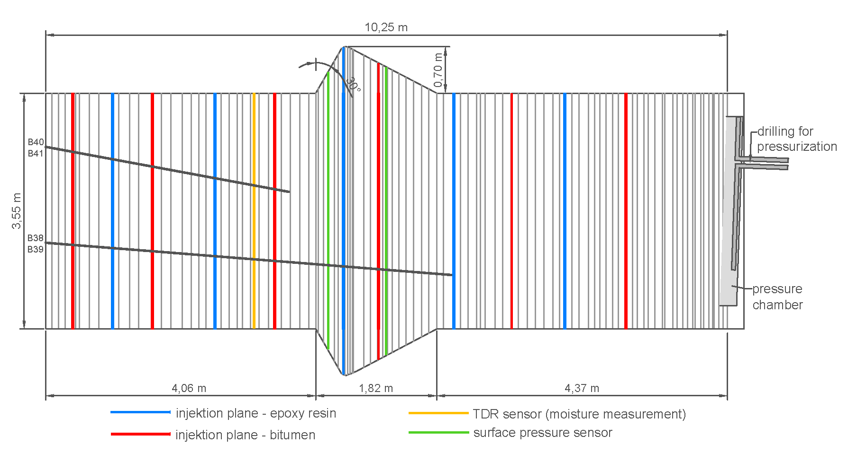
Longitudinal section of dam GV2
abut-ment notch
grey lines = concreting section boundary
layer thickness: 2 cm …19 cm; in average: 10 cm
in abutment notch: lower thickness
➔ Are these construction joints possibly weakness zones?
5

Slide 6
MgO-concrete
Formulation:
MgO | Salty solution with NaCl and MgCl₂ | Surcharge (sand/ gravel, grain size: 0-8 mm)
[m.%] | [m.%] | [m.%]
15,6 | 11,4 | 73,0
during setting the metastable 5‑1‑8‑phase (5 Mg(OH)₂·1 MgCl₂·8 H₂O) is formed
solution access causes a binder phase transformation, the 5-1-8-phase transforms into the long-term stable 3-1-8-phase (3 Mg(OH)₂·1 MgCl₂·8 H₂O) in presence of NaCl saturated, MgCl₂-containing solution
this conversion is accompanied by an increase in volume
closure of the pore space in the contact area between concrete and solution if dam is clamped
a crystallization pressure builds up under tension (by clamping)
→ reduction of permeability → self-sealing
this process was only observed in laboratory → now in situ testing at a large-scale dam
6

Slide 7
Concept of permeability measurements
gas permeability
on core samples
in situ (boreholes)
medium: dry compressed air
parallel to concreting section boundaries
inside a layer
with concreting section boundary
perpendicular to concreting section boundaries
integral
solution permeability
on core samples
in situ (boreholes)
2 salt solutions:
(1) saturated with NaCl
(2) saturated with NaCl, n containing MgCl₂
parallel to concreting section boundaries
integral
perpendicular to concreting section boundaries
core samples of 5 drillings
2 short boreholes with a length of ~ 3,7 m (intact dam)
2 long boreholes with a length of ~ 6,0 m (into abutment notch)
7

Slide 8
Gas permeability on core samples
Orientation to concreting section boundaries | gas permeability [m²]
 | minimum | maximum | average
parallel | 9*10^{‑20} | 6*10^{‑18} | 7*10^{‑19}
perpendicular | 8*10^{‑21} | 8*10^{‑20} | 2*10^{‑20}
Gas permeability in situ
Test area | gas permeability [m²]
 | minimum | maximum | average
inside a layer | 1*10⁻¹⁹ | 4*10⁻¹⁹ | 3*10^{‑19}
with concreting section boundary | 2*10⁻¹⁹ | 2*10⁻¹⁶ | 5*10^{‑17}
integral | 2*10⁻¹⁹ | 2*10⁻¹⁹ | 2*10⁻¹⁹
solution permeability in situ
Orientation to concreting section boundaries | gas permeability [m²]
 | minimum | maximum | average
parallel | 2*10^{‑20} | 4*10^{‑20} | 3*10^{‑20}
perpendicular | 1*10^{‑20} | 2*10^{‑19} | 5*10^{‑20}
8

Slide 9
Solution permeability in situ
borehole | time after filling the borehole with solution | pressure | length of test area | centre of test area | solution permeability
- | [d] | [MPa] | [m] | [m v. AP] | [m²]
B40 | 57 | 0,37 | 3,09 | 2,03 | 6*10^{‑20}
 | 155 | 0,36 |  | 2,03 | 2*10^{‑20}
 | 267 | 0,33 |  | 2,03 | 3*10^{‑20}
 | 602 | 0,94 |  | 2,03 | 1*10^{‑20}
B41 | 58 | 0,35 | 3,14 | 2,06 | 7*10^{‑20}
 | 155 | 0,26 |  | 2,06 | 2*10^{‑20}
 | 267 | 0,27 |  | 2,06 | 3*10^{‑20}
 | 602 | 0,92 |  | 2,06 | 3*10^{‑20}
➔ decreasing permeability over time due to transformation of the 5-1-8-Phase into 3-1-8-Phase with increasing volume
9

Slide 10
Stationary injection tests
Measurement of solution permeability in a long-term test over 2,5 years
filling the boreholes with solution at day 0
periodically injection with constant pressure
determination of permeability via injection rate
borehole | time after filling the borehole with solution | pressure | solution permeability
 | [d] | [MPa] | [m²]
B38 |  |  | length of test area: 4,8 m
 | 44 | 0,04 | 1,7*10⁻¹⁵
 | 247 | 0,50 | 9,8*10⁻¹⁸
 | 462 | 0,27 | 1,5*10⁻¹⁸
 | 513 | 0,25 | 5,4*10⁻¹⁹
 | 629 | - | -
 | 800 | 0,48 | 2,8*10⁻¹⁹
 | 835 | 0,50 | 8,2*10⁻²⁰
 | 898 | 0,50 | 4,3*10⁻¹⁹
 | 982 | 0,50 | 2,8*10⁻²⁰
B39 |  |  | length of test area: 4,5 m
 | 44 | 0,20 | 3,6*10⁻¹⁶
 | 305 | 0,12 | 1,7*10⁻¹⁹
 | 462 | 0,12 | 1,5*10⁻¹⁸
 | 513 | 0,12 | 3,4*10⁻¹⁹
 | 629 | 0,12 | 1,2*10⁻¹⁹
 | 800 | 0,41 | 5,4*10⁻²⁰
 | 835 | 0,41 | 2,5*10⁻²⁰
 | 898 | 0,41 | 4,9*10⁻²⁰
 | 982 | 0,41 | 7,5*10⁻²⁰
initial permeability is quite high because of local defects in the abutment notch
decreasing permeability due to phase transformation and volume increase
10

Slide 11
Stationary injection tests
Permeability was calculated with an assumed concreting section boundary (2 cm width) while rest of test area is absolutly dense
borehole | time after filling the borehole with solution | pressure | solution permeability
 | [d] | [MPa] | [m²] | assumed concreting section boundaries
 |  |  |  | [m²]
B38 |  |  | length of test area: 4,8 m | Assuming a boundary or crack with 2 cm length
 | 44 | 0,04 | 1,7*10⁻¹⁵ | 4,1*10⁻¹³
 | 247 | 0,50 | 9,8*10⁻¹⁸ | 2,4*10⁻¹⁵
 | 462 | 0,27 | 1,5*10⁻¹⁸ | 3,6*10⁻¹⁶
 | 513 | 0,25 | 5,4*10⁻¹⁹ | 1,6*10⁻¹⁶
 | 629 | - | - | -
 | 800 | 0,48 | 2,8*10⁻¹⁹ | 9,6*10⁻¹⁷
 | 835 | 0,50 | 8,2*10⁻²⁰ | 2,8*10⁻¹⁷
 | 898 | 0,50 | 4,3*10⁻¹⁹ | 1,5*10⁻¹⁶
 | 982 | 0,50 | 2,8*10⁻²⁰ | 9,6*10⁻¹⁸
B39 |  |  | length of test area: 4,5 m | Assuming a boundary or crack with 2 cm length
 | 44 | 0,205 | 3,6*10⁻¹⁶ | 8,1*10⁻¹⁴
 | 305 | 0,115 | 1,7*10⁻¹⁹ | 3,8*10⁻¹⁷
 | 462 | 0,115 | 1,5*10⁻¹⁸ | 3,0*10⁻¹⁶
 | 513 | 0,115 | 3,4*10⁻¹⁹ | 8,5*10⁻¹⁷
 | 629 | 0,115 | 1,2*10⁻¹⁹ | 3,6*10⁻¹⁷
 | 800 | 0,410 | 5,4*10⁻²⁰ | 1,9*10⁻¹⁷
 | 835 | 0,410 | 2,5*10⁻²⁰ | 4,0*10⁻¹⁸
 | 898 | 0,41 | 4,9*10⁻²⁰ | 1,7*10⁻¹⁷
 | 982 | 0,41 | 7,5*10⁻²⁰ | 2,6*10⁻¹⁷
decreasing permeability
11

Slide 12
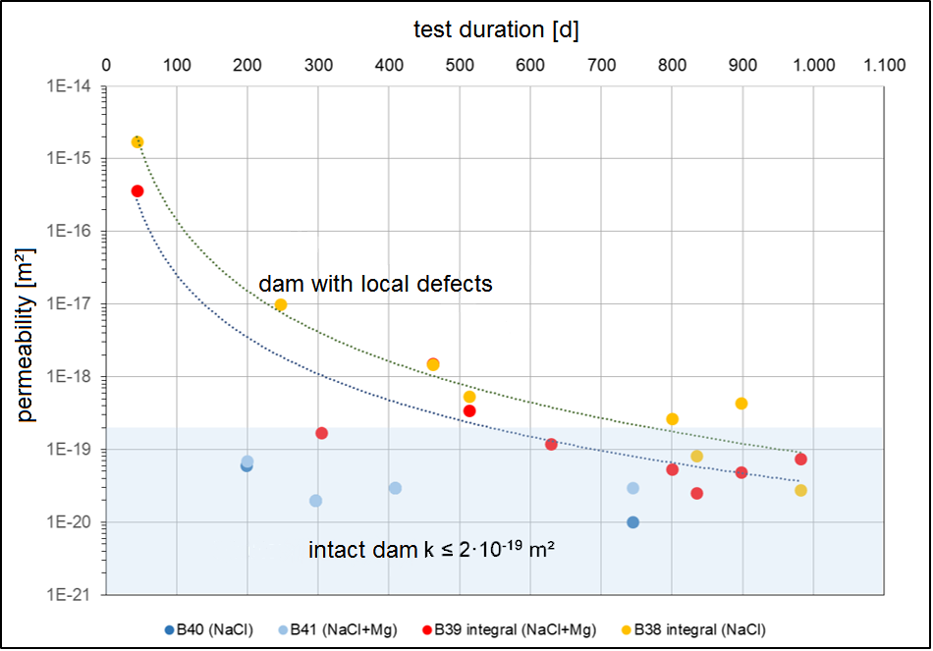
Results of permeability
Summarized in situ solution permeability
decreasing permeability over time after access of solution, especially local defects are sealed
12

Slide 13
summary
For long-term drift-sealing a large-scale dam was build using dry-mix shotcrete technology in a highly soluble salt environment in 2008
MgO-concrete was used as building material
Concreting section boundaries do not necessarily represent a mechanical or hydraulical weakness zone
Phase transformation takes place in the MgO-concrete due to the contact with different salt solutions, which leads to a volume increase and a permeability decrease
to see this effect on a real dam, permeability measurements were performed on core material and in situ in boreholes using gas and solution
Significant initial differences were observed for dam portions with intact construction joints and sections with defects
13

Slide 14
summary
average permeability with or parallel to concreting section boundaries is slightly higher than without or perpendicular
decrease of in situ solution permeability proves self-sealing effect
These long-term permeability measurements demonstrate the unique capability of the MgO-material for self-sealing of possible defects, ensuring tightness of the dam material!
average permeability* | gas |  | solution
 | core samples | in situ | core samples | in situ
with/parallel concreting section boundaries | 7*10^{‑19} m² | 5*10^{‑17} m² | 3*10^{‑20} m²
without/perpendicular concreting section boundaries | 2*10^{‑20} m² | 3*10^{‑19} m² | 5*10^{‑20} m²
integral |  | 2*10^{‑19} m² |  | 6*10^{‑20} → 1*10^{‑20} m² 7*10^{‑20} → 3*10^{‑20} m²
stationary injection test |  |  |  | 1,7*10⁻¹⁵ → 2,8*10⁻²⁰ m² 3,6*10⁻¹⁶ → 7,5*10⁻²⁰ m²
* Consider dispersion
14

Slide 15
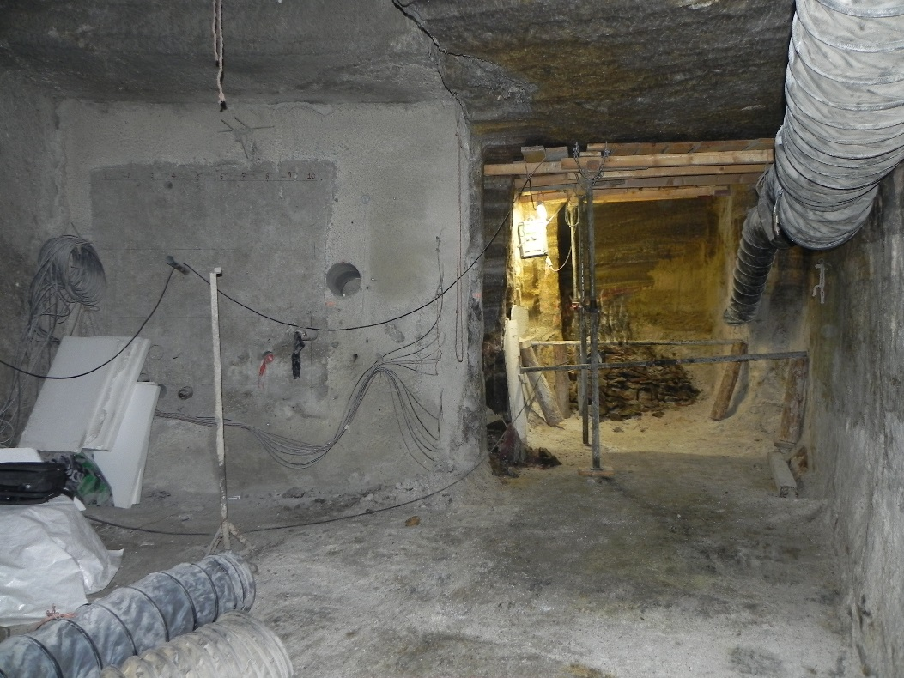
forecast
in addition to the pressurization via the boreholes, the entire dam was also pressurized with solution via the pressure chamber
→ in 17 steps up to 28 bar within 2,5 years
due to the easily soluble rock, the dam was surrounded by solution
in our current project the dam is partially exposed on the right side
samples are drilled from these exposed side to figure out how far the solution has penetrated the concrete
GV2 dam
15

Slide 16
contributing institutions:
TU Bergakademie Freiberg
Institute of Mining and special civil engineering
Institute of Inorganic Chemistry
Institute of Geomechanics GmbH Leipzig
IBeWa - Ingenieurpartnerschaft für Bergbau, Wasser und Deponietechnik Wilsnack und Partner
TS-BAU GmbH
GTS Grube Teutschenthal Sicherungs GmbH & Co. KG
Materialforschungs- und -prüfanstalt an der Bauhaus-Universität Weimar (MFPA)
16

Slide 17
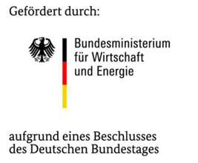
Research projects:
“CARLA“ → construction of the dams
(funding code: 02C1204; project duration: 01.11.2004 – 30.06.2010)
“MgO-SEAL“ → studies on the permeability, pressurization
(funding code: 02E11435; project duration: 01.10.2015 – 30.04.2019)
“MgO-S³“ → exposion of the dam; adjustment and test of shotcrete formulation
(funding code: 02E11769A; project duration: 01.04.2019 – 31.10.2021)
Thank You!
17

