Slide 1
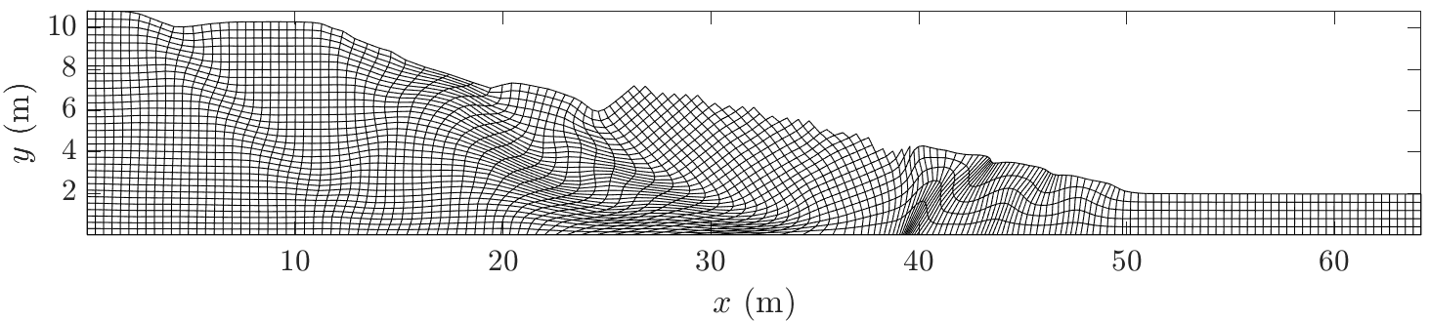
From experimental granular collapses to a three-dimensional numerical solver for landslides
Emmanuel Wyser, Yury Podladchikov, Marc-Henri Derron, Michel Jaboyedoff

Slide 2
Outlines
General introduction
  Granular collapses
  The Material Point Method and its latest advancements (GIMPM and CPDI/CPDI2q)
Methods
  Experimental settings and aparatus (collapse) in the lab
  Numerical implementation, validation & computational efficiency with MATLAB
Results
Application to three-dimensional analysis
Perspectives

Slide 3
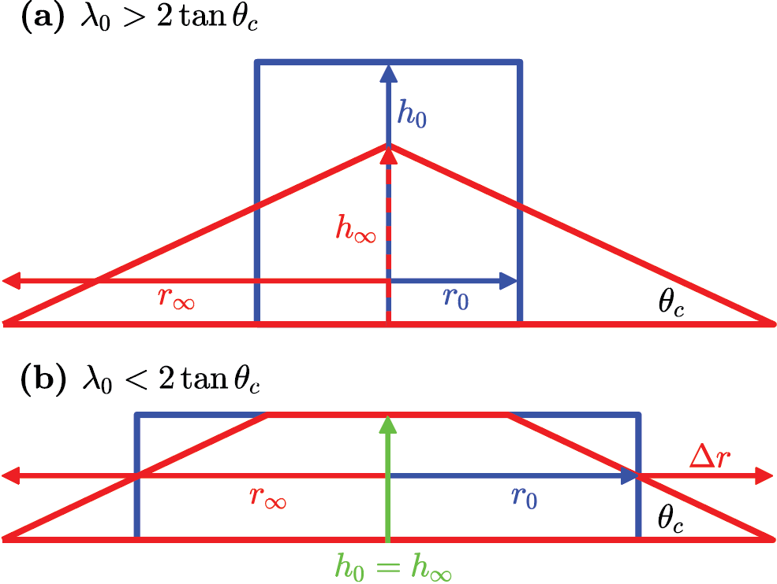
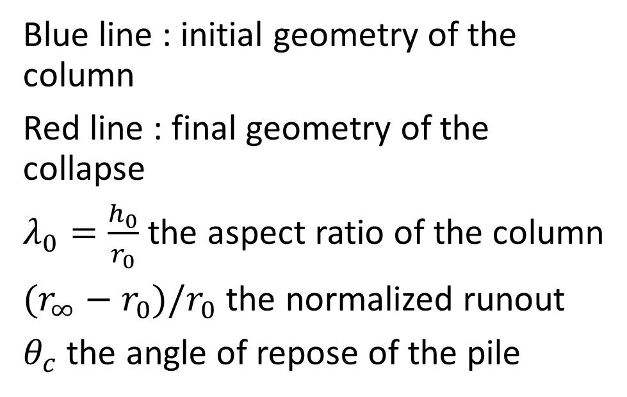
Overview of the granular collapse
We briefly describe the metrics commonly used for the study of granular collapses.
Blue line : initial geometry of the column
Red line : final geometry of the collapse
$λ_{0}=\frac{h_{0}}{r_{0}}$ the aspect ratio of the column
$(r_{∞}−r_{0})/r_{0}$ the normalized runout
$θ_{c}$ the angle of repose of the pile

Slide 4
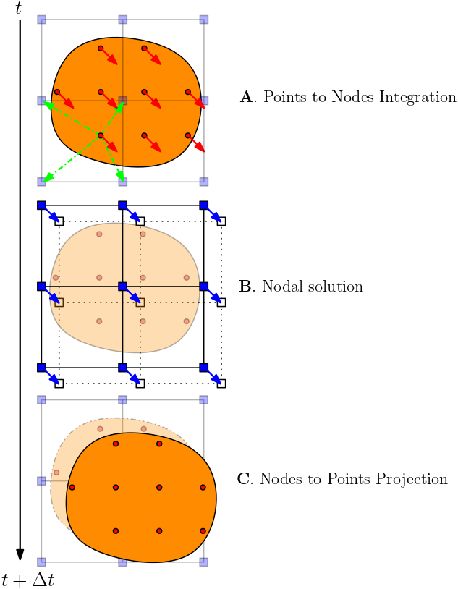
Overview of the Material Point Method (I)
MPM (Sulsky etal, 1994) can be regarded as a FEM in which integration points (e.g., material points) are allowed to move (Guilkey etal, 2003).
A computational is given by:
  Mapping phase (A.)
  Nodal solution (B.)
  Projection of nodal solution to the material points (C.)
The background mesh is reset at every steps
  Avoids excessive mesh distortions
We select the explicit Generalized Interpolation Material Point Method (GIMPM, Bardenhagen etal, 2004) variant

Slide 5
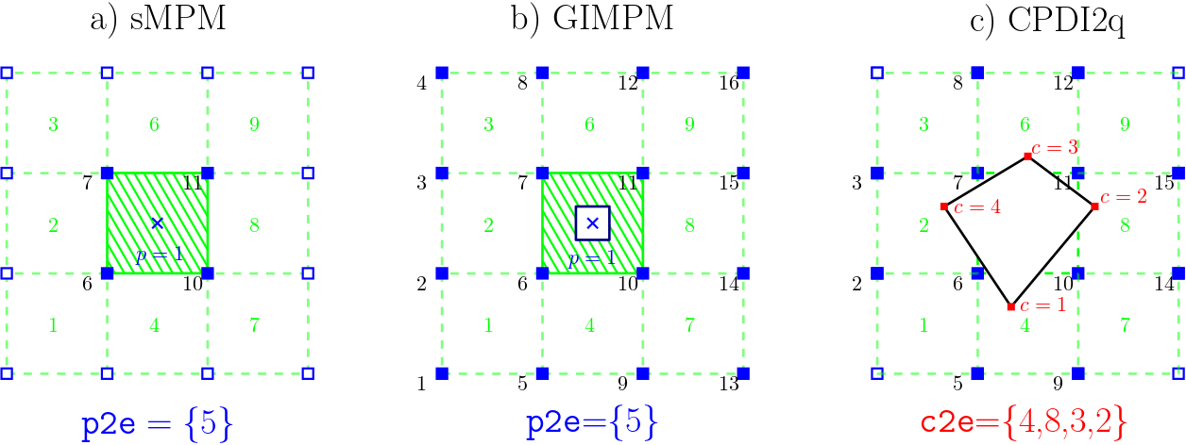
Overview of the Material Point Method (II)
Figure 1: material point to element p2e connectivity array for a) standard MPM, b) GIMPM and c) CPDI2q. Whereas for sMPM and GIMPM the connectivity list is based on the material point’s coordinates, the CPDI2q uses the material point’s corners. Associated nodes of a material point are denoted by filled blue squares. The remaining nodes are said « inactive » with respect to the material point

Slide 6
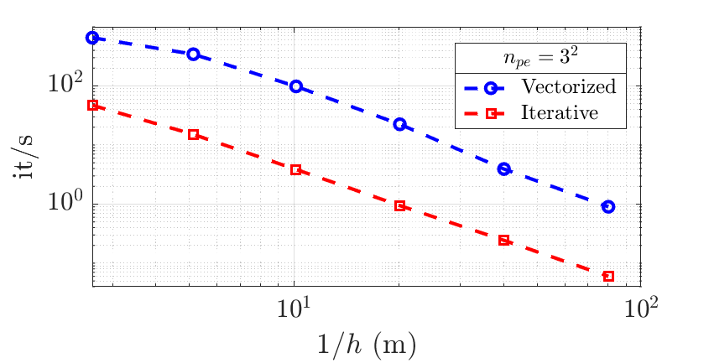
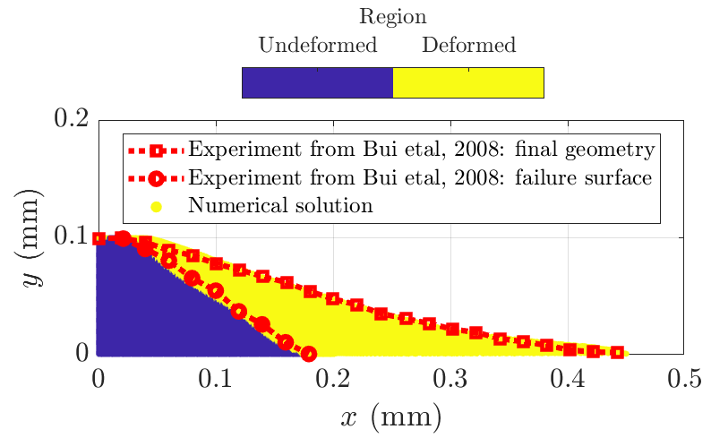
Numerical implementation in MATLAB (I)
We implemented an explicit GIMPM (and CPDI/CPDI2q) with a MUSL scheme in MATLAB, taking advantages of its vectorization capabilities
Figure 2: number of iteration per second (it/s) relative to the mesh spacing h (4 material points per element) for the collapse of a column, following the work of Bui etal, 2008 and Huang etal, 2015.
Figure 3: numerical results of the solver obtained by the vectorized solver, compared with the experimental work of Bui etal, 2008. Both the free surface and failure surface are in agreement.

Slide 7
Numerical implementation in MATLAB (II)
From this preliminary validation test, we report the following:
The GIMPM solver implemented in MATLAB is fast, ad minima 20 times faster than an iterative implementation.
It is also efficient, delivering useful numerical results in agreement with experimental works of Bui etal, 2008 of a collapse of an aluminum-bar assemblage.
The CPDI/CPDI2q variant results failed during simulation because of the extreme plastic deformations of the granular material
→ This variant is not ideally suited for granular collapses

Slide 8
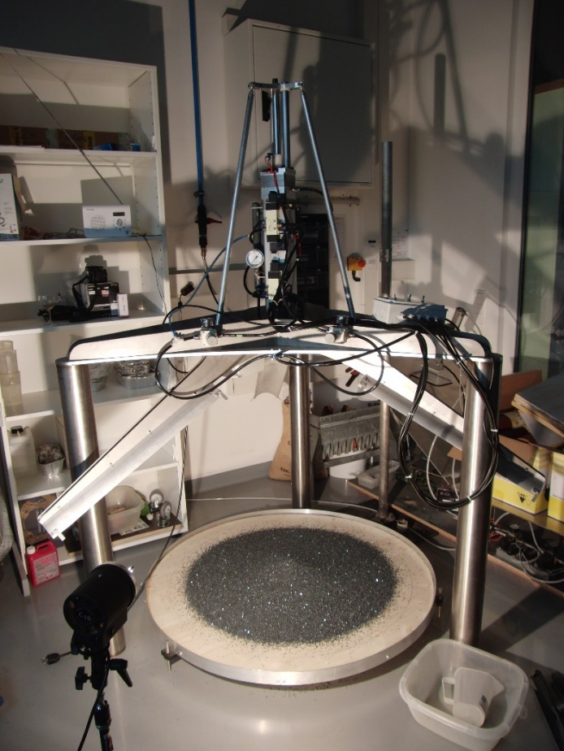
Experimental setting and apparatus (I)
The features of the apparatus are the following:
The metallic cylinder is composed of three independent shells.
Those shells radially open outwards very quickly (opening speed can be controlled).
The granular material contained is the suddenly released and can freely flows on the wooden surface below.
Figure 4: Overview of the experimental apparatus we used in this study

Slide 9
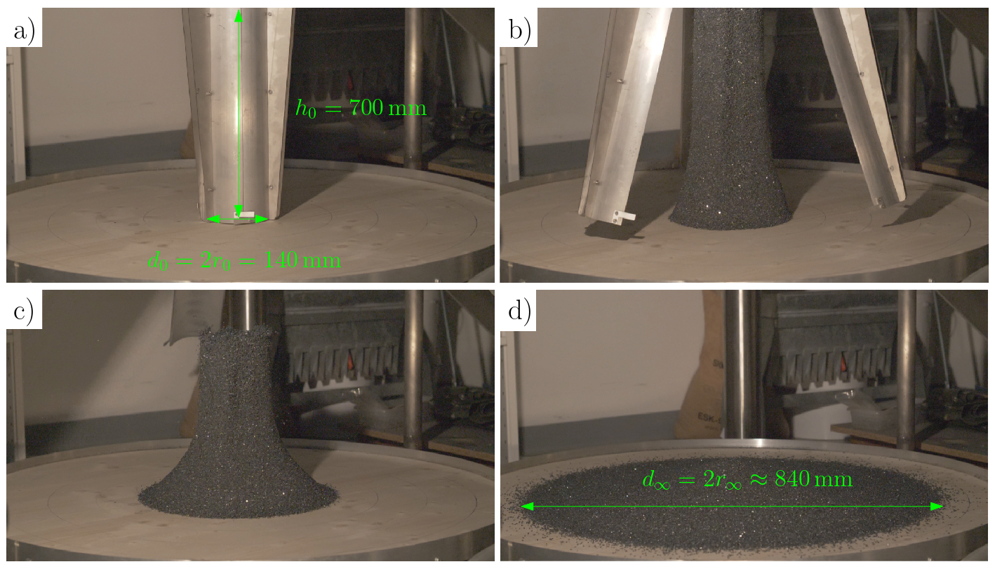
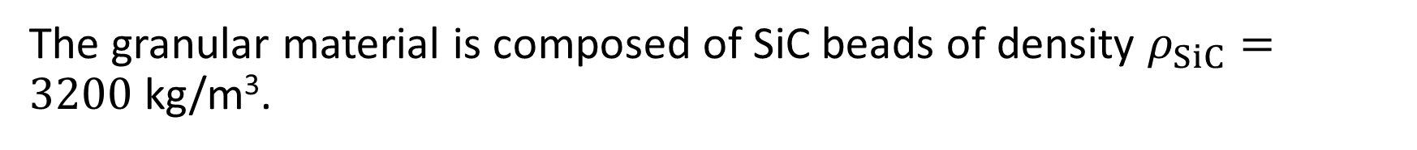
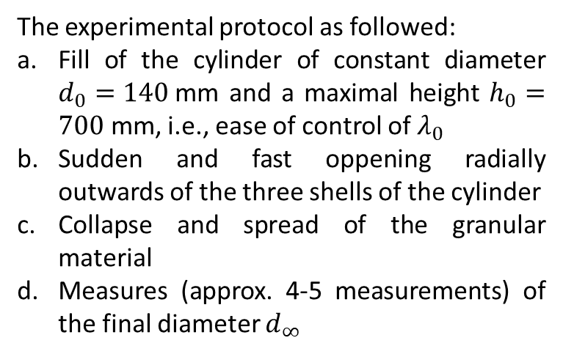
Experimental setting and apparatus (II)
The granular material is composed of SiC beads of density $ρ_{SiC}=3200$kg/m³.
The experimental protocol as followed:
Fill of the cylinder of constant diameter $d_{0}=140$mm and a maximal height $h_{0}=700$ mm, i.e., ease of control of $λ_{0}$
Sudden and fast oppening radially outwards of the three shells of the cylinder
Collapse and spread of the granular material
Measures (approx. 4-5 measurements) of the final diameter $d_{∞}$
Figure 4: Snapshots of a typical experience. The inital mass is quickly released and flows freely.

Slide 10
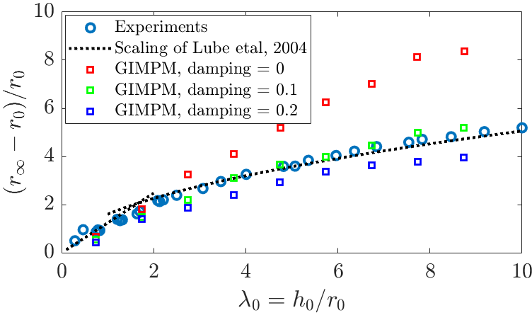
Comparison of numerical and experimental results
Our experimental results are in agreement with the scaling proposed by Lube etal (2004).
The local damping force influences positively the dynamic of the collapse in the MPM simulation
A damping value of approx. 0.1 shows a relative good aggreement with both the experience we carried and the scaling proposed by Lube etal (2004)
This shows indirectly the high dissipation of the granular collapse. When no damping is considered, the normalized runout distance scales linearly with the inital aspect ratio of the column, and thus, is much greater as well.
Figure 5: Comparison of experimental results with the solution of GIMPM, considering an elastic modulus of 0.6 Mpa (Bui etal, 2008) and a friction angle of 37°. Several test were conducted and the elastic modulus had little influence over the dynamic

Slide 11
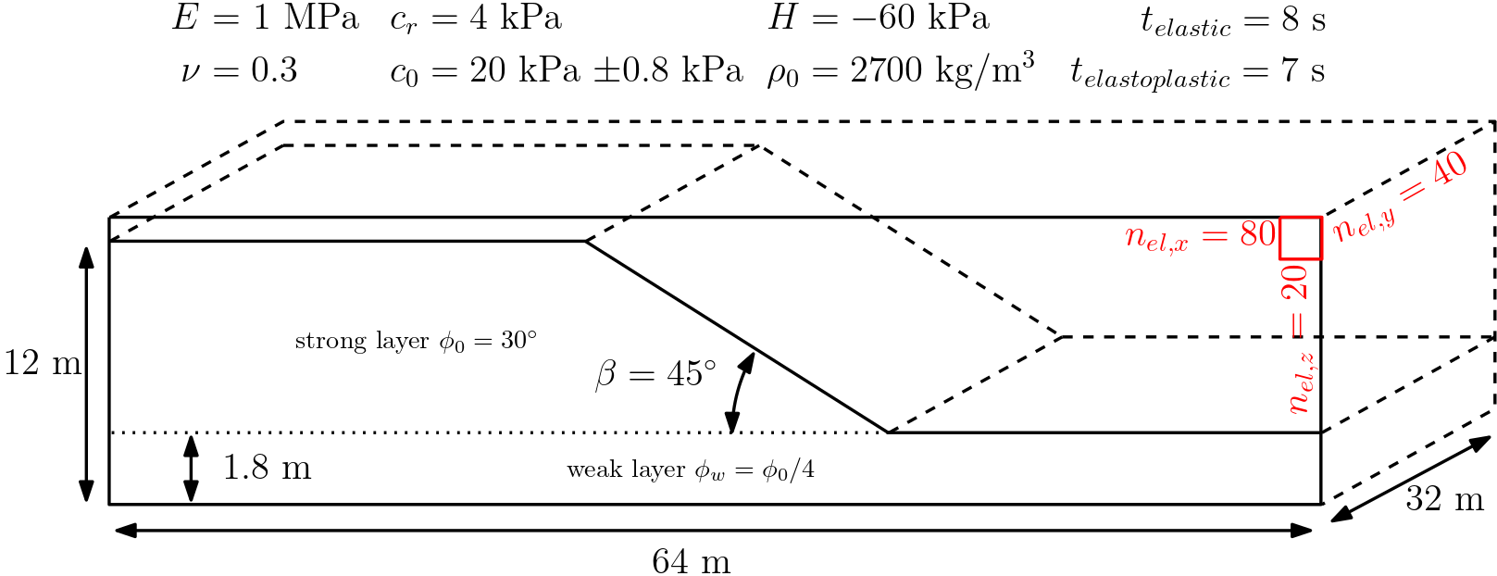
Slumping case: settings
2D: CPDI2q and a Mohr-Coulomb non-associated plasticity (Simpson, 2017) with linear strain softening (cohesion)
3D: GIMPM and Drucker-Prager non-associated plasticity (Huang etal, 2015) with linear strain softening (cohesion)
Figure 6: Initial setting of the slump case. The softening modulus H is set to -60 kPa and the density is 2700 kgm⁻³. This is to localize and to exagerate plastic deformations to demonstrate the suitability of MPM for slumping processes. The cohesion field is slightly heterogeneous throughout space. The local damping is set to 0.1.

Slide 12
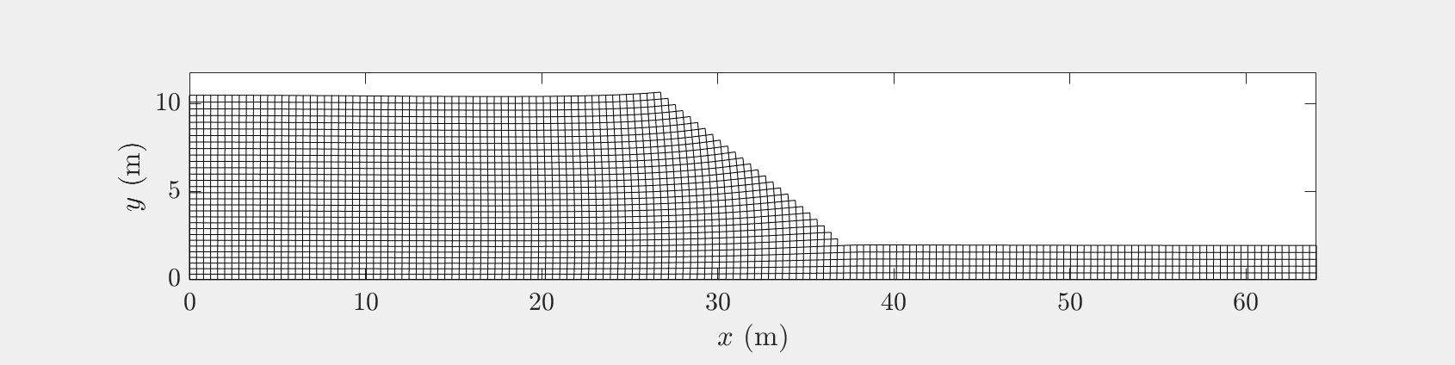
2D CPDI2q slumping process (GIF in fullscreen)
Figure 7: Evolution of the geometry from the failure of the material to the new equilibrium of the slump. The material point’s domain appears as deformed quadrilaterals, which allows a continuous description of the elasto-plastic material without gaps, as in a GIMPM variant.
CPDI2q variant provides usefull additional information relative to the description of the actual geometry of elastoplastic deformations, compared to GIMPM.

Slide 13
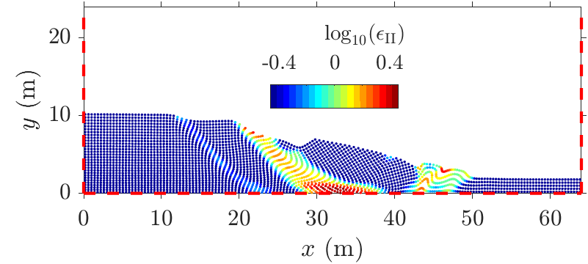
2D CPDI2q slumping process
The overall dynamic of the slump is coherant: an extensional zone develops on the top while moving materials accumulate at the toe, resulting in a bulging of the front. A shear zone propagates from the base to the top.
The CPDI2q allows an accurate visualisation of the free surface, similarly to the FEM.
The simulation achieved in 24 s (2785 material points) on a modern laptop.
Figure 8: Final second invariant of the plastic strain. The principal shear zone rapidly develops at the base of the material and quickly propagtes upward. An extension zone develops at the top where the shear zone intersect the free surface while a compression zone progressively develops at the toe of the slide.

Slide 14
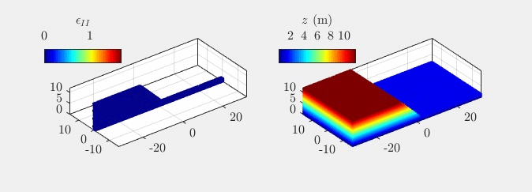
3D GIMPM slumping process (GIF in fullscreen)
Figure 9: Evolution of the second invariant of the plastic strain and the elevation at the material point’s locations.

Slide 15
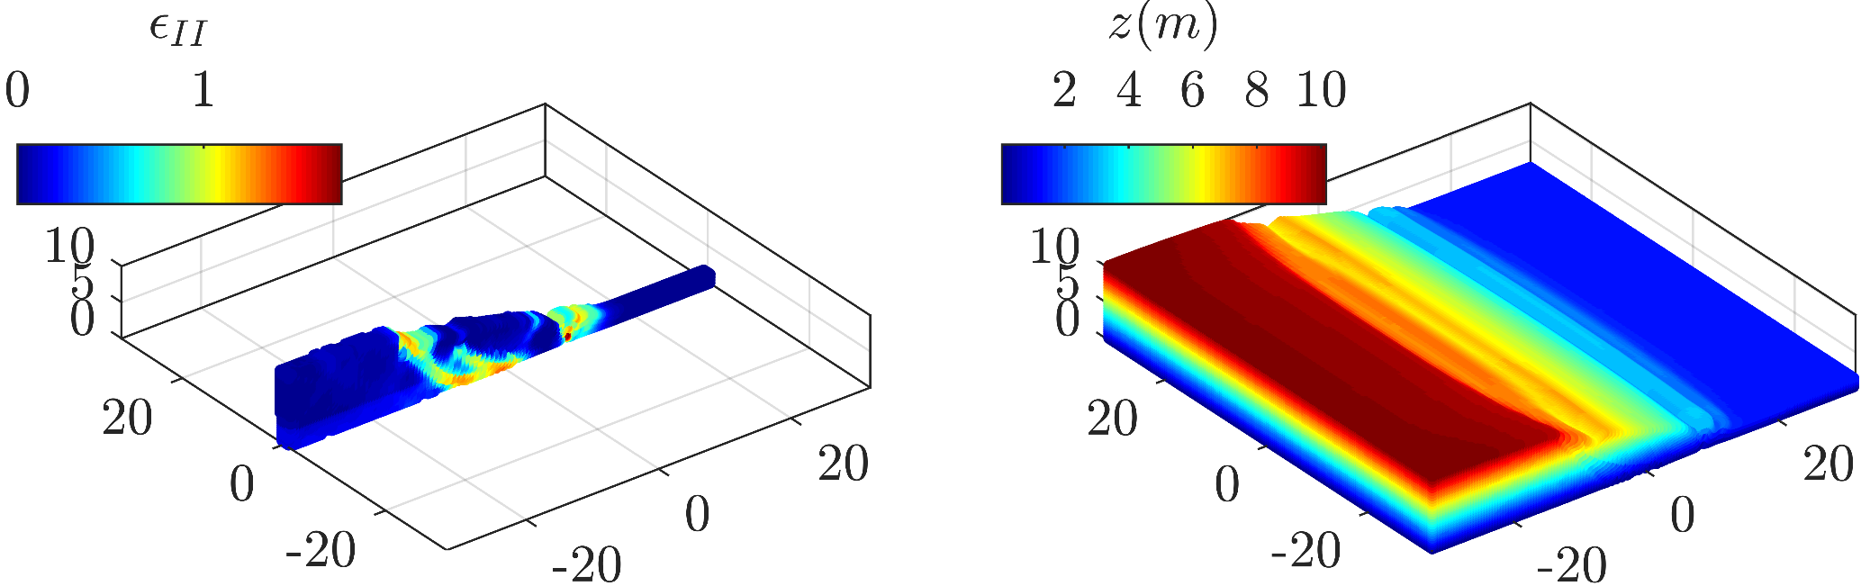
3D GIMPM slumping process
The dynamics of 3D simulation is similar to the CPDI2q solution
The simulation achieved in 9.3 h (399’840 material points) on a modern laptop –> decent runtime
Figure 10: Final geometry of the slump. The second invariant of the plastic stain and the final elevation are shown at the material point’s location

Slide 16
3D vs 2D – CPDI2q vs GIMPM
Both 2D and 3D solutions are similar regarding the overall dynamics
CPDI2q provides more useful results compared to the GIMPM solution: the exact geometry of the slump is rendered, compared to the GIMPM where only the location of the material points is acknowledged (GIMP → spatial gaps between material points)
CPDI2q provides a continuous solution of the deformed solid
The MATLAB implementation can reach good computational efficiency → useful for production task and provides a friendly implemetation compared to a C implementation

Slide 17
Perspectives
A MATLAB-based solver could be efficient in successfully implement the GIMPM/CPDI2q variant of MPM
Its efficiency was demonstrated via a comparison with experimental results of Bui etal, 2008 and our experimental work of granular collapses
An application to slumping process was demonstrated in 2D and 3D
CPDI2q provides useful additional information regarding the post-failure geometry of the slump.
A greater computational efficiency could be reached by translating the solver into C-CUDA

Slide 18
References
H. Bui, R. Fukagawa, K. Sako, and S. Ohno, International Journal for Numerical and Analytical Methods in Geomechanics 32, 1537 (2008).
D. Sulsky, Z. Chen, and H. L. Schreyer, Computer Methods in Applied Mechanics and Engineering 118, 179 (1994).
J. E. Guilkey and J. A. Wiess, International Journal for Numerical Methods in Engineering (2003).
P. Huang, S. L. Li, H. Guo, and Z. M. Hao, Computational Geosciences 19, 951 (2015).
S. G. Bardenhagen and E. M. Kober, Computer Modeling in Engineering and Science 5, 447 (2004).
G. Simpson, Practical Finite Element Modelling in Earth Science using MatLab (Wiley, 2017).
Lube, G., Herbert, E.H., Sparks, R.S.J., Hallworth, M.A., Journal of Fluid Mechanics (2004)

