Slide 1
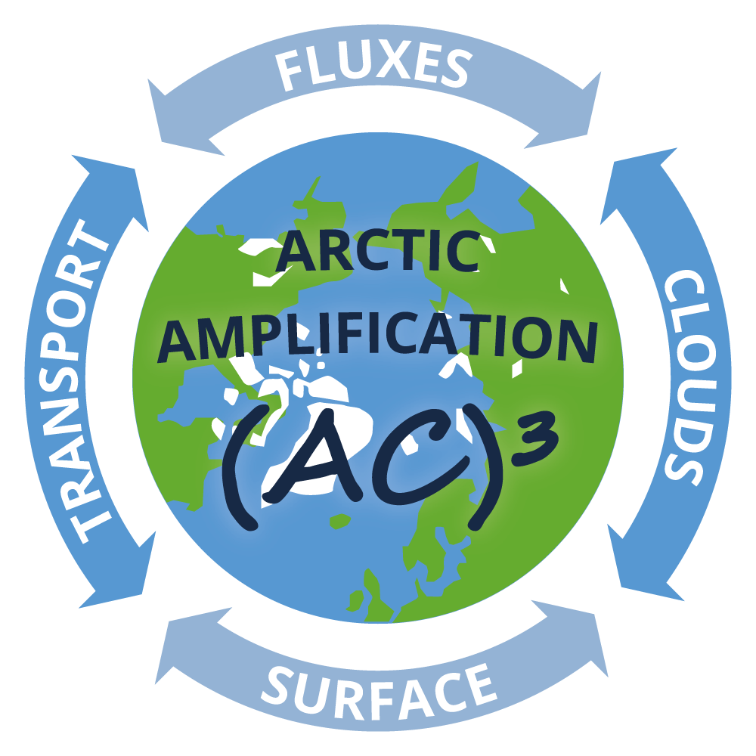
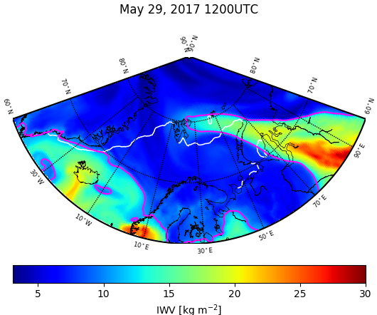
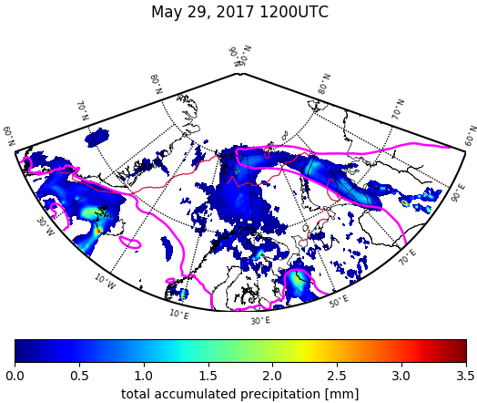
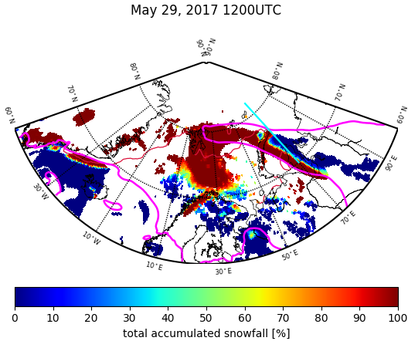
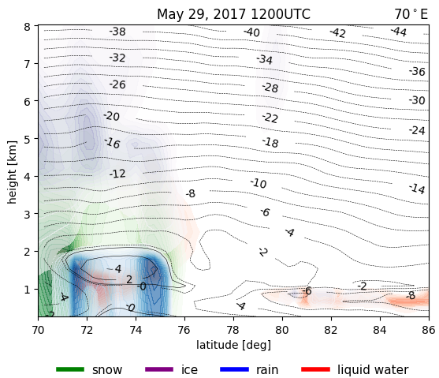
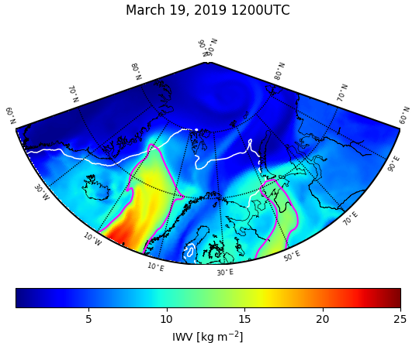
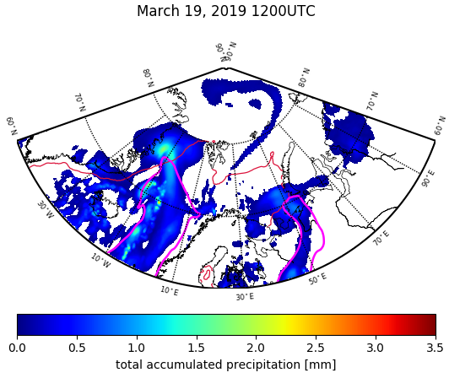
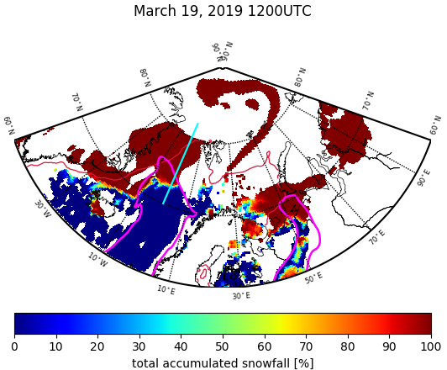
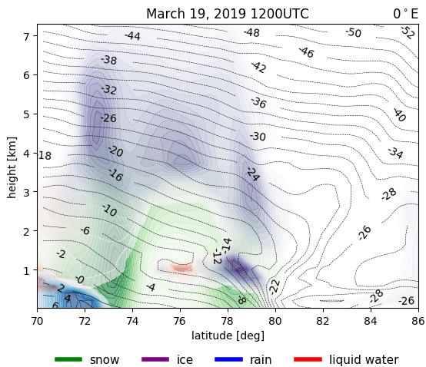

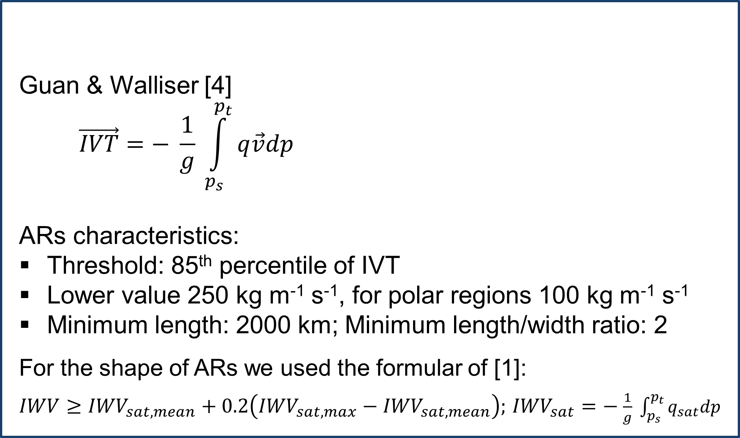
Poleward moisture transport and its influence on precipitation in the Arctic
Lauer, M¹, S. Crewell¹, A. Rinke² and I. V. Gorodetskaya³
¹ Institute of Geophysics and Meteorology, University of Cologne, Cologne, Germany ² Alfred Wegener Institute, Helmholtz Centre for Polar and Marine Research, Research Unit Potsdam,
Potsdam, Germany, ³ Centre for Environmental and Marine Studies, Department of Physics, University of Aveiro, Aveiro, Portugal
Motivation
Atmospheric moisture and heat transport from the lower latitudes plays an important role in the Arctic Amplification
Poleward moisture and heat transport accomplished by extratropical cyclones, often by Atmospheric Rivers (ARs)
ARs are long narrow bands of enhanced water vapour transport with important impacts in polar regions, such as:
  producing significant amounts of precipitation [1]
  causing thinning of sea ice and snow due to the greenhouse effect [2,3]
  While ARs have a strong influence on Arctic mass and energy budget, their mechanisms are not well understood.
Detection of Atmospheric Rivers
Statistic
T
Data
ERA5 reanalysis was used
to analyse the influence of ARs on precipitation (intensity and type) during campaigns (ACLOUD, 2017; AFLUX 2019)
to construct maps of water vapour transport, total precipitation, snow and rain
As input to the AR detection algorithm [4]
Guan & Walliser [4]
$$\vec{IVT}=− \frac{1}{g} \int_{p_{s}}^{p_{t}}{q\vec{v}dp}$$
ARs characteristics:
Threshold: 85th percentile of IVT
Lower value 250 kg m⁻¹ s⁻¹, for polar regions 100 kg m⁻¹ s⁻¹
Minimum length: 2000 km; Minimum length/width ratio: 2
For the shape of ARs we used the formular of [1]:
$IWV≥{IWV}_{sat,mean}+0.2\left({IWV}_{sat,max}−{IWV}_{sat,mean}\right);$ ${IWV}_{sat}=−$ $\frac{1}{g} \int_{p_{s}}^{p_{t}}{q_{sat}dp}$
IVT = Integrated Vapour Transport
p_{s} = 1000 hPa
p_{t} = 300 hPa
q = specific humidity
v = meridional wind
g = gravitational acceleration
ACLOUD
 | precipitation |  |  | snowfall |  |  | rainfall
 | total | AR | (%) | total | AR | (%) | total | AR | (%)
29 & 30 May | 93 | 85 | 92 | 79 | 72 | 91 | 14 | 13 | 93
6 June | 24 | 16 | 66 | 15 | 10 | 66 | 9 | 6 | 66
9 June | 53 | 21 | 40 | 43 | 13 | 30 | 10 | 8 | 80
AFLUX
 | precipitation |  |  | snowfall |  |  | rainfall
 | total | AR | (%) | total | AR | (%) | total | AR | (%)
19 & 20 March | 190 | 93 | 49 | 167 | 71 | 42 | 23 | 22 | 96
23 March | 62 | 42 | 68 | 54 | 34 | 63 | 8 | 8 | 100
26 & 27 March | 137 | 67 | 49 | 128 | 59 | 46 | 9 | 8 | 88
4 & 5 April | 107 | 56 | 52 | 100 | 50 | 50 | 7 | 6 | 86
ll
Case studies
Integrated Water Vapour
Total accumulated precipitation
Snow and rain amount
Hydrometeors
Click on each image to animate
Table 1: Total accumulated and AR related precipitation, snowfall, and rainfall (in m) for the investigated area in the Arctic (70°N to 90°N, 50°W to 100°E) and for each AR event during the ACLOUD and AFLUX campaign. The relation between total and AR-related precipitation type is given in percent.
ACLOUD
Arctic Cloud Observations Using airborne measurements during polar Day)
Outlook
The ongoing and future analysis includes:
compare reanalysis with observational data (satellite data, in-situ measurements)
compile a new multi-parameter, multi-dataset for precipitation (snowfall, rainfall) for at least the past 10 years to answer the following questions
  How does the precipitation change in terms of type, frequency, and intensity?
  Which phase of precipitation (snow or rain) dominates in different regions and if there is a recent shift?
  Are there differences in terms of pathways of moisture into the Arctic (Atlantic, Pacific, Siberian)?
  Are there seasonal differences?
  How does the mass and surface energy balance change?
  How much do ARs contribute to the Arctic warming?
Fig 1: Integrated Water Vapour IWV (in kg m⁻²) for the 29 May 2017, 1200 UTC (top), and the 19 March 2019 , 1200 UTC (bottom). The white contour line shows the sea ice edge at 15% sea ice. The magenta contour line shows the shape of the AR. You can see the temporal change of IWV and the life cycle of the AR in an animation by clicking on the respective figure.
Fig 2: Total accumulated precipitation (in mm) for the 29 May 2017, 1200 UTC (top), and the 19 March 2019 , 1200 UTC (bottom). The red contour line shows the sea ice edge at 15% sea ice. The magenta contour line shows the shape of the AR. You can see the temporal change of precipitation in an animation by clicking on the respective figure.
Fig 3: Percentage amount of rain and snow (in %) for the 29 May 2017, 1200 UTC (top), and the 19 March 2019 , 1200 UTC (bottom). 0% incicates rain, 100% indicates snow. The red line shows the sea ice edge at 15% sea ice. The cyan line shows the transition zone for the cross section in figure 4. The magenta contour line shows the shape of the AR. You can see the temporal change of rain and snow amount for the total, large-scale, and convective precipitation in an animation by clicking on the respective figure.
Fig 4: Cross section of hydrometeors in the transition zone from snow and rain for the 29 May 2017, 1200 UTC (top), and the 19 March 2019 , 1200 UTC (bottom). The transition zone for 29 May 2017 is at 70°E, and for 19 March 2019 at 0°E. The black lines show the isotherms. You can see the temporal change of hydrometeors in an animation by clicking on the respective figure.
AFLUX
Arctic Amplification: Fluxes in the Cloudy Atmospheric Boundary Layer
References:
[1] Gorodetskaya, I. V., M. Tsukernik, K. Claes, M. F. Ralph, W. D. Neff, N. P.M. Van Lipzig, 2014: The role of atmospheric rivers in anomalous snow accumulation in East Antarctica, Geophys. Res. Lett., 41, 6199-6206
[2] Komatsu, K.K., V.A. Alexeev, I.A. Repina, and Y. Tachibana, 2018: Poleward upgliding Siberian atmospheric rivers over sea ice heat up Arctic upper air. Sci Rep 8, 2872
[3] Wille et al. 2019: West Antarctic surface melt triggered by atmospheric rivers. Nat. Geosci. 12, 911–916. https://doi.org/10.1038/s41561-019-0460-1
[4] Guan, B., and D. Walliser, 2015: Detection of atmospheric rivers: Evaluation and application of an algorithm for global studies. J. Geophys. Res. Atmos., 120, 12,514-12,535
2020 EGU conference, Vienna, Austria, 04-08/05/2020 contact: melanie.lauer@uni-koeln.de

Slide 2
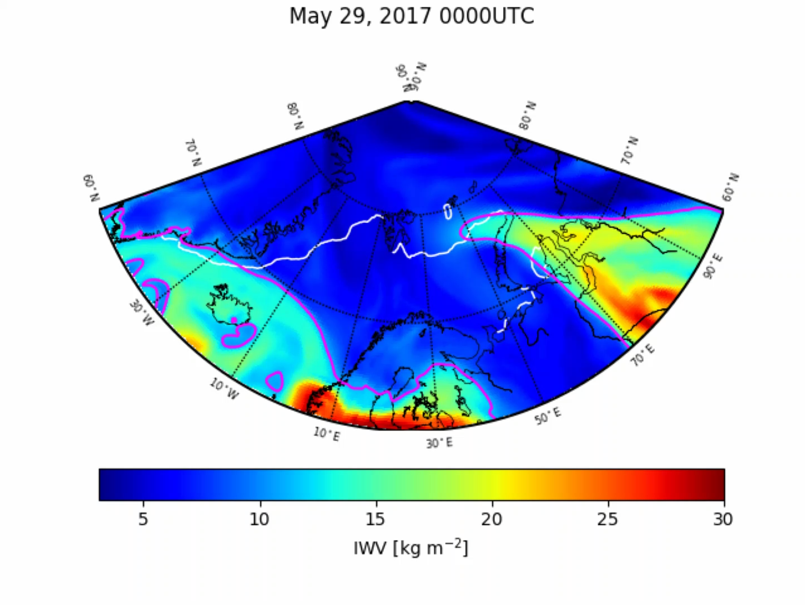

Integrated Water Vapour
ACLOUD
overview
2020 EGU conference, Vienna, Austria, 04-08/05/2020
2020 EGU conference, Vienna, Austria, 04-08/05/2020

Slide 3
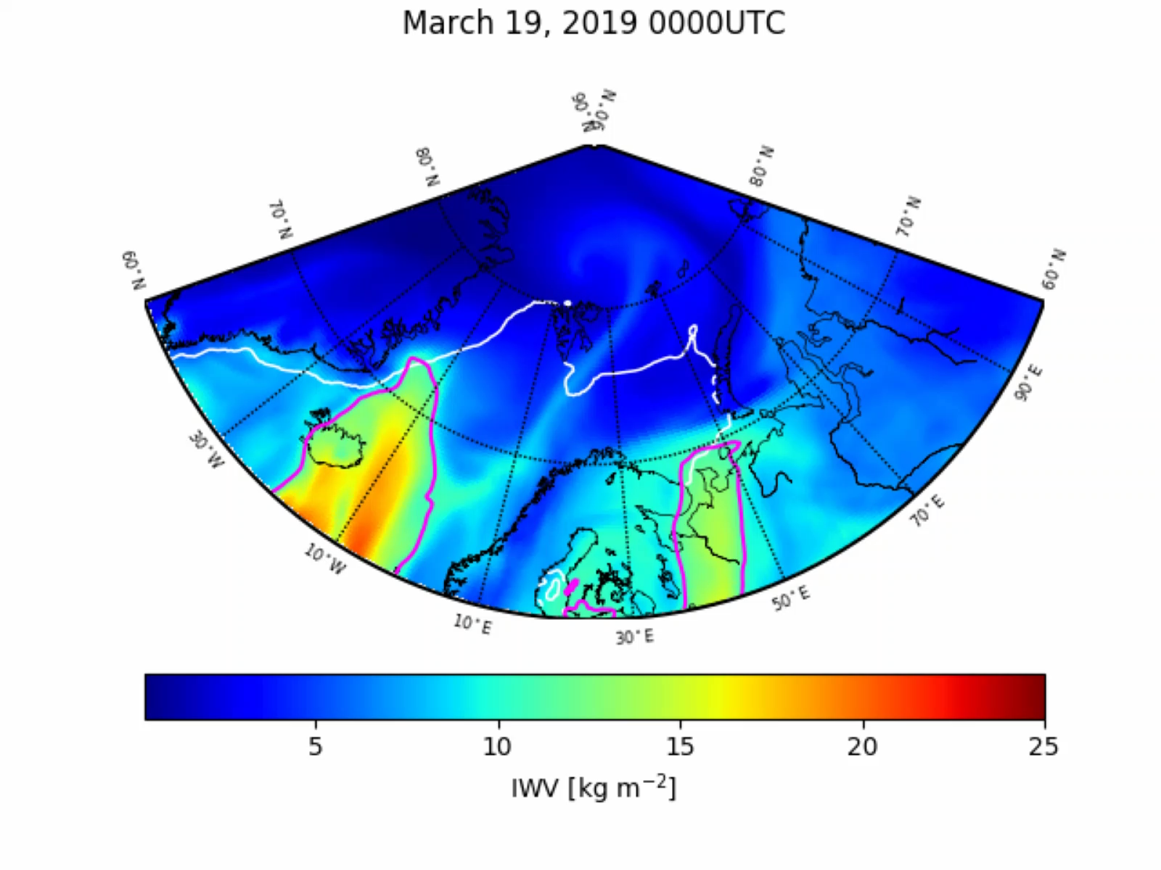
Integrated Water Vapour
AFLUX
overview
2020 EGU conference, Vienna, Austria, 04-08/05/2020

Slide 4
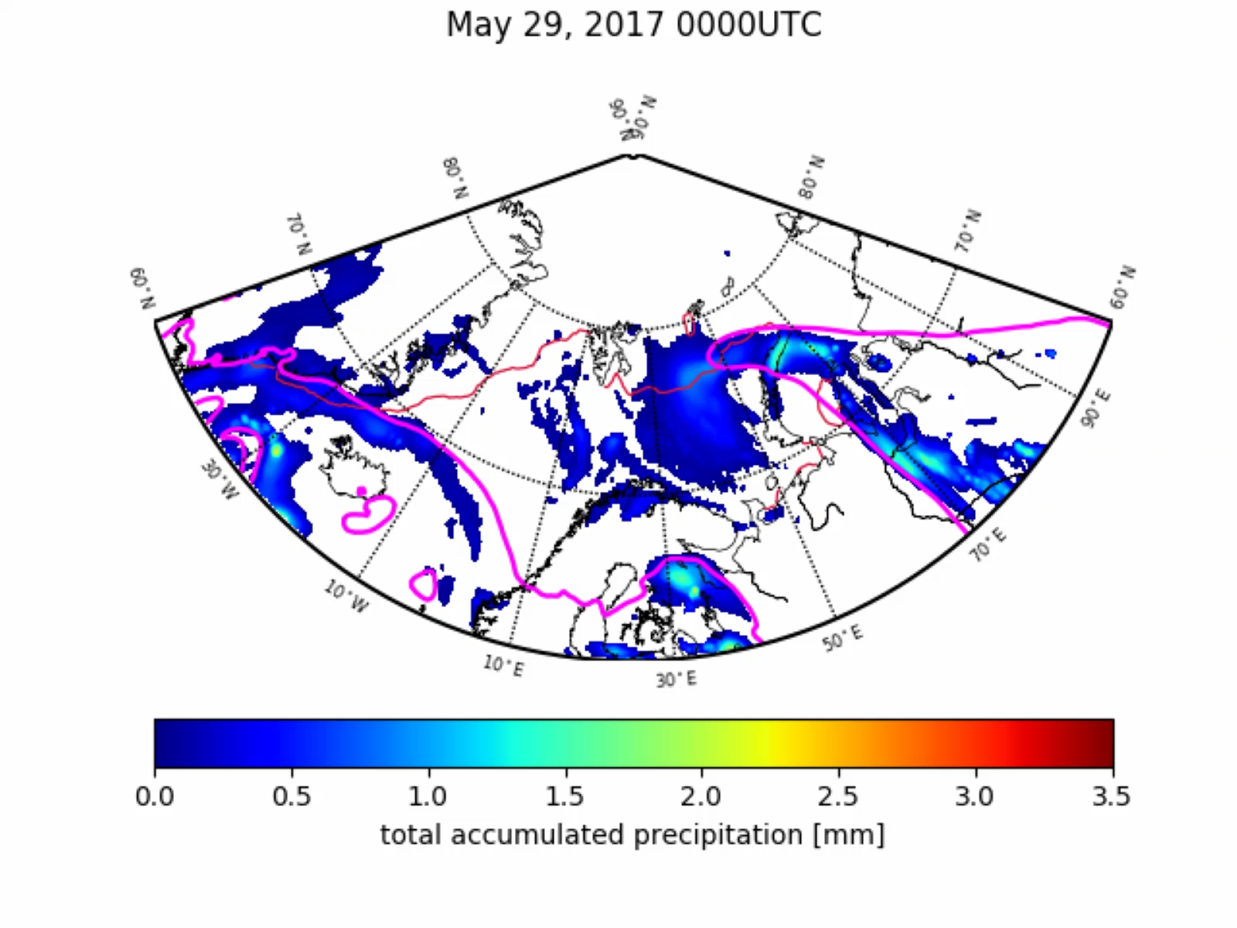
Total accumulated precipitation
ACLOUD
overview
2020 EGU conference, Vienna, Austria, 04-08/05/2020

Slide 5
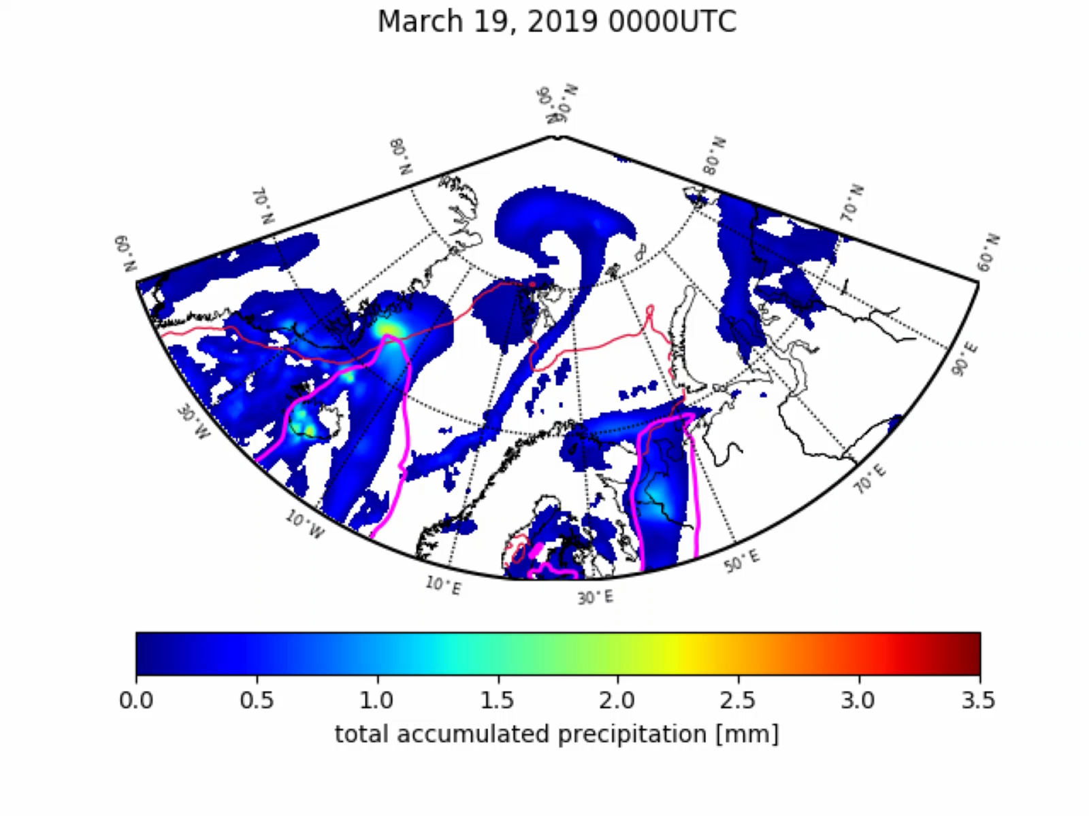
Total accumulated precipitation
AFLUX
overview
2020 EGU conference, Vienna, Austria, 04-08/05/2020

Slide 6
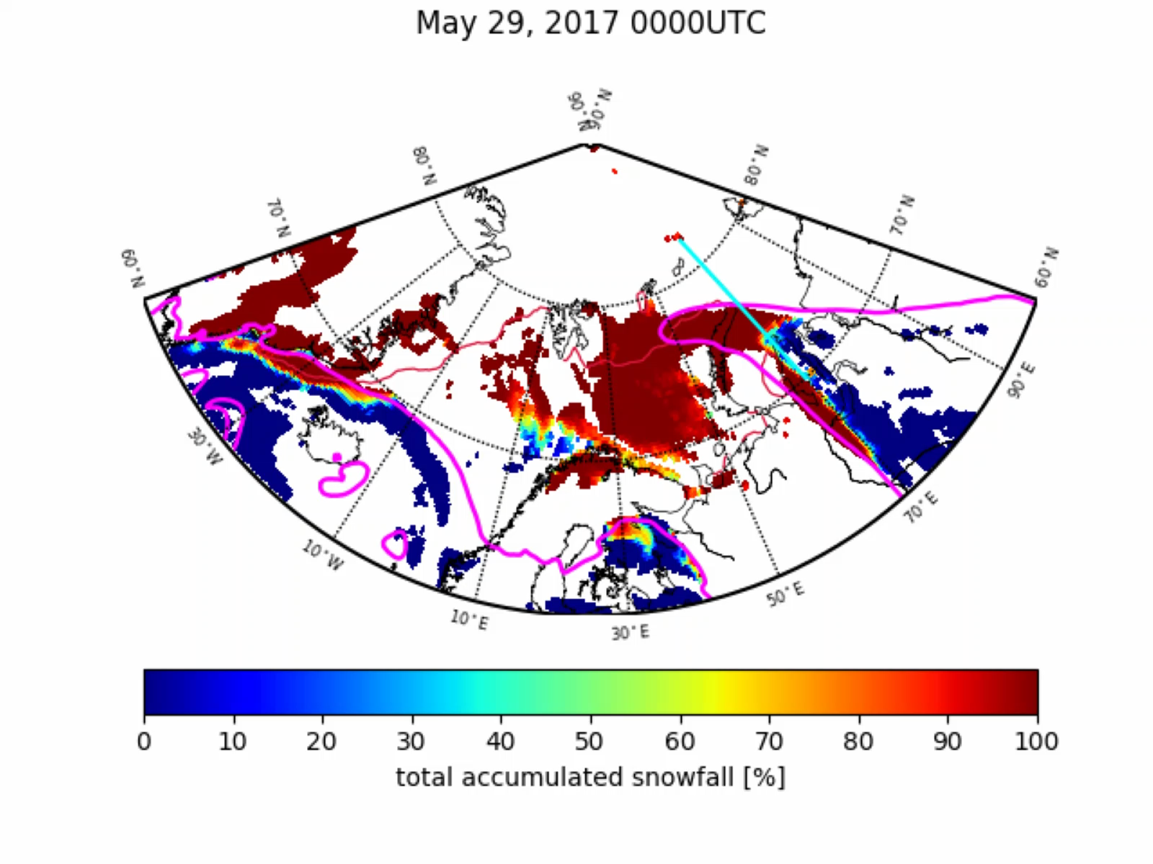
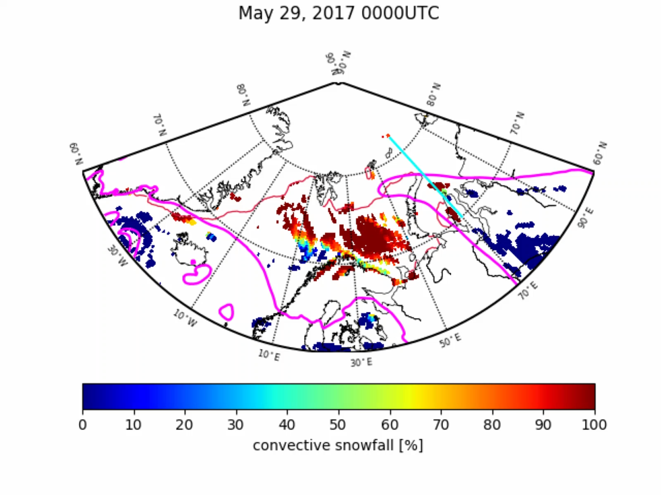
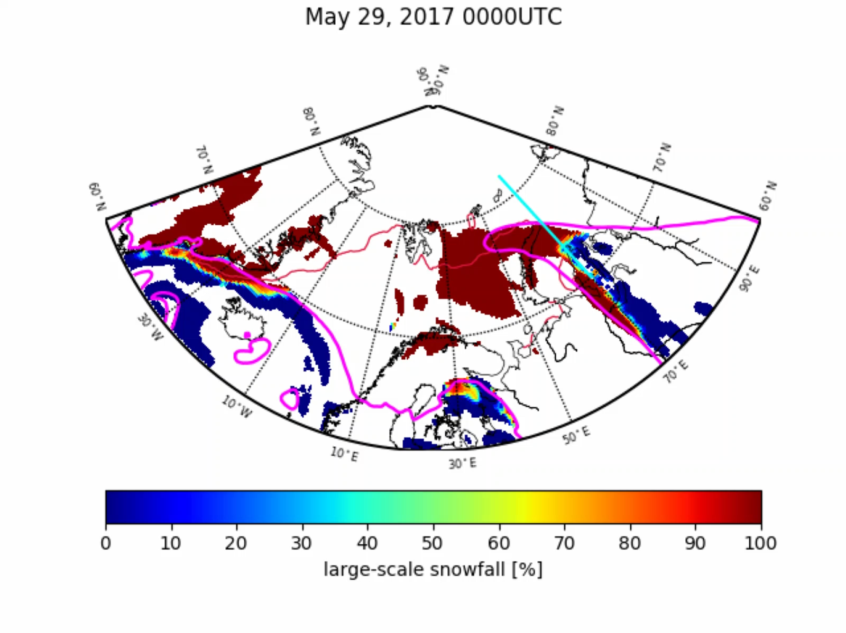
Snow and rain amount
ACLOUD
Total precipitation
Convective precipitation
Large-scale precipitation
overview
2020 EGU conference, Vienna, Austria, 04-08/05/2020

Slide 7
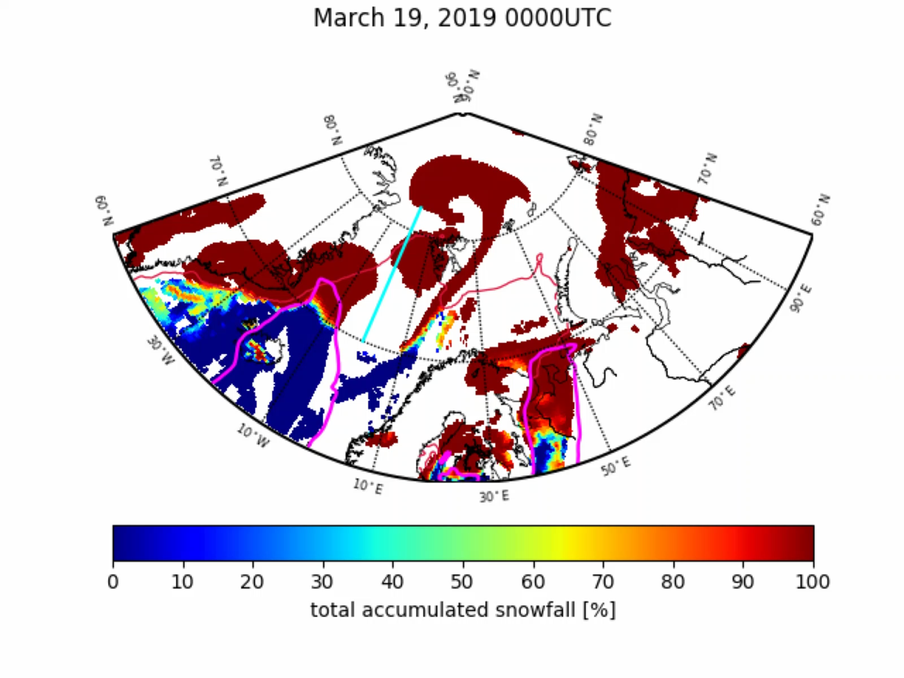
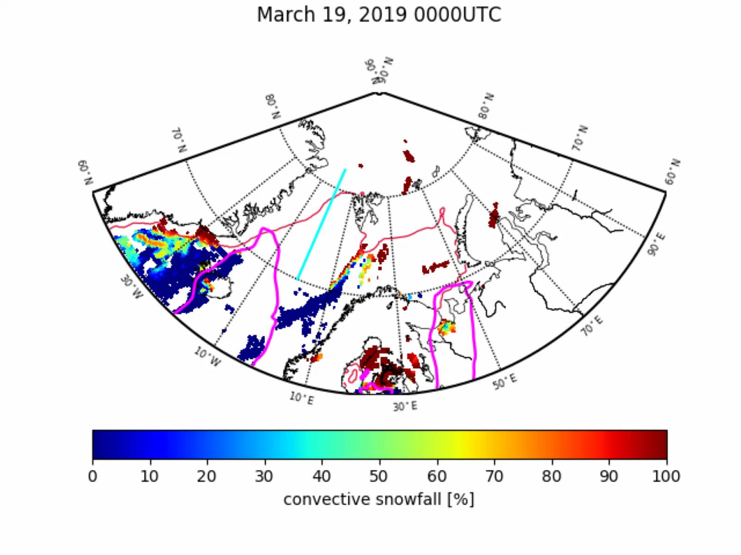
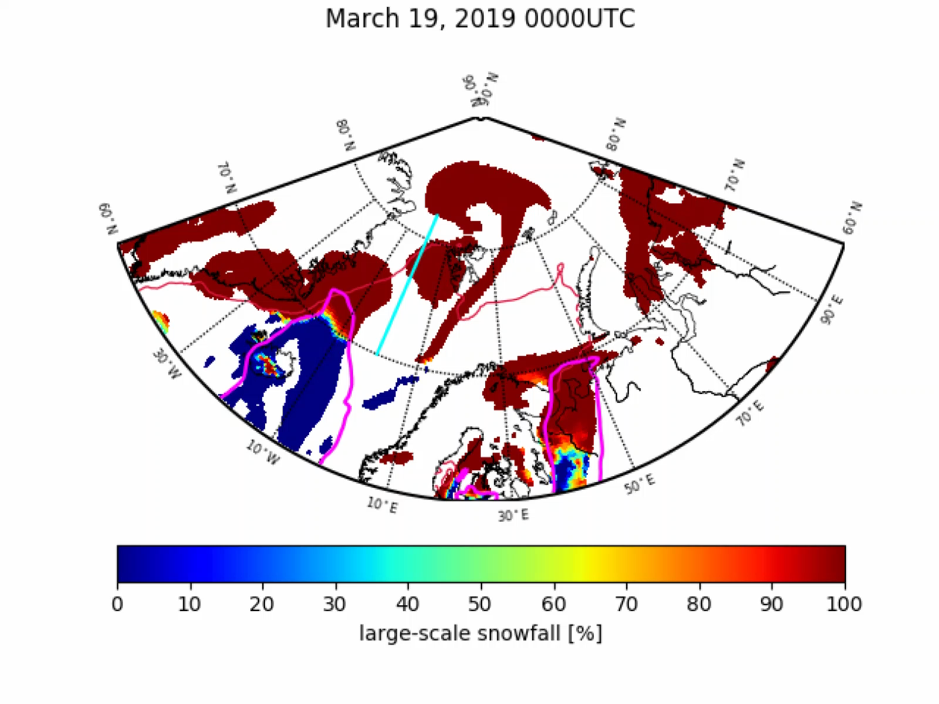
Snow and rain amount
AFLUX
Total precipitation
Convective precipitation
Large-scale precipitation
overview
2020 EGU conference, Vienna, Austria, 04-08/05/2020

Slide 8
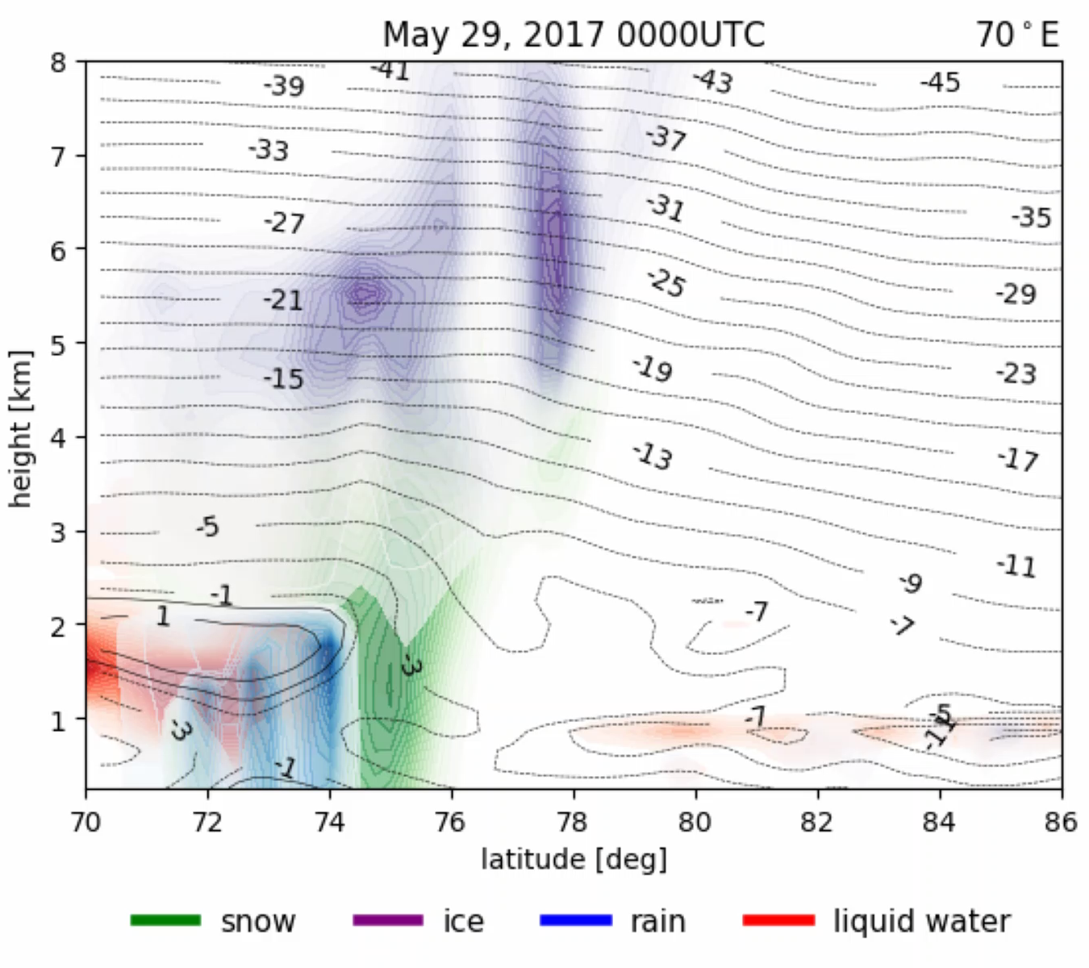
Hydrometeors
ACLOUD
overview
2020 EGU conference, Vienna, Austria, 04-08/05/2020

Slide 9
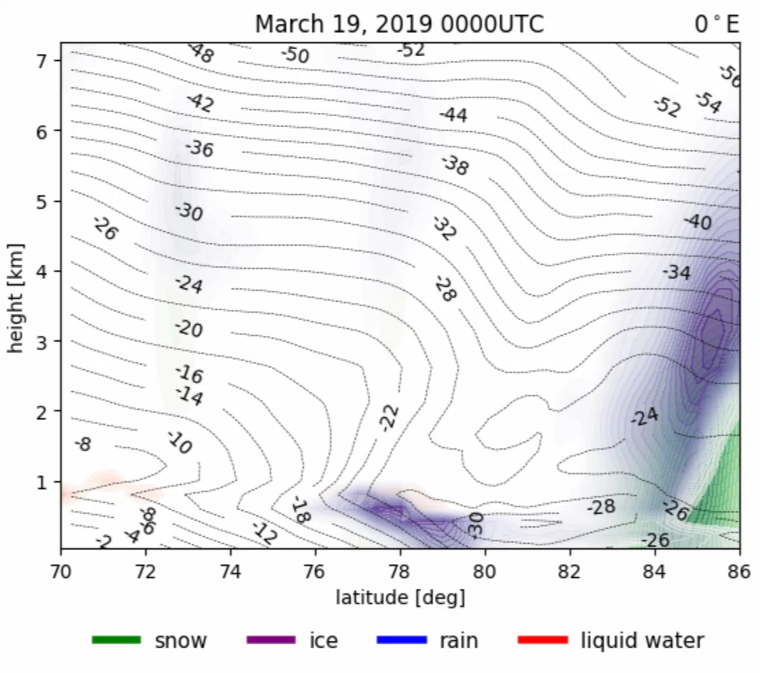
Hydrometeors
AFLUX
overview
2020 EGU conference, Vienna, Austria, 04-08/05/2020

