Slide 1
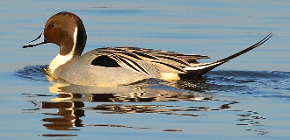
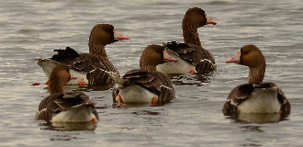
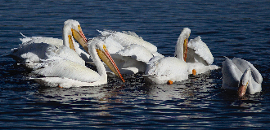
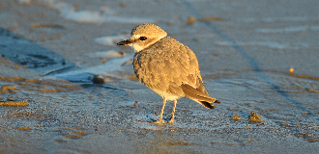
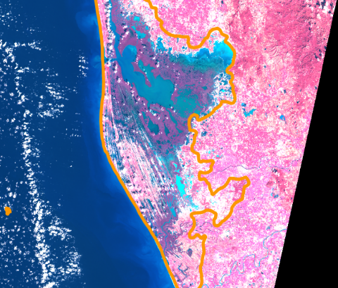
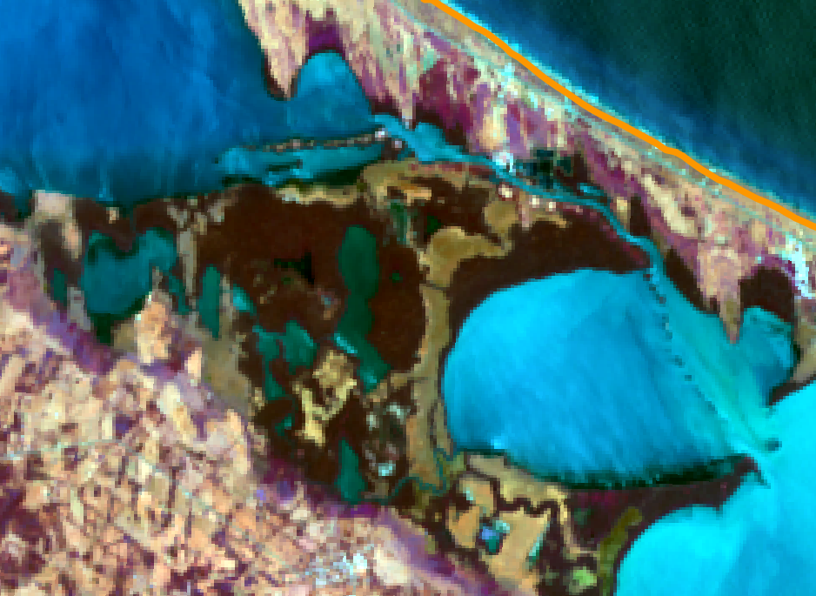
Monitoring Hydroperiod and Hydropatterns of coastal wetland
systems in Mexico using Landsat time series
EGU 2020
HS6.7 “Water Level, Storage and Discharge from Remote Sensing and Assimilation in Hydrodynamic Models”
Bart (A.J.) Wickel¹, Rene Colditz², Rainer Ressl³, John Kucharski⁴, and Sergio Salinas-Rodríguez⁵
¹Stockholm Environment Institute (SEI), Davis, CA, USA (bart.wickel@sei.org)
²Directorate General for Climate Action (DG CLIMA) European Commission, Brussels, Belgium
³National Commission for Knowledge and Use of Biodiversity (CONABIO), Mexico City, Mexico
⁴Institute for Water Resources (IWR) US Army Corps of Engineers, Davis, CA, USA
⁵World Wildlife Fund (WWF), Mexico City, Mexico

Slide 2
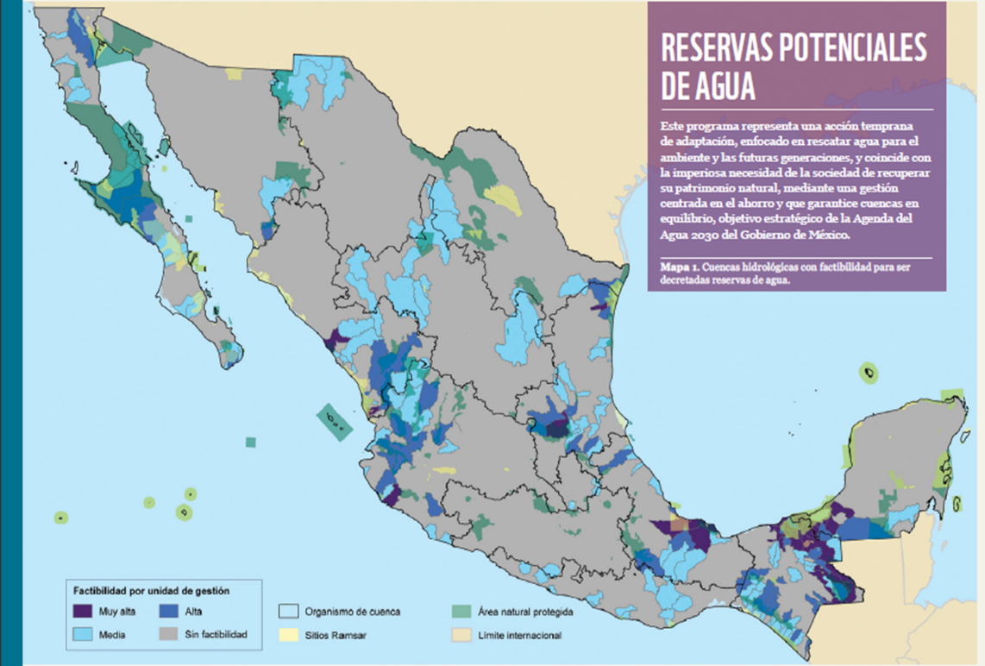
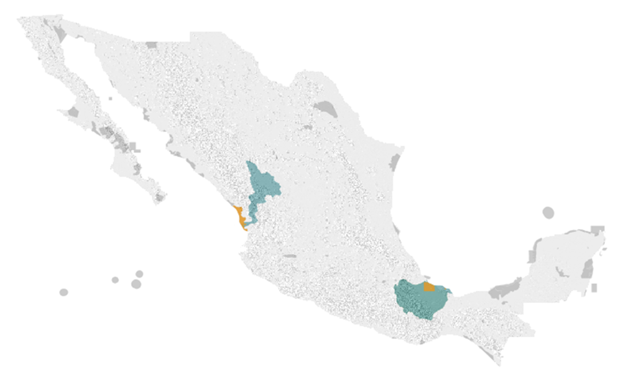
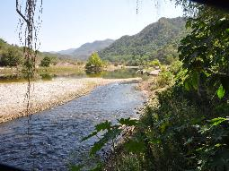
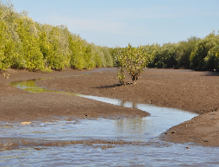
Study Objectives
Project objectives
Determine environmental water requirements of wetland systems of critical importance as migratory bird habitat along the Pacific and Central flyways
Test new remote sensing-based metrics for eventual integration in water reserves and management plan
Include the migratory bird/large wetland considerations in a National Environmental Flows Program – Water Reserves of Mexico
Research questions
What remote sensing (RS) methods can be used to capture hydrological variability, in particular: Wetland Hydroperiod and Hydropattern?
Which remote sensing derived index-based metrics be linked to in situ measurements?
How can we link hydrological observations to habitat types?
Development opportunities
Long term open access RS data (Landsat)
Deployment of open software tools (GDAL/QGIS)
Central flyway
Pacific flyway

Slide 3
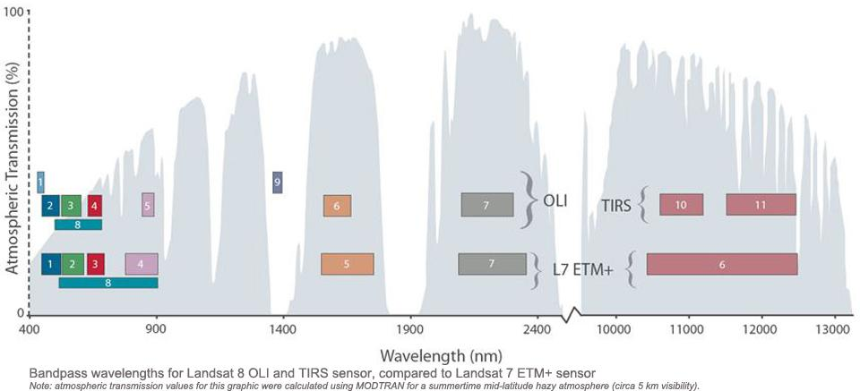
Methods
Data sources
Landsat 4/5 TM, 7 ETM+ and 8 OLI archive
MODIS Aqua/Terra
Tools
GDAL
QGIS/SAGA/Grass
Processing steps
Automated query and download
Calculation of standardized indices
Develop a first set of classifications that
Analytical steps
Test indices/sensitivity to open water
Single flood event
Seasonal variability
Interannual variability
Hydrological analysis – Water NDWI, MNDWI, TCwet
Vegetation analysis – Vegetation (NDVI), Tcgreen
Overview of Landsat missions and the main bands of the Landsat sensors
Source: https://landsat.gsfc.nasa.gov/about/technical-information/

Slide 4
Methods
Summary of Indices
Remote sensing derived indices
Band ratio methods – contrasting bands with a wavelength sensitive to a characteristic
Single, dual, multi-band
Vegetation Indices
NDVI, EVI
Sensitive to greenness and wetness
Negative values for water, positive values for vegetation
Water Indices
NDWI, MNDW
Sensitive to wetness of soil and open water
Values range
Loss of signal under canopy
Positive values
Other Indices
TC-wet, TC-green
Performed poorly overall and were not used
Index | Equation | Water
NDVI Normalized Difference Vegetation Index Tucker, 1980 | $$\frac{NIR−Red}{NIR+Red}$$ | Negative
EVI Enhanced Vegetation Index Liu and Huete, 1995 | $$2.5∙\frac{NIR−Red}{NIR+Red}+6∙NIR−7.5∙Blue+1$$ | Negative
NDWI Normalized Difference Water Index McFeeters, 1996 | $$\frac{Green−NIR}{Green+NIR}$$ | Positive
MNDWI Modified Normalized Difference Water Index McFeeters, 1996 | $$\frac{Green−MIR}{Green+MIR}$$ | Positive
TC Tasseled Cap Kauth and Thomas, 1975 | $$c1∙Blue+c2∙Green+c3∙Red+c4∙NIR+c5∙MIR+c6∙SWIR$$ | Mixed
Summary of bands, wavelengths and spatial resolutions
 | Landsat 4 & 5 TM |  |  | Landsat 7 ETM+ |  |  | Landsat 8 OLI
Band | No | µ | m | No | µ | m | No | µ | m
Aerosol |  |  |  |  |  |  | 1 | 0.433–0.453 | 30
Blue | 1 | 0.45-0.52 | 30 | 1 | 0.45-0.515 | 30 | 2 | 0.450–0.515 | 30
Green | 2 | 0.52-0.60 | 30 | 2 | 0.525-0.605 | 30 | 3 | 0.525–0.600 | 30
Red | 3 | 0.63-0.69 | 30 | 3 | 0.63-0.69 | 30 | 4 | 0.630–0.680 | 30
NIR | 4 | 0.76-0.90 | 30 | 4 | 0.775-0.90 | 30 | 5 | 0.845–0.885 | 30
SWIR-1 | 5 | 1.55-1.75 | 30 | 5 | 1.55-1.75 | 30 | 6 | 1.560–1.660 | 30
TIRS-1 | 6 | 10.41-12.5 | 120 | 6 | 10.4-12.5 | 60 | 10 | 10.60-11.19 | 100
TIRS-2 |  |  |  |  |  |  | 11 | 11.50-12.51 | 100
SWIR-2 | 7 | 2.08-2.35 | 30 | 7 | 2.08-2.35 | 30 | 7 | 2.100–2.300 | 30
Panchromatic | 8 |  |  | 8 | 0.52-0.9 | 15 | 8 | 0.500–0.680 | 15
Cirrus |  |  |  |  |  |  | 9 | 1.360–1.390 | 30

Slide 5
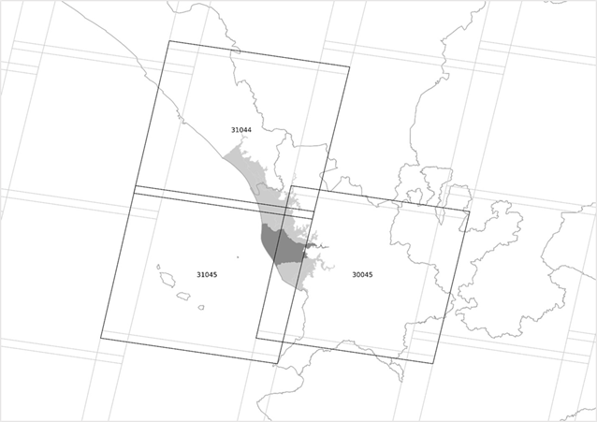
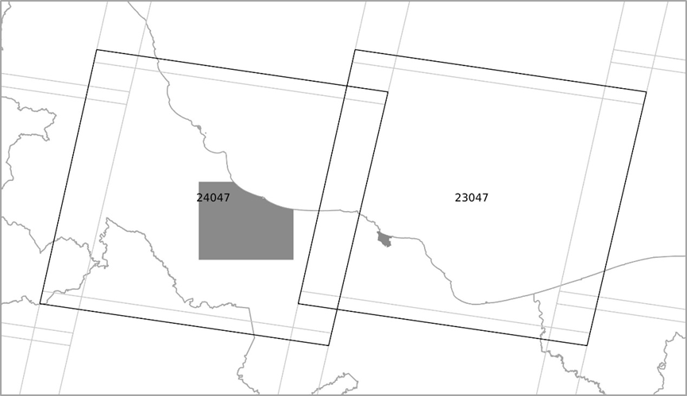
Study Area
Marismas Nacionales
Ramsar site – area of international importance
Coastal Lagoon - ~200,000 ha
San Pedro-Mezquital River 2nd Largest tributary
Most Northern extent of Mangroves in the Pacific
High biodiversity
Threats
Damming
Aquaculture development
Over-abstraction/diversion of water
Deforestation
Laguna Alvarado
Ramsar site – area of international importance
Coastal Lagoon - ~300,000 ha
Largest tributary Papaloapan River
Tributaries heavily regulated
High biodiversity
Threats
Over-abstraction/diversion of water
Deforestation
Agricultural expansion
Cattle
Laguna Alvarado
Marismas Nacionales
Landsat Path/Row footprint over the study area
Landsat Path/Row footprint over the study area

Slide 6
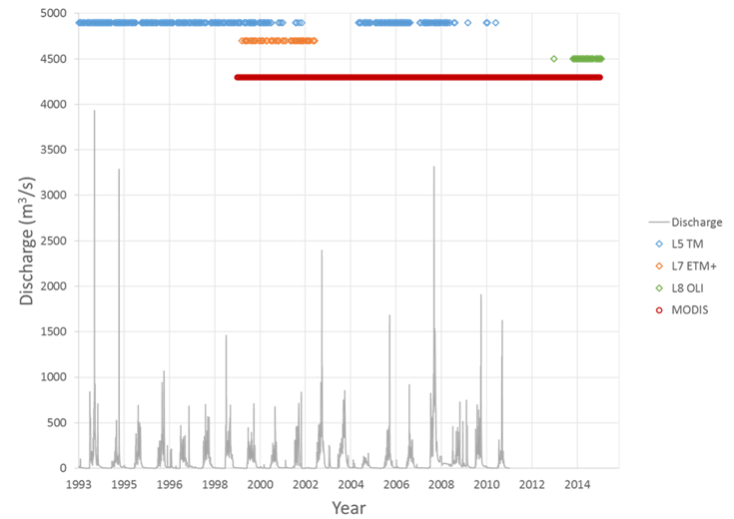
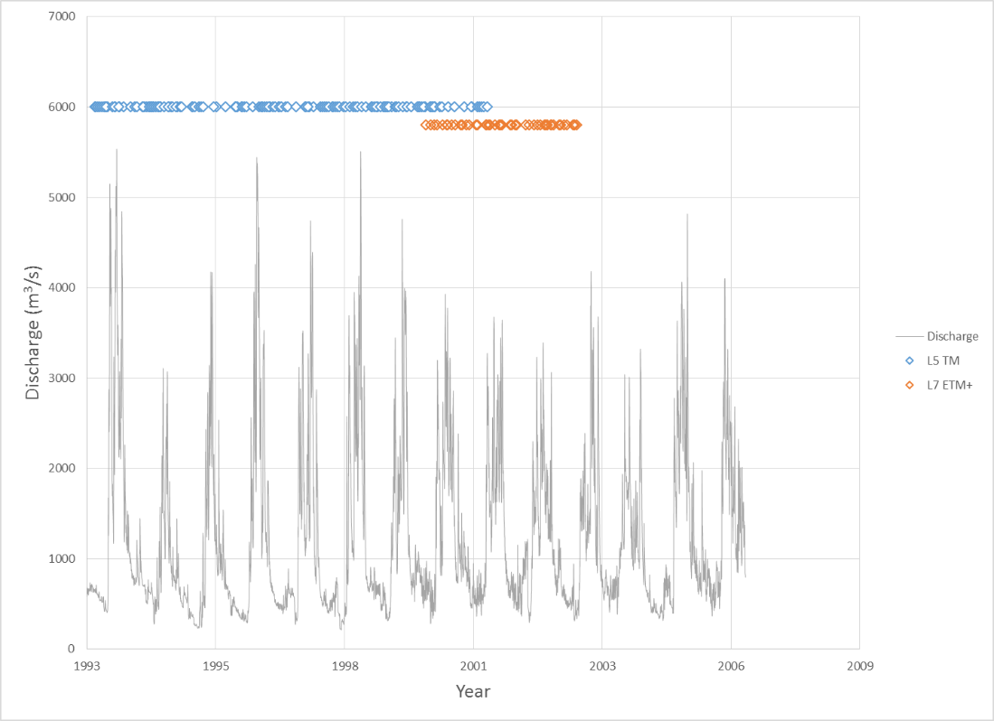
Study Area
Marismas Nacionales
Main river San Pedro-Mezquital
Peak discharges up to 4000 m³/s
Distinct dry season
Extreme seasonal regime
Landsat 5 – 332 usable scenes
Landsat 7 – 46 usable scenes
Landsat 8 – 29 usable scenes
Laguna Alvarado
Main river Papaloapan
Peak discharges up to 5000 m³/s
Much greater annual discharge than San Pedro
Much stronger cloud cover and haze
Landsat 5 – 115 usable scenes
Landsat 7 – 26 usable scenes
Data availability and discharge record
Data availability and discharge record

Slide 7
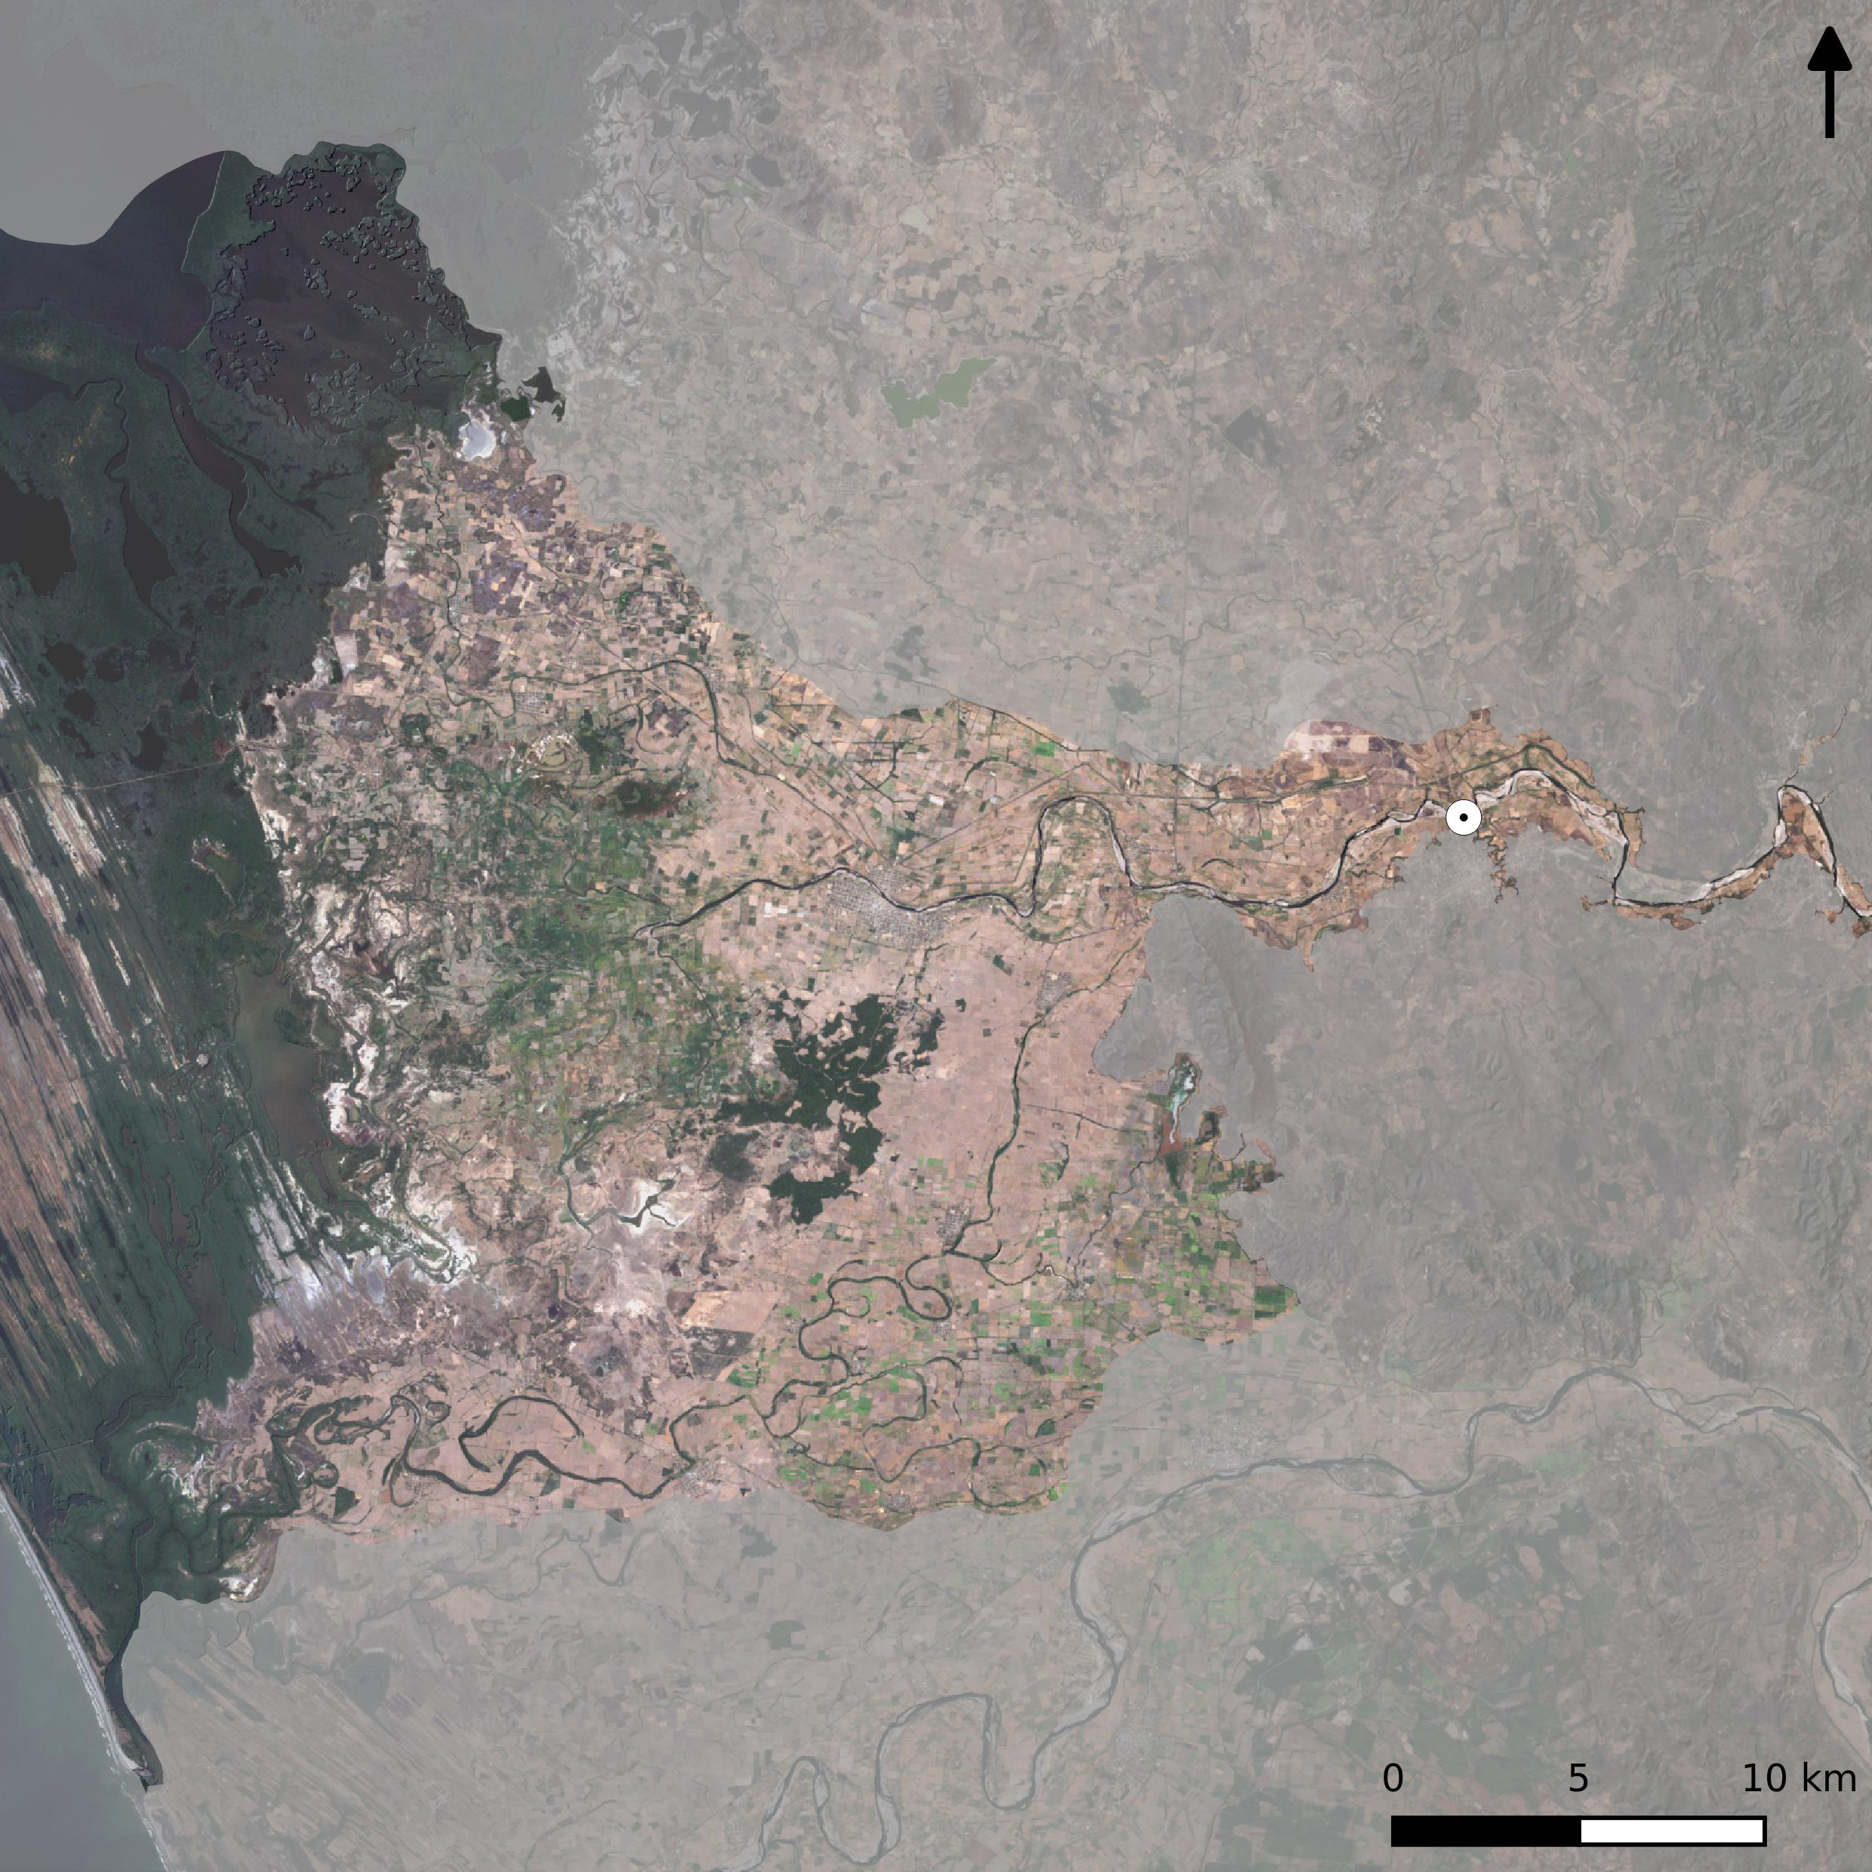
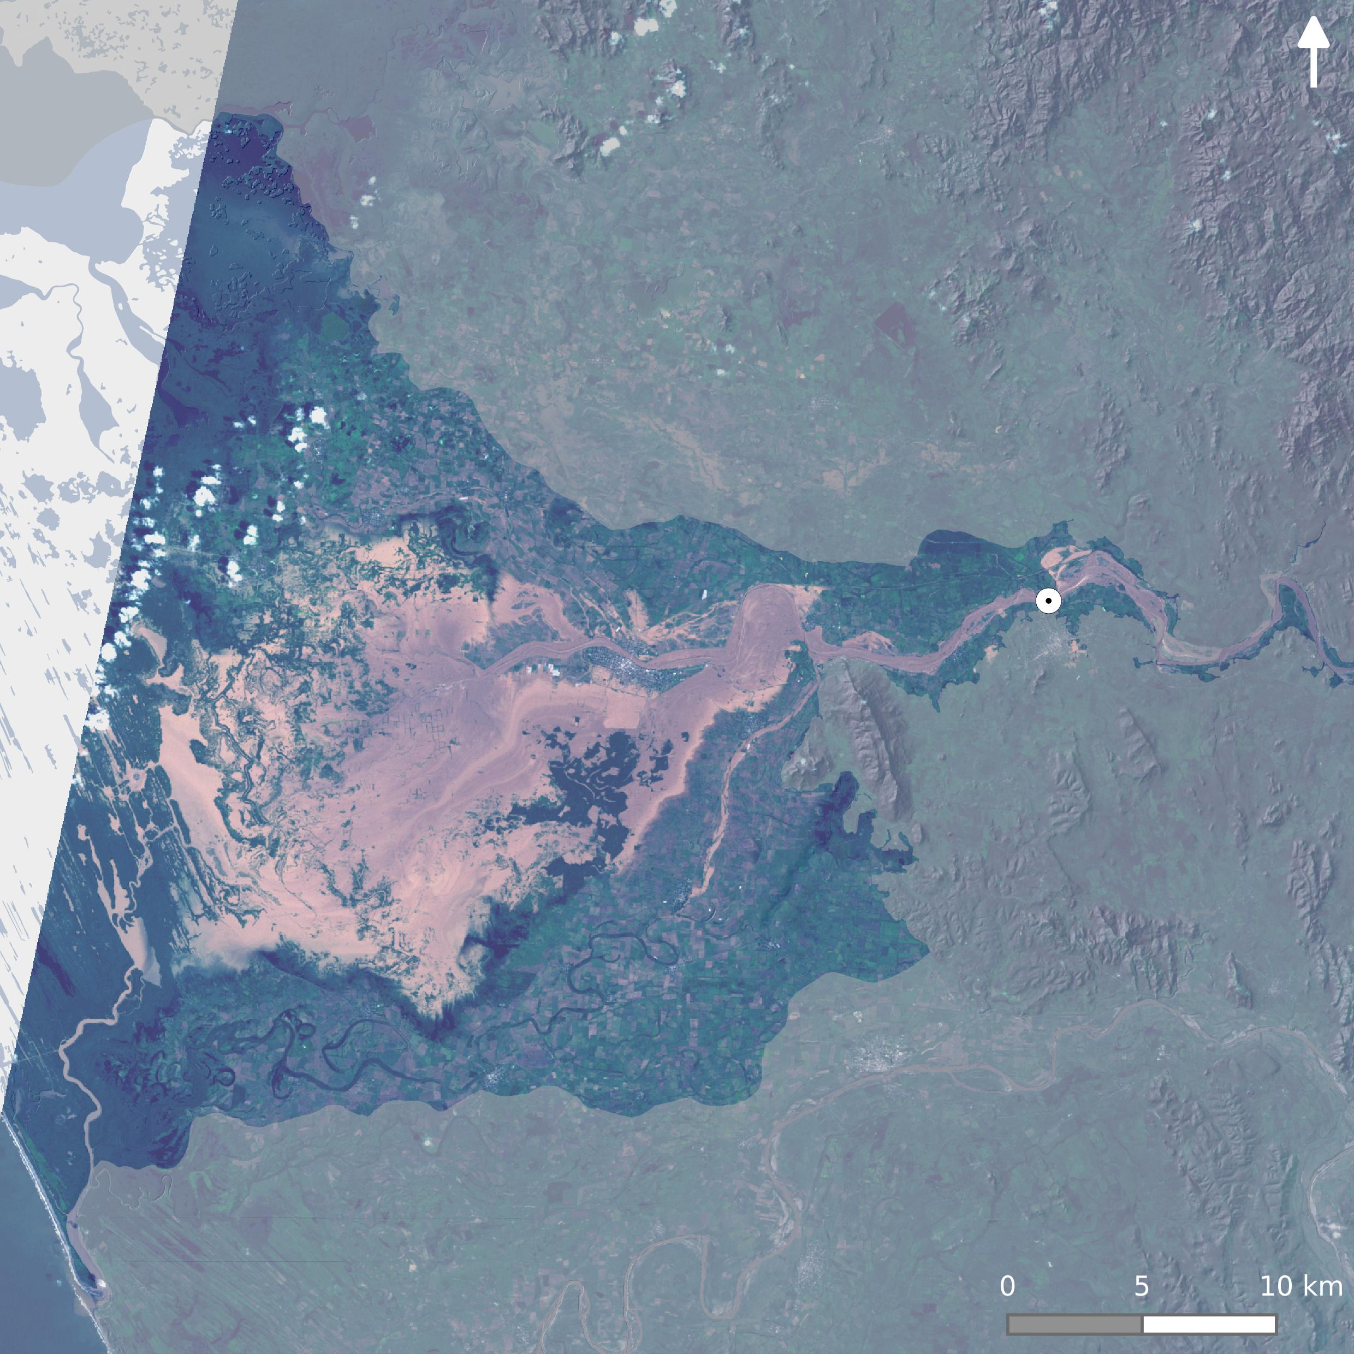
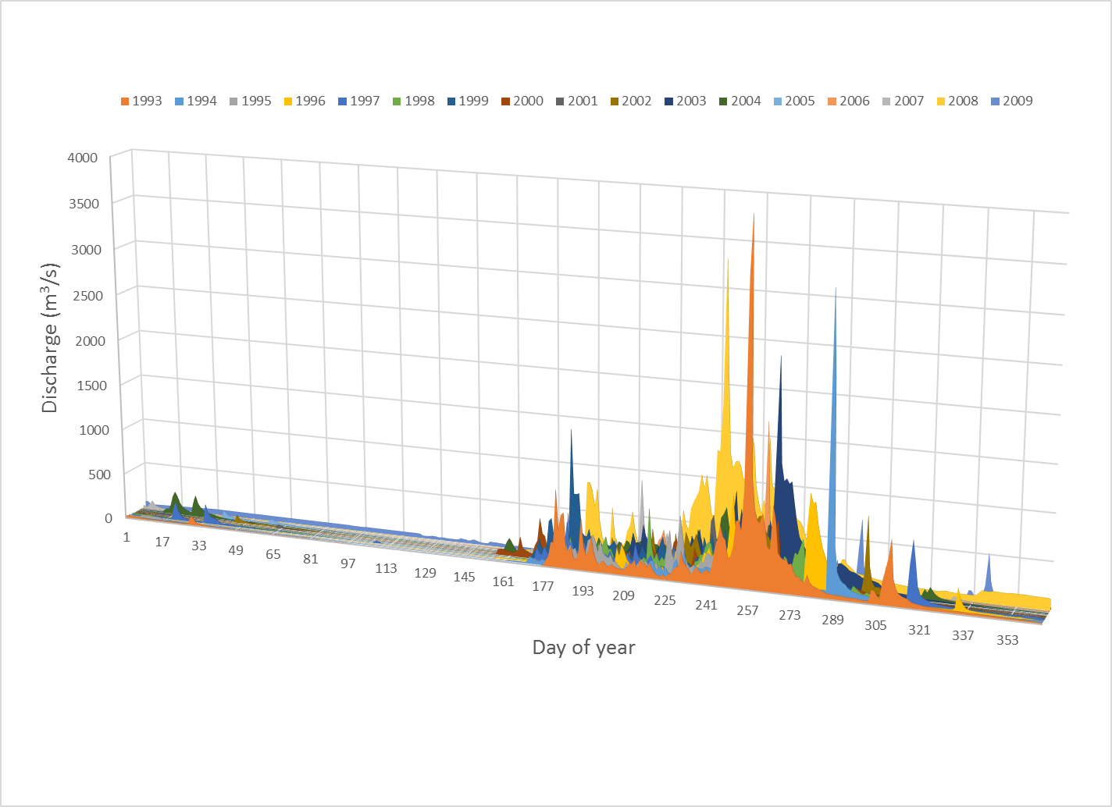
Results: Marismas
Hydrology
Single tributary (Rio San Pedro-Mezquital)
Unmasked area highlights functional floodplain
Monsoonal climate with distinct dry season
Large seasonal and inter-annual variation
Extreme rainfall events driven by hurricanes and tropical depressions
Extremely slow/long recession curve
Strong influence of El Nino/La Nina cycle
Dry season
Hurricane Gert
DOY 129 - 9 May, 1993
DOY 257 – 14 September, 1993
Stream Gauge
Discharge record for the San Pedro-Mezquital River

Slide 8
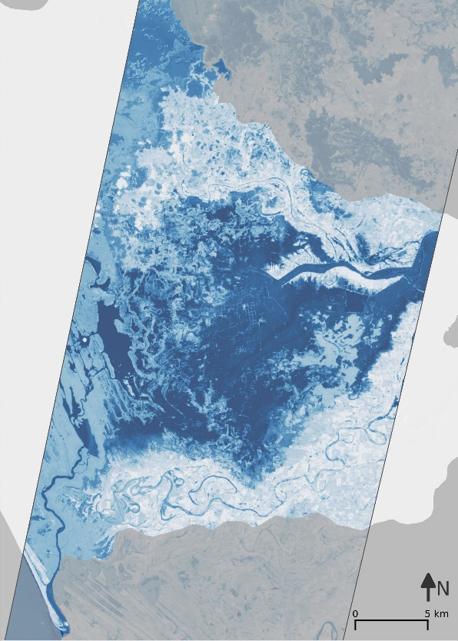
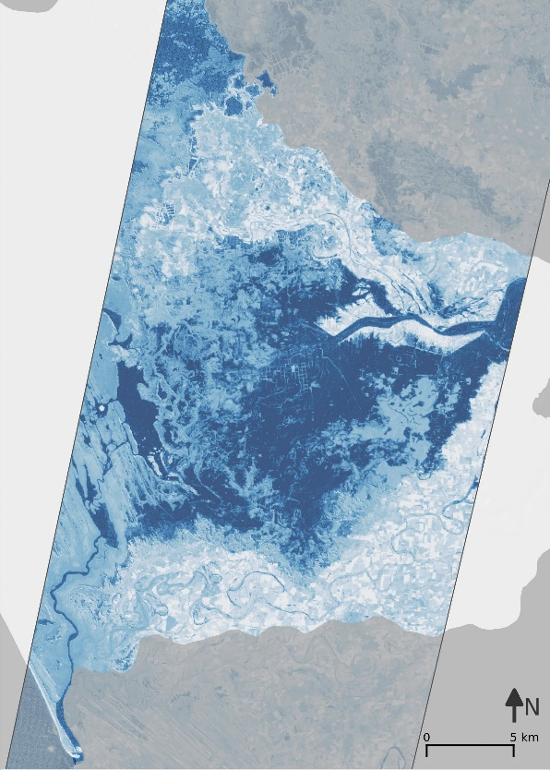
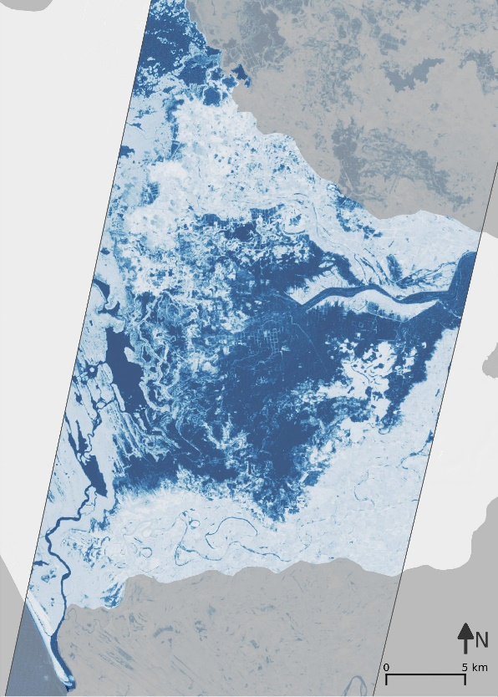
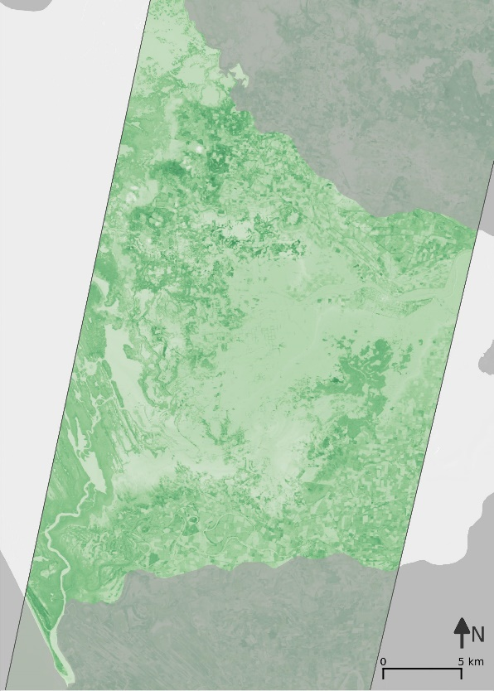
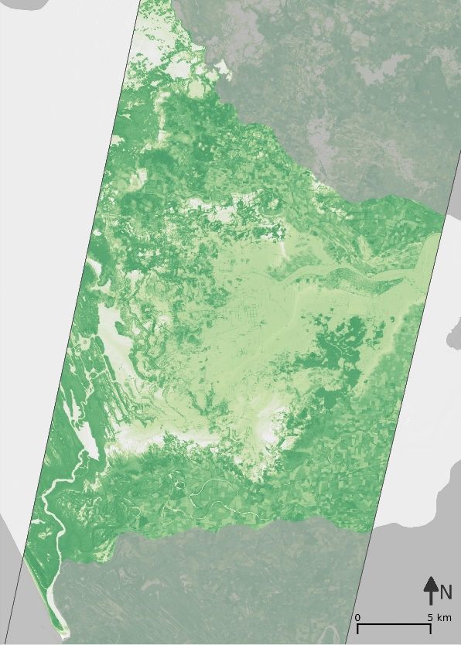
Results: Marismas
Wetness Indices
The MNDWI reveals a much greater contrast between open water and wet soil than the other two indices that were tested (TC–wet and NDWI)
Vegetation Indices
TC-Green saturates
NDVI negative values show similar patterns as MNDWI positive values
Observation
MNDWI is very sensitive to open water and with the right threshold a very effective index for extracting open water in this region
TC Wet
NDWI
MNDWI
TC Green
NDVI
DOY 257
14 September 1993

Slide 9
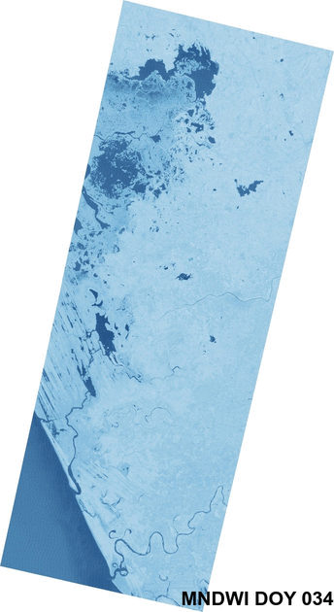
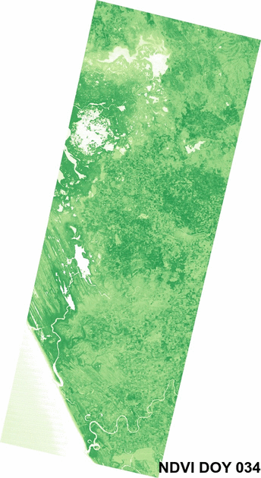
Results: Marismas
2008
Seasonal variability
Note the strong contrast between open water and dry land
Note how until day 178 the NDVI slowly increases
On day 210 the large flood event begins
A second peak occurs on day 267
Note the strong contrast between the largely natural Rio San Pedro and the highly regulated Rio Santiago
Note the much slower recession of flood waters in the San Pedro
Note how certain areas have continuously high NDVI (mangroves and permanent wetlands) while other parts show a strong seasonal variation
Observation
MNDWI is very useful to capture seasonal variability!
Rio San Pedro
Rio Santiago

Slide 10
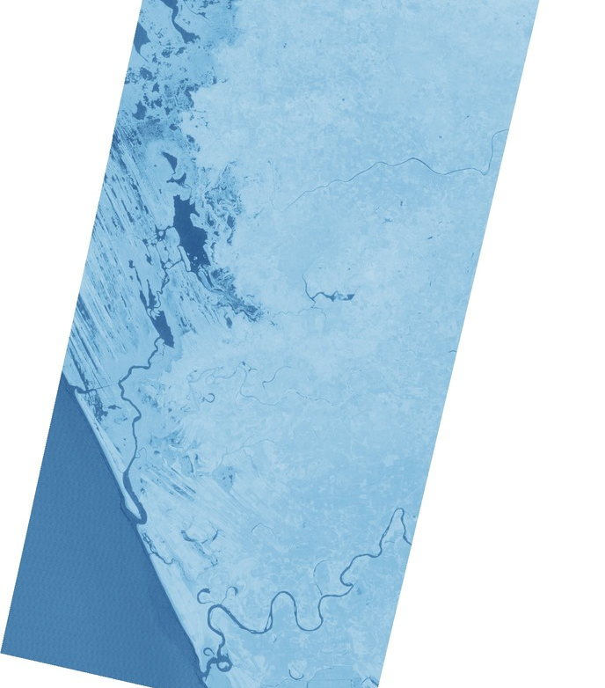
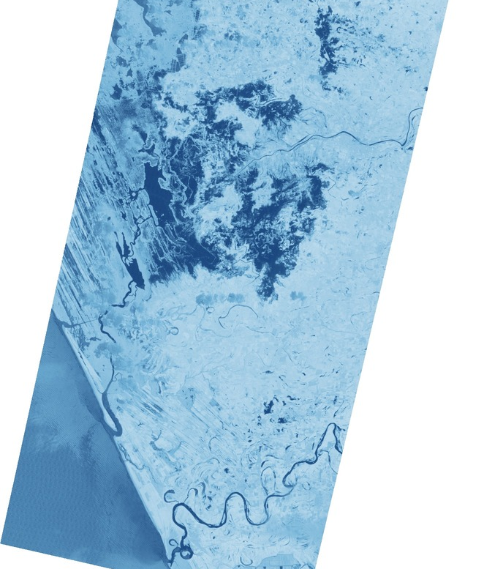
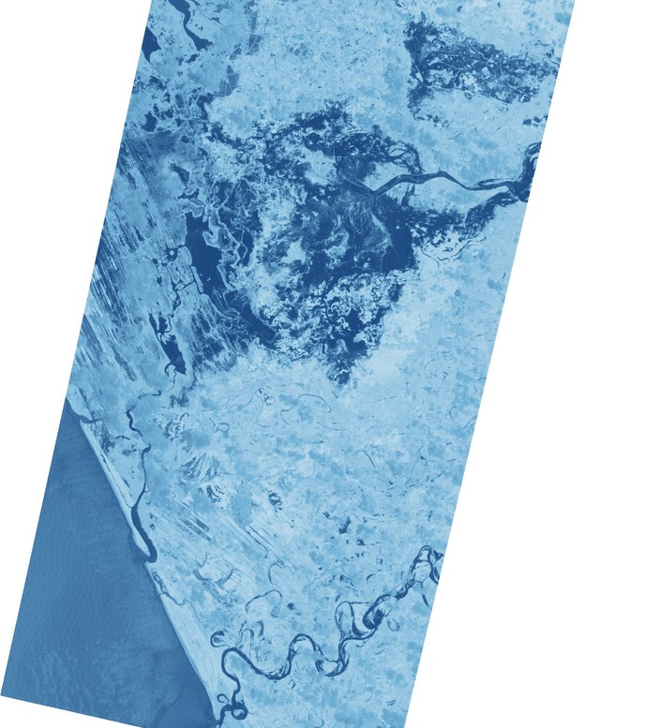
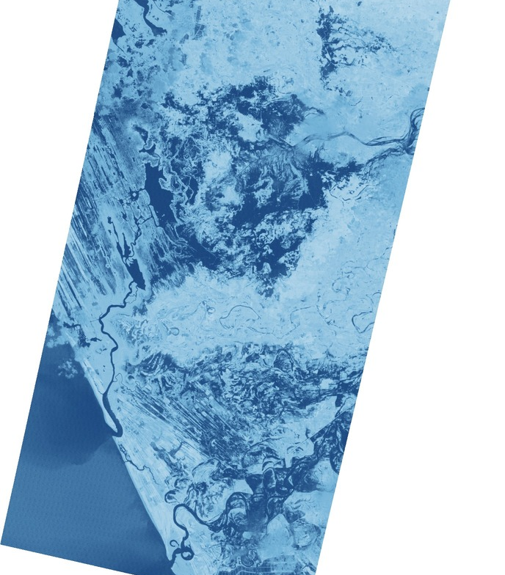
Results: Marismas
Seasonal Variability
In 2008 the region experienced the second largest flood event
The MNDWI images on the left clearly illustrate
Beginning of flooding around day 171
A second peak occurs on day 267
A strong contrast in hydrologic response between the largely natural Rio San Pedro and the highly regulated Rio Santiago
114 – 23 April
171 – 19 June
242 – 29 August
267 – 23 September
Rio San Pedro
Rio Santiago

Slide 11
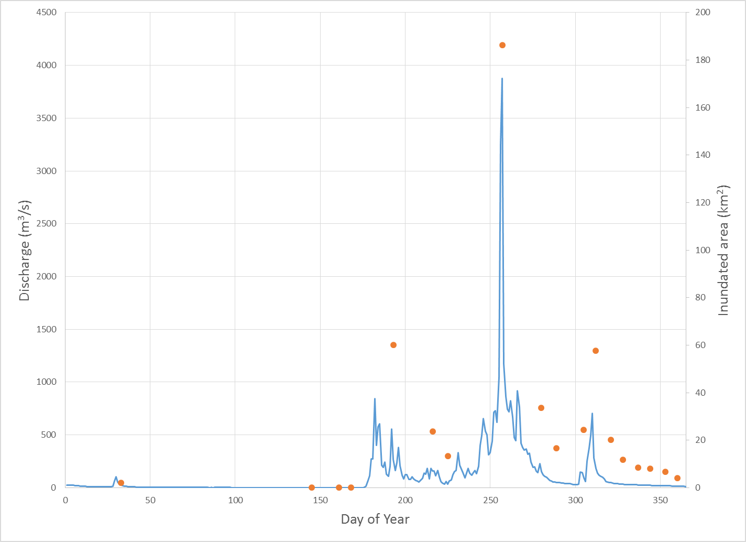
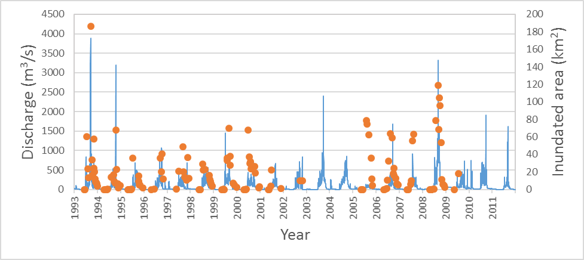
Results: Inundated area
2008
Left axis: discharge – blue line
Right axis: inundated area – orange dots
Time series for 2008
Note how the inundated area pattern strongly resembles discharge pattern
Full recession from peak (day 267) takes almost 40 days
Long term series for 1993-2011
Note how the inundated area pattern strongly resembles discharge pattern
Landsat data gap 2003-2004
Gauge failure in 2006?
Magnitude of mx discharge close to inundated area
1993-2011

Slide 12
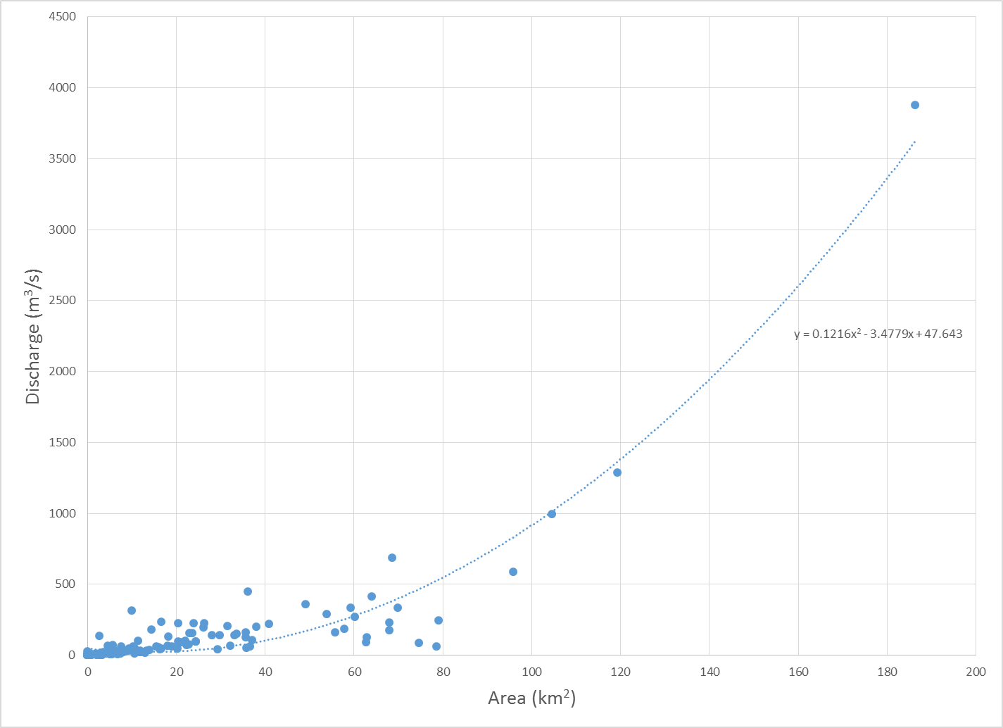
Results: Marismas
Inundated area
Note the extremely strong correlation between Discharge and inundated area
This system basically behaves as large tub
Curve is a rating curve at a large scale
This curve can be used to estimate large scale discharge based on inundated area during periods of rising flood waters
The deviating points are observed during the recession period, while correlation is lost
Observation
There is a surprisingly strong correlation between MNDWI derived open water area and discharge in this river system
R²=0.98

Slide 13
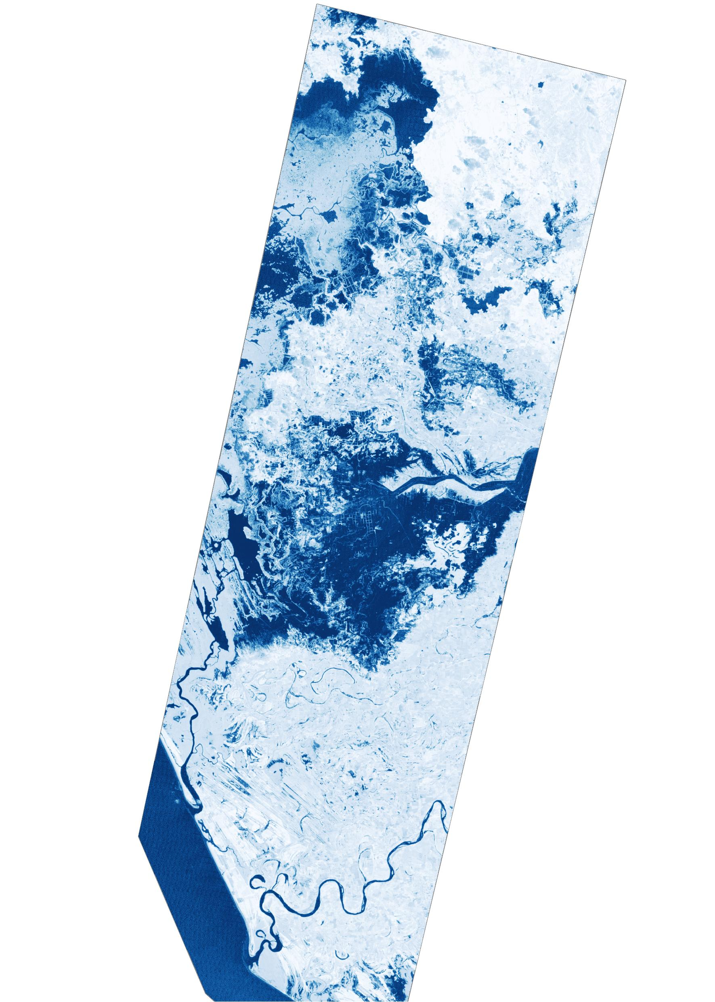
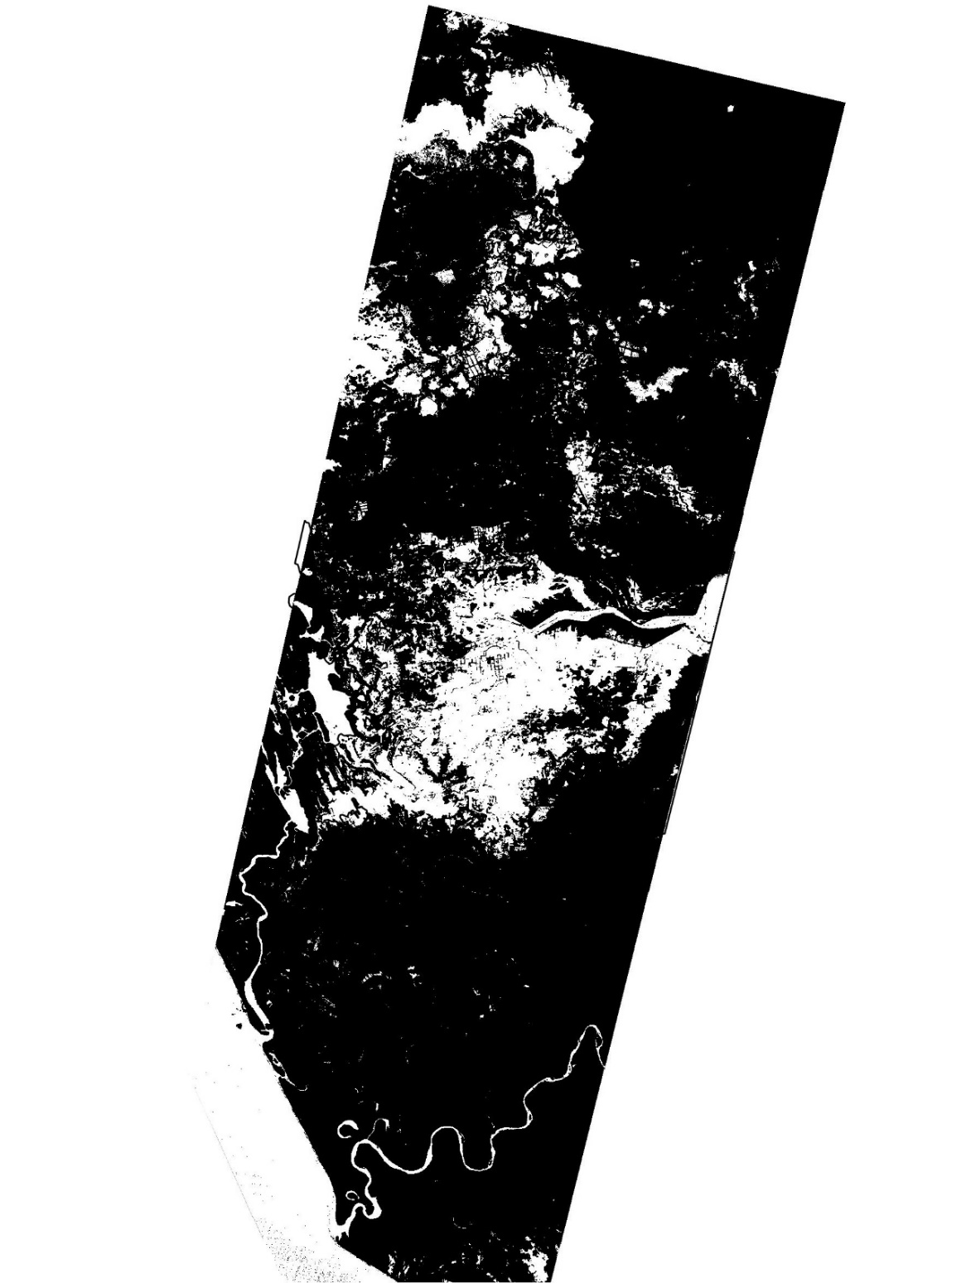
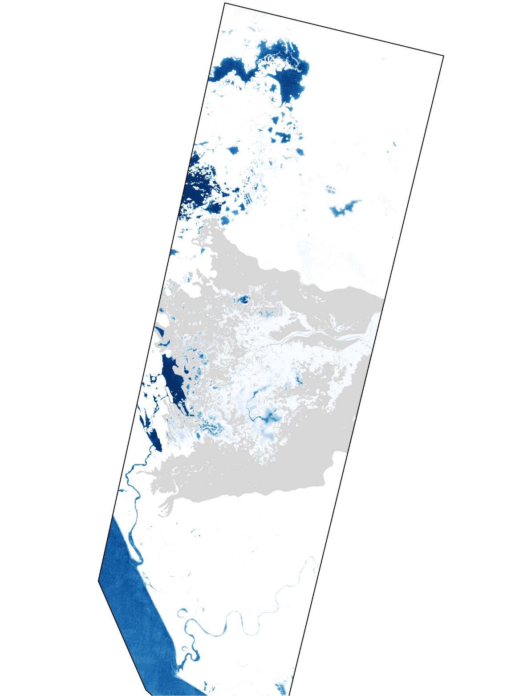
Results: Marismas
MNDWI
Mask
MNDWI_{sum}
MNDWI SUM
The MNDWI sum can be calculated by summing all MNDWI masks that are available for any given period (e.g. wet season) or multiple decades
The MNDWI provides a metric for: long term persistence as well as recurrence of inundation yielding metrics for frequency of distribution (hydropattern) and duration (hydroperiod)
By tracking persistence of water in the landscape we can identify areas with greater wetness – potential refugia as well as episodic habitats
By matching the timing of likely inundation with migration patterns we can identify priorities for conservation and critical periods
Conclusion
The hydropattern and hydroperiod can be extracted by summing MNDWI masks
Mask > 0.5
Sum of 241 images
1993-2009

Slide 14
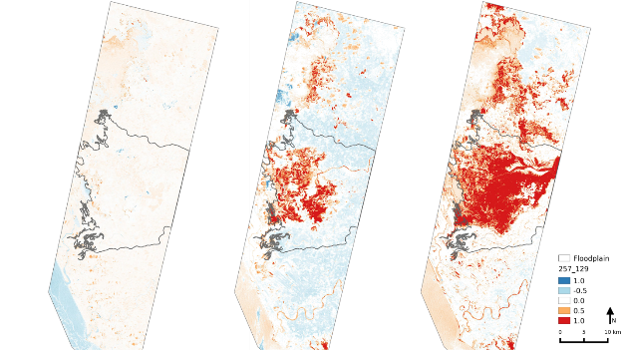
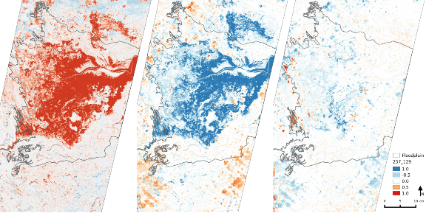
Difference images in MNDWI values between days 168 - 17 June (left), 193 - 12 July (center) and 257 - 14 September (right) and the base image of day 129 - 9 May). Positive values (red) indicate an increase in open water while blue values indicate a decrease.
Difference images in MNDWI values between days 168 - 17 June (left), 193 - 12 July (center) and 257 - 14 September (right) and the base image of day 129 - 9 May). Positive values (red) indicate an increase in open water while blue values indicate a decrease.
Results: Marismas
MNDWI Difference
The MNDWI difference can be calculated by subtracting a “wet” image from a preceding base line image that was taken towards the end of the dry season after which a threshold is applied
$${MNDWI}_{diff}={MNDWI}_{wet}− {MNDWI}_{dry}$$
The resulting image eliminates areas that are inundated in both images and emphasizes areas that were newly inundated and in case of this study area even allows for separation of wetted and dried areas between time steps
The MNDWI difference images provide a metric for seasonal persistence of episodically inundated parts of the landscape which are thought to serve a suite of ecological needs
Ephemeral wetlands are of great importance to shorebirds while more permanent water bodies are of greater importance to waterfowl

Slide 15
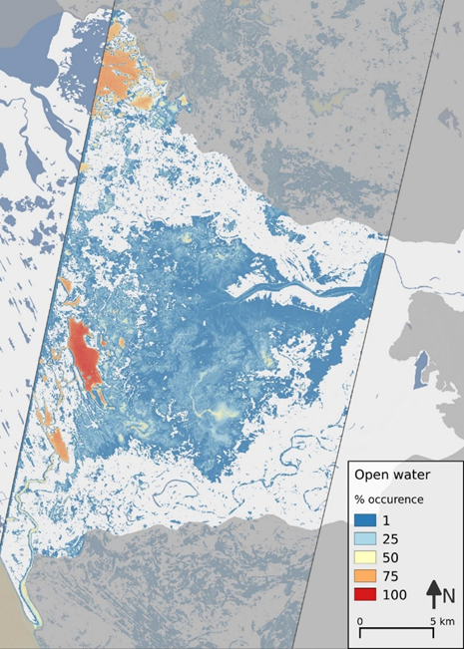
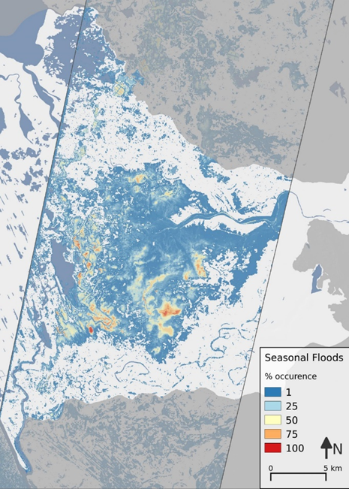
Results: Marismas
MNDWI Sum
MNDWI Difference Sum
MNDWI Sum
The MNDWI provides a metric for: long term persistence and recurrence
MNDWI Difference Sum
By subtracting a dry season baseline image before masking and summing MNDWI values we get a metric for seasonally variable areas and much greater detail
Observations
Both metrics are thought to provide valuable information for eco-hydrological studies
By identifying recurrent waterbodies at a relatively high precision we can begin the development of model that evaluate the impact of changes in discharge
We can also identify potential refugia and important linkages in connectivity that were previously not very evident
0-10% | Only during extreme events
10-50% | Infrequent inundation
50%-75% | Frequent inundation
75-100% | Permanent inundation
0-10% | Only during extreme events
10-50% | Marginal inundation
50%-75% | Infrequent inundation
75-100% | Frequent episodic inundation

Slide 16
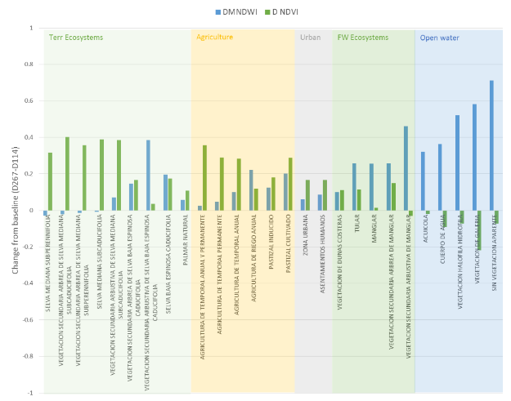
Results: Marismas
MNDWI and NDVI min/max
By calculating a difference image between peak wetness which largely coincides with peak greenness, and performing a zonal statistics analysis for each land cover type we see a predictable and logical pattern
Terrestrial ecosystems see a large increase in greenness while hardly observing a change in water (in most types)
In classes related to agriculture we see the same, and pick up a clear irrigation signal
Freshwater ecosystems observe a predictable increase in surface water extent while classes related to open water see a drop in NDVI (due to episodic submersion of vegetation)

Slide 17
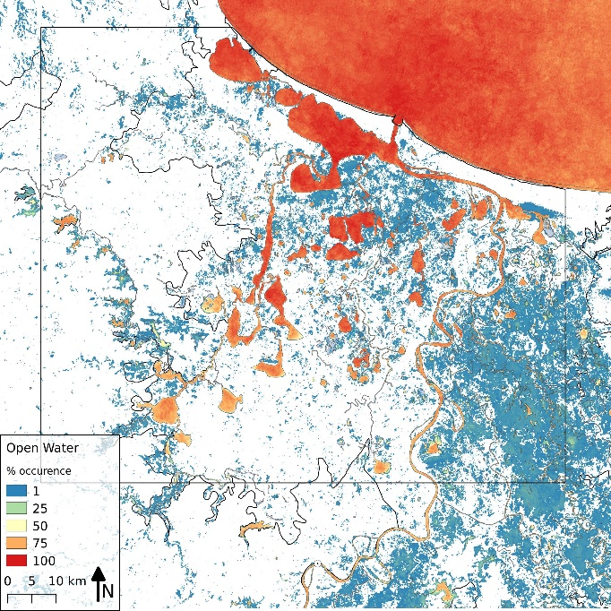
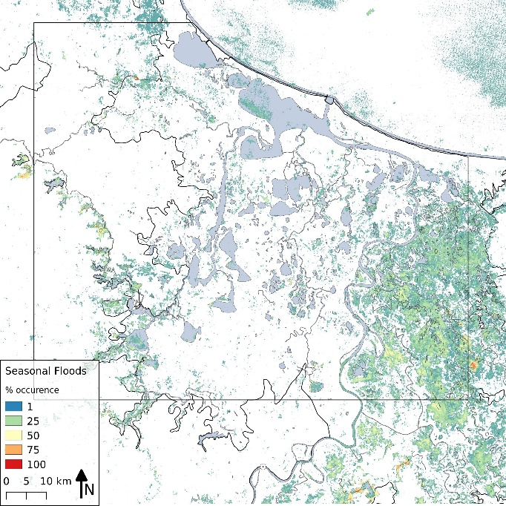
Results: Laguna Alvarado
MNDWI Sum
MNDWI Difference Sum
MNDWI Sum
Due to a lack of sufficient imagery , largely in the wet season due to cloud cover, we were only able to capture a few large events, resulting in a distinctly different image than for Marismas Nacionales
The hydrological variability of this system is also much greater with, much faster recession times for discharge
MNDWI Difference Sum
Due to the lack of wet season imager the seasonal variability derived from the MNDWI difference approach does not provide
Observation
The outcomes of this analysis are not as promising as the Marismas study, yet some variability metrics can be extracted and deserve further rinvestigation
0-10% | Only during extreme events
10-50% | Infrequent inundation
50%-75% | Frequent inundation
75-100% | Permanent inundation
0-10% | Only during extreme events
10-50% | Marginal inundation
50%-75% | Infrequent inundation
75-100% | Frequent episodic inundation

Slide 18
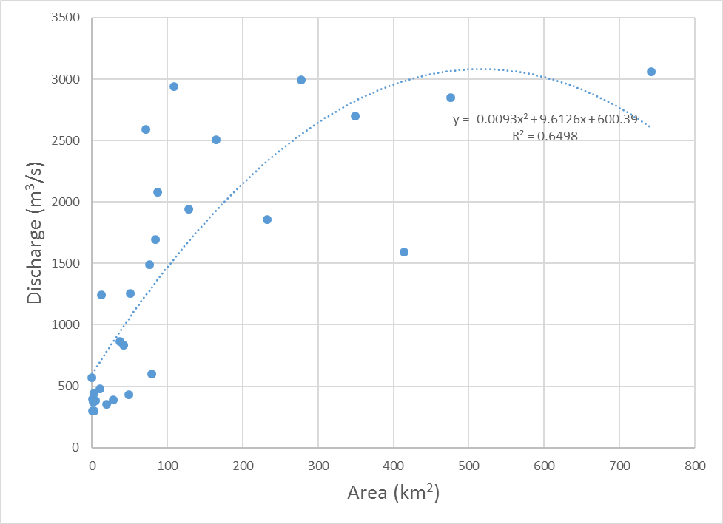
Results: Laguna Alvarado
The discharge/area comparison for Laguna Alvarado shows a similar potential for correlation between discharge and inundated area as was observed for Marismas Nacionales
However, the lack of imagery prevents us from coming to a similar conclusion
There seems to be some level of correlation between inundated are and discharge for lower discharges, but at a certain point (~3000 m^{3/}s) this correlation is lost
It is possible that this is due to an exceedance of a topographic threshold but the number of samples for this analysis is too small to come to a conclusion

Slide 19
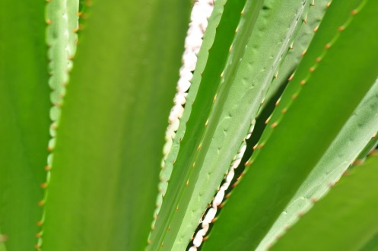
Conclusions
Using openly accessible data (Landsat) and open-source tools we developed a semi-automatic processing chain that produces ecologically relevant metrics for wetland hydroperiod and hydropattern
MNDWI works very well for the identification of permanent waterbodies
The MNDWI sum method can be very helpful for the ecohydrological classification of episodic water bodies
The MNDWI difference method provided additional insights in seasonal hydropatterns and hydroperiods that could not be discerned as readily as by using the MNDWI sum
For one study area an incredibly strong correlation between discharge and inundated area was found. It is likely that this correlation would be lost once a river system gets altered
In areas where optical imagery is poor due to cloud cover, SAR imagery might be useful
Footnote
The global surface water explorer was released after completion of this study
While some similarities exist since that product is based on MNDWI derived from Landsat imagery as well, we believe that our approach has various distinct advantages:
Full control over algorithms and data
Greater accuracy due to customization of thresholding
Ability to apply MNDWI difference method
© Bart Wickel

