Slide 1
Vertical distributions of suspended sediment concentration in the Turbidity Maximum Zone (TMZ) of the partially stratified Changjiang Estuary
Li Zhanhai
State Key Laboratory of Estuarine and Coastal Research (SKLEC), East China Normal University, Shanghai, China
2020-05-06

Slide 2
Outline 一、Significance and purpose 二、 Materials and methods 三、Results and discussion 四、Summary

Slide 3
一、Significance and purpose of the study
The vertical distribution of suspended sediment concentration (SSC) plays an important role in estuarine and coastal sediment transport. Many studies were carried out in the wave-dominated coastal environments and the field measurements were mainly focused on the near bottom water layer.
The Changjiang Estuary is a famous estuary with strong current velocity, high SSC, remarkable saline water intrusion and notable density stratification.
The purpose of the study is to (1) investigate the major types and temporal variation patterns of SSC profiles in the partially stratified estuary; (2) analyze the formation mechanisms of different types of SSC profiles; (3) predict the observed linear, exponential and two-layer structure SSC profiles.

Slide 4
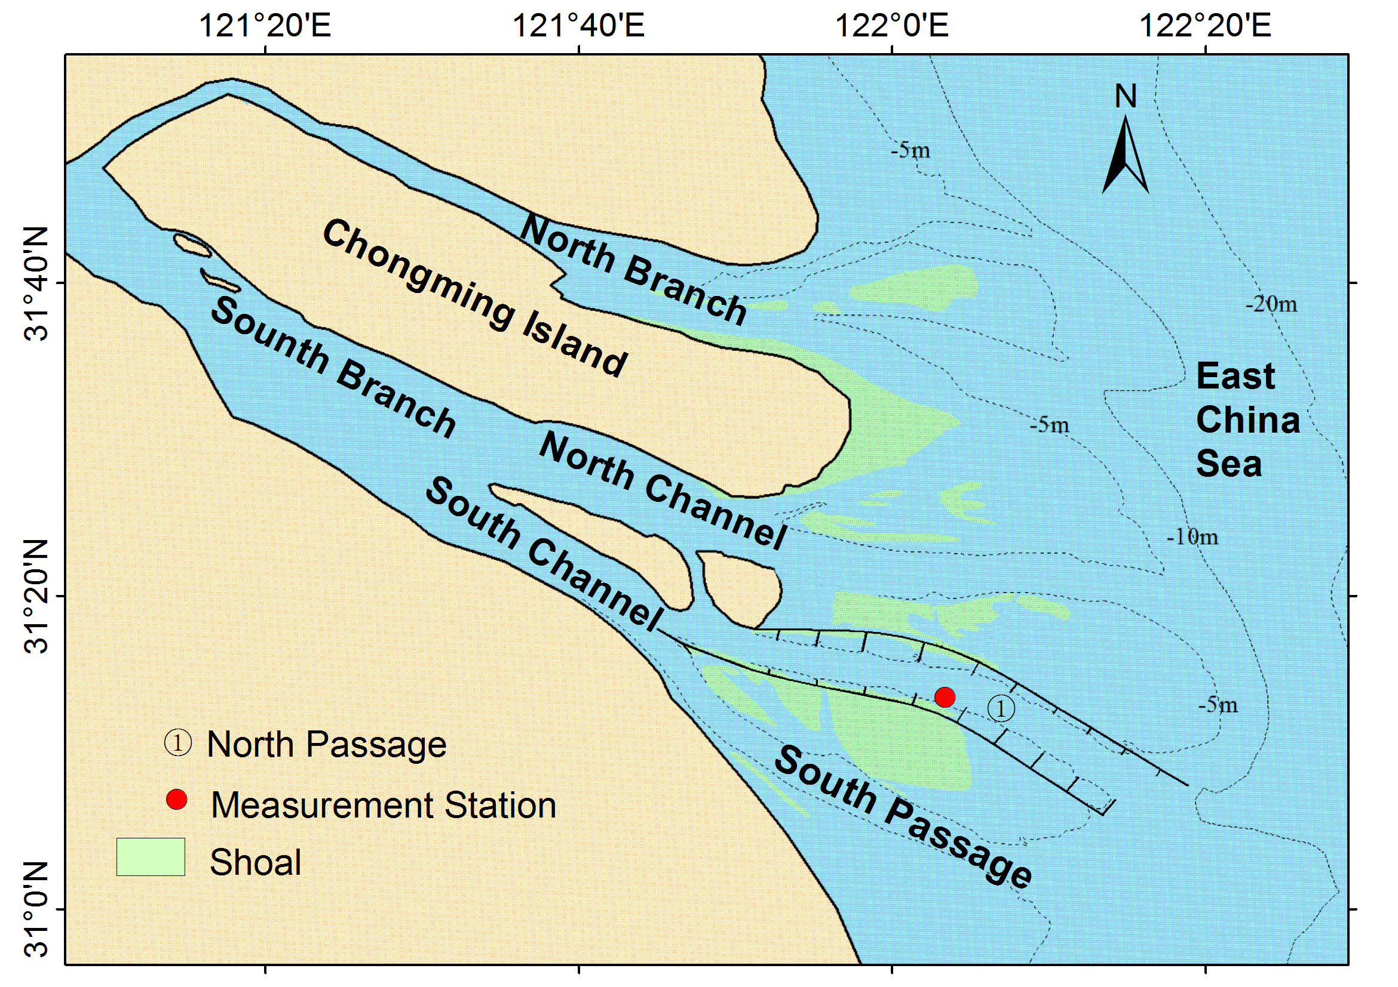
二、 Materials and methods
(1) Measurement station is located in the TMZ of the North Passage, with the mean water depth about 11m;
(2) Observation lasted 16 tidal cycles from neap to spring tide in April 2012；
(3) Current velocities were measured by ADCP 600 kHz；
(4) Vertical profiles of SSC, salinity and water temperature were measured by OBS at the beginning of each hours, and 204 SSC profiles were obtained over the survey period;

Slide 5
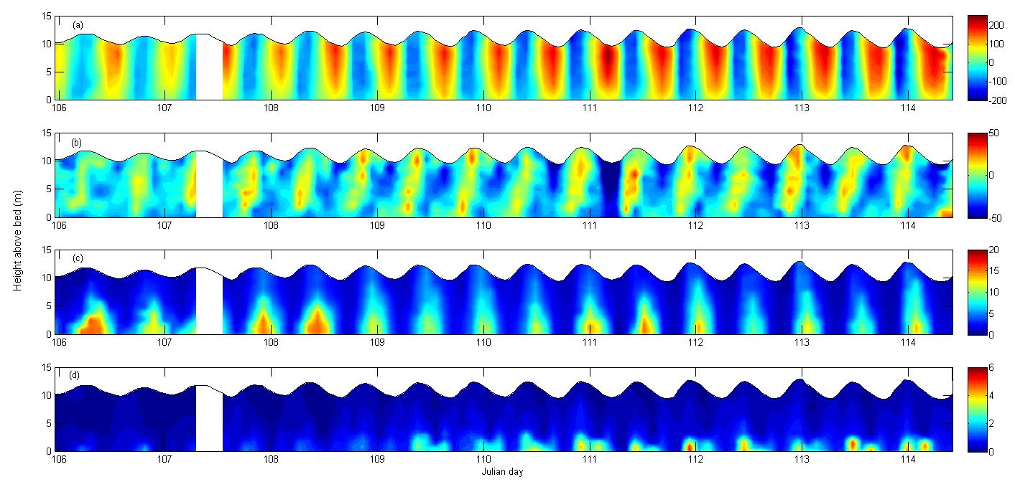
3.1 current velocity
along-channel currents
lateral currents
Neap tide spring tide
（1）Strong current velocity
The maximum value: 260 cm/s, the tidally averaged value: 51-112 cm/s over the neap-spring cycle； （2）Remarkable flood-ebb asymmetry：
The magnitude and duration of ebb currents were remarkably larger than that of the flood currents； （3）Strong lateral currents:
Ranged from -47~24 cm/s and directed toward the south flank during 87% of the survey period.
Notes:
g/l

Slide 6
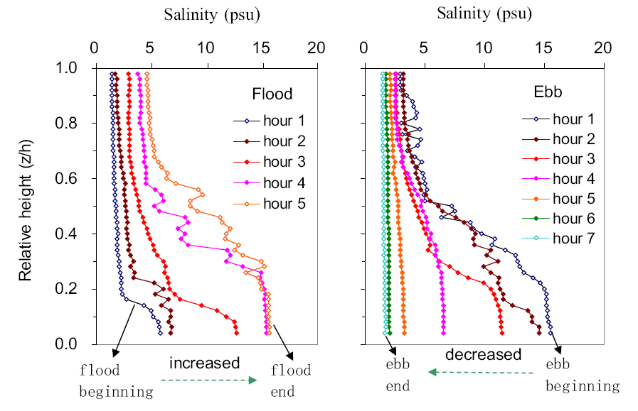
1) Conspicuous saltwater intrusion and retreat processes, with maximum salinity of 16 psu. 2) Both salinity and its vertical gradient displayed remarkable flood-ebb variation patterns. 3) Affected by lateral currents, salinity-induced density stratification increased in flood phase and decreased in ebb phase. Such intratidal variation pattern is contrary to the Strain-Induced Periodic Stratification (SIPS) which tends to decrease in flood and increase in ebb (Simpson et al., 1990).
3.2 Salinity variation pattern
Example of salinity variation pattern during flood and ebb phases.

Slide 7
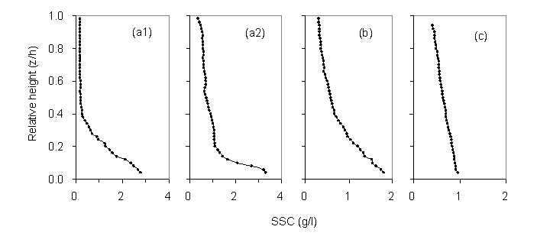
Over the neap-spring cycle: 1) Two-layer structure profile accounted for 60% of the total observed profiles. 2) Approximately 20% of the observed profiles were exponential profiles. 3) The occurrence of linear profile was 20% during the survey period.
3.3 The main types of observed SSC profiles

Slide 8
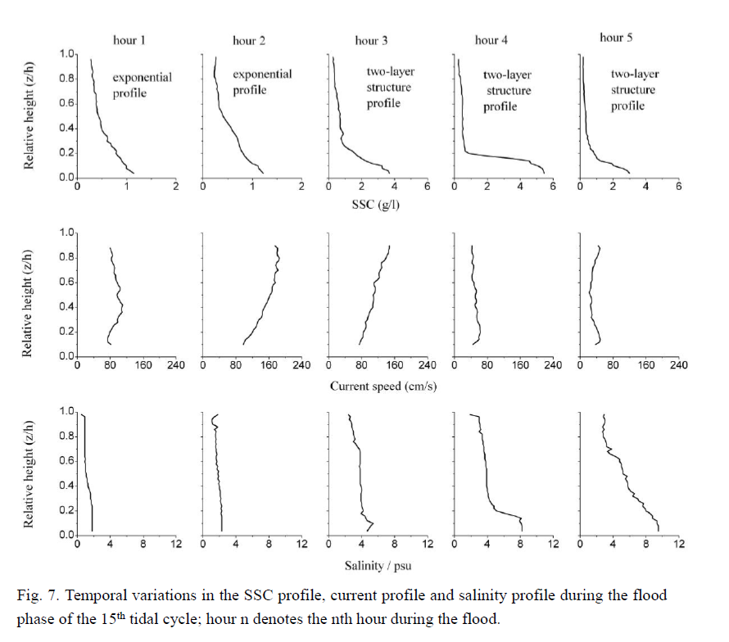
Affected by lateral currents, the two-layer structure SSC profiles usually occurred during the latter half of flood.
3.3.1 Variation patterns of SSC profiles during flood phase of spring and intermediate tides
Beginning of flood end of flood

Slide 9
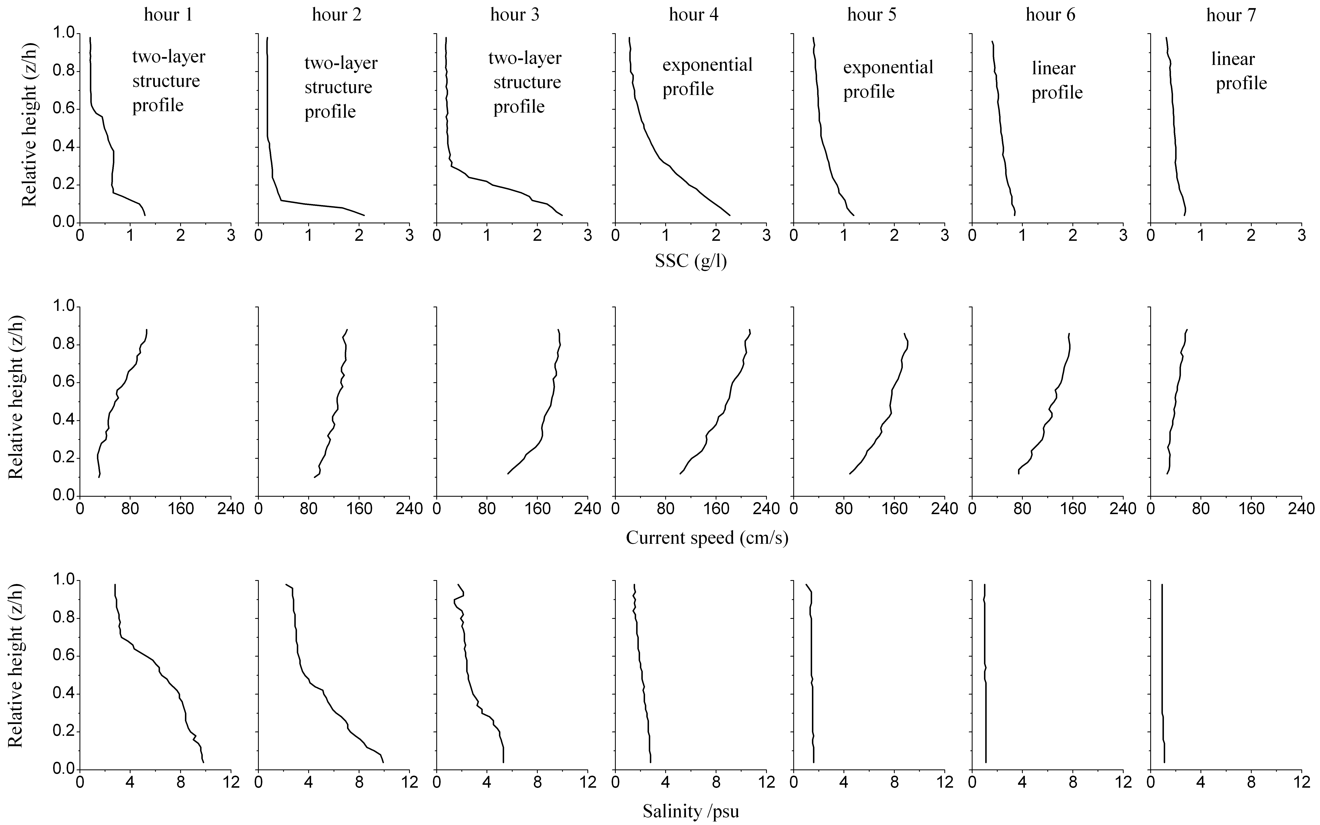
During ebb phases： 1) two-layer structure profiles generally occurred in the first 3 hours； 2) exponential profiles generally occurred during peak current period； 3) linear profiles generally occurred in the late ebb.
3.3.2 Variation patterns of SSC profiles during ebb phase of spring and intermediate tides
Beginning of ebb end of ebb

Slide 10
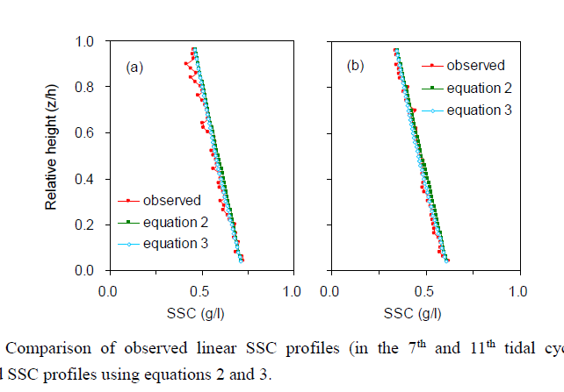
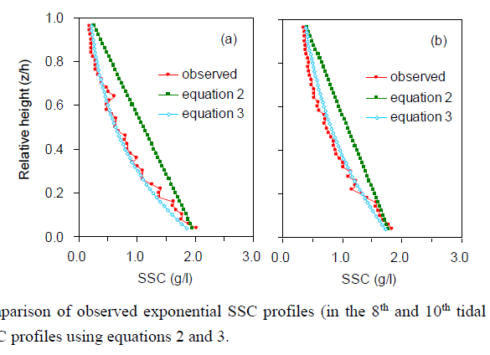
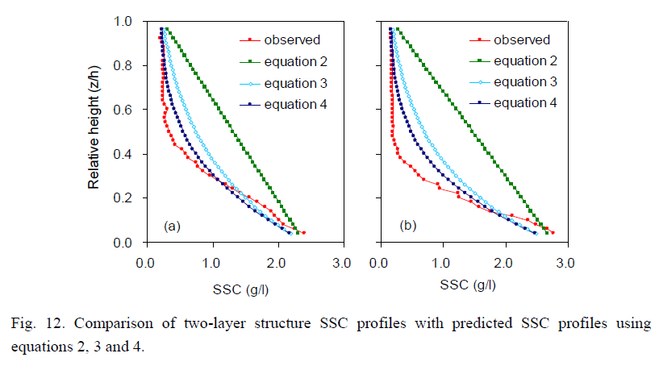
Observed linear profiles fit the Soulsby’s equation very well.
3.4 New empirical equations for the observed linear, exponential and two-layer structure SSC profiles
Modified equation
Modified equation
(Soulsby, 2000)
(Eq. 2)
(Eq. 3)
(Eq. 4)
Observed exponential and linear profiles fit the modified equation very well.
Observed two-layer structure profile fit the modified equation reasonably.

Slide 11
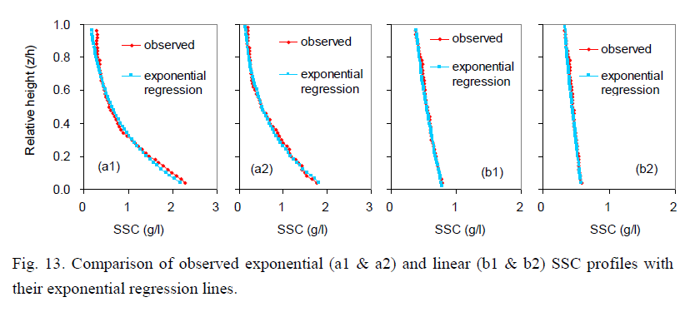
3.5 Sediment diffusivity coefficient for the exponential and linear SSC profiles
The diffusivity coefficients of linear and exponential profiles are constant in the whole water column.
The observed data of linear and exponential SSC profiles;
So, essentially, both the linear and exponential profiles fit the same equation.

Slide 12
Summary: 1) The observed vertical profiles of SSC can be categorized into three typical types, (I) the two-layer structure profile, (II) exponential profile, and (III) linear profile. Type I mainly occurred in the conditions with high stratification, while type II and III mainly occurred in the weak stratification and well-mixed conditions. 2) Two new empirical equations are developed, which can accurately describe the observed linear and exponential SSC profiles, and reasonable or accurately describe the observed two-layer structure profiles. 3) Both the linear and exponential SSC profiles have constant diffusivity coefficients within the water column, and they can be expressed by a unified equation. 4) Lateral currents played an important role in the formation of two-layer structure SSC profile and strong density stratification, and the mass exchange between the main channel and the shoal in the estuaries.

Slide 13
Thanks for your attention！

