Slide 1
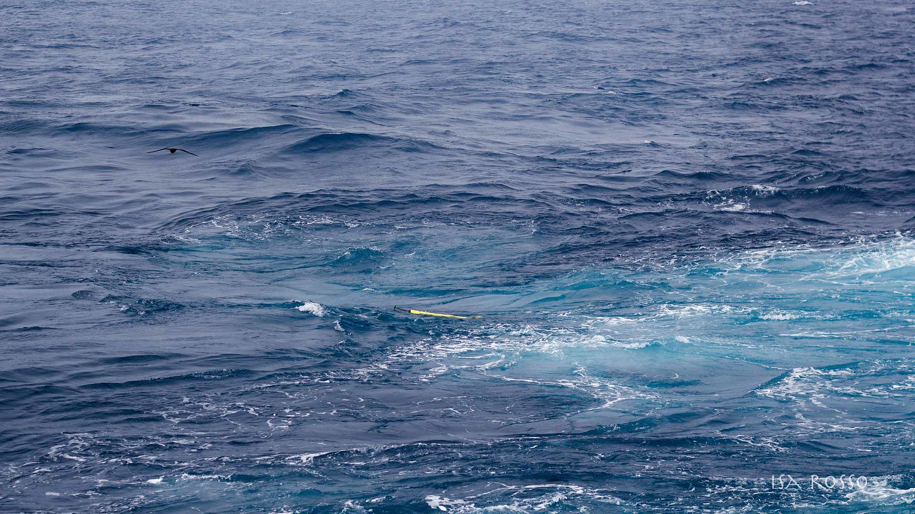


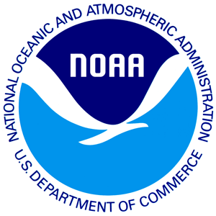


A global Biogeochemical Argo pilot array: Southern Ocean Carbon and Climate Observations and Modeling (SOCCOM) profiling floats and results
EGU2020-13069
OS1.6/CL2.15 ‘Improved Understanding of Ocean Variability and Climate’
Lynne Talley, Kenneth Johnson, Stephen Riser, Jorge Sarmiento, Joellen Russell, Emmanuel Boss, Matthew Mazloff, and Susan Wijffels
EGU General Assembly 2020
Virtual meeting: Chat Session 8 May 2020

Slide 2
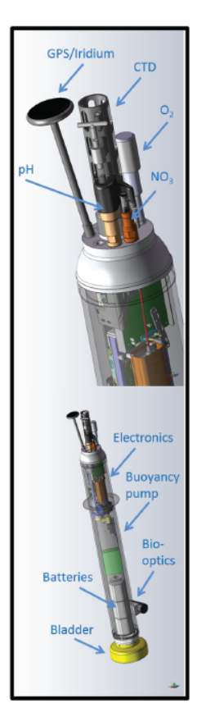

Why BGC Argo? https://biogeochemical-argo.org/
Claustre, Johnson and Takeshita (Ann. Rev. Mar. Sci., 12, 2020)
The ocean provides critical services to life on the planet, absorbing 93% of the heat from anthropogenic warming and a quarter of human carbon dioxide (CO2) emissions each year.
However, rising ocean temperatures and CO₂ levels also change the marine environment:
pH and oxygen levels fall
ocean currents change
nutrient fluxes and concentrations are shifting
Large effects on ecosystems and the cycles of oxygen, nitrogen, and carbon throughout the ocean and atmosphere.
Observing these biogeochemical (BGC) processes across remote ocean areas with
seasonal to interannual resolution
has been impractical due to the prohibitive costs associated with ship observations.
Notes:
Argo data basis for many strong conclusions:
Since 1993 the rate of ocean warming and thus heat uptake has more than doubled (likely)from 3.22 ± 1.61 ZJ yr–1 (0–
700 m depth) and 0.97 ± 0.64 ZJ yr–1 (700–2000 m) between 1969 and 1993, to 6.28 ± 0.48 ZJ yr–1 (0–700 m) and
3.86 ± 2.09 ZJ yr–1 (700–2000 m) between 1993 and 201717, and is attributed to anthropogenic forcing (very likely).

Slide 3
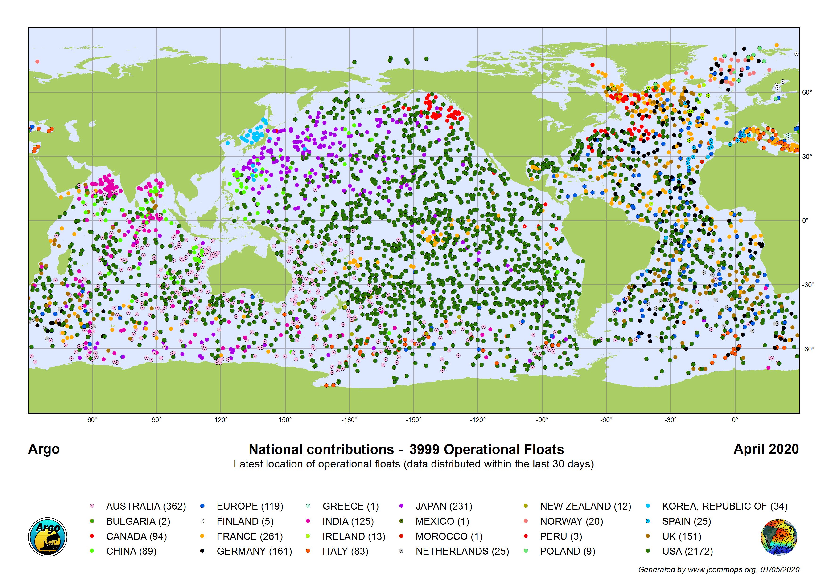
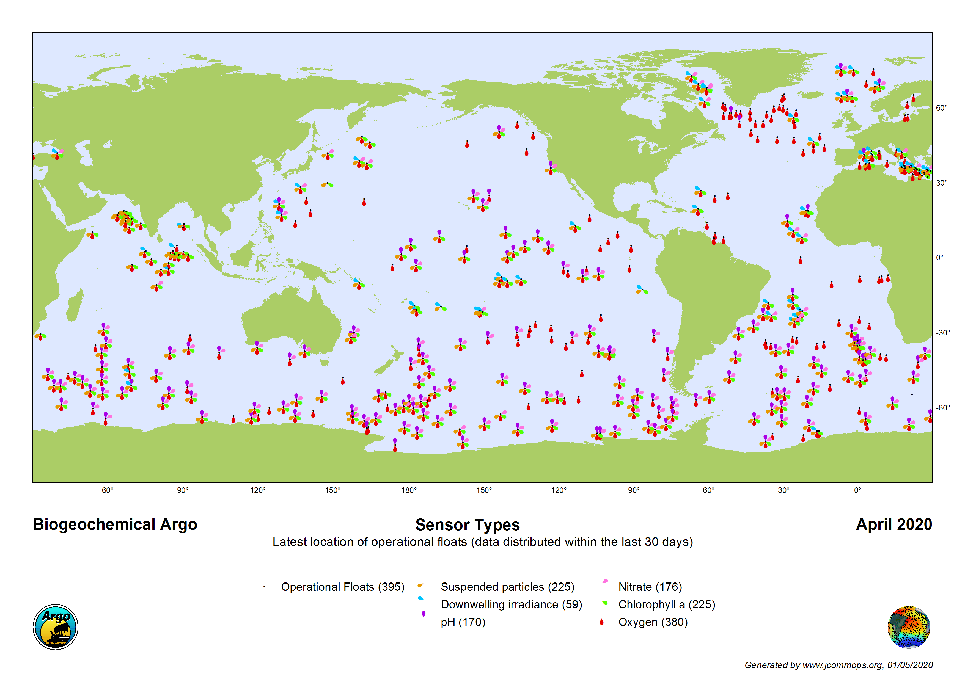
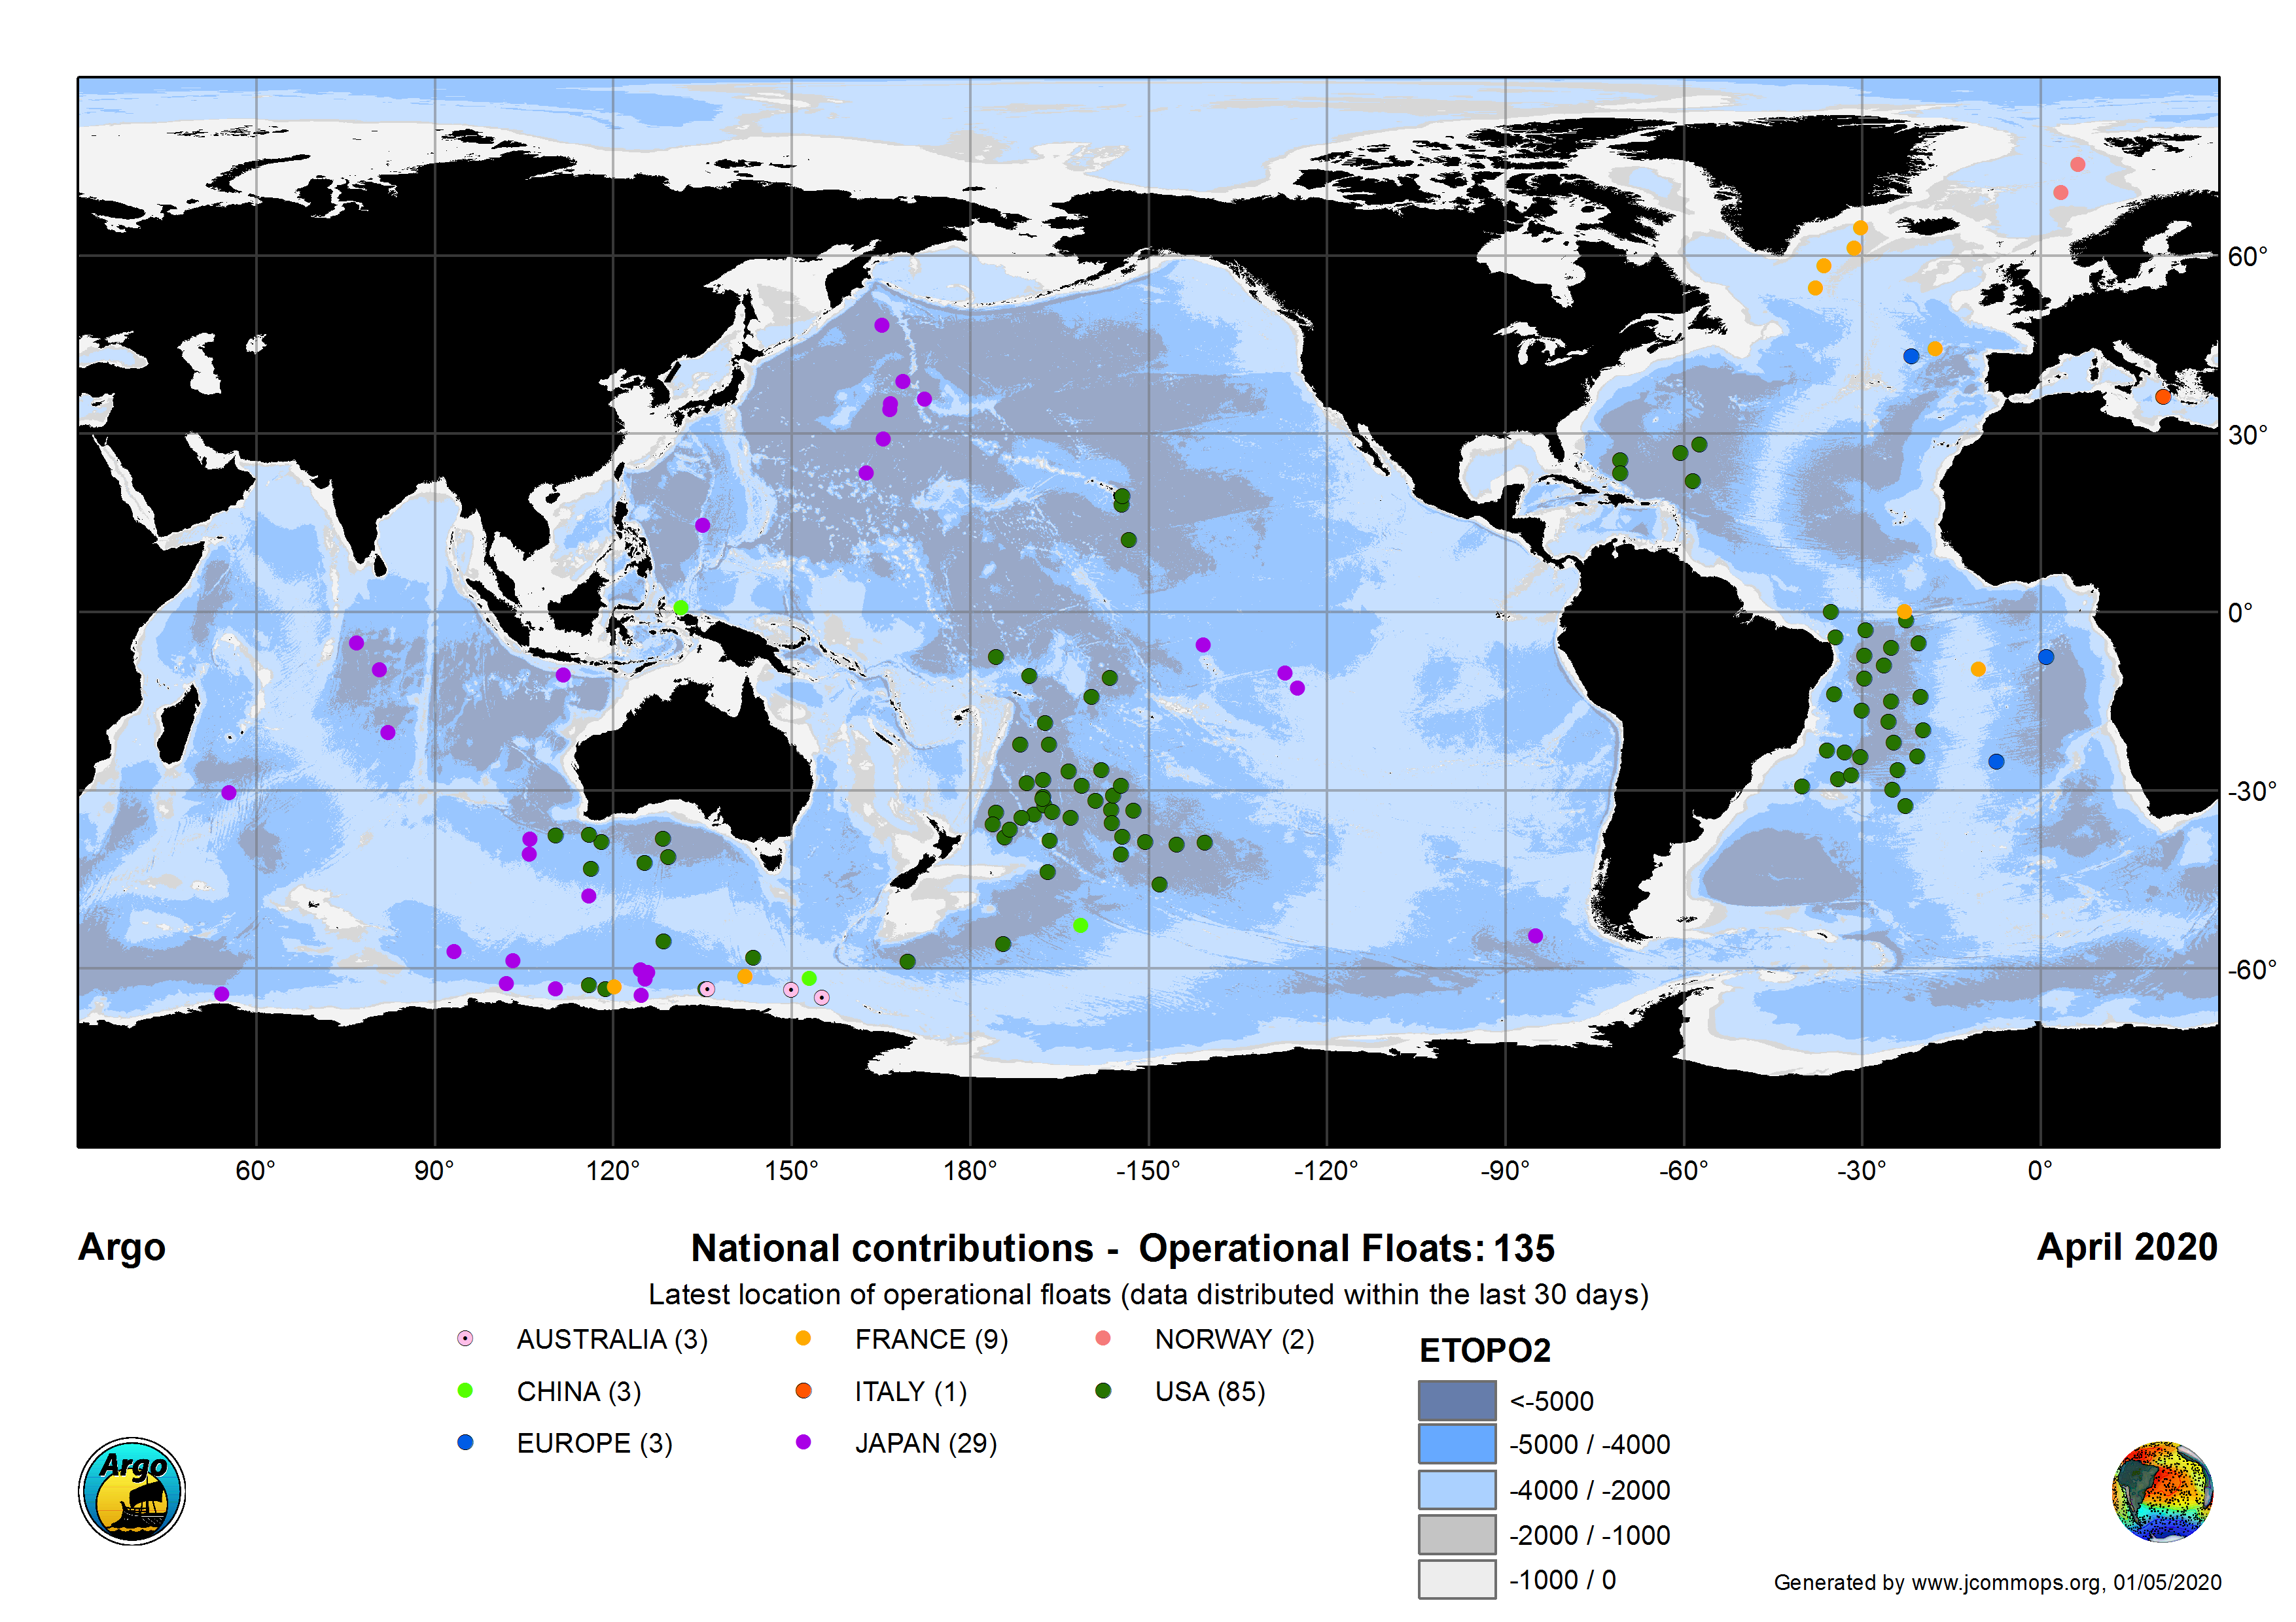
One Argo: Core, BGC and Deep
Core Argo has observed ocean temperature and salinity since 2001
“..one of the scientific triumphs of the age” (NYT, 8/11/2014).
3800+ floats operating, > 3800 publications
Biogeochemical Argo
Measuring temperature, salinity, oxygen, pH, nitrate, chlorophyll, particles, and irradiance from 2000 m to the surface every 10 days
Deep Argo
Roemmich et al. (OceanObs19, Frontiers (2019))
Notes:
Argo data basis for many strong conclusions:
Since 1993 the rate of ocean warming and thus heat uptake has more than doubled (likely)from 3.22 ± 1.61 ZJ yr–1 (0–
700 m depth) and 0.97 ± 0.64 ZJ yr–1 (700–2000 m) between 1969 and 1993, to 6.28 ± 0.48 ZJ yr–1 (0–700 m) and
3.86 ± 2.09 ZJ yr–1 (700–2000 m) between 1993 and 201717, and is attributed to anthropogenic forcing (very likely).

Slide 4
What is a BGC-Argo float ?
BGC-Argo Science and Implementation Plan targets
  1000 floats
  O₂, NO₃, pH, Fluorescence, Backscatter, downwelling irradiance
Few BGC floats now carry the complete sensor set.
SOCCOM (Southern Ocean Carbon and Climate Observations and Modeling) deployments are the largest set with most (5 out of 6) sensors
Many programs deploying O₂ only floats (Euro-Argo is targeting 50% with O₂).
Discuss within Argo (e.g. with Deep mission) the objective of having an O₂-only mission.
Work with JCOMMOPS to develop the appropriate monitoring tools and display with respect to objective / target for the network.

Slide 5
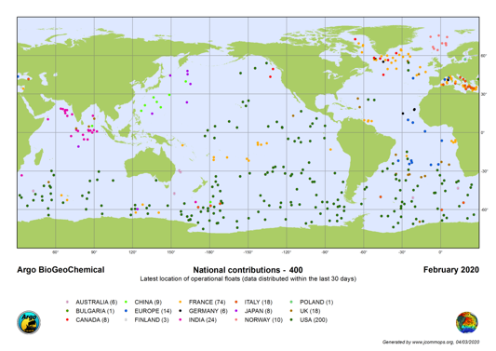
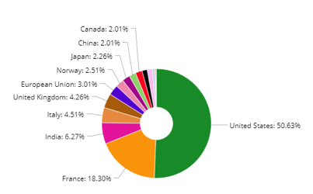
15 nations with operating BGC floats, more coming.
Notes:
International diversity. 400 operational floats with at least one BGC sensor

Slide 6
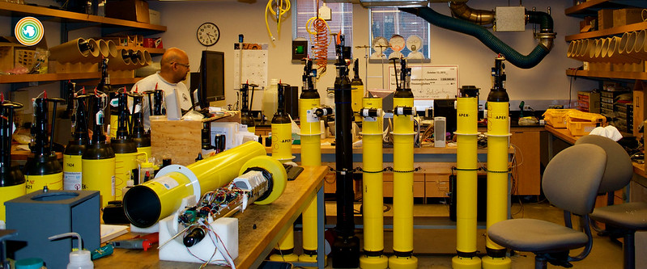
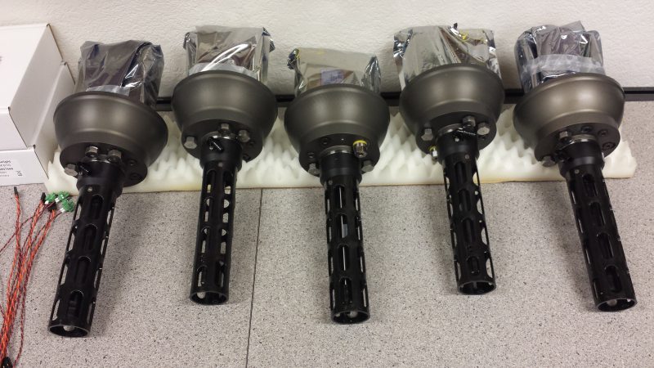
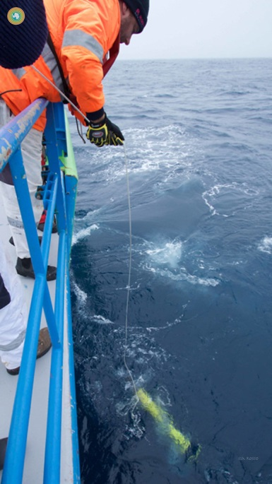
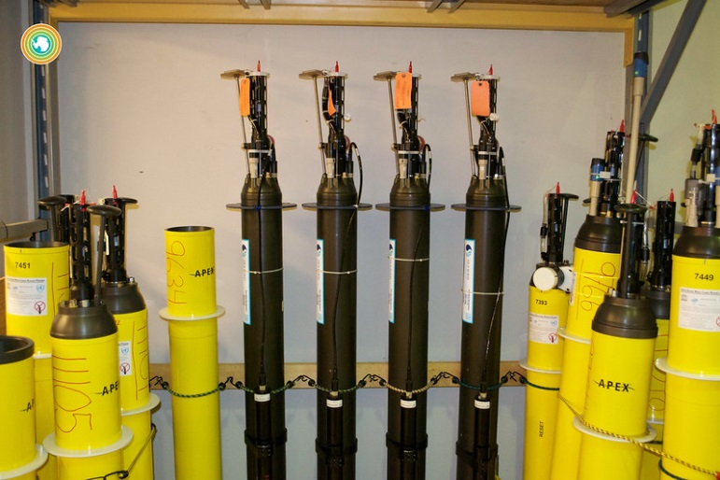
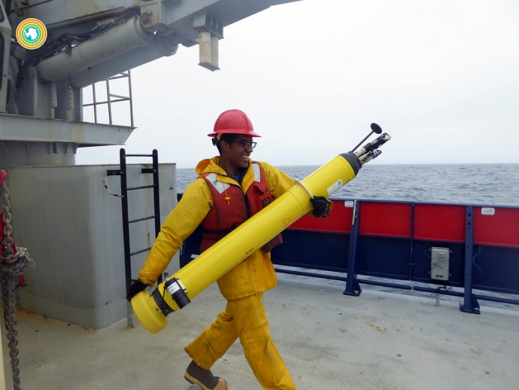
Readiness for global BGC Argo:
The SOCCOM, Core-Argo, and growing national programs enable implementation of a global BGC-Argo float array immediately.

Slide 7
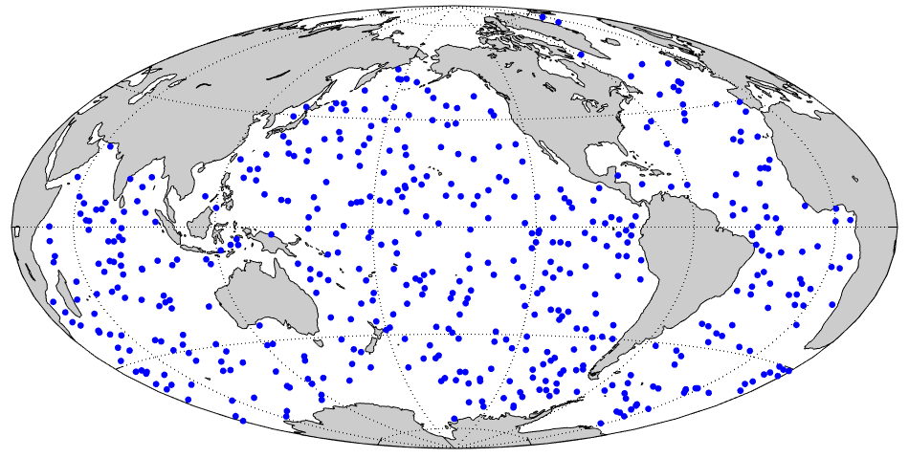

Expansion to global coverage
SOCCOM program demonstrates that the U.S. is ready for global deployment of 500 BGC profiling floats
  Measuring temperature, salinity, oxygen, pH, nitrate, chlorophyll, particles, and irradiance from 2000 m to the surface every 10 days
Open source data, available in near real-time
  Established international data centers and protocols

Slide 8
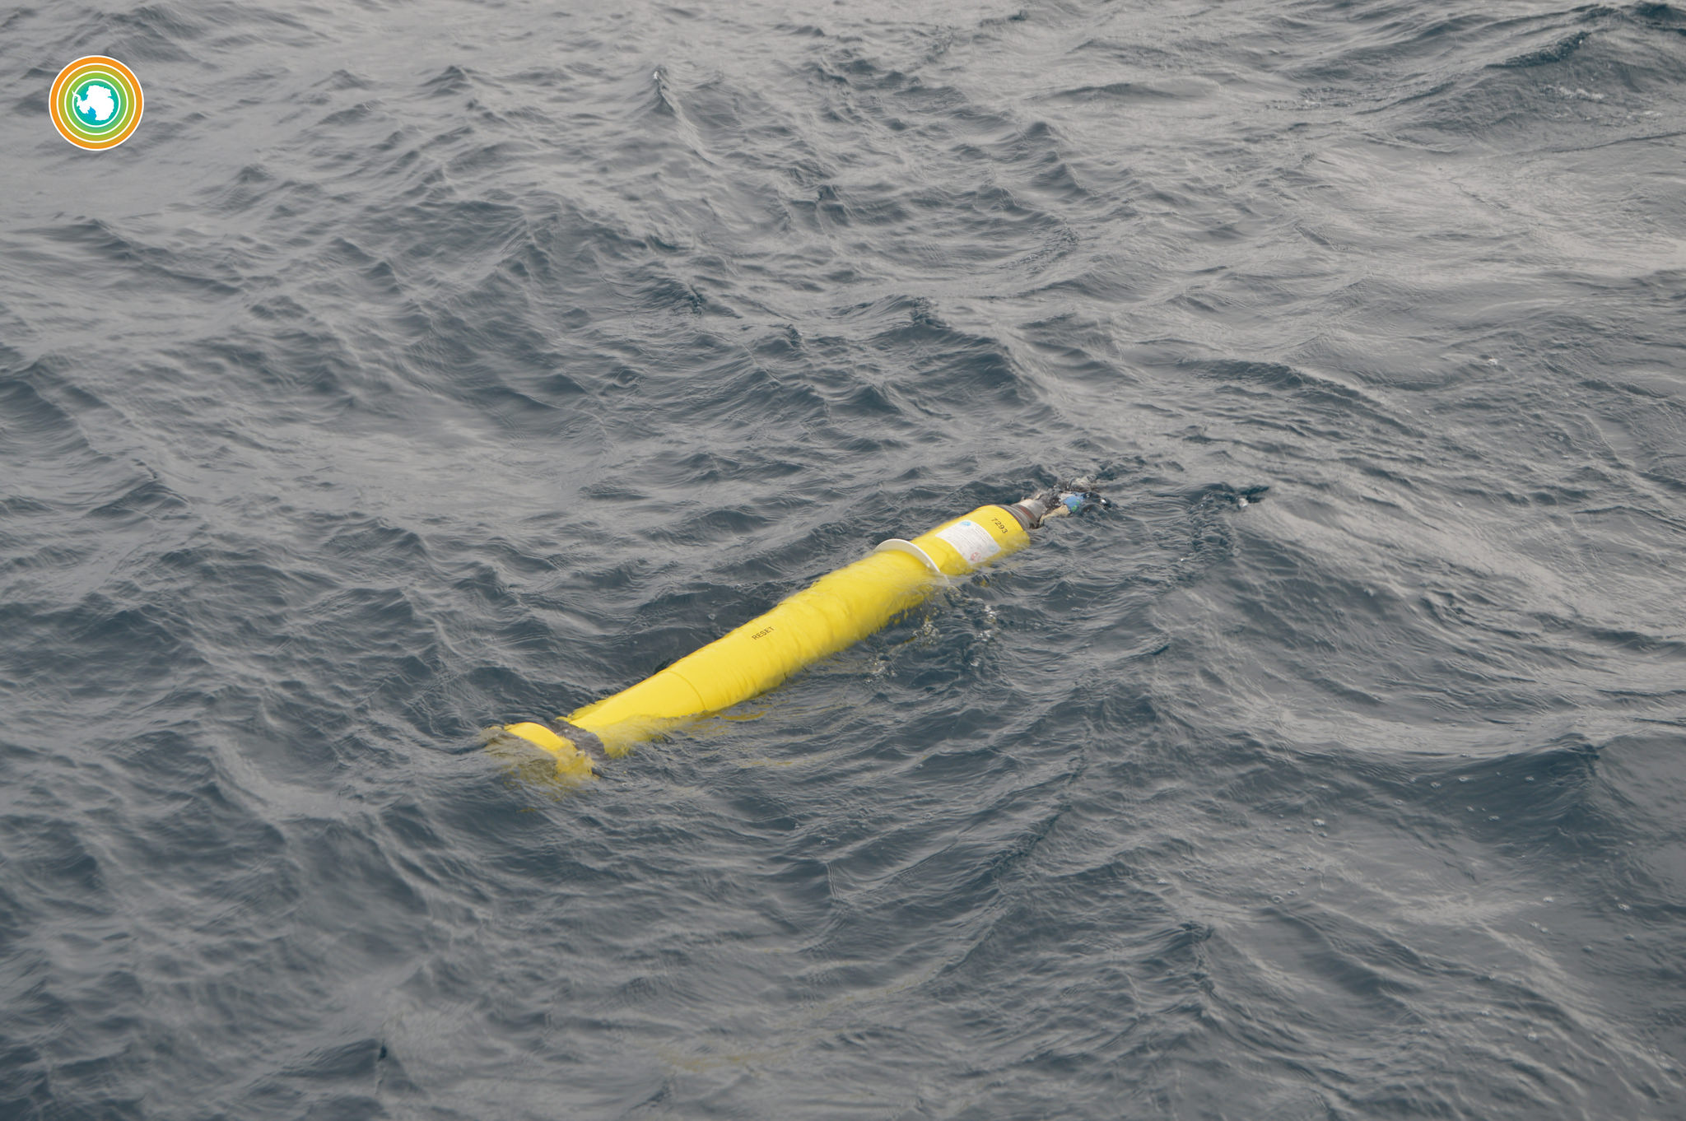

Slide 9
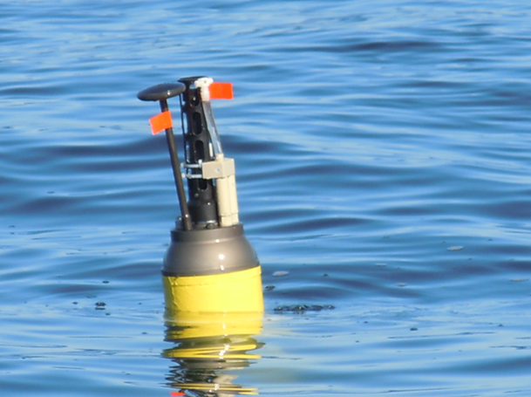
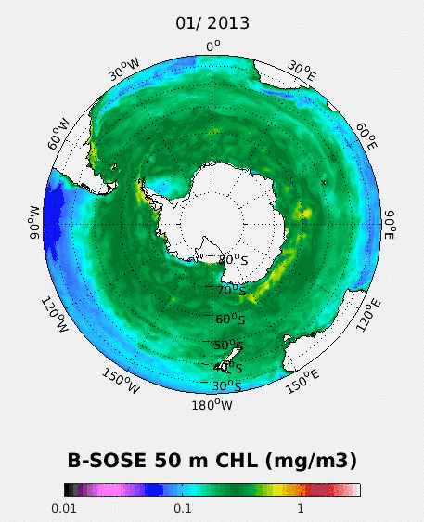
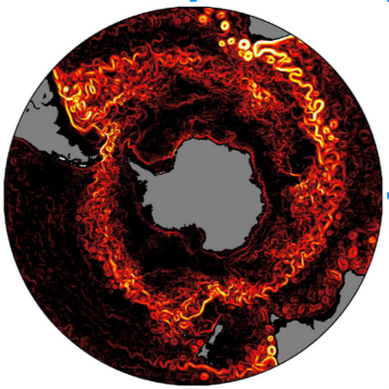
SOCCOM Strategy
200 profiling floats over 6 (now 10) years with pH, NO₃⁻, O₂, & biooptical sensors. Sea-ice enabled. Calibration methods established, derived carbon and chlorophyll parameters, data public through Argo and on SOCCOM website.
http://soccom.princeton.edu
BGC Southern Ocean State Estimate (B-SOSE) for 4D fields & fluxes, constrained by observations
Improve Earth System (GFDL) model simulations of future Southern Ocean health and role in carbon and climate.
SOMIP (Southern Ocean Model Intercomparison Project)
Model metrics; CMIP5, CMIP6 analyses
A. Morrison: GFDL CM2.6 current velocities
Notes:
From Sarmiento 2017 GFDL symposium slides

Slide 10
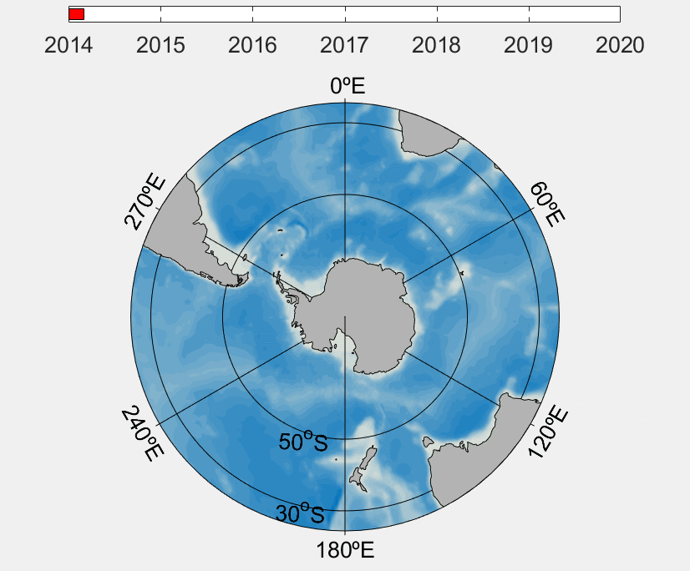
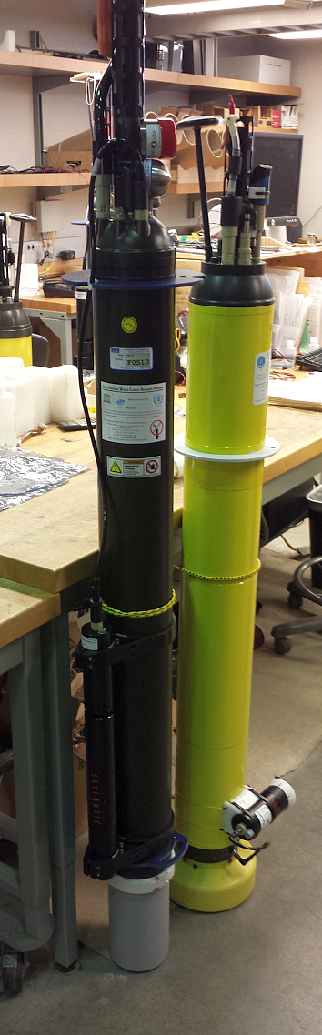
SOCCOM 2014-2020: floats and data sets http://soccom.princeton.edu
Total number of floats deployed, years 1-6: 190
31 research ship cruises utilized
Total number active: 159
Total number active expected at end of year 7: ~180
Interactive map on SOCCOM website
(Observations->Map Room)
Data on SOCCOM website with derived parameters, and Argo
(Observations -> Data access)
http://soccom.princeton.edu

Slide 11
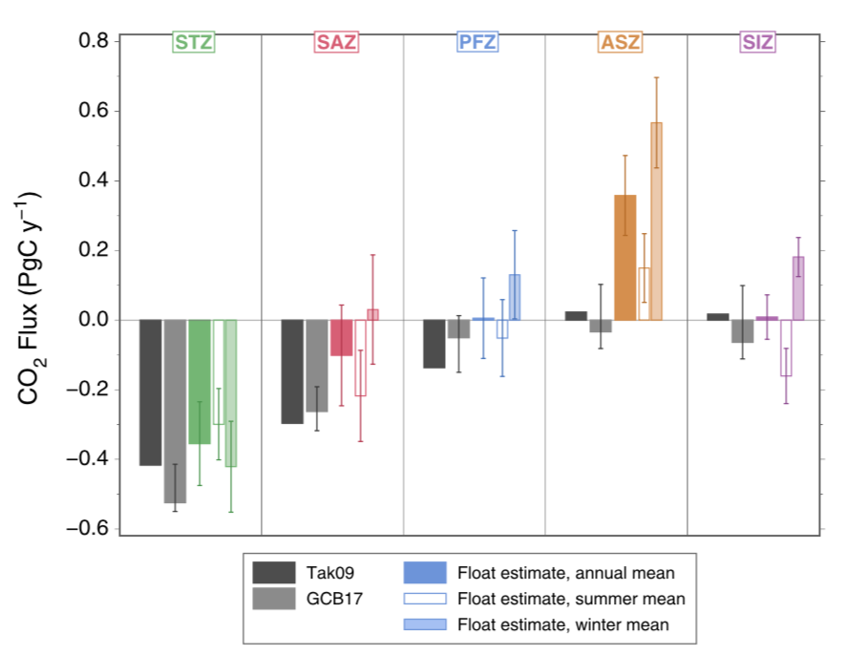
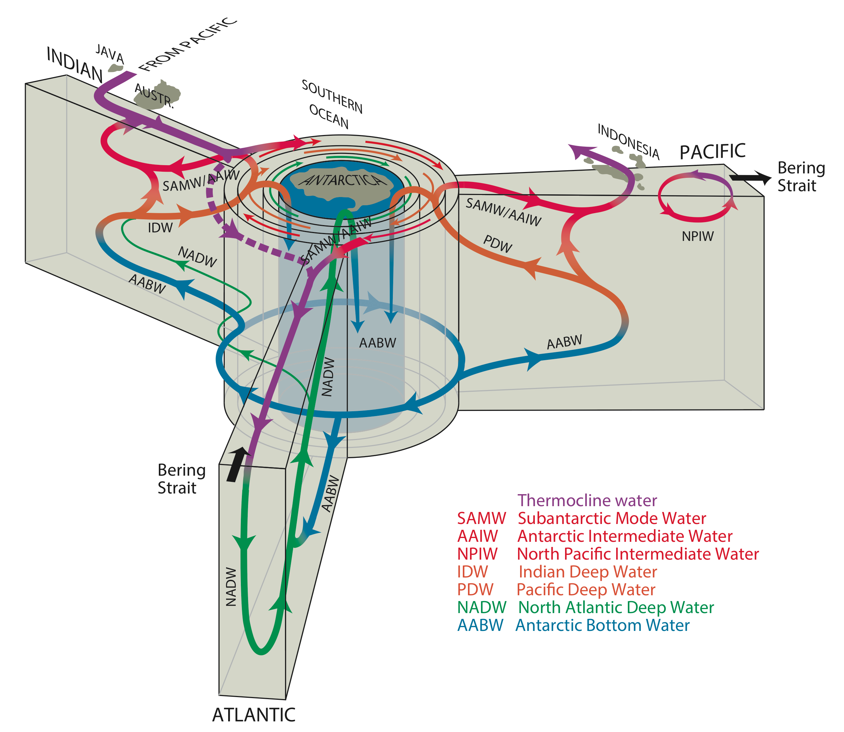
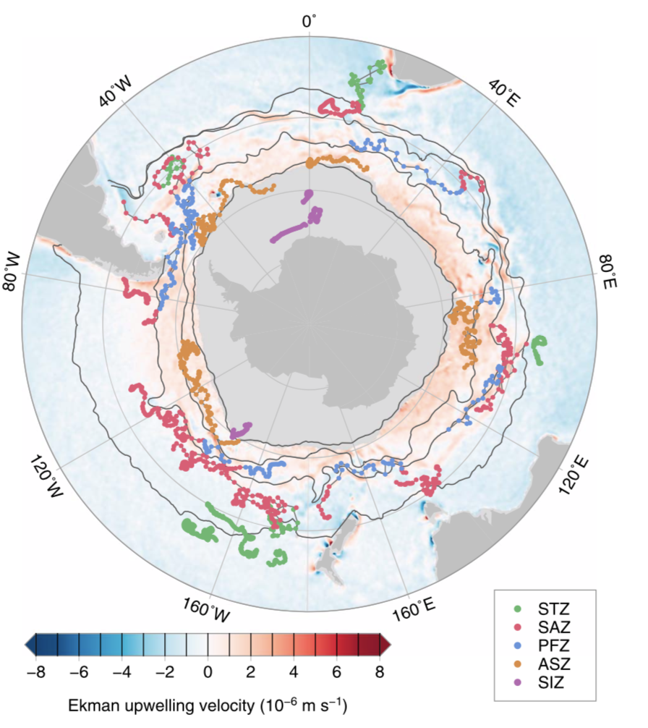
Overturning circulation and carbon from SOCCOM BGC-Argo floats
Global Overturning Circulation
Global Overturning Circulation
Gray et al. (GRL, 2018)
Unexpected large carbon outgassing in southern ACC.
Winter signal missed previously due to lack of winter observations.

Slide 12
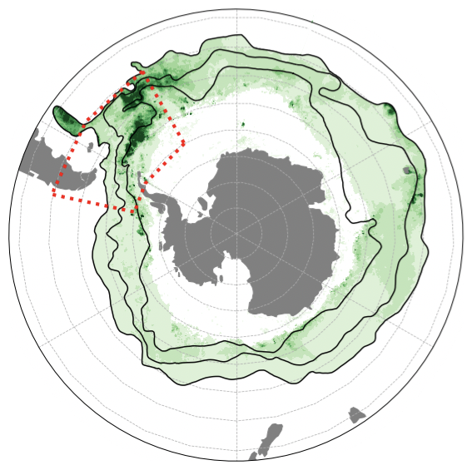
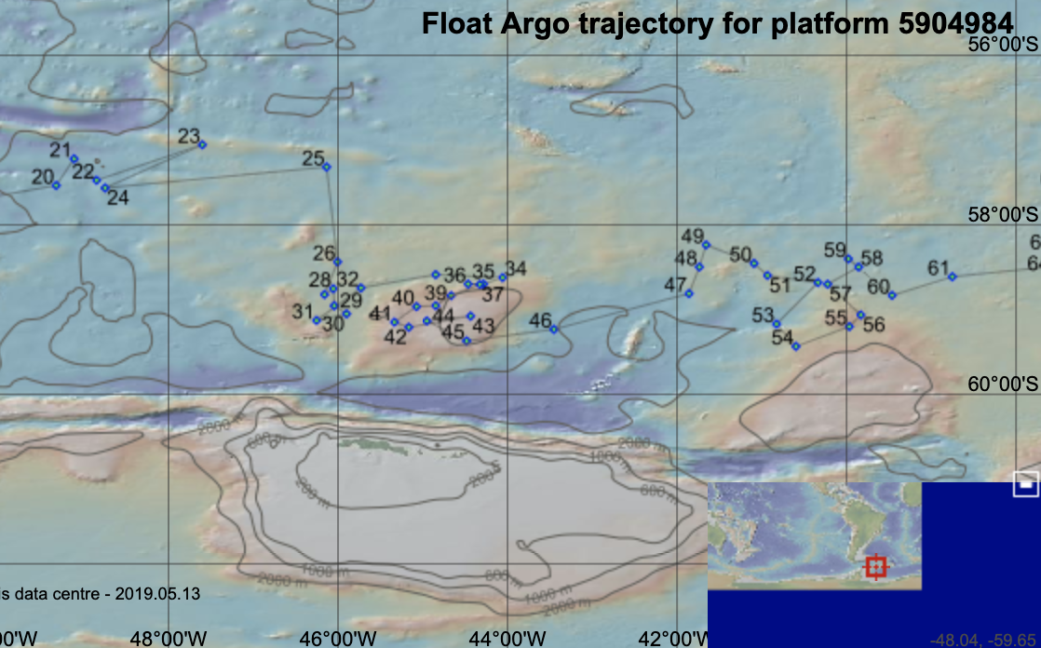
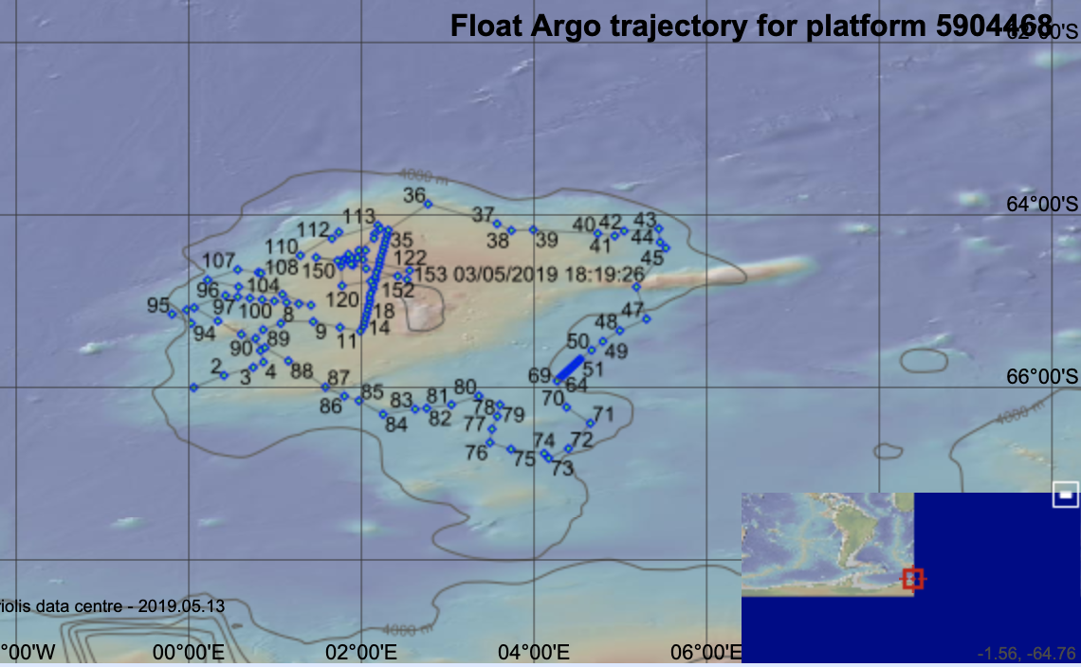
Topographic effects on circulation and vertical mixing: Taylor columns
Scotia Sea early onset bloom
(Oct. chlorophyll composite)
Maud Rise polynya 2016-2017
(sea ice image )

Slide 13
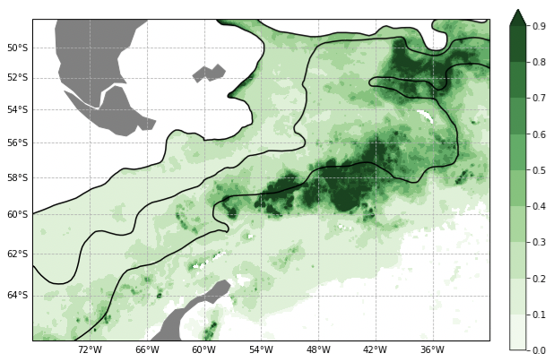
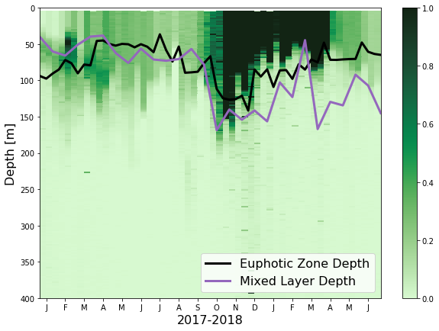

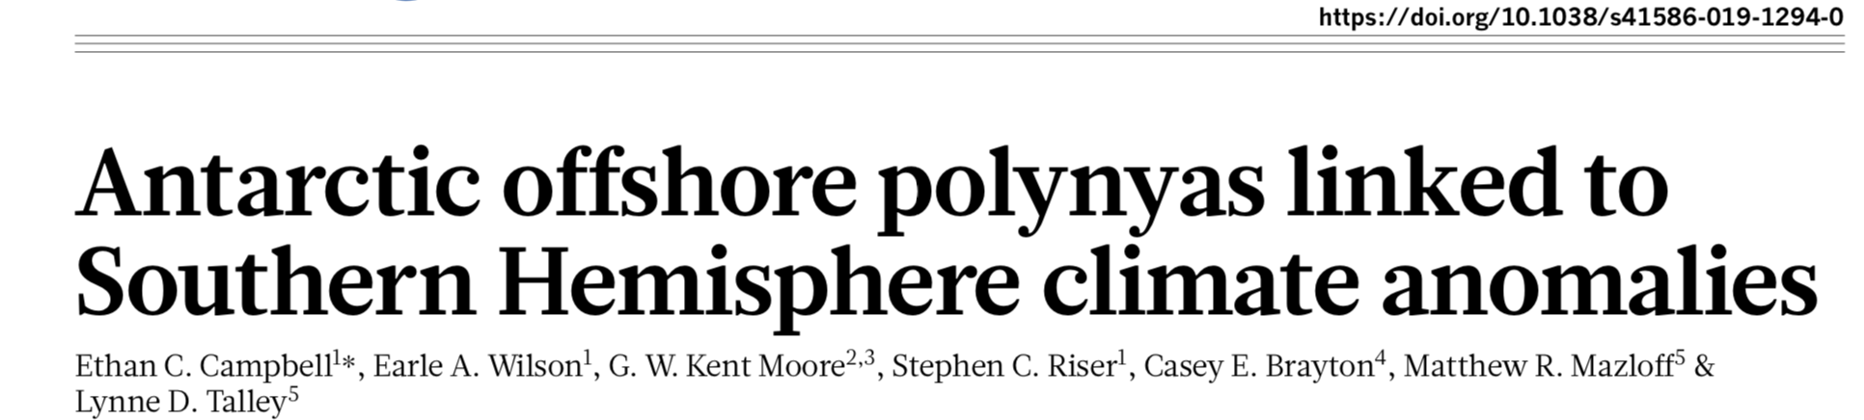
Topographic effects on circulation and vertical mixing: Taylor columns
Prend et al. (JGR 2019)
Campbell et al. (Nature 2019)
2017
2018

Slide 14
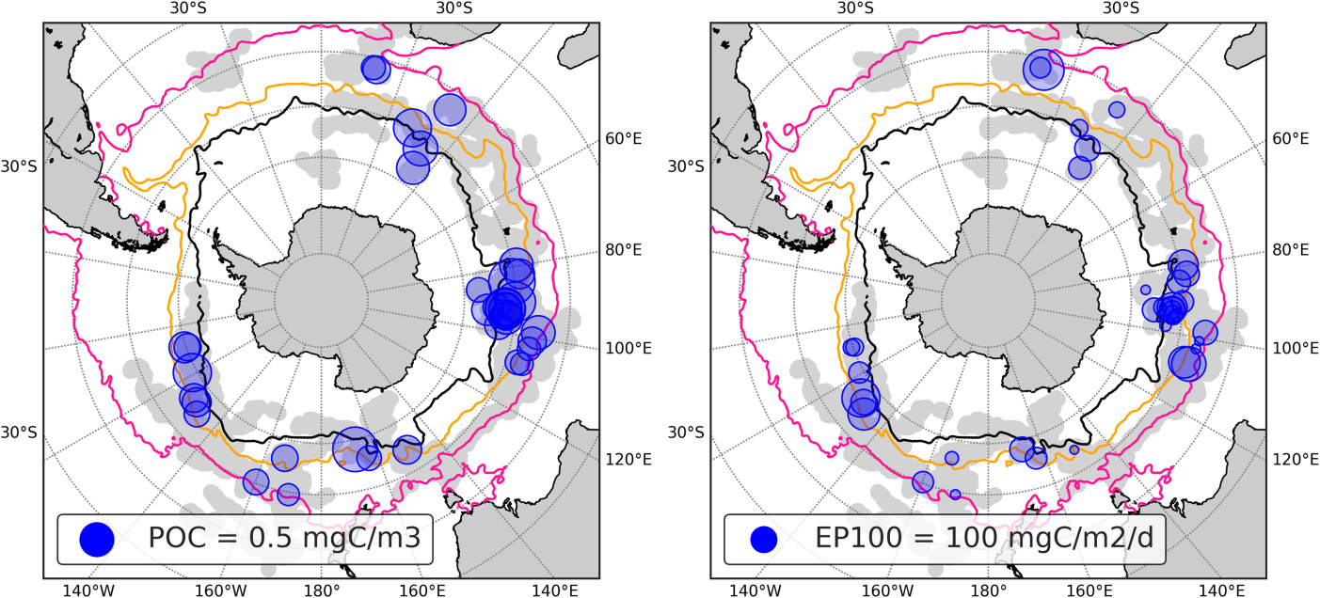
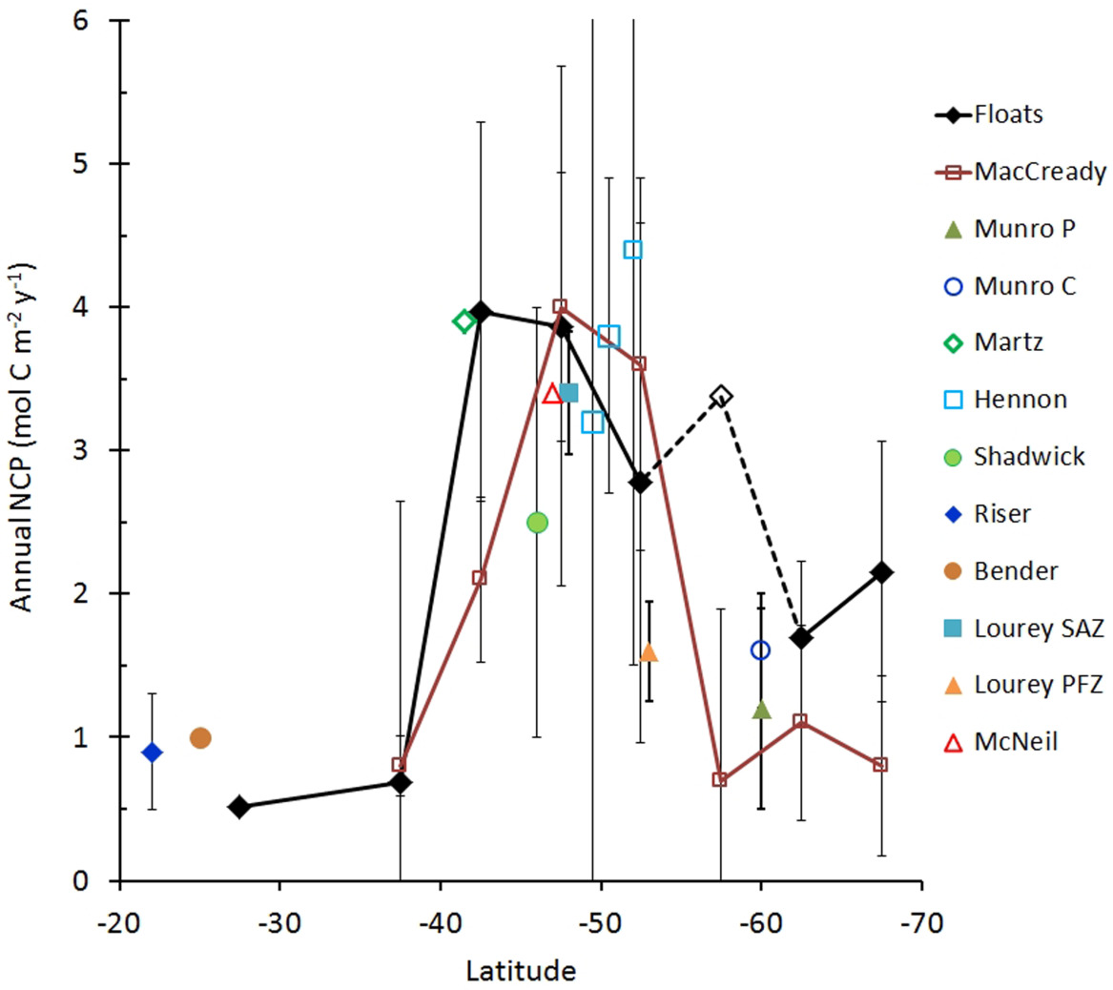

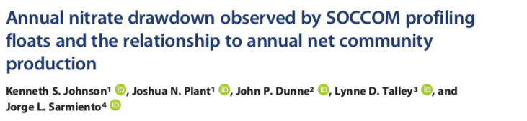
Biological cycles: Export & Annual Net Community Production
Lort et al. (JGR 2018)
Johnson et al. (JGR 2017)
Identifying events that indicate sporadic export; relationship to topographic features
(Note: non-SOCCOM authors using SOCCOM data which are public)
Annual Net Community Production as a function of latitude from SOCCOM BGC Argo floats
Notes:
Map of the Southern Ocean showing geographical positions of subduction events. (a) Blue circles areas respresent the mean concentration of POC measured at each subudcted feature. (b) Blue circles areas represent the EP100 associated to the subduction events. Pink, red, and black solid lines represent the climatological position of the STF, SAF, and PF, respectively, based on Venables et al., ().
IF THIS IMAGE HAS BEEN PROVIDED BY OR IS OWNED BY A THIRD PARTY, AS INDICATED IN THE CAPTION LINE, THEN FURTHER PERMISSION MAY BE NEEDED BEFORE ANY FURTHER USE. PLEASE CONTACT WILEY'S PERMISSIONS DEPARTMENT ON PERMISSIONS@WILEY.COM OR USE THE RIGHTSLINK SERVICE BY CLICKING ON THE 'REQUEST PERMISSIONS' LINK ACCOMPANYING THIS ARTICLE. WILEY OR AUTHOR OWNED IMAGES MAY BE USED FOR NON-COMMERCIAL PURPOSES, SUBJECT TO PROPER CITATION OF THE ARTICLE, AUTHOR, AND PUBLISHER.

Slide 15
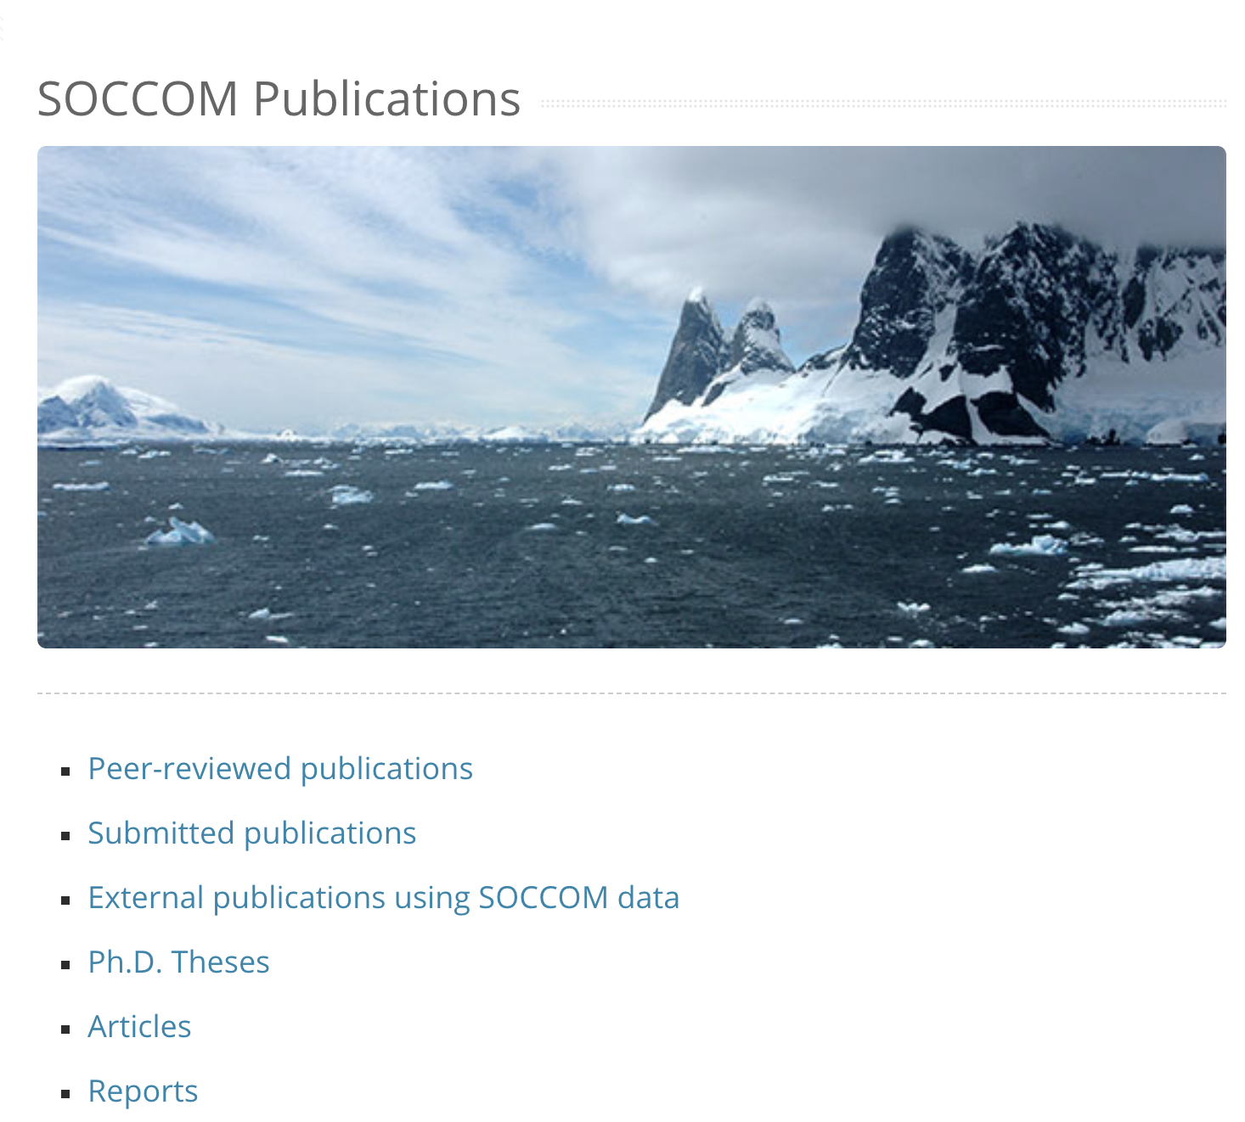
And many more publications, products, projects, discussions, future plans…
107 publications
https://soccom.princeton.edu/content/soccom-publications
https://biogeochemical-argo.org/peer-review-articles.php

Slide 16
