Slide 1
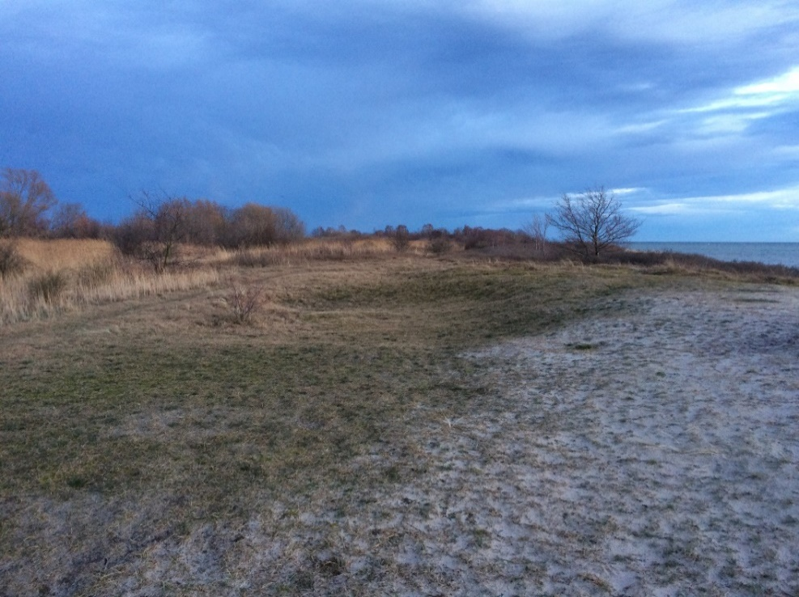
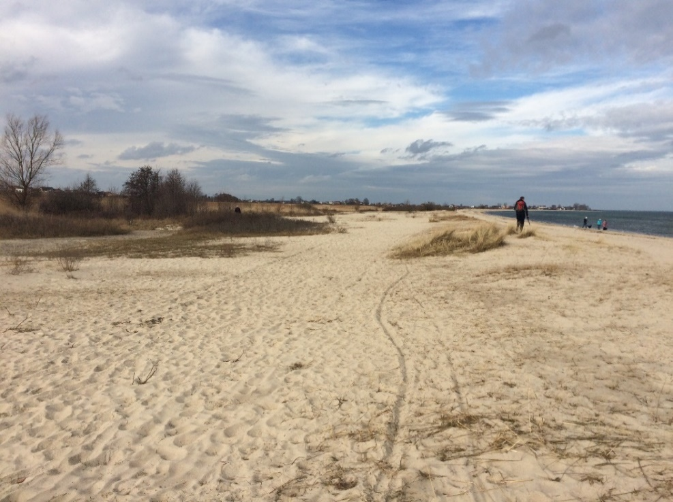
Catastrophic costal flooding events
along the southern Baltic Sea coast during the Late Holocene
Leszczyńska, Karolina¹, Moskalewicz, Damian², Stattegger, Karl¹, Szczuciński, Witold¹
¹GEOHAZARDS Lab, Institute of Geology, Adam Mickiewicz University in Poznan, ul. Bogumiła Krygowskiego 12, 61-680 Poznań, Poland
² , Department of Geomorphology and Quaternary Geology, University of Gdanskul, ul. Bażyńskiego 4, 80-952 Gdańsk, Poland
Photographies: Examples of overwash features created by marine inundation events assciated with storms on the Polish coast. A) Jastarnia; B) Mechelinki.

Slide 2
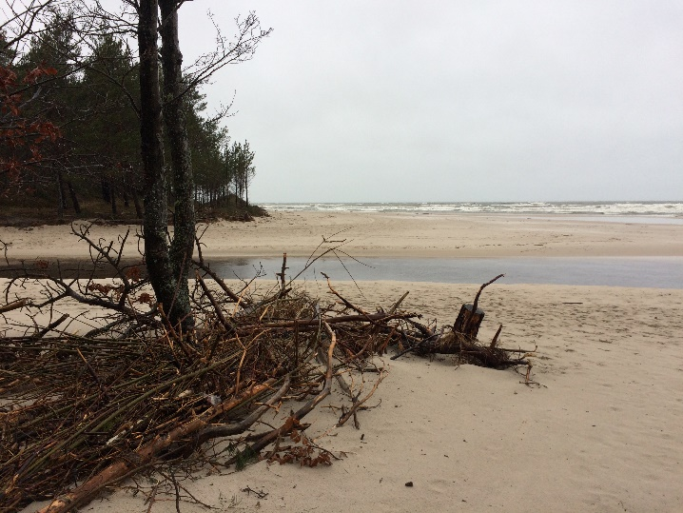
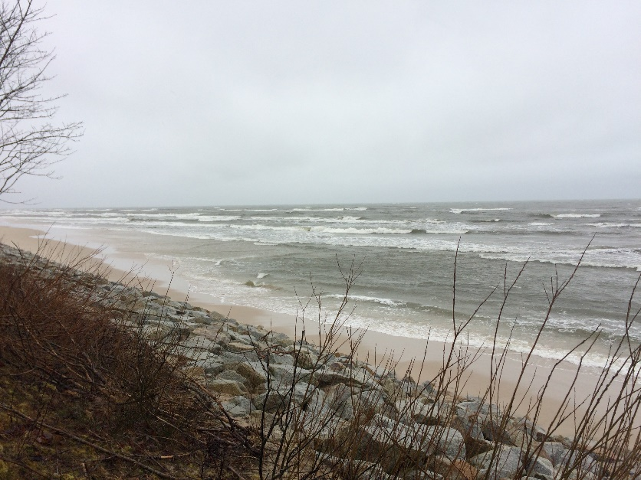
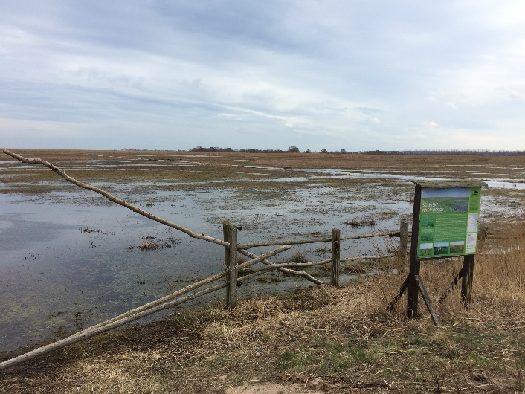
Background and aim of the project:
Photo: K. Leszczyńska
Catastrophic costal flooding events are one of the main forcing agents of short- and long-term coastal system changes and a major threat to coastal urbanized areas. The frequency and intensity of unexpected marine inundation events worldwide changes according to fluctuations of climate. To understand ongoing alternations in the frequency, magnitude and severity of coastal flooding it is essential to decipher the long-time records of past events. The localities predestined for preservation of imprints of catastrophic costal flooding are low lying marsh areas behind low costal dunes and river mouth.
In 2019 Profesor Karl Stattegger and researchers from the Geohazards Lab (Adam Mickiewicz University) launched the CatFlood project. The aim of the project is to reconstruct the chronology and intensity of catastrophic coastal flooding events on the southern Baltic coast in Poland during the late Holocene embedded in relative sea-level history.

Slide 3
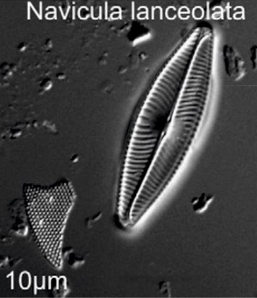
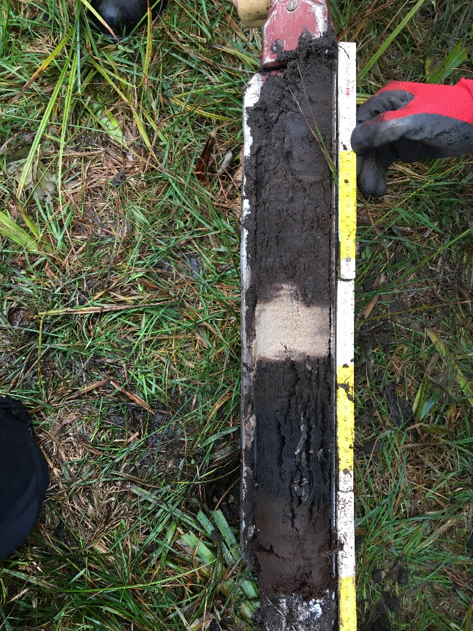
Methods:
Marine inundation events may be deciphered from:
i) sedimentary evidence (usually: sandy layers within organic marsh successions);
ii) palaeoecological traces by marine microorganisms or
iii) by their palaeo-DNA
i)
ii)
iii)
Sedimentary evidence
in form of sandy layer within peat
Exemplary diatom,
part of figure from
Szczuciński et al. 2012
Exemplary DNA chain,
visualization taken from:
www.tylkonauka.pl,
author unknown
Notes:
This is what you are showing here

Slide 4
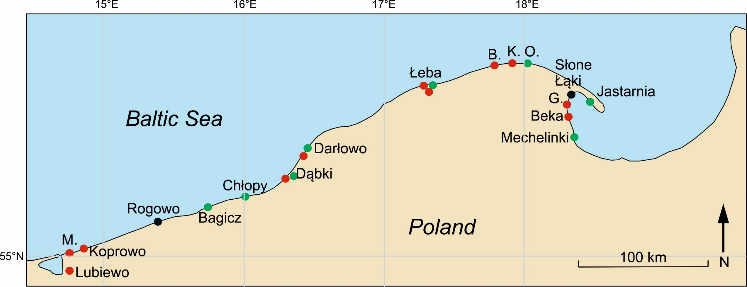
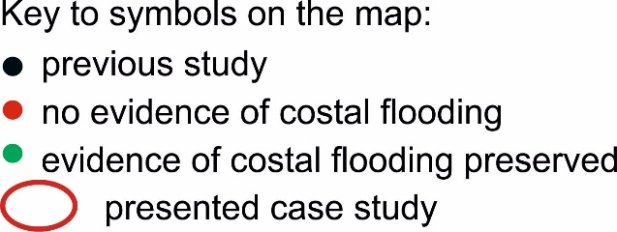
Selection of research sites:
Within the CatFlood project we investigate catastrophic costal flooding along the Polish Baltic Sea coast during the last 5000 years. The southern Baltic Sea coast is important study area as:
i) low lying marsh areas behind costal dunes or at active river mouth are sedimentary environments prone to archive sedimentary record of costal flooding;
ii) the Polish coast of the southern Baltic Sea is exposed to both (north) westerly and (north) easterly storms;
iii) negligible tidal forcing does not bias elevated water table of catastrophic marine inundations.
Map of field localities visited in search for sedimentary evidence of catastrophic costal flooding. Letter denotes: M. – Międzywodzie, B. – Białogóra, K. – Karwia, O. – Ostrowo. Reference: Rogowo - Piotrowski et al. 2017; Słone Łąki – Moskalewicz et al. 2020
Notes:
I would take only one colour for the dots in this slide. You show the differentiation in the next slide.

Slide 5
Results – regional scale:
Drilling and sampling was undertaken in 21 sites within the Polish Baltic Sea coast.
Green dots indicate sites were sedimentary evidence hypothesised to be of marine inundation origin was found: Mechelinki, Jastarnia, Ostrowo, Darłowo, Dąbki, Chłopy, Bagicz.
Black dots denote sites were storm deposits were found by other researchers: Słone Łąki (Moskalewicz et al., 2020) and Rogowo (Piotrowski et al. 2017).
Red dots indicate places where, despite the fact that topographically the areas were predestined to record sedimentary evidence of coastal flooding, there were no deposits of such origin found.
Map of field localities visited in search for sedimentary evidence of catastrophic costal flooding. Letter denotes: M. – Międzywodzie, B. – Białogóra, K. – Karwia, O. – Ostrowo. Reference: Rogowo - Piotrowski et al. 2017; Słone Łąki – Moskalewicz et al. 2020
Notes:
I would not mark Miedzywodzie here with a red dot, we have to check this location more carefully.

Slide 6
Results – regional scale:
The southern Baltic Sea coast in relation to dominant wind directions:
30 deg
30 deg
330 deg
https://geogermanykat.wordpress.com/2014/10/06/the-surface-winds-of-germany/

Slide 7
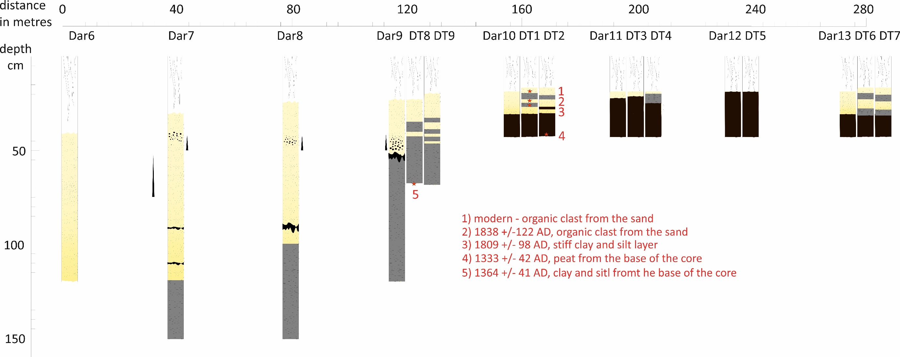
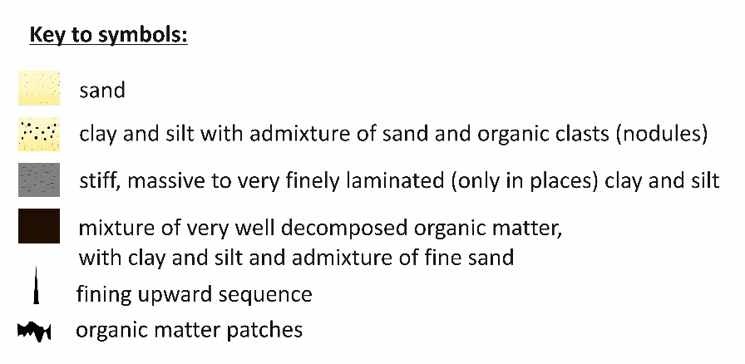
Results – Darłowo case study

Slide 8
Results - characteristics of event layer
Darłowo case study
Sediments interpreted to be of marine flooding origin consist of sand layers/beds deposited within otherwise organic succession;
sand beds thin landward: from more than 1 m just behind the dune belt to few centimetres in a distance of 200 metres from the dunes;
laser particle size analyses revealed multiple fining upward layers within discrete sand beds;
multiple soil/peat clasts cf. rip-up-clasts are present, being a diagnostic feature of catastrophic flooding deposits;
¹⁴C dating revealed that between XIV and XIX century at least two flooding events took place;
²¹⁰Pb and ³⁷Cs measurements established the accumulation rate of the upper-most part of the succession to few milimetres per year.
ongoing analyses: heavy mineral analysis, micromorphological analysis, further ¹⁴C dating and ²¹⁰Pb/³⁷Cs measurements.

Slide 9
Conclusion – regional scale
after the first stage of the CatFlood Project
Along the southern Baltic Sea coast, sedimentary evidence of catastrophic coastal flooding usually takes form of sandy layers intercalated into peat deposits.
The preservation potential of the sedimentary evidence of costal flooding depends in the first instance on the topographical and sedimentary context of the site. The link between the exposure of the site towards dominant wind direction and the preservation potential is still to be tested.
In some sites, deposits associated with marine inundations tend to be patchy and do not spread laterally along the sea coast for long distances.
The limited of knowledge on the sedimentary evidence of costal flooding may be the artefact of lack research on that topic.

Slide 10
Conclusion – local scale
after the first stage of the CatFlood Project
At the visual inspection it is difficult to decipher whether a sandy event layer was deposited as a result of one or mulitple events. To account for that the micromorphological analysis is necessary.
In all deposits hypothesised to be of catastrohic costal flooding origin soil/peat clasts cf. rip-up clasts are an important diagnostic feature.
¹⁴C dating proved to be useful tool for setting the general time-frame of marine inundation events, however OSL dating of sandy material from within the layer is desirable to establish exact dating of the event.
Reference:
Piotrowki A., Szczuciński W., Sydor P., Kortys B., Rzodkiewicz M., Krzymińska J. 2017. Sedimentary evidence of extreme storm surge or tsunami events in the southern Baltic Sea (Rogowo area, NW Poland). Geological Quarterly 61, 973-986.
Moskalewicz D., Szczuciński W., Mroczek P., Vaikutiene G. 2020. Sedimentary record of extreme storm surges on the Gulf of Gdańsk coast, Baltic Sea. Marine Geology.

