Slide 1
Mathematical Modeling Algorithms for Obtaining New Materials with Desired Properties Using Nano-hierarchical Structures.
EGU2020-1323
Oleg Khachay ,Olga Hachay, Andrey Khachay

Slide 2
Abstract
In the enormous and still poorly mastered gap between the macro level, where well developed continuum theories of continuous media and engineering methods of calculation and design operate, and atomic, subordinate to the laws of quantum mechanics, there is an extensive meso-hierarchical level of the structure of matter. At this level unprecedented previously products and technologies can be artificially created. Nano technology is a qualitatively new strategy in technology: it creates objects in exactly the opposite way - large objects are created from small ones [1]. We have developed a new method for modeling acoustic monitoring of a layered-block elastic medium with several inclusions of various physical and mechanical hierarchical structures [2].

Slide 3
Abstract
An iterative process is developed for solving the direct problem for the case of three hierarchical inclusions of l, m, s-th ranks based on the use of 2D integro-differential equations. The degree of hierarchy of inclusions is determined by the values ​​of their ranks, which may be different, while the first rank is associated with the atomic structure, the following ranks are associated with increasing geometric sizes, which contain inclusions of lower ranks and sizes. Hierarchical inclusions are located in different layers one above the other: the upper one is abnormally plastic, the second is abnormally elastic and the third is abnormally dense. The degree of filling with inclusions of each rank for all three hierarchical inclusions is different. Modeling is carried out from smaller sizes to large inclusions; as a result, it becomes possible to determine the necessary parameters of the formed material from acoustic monitoring data.

Slide 4
References: [1] [Nanotechnology in the coming decade. Forecast of the direction of research. (2002). World, Moscow - 292 p.] [2] Hachay, O. A., Khachay, A. Yu. and Khachay O. Yu. (2018). Modeling algorithm of acoustic waves penetrating through a medium with composite hierarchical inclusions.// AIP Conference Proceedings 2053, 030023; https://doi.org/10.1063/1.5084384.

Slide 5
A Modeling Algorithm of Acoustic Waves Penetrating through a Medium with Composite Hierarchical Inclusions
Introduction
The idea of ​​multiscaled phenomena in solids during their plastic deformation and destruction was formulated in the Tomsk school of solid state physics as the concept of structural levels of deformation of solids [1]. Structural levels of deformation belong to the class of mesoscopic scales. It is not always realized that the mesoscopic approach is a fundamentally new paradigm, qualitatively different from the methodology of continuum mechanics (macro scale approach) and dislocation theory (micro scale approach).

Slide 6
Introduction
Experimental and theoretical studies of mesoscopic structural levels of deformation led to a qualitatively new methodology for describing a deformable solid as a multi-level self-consistent system. Formed at various scale levels, disoriented substructures are a large-scale invariant. This is the basis for constructing a multilevel model of a deformable solid body, in which the entire hierarchy of scales of structural levels of deformation is taken into account. In the coming decades, the most relevant areas of work in the field of physical mesomechanics should be considered: the application of methods of physical mesomechanics of structurally heterogeneous media to the problems of modern materials science, including nanomaterials, thin films and multilayer structures, surface hardening and application of hardening and protective coatings. When constructing a mathematical model of a real object, it is necessary to use, as a priori information, active and passive monitoring data obtained during the current operation of the facility.

Slide 7
Introduction
At present, the following is very significant: the interaction between physics and mathematics is becoming more pronounced, the influence of the needs of physics on the development of mathematical methods, and the inverse effect of mathematics on physical knowledge. In a number of questions of physics and technology, a number of problems arose for which the apparatus of linear mathematics was either insufficient or even completely inapplicable [2]. For a comprehensive coverage of various phenomena in acoustics and mechanics, the mathematical apparatus of linear differential equations is absolutely insufficient. It is precisely those phenomena that are most characteristic and interesting here that obviously do not fit into its framework. The fact is that differential equations that adequately describe these phenomena are obviously nonlinear. Accordingly, we are talking about “nonlinear” systems. The foundations of the mathematical apparatus, adequate not only to individual problems, but to the entire cycle of nonlinear problems, are laid down in the famous works of Poincare and Lyapunov [4, 6].
2.Arnold V.I. Catastrophe theory. 3rd ed., Ext. - M .: Science. ch. ed. Phys.-Math. Lit., 1990. - 128 s. 4.Lyapunov A.M. Collected works in three volumes. - M .; L .: Publishing house of the Academy of Sciences of the USSR, 1954-1959. - 446, 472, 374 s. 6. Poincare. A. Selected works in three volumes. M. Science, 1971-1974. - 776, 901, 703

Slide 8
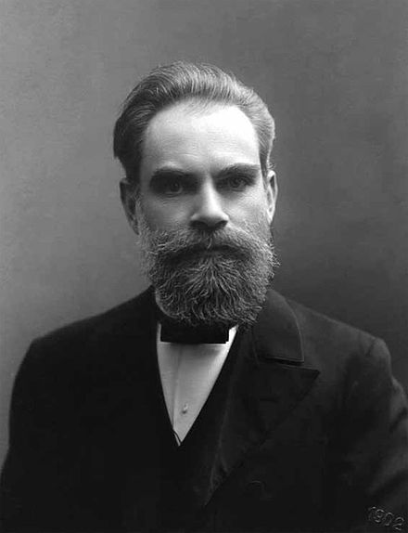
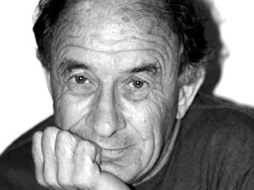
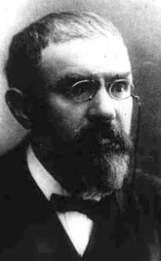
2
4
6
2.Arnold V.I. Catastrophe theory. 3rd ed., Ext. - M .: Science. ch. ed. Phys.-Math. Lit., 1990. - 128 s. 4.Lyapunov A.M. Collected works in three volumes. - M .; L .: Publishing house of the Academy of Sciences of the USSR, 1954-1959. - 446, 472, 374 s. 6. Poincare. A. Selected works in three volumes. M. Science, 1971-1974. - 776, 901, 703

Slide 9
Introduction
In [2,3], modeling algorithms were constructed in the electromagnetic case for 3-D heterogeneities, in the seismic case for 2-D heterogeneities for an arbitrary type of excitation source of an N-layer medium with a hierarchical elastic inclusion located in the J-th layer. In work [4], a new 2D modeling algorithm for sound diffraction on elastic and porous, moisture-saturated inclusion of a hierarchical structure located in the J-th layer of an N-layer elastic medium was developed. In [5], modeling algorithms were constructed in the acoustic case for a 2-D heterogeneity for an arbitrary type of excitation source of an N-layer medium with a separate hierarchical anomalous density, stressed and plastic inclusions located in the J-th layer.

Slide 10
Introduction
FIGURE 1. The scheme of composite anomalously plastic (upper), anomalously elastic (medium) and anomalously dense (lower) heterogeneities of hierarchical type located in an N-layer elastic medium.

Slide 11
Introduction
In this paper, using the method described in [6-9], an algorithm for modeling the acoustic field (longitudinal acoustic wave) has been developed in the form of an iterative process for solving a direct problem for the case of three hierarchical inclusions of l, m, s-ranks using 2D integral and integro-differential equations. The degree of hierarchy of inclusions is determined by the values ​​of their ranks, which can be different. Hierarchical inclusions are located in different layers above each other: the top is anomalously plastic (in layer j-1), the second is anomalously elastic (in layer j) and the third is anomalously dense (in layer j + 1) (Fig. 1)

Slide 12
ALGORITHM OF MODELING SOUND DIFFRACTION ON A TWO-DIMENSIONAL BLOCK N-LAYERED MEDIUM WITH COMPOSITE HIERARCHICAL TYPE INCLUSIONS

Slide 13
ALGORITHM OF MODELING SOUND DIFFRACTION ON A TWO-DIMENSIONAL BLOCK N-LAYERED MEDIUM WITH COMPOSITE HIERARCHICAL TYPE INCLUSIONS

Slide 14
ALGORITHM OF MODELING SOUND DIFFRACTION ON A TWO-DIMENSIONAL BLOCK N-LAYERED MEDIUM WITH COMPOSITE HIERARCHICAL TYPE INCLUSIONS

Slide 15
ALGORITHM OF MODELING SOUND DIFFRACTION ON A TWO-DIMENSIONAL BLOCK N-LAYERED MEDIUM WITH COMPOSITE HIERARCHICAL TYPE INCLUSIONS

Slide 16
ALGORITHM OF MODELING SOUND DIFFRACTION ON A TWO-DIMENSIONAL BLOCK N-LAYERED MEDIUM WITH COMPOSITE HIERARCHICAL TYPE INCLUSIONS

Slide 17
ALGORITHM OF MODELING SOUND DIFFRACTION ON A TWO-DIMENSIONAL BLOCK N-LAYERED MEDIUM WITH COMPOSITE HIERARCHICAL TYPE INCLUSIONS

Slide 18
Algorithm

Slide 19
Algorithm

Slide 20
Conclusion

Slide 21
References

