Slide 1
S-wave reflection imaging of a tectonically determined cavern by use of next generation electro-mechanic vibrator
Peter Labak¹, Attila Kovacs² & Endre Hegedus³
¹OSI Division, CTBTO; ²Geo-Log, Hungary; ³ MBFSZ, Hungary
Views expressed in this presentation are personal views of the authors and do not necessarily reflect the views of the CTBTO Preparatory Commission

Slide 2
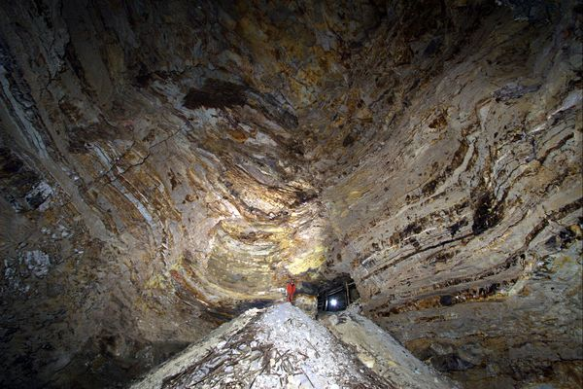
Introduction
Active seismic surveys – one of the CTBT
permitted techniques for on-site inspections
The objective is to identify area of cavity
and rubble zone after an underground
nuclear explosion (UNE)
A natural cavity – an analogue to UNE cavity
with some limitations
Notes:
The Great Cavern 30 m diameter at 100 m depth near Bank, Hungary.
Finding a natural (karstic) analogue of a deep UNE site requires careful considerations, It may provides good natural like the size of the cavern but the others like the lack of the thermal effects and the nature of the surrounding damage zone not.
The natural caverns are mainly developed in the weakest zones of the rock matrix and the thermal and pressure effects of a UNE are lacking.
The site, part of an abandoned deep mine, was selected with these circumstances in mind.

Slide 3
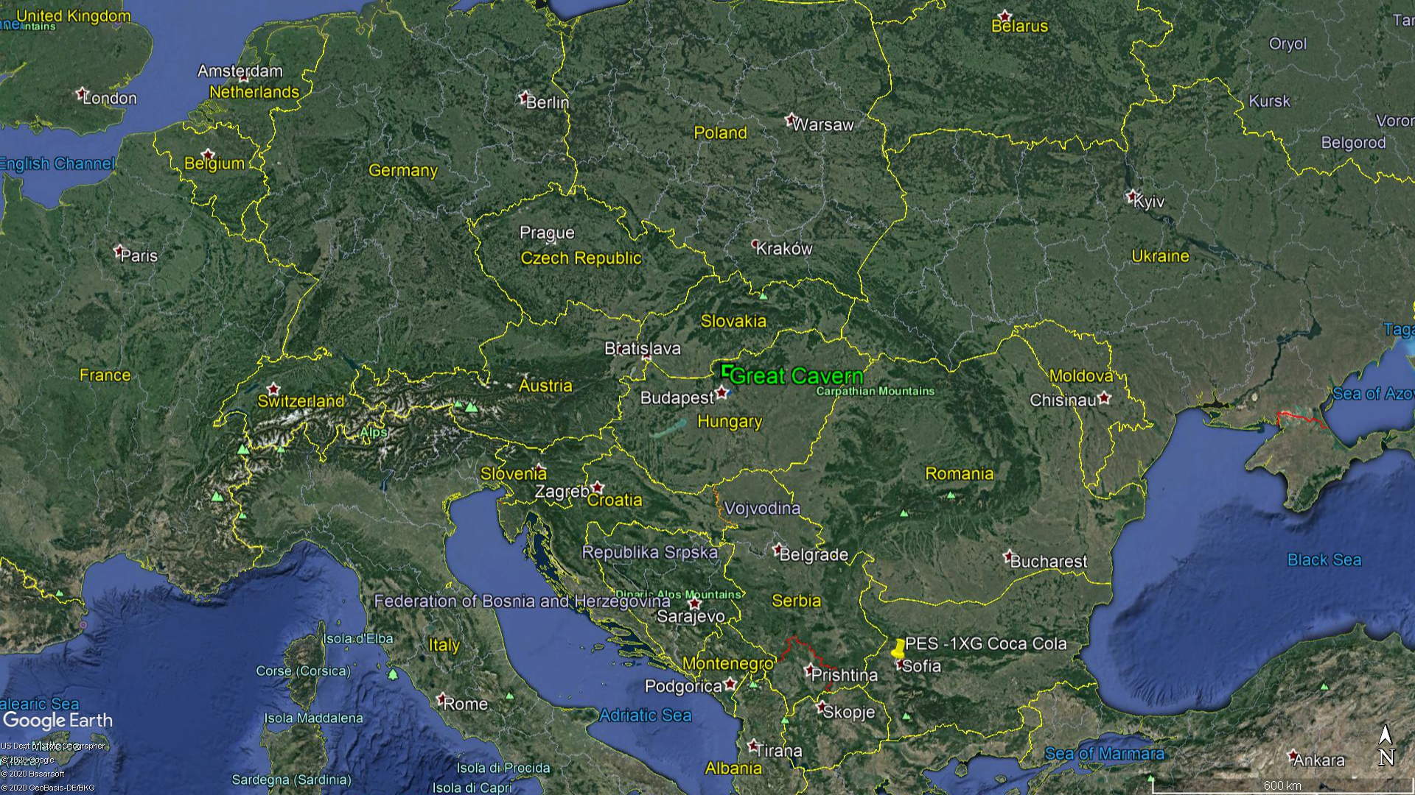
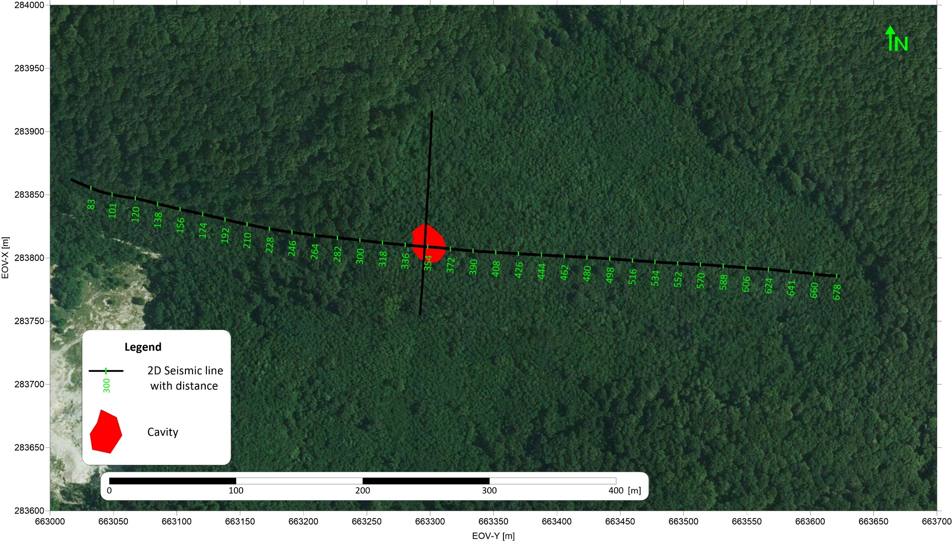
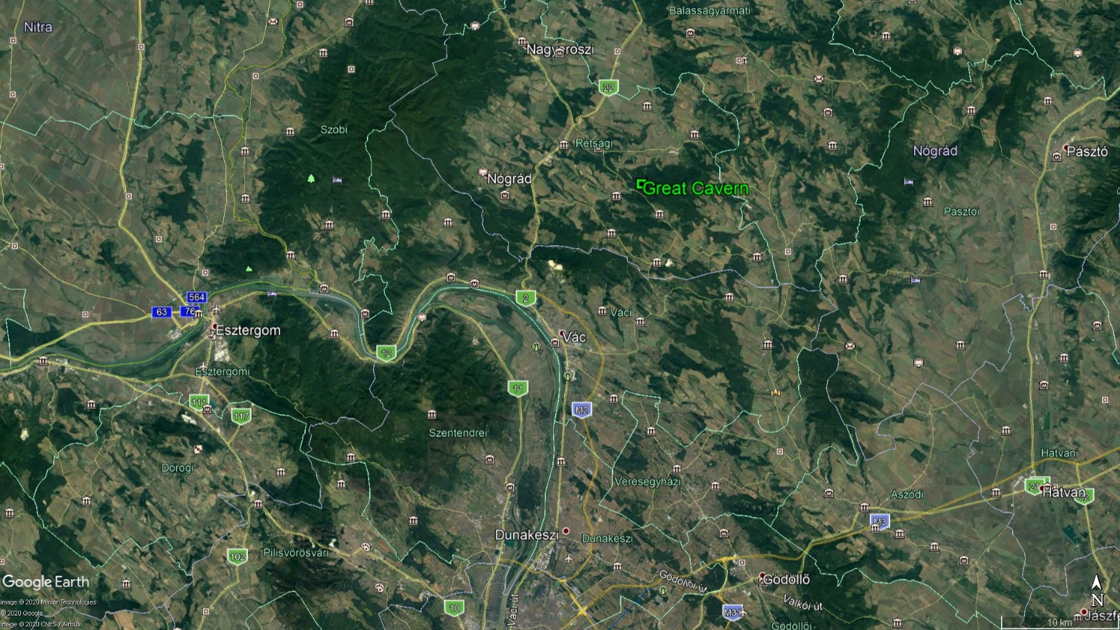
Location
North Hungary
Left bank of the Danube
60 km North from Budapest
Notes:
The study area is located at the left bank of the Danube about 60 km to the north from Budapest

Slide 4
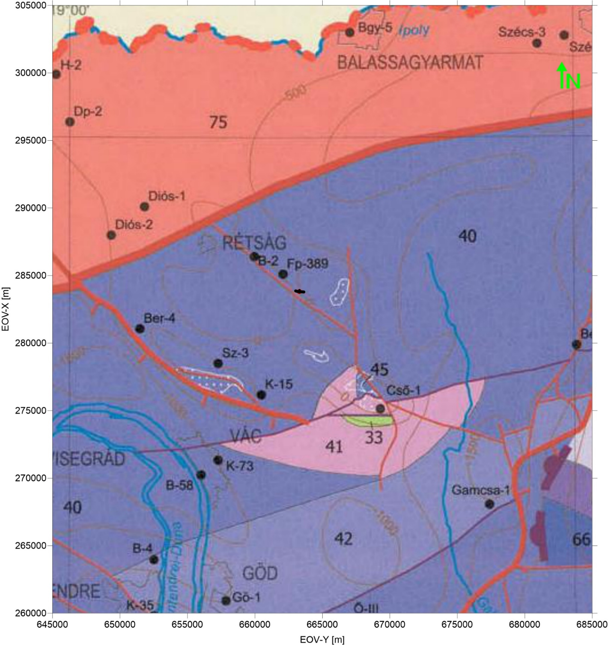
Geological setting
Basement - Upper-Triassic limestone (Dachsten Limestone Formation)
Oligocene sediments – clay (kaolinite, other fire-resistant clay)
Legend:
40 Dachsten Limestone Formation
42 Great Dolomite Formation
75 Polymetamotph Complex
Pre-Cenozoic geological map of Hungary, HAAS, 2010
Notes:
The Mesozoic basement rocks forming horsts, some of the breaking to the surface.
The easternmost basement highs forming gentle hills on the surface can be found near Felsőpetény village
The deep basement is composed of about 270 Ma old Upper-Triassic limestone (Dachsten Limestone Formation) overlain by Eocene coral limestone accumulated with time discordance on the karstified surface.
The kaolinite and other fire-resistant clay deposits are found within the sandstone layers of Oligocene strata
The Pleistocene sediments are clayey and contain gravels inherited from the host rocks after weathering
The most probable explanation for the formation of the cavern can be the opening of a deeper karstic cave. Due to the hydrothermal activity during the Pleistocene a cave formed in the Dachstein Limestone which may have opened upward, influenced the overlying Oligocene layers but did not reach the surface

Slide 5
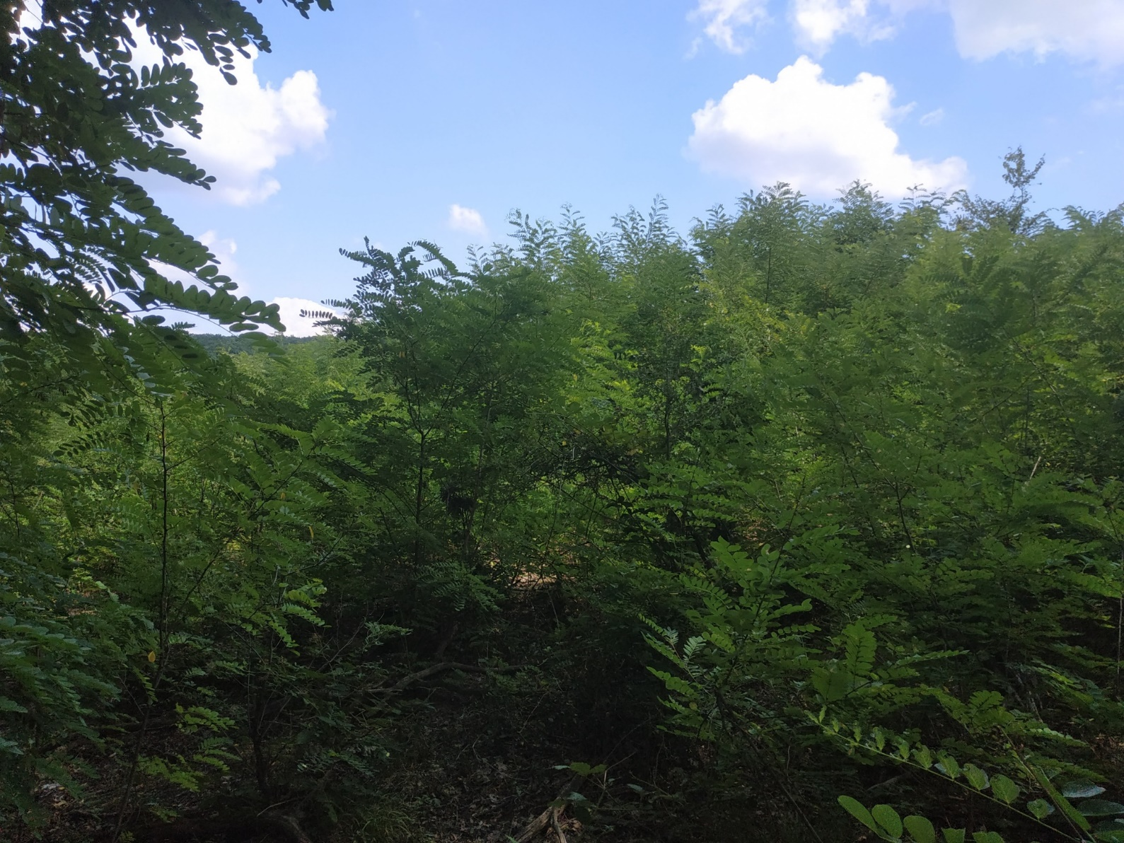
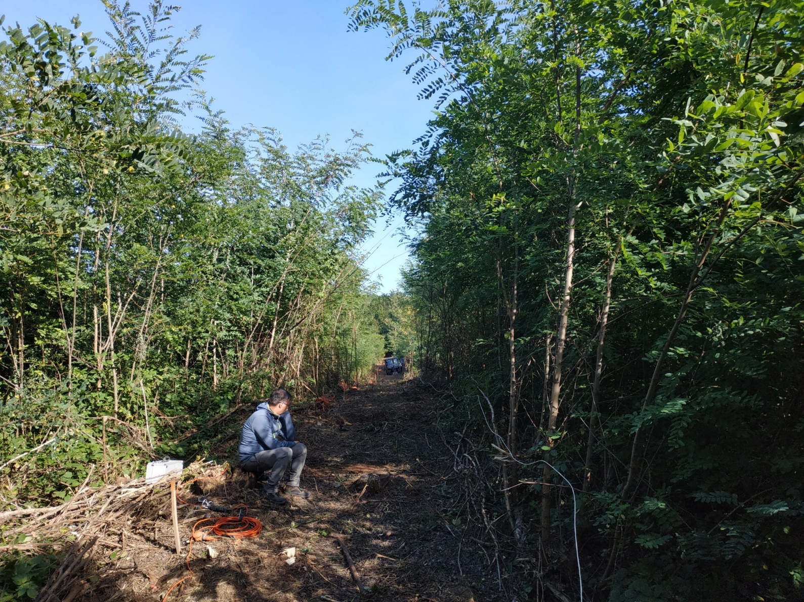
Pre-measurement task
Planning – several site visits
Permitting
Site preparation incl. forest cleaning
Geodetical survey
Notes:
The owner of the forest is the National Forest Enterprise of the Nograd Country. The forest is under property protection therefore a scientific survey licence had to be accurized.
The licence for the field activity was granted for the time window of August-September 2019.
The owner of the mining rights also granted access to the site as well as to the underground galleries.
A crucial point of the geophysical field activities is to establish a grid of the measuring points. The working pegs of the points were accurately surveyed prior to the geophysical measurements.
The line profiles were marked by wooden pegs and levelled to determine the accurate heights. A digital terrain model was developed to obtain the accurate topographic corrections.
The hilltop above the cavern is a forested area covered by dense vegetation, mainly scrubs
The cleaning of the line profiles required the use special forest machinery for cutting the scrubs and extra manpower to make it accessible to the seismic vibrator source.

Slide 6
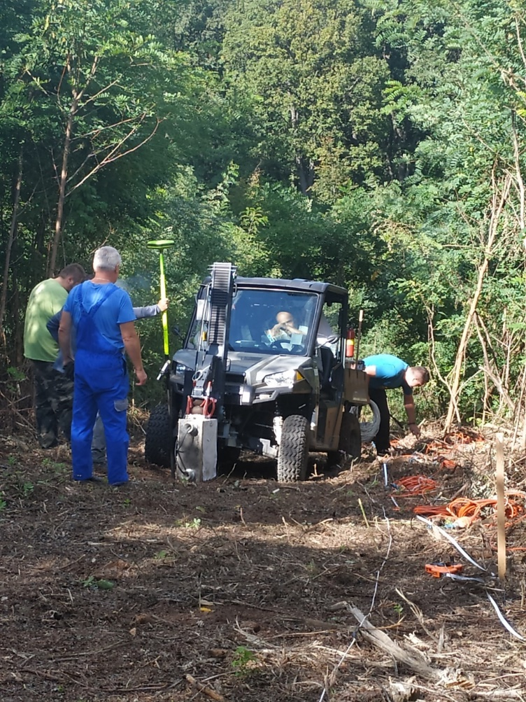
Seismic source
Vibrator technology for the oil industry is available for shallow seismic measurement
New types of P/S-wave vibrators, fast, safe and easy measurement in all terrain
Fully electrically control, all terrain vehicle
Name | Lightning seismic source
Weight | 90 kg + 1100kg vehicle
Cont. force S-wave | 1700N (400lbs)
Cont. force P-wave | 1200 N (270lbs)
Frequency range | 1-1000 Hz (8-400 Hz full drive)
Signal penetration depth | Approx. 200 m
Operational temperature | -20 - + 50 °C
Sweep length | Unlimited
Power Supply | 48 VDC battery/230 VAC power
P-wave mode layout S-wave mode layout
Notes:
The field activity consisted of a short familiarization with the U-Node type data logger and its accessories (cables, geophones) as well as.
The seismic source a new type of P and S wave vibrator. The field preparations: laying out the cables and sensors followed by data collection along the prepended geodetic lines.
In total three horizontally polarized vibrator signals were generated at the source points and 90 one component, horizontally polarised (SH) geophones detected the emitted signals.
The length of the used signal was 14 sec 5-120 Hz linerar sweep.

Slide 7
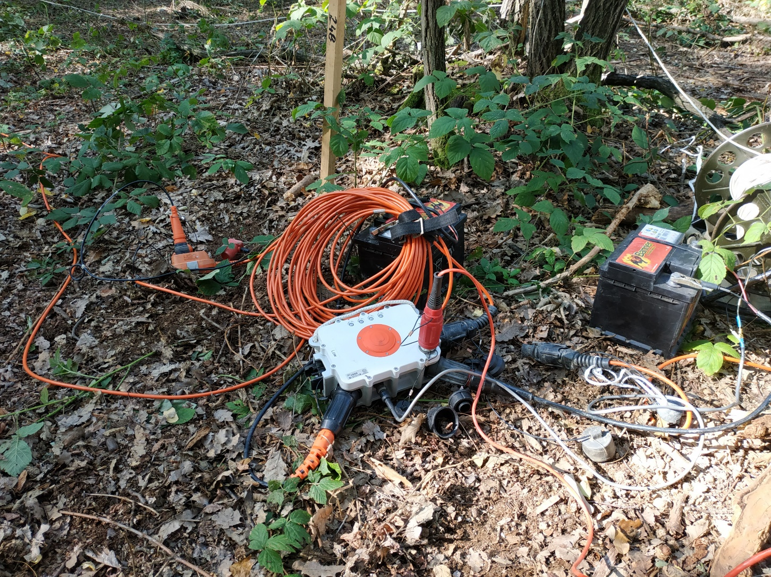
Acquisition equipment
Data logger:
Seismic Instruments U-node Lite
90 channel Sercel 408 FDU
Measurement:
4 m geophone distance
4 m source distance
Sweep 5-120 Hz 14 sec, linear, 3 times each location

Slide 8
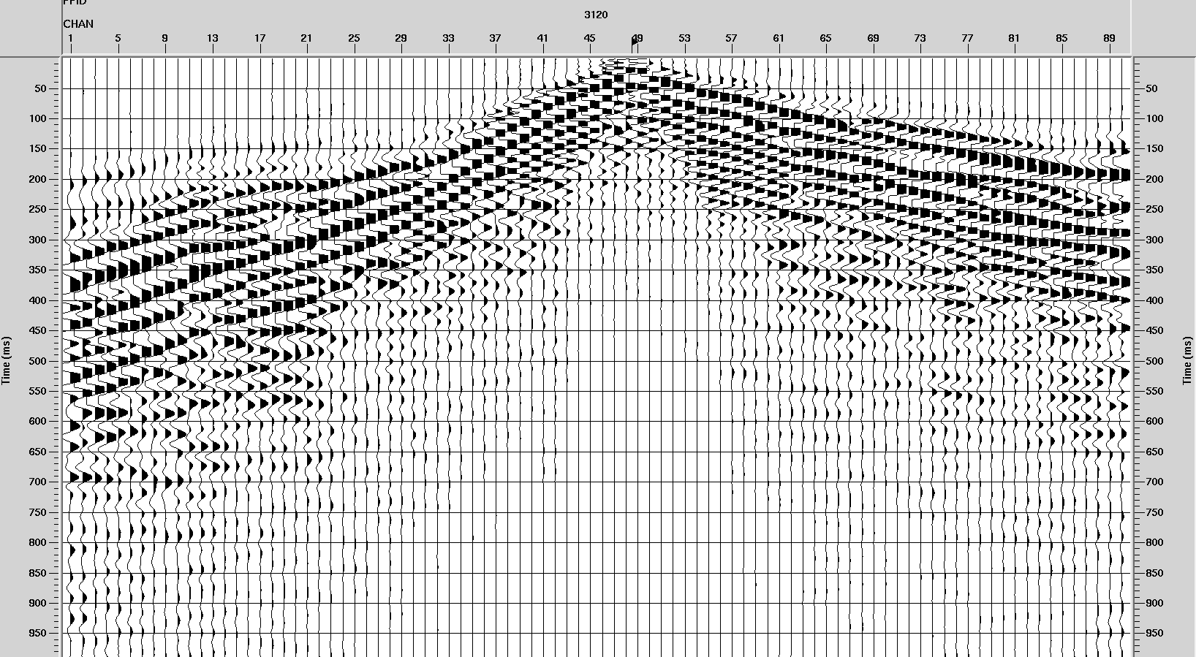
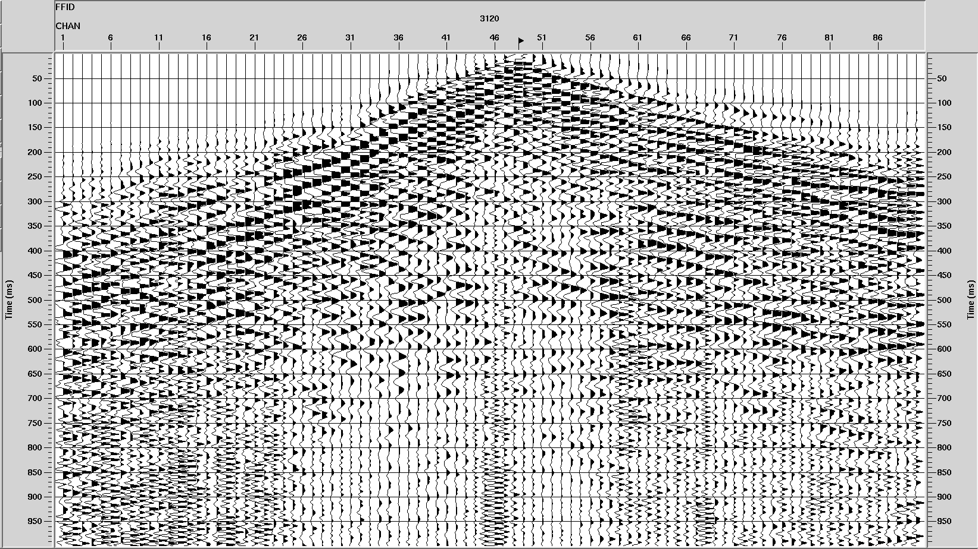
Data pre- and final processing
Main seismic processing steps:
constructing of SEG-Y datafiles,
editing/muting of seismic channels,
surface-consistent amplitude correction,
surface-consistent deconvolution,
refraction statics inversion,
velocity analysis,
automatic static correction,
residual velocity analysis,
common-depth-point stacking of corrected seismic channels,
2D poststack/prestack time migration,
2D prestack depth migration,
amplitude versus offset investigation and analysis of other seismic attributes;
Notes:
Reflection Method
Improving signal-to-noise ratios by adding together several traces (stacking) is fundamental to deeper reflection surveys. In shallow surveys this technique is normally used only to stack (enhance) results obtained with identical source and detector positions. NMO corrections can be made to traces produced with different source-receiver combinations. The technique normally used is to collect together a number of traces that have the same midpoint between source and receiver (common midpoint or CDP traces), apply the corrections and then stack.
The generic layout of the 2D/3D seismic processing consists of 12 main steps:
• constructing of SEG-Y datafiles,
• editing/muting of seismic channels,
• surface-consistent amplitude correction,
• surface-consistent deconvolution,
• refraction statics inversion,
• velocity analysis,
• automatic static correction,
• residual velocity analysis,
• common-depth-point stacking of corrected seismic channels,
• 2D/3D poststack/prestack time migration,
• 2D/3D prestack depth migration,
• amplitude versus offset investigation and analysis of other seismic attributes;
Seismic tomography
Tomography is the process of obtaining 2D and/or 3D images of a slice through the interior of a 3-dimensional object by passing rays of some short through the object and observing how the rays are affected ( attenuated or delayed in time) by passage through the material. In the earth sciences, tomography is widely used in seismic and EM imaging. Tomography techniques are also used in the analysis of controlled source seismic data generated by reflection of seismic waves from geological structures. Tomography depends on the assumption that energy from the transmitter follows ray paths through the 3-dimensional body to receivers. Under this assumption we can evaluate path integrals along ray paths to determine travel times and attenuations. Computing the travel time or attenuation from the known physical parameters of the 3-dimensional problem is forward problem. The problem becomes nonlinear and much more difficult as we consider refraction effects which results in curved ray paths.

Slide 9
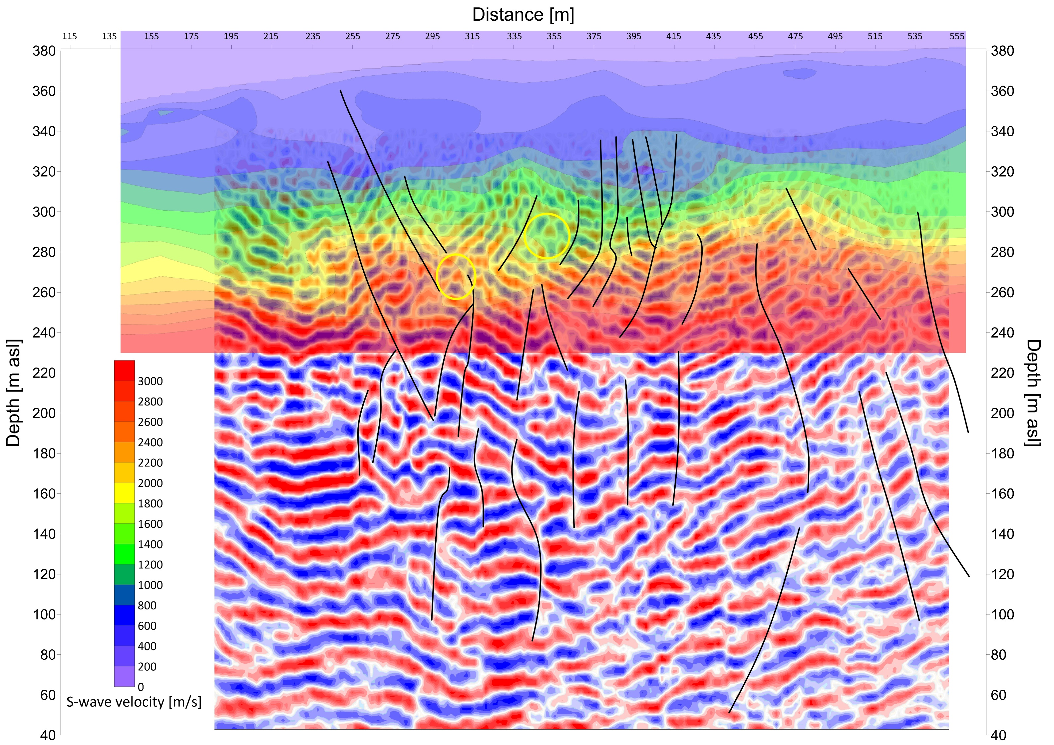
Results
2D SH-wave reflection section with 2D SH-wave tomography
Black lines – tectonic elements
Great Cavern
Other cavern ?
Notes:
Findings along the W-E profile:
Above the present roof of the cavern seismic anomalies were detectable in the overburden. Thee upper yellow circle shows the position of the cavern.
The tomographic profile shows an anomaly in the central part characterized by low velocity.
The reflection section exhibits emerging tectonized zones at both side of the low velocity central part;
The tectonically determined position of the cavern is supported by seismic results
The other yellow circle is deeper/lower level shows the position of the similar feature to the known cavern. It might be a similar week zone of the karstic rock matrix

Slide 10
Conclusions
The Active Seismic surveys have potential to detect the peculiar variations of the seismic wave field due to changes in the rock matrix caused by an UNE. In order to validate expected accuracy as well as the limitations of the high-resolution reflection and velocity tomography method a field experiment was carried out over a 30-meter-wide cavern of natural origin in North Hungary.
Various arrangements of a novel small scale electro-mechanical vibroseis source were tested using both P and SH-wave fields. The SH data using 5-120 Hz vibro signal (sweep) were fitting the purpose, i.e. provided adequate resolution comparing to other arrangements.
The processed (depth migrated ) seismic cross section imaged the wider tectonic features supported by the tomographic velocity distribution.
The 8-10 meter horizontal and 1-2 meter vertical resolutions were suitable to detect the small scale faults/fractured zones of the rock matrix and a possible anomaly at the position of the known cavern.

Slide 11
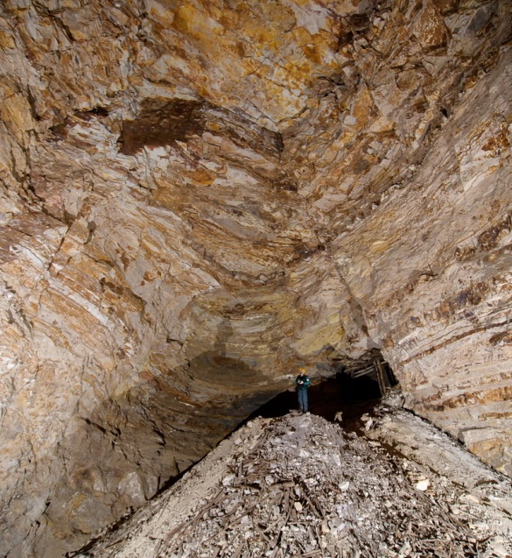
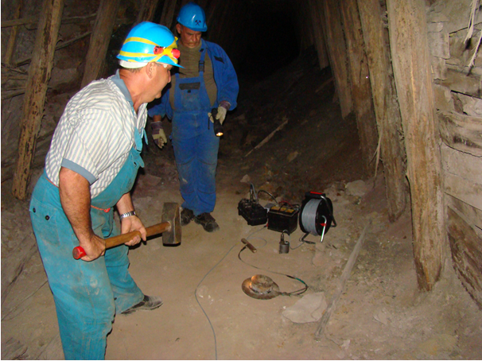
Thank you

