Slide 1
Lidar measurement of cirrus at Palau Island (7°N 134°E)
Francesco Cairo [1], Marcel Snels [1], Andrea Scoccione [1,2], Mauro De Muro [1,3], Luca Di Liberto [1], Stefano Ghisu [4], Ajil Kottayl [5], Bernard Legras [6], Silvia Bucci [6].
[1] Institute of Atmospheric Sciences and Climate, ISAC-CNR, Rome, Italy
[2] Now at: Centro Operativo per la Meteorologia, Aeronautica Militare, Pomezia, Italy
[3] Now at: AIT Thales Alenia Space, Roma, Italy
[4] Università degli Studi di Roma "Tor Vergata", Dipartimento di Fisica, Roma, Italy
[5] Cochin University of Science and Technology, CUSAT, Cochin, India
[6] Laboratoire de Météorologie Dynamique, LMD-CNRS, Paris, France

Slide 2
Abstract
A polarization diversity elastic backscatter lidar has been deployed in the equatorial island of Palau in Feb- Mar 2016. The system operated unattended in the Atmospheric Observatory of Palau Island, from 15 February to 25 March 2016, working automatically 8 hrs per night, delivering 3650 atmospheric profiles (5 min average). Each profile extends from 1 to 30 km height. Here the dataset is presented and discussed in terms of the temperature structure of the UTLS, as derived from co-located PTU soundings. During the timeframe of the campaign it was found that the main convective outflows peaks roughly 3 km below the Cold Point Tropopause, its occurrence associated with cold anomalies in the upper troposphere (UT). When warm UT anomalies occur, presence of particles is restricted to a 5 km wide layer centered 5 km below the CPT. Particles have been detected also slightly above the CPT. These particles are depolarizing, with depolarization values generally lower than those encountered in the TTL. Results show a correlation between presence of optically detectable particles and cold anomalies above the Cold Point.

Slide 3
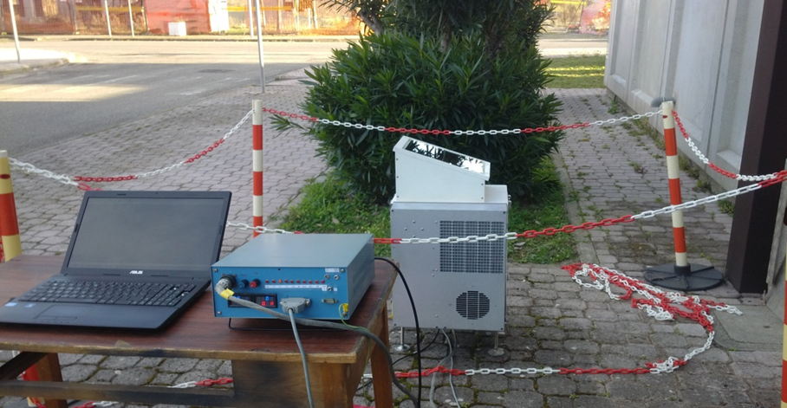
Instrument description
The MuLid is a compact elastic polarization diversity two-channel lidar, for particle measurements in the troposphere and lower stratosphere.
It uses a Nd:Yag 532nm laser with pulse energy of 2mJ per pulse @1kHz. The telescope is a 200 mm Schmidt-Cassegrain Telescope with 30cm focus length. The spectral Interference Filter has 10 nm FWHM @532nm.
MuLid operates both in Photocounting mode (Max range: 60Km; Vertical resolution: 60m) and Current mode (Max range: 15km; Vertical resolution: 15m).

Slide 4
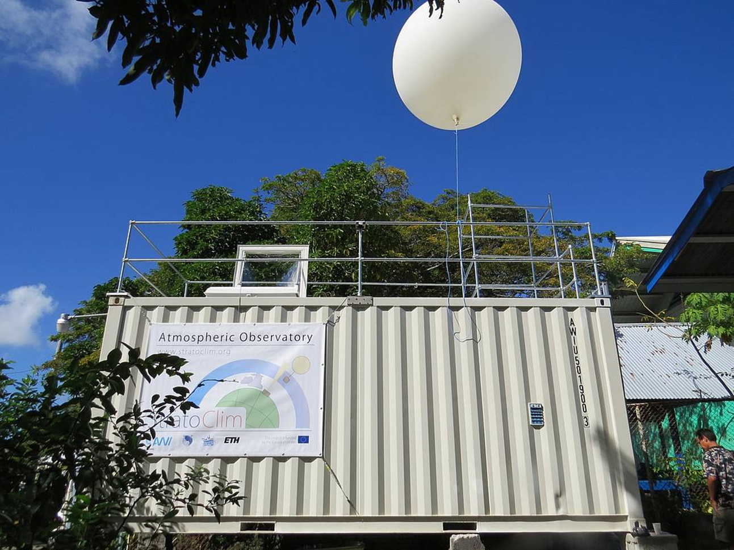
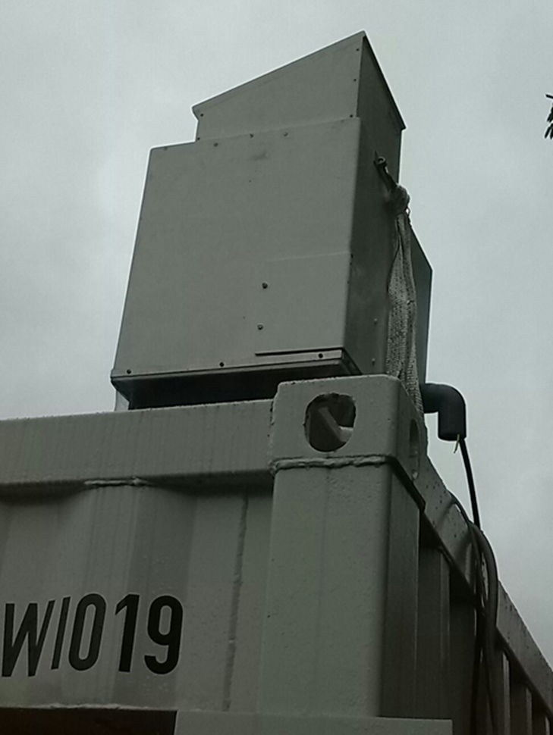
Deployment
The system operated unattended in the Atmospheric Observatory of Palau Island, from 15 February to 25 March 2016. It worked automatically 8 hrs per night, delivering 3650 atmospheric profiles (5 min average). Each profile extends from 1 to 30 km height.
A statistical analysis of cloud occurrence, morphology will be presented.
Temperature data from Koror radiosounding.

Slide 5
The deployment time covered a whole oscillation of the MJO, with the most intense phases at the beginning and at the end of the period.

Slide 6
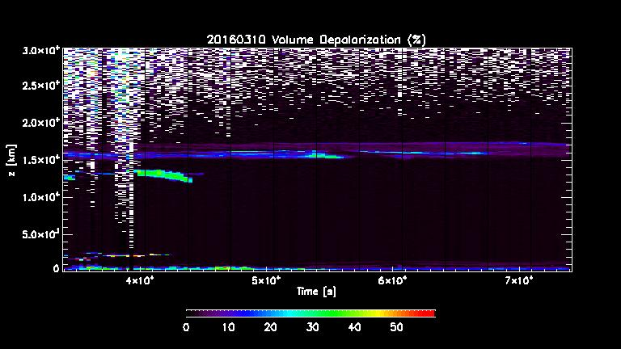
Dataset
Molecular calibration
SR=1.05 at 8-10 km
DR=1.4 at 8-10 km
LR 30 sr-1 (Klett inversion) or
Young inversion between cloud
base and 18 km.
Do not work for very thin clouds.

Slide 7
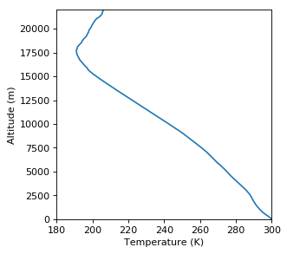
Clouds occurrence histogram vs altitude
Clouds have been frequently measured in the PBL and in the Upper Troposphere,
from 10 km up to the CPT at 17.5 km

Slide 8
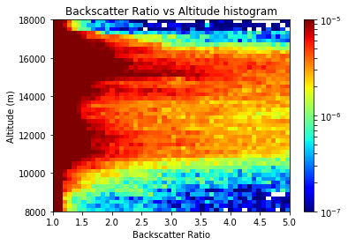
Cirrus occurrence in the Upper Troposphere
Two modes:
One close to the Lapse Rate Minimum
slightly below 12 km;
One roughly 1 km below the
Cold Point Tropopause

Slide 9
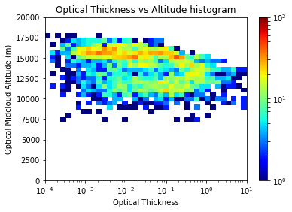
Cloud morphology: Geometrical and optical thickness vs altitude
SVC
Thickest clouds between 10 and 15 km. Frequent observations of very thin clouds (SVC) above 15 km, slightly below or at the Cold Point Tropopause. While the clouds around 12 km populate a whole range of geometrical and optical thickness, those closer to the Tropopause tend to be geometrically thinner.

Slide 10
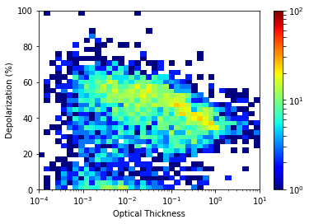
Thin clouds are colder and with higher depolarization
Right panel shows how clouds of low optical thickness are found preferentially at higher altitude and are colder and with higher depolarization.
Left panel shows how at a given geometrical thicknes (vertical axes) colder clouds tend to have smaller optical thicknes.

Slide 11
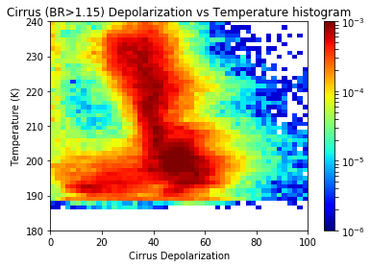
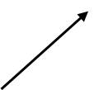
Depolarization vs Altitude and Temperature
SVC
There is a general increase of depolarization vs decreasing temperature (increasing altitude) up to the tropoause. There, depolarization show a larger range ov falues, with the lowest ones associated with subvisible cirrus.

Slide 12
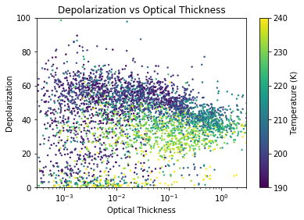
Depolarizaton vs backscatter ratio and optical thickness High depolarization on cold and thin clouds Low depolarization on cold and very thin clouds (SVC)

Slide 13
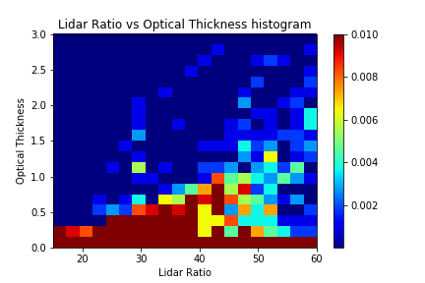
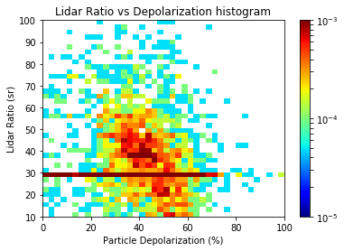
LR vs Temperature, optical thickness, depolarization
LR (extinction-to-backscatter) ratio is linked to the average size dimension of the particles.
Grossly speaking the lower LR, the bigger the particles
Small LR associated with low temperatures, high depolarization,
Suggestive of particles of large dimensions.
LR for SVC assumed 30 sr.

Slide 14
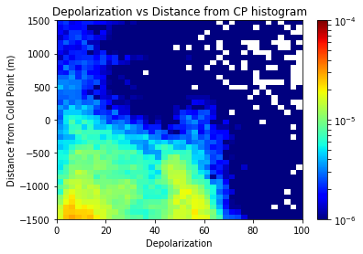
Bckscatter and Depolarization occurrences Altitude referenced to the Cold Point
Presence of clouds close to the troposphere do not extend significantly beyond the CPT
Note the presence of two modes in the depolarization, one with lower values is associated
with thicker clouds, the other with higher values is associated with thinner clouds (not shown)

Slide 15
Temperature Anomaly in Feb-Mar 2016
Added on the figure are the altitudes of the Cold Point Tropopause (blue dots).
The pronounced wave-fronts in the stratosphere that are descending in time and entering the UT are the result of large scale equatorial wave activity.

Slide 16
BR vs Temperature anomaly in the Troposphere
Presence of clouds in the upper troposphere associated with cold anomalies,
especially true for thick clouds

Slide 17
BR vs Temperature anomaly around the Tropopause
Presence of clouds close to the troposphere strongly associated with cold anomalies,
especially true for thick clouds

Slide 18
Conclusions
Clouds presence as two peaks: at 12-14 km, and slightly below the CPT
Only close and slightly below the CPT, clouds are largely affected by atmospheric temperature anomalies.
Clouds do not extend above CPT.
Depolarization increases with heigh and derease with temperature. At the tropopause depolarization may vary, but show two mode: High altitude clouds have large to low depolarization; but the thinnest of them (SVC) have low depolarization. May be an effect of sedimentation/sublimation? May be an effect of different formation mechanisms (injecton/insitu formation)? Further work is to study the thermal and convective histories of clouds.

