Slide 1


A comparison between vegetable intercropping systems and monocultures in greenhouse gas emissions under organic management
Virginia Sánchez-Navarro
Mariano Marcos-Pérez
Raúl Zornoza
Sustainable Use, Management and Reclamation of Soil and Water Research Group. ETSIA, Universidad Politécnica de Cartagena, Paseo Alfonso XIII, 48, 30230 Cartagena, Spain.

Slide 2
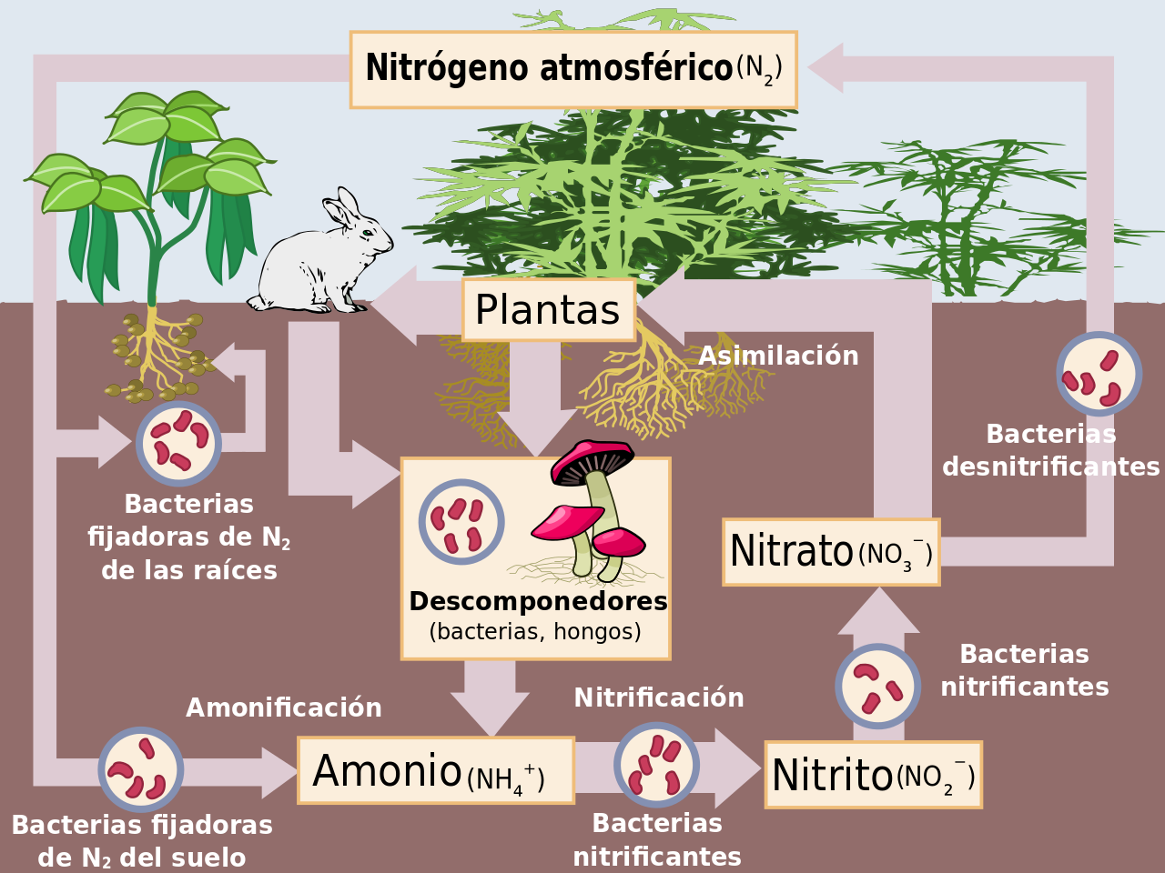
Introduction
The cultivation of legume crops has been proposed as a way of reducing greenhouse gas (GHG) emissions because of their ability to fix atmospheric N and thus reduce the need for external N fertilizers

Slide 3
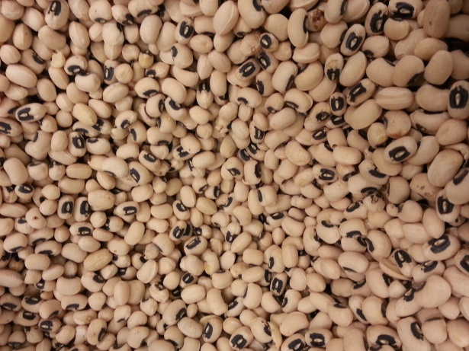

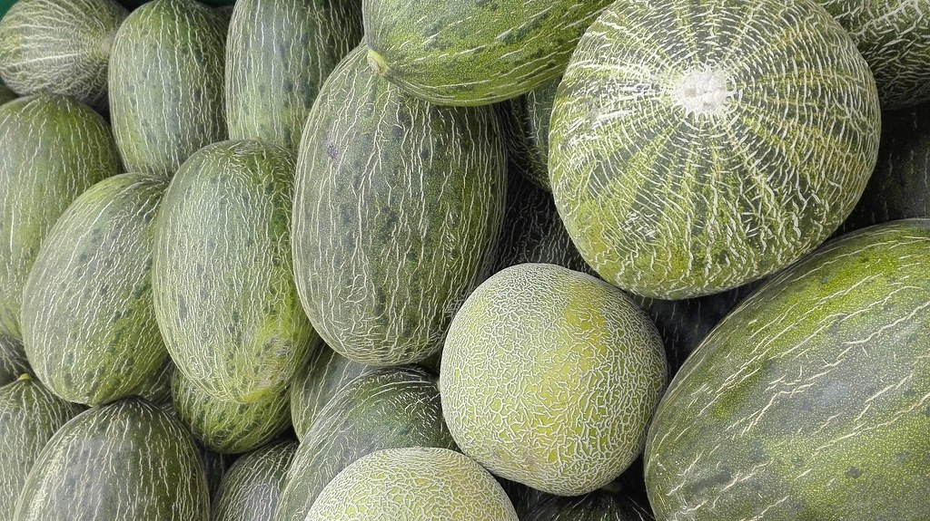
Intercropping is the simultaneous cultivation of two or more crop species in the same field.
This farming method is considered sustainable because it introduces greater plant diversity and functional complementarity in arable crop systems.
Growing more than one crop at time in the same field, farmers maximize water use efficiency, maintain soil fertility, and minimize soil erosion, which are all problems that affect the conventional agriculture.
The higher productivity in intercropping has been attributed to complementarity between crop species in temporal and spatial patterns of resource acquisition, facilitation, and/or reduction in the impacts of pests, diseases and weeds

Slide 4
OBJETIVES
The aim of this study was to assess the effect of the association between cowpea (Vigna unguiculata L.) and melon (Cucumis melo L.) growing in different intercropping patterns on soil CO2 and N2O emissions compared to cowpea and melon monocultures under organic management as a possible strategy for climate change mitigation.

Slide 5
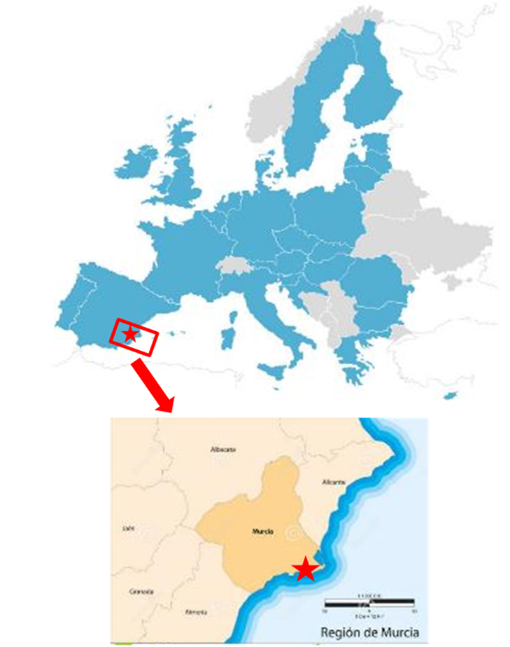
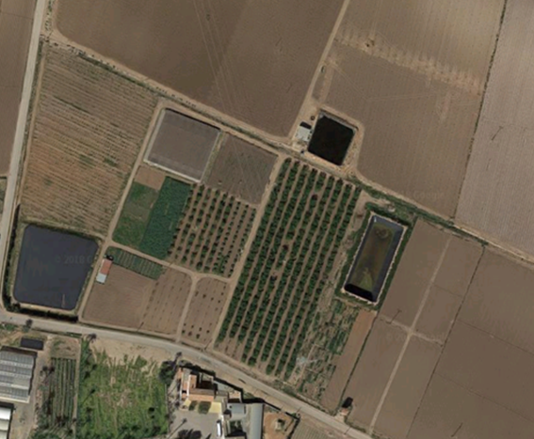
Materials and methods
This study was carried out in Cartagena, South-East Spain. The area was characterized by a semiarid Mediterranean climate with a mean annual temperature of 18 °C and total annual precipitation of 275 mm.

Slide 6
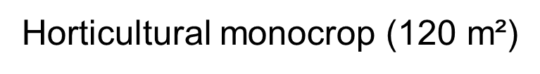
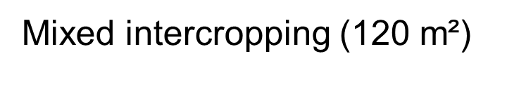
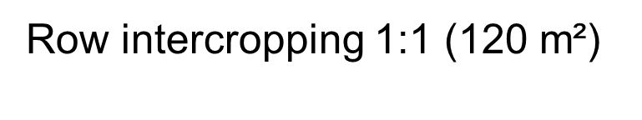
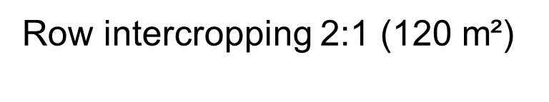

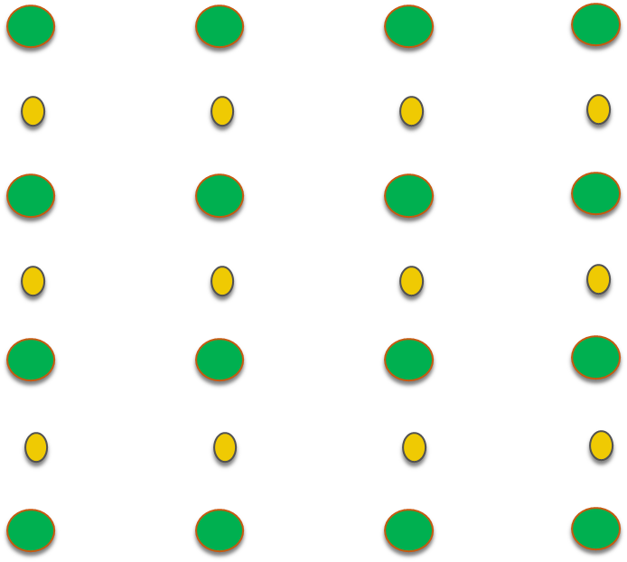
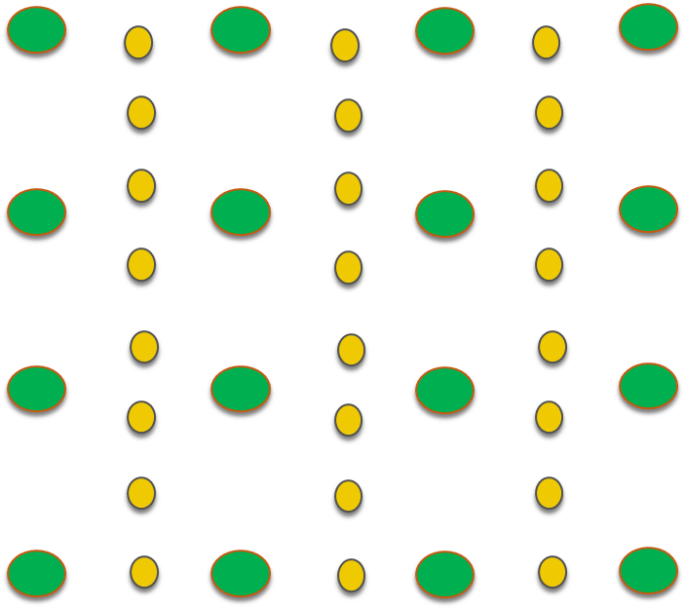
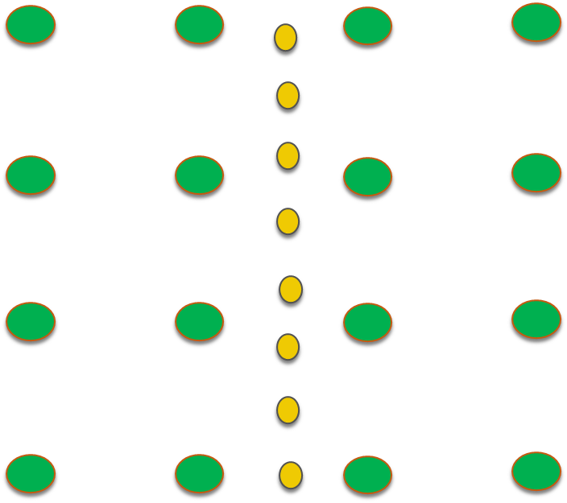
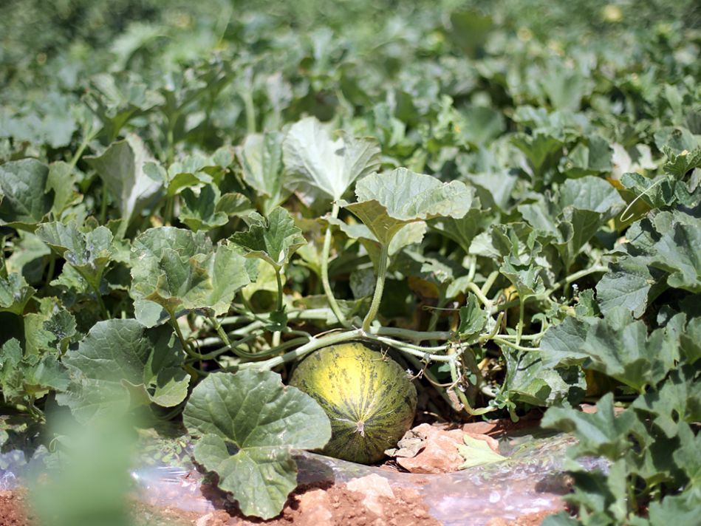
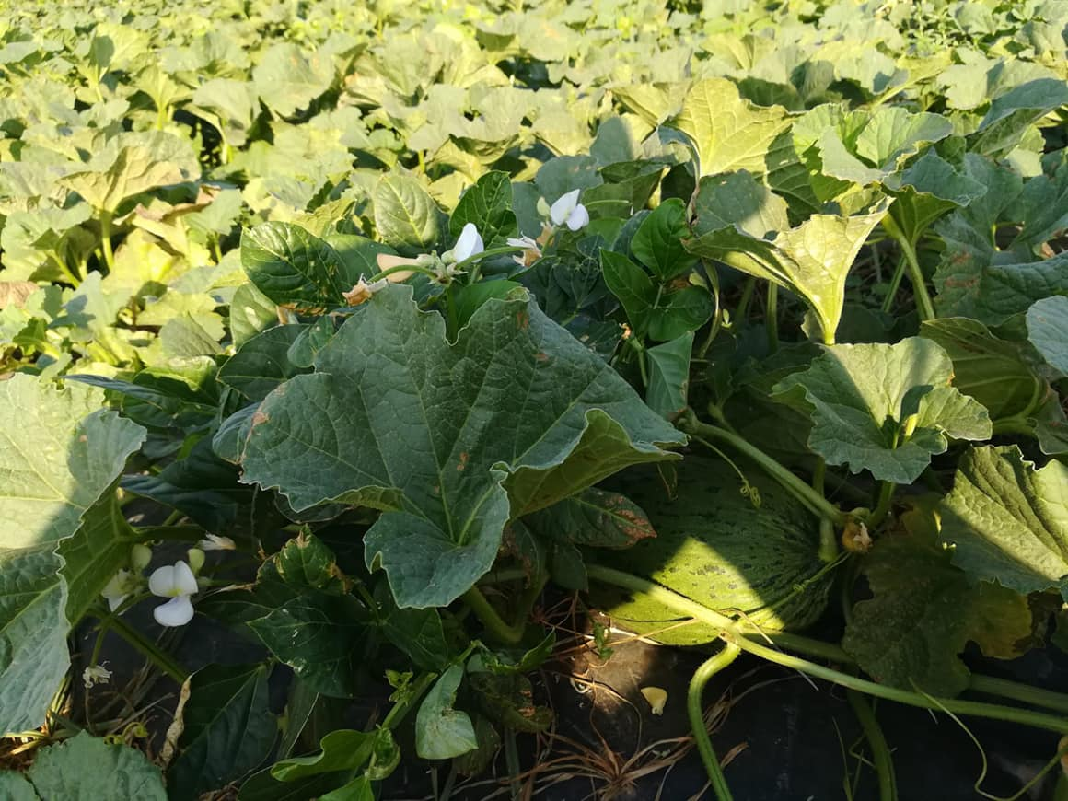
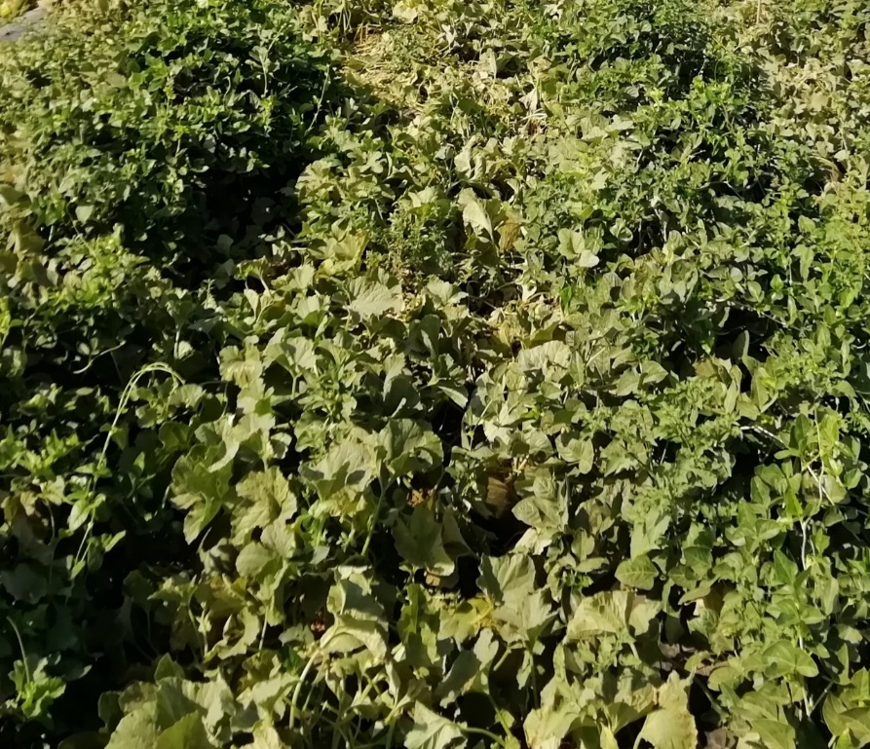
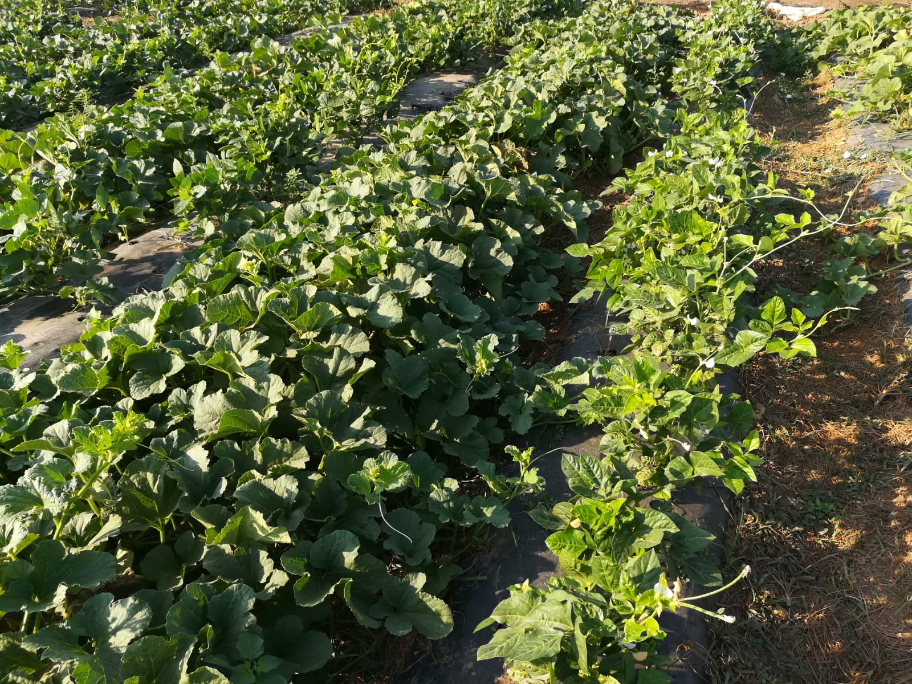
EXPERIMENTAL DESIGN
x3 repetitions were made

Slide 7
EXPERIMENTAL DESIGN
Melon seedlings were planted in a density of 0.4 plants m⁻², with a spacing of 200 cm between rows and 120 cm between plants in all plots (monocropped and intercropped systems).
Cowpea seeds were sown between two rows of melon in the row intercropped systems, spacing 100 cm between melon and cowpea rows. Under row intercropped systems, cowpea was separated 20 cm plants in the same row.
Density of plants was 2.5 plants m⁻² and 1.5 plants m⁻² in the row 1:1 and row 2:1 systems, respectively. In the mixed system, cowpea was sown in all melon rows between two melon plants, and so in a density of 0.4 plants m⁻², with a spacing of 200 cm between rows and 120 cm between plants.

Slide 8
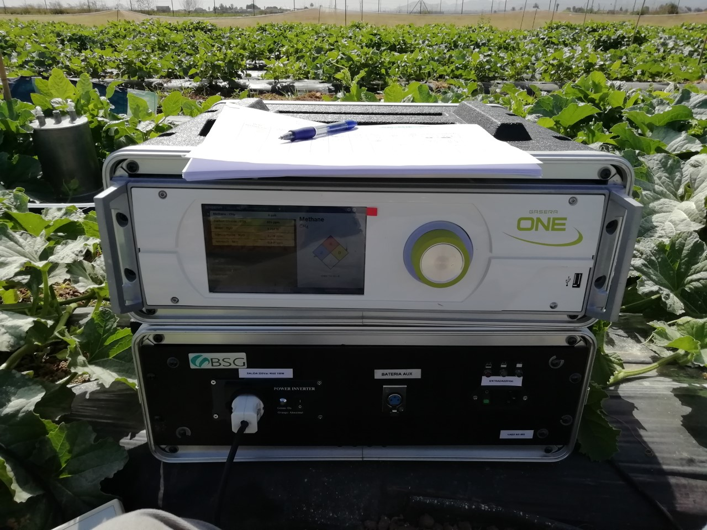
Gas sampling
Soil CO₂ and N₂O emissions were weekly measured in melon and cowpea rows using the dynamic chamber method during one cropping cycle in 2019.
The chamber was made of stainless steel, with an inlet and outlet to connect to an ultrasensitive cantilever photoacoustic infrared spectroscopy analyser Gasera One.
The chambers were inserted into the bare soil to a depth of 10 cm, at 10 cm from the plant stems to ensure that roots would influence N and water uptake in the soil.

Slide 9
Statistical analyses
Data were checked to ensure normal distribution using the Kolmogorov–Smirnov test.
A one-way ANOVA was performed to analyze significant differences in data between the different culture systems, with Tukey’s post hoc analysis at p <0.05.
The relationships between variables were studied using the Pearson correlation.
Statistical studies were performed using IBM SPSS software for Windows version 22.

Slide 10
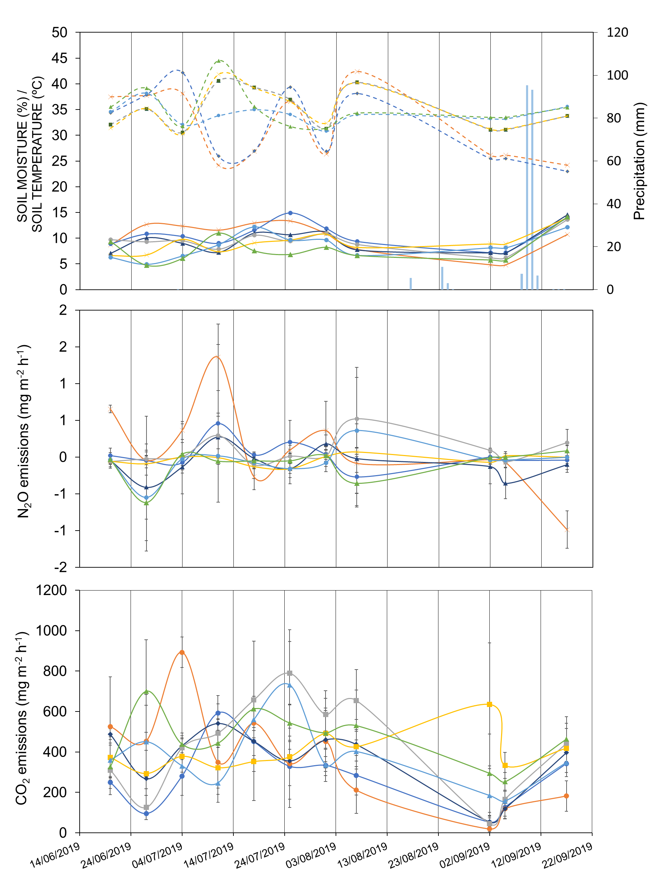
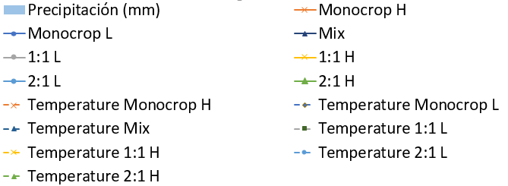
Results
N₂O and CO₂ emission patterns did not directly follow soil moisture or temperature patterns in the experimental period, with no significant correlations.
There were no significant differences among intercropping treatments with regard to NO₂ and CO₂ emissions.
Cowpea harvest:
05.09.2019
Melon harvest:
24.07.2019
Tillage in all systems: 25.09.2019

Slide 11
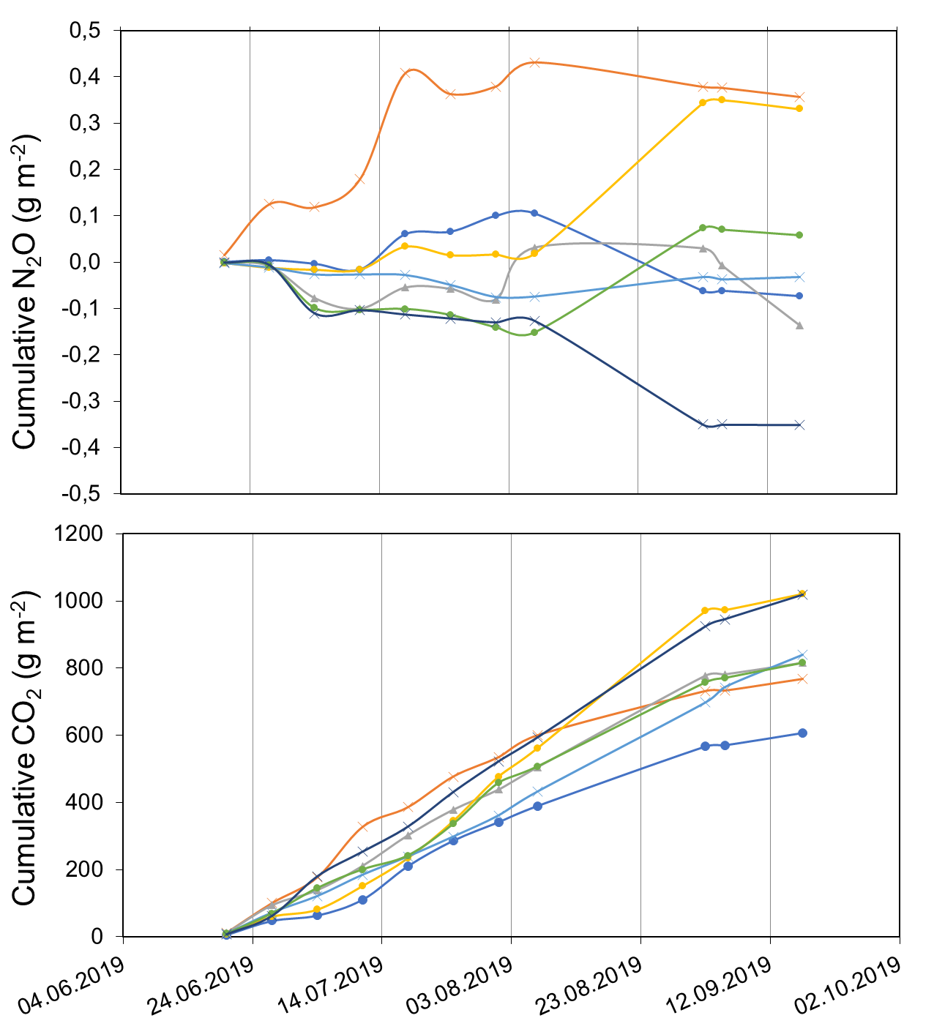
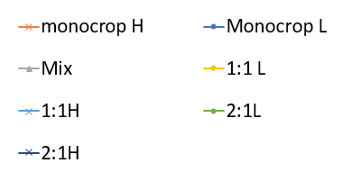

Results
Melon growing as monoculture was related to increases in $N_{2}$O cumulative emissions (0.431 g m⁻²) compared to the average of the rest of treatments (0.036 g m⁻²).
Cowpea growing as monoculture was related to decreases in CO₂ cumulative emissions (390 g m⁻²) compared with the other treatments (512 g m⁻² average).

Slide 12
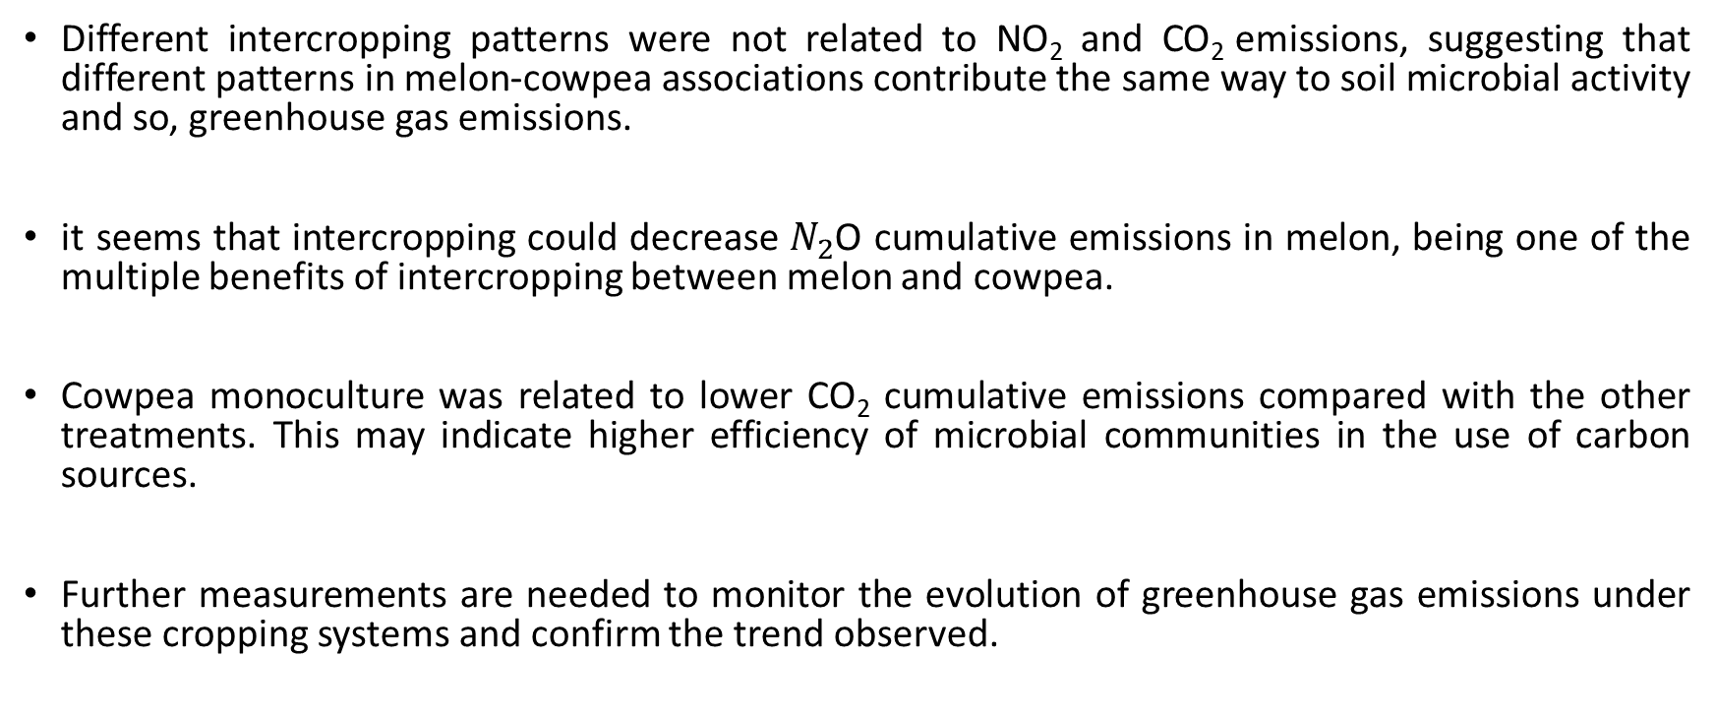
Conclusions
Different intercropping patterns were not related to NO₂ and CO₂ emissions, suggesting that different patterns in melon-cowpea associations contribute the same way to soil microbial activity and so, greenhouse gas emissions.
it seems that intercropping could decrease $N_{2}$O cumulative emissions in melon, being one of the multiple benefits of intercropping between melon and cowpea.
Cowpea monoculture was related to lower CO₂ cumulative emissions compared with the other treatments. This may indicate higher efficiency of microbial communities in the use of carbon sources.
Further measurements are needed to monitor the evolution of greenhouse gas emissions under these cropping systems and confirm the trend observed.

Slide 13

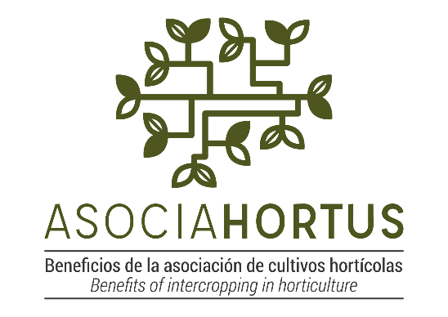

Acknowledgments
This work was supported by the project AsociaHortus [AGL2017-83975-R] funded by Spanish Ministry of Science, Innovation and Universities .
Mariano Marcos acknowledges the financial support from the Spanish Ministry of Science, Innovation and Universities through the “Ayudas para contratos predoctorales para la formación de doctores 2018” Program [PRE2018-085702].
Raúl Zornoza acknowledges the financial support from the Spanish Ministry of Science, Innovation and Universities through the “Ramón y Cajal” Program [RYC-2015-18758].

