Slide 1
Validation for ESA’s Aeolus Mission using the in-situ instruments at Canadian Arctic and reanalysis data
EGU 2020 Online Meeting
May 5th, 2020
C.C. Chou¹, P. Kushner¹, Z. Mariani², P. Rodriguez², S. Laroche² , C. Fletcher³ ¹University of Toronto, Department of Physics, Toronto, Canada. ²Environment and Climate Change Canada. ³University of Waterloo, Department of Geography and Environmental Management, Waterloo, Canada.

Slide 2
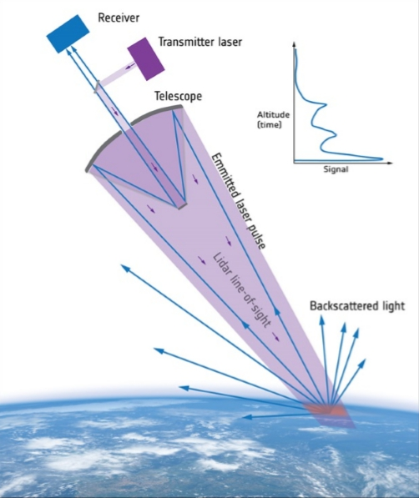
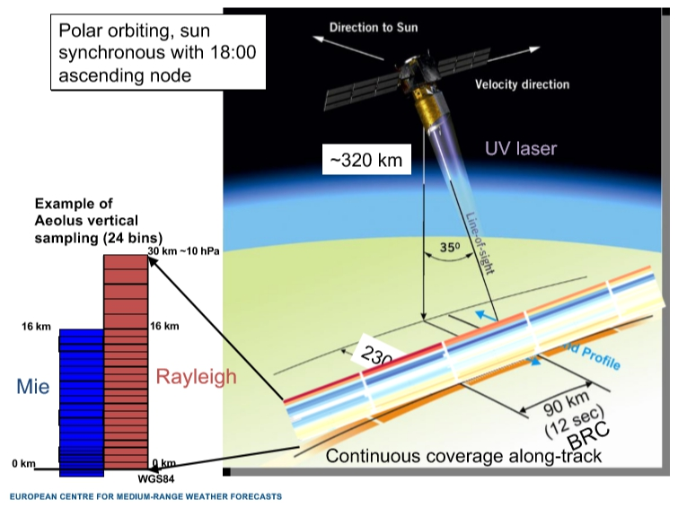
The ESA’s Aeolus Mission
ALADIN: Atmospheric LAser Doppler Instrument
Doppler wind lidar: Measure Doppler frequency shift of backscattered laser light
For Aeolus (UV), scattering from:
Rayleigh scattering from air molecules
Mie scattering from particles (aerosol/cloud)
Aeolus measures profiles of line-of-sight (LOS) winds from 0 to 30 km altitude, perpendicular to satellite velocity
Mostly u-wind information, apart from at poles, where LOS is pointing in v-wind direction
w-wind assumed to be small (negligible)

Slide 3
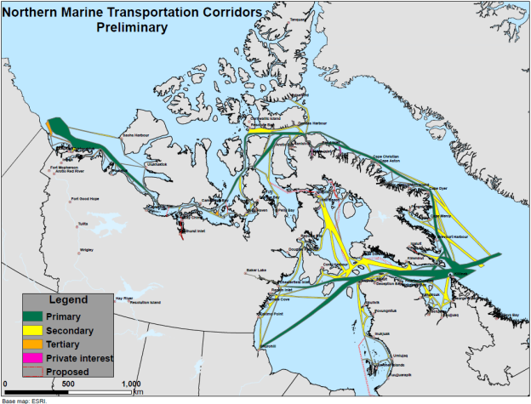
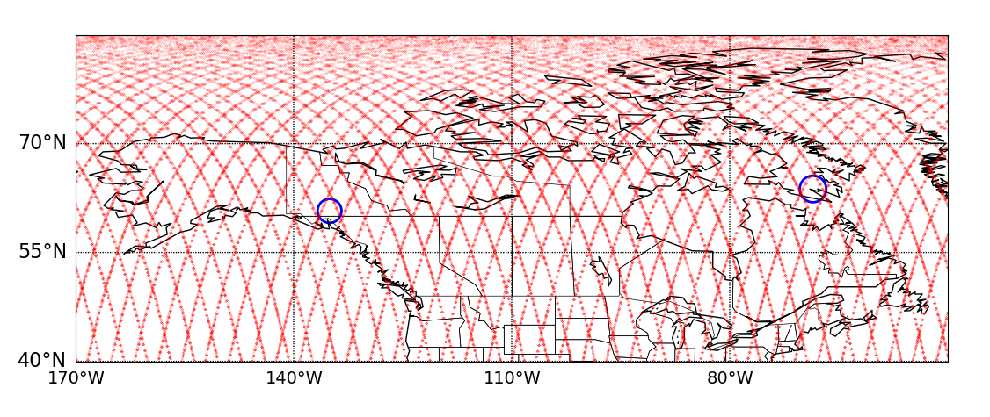
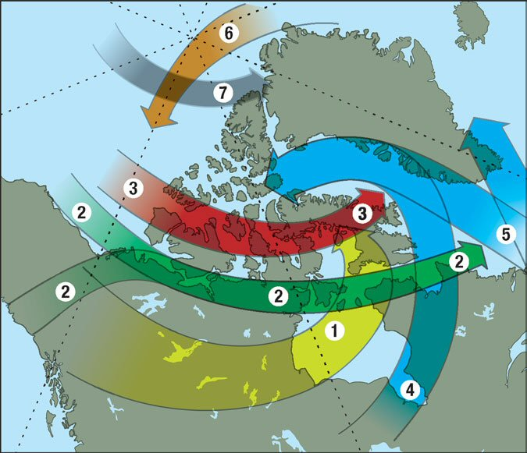
Canadian Contribution for Aeolus Cal/Val Team
ECCC Canadian Arctic Weather Sciences (CAWS)
Iqaluit Supersite (63.75N 68.55W)
Whitehorse Supersite (60.73N 135.06W)
Early FM-B period: August 2nd-September 30th, 2019
Iqaluit & Whitehorse are weather and transportation hot spots
Common storm tracks in the Arctic as identified by MSC operational forecasters
Mariani, Z.

Slide 4
Datasets Used in the Validation of Aeolus Level-2B Product
Datasets | Operation | Wind measurement and temporal/geographic resolution
Background | Short-range (6h) forecast from ECCC | HLOS wind At Aeolus measurement locations
Reanalysis ERA5 | Hourly reanalysis data on pressure levels | U- and V-component of wind 1 hour / 137 pressure levels up to ~80 km range
Radiosondes | Balloon-launched sonde | Profiles of winds 12 hours / ~15 m res. up to ~30 km a.g.l.

Slide 5
HLOS Wind Bias Correction Strategy
The biases of FM-2 HLOS winds are significant and should be corrected as much as possible before using them for data assimilation and validation against other wind measurements
The biases are more important for Rayleigh channel than Mie channel
The biases vary mostly with the orbit node and latitude, and to a lesser extend with longitude and height
ECCC develops a bias correction scheme similar to the ECMWF one:
A dynamic bias correction based on the mean O-B from the previous 7 days as a function of orbit phase and latitude (more specifically argument of latitude) for both Rayleigh and Mie HLOS winds
For the Rayleigh HLOS wind, the correction is also function of longitude (36 degrees wide)

Slide 6
Examples of Bias Corrections
Laroche, S.

Slide 7
Data Screening and Processing
Data screening and processing as recommended by ECMWF for the intercomparison study
Remove all HLOS winds within 20 hPa (~250 m) of the surface (to try to avoid any undetected ground returns)
Remove Rayleigh winds at pressure > 850 hPa
Remove Rayleigh winds with:
estimated errors > 12 m/s if pressure <= 200 hPa
estimated errors > 8.5 m/s if pressure > 200 hPa
horizontal accumulation lengths < 60 km
vertical accumulation lengths < 300 m
Remove Mie winds with ▪ estimated errors > 5 m/s
Additional data screening:
Background Check

Slide 8
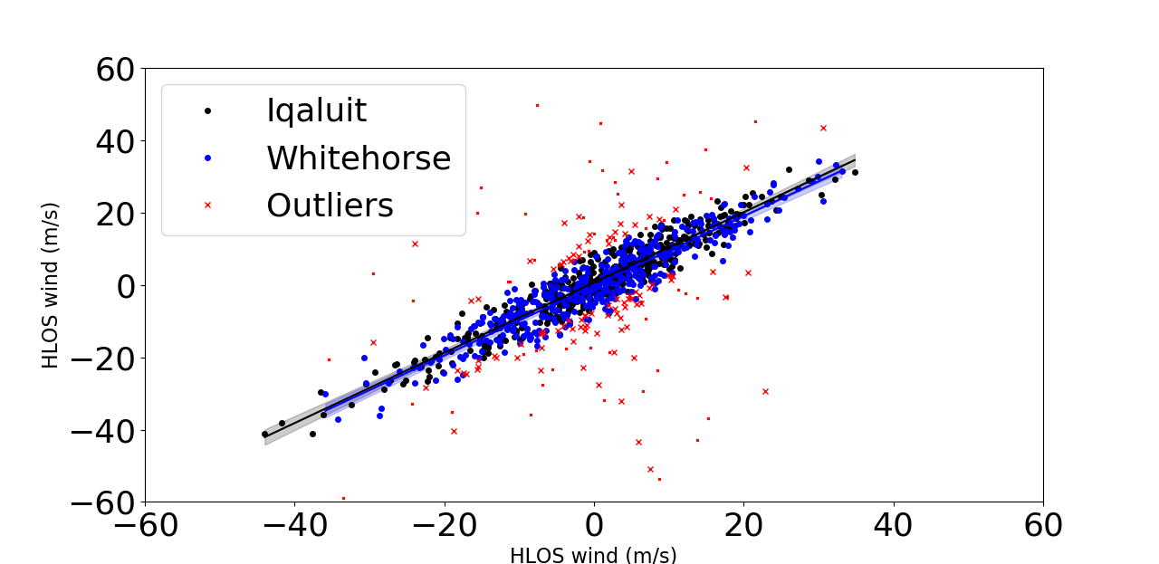
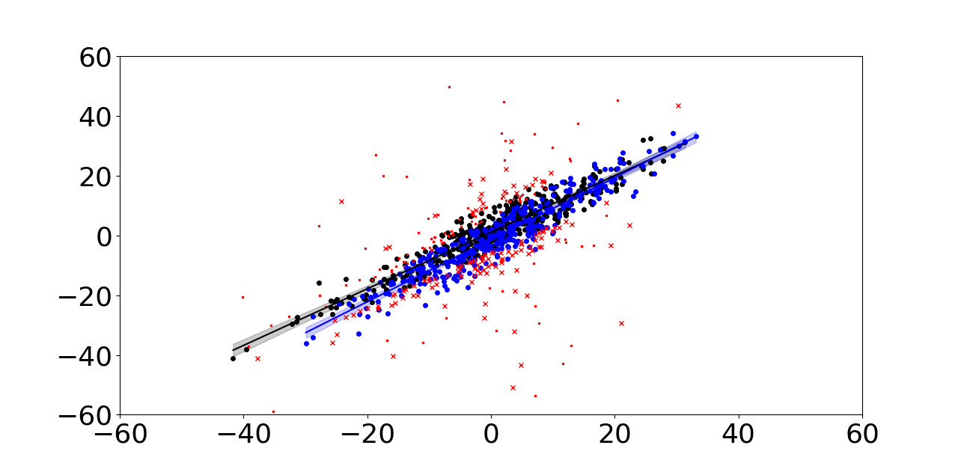
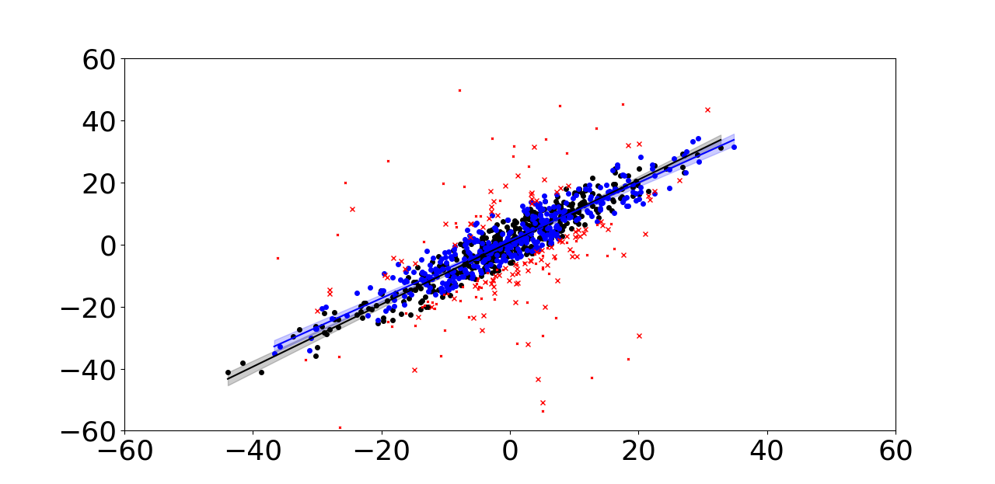
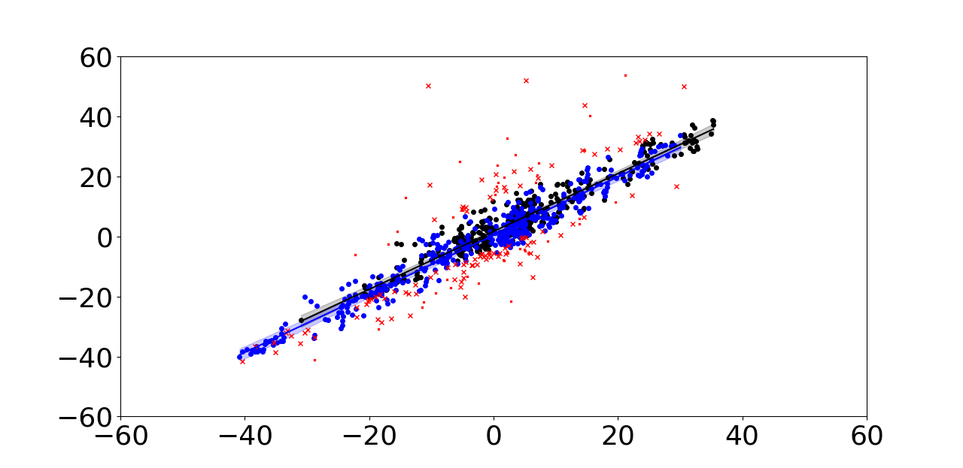
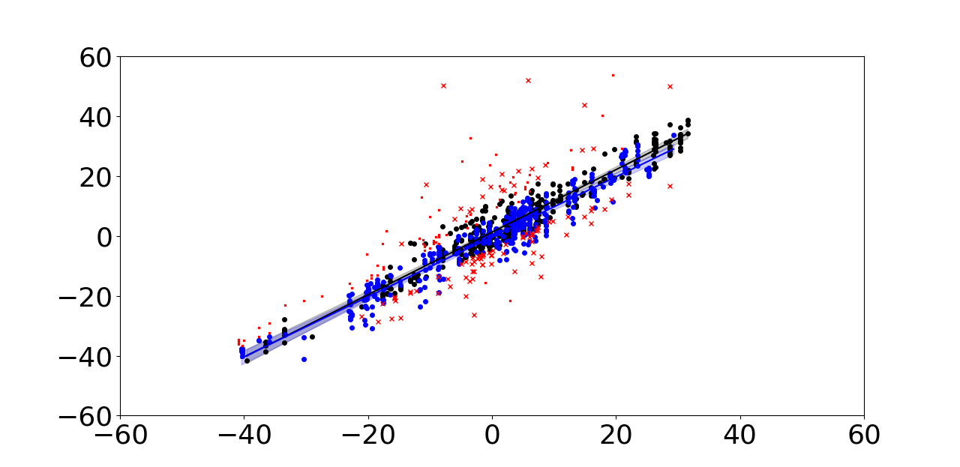
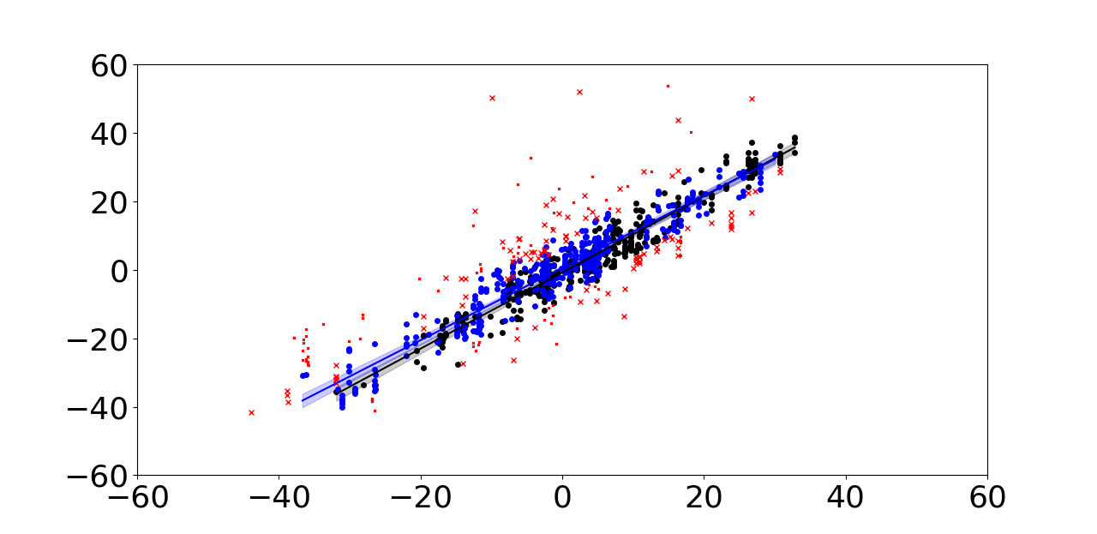
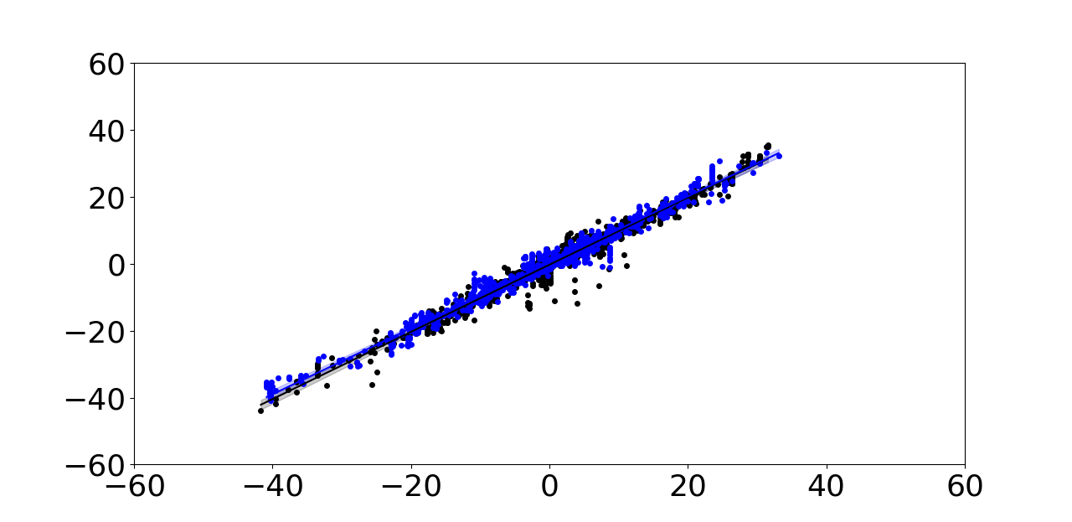
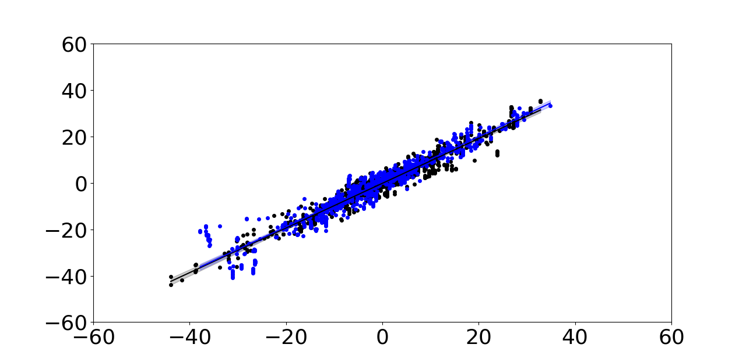
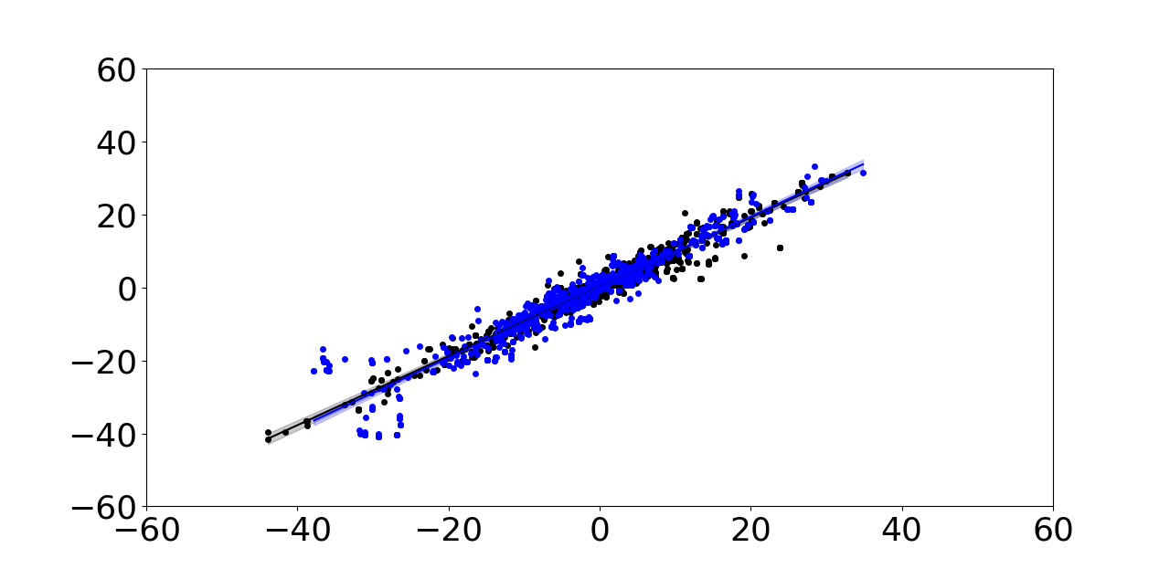
Background
Reanalysis
Radiosonde
Aeolus
Rayleigh clear
Apply RANSAC algorithm to Aeolus measurements
Aeolus
Mie cloud
Background
Reanalysis

Slide 9
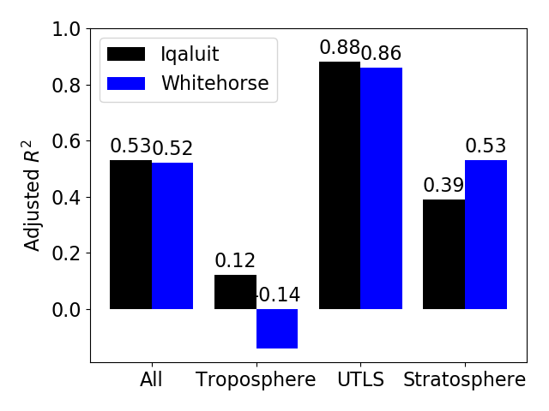
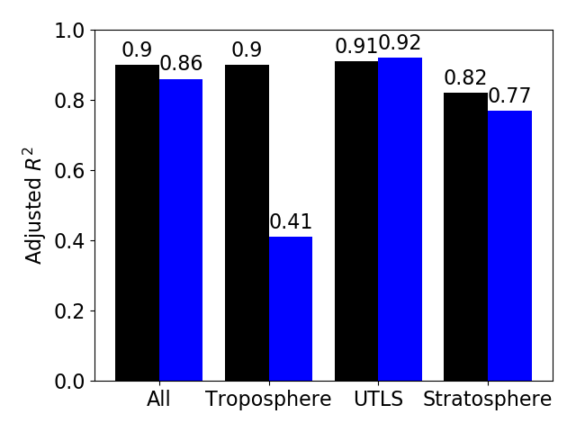
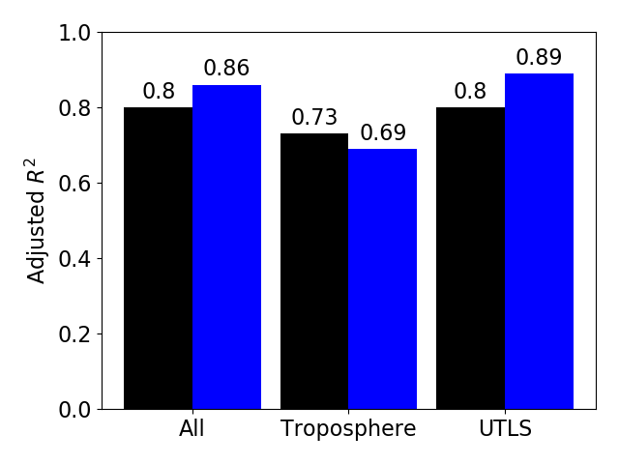
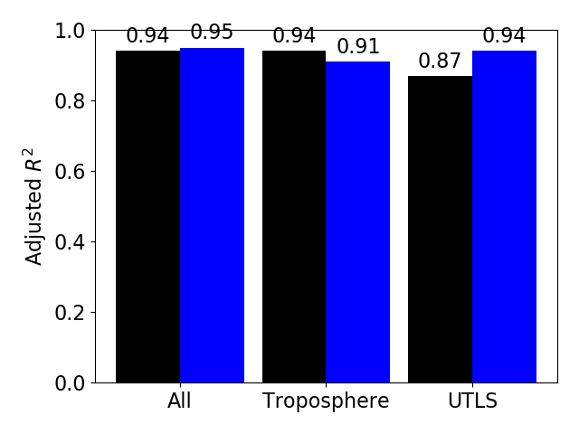
Impact of outliers on r-square in different levels
Background
Aeolus Rayleigh clear
Aeolus is more consistent in the upper troposphere to lower stratosphere (8-16 km)
Aeolus is less consistent in the lower troposphere (2-8 km)
The results from Rayleigh clear are less consistent than from Mie cloud
When excluding the outliers, the r-square between Rayleigh clear and background is still low at Whitehorse in the troposphere
Aeolus Mie cloud
Inliers + Outliers
Inliers

Slide 10
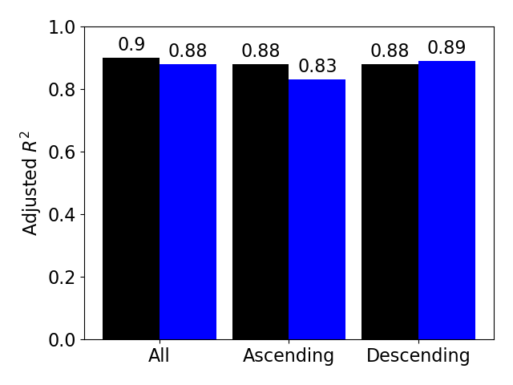
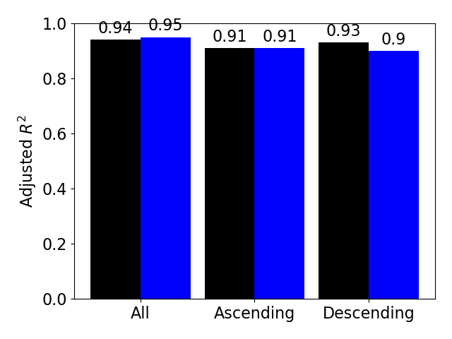
No significant difference is observed in ascending and descending
Background
The inliers using RANSAC algorithm between Aeolus and background show no significant statistical difference between the ascending and descending Aeolus winds
The results of Mie cloud are more consistent than Rayleigh clear
Aeolus Rayleigh clear
Aeolus Mie cloud
Inliers, all level

Slide 11
Conclusions
The ESA Aeolus provides the first global coverage wind profile measurements from space
As Canadian contribution for Aeolus cal/val team, UofT collaborates with ECCC to validate the Aeolus Level-2B product at Iqaluit and Whitehorse supersites
Biases were corrected using O-B statistics where background is the short-range forecast at ECCC
Bias corrected and quality controlled Aeolus winds are noisier than other datasets
Aeolus is more consistent with other datasets in the upper troposphere to lower stratosphere
The results from Rayleigh clear are less consistent than from Mie cloud
The agreement has significantly improved when we excluded the outliers using the RANSAC algorithm, especially for the Rayleigh channel
Biased corrected ascending and descending winds perform similarly

