Slide 1
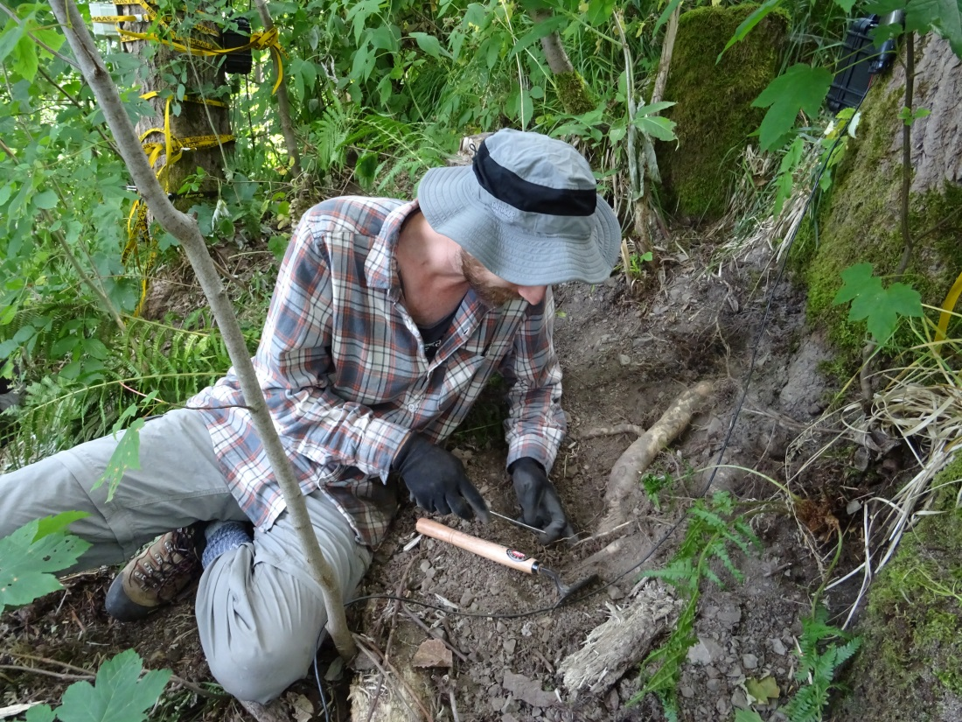
Respiration and C dynamics in Poplar roots Boaz Hilman ¹, Jan Muhr^{1,2}, Juliane Helm ¹, Iris Kuhlmann ¹, Susan Trumbore ¹ ¹ Department of Biogeochemical Processes, Max-Planck Institute for Biogeochemistry, Jena, 07745, Germany ² University of Goettingen, Bioclimatology, Faculty of Forest Sciences, Germany

Slide 2
Introduction
Fine roots (≤ 2mm) are estimated to contain ~40 Pg C globally that equal to ~1/3 of GPP (Jackson et al., 1997)
We know that in temperate and boreal forests the radiocarbon age of fine roots might be a decade older than their chronological age (Solly et al., 2018)
Such discrepancy can be explained by allocation of stored old C to build the tissue
Only little is known about the C dynamics in the roots

Slide 3
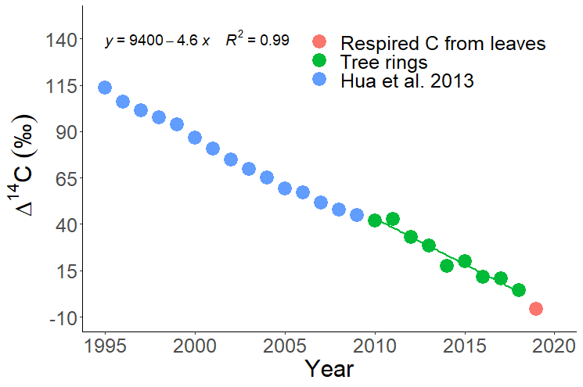
Estimating the mean time elapsed (‘age’) since the carbon was fixed from the atmosphere using radiocarbon
Age
ΔΔCO₂
The estimated composition of atmospheric CO₂ in our site

Slide 4
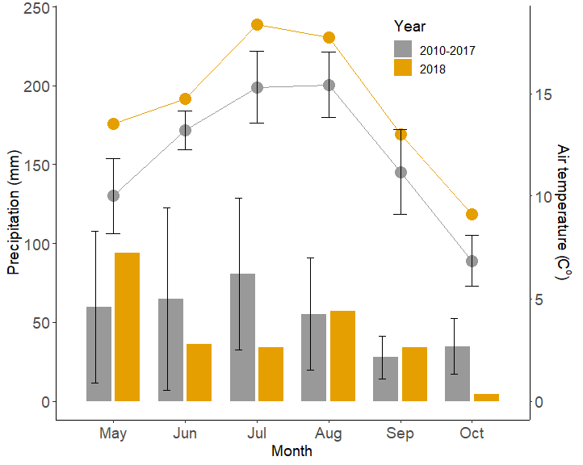
Experimental design
We sampled roots from 12 poplar trees (Populus tremula hybrids) grow in a forest stand in Germany
Roots were divided to:
Coarse roots (>2 mm) mean diameter 2.91 mm
Fine roots (<2 mm)
Field work conducted during 2018 exceptional hot summer in Europe - and also in our site as can be shown in the figure
In 2019 we harvested roots that grew through screens buried before winter to estimate the age of current year roots
Second sampling
Burial of in-growth screens
Girdling
Gaundinski et al 2010 GBC

Slide 5
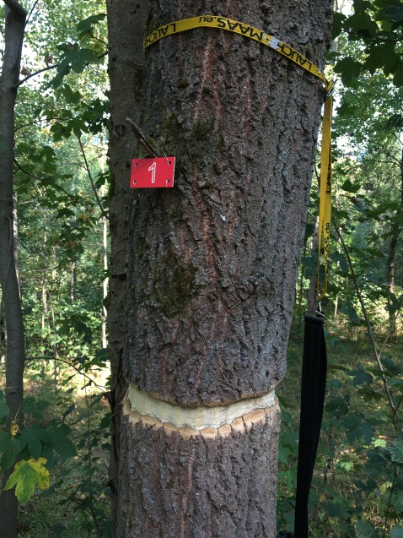
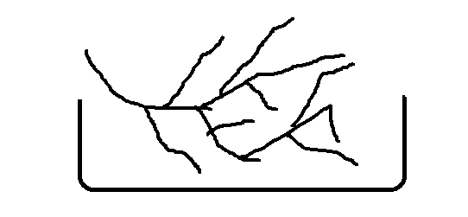
Manipulations of the carbon supply to the roots
Girdling: the removal of bark and phloem
blocks the supply of fresh C to belowground
Roots collected in the field were kept moist and re-incubated for three weeks

Slide 6
Scheme of carbon dynamics in a root (based on Richardson et al., 2013)
Input from phloem
metabolism
Respired C
fast storage pool
The incoming C is stored in ‘fast storage pool’ (usually sugars). From this pool C is allocated to growth, storage, and metabolism (respiration).
We measured the radiocarbon in the purple pools:
Fast storage pool –represented by the respired CO₂
Storage C – represented by water-soluble metabilites Structural C – alphe-cellulose
Storage C (NSC)
slow storage
Growth
Structural C

Slide 7
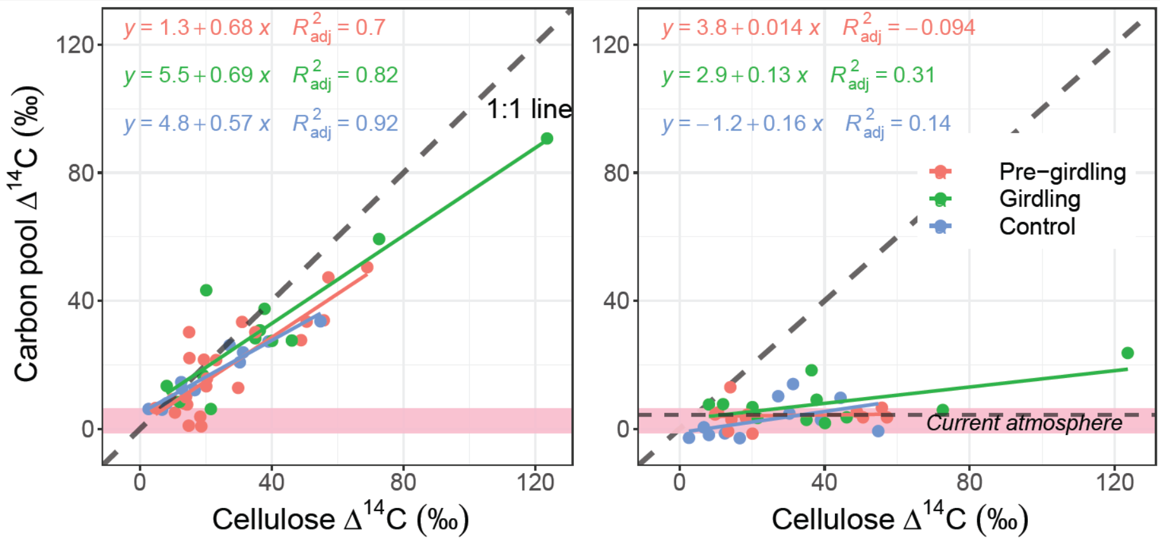
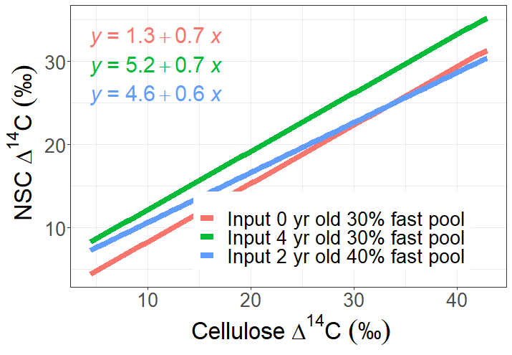
NSC vs. structural Δ¹⁴C results
Relation between the Δ¹⁴C content of NSC and structural C
Results can be interpreted according to a simple mixing model (example with 3 scenarios in the bottom) where the relation can be manipulated by changing the fast pool Δ¹⁴C (input) and the fraction of the fast pool from total storage. The Δ¹⁴C of the slow pool is equal to cellulose age.
The slope of the relation is determined by the fraction of the fast pool. Thus, the fast pool fraction increased from 30% (pre-girdling) to 40% (control trees, 3 months later)
Older C input will shift the intercept towards higher values. In both control and girdled trees we observed this shift
*
NSC vs. structural Δ¹⁴C mixing model after Richardson et al. 2015

Slide 8
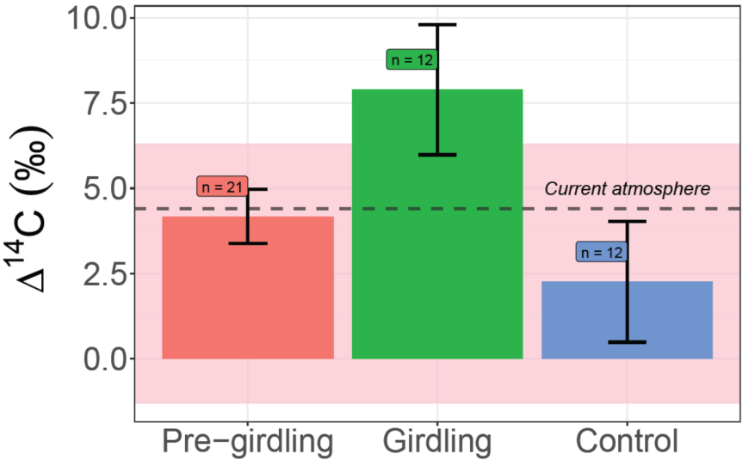
NSC vs. structural Δ¹⁴C Respired CO₂ vs. structural Δ¹⁴C
In contrast to NSC in intact trees the respired CO₂ was unrelated to structural C
But in the girdled trees the respired CO₂ correlated with structural C –evidence for contribution of local storage to respiration
*

Slide 9
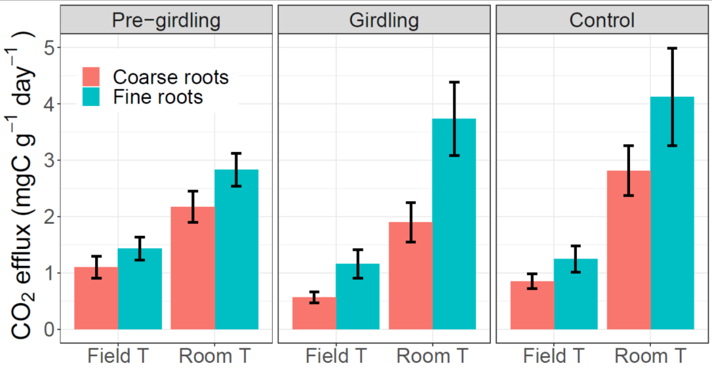
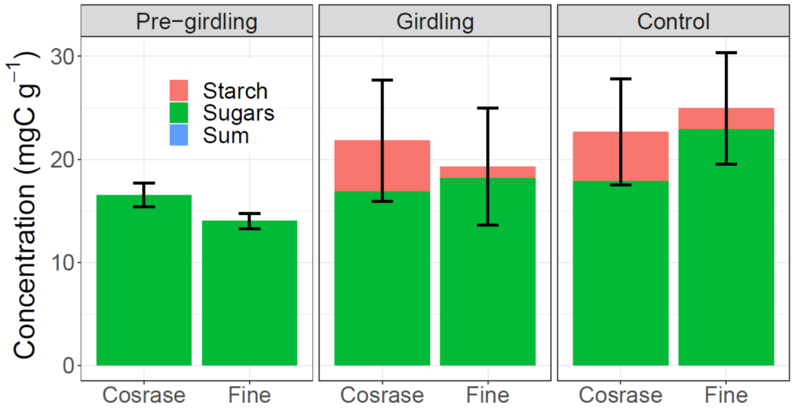
NSC concentration and CO₂ efflux rate
We converted the CO₂ efflux rate measured at room temperature (Room T) to field temperature (Field T) using Q₁₀ = 2.3 measured in sub-sample of roots (n=11). The Q₁₀ factor means that 10ºC warming causes 2.3-fold higher efflux rate
Fine roots respired faster than coarse roots, with no seasonal or girdling effect
NSC concentrations did not varied significantly with season or girdling
Turn over times are 17.3 days for fine roots and 26.5 days for coarse roots.
In the days passed since girdling (82) fine roots were expected to turned over stored C nearly 5 times, while coarse roots 3 times
In this campaign starch was not measured

Slide 10
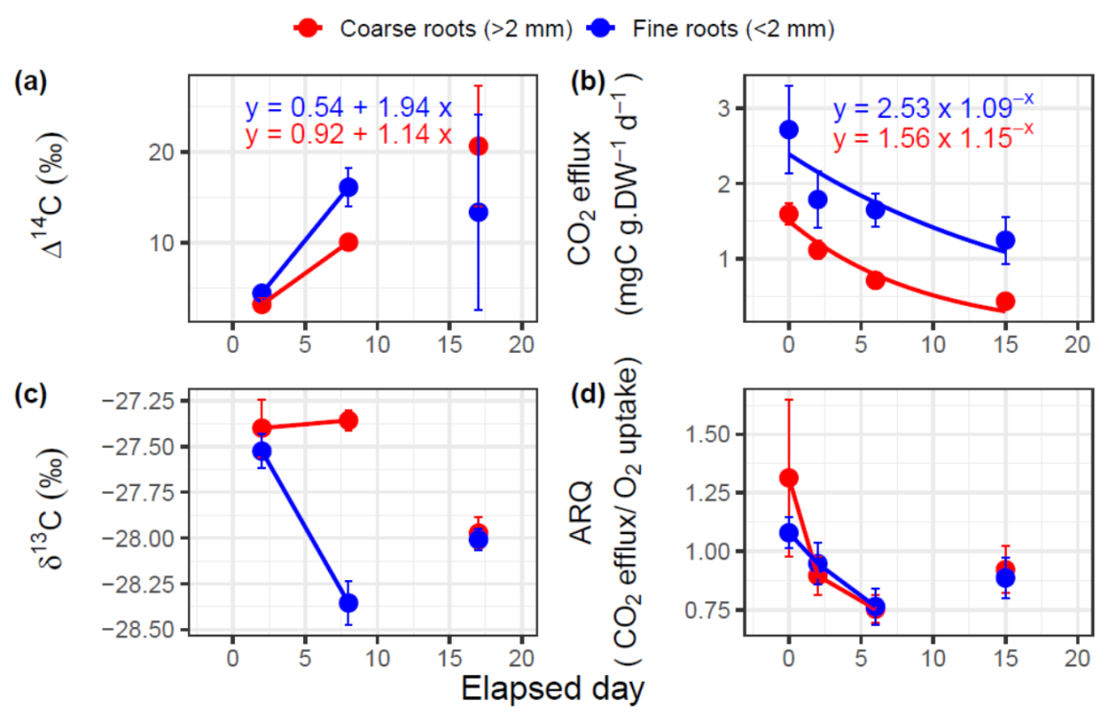
Repeated respiration incubations of stored roots
Of respired CO₂
Strong response of respiration to storage time in first 8 days-
Increase in Δ¹⁴C – storage with old C was used
Decrease in respiration rate
Decrease in δ¹³C and ARQ – probably change in respiratory substrate
But incubation in days 15 and 17 are less consistent, maybe the roots reacted with laboratory CO₂
Fast pool can be defined as the amount of C with Δ¹⁴C signature of current year
With confidence interval of two analytical errors we defined 8.2‰ as the threshold – all C with Δ¹⁴C below that value belongs to the fast pool.
Of respired CO₂
 | Coarse roots | Fine roots
How many days the fast pool lasted? | 6.4 days | 3.9 days
How much C respired in these days? | 5.9 mgC | 6.3 mgC
Maximal Δ¹⁴C | 42.2‰ ~ 9 yr | 28.6‰ ~ 6 yr

Slide 11
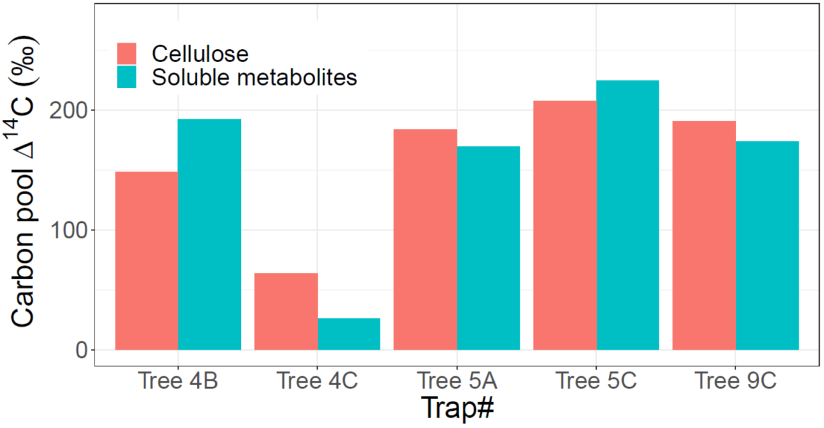
Newly grown roots harvested in summer 2019
The mean cellulose- Δ¹⁴C signature corresponds to the atmospheric CO₂ observed in 1989 (31 years ago) !

Slide 12
Conclusions
The good correlations between NSC and cellulose Δ¹⁴C suggest most of the C storage (slow pool) is not used regularly
However, the slow pool is accessible for metabolism when needed
The fast pool storage that supports respiration is ~30%-40% of total storage and it contains C fixed in current year
The size of the ‘fast pool’ storage that supports respiration is ~6 mgC g⁻¹
Almost 3 months after girdling storage pools and CO₂ efflux rate were stable
Almost 3 months after girdling the respired CO₂ was only slightly older than in the control trees, unlike respired CO₂ from stored roots that increased rapidly, suggesting the fast pool was replenished by relatively young C from the lower stem or main roots.
New roots can be formed by extremely old C

