Slide 1
AGEO
Natural hazard prevention and awareness raising through citizen observatories.
Ariadna Ortega Rodriguez, Rui Carrilho Gomes, Filipe Telmo Jeremias, Juan Carlos Santamarta Cerezal, Lidia Quental, Inés Galindo Jiménez,Vitor Correia, Cláudia Narciso Pinto, Nicolas Le Dantec, Fátima Gouveia, Kirstin Lemon, Alain Hénaff, and Gregory O’Hare

Slide 2
Interreg Atlantic Area
What is AGEO?
Goals
Citizen Observatories
Pilots

Slide 3

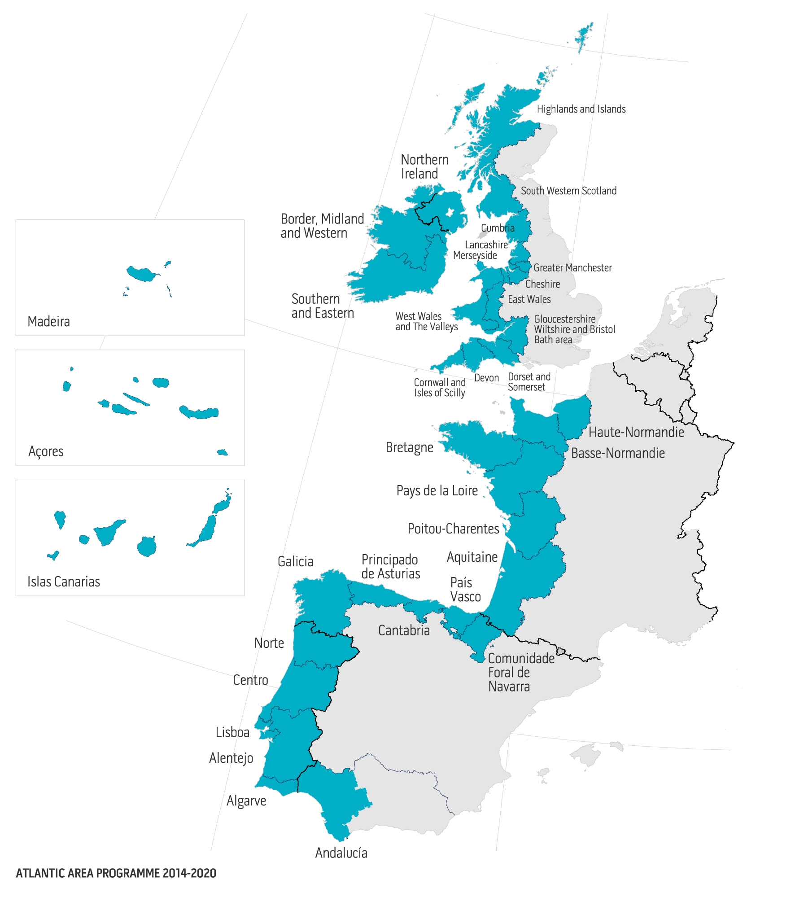
Interreg Atlantic Area
INTERREG Atlantic Area is an European funding programme that promotes transnational cooperation among 36 Atlantic regions of five European countries this programme co-finances cooperation projects in the fields of Innovation & Competitiveness, Resource Efficiency, Territorial Risks Management, Biodiversity and Natural & Cultural Assets.
Notes:
INTERREG Espacio Atlántico es un programa de financiación europeo que promueve la cooperación transnacional en 36 regiones atlánticas de cinco países europeos.), este Programa cofinancia proyectos de cooperación en los campos de la Innovación y Competitividad, Eficiencia de los Recursos, Gestión de Riesgos Territoriales y, Biodiversidad, Patrimonio Natural y Cultural.

Slide 4
Interreg Atlantic Area Priorities
Priority 3: Strengthening the territory's resilience to risks of natural, climate and human origin
Priority 1: Stimulating innovation and competitiveness
Priority 4: Enhancing biodiversity and the natural and cultural assets
Priority 2: Fostering resource efficiency
Notes:
INTERREG Espacio Atlántico es un programa de financiación europeo que promueve la cooperación transnacional en 36 regiones atlánticas de cinco países europeos.), este Programa cofinancia proyectos de cooperación en los campos de la Innovación y Competitividad, Eficiencia de los Recursos, Gestión de Riesgos Territoriales y, Biodiversidad, Patrimonio Natural y Cultural.

Slide 5
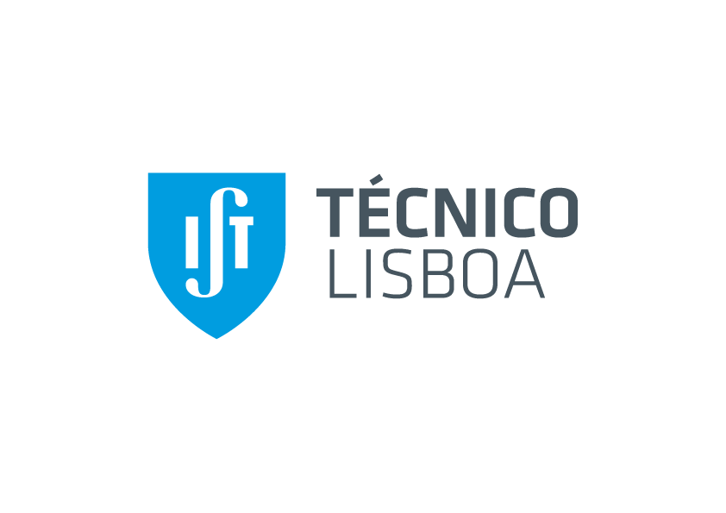
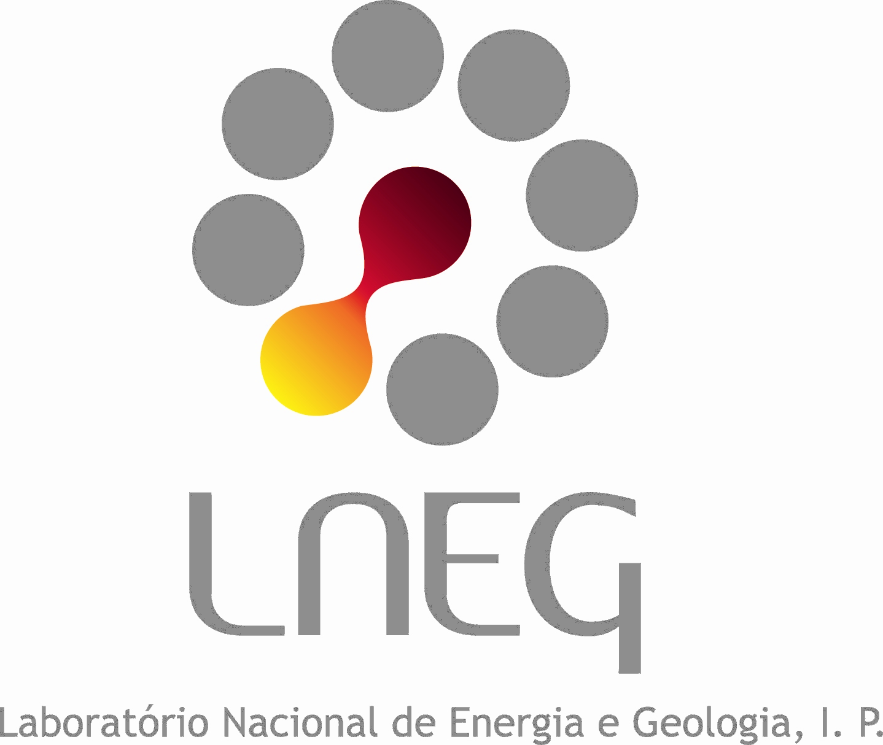












Consortium
Notes:
14 socios de 5 países: España, Portugal, Irlanda, Reino Unido y Francia.

Slide 6
Notes:
Plataforma de cooperación – a través de una aplicación móvil/web
Copernicus – talleres y jornadas informativas, otras acciones
Observatorios Ciudadanos – resultados de la plataforma/Proyecto y a través de talleres, actividades para la población general

Slide 7



Specific Objectives
Encourage the regional-level uptake and use of products and services provided by European spatial data infrastructures, such as Copernicus or EGDI.
Create a cooperation and resource platform on Atlantic geohazards risk assessment, preparedness, mitigation and prevention.
Deliver concrete case studies to confirm the capacities of Citizens’ Observatories in improving risk management systems.
Notes:
Plataforma de cooperación – a través de una aplicación móvil/web
Copernicus – talleres y jornadas informativas, otras acciones
Observatorios Ciudadanos – resultados de la plataforma/Proyecto y a través de talleres, actividades para la población general

Slide 8


Citizen Science
Citizen Observatories
Citizen Observatories¹ → Citizens' Observatories are community-based environmental monitoring and information systems.
They build on innovative and novel Earth observation applications embedded in portable or mobile personal devices.
This means that citizens can help and be engaged in observing our environment.
^{1.} Definition by the European Commission: https://ec.europa.eu/easme/en/news/have-you-heard-about-concept-citizens-observatories

Slide 9
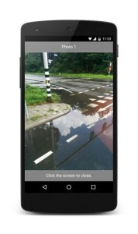
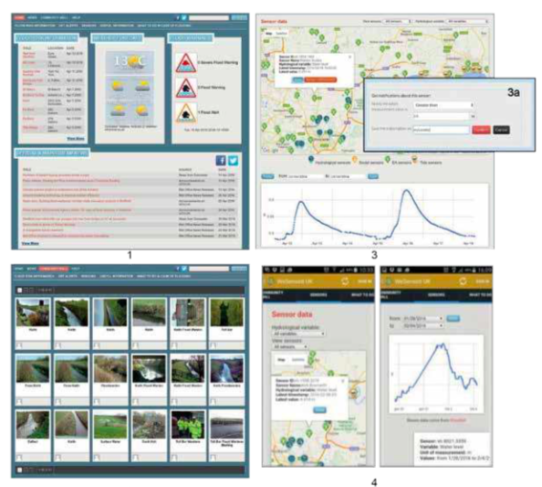
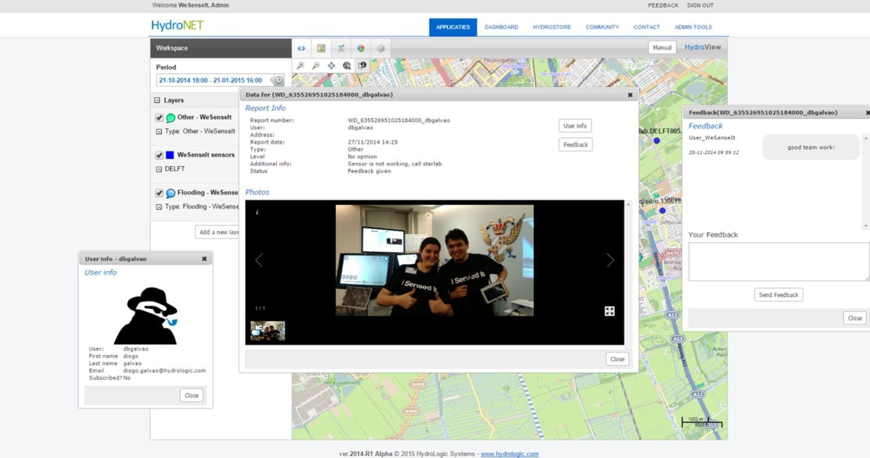
Citizen Observatories
Examples for AGEO : WeSenseIt

Slide 10
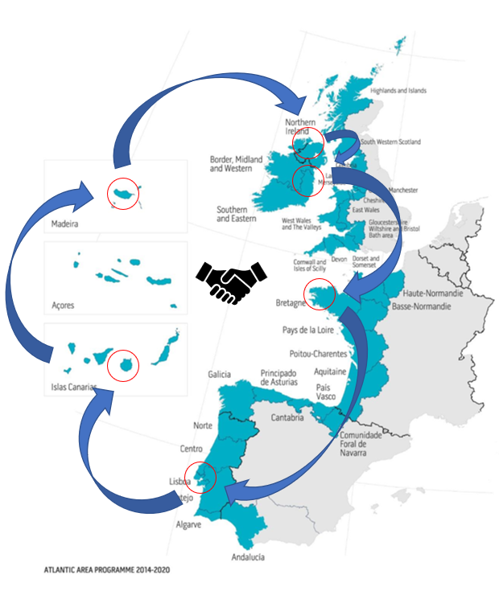
7 Pilots on regional priorities
Citizens’ Observatory on rockfalls and rockfall-triggers in the Canary Islands, Spain
Peat-slides and peat massmovement monitoring and control in Cuilcagh Mountain, Northern Ireland
Multi-hazard Citizens’ Observatory in Lisbon, Portugal
Citizens’ Observatory of slope instability monitoring along the Cliffs of Moher, Ireland
Citizens’ Observatory of vulnerability to coastal Risks in Brittany, France

Slide 11
Pilots’ phases
Stakeholder engagement: First phase already in swing are a series of workshops and info days in all participating regions for the identified stakeholders.
Citizen awareness: With the help of the stakeholders, citizens will be reached to a local level and be made aware of the project and the geohazards faced by their regions.
Citizen engagement: During the citizen awareness campaign, those interested will be informed about the online tool to be developed and the activities organised for the consecution of the data gathering.
Data gathering: Citizens are key for the collection of massive amounts of data throughout the implementation of the pilots, thus helping the consortium prove the effectiveness of the Citizen Observatories and its usefulness for prevention, policy and resilience in areas prone to geohazards.
Data processing: Once the pilots are over, all results -from societal to policy level- will be compiled and published.
Notes:
CITIZEN ENGAGEMENT / APPLICATION / OTHER CITIZEN OBSERVATORIES / CLUSTERING ACTIVITIES – COLABORAR

Slide 12
Clustering
AGEO is looking for further capitalisation and collaboration through clustering with other relevant initiatives or projects in the areas of:
Citizen Science / Observatories
Geo-hazard prevention, resilience and policy
Products and services provided by European spatial data infrastructure
CONTACTS
Coordinator: Rui Carrilho Gomes - Rui.carrilho.gomes@tecnico.ulisboa.pt
Capitalisation: Vitor Correia - vcorreia@apgeologos.pt
Communication: Ariadna Ortega – Ariadna.ortega@lapalmacentre.eu

Slide 13
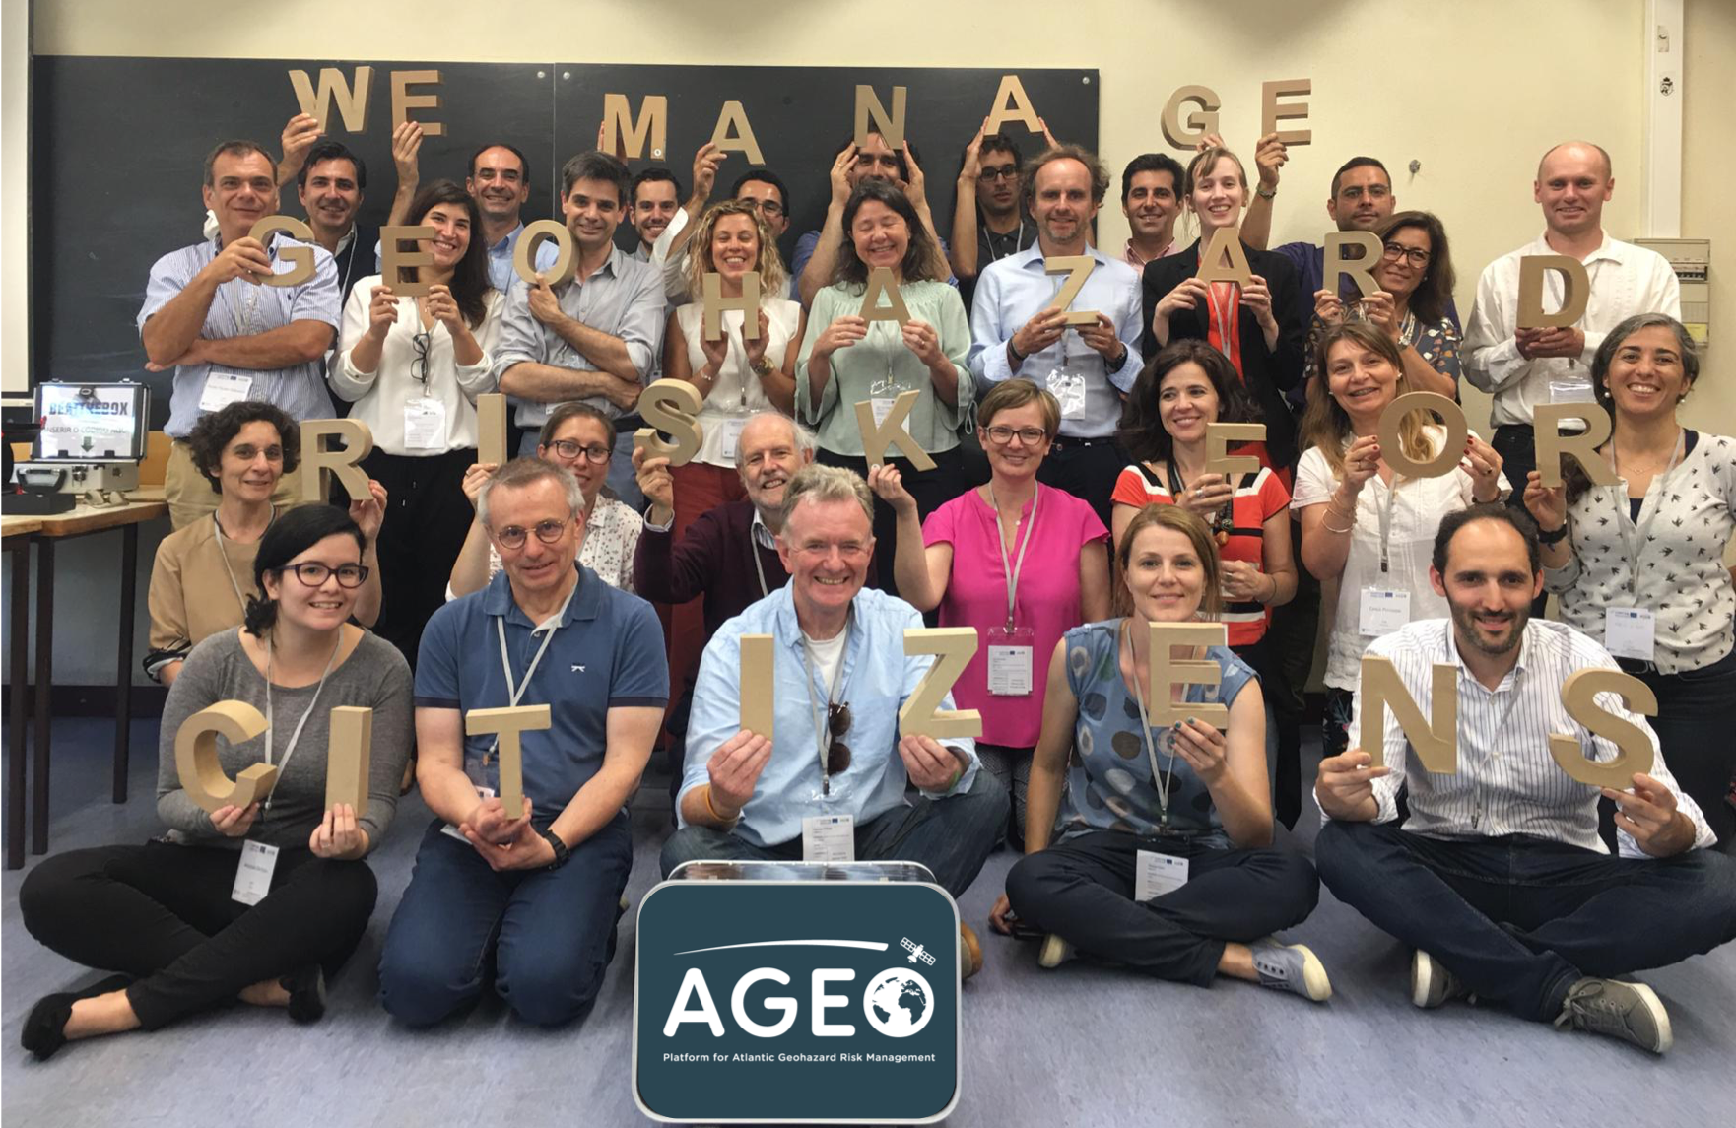
¡GRACIAS POR SU ATENCIÓN!
ARIADNA.ORTEGA@LAPALMACENTRE.EU
WWW.LAPALMARESEARCH.EU

