Slide 1

Aircraft-borne measurements of HONO and other UV/vis absorbing trace gases during EMeRGe Europe and Asia in 2017/2018
Benjamin Schreiner¹, Birger Bohn², Katharina Kaiser³, Flora Kluge¹, Mariano Mertens⁴, Meike Rotermund¹, Johannes Schneider³, and Klaus Pfeilsticker¹
¹Institute for Environmental Physics, University of Heidelberg, Heidelberg, Germany
²Forschungszentrum Jülich
³Max Planck Institut für Chemie, Mainz, Germany
⁴Institute of Atmospheric Physics, Deutsches Zentrum für Luft und Raumfahrt, Germany
Contents
  An overview of the EMeRGe campaign and its objectives
  The air-borne mini-DOAS instrument and the scaling method
  Retrieved trace gas profiles
  Inter-comparison results and sample spectral HONO fits
  HONO as a function of relative humidity and aerosol composition
  Summary & Outlook
Notes:
<number>
<number>

Slide 2
Overview of EMeRGe objectives
  to measure NO₂, HONO, CH₂O, BrO, IO, SO₂, C₂H₂O₂, C₃H₄O₂* if detectable. These measurements are provided to the Schumann et al., comparison as well as serve for the measurement model inter-comparisons (MECO, WRF/CMAQ, etc.) (ongoing)
  to study the NO_{X} partitioning (NO₂/NO) as function of O₃, J(NO₂), HO₂, i.e. the Leighton ratio → oxidation potential of the investigated air masses. Here the NO₂ measurements are contributing to the NO_{X}/NO_{Y} partitioning study of H. Ziereis (ongoing)
  To investigate the oxidation of VOCs via measured CH₂O, C₂H₂O₂, C₃H₄O₂* → CO Comparison of mini-DOAS CH₂O measurements with HKMS (ongoing)
  to detect BrO, IO, in pristine air from marine emissions and/or salt pans (Tainan) and SO₂ emitted from power plants (tbd)
  to monitor HONO via its formation reaction NO + OH, and destruction by photolysis. Ongoing is the investigation on the reasons for the excess HONO (HONO_{meas} – HONO_{model}), i.e. on a missing HONO source in the boundary layer and free troposphere (this talk)
1/17

Slide 3
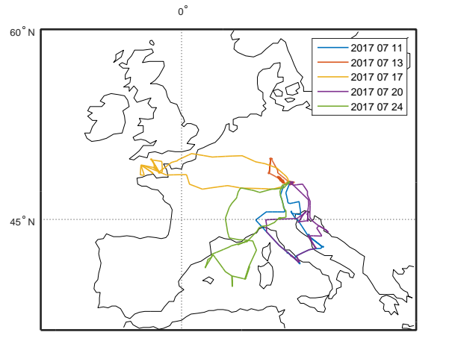
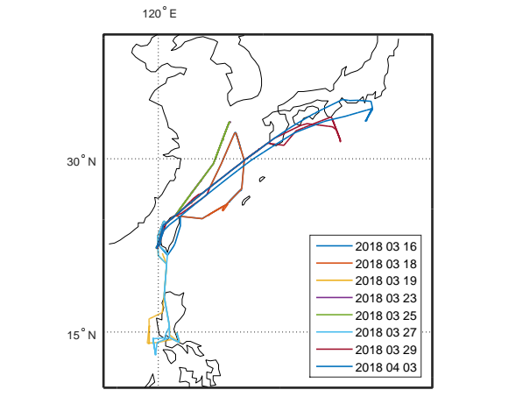
HALO Flight Tracks from EMeRGe
Europe (summer 2017) Asia (spring 2018)
OP
Tainan
More information on EMeRGe can be found here:
http://www.iup.uni-bremen.de/emerge/home/home.html

Slide 4
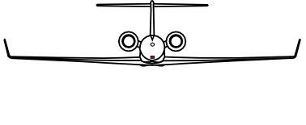
HALO mini-DOAS: Basic Features
Measurement principle:
Remote sensing of UV/vis/near-IR skylight
in nadir and limb scanning geometry
the focus here is on limb data
Data Evaluation includes 3 steps:
Retrieval of trace gas slant column densities (SCDs) using the DOAS method (Platt & Stutz, 2008)
Forward radiative transfer modelling for each measurement using McArtim (Deutschmann et al., 2011)
Concentration retrieval using the novel scaling method for UV/vis data (Stutz et al., 2017, Hüneke et al., 2017; Werner et al., 2017).
 | Wavelength Region [nm] | Resolution FWHM [nm] | Field of View [deg] | Targeted Trace Gases
UV | 310 – 440 | 0.72 | 0.4 | O₄, O₃, HONO, SO₂, CH₂O, BrO, OClO
VIS | 420 – 550 | 0.76 | 0.4 | O₄, O₃, NO₂, C₂H₂O₂, C₃H₄O₂, H₂O(g), IO, I₂
NIR | 1100 - 1680 | 4-7 | 0.52 | H₂O: vapor, liquid, ice CO₂, CH₄

Slide 5
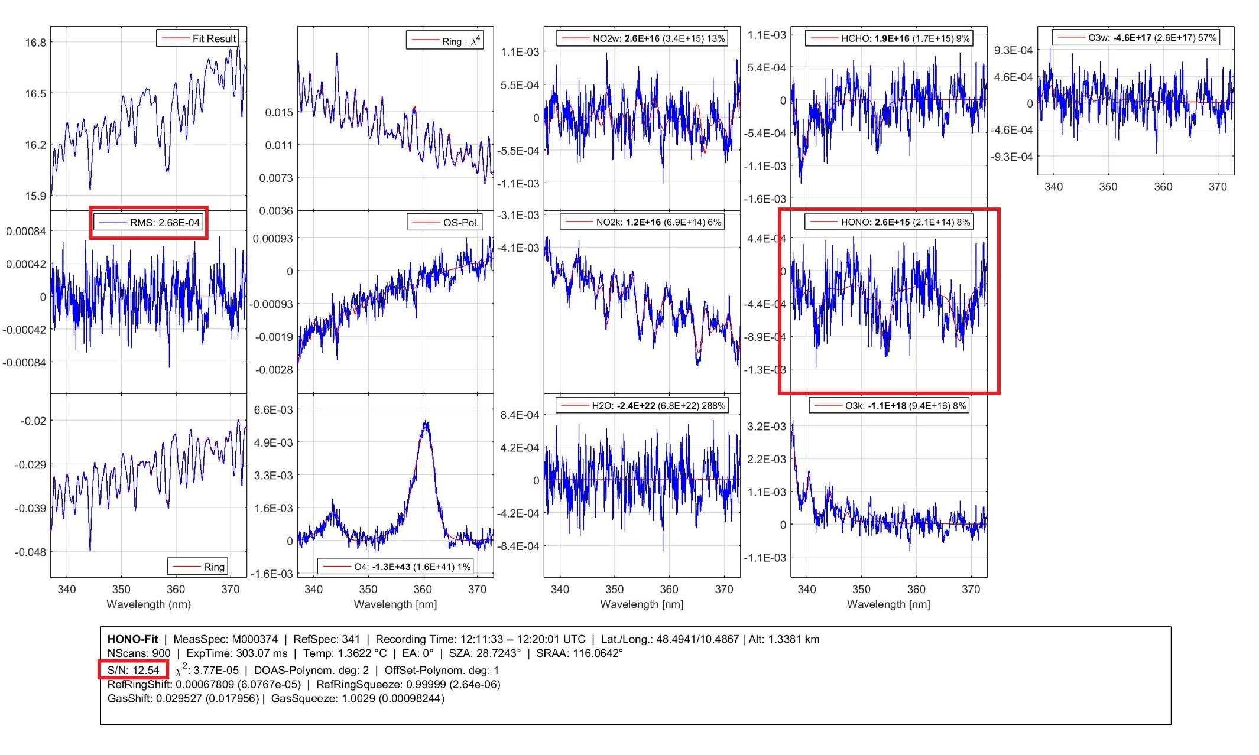
DOAS Detection of HONO from the HALO/FAAM Inter-comparison (13/07/17)
CH₂O
O₃
NO₂
NO₂
S/N~12.5
O₄
O₃
HONO
H₂O
S/N: 13

Slide 6
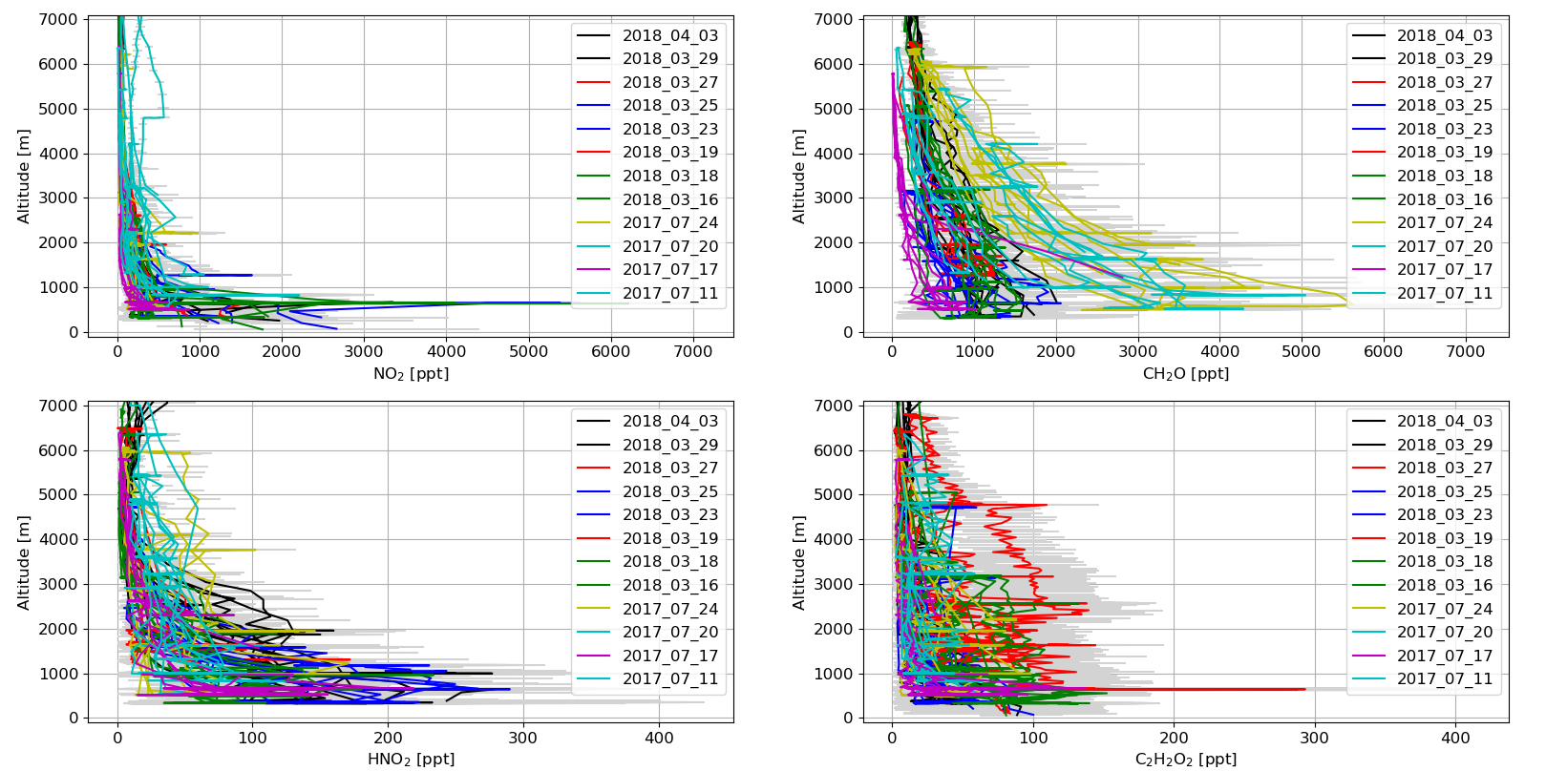
Altitude Profiles of NO₂, CH₂O & HONO from EMeRGe-EU/Asia
Upper panels: EMeRGe-EU/Lower panels: EMeRGe-Asia
NO₂ [ppt]
HCHO [ppt]
Altitude [m]
Altitude [m]
HONO [ppt]
C₂H₂O₂ [ppt]

Slide 7
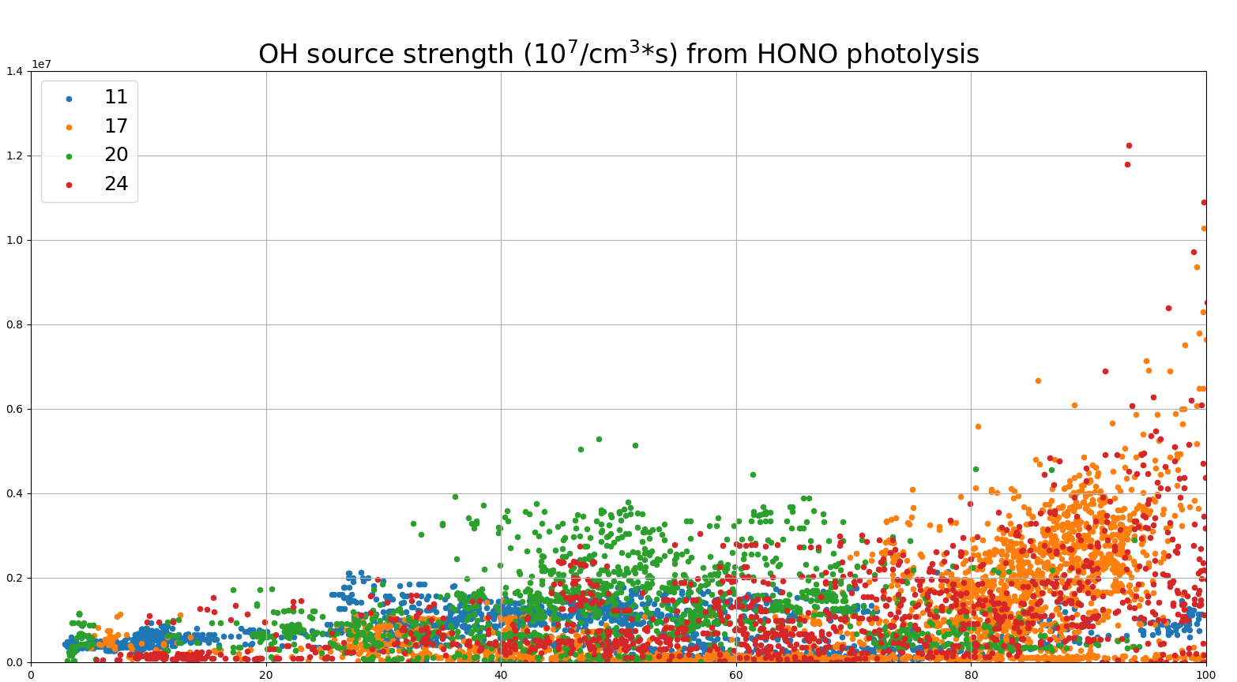
Excess-HONO v Relative Humidity
Flights over Europe
in July 2017
HONO source strength [10⁷/cm³sec]
Indicative mass change by water uptake
Relative Humidity [%]
Steady state HONO source strength:
P_{HONO} = j_{HONO}∙[HONO]_{excess} = j_{HONO}∙([HONO]_{meas}- [HONO]_{MECO})
11/17

Slide 8
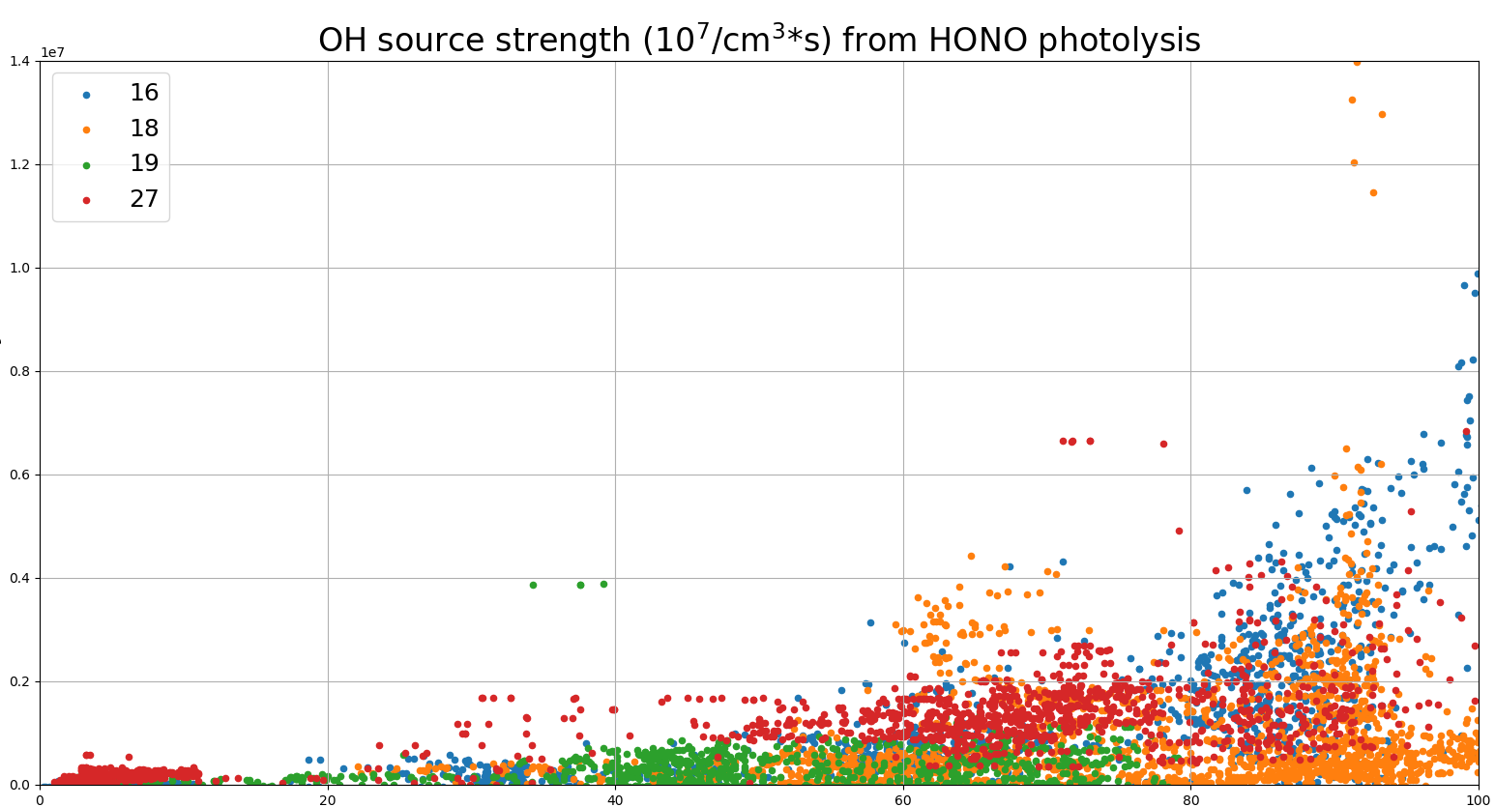
Excess-HONO v Relative Humidity
Flights toward China Sea & Philippines
in March 2018
HONO source strength [10⁷/cm³sec]
Indicative mass change by water uptake
Relative Humidity [%]
Steady state HONO source strength:
P_{HONO} = j_{HONO}∙[HONO]_{excess} = j_{HONO}∙([HONO]_{meas}- [HONO]_{MECO})
11/17

Slide 9
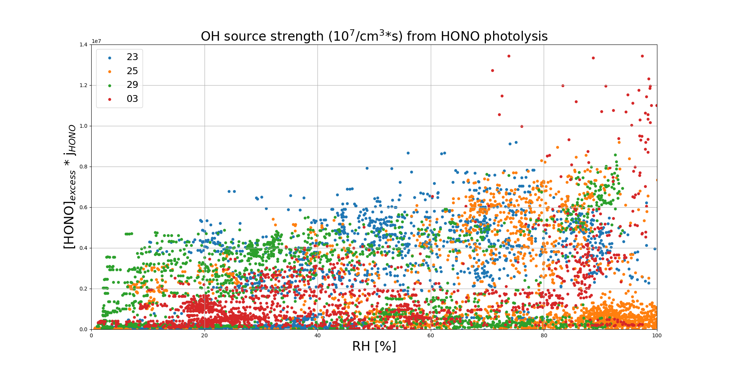
Excess-HONO v Relative Humidity
Flights toward Korea & Japan
in March & April 2018
HONO source strength [10⁷/cm³sec]
Indicative mass change by water uptake
Relative Humidity [%]
Steady state HONO source strength:
P_{HONO} = j_{HONO}∙[HONO]_{excess} = j_{HONO}∙([HONO]_{meas}- [HONO]_{MECO})

Slide 10
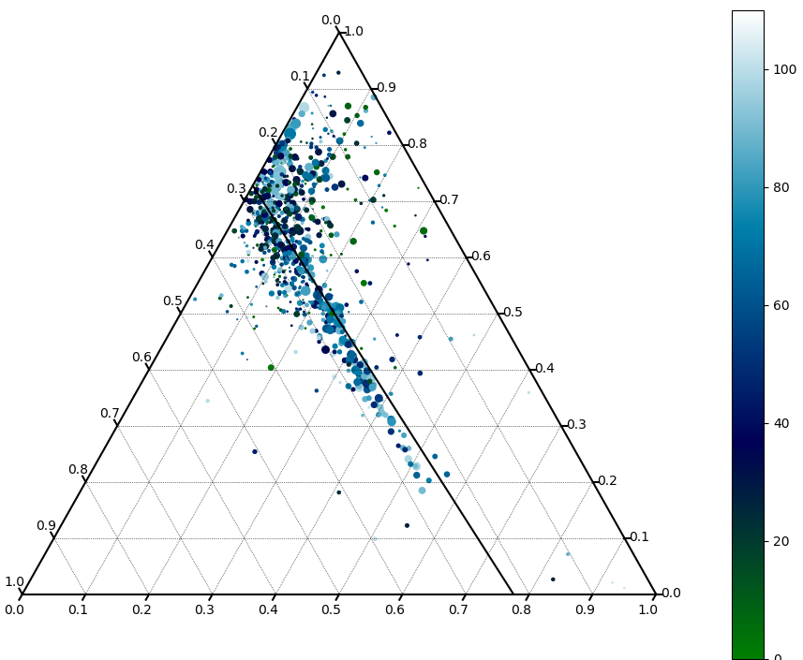
Aerosol composition and excess-HONO
Size parameter is excess-HONO!
Sulfate
(NH₄)₃∙H(SO₄)₂
(95,4%)
NH₄∙HSO₄
(84,45%)
(NH₄)₂SO₄
(72,73%)
Threshold (53%) for HNO₅S formation from HONO (Becker et al., 1996)
weight (%)
weight (%)
Relative Humidity [%]
(77,5%)
Ammonium
weight (%)
NH₄∙NO₃
Nitrate

Slide 11
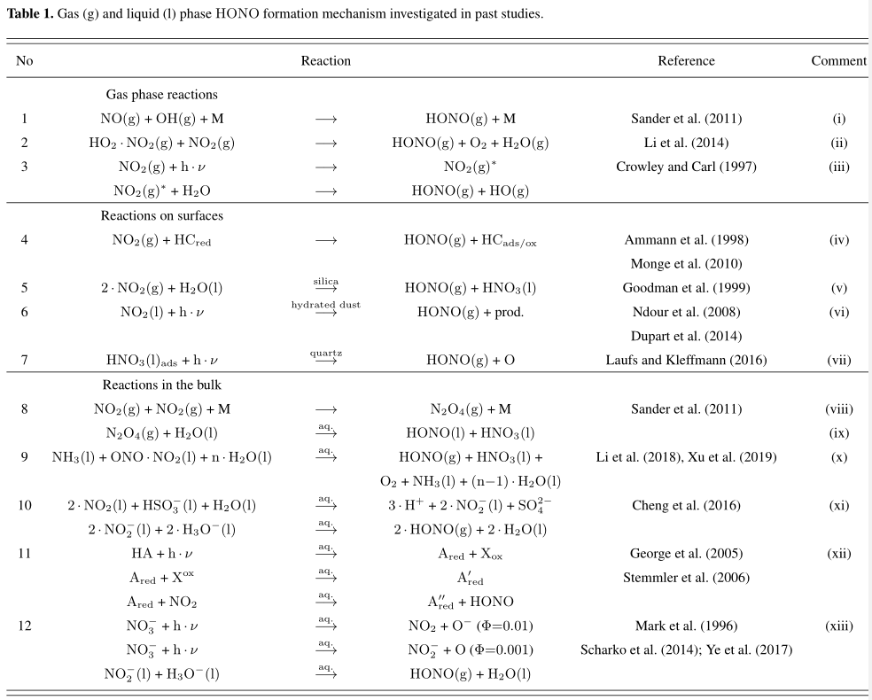
HONO formation mechanisms (discussed in the literature)
17/17

Slide 12
Summary and (preliminary) conclusions
NO₂, HONO, CH₂O, C₂H₂O₂, and C₃H₄O₂ were inferred from aircraft-borne limb measurements
NO₂, and CH₂O compare well with other measurements and models
HONO could be detected during all EMeRGe flights, and at least for one flight towards the Philippines (19/03/18) the amounts are comparable to the HEIDI observations
The inferred HONO source strength is up to P_{HONO} <=1000 ppt/h, i.e. about as much as Zhang et al., (2009) and Li et al., (2014) detected but up to factor of 5 larger than Ye et al., (2016, and 2017) found in the BL, and FT.
In polluted air masses of the BL and free troposphere OH formed by HONO photolysis could be as large as 30% (max 50%) due to O(¹D) + H₂O
Some known HONO formation mechanisms can be ruled out, c.f. those which are related to reactions at the Earth surface, direct emissions, ~ [NO₂]₂, ..
Humid conditions (i.e. the deliquescence of the ammonium sulfate/nitrate system) seems to favor excess-HONO (a necessary but probably not sufficient condition?)
A second HONO formation mechanism is likely to act occasionally, c.f. heterogeneous reactions of HNO₃ on mineral dust, …
16/17

Slide 13
Outlook
The Roles of aerosol Cl⁻ and organics, gas phase SO₂ are elusive (no clear picture), and relation to organics (acids) soot, mineral dust, ….. still need to be investigated.
Mostly likely mechanisms are photolysis of particulate nitrate (with VOCs acting as OH scavengers) within the aerosol or reaction of NO₂ on mineral dust.
Also, presently the MPIC (Andrea Pozzer) undertakes ISORROPIA pH calculations, and we argue that excess-HONO formation as functions of aerosol composition and radiation should be studied in the laboratory, c.f. in the AIDA chamber.
17/17

Slide 14
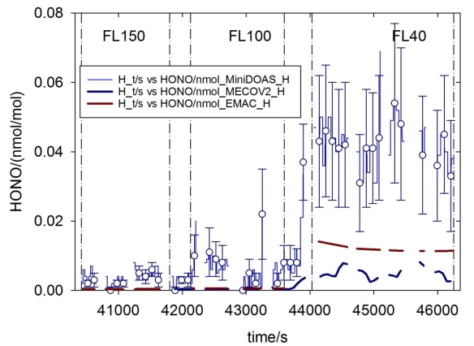
Inter-comparison results for HONO
4.5 km
3 km
1.2 km
excess-HONO =
[HONO]_{measured}
- [HONO]_{modelled}
from the EMeRGe4 TEAM4 meeting, as an update of the inter-comparison report, Schumann et al., (Dec., 2019)

Slide 15
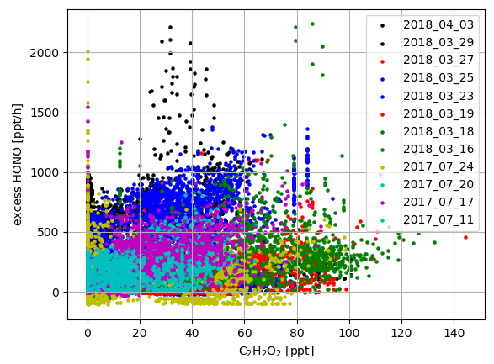
Nitrous Acid as a function of Glyoxal

Slide 16
Method: Concentration retrieval using the novel scaling method
The concentration of the targeted gas x is inferred from the knowledge of concentration of a reference gas
  Use the differential absorption measured adjacent to an O₄ (or O₃) absorption band
  Scale concentration of X to the in-situ measured [O₄] (or [O₃], ..) concentration, via
DOAS_{meas}
RT model
calculations
calculated
SCD = dSCD_{meas} + dSCD_{ref,solar}
DOAS_{meas}
calculated
Stutz et al., (2017), Werner et al., (2017), Hüneke et al., (2017)

Slide 17
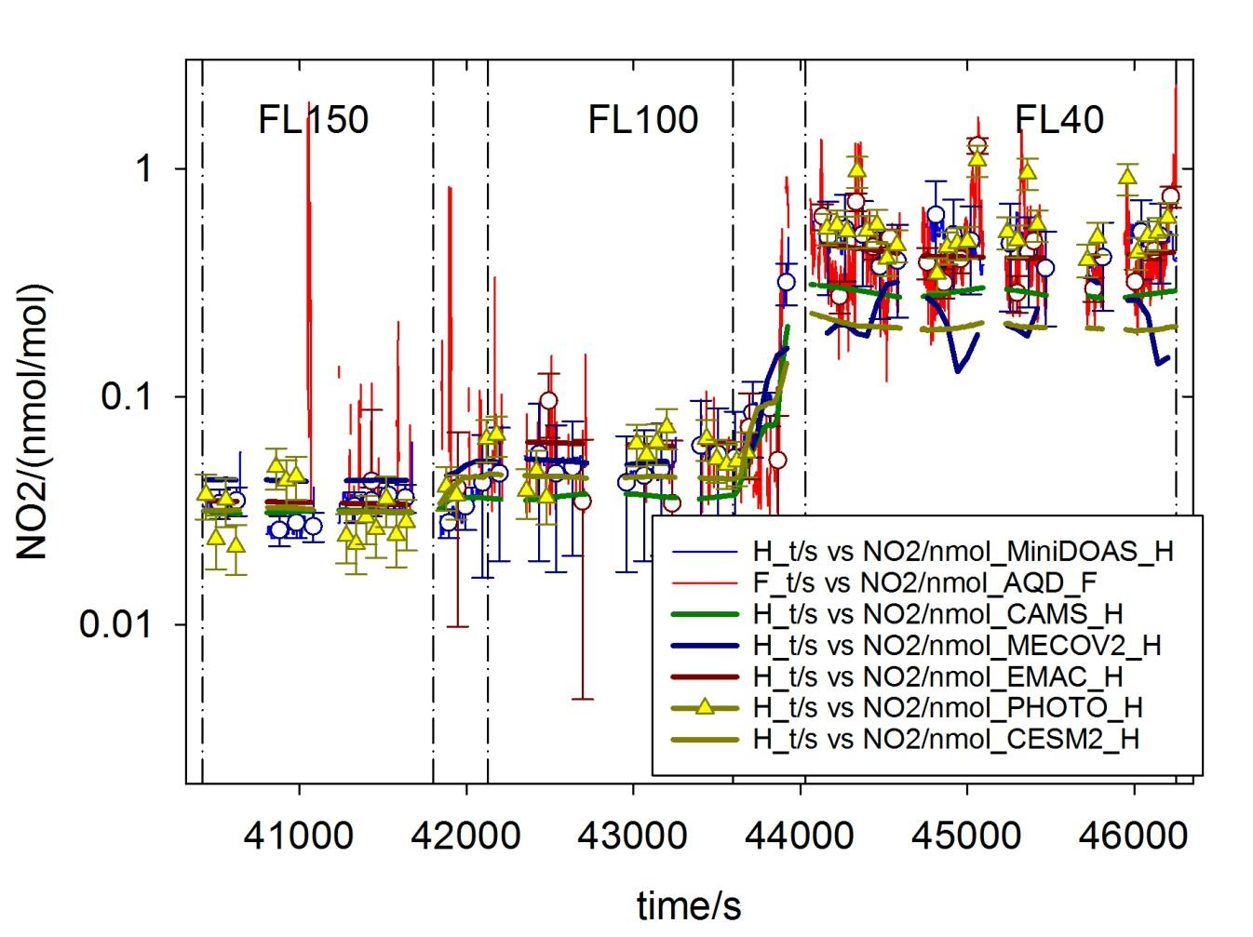
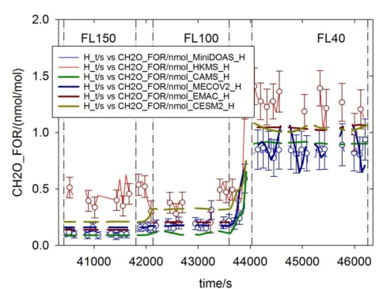
Inter-comparison results for NO₂ & HCHO
NO₂
CH₂O
from the EMeRGe4 TEAM4 meeting, as an update of the inter-comparison report, Schumann et al., (Dec., 2019)

Slide 18
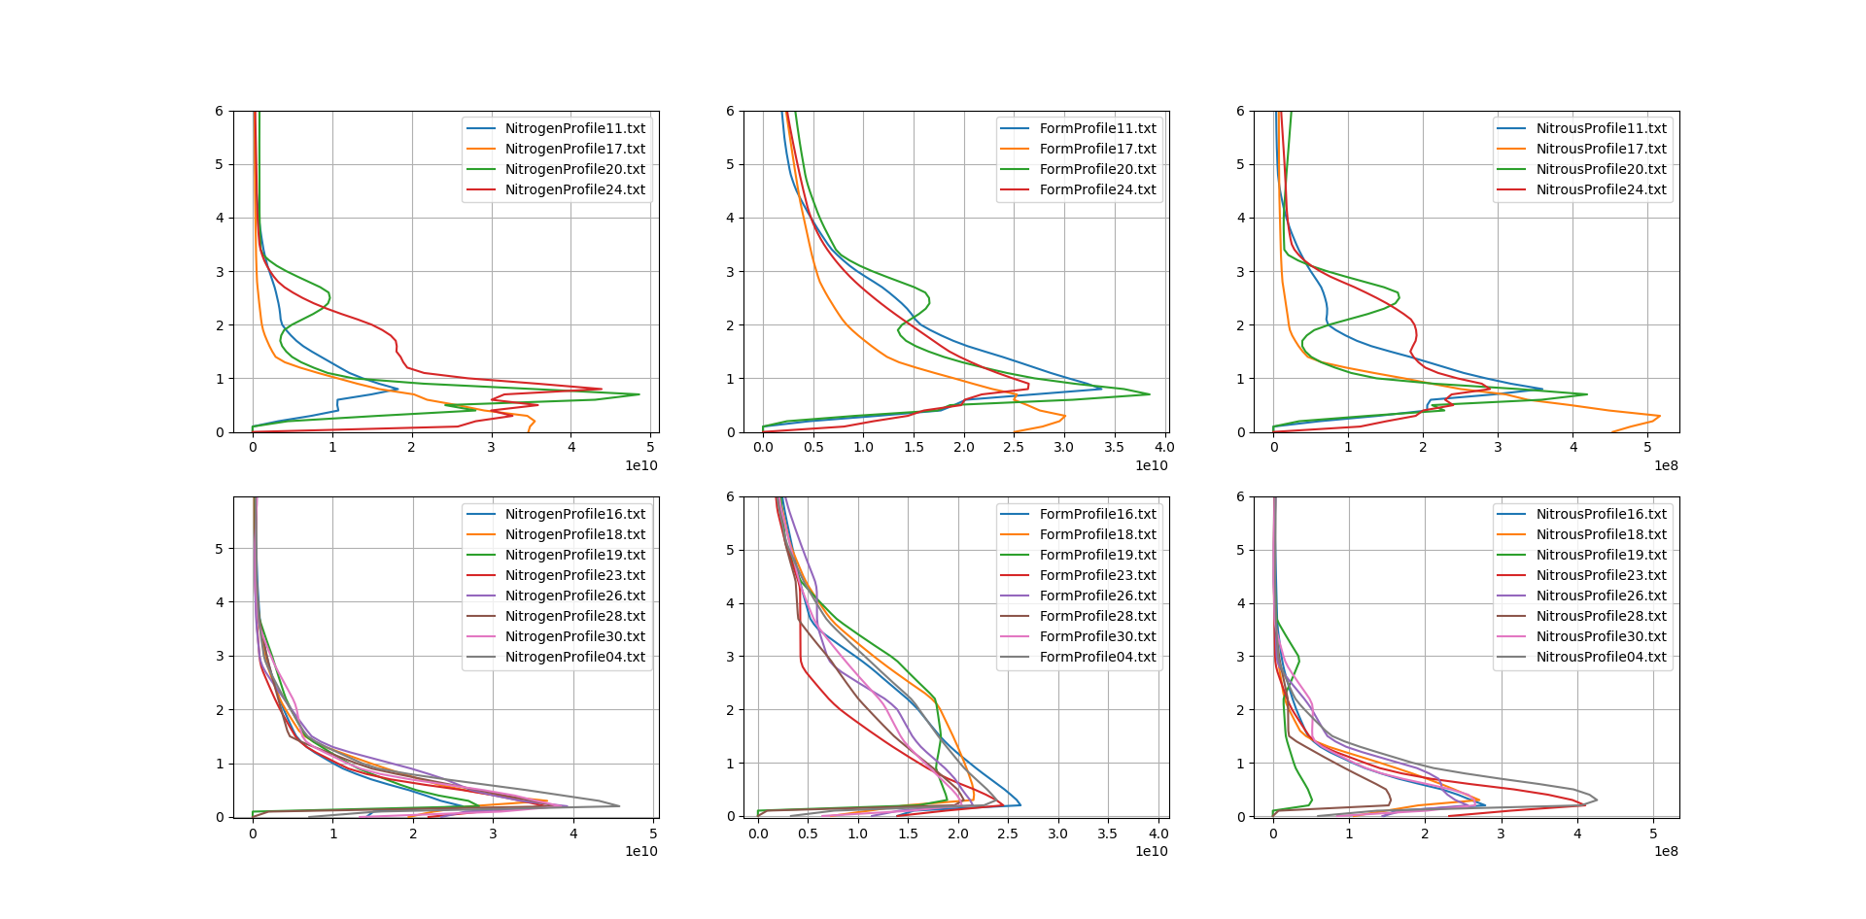
Model (EMAC) a-priori
Upper panels: EMeRGe-EU
NO₂ [/cm³]
HCHO [/cm³]
HONO [/cm³]
[km]
[km]
NO₂ [/cm³]
HCHO [/cm³]
HONO [/cm³]
Lower panels: EMeRGe-Asia

Slide 19
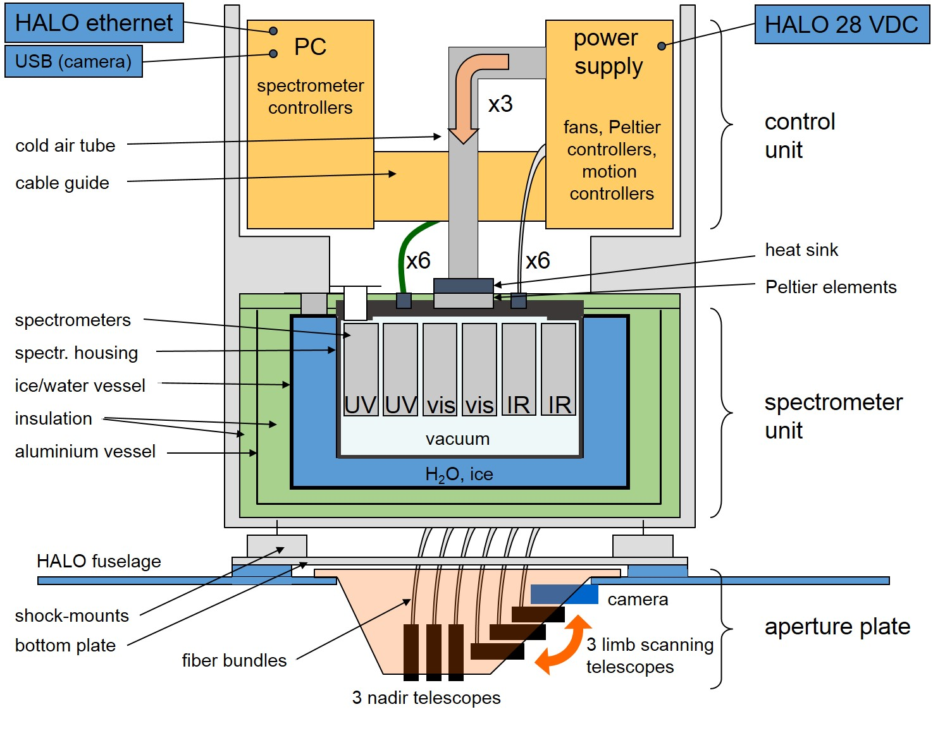
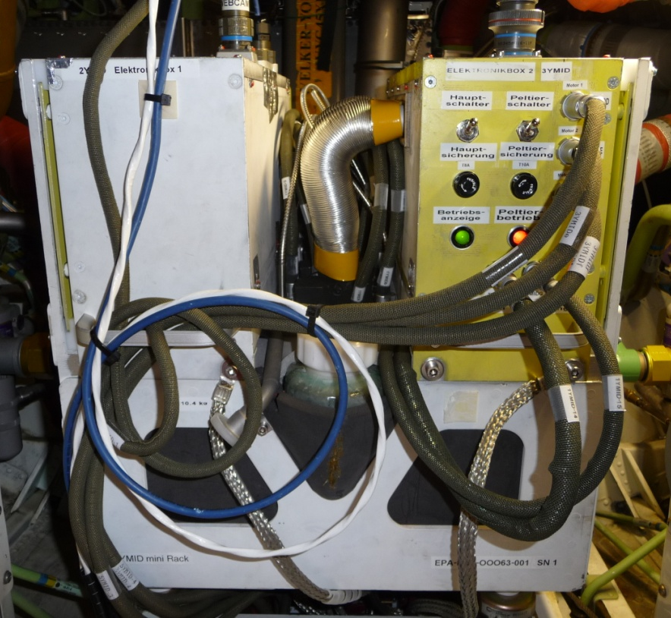
The mini-DOAS Instrument
Weight: 58 kg including aperture plate
Power consumption: ~200 W at 28 DC
Location: boiler room (in the fuselage of HALO aircraft)

