Slide 1
Spatial variability of surface snow isotopic composition on the East Antarctic Plateau and implications for climate reconstructions
Alexander Weinhart, Maria Hörhold, Sepp Kipfstuhl, Johannes Freitag, Georgia Micha, Martin Werner, and Gerrit Lohmann

Slide 2
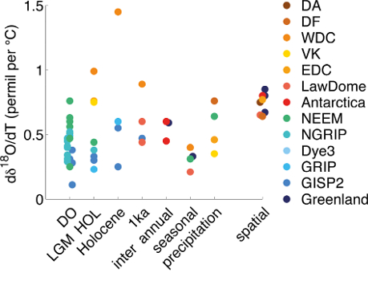
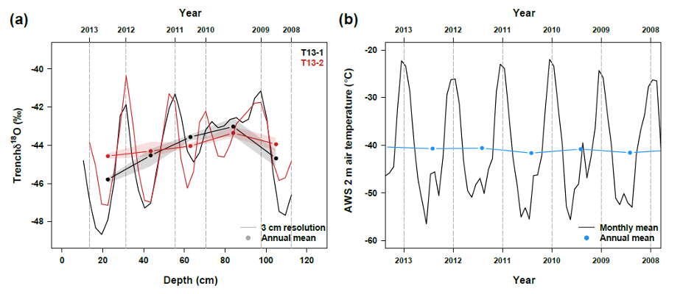
Stable water isotopes in Antarctica
Why investigating…?
High spatial & temporal variability of
stable water isotopes in East Antarctica
(Casado et al., 2017)
Seasonal/Annual/Decadal Temperature fluctuations not directly visible in isotopic record
(Münch et al., 2016)
Data gap on the East Antarctic Plateau
(Dataset from Masson-Delmotte et al., 2008)

Slide 3
Setting & sampling
10m
4 spatially independent samples per location
1m
A
10m
X
C
1m
10m
2m
Manpower!
1m
B
This study
Klick
Masson-Delmotte
et al., 2008

Slide 4
Analysis
Snow profiles cut into discrete samples (1 cm or 2 cm resolution) & analysed for stable water isotopes (¹⁸O & ²H)
Ice lab at T = -18°C
Klick
Mean values of each profile
Isotope record of each profile
Mean values of each location

Slide 5
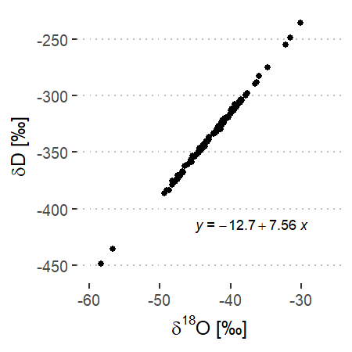
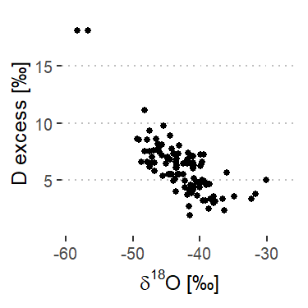
Isotope overview (1 m means)
Samples from Dronning Maud Land only!
(Masson-Delmotte et al., 2008)
Low annual mean temperatures (< -45°C)
Low accumulation rates (20 – 60 mmWE)

Slide 6
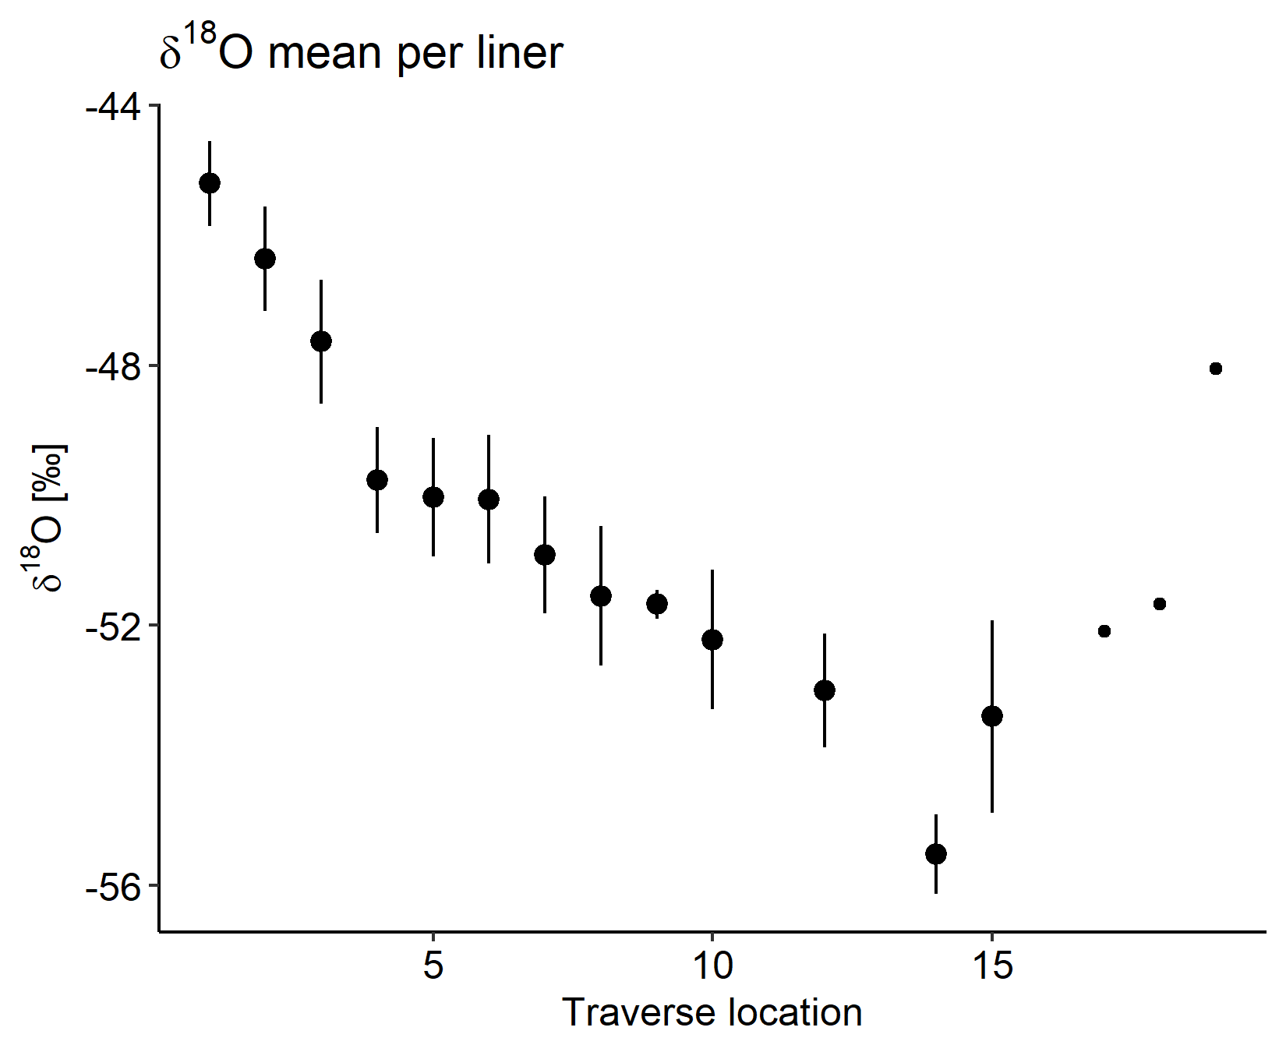
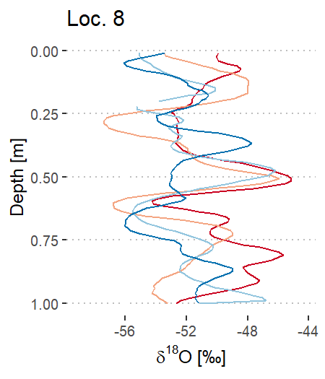
From spatial variability…
Local
Vs.
Regional
Possible effects on isotopic signal:
Noise?
Postdepositional changes?
Precipitation intermittency?
Topography?

Slide 7
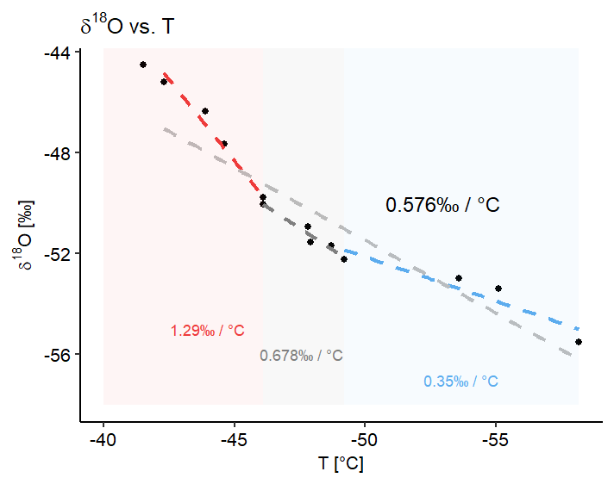
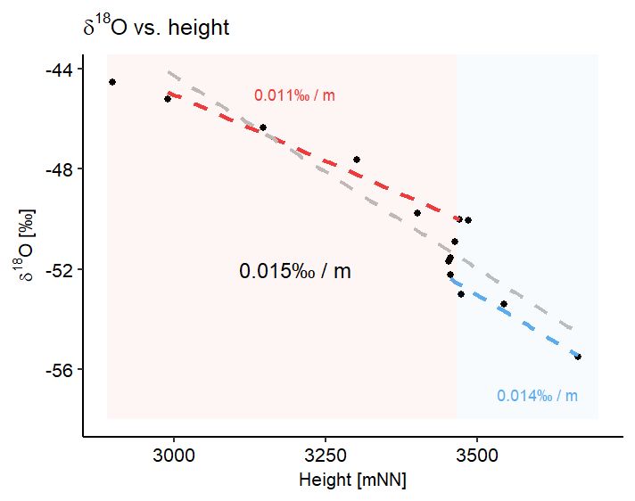
… to temperature relationship
Elevation parallel part, distance from coast increases
-> Use regional T-slopes to reconstruct climate
from East Antarctic firn cores!
(COMBI project)

