Slide 1

EGU2020-1365
Inhomogeneous waves in isotropic anelastic media: explicit expressions for Q
Xu Liu ^{1*}, Stewart Greenhalgh ¹, Bing Zhou ², Huijian Li ¹
1. College of Petroleum Engineering & Geosciences, King Fahd University of Petroleum & Minerals, Dhahran, 31261, Kingdom of Saudi Arabia
2. Department of Earth Science, Khalifa University of Science and Technology, UAE.

Slide 2
Motivation
The seismic waves which propagate in dissipative materials are generally inhomogeneous waves.
The dissipation factors of inhomogeneous waves are dependent on the degree of inhomogeneity of the wave.
Furthermore, the dissipation factors of inhomogeneous waves are dependent on the different definitions. They need to be clarified and unified.

Slide 3
Wave equation and the degree of inhomogeneity
The wave equation
Plane wave solution
wave number vector: real and imaginative parts
complex slowness in direction of wave
real valued inhomogeneity parameter
in the perpendicular direction
and
may have different directions
attenuation angle

Slide 4
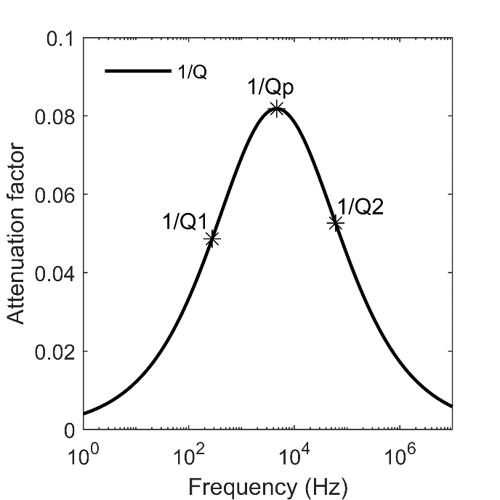
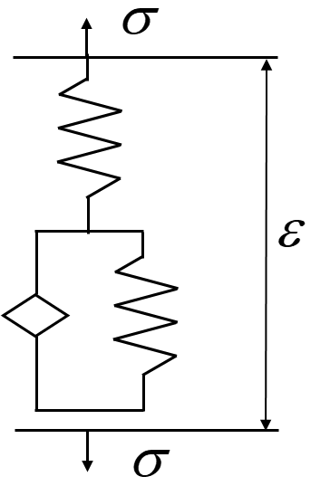
Fractional Zener model to represent material attenuation features
The wave equation
Frequency dependent elastic parameter
Relaxed modulus × relaxation function
Fractional Zener model:
fractional order
To calculate the dispersion curves and 1/Q in full frequency range

Slide 5
Dispersion curves and 1/Q calculation
Plane wave
The wave equation

Slide 6
Elliptical particle motion for P- and S- inhomogeneous waves
Borcherdt, 1973, JGR, 78(14), 2442-2456

Slide 7
General definitions of 1/Q and the special cases for homogeneous waves
Three definitions: Ratio of the time-averaged dissipated energy density
to:
(1) maximum strain-energy density
(Borcherdt 1977, 1982; Borcherdt & Wennerberg 1985).
(2) twice the time-averaged strain-energy density
(Carcione 2001).
(3) the time-averaged energy density
(normally the sum of
and the time-averaged kinetic-energy density
) (Buchen 1971).

Slide 8
Previous results of 1/Q_{B} for inhomogeneous waves
‘..an increase in inhomogeneity of the wavefields causes the velocity to decrease, the fractional-energy loss (1/Q) to increase, …’
.. 1/Q for inhomogeneous waves are shown to be greater than corresponding characteristics for homogeneous waves, with the deviations
increasing as the degree of wave inhomogeneity is increased for waves of fixed maximum displacement amplitude.
*Borcherdt and Wennerberg, 1985. BSSA, 75(6), 1729-1763.
Inhomogeneity
or
attenuation
1/Q

Slide 9
Explicit dissipation factors for inhomogeneous P-waves
Liu et al., 2020, JGE
Dissipation factors of homogeneous P-waves as the special case
P- waves limiting dissipation factors

Slide 10
Explicit dissipation factors for inhomogeneous SV-waves
Liu et al., 2020, JGE
Dissipation factors of homogeneous S-waves as the special case
S- waves limiting dissipation factors
Independent of D !

Slide 11
Some important features of dissipation factor for inhomogeneous waves
Liu et al., 2020, JGE
Under the definition of 1/Qv
Independent of D !
P- & S- waves - same limiting dissipation factors
Under the definition of 1/Q_{T}
P- & S- waves- same limiting dissipation factors
because both P-and S-waves have circular particle motion at infinite degree of wave inhomogeneity

Slide 12
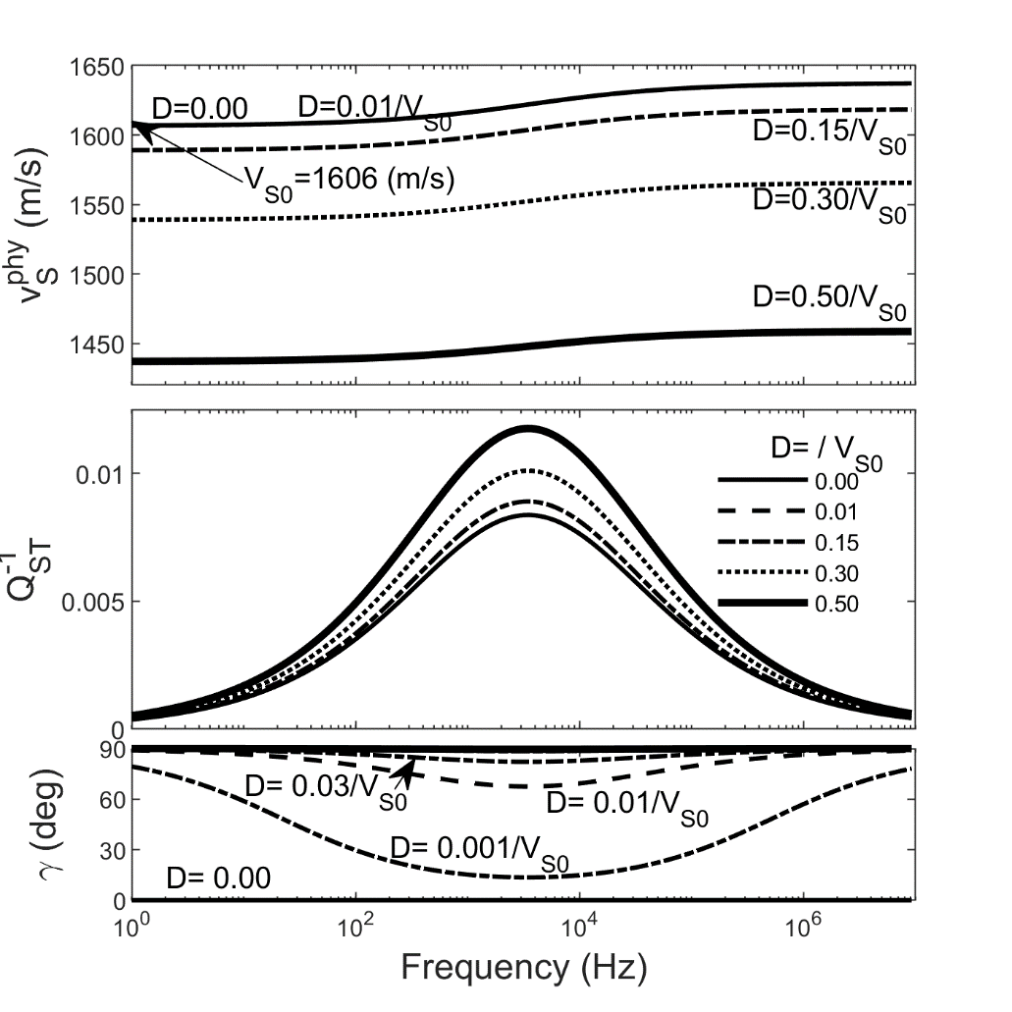
Dispersion curves and 1/Q of inhomogeneous S-wave
Phase velocity increases with frequency and decreases with
inhomogeneity parameter D
Dissipation factor increases with inhomogeneity parameter D
For pure elastic case (zero or infinite frequency), attenuation angle only has values of 0⁰ or 90⁰.

Slide 13
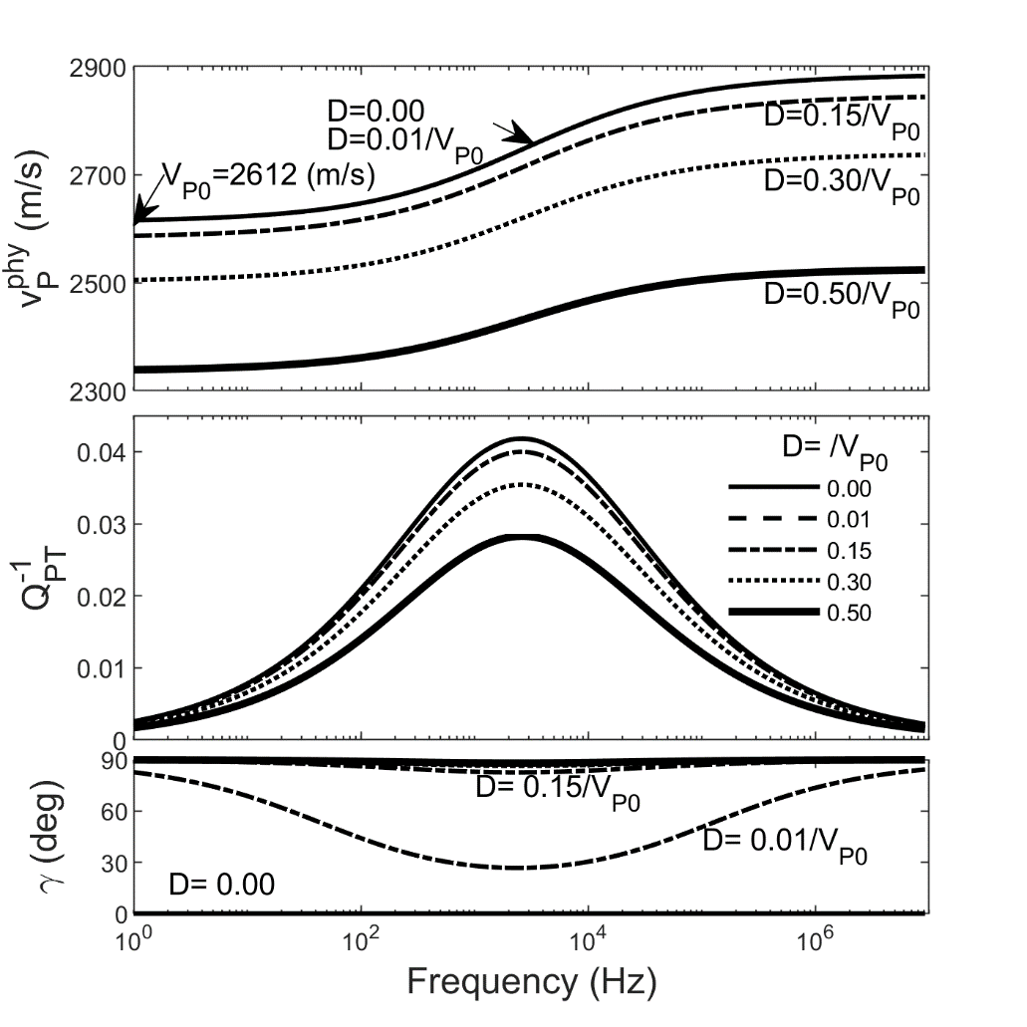
Dispersion curves and 1/Q of inhomogeneous P-wave
Phase velocity increases with frequency and decreases with
inhomogeneity parameter D
Dissipation factor decreases with inhomogeneity parameter D
For pure elastic case (zero or infinite frequency), attenuation angle only has values of 0⁰ or 90⁰.

Slide 14
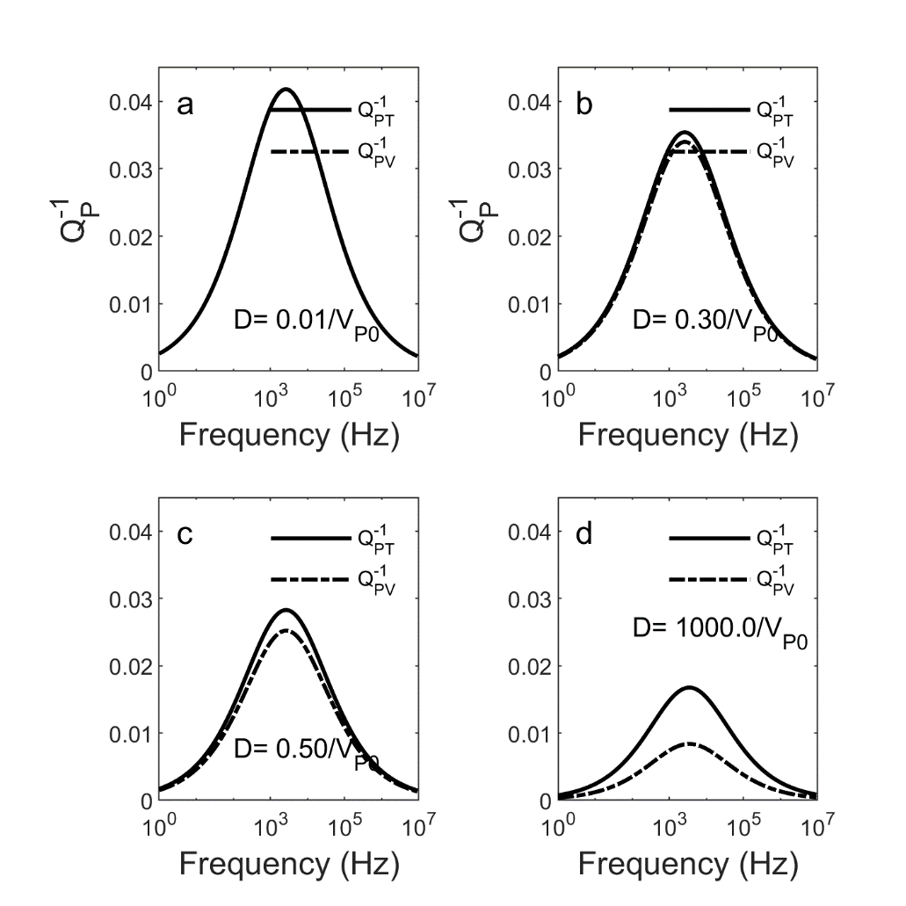
Vs.
With

Slide 15
Comparison with previous results of 1/Q for inhomogeneous waves
Inhomogeneity
or
attenuation
1/Q
*Borcherdt and Wennerberg, 1985. BSSA, 75(6), 1729-1763.
Under the definition:
Sample material, S-waves are more dissipative than P-wave
Liu et al (2020):
1/Qsv is independent of D
(2) If P-waves are more dissipative than S-wave, 1/Q may decrease with increasing D

Slide 16
Conclusions
Explicit formulas for the dissipation factors of P- and SV-waves are developed under the two different definitions.
The dissipation factor of the SV-wave under the definition 1/Qv is found to be independent of the degree of wave inhomogeneity.
P- & S- waves have same limiting dissipation factors that only depend on the ratio of the imaginary to the real part of the complex shear modulus
If P-waves are more dissipative than S-waves, 1/Q may decrease with increasing D

