Slide 1
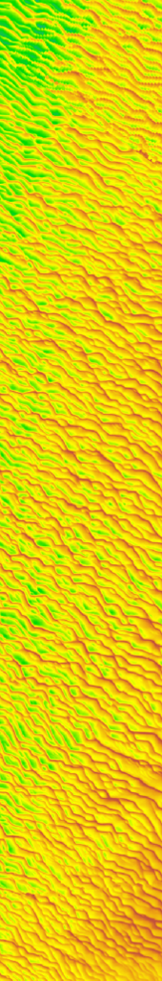



Sediment sorting in tidal sand wave fields: the internal structure revealed?
A model study with Delft3D
Johan Damveld, Bas Borsje, Pieter Roos, and Suzanne Hulscher
Water Engineering & Management, University of Twente, Enschede, Netherlands
EGU2020-13679: Damveld et al.

Slide 2
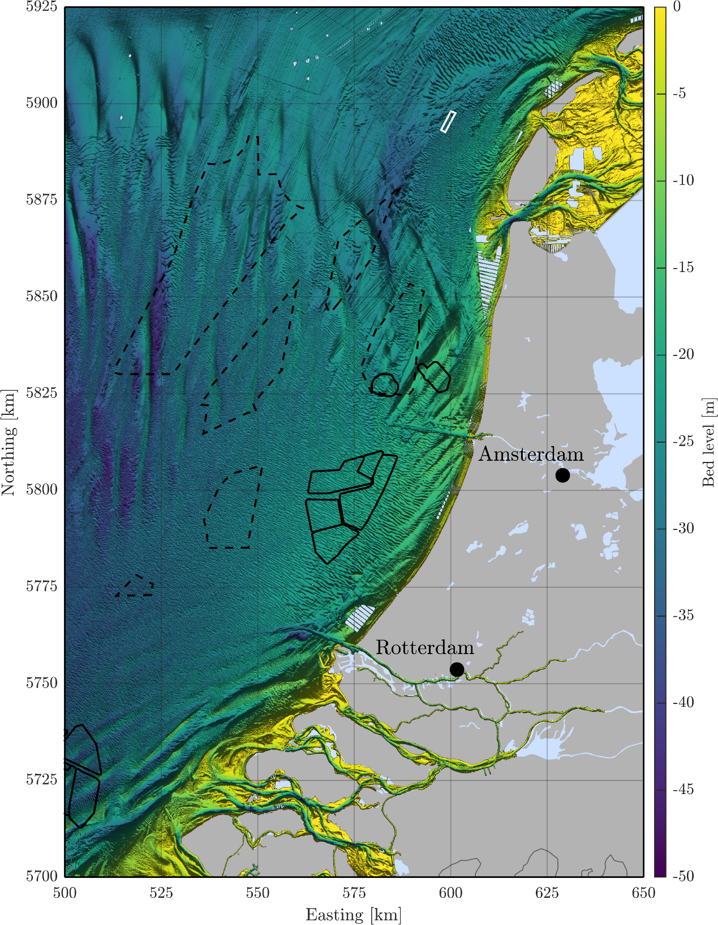
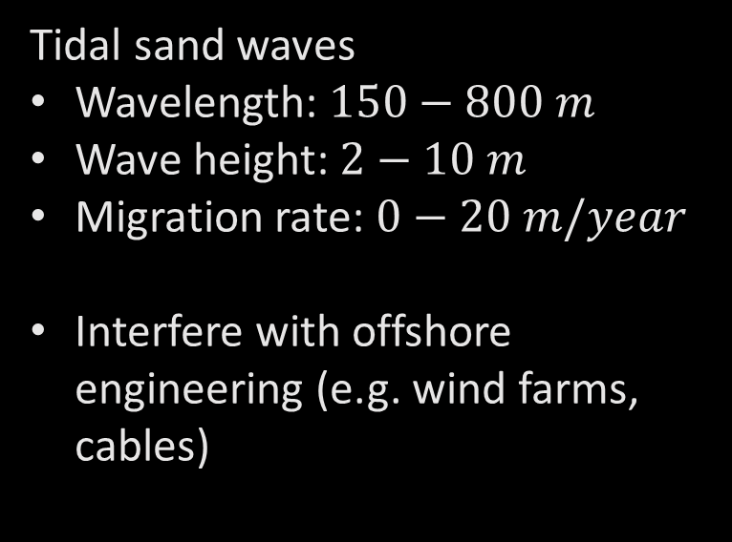
Netherlands continental shelf
Future wind farms
Tidal sand waves
Wavelength: $150−800 m$
Wave height: $2−10 m$
Migration rate: $0−20 m/year$
Interfere with offshore engineering (e.g. wind farms, cables)
Sediment sorting over sand waves
General trend shows a coarsening of the crests
Also field sites with finer crests
No information on the internal structure
Current wind farms
EGU2020-13679: Damveld et al.

Slide 3

Basic model set-up: Delft3D Flow
EGU2020-13679: Damveld et al.
Hydrodynamics: 2DV Navier-Stokes + flow continuity
Sediment transport: bed load + slope-induced transport + suspended load
Waterdepth: 25 m
$U_{S2}:$ 0.65 m/s
$U_{S0}:$ 0.05 m/s
Mean grain size: 0.35 mm

Slide 4
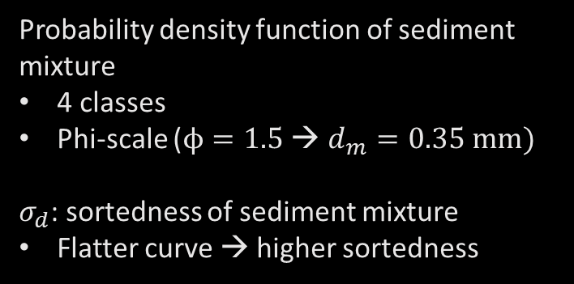
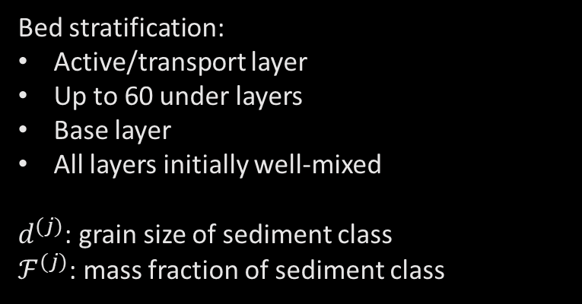
Model set-up: sediment sorting
EGU2020-13679: Damveld et al.
Bed stratification:
Active/transport layer
Up to 60 under layers
Base layer
All layers initially well-mixed
$d^{(j)}$: grain size of sediment class
$ℱ^{(j)}$: mass fraction of sediment class
Probability density function of sediment mixture
4 classes
Phi-scale ($ϕ=1.5$ → $d_{m}=0.35 mm)$
$σ_{d}$: sortedness of sediment mixture
Flatter curve → higher sortedness

Slide 5
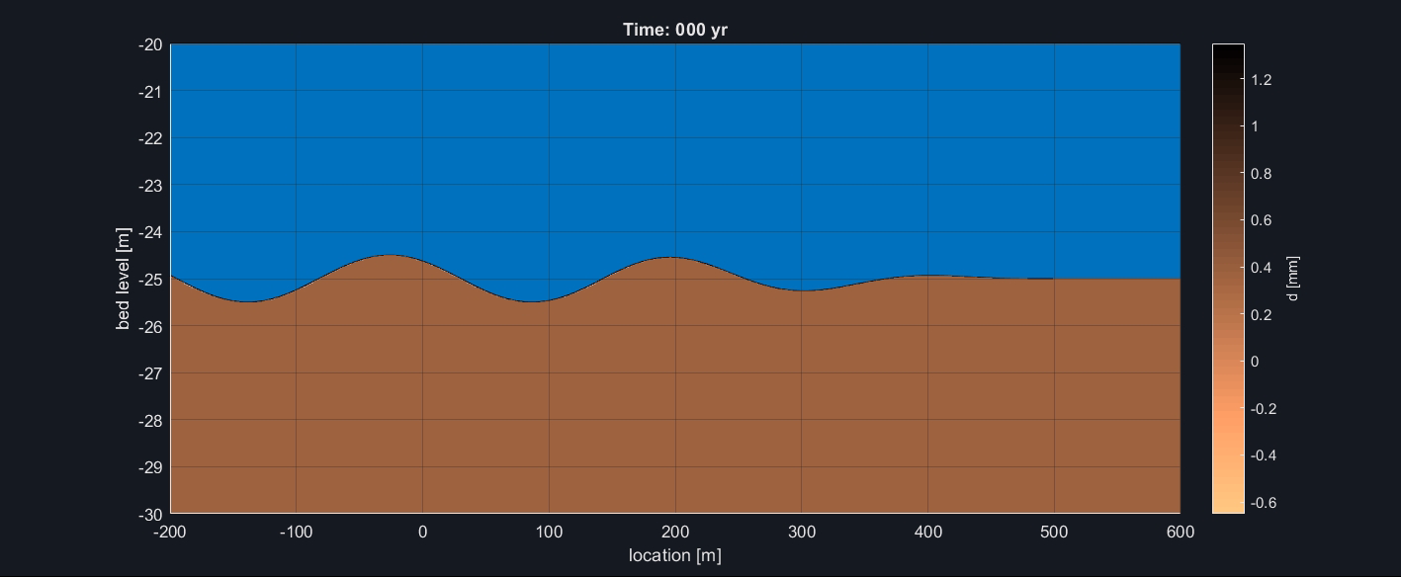
Sediment sorting: asymmetrical tidal forcing
EGU2020-13679: Damveld et al.
Mean grain size
Play me

Slide 6
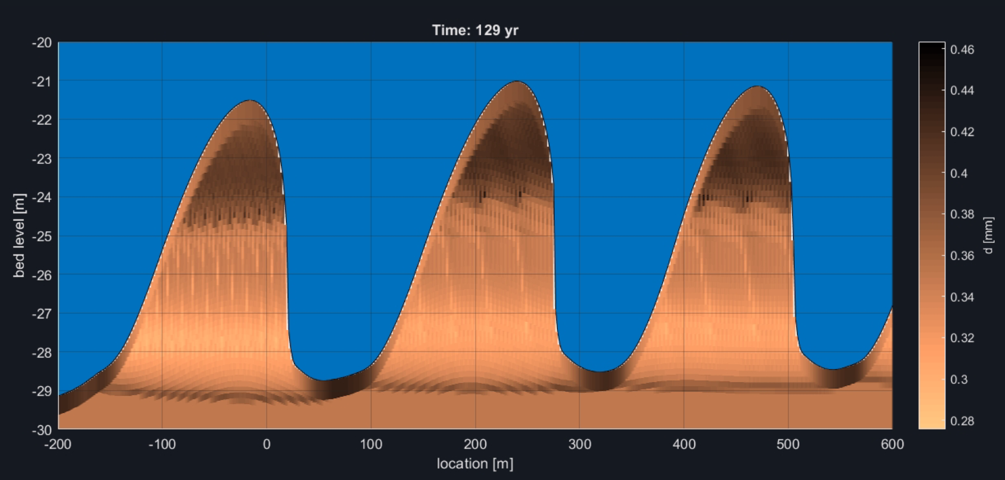
Sediment sorting: model observations
EGU2020-13679: Damveld et al.
Sedimentation lee side
Upper: coarse
Lower: finer
Fine sediments get re-entrained due to migration
Coarser trough due to different motion thresholds among fractions
Inner structure revealed: same pattern as lee side surface

Slide 7
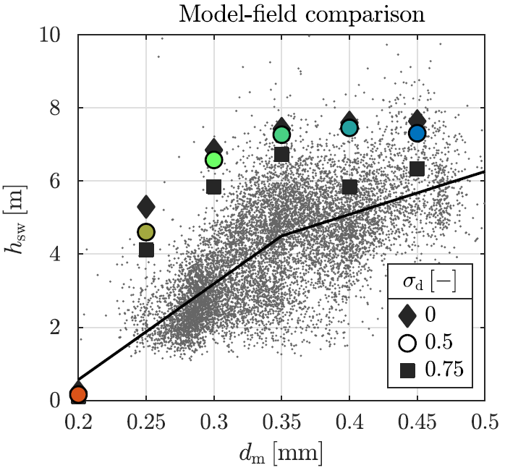
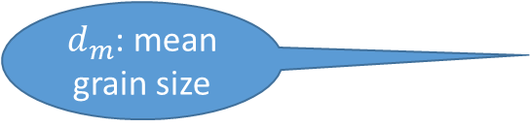
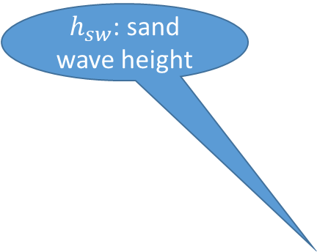
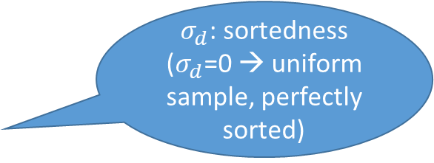
Sediment sorting: influence on wave height
EGU2020-13679: Damveld et al.
Grey dots: North Sea observations
$h_{sw}$: sand wave height
$σ_{d}$: sortedness
($σ_{d}$=0 → uniform sample, perfectly sorted)
Increasingly poorly-sorted mixtures lead to lower sand wave heights
$d_{m}$: mean grain size

Slide 8
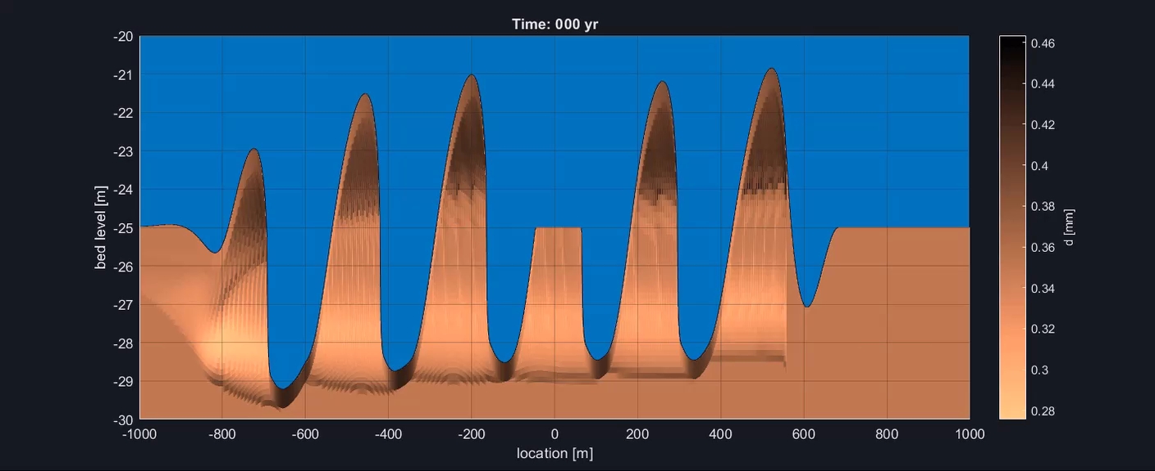
Utilisation: dredging example
EGU2020-13679: Damveld et al.
Play me

Slide 9
Discussion and conclusions
EGU2020-13679: Damveld et al.
Including sediment sorting leads to lower sand wave heights
  Model predictions fall in range of North Sea sand waves
Surficial sorting pattern generally agrees with field observations
Internal sediment structure exposed
  Lack of field evidence for validation → any suggestions from EGU community?
This work is undergoing peer-review, so you will be able to read more soon!

