Slide 1
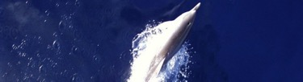



Towards a unified framework for maximum wave computation from numerical models: outcomes from the LATEMAR project
Alvise Benetazzo, F. Barbariol, P. Pezzutto,
S. Davison, L. Bertotti, M. Sclavo, L. Cavaleri
Institute of Marine Sciences, ISMAR
National Research Council, CNR
(Venice, Italy)

Slide 2
  Abstract
  Context and Motivation
  Objectives
  Methodology
  Results
  Uptake

Slide 3
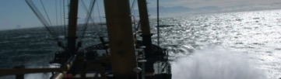
ABSTRACT (1/3)
Reliable prediction of oceanic waves during severe marine storms has always been foremost for offshore platform design, coastal activities, and navigation safety. Indeed, many damaging accidents and casualties during storms were ascribed to the impact with abnormal and unexpected waves.
However, predicting extreme wave occurrence is a challenging task, at first, because of their inherent randomness, and because the observation of large ocean waves, of primary importance to assess theoretical and numerical models, is limited by the costs and risks of deployment during severe open-ocean sea-state conditions.

Slide 4
ABSTRACT (2/3)
In the context of the EU-based Copernicus Marine Environment Monitoring Service (CMEMS) evolution, the LATEMAR project (https://www.mercator-ocean.fr/en/portfolio/latemar/) aimed at improving the modelling of large wave events during marine storms.
Indeed, at present, operational systems only provide average and peak wave parameters, with no information on individual waves whatsoever. However, developments of the state-of-the-art third-generation wave models demonstrated that using the directional wave spectrum moments into theoretical statistical models for wave extremes, forecasters are able to accurately infer the expected shape and likelihood of the maximum waves during storms

Slide 5
ABSTRACT (3/3)
The main purpose of the activity is therefore to provide the wave models WAM and WAVEWATCH III with common procedures to explicitly estimate the maximum wave heights for each sea state.
LATEMAR achieved this goal by: performing an extensive assessment of the model maximum waves using field observations collected from an oceanographic tower; comparing WAM and WAVEWATCH III maximum wave estimates in the Mediterranean Sea; investigating the sensitivity of the maximum waves on the main sea state parameters.
All model developments and evaluations resulting from this research project will be directly applicable to the wave model forecasting systems to expand their catalogue.

Slide 6
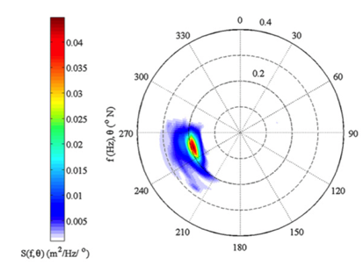
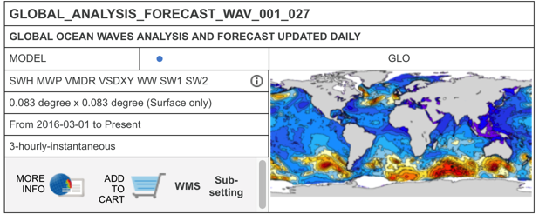
WAVE ANALYSIS AND FORECAST
Context: CMEMS Ocean products “Sea Surface Waves”
SWH Wave significant height
MWT Wave mean period
VMDR Wave mean direction
VSDXY Stokes drift
WW Wind wave (period, height, direction)
SW1 Primary swell wave (period, height, direction)
SW2 Secondary swell wave (period, height, direction)
Model Wave Spectrum
CMEMS product

Slide 7
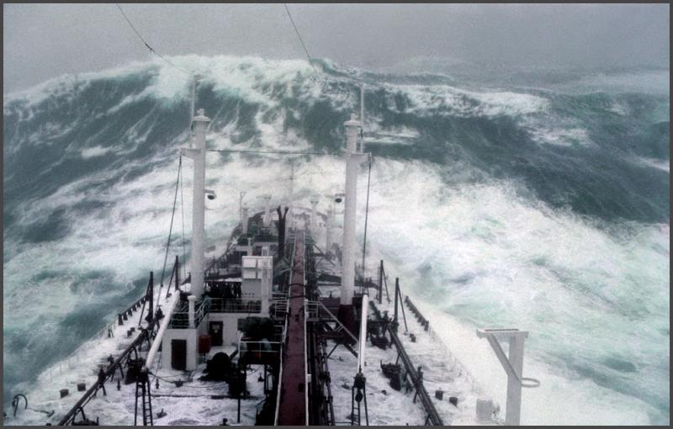
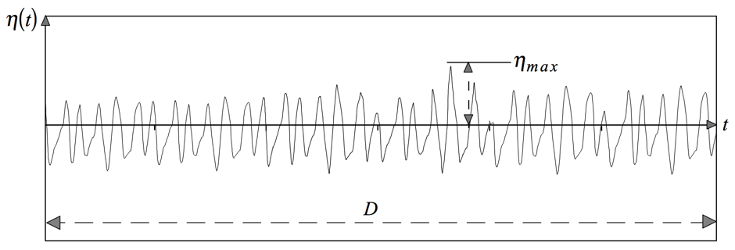
BEYOND H_{S}: EXTREMES WAVES DURING STORMS
η_{max}
Η_{max}
For a sea state, maximum heights in a random wave train are randomly distributed and cannot be deterministically predicted
H_{max}
H_{s}

Slide 8
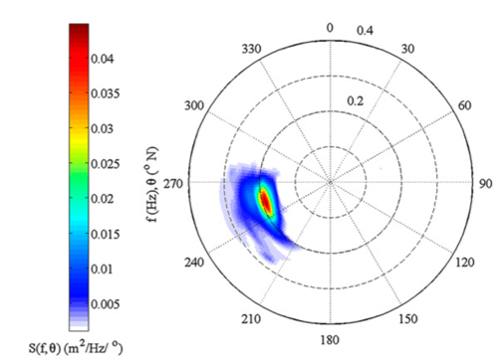
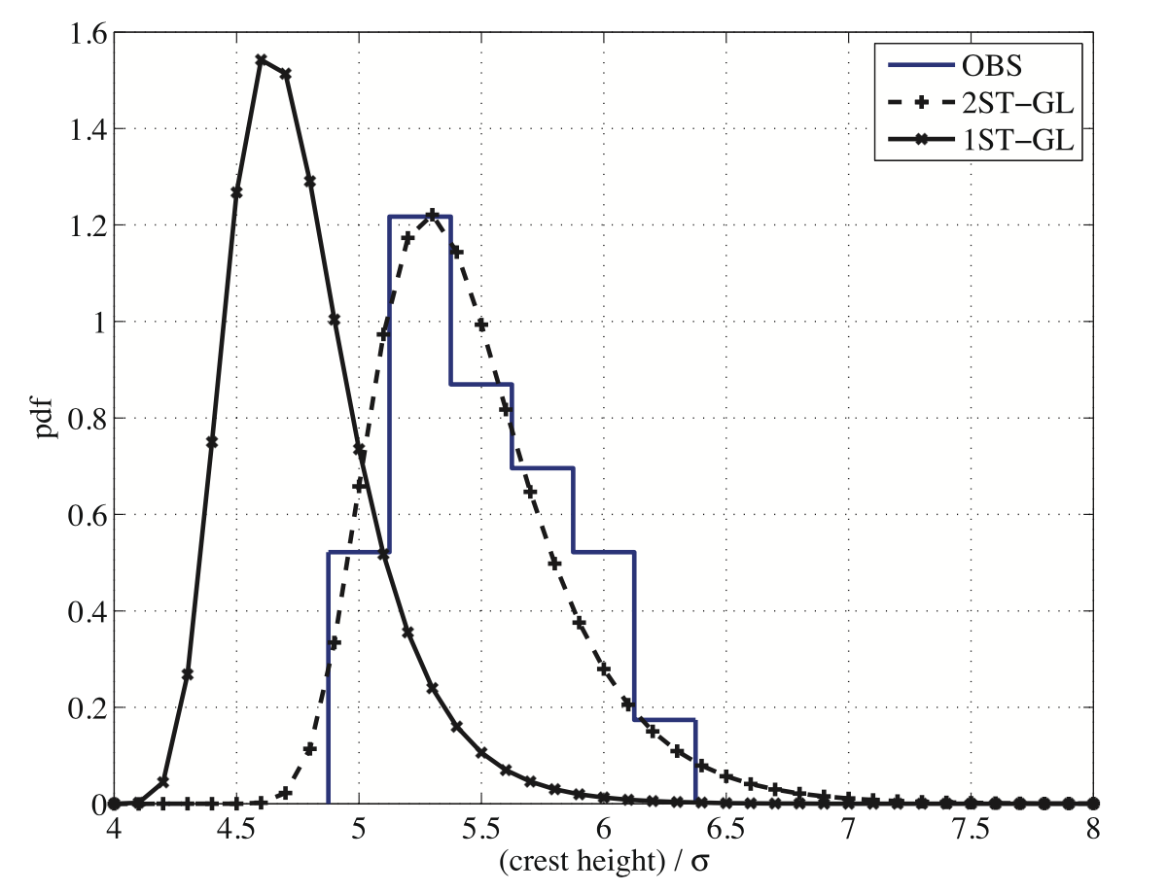
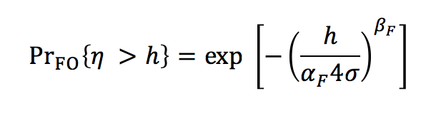
HOW CAN WE DETERMINE η_{max} and H_{max}
FROM MODEL DATA?
Combination of
Higher-order moments of the directional wave spectrum
Theoretical statistical models for wave extremes
➔ Shape and probability of extreme waves during storms
pdf of η_{max} and Η_{max}

Slide 9
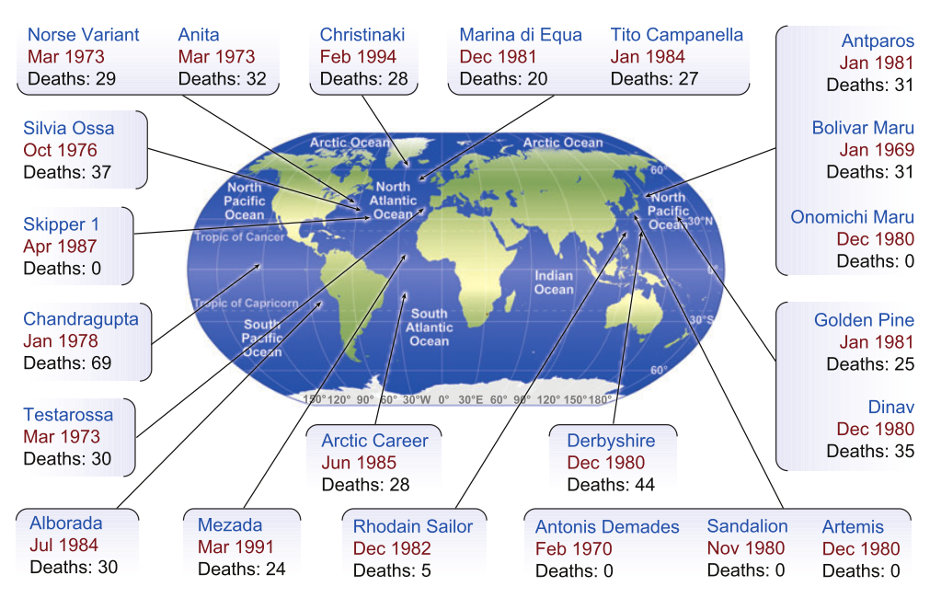
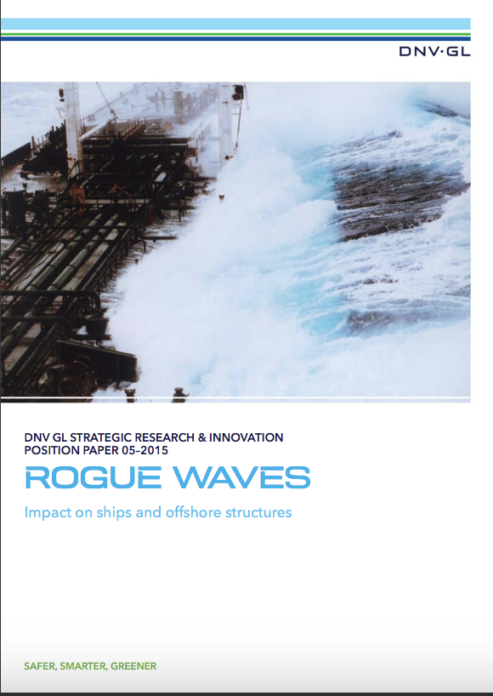
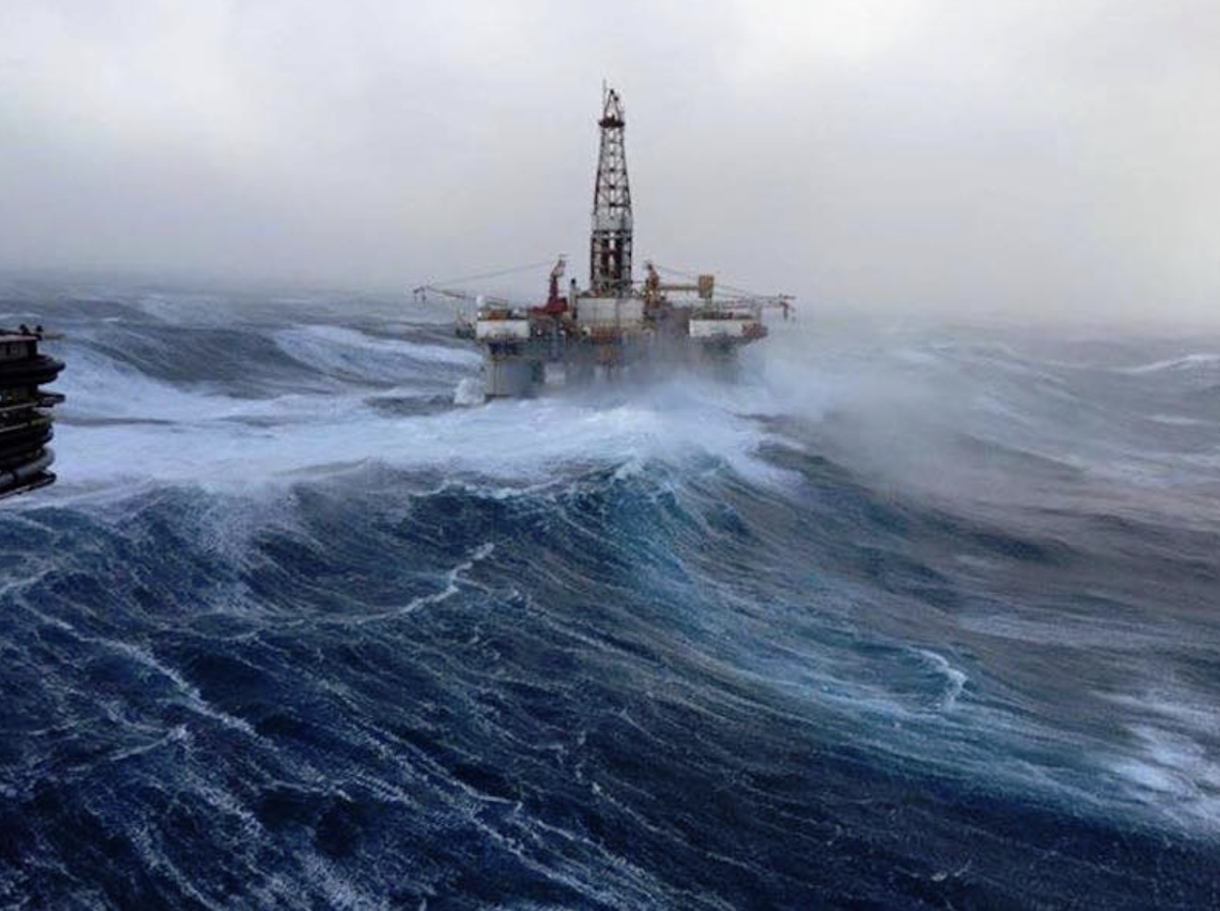
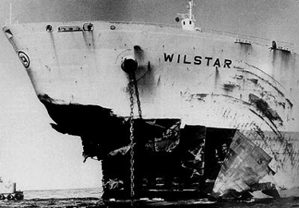
APPLICATIONS
MARINE SAFETY, DESIGN, AND OPERATION
Location of the ships sunk after collision with large waves (copyright C. Kharif and E. Pelinovsky, 2003)

Slide 10
LATEMAR OBJECTIVES
Improving wave forecast and analysis products, by providing wave models used by CMEMS (WAM and WW3) with the procedures to estimate maximum waves. Three phases:
Implementation new routines in WAM to compute the expectation of maximum waves (as for WW3, since ver. 5.16)
  Numerical optimization
Assessment WAM and WW3 maximum wave outputs against obs.
  Influence of WW3 input/dissipation source terms
Application Mediterranean Sea maximum wave climate
  WAM/WW3 comparison
  Analysis of key spectral parameters
At longer-term
Extend the CMEMS ocean product (Sea Surface Waves) catalogue
CMEMS Service Evolution Strategy, R&D priorities: “Improved modelling of extreme and rogue waves”
Notes:
Dire che i tre punti corrispondono ai WPs. Parlare qui della tabella messa nel report

Slide 11
The model implementation for maximum waves (Development of software for wave maxima in WAM)
Implementation of the numerical code for the prediction of extreme waves in WAM.
Optimization of the developed wave extreme parameters estimation algorithms to improve performance in the context of operational forecasts.

Slide 12
Extreme waves: Time vs. Space-Time domain
TIME
SPACE-TIME

Slide 13
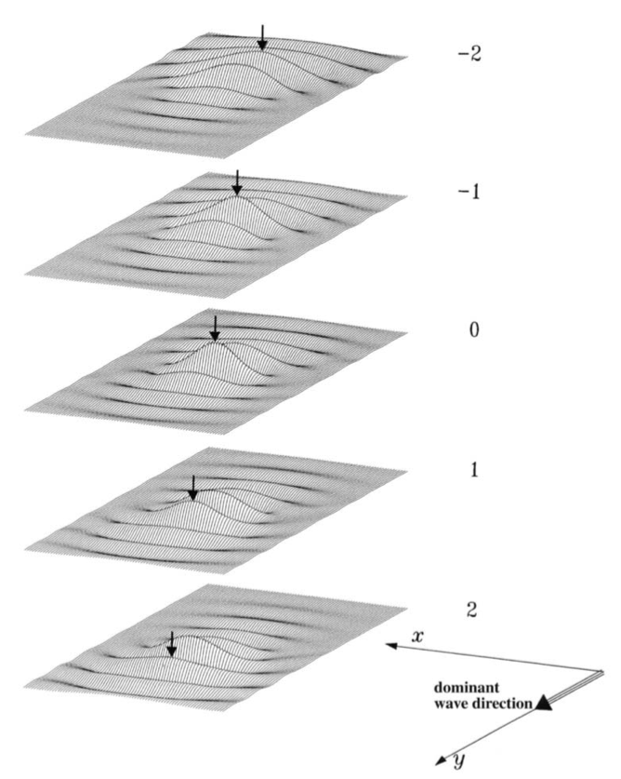
Extreme waves: Time vs. Space-Time domain
Space-Time wave group
A
Time ➔ max. wave in { time }
Space-Time ➔ max wave in { time + Area }
t
TIME
P

Slide 14
Space-Time extreme formulations
The space-time extreme wave parameters were implemented in WAM following the Space-Time Quasi-Determinism model
The expected value of the space-time maximum crest height during a sea state of duration D and over a sea surface region of area A
The expected value of the space-time maximum crest-to-trough wave height during a sea state of duration D and over a sea surface region of area A

Slide 15
Time extreme formulations
The time extreme wave parameters were implemented in WAM following the conceptual scheme from the DNV-RP-C205 Recommendations Practice
The expected value of the time maximum crest height during a sea state of duration D ➔ second-order nonlinear theories of Forristall (2000) and Tayfun (1980).
The expected value of the time maximum crest-to-trough wave height during a sea state of duration D ➔ linear theories of Rayleigh (1880) and Naess (1985).

Slide 16
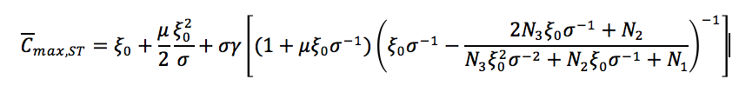
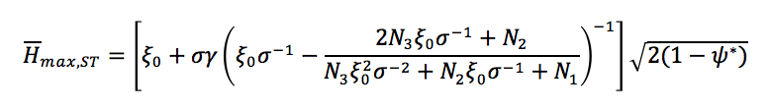

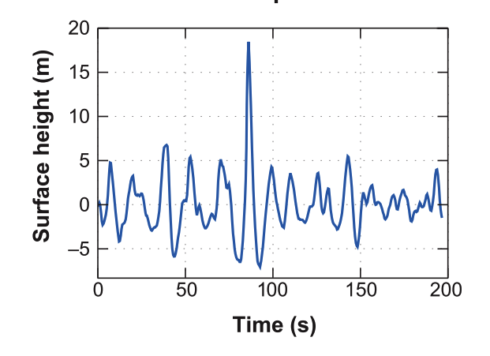

New variables in WAM (new routine WAMAX)
SPACE-TIME EXTREMES
TIME EXTREMES
➔ 14 new variables; 4 new outputs

Slide 17
WAM Optimization (Auto-covariance ψ*)
From the Model Spectrum
Maximum wave height

Slide 18
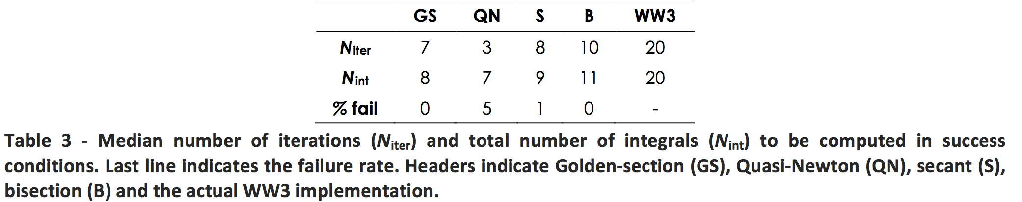
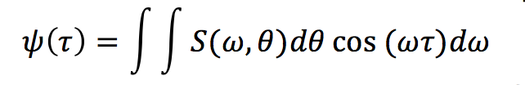
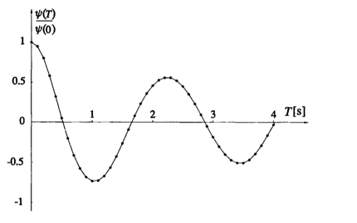
WAM Optimization (Auto-covariance ψ*)
Efficiency: - 50% computational time
E{H_{max}}
ψ*
Maximum wave height

Slide 19
Summary (Phase 1)
With the WAMAX routine implementation, both WAM and WW3 (since ver. 5.16) are equipped with procedures to compute maximum waves parameters
The new WAM code that includes the WAMAX routine was tested and debugged, and transferred to the code maintainer and CMEMS production unit HZG (we acknowledge the support by Dr. Joanna Staneva and Dr. Arno Behrens)
The computational burden for the new variables to be computed is limited (< + 0.5 %)

Slide 20
WAM and WW3 maximum wave assessment
(WAM and WW3 extreme wave validation and metrics)
Field campaign at Acqua Alta tower (northern Adriatic Sea) to collect in-situ test cases
Numerical simulations of the test cases in WAM and WW3 for comparison with observations
Plus
+ North Sea buoy extreme wave data comparison (two stations)
+ Tests with different WW3 input/dissipation source terms (ST3, ST4, ST6)

Slide 21
WAM and WW3 maximum wave assessment
OBSERVATIONS
Stereo-video ➔ Space-time extremes (Adriatic Sea)
2018
Wave radar ➔ Time extremes (Adriatic Sea)
2018
Wave buoys ➔ Time extremes (North Sea) 2011-2017

Slide 22
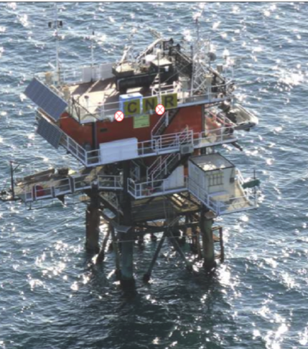
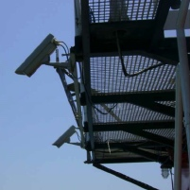
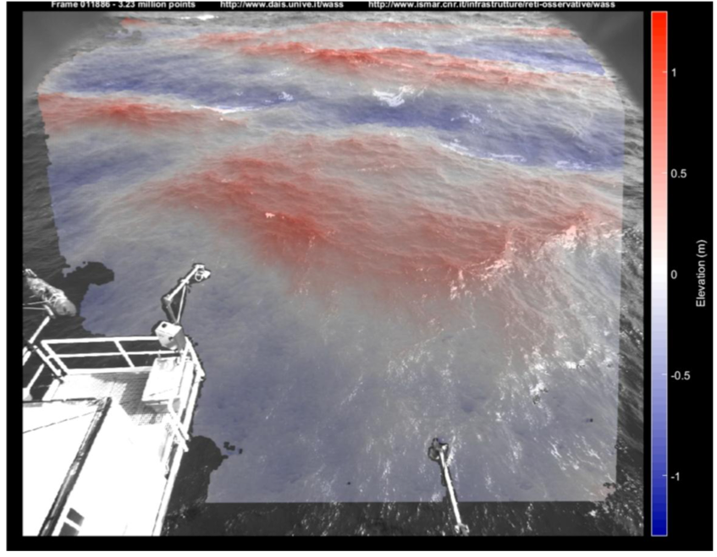
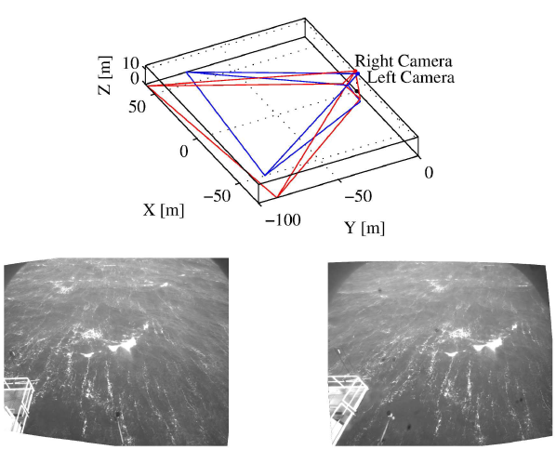
Space-Time observations @ Acqua Alta

Slide 23

Space-Time wave fields

Slide 24
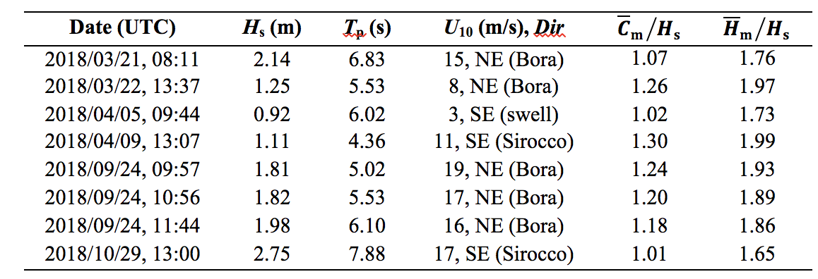
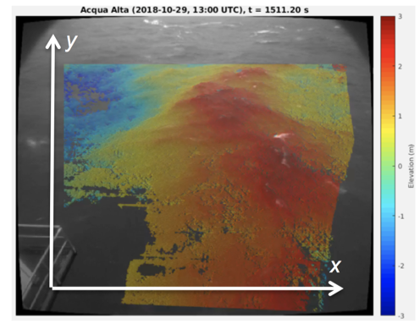
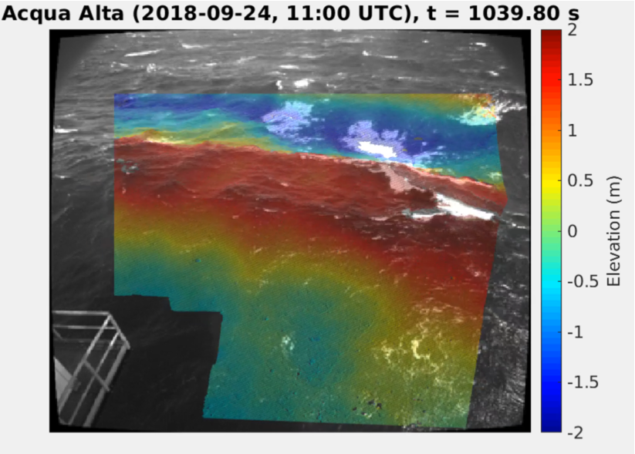
Space-Time extremes: observations
Sirocco
Bora
Targeted Events
Developed sea (Sirocco)
Limited fetch (Bora)
Swell
Crossing-sea

Slide 25
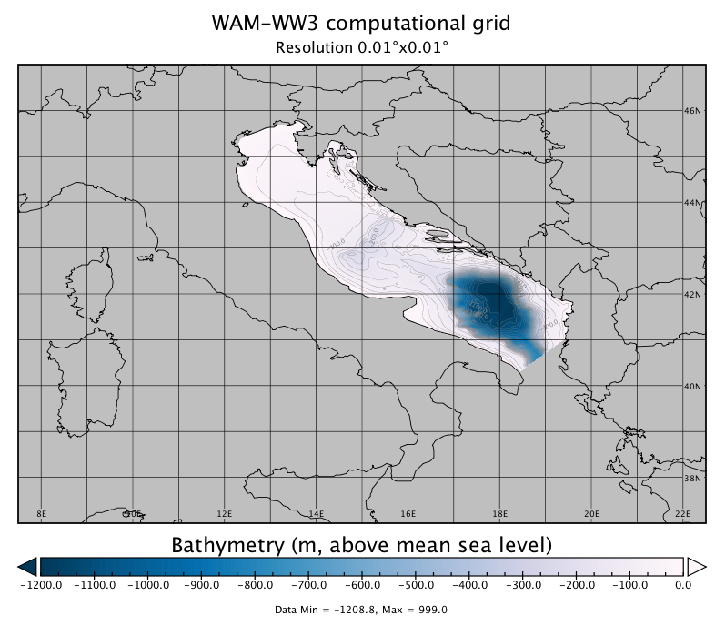
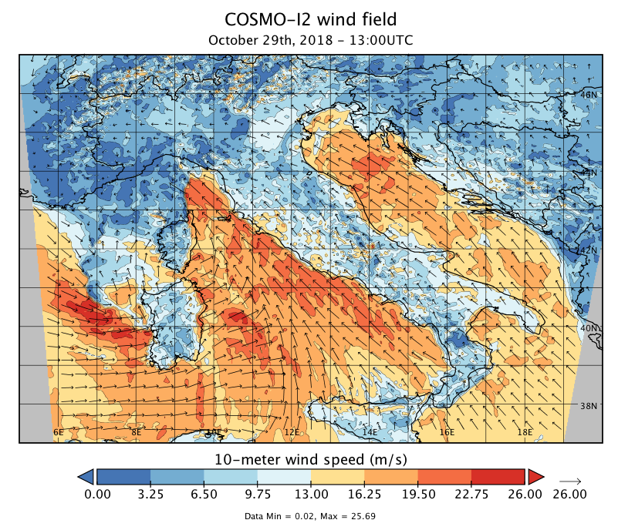
WAM and WW3 setups (Adriatic Sea)
Acqua Alta
Winds
2.75-km
hourly
WAM [wind input + dissipation] source terms (ST) switched with the “MyWave” project configuration (Bidlot et al., 2005), but updated to match ECWAM (ECMWF, 2012).
WW3
  ST3 parameterization follows ECMWF (2012)
  ST4 parameterization follows Ardhuin et al. (2010)
  ST6 parameterization follows Babanin, Young and Babanin (2006, 2007)

Slide 26
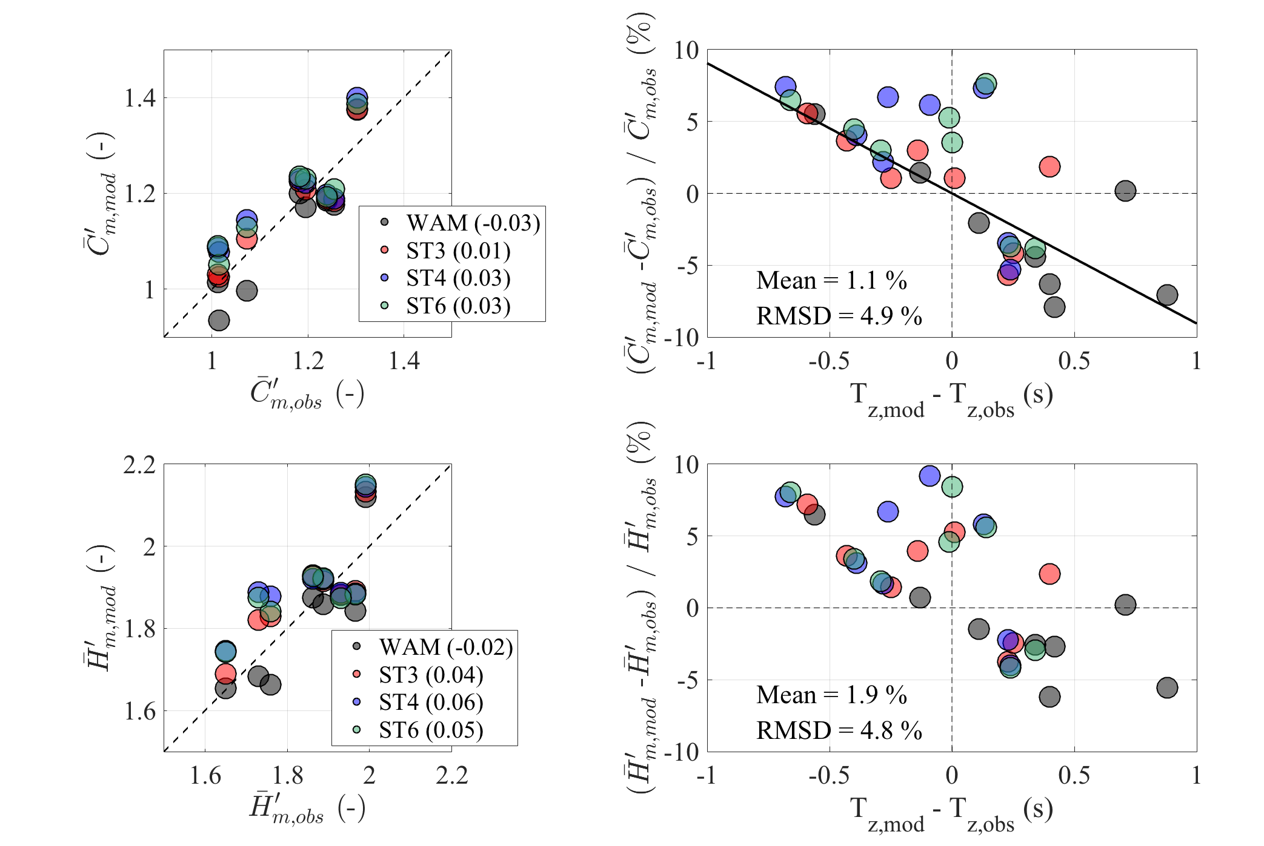
Space-Time extremes, WAM & WW3 vs. OBS
Extreme values normalized with H_{s} to remove bias due to sea severity
mod (Model)
obs (observation)
Legend: bias of normalized extremes (on average, < a few percentage of H_{s})

Slide 27
Space-Time extremes, WAM & WW3 vs. OBS
normalized
See note
below
Notes:
It is noteworthy that the normalization with H_{s} removes only part of the difference between observed and modeled values, since the extreme distributions incorporate also the average number of waves (N₁, N₂ and N₃) over the space-time region of volume V. For example, for a fixed number of waves, the maximum wave height distribution in the time domain according to Rayleigh theory is constant. We shall remove the effect of the number of waves in the analysis provided in section 2.3 (WP3). For the time being, we observe that, after normalization, more (less) energetic sea states produce longer (shorter) waves and, hence, for a fixed volume, a smaller (larger) number of waves, which imply smaller (larger) wave extremes. To account for this contribution, we have analyzed the relative error between model and observed normalized extremes as a function of the difference between mean wave periods, that we assume being a signature of the number of waves (Figure 4, right panels). As expected in confirmation of the theoretical approaches, positive errors (i.e. model > observation) imply the model period is smaller than the observed period, and vice versa. Overall, for all model runs, errors are however small. Indeed, model estimates of normalized space-time maximum wave parameters compared fairly well with stereo observations: for the crest height, the mean difference (model - observations) is 1.1% with a root-mean-square-difference (RMSD) of 4.9%, while for the wave height the mean difference is 1.9% and the RMSD of 4.8%.

Slide 28
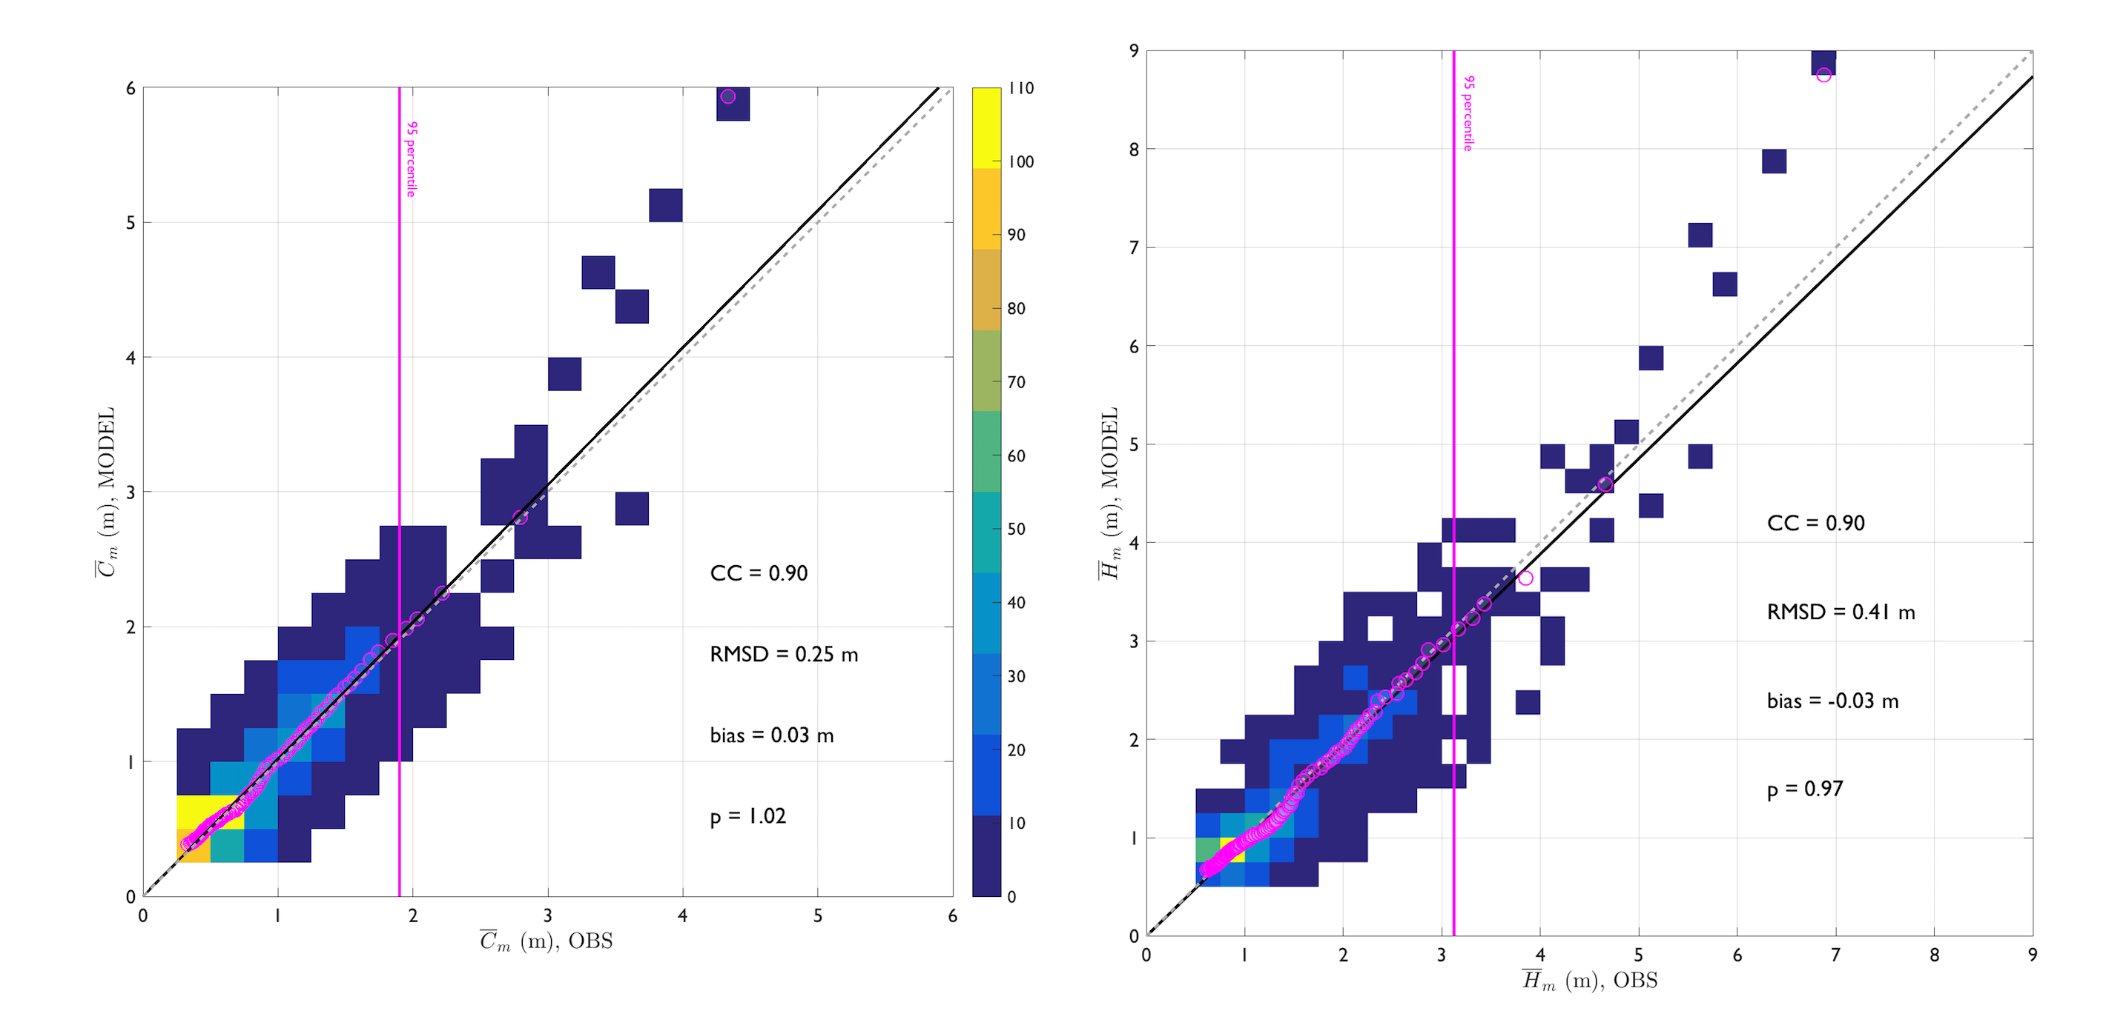
Time extremes, WAM vs. OBS (Acqua Alta)
Fair agreement between model time extremes and observations (Forristall and Naess models)

Slide 29
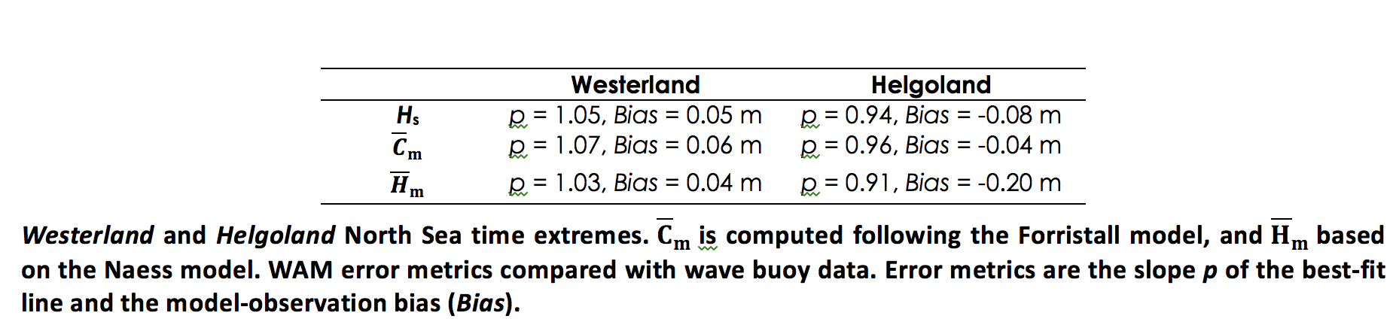
Time extremes, WAM vs. OBS (North Sea)

Slide 30
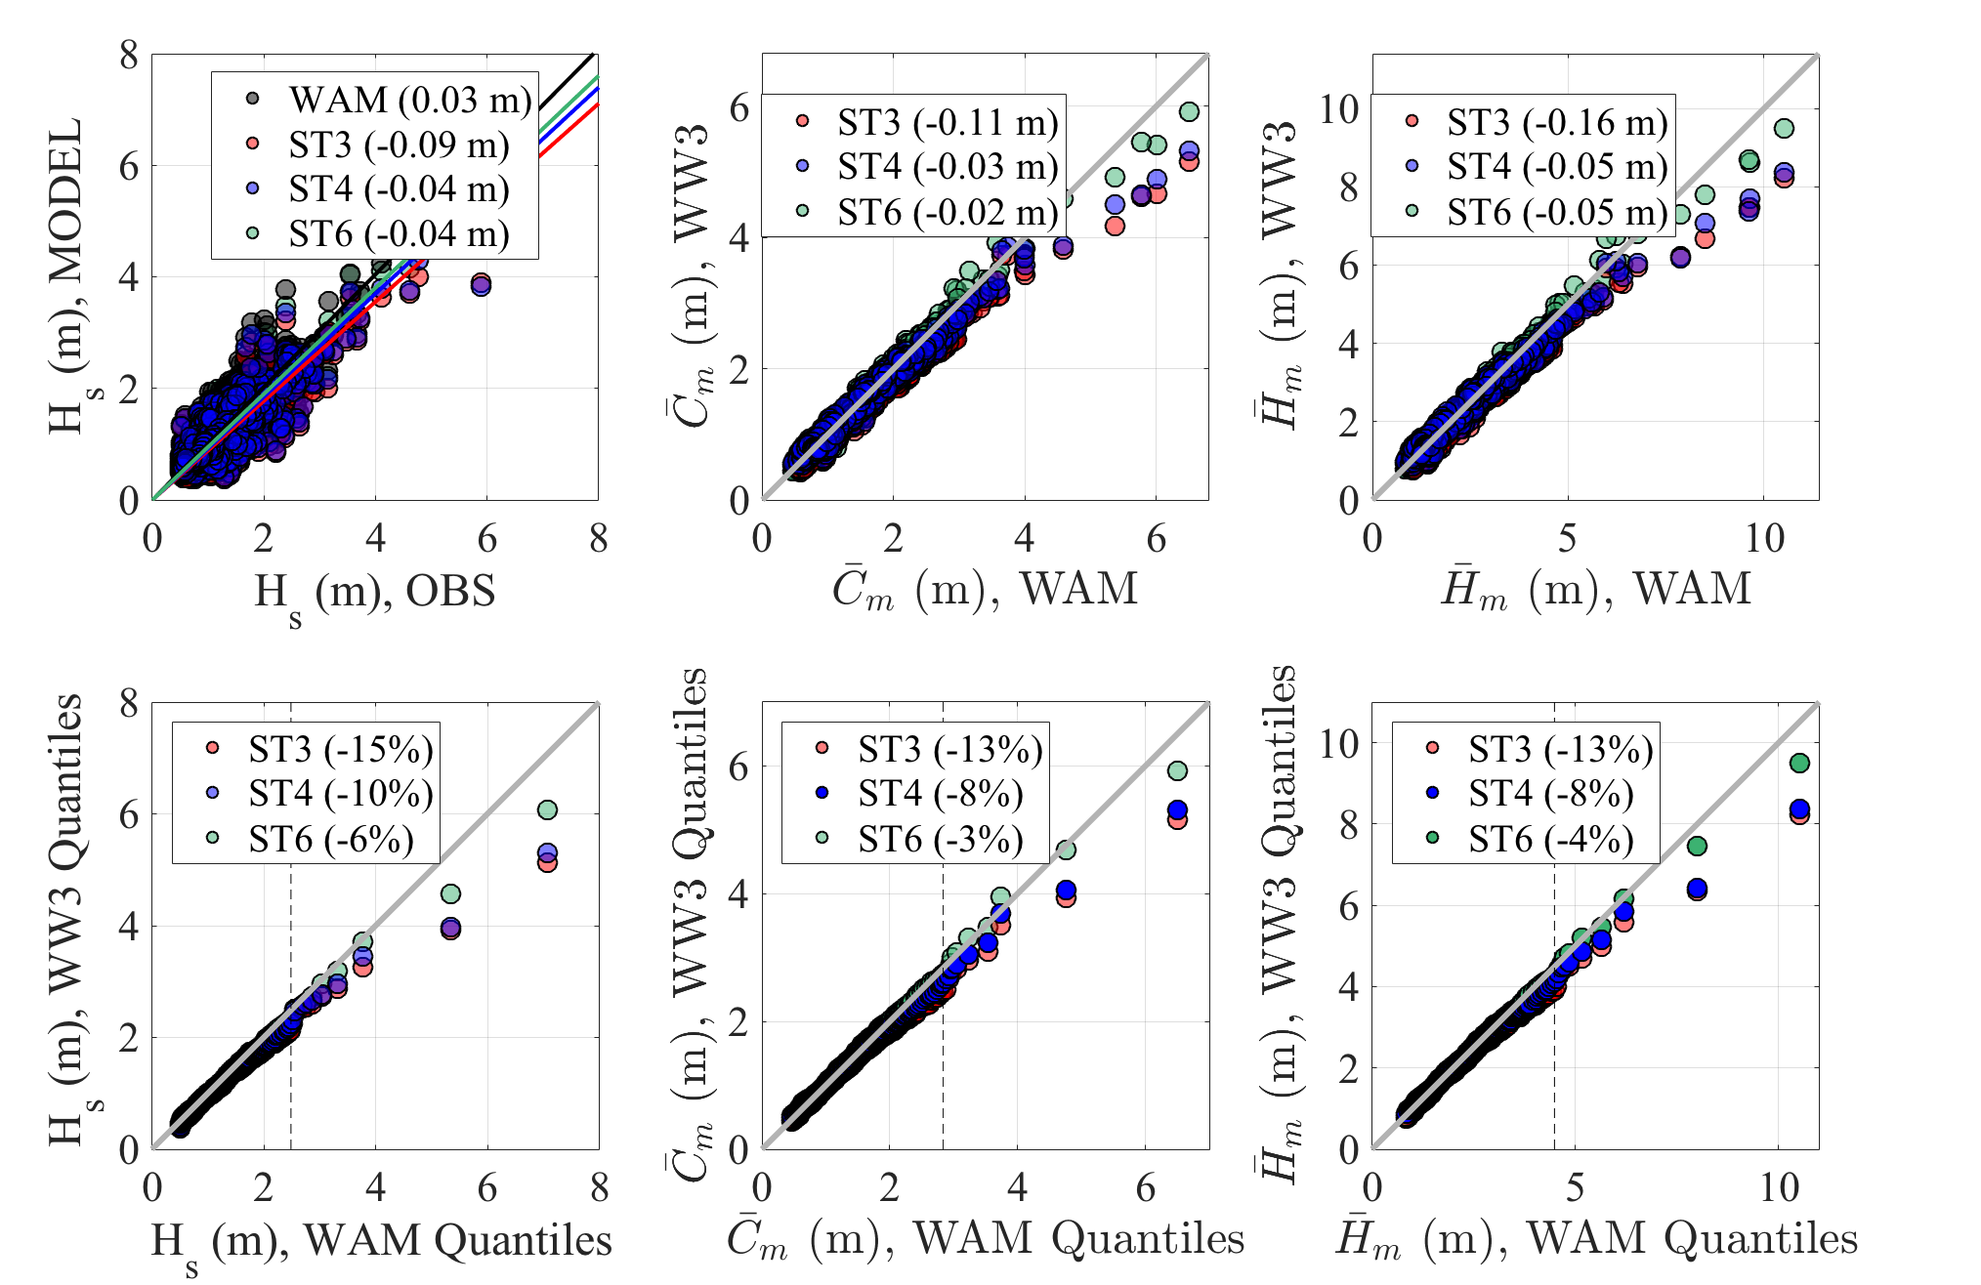
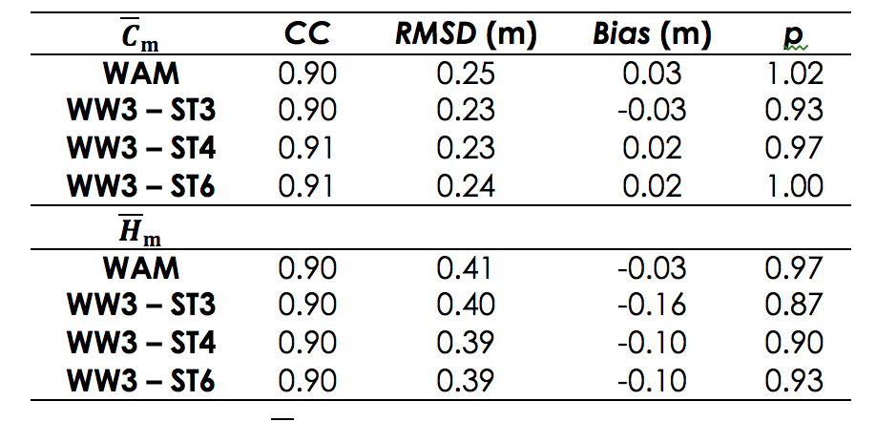
WAM and WW3 Source Term comparison
On average, small differences between WAM and WW3

Slide 31
Summary (Phase2)
WAM and WW3 model estimates of normalized space-time maximum wave parameters compared fairly with stereo observations
Adriatic and North Sea data indicates that WAM well reproduces time extremes
The model choice (WAM, WW3) has impact for the more energetic storms (however, few cases analyzed)
The WW3 source term parameterization seems to have a small impact on extremes

Slide 32
Extreme sea conditions in the Mediterranean Sea
(model-model intercomparison and sensitivity assessment)
Configuration of WW3 and WAM Mediterranean Sea models and long-term hindcast.
Comparison of the extreme wave fields, with particular attention to sea state parameters.

Slide 33
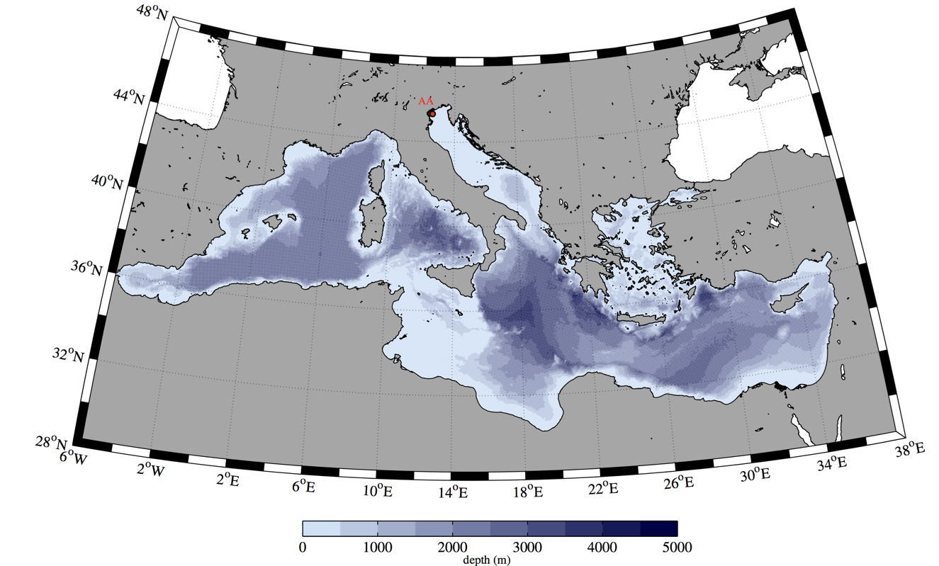
WAM and WW3-ST4 setup
Grid 5-km resolution
Bathymetry EMODNET bathymetry dataset
Wind fields ERA5 dataset (28-km, hourly, 10 years). Verification: ENVISAT-1

Slide 34
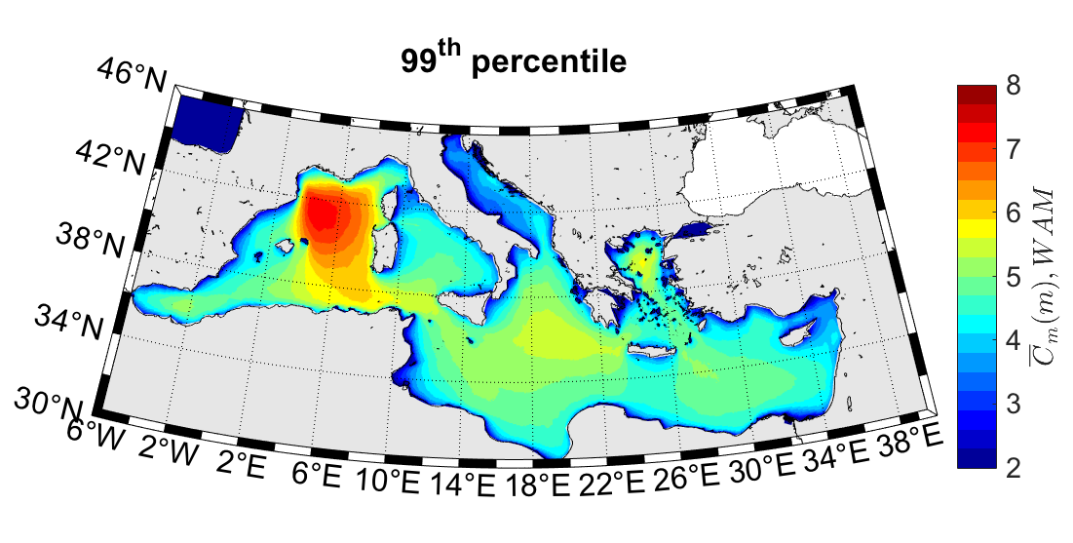
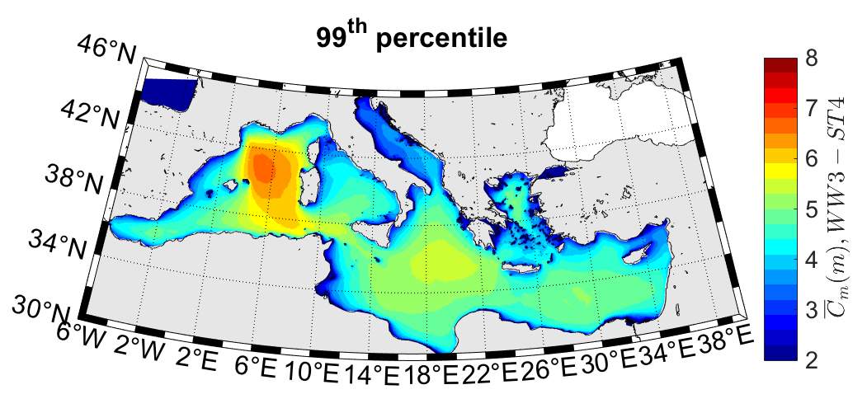
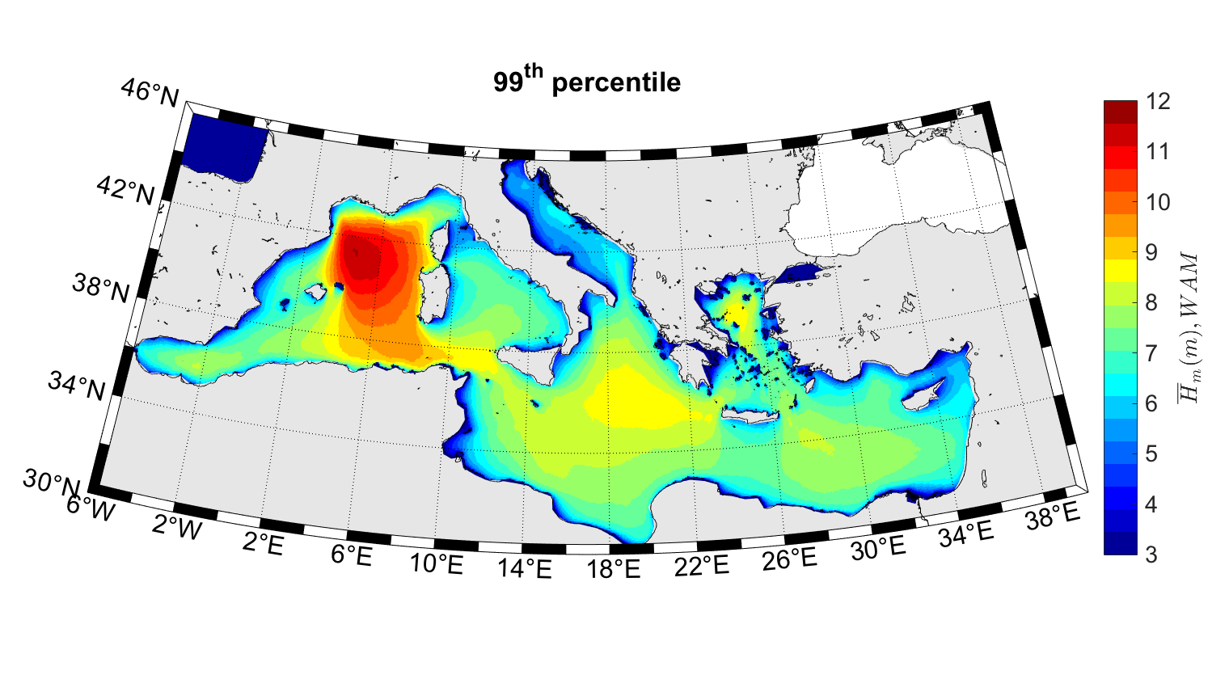
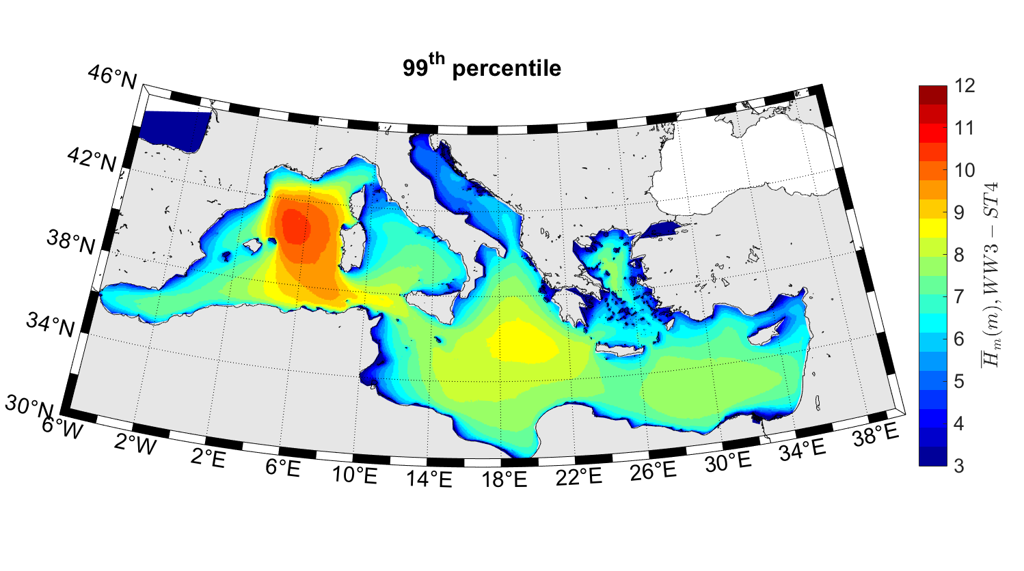
Extreme wave statistics in the Med. Sea
It is relevant the significance of the mistral wind jet in driving very intense storms in the Gulf of Lion (C_{m} = 8 m, H_{m}= 12 m), whilst the rest of the basin do not exceed C_{m} = 5.5 m (H_{m}= 8 m). For the strongest storms, differences between WAM and WW3-ST4 are articulated, with WAM that overestimates WW3-ST4 up to (Gulf of Lion) 0.5 m (1.0 m) in the northernmost part of the basin, while an underestimation of about 0.2 m is visible in the southern basins.

Slide 35
Summary (Phase 3)
Analysis revealed that maximum waves as high as 12 m (99th-percentile) are driven by Mistral winds
There are differences between WAM and WW3-ST4 maxima. In all the areas with largest median (50th-percentile) conditions WW3-ST4 overestimates WAM, while differences are negligible in the calmest areas
The pattern of extremes for the more intense storms (99th-percentile) show differences between WAM and WW3-ST4

Slide 36
IMPACT AND RELEVANCE FOR CMEMS
New wave parameters in the catalogue of model products
Improvement of the Marine Warning System (production of more complete information on surface waves, which is often requested by users).
Most of the CMEMS target fields - marine safety, marine resources, marine environment and forecasting – will directly benefit from the proposed R&D work.
Relevant to the R&D area “4.3 COUPLED OCEAN-MARINE WEATHER INFORMATION, SURFACE CURRENTS AND WAVES”.
R&D area “4.9 Observation technology and methodologies”

Slide 37
LARGEST WAVES IN MARINE ENVIRONMENT
- New products for wave model forecast -
LATEMAR
Alvise Benetazzo, F. Barbariol, P. Pezzutto,
L. Bertotti, M. Sclavo, L. Cavaleri
Institute of Marine Sciences, ISMAR
National Research Council, CNR
(Venice, Italy)
CMEMS-SE, Final Meeting, March 17, 2020

