Slide 1
EGU 2020 Peatland hydrological behavior with global warming
Stefano Ferraris (1), Davide Canone (1), Davide Gisolo (1),
Mario Putti (2), Pietro Teatini (2), and Maurizio Previati (1)
University of Turin (1) and University of Padua (2), ITALY
All rights are reserved but I still grant Copernicus Meetings the right to hold my presentation materials online for viewing and download by individuals

Slide 2
The Adriatic coast is subject to land subsidence, large areas are some meters lower than the sea level. This also due to peat oxidation, due to the increased frequency of warmer period.

Slide 3
We took a big monolith in the field and we built a lisimeter in the laboratory, with weighting, soil moisture and soil potential measurements.

Slide 4
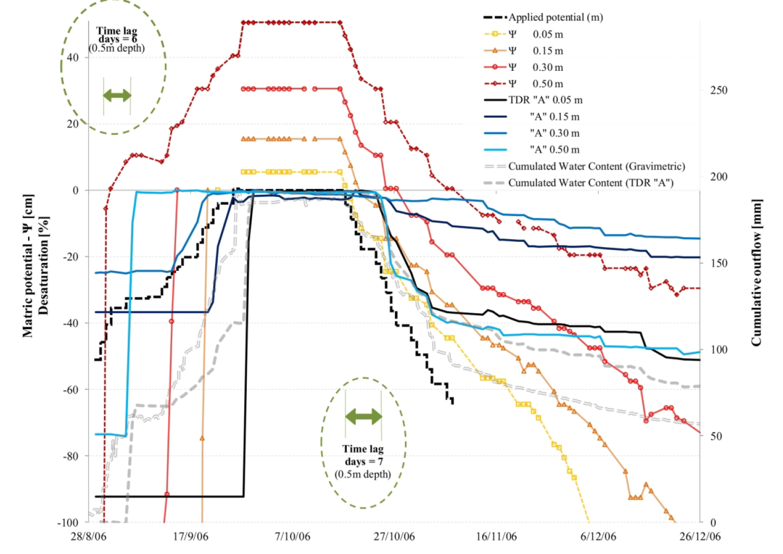
A thorough cycle of wetting and drying was made in order to simulate the drier states we can guess to be more frequent in the future.

Slide 5
Also, the hysteresis behaviours in the lab and in the field were different, with much wider loops in the lab conditions because of extended range of potential.

Slide 6
Conclusion Variations were found, with respect to the field natural conditions, in the relations between the matric potential and the volumetric water content of different horizons as a result of the initial prolonged drying. Previati et al. (2020) Thorough wetting and drainage of a peat lysimeter in a climate change scenario, in: Hydrological processes

