Slide 1
P-wave travel time tomography of the Alpine upper mantle using AlpArray seismic network data
Marcel Paffrath, Wolfgang Friederich and the AlpArray Working Group
© Authors. All rights reserved

Slide 2
Abstract
We perform a teleseismic P-wave travel time tomography to examine geometry and slab structure of the upper mantle beneath the Alpine orogen. Vertical component data of the extraordinary dense seismic network AlpArray are used which were recorded at over 600 temporary and permanent broadband stations deployed by 24 different European institutions in the greater Alpine region, reaching from the Massif Central to the Pannonian Basin and from the Po plain to the river Main. Mantle phases of 347 teleseismic events between 2015 and 2019 of magnitude 5.5 and higher are evaluated automatically for direct and core diffracted P arrivals using a combination of higher-order statistics picking algorithms and signal cross correlation. The resulting database contains over 170.000 highly accurate absolute P picks that were manually revised for each event. The travel time residuals exhibit very consistent and reproducible spatial patterns, already pointing at high velocity slabs in the mantle.
For predicting P-wave travel times, we consider a large computational box encompassing the Alpine region up to a depth of 600 km within which we allow 3D-variations of P-wave velocity. Outside this box we assume a spherically symmetric earth and apply the Tau-P method to calculate travel times and ray paths. These are injected at the boundaries of the regional box and continued using the fast marching method. We invert differences between observed and predicted travel times for P-wave velocities inside the box. Velocity is discretized on a regular grid with an average spacing of about 25 km. The misfit reduction reaches values of up to 75% depending on damping and smoothing parameters.
The resulting model shows several steeply dipping high velocity anomalies following the Alpine arc. The most prominent structure stretches from the western Alps into the Apennines mountain range reaching depths of over 500 km. Two further anomalies extending down to a depth of 300 km are located below the central and eastern Alps, each of them separated by clear gap. Regarding the lateral position of the central and eastern Alpine slabs, our results confirm previous studies. However, there are differences regarding depth extent, dip angles and dip directions. The central as well as eastern high velocity structure dip very steeply with a tendency towards northward dipping. We perform various general, as well as purpose-built resolution tests, to verify the capabilities of our setup to resolve slab gaps as well as different possible slab dipping directions.
© Authors. All rights reserved
Notes:
To get first motion of P-waves we use CF, calculating Kurtosis in a moving window
→ measure deviation from mainly normal distributed noise
→ CF increases when first motion occurs
Figure:
Top: Z component of A102A part of temporary AlpArray network Z3, dashed line: theoretical onset Tau-P for spherical symmetric earth
Bot: CF calculated around Tau-P pick, same level until first motion occurs, red line: AIC analysing loss in information content of CF → minimum: pick

Slide 3
Please activate presentation mode to correctly view animations and slide transitions.
© Authors. All rights reserved
Notes:
To get first motion of P-waves we use CF, calculating Kurtosis in a moving window
→ measure deviation from mainly normal distributed noise
→ CF increases when first motion occurs
Figure:
Top: Z component of A102A part of temporary AlpArray network Z3, dashed line: theoretical onset Tau-P for spherical symmetric earth
Bot: CF calculated around Tau-P pick, same level until first motion occurs, red line: AIC analysing loss in information content of CF → minimum: pick

Slide 4
METHODS
Automatic picking, event selection and inversion

Slide 5
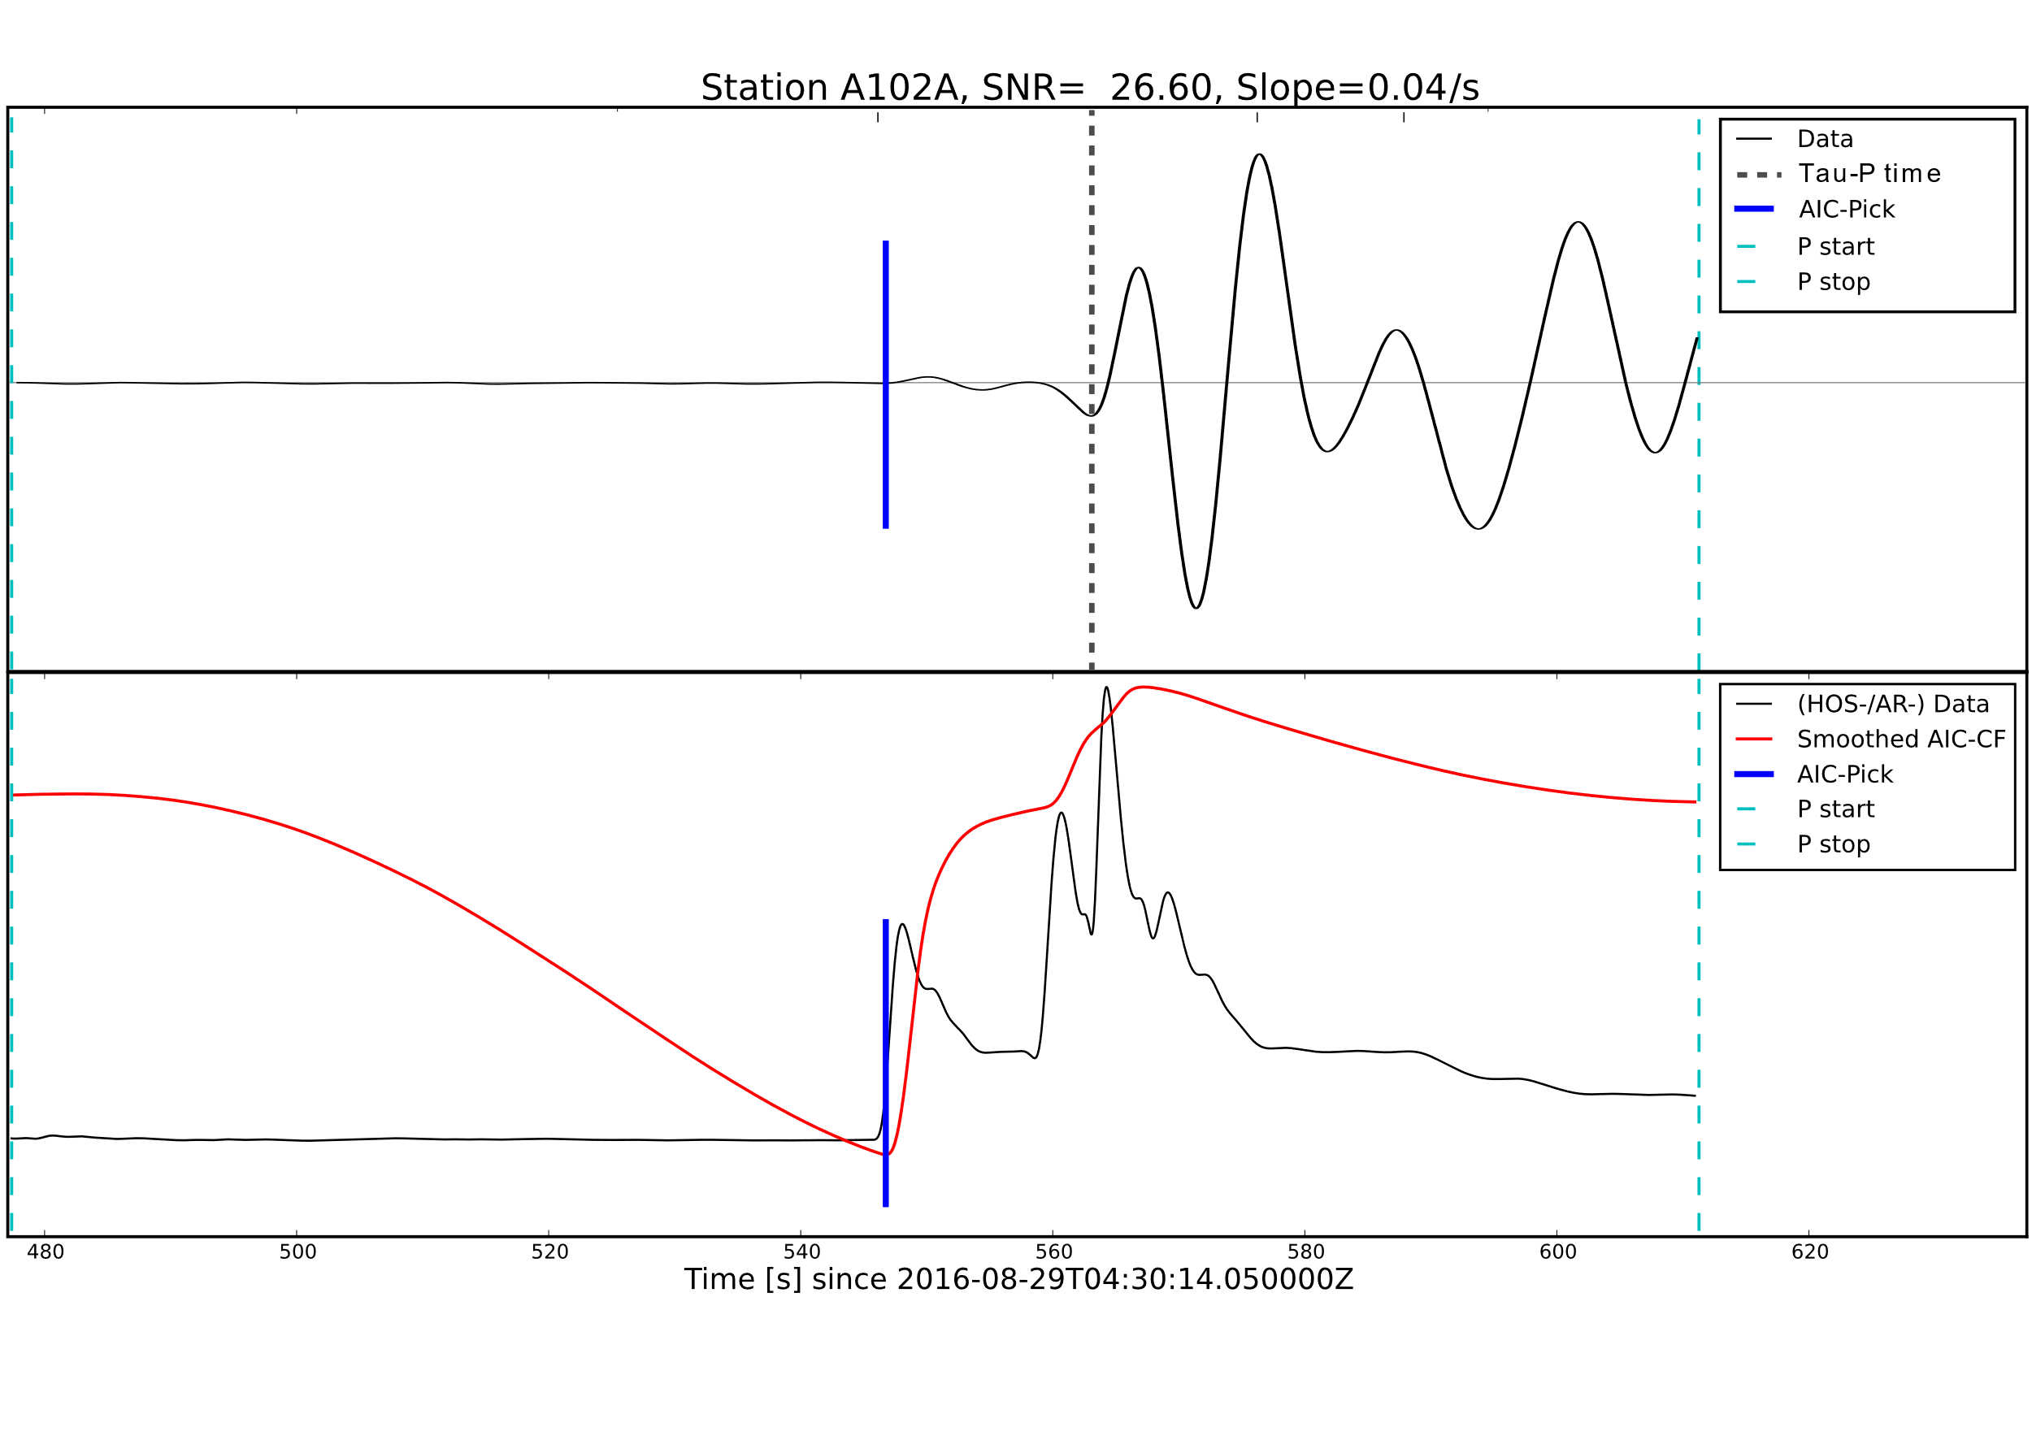
Automatic picking using PyLoT
Initial picks using characteristic functions of higher order statistics
We calculate deviation from normal distribution (Kurtosis) in a moving window (Küperkoch et al. 2010)
Waveforms are restituted, resampled and frequency filtered
Search for minimum Akaike Information Criterion (AIC) around first maximum of Kurtosis function
Vertical component of signal
AIC
AIC pick
Kurtosis function
© Authors. All rights reserved
Notes:
To get first motion of P-waves we use CF, calculating Kurtosis in a moving window
→ measure deviation from mainly normal distributed noise
→ CF increases when first motion occurs
Figure:
Top: Z component of A102A part of temporary AlpArray network Z3, dashed line: theoretical onset Tau-P for spherical symmetric earth
Bot: CF calculated around Tau-P pick, same level until first motion occurs, red line: AIC analysing loss in information content of CF → minimum: pick

Slide 6
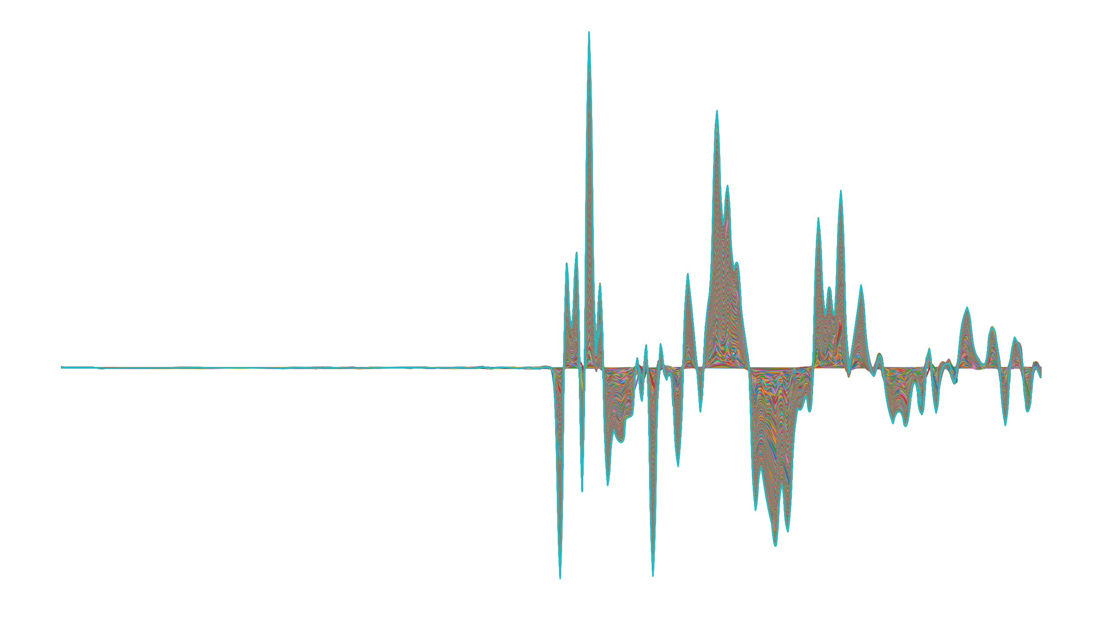
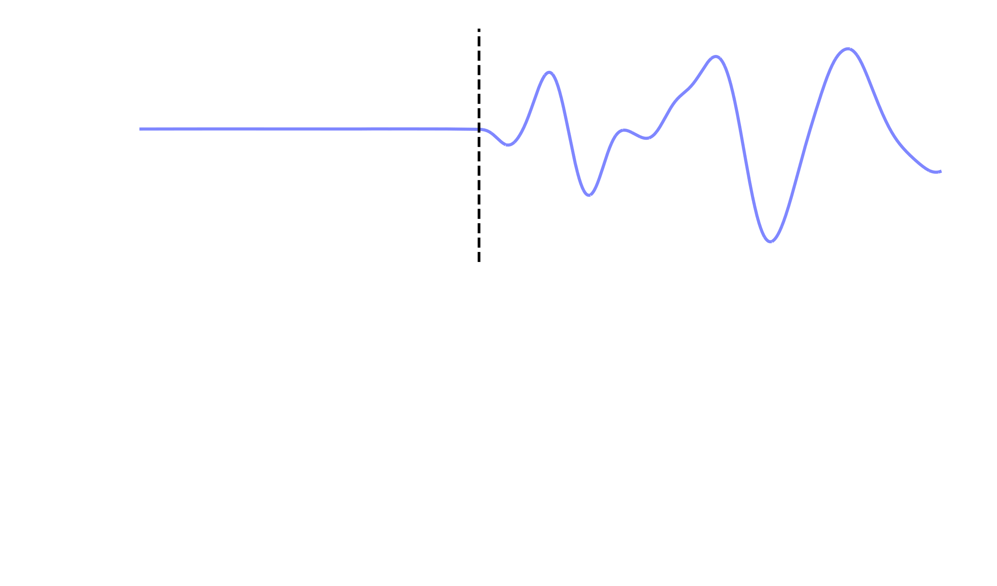
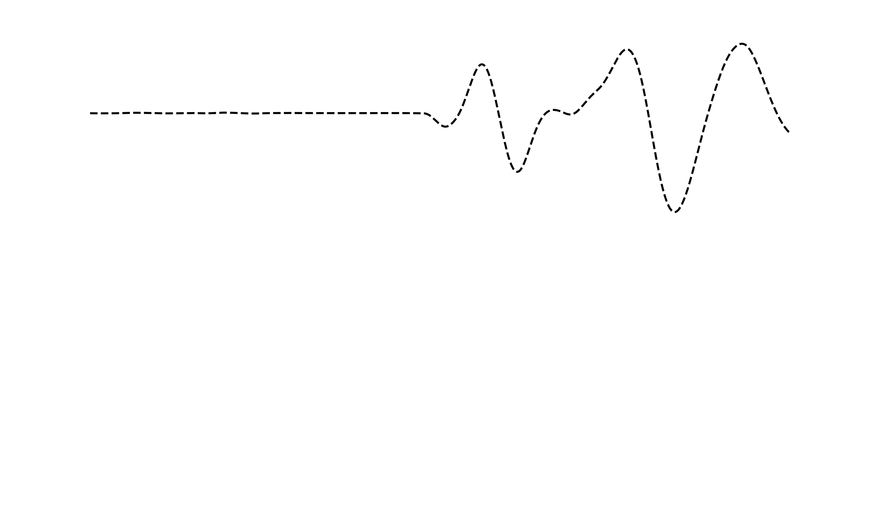
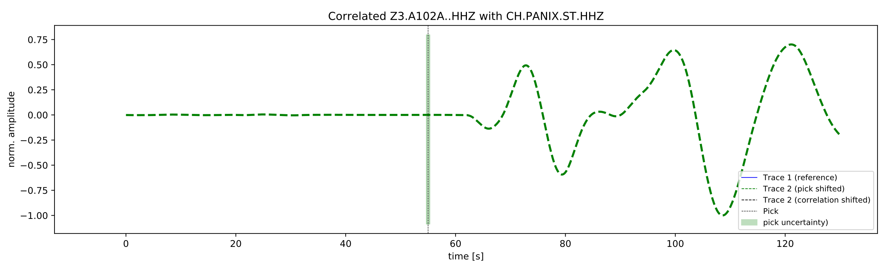
Automatic Picking & Cross Correlation
Stack traces
Filter & pick
Accuracy of automatic picking using kurtosis and AIC is not sufficient:
Station noise may mask first onset leading to picking of noise or later phases
After removing outliers, pick uncertainty remained higher than actual travel time differences to 1D model
Solution:
Correlation of signals of one event using kurtosis picks as reference times, then shifting and stacking to obtain master trace.
Pick high quality master trace and obtain time difference to all stations using cross correlation with master trace.
Estimate error from width of cross correlation function
correlate
Cross-correlation function
dt
© Authors. All rights reserved
Notes:
For the automatic picking we use a Kurtosis based picking algorithm:
Works very well generally but has major downsides
False detections of other signals in vicinity as it can not differentiate different types of signals
First onset masked in noise, picks later phases
After removing outliers, pick uncertainty still higher than data residuals
What we did to address problems, increase certainty:
Make use of similarity of signals of an event on the whole array
Stack signal of all stations on reference station at time of maximum correlation
Pick the resulting high quality, high SNR reference signal, representing all stations for that event
Correlate again with stacked signal and assign new picks by shifting reference pick
Figure: three traces:
Green line: Z component of A102A that is examined with old pick
Blue line: Stacked reference trace with pick
Black line: Shifted trace with new pick
Figure bot: cross correlation function:
Maximum ccc: 0.96, pick shifted by over 6 s
Error estimated using (1) FWHM: wider cross correlation function → larger error (frequency dependant) (2) cross correlation coefficient → low ccc high error

Slide 7
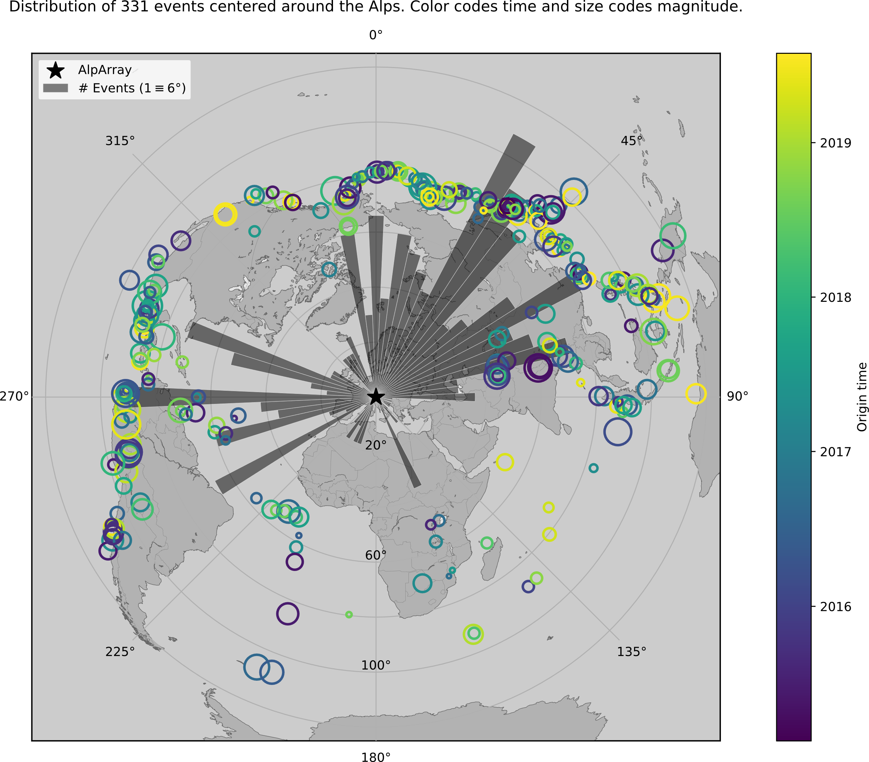
Event Database
HF
Azimuthal Distribution of 331 events of main dataset used for inversion. Color codes origin time. Size codes magnitude.
AlpArray Seismic network + complementary experiments + surrounding stations (5° radius around 46°N 11°E)
Absolute travel times for use in full-waveform inversion, relative travel times for travel time tomography
Two Datasets:
HF (up to 0.5 Hz) / LF (up to 0.1 Hz)
> 170.000 picks from 370 events (HF)
> 255.000 picks from 421 events (LF)
Main dataset
© Authors. All rights reserved

Slide 8
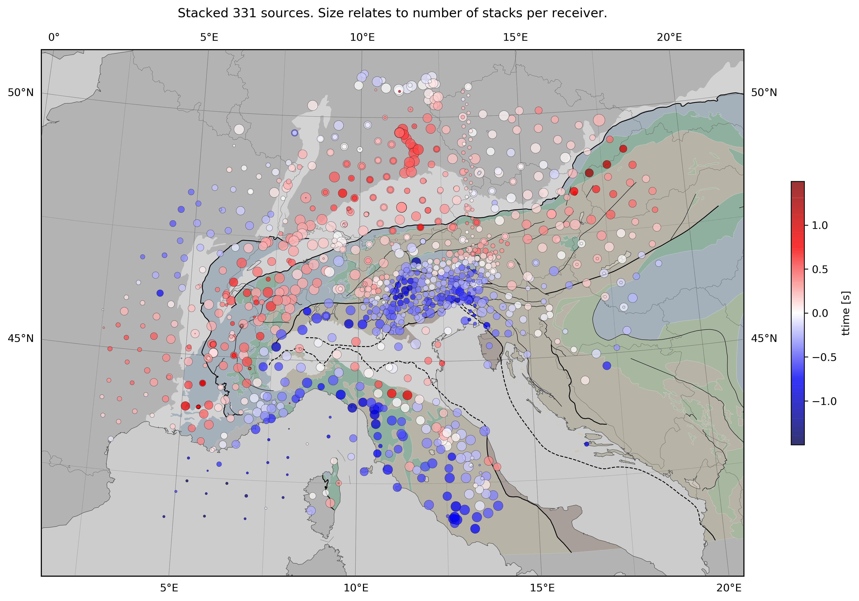
Stacked travel time residuals (HF)
Stacked and demeaned travel time residuals relative to 1D earth model for all 331 events
A: SWATH-D network above highly discussed (possible) slab gap and polarity flip in the eastern alps; highly complex high velocity pattern with NE striking features
B: Strong high velocity zone below Apennines extending to the southern borders of the array
C: Alps-Apennines transition zone
A
C
B
© Authors. All rights reserved

Slide 9
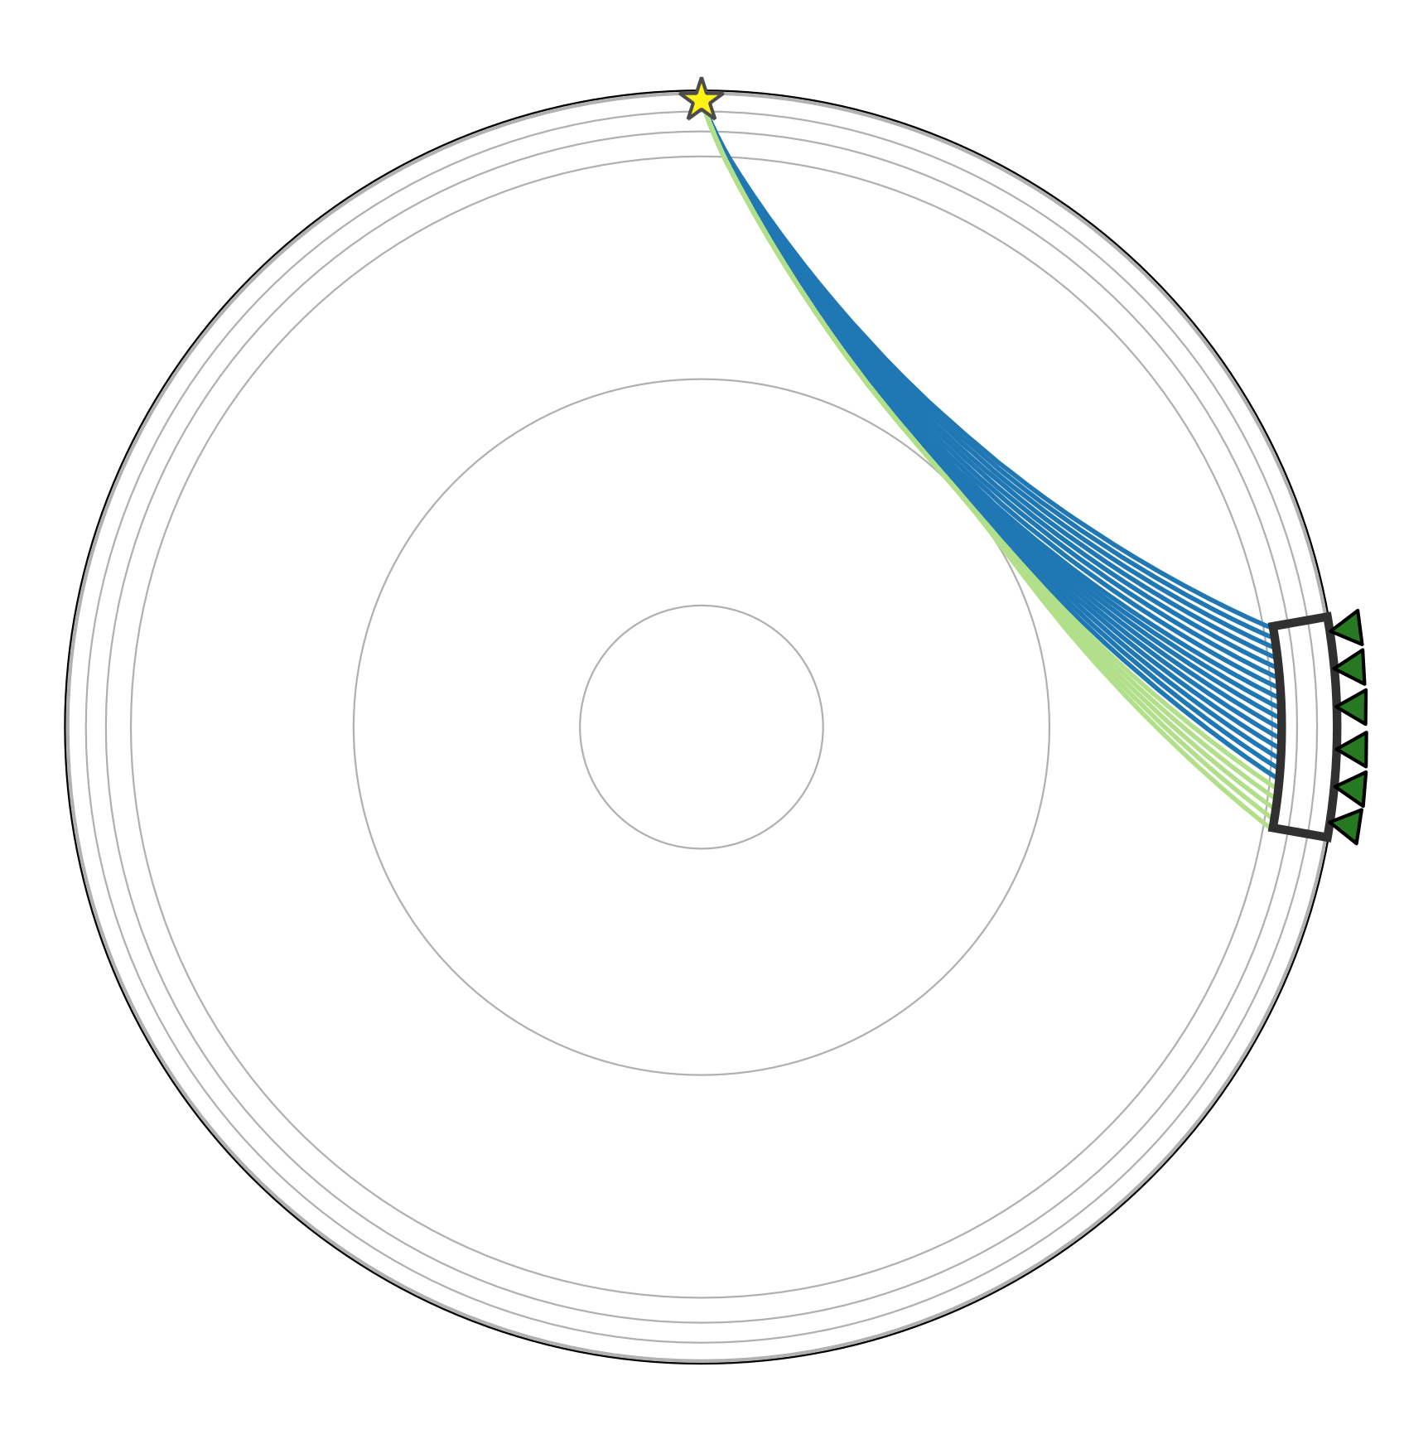
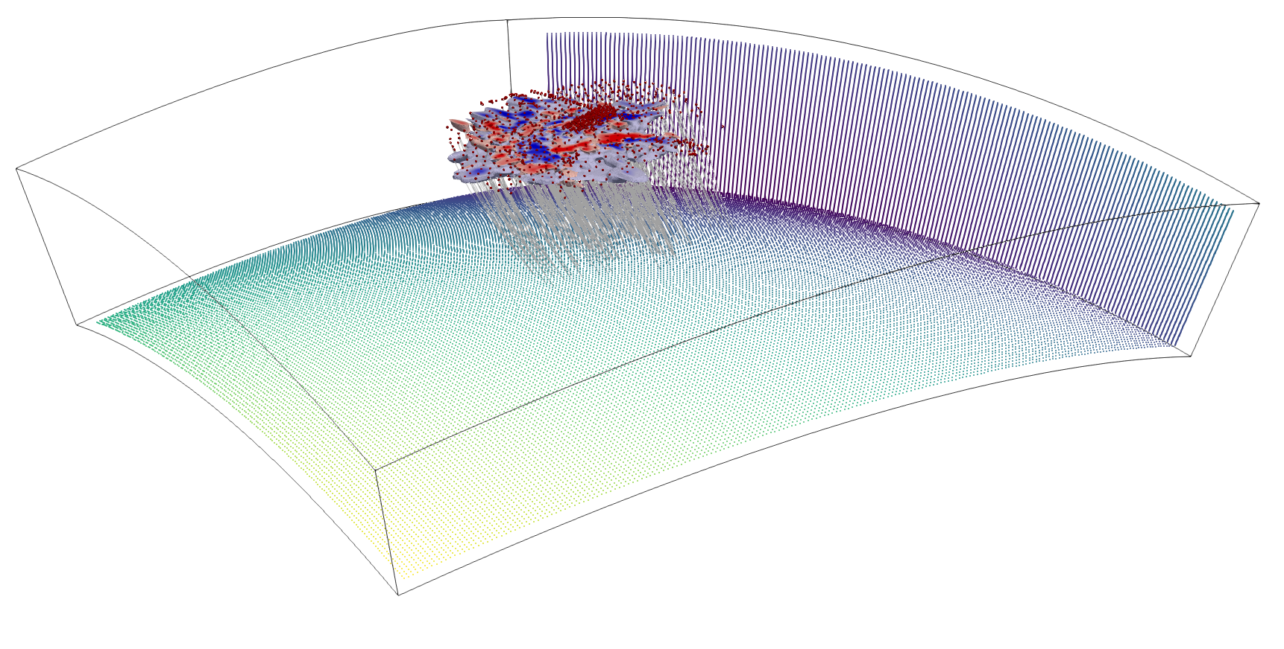
Hybrid method
Global (1D)
We reduce computational costs by calculating wave propagation assuming a spherically symmetric global earth (1D) and only account for regional heterogeneities in a 3D meshed box
1D calculation to grid boundaries of regional box using Tau-P (ObsPy)
Inside box: Fast Marching Method (Rawlinson et al. 2004)
FMTOMO inversion code, subspace inversion method (Rawlinson et al. 2004)
Correction for 3D crustal structure
We directly inject a precise 3D crustal model (T. Diehl 2009), including full resolution information
Well resolved areas of the crustal model will be fixed for the inversion process, whereas poorly resolved areas are still subject to change by the teleseismic tomography
Regional (3D)
CRUSTAL MODEL
© Authors. All rights reserved
Notes:
To solve the forward problem we use a hybrid method to reduce computational costs
Assume spherically symmetric global earth, calculate rays with Tau-P method up to grid boundaries of regional domain
Inject wavefront into grid and calculate wavefront in 3D with Fast Marching Method
Simulate through crust and correct for influence of crustal structure
Solve the inverse problem iteratively with FMTOMO using subspace inversion method

Slide 10
RESULTS
Interpretation and comparison

Slide 11
Model interpretation on 2% velocity increase contour lines
HF
Interpreted with the gracious help of Stefan Schmid and Mark Handy
© Authors. All rights reserved

Slide 12
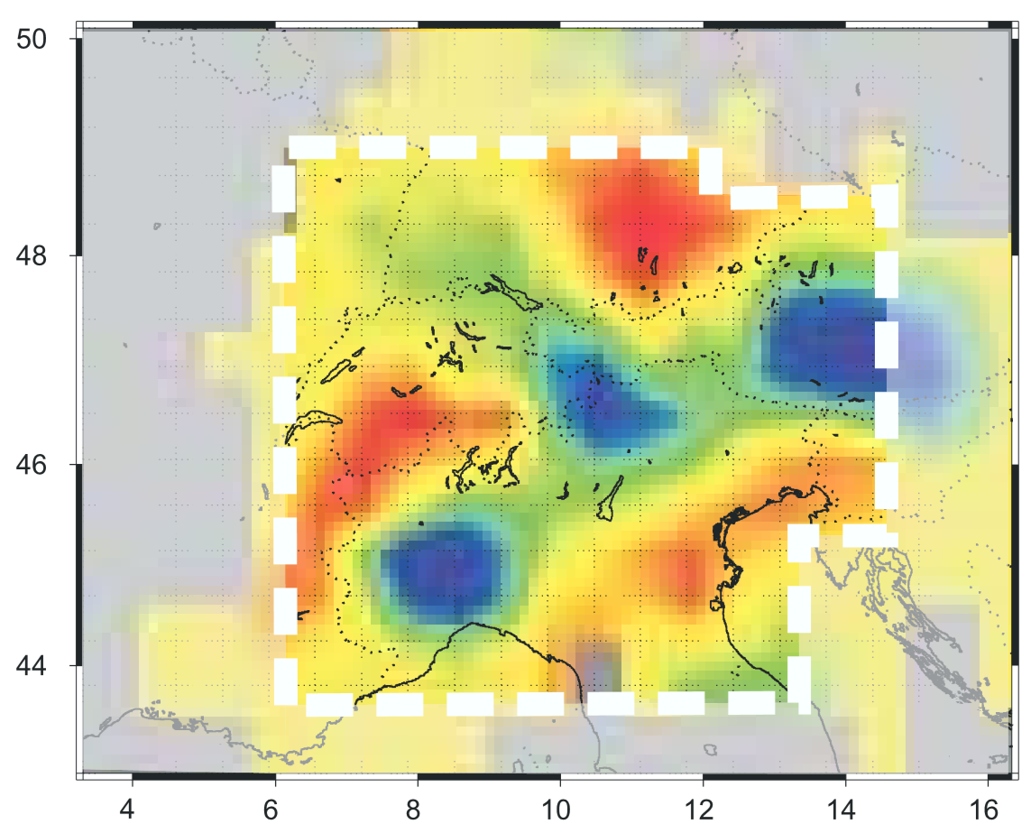
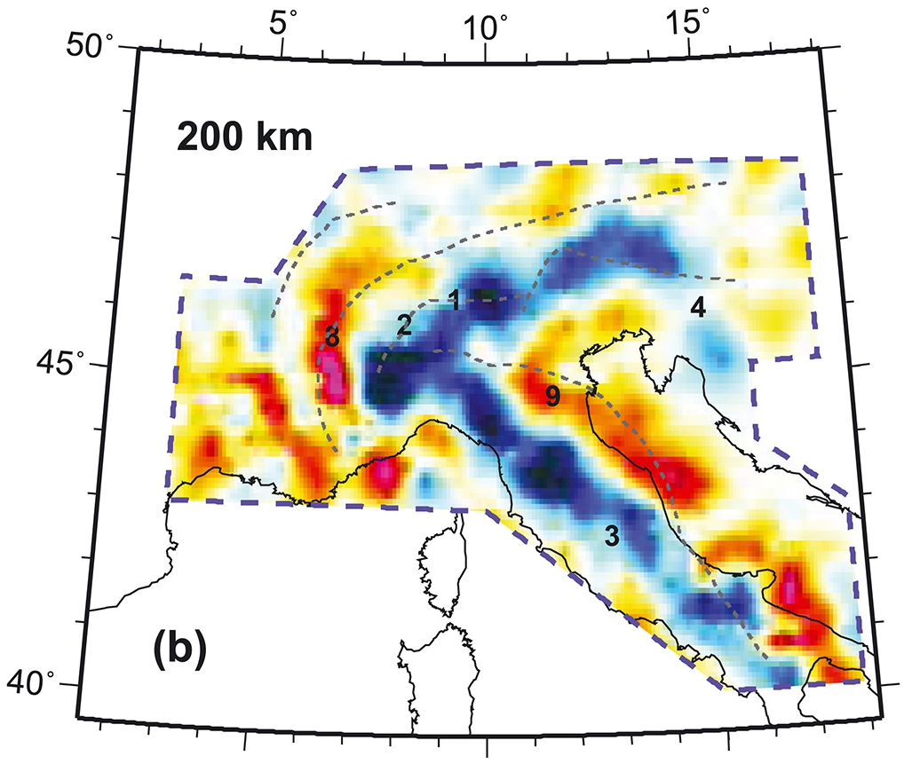
Comparison to other studies
Zhao et al. 2016, 200 km depth
Lippitsch et al. 2003, 210 km depth
Two depth slices at 200km and 210 km depth
Relative velocity perturbation with regard to background velocity at that depth
© Authors. All rights reserved

Slide 13
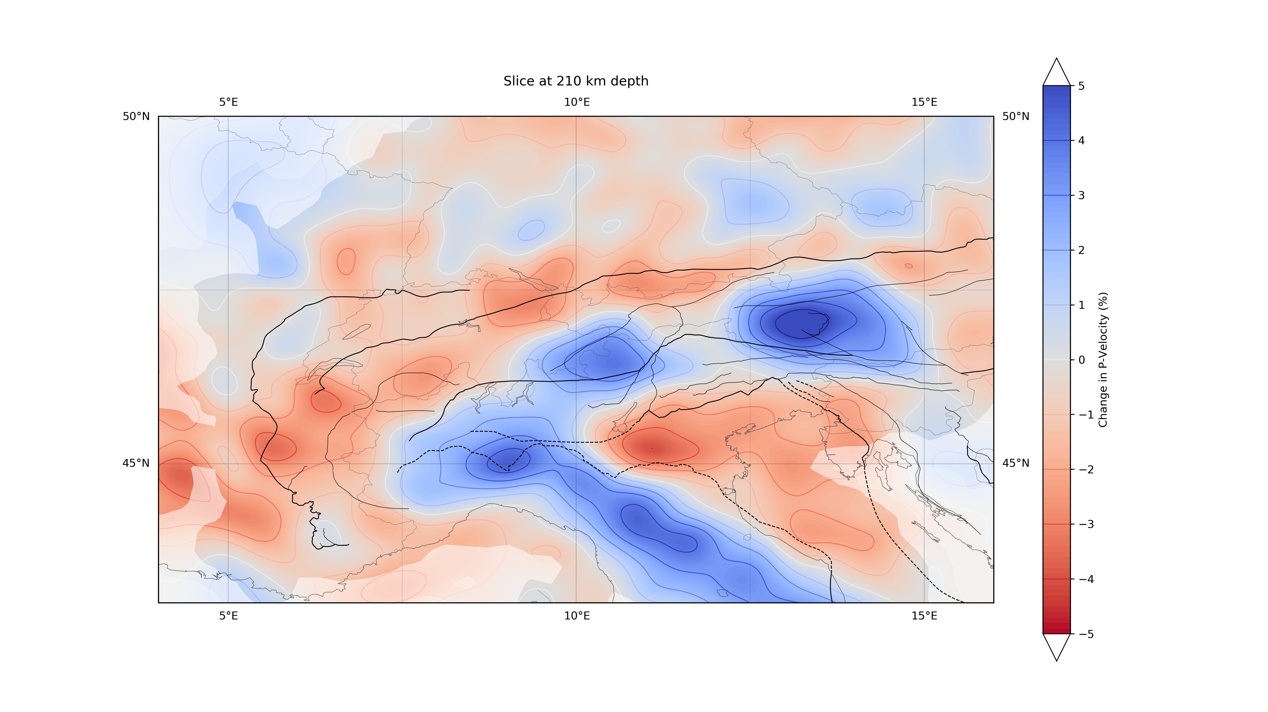
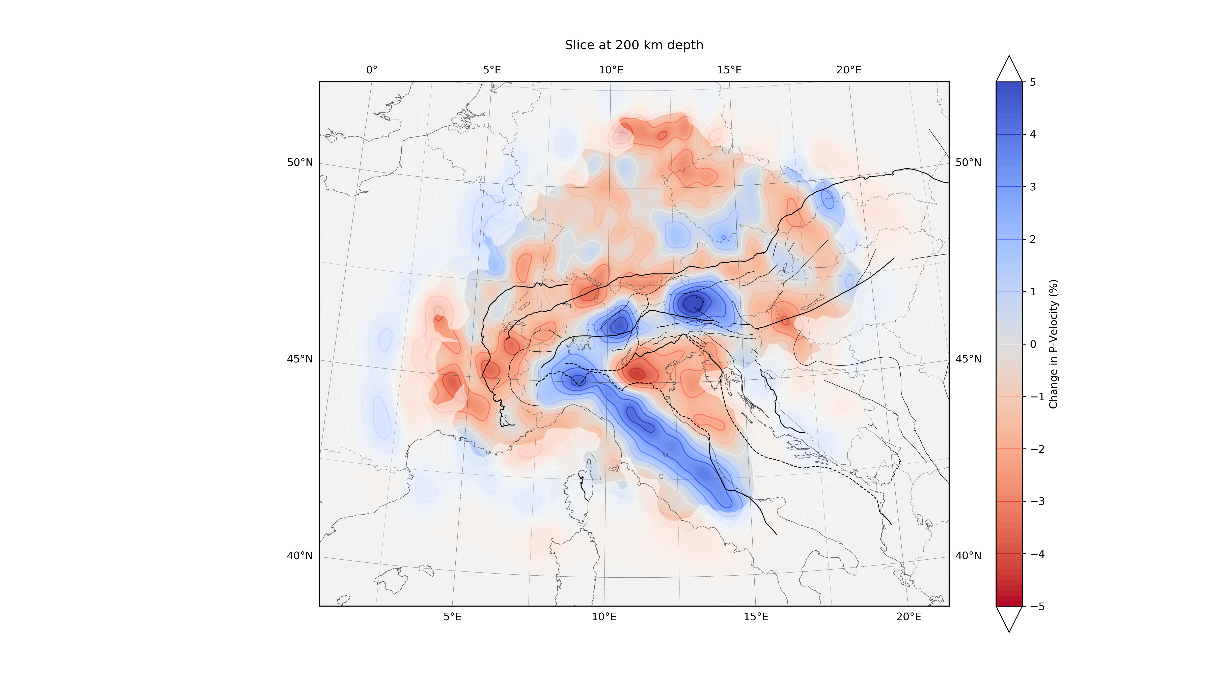
Comparison to other studies
roughly fitted! (unknown projection parameters)
Zhao et al. 2016, 200 km depth
Lippitsch et al. 2003, 210 km depth
Very good agreement of high velocity anomalies with both models
vs. Zhao (200km): High velocity anomalies more differentiated in our model
vs. Lippitsch (210km): Western Alpine anomaly connected to Apennines anomaly
© Authors. All rights reserved

Slide 14
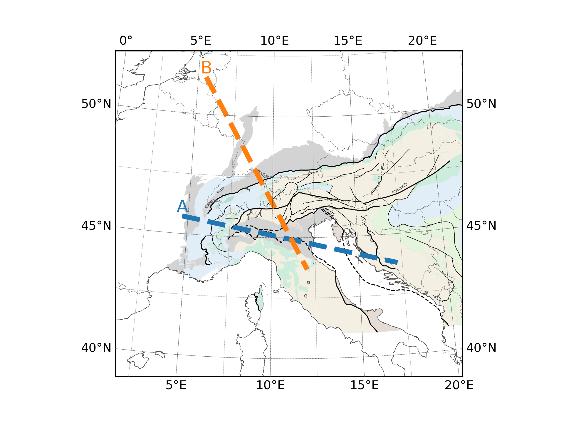
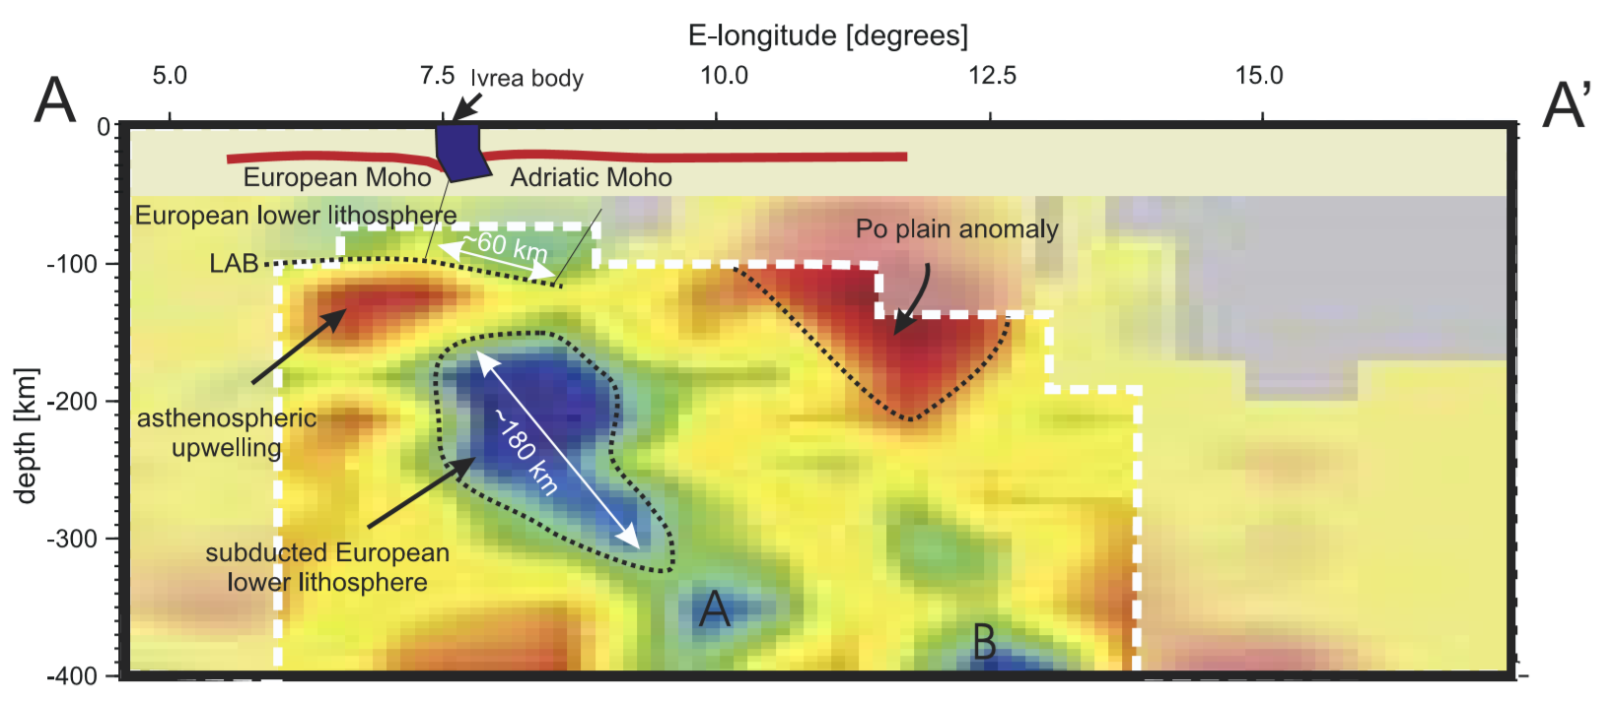
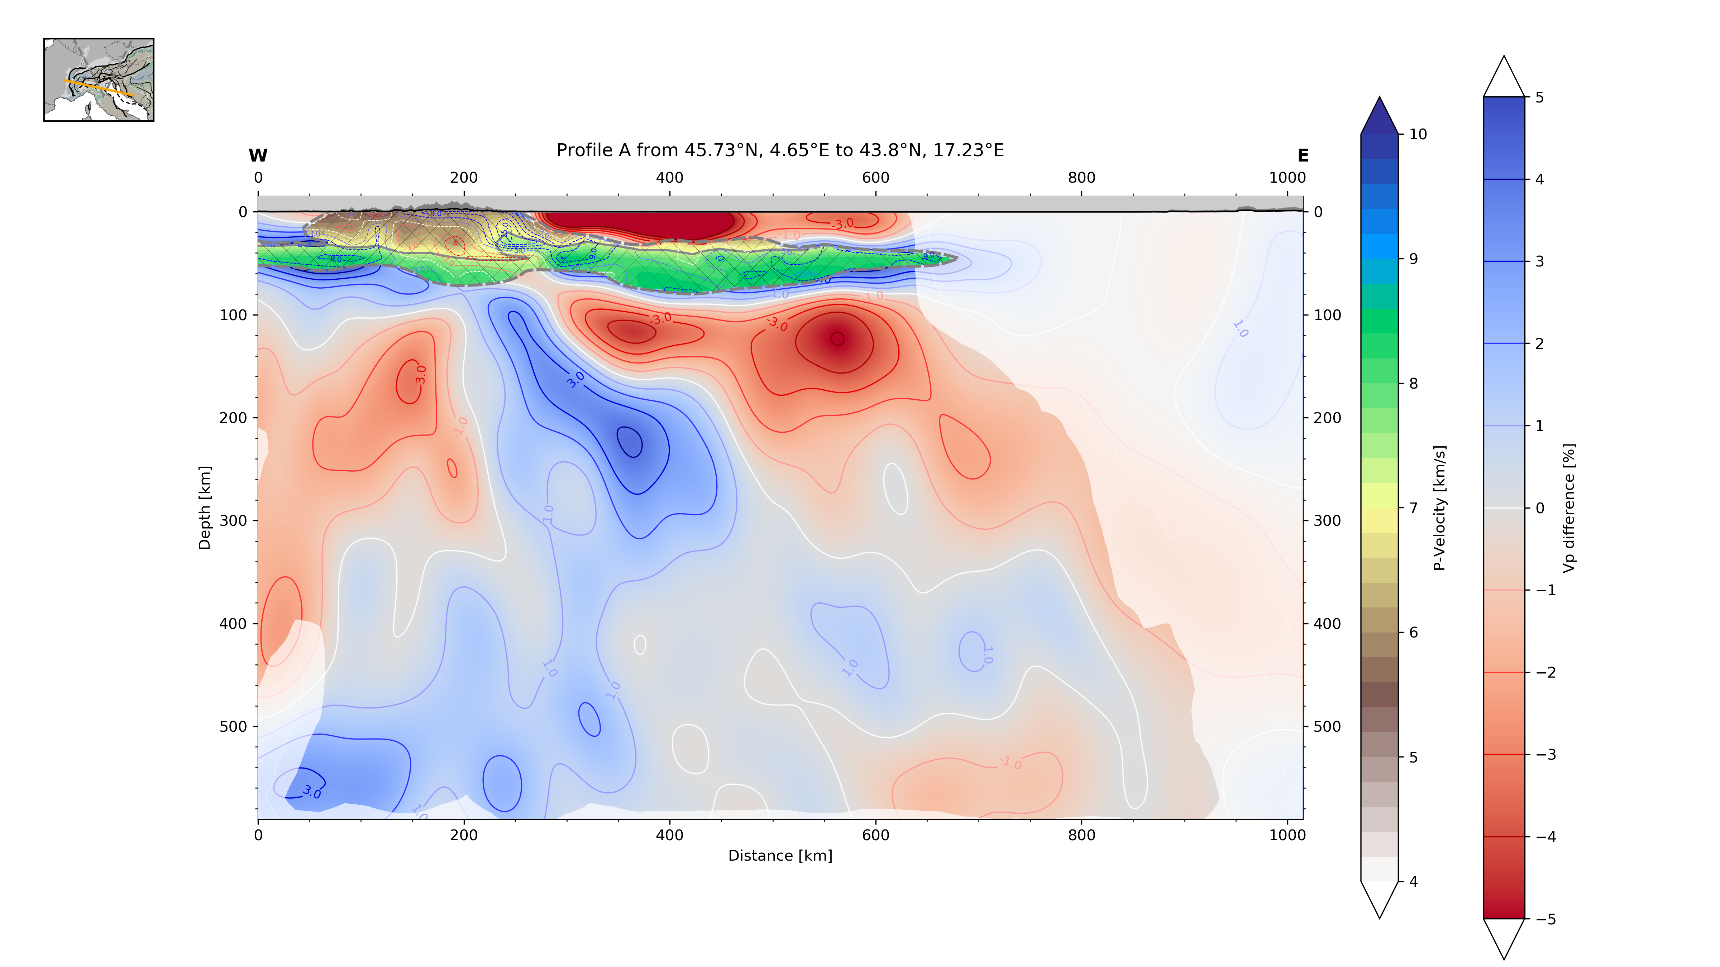
Comparison to other studies
Lippitsch et al. 2003
Slice A
Excellent agreement in structures, Po plain anomaly and asthenospheric upwelling nearly identical
Subducted European lower lithosphere extends further downwards (to A?) increasing in size and amplitude
Lippitsch et al. 2003, slice A & B
T. Diehl crustal model
Po plain anomaly
Asthenospheric upwelling
A?
B?
© Authors. All rights reserved

Slide 15
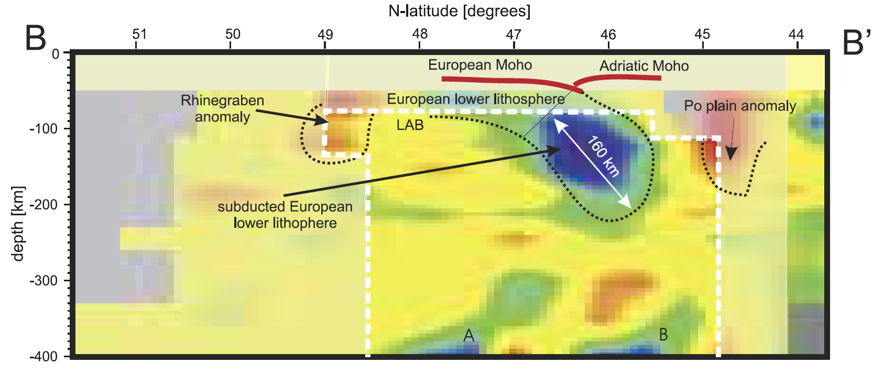
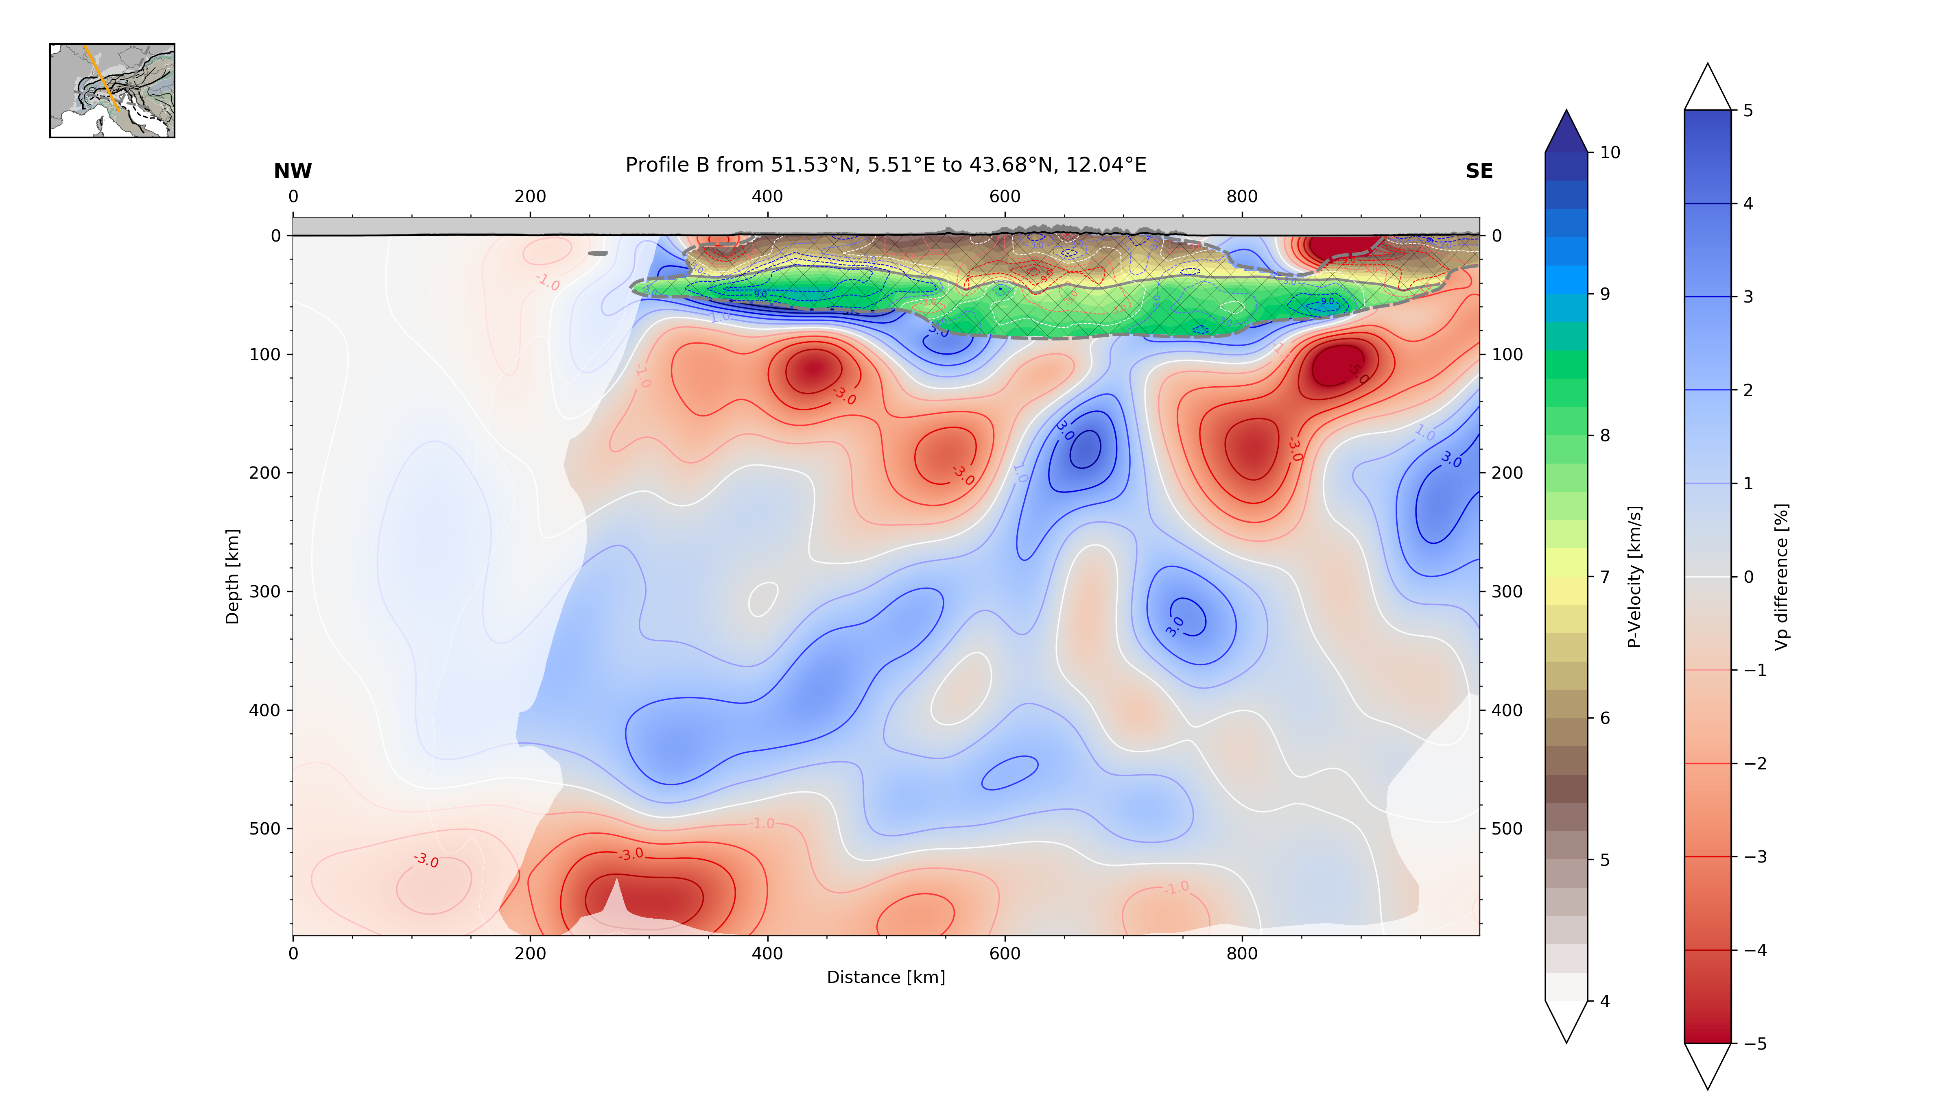
Comparison to other studies
Lippitsch et al. 2003
Slice A
Excellent agreement in structures, Po plain anomaly and asthenospheric upwelling nearly identical
Subducted European lower lithosphere extends further downwards (to A?) increasing in size and amplitude
Slice B
Discrepancy in lithospheric slab orientation, slab connected to Adria?
Dipping direction seems to be reversed (NW) in comparison, however structure of this slab is highly complex with eastern part showing tendency to dip SE
Still we see a clear gap to European lower lithosphere → Resolution analysis
Lippitsch et al. 2003, slice A & B
T. Diehl crustal model
T. Diehl crustal model
Po plain anomaly
gap
Po plain anomaly
Asthenospheric upwelling
Apenninic Slab
A?
A
B?
B?
B?
© Authors. All rights reserved

Slide 16
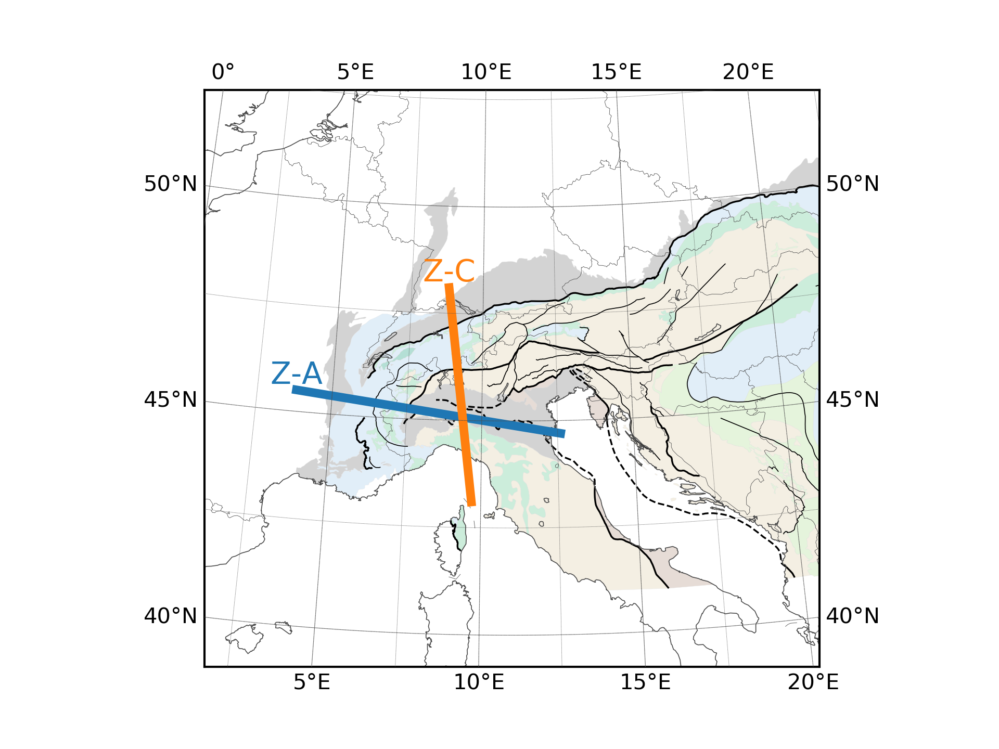
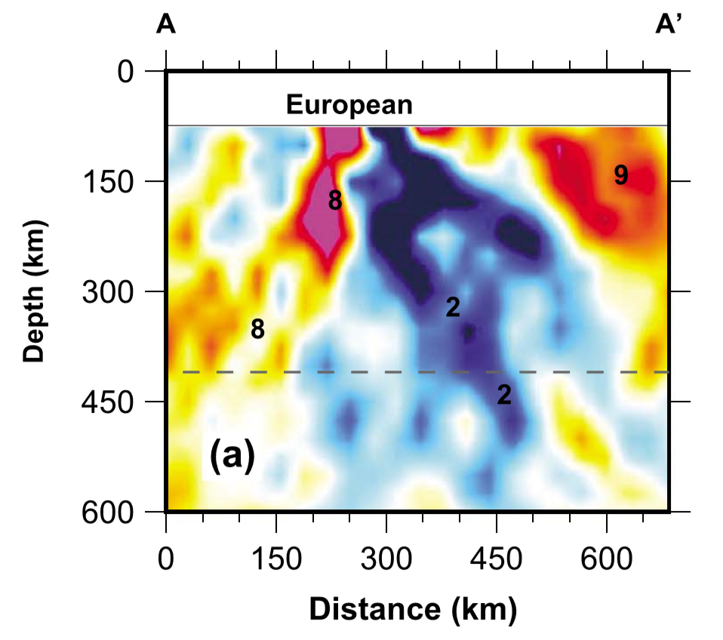
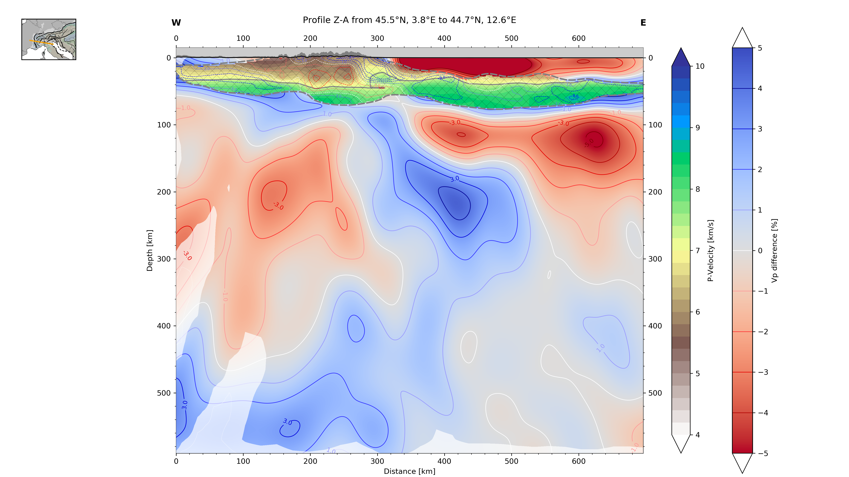
Comparison to other studies
Zhao et al. 2016, Slice A & C
Zhao et al. 2016
Slice A
Really good fit of different structures (asthenospheric upwelling, po plain anomaly)
Different inner structure of European lithospheric slab
No connection of lithospheric slab to crust in Zhao model
8
9
2
© Authors. All rights reserved

Slide 17
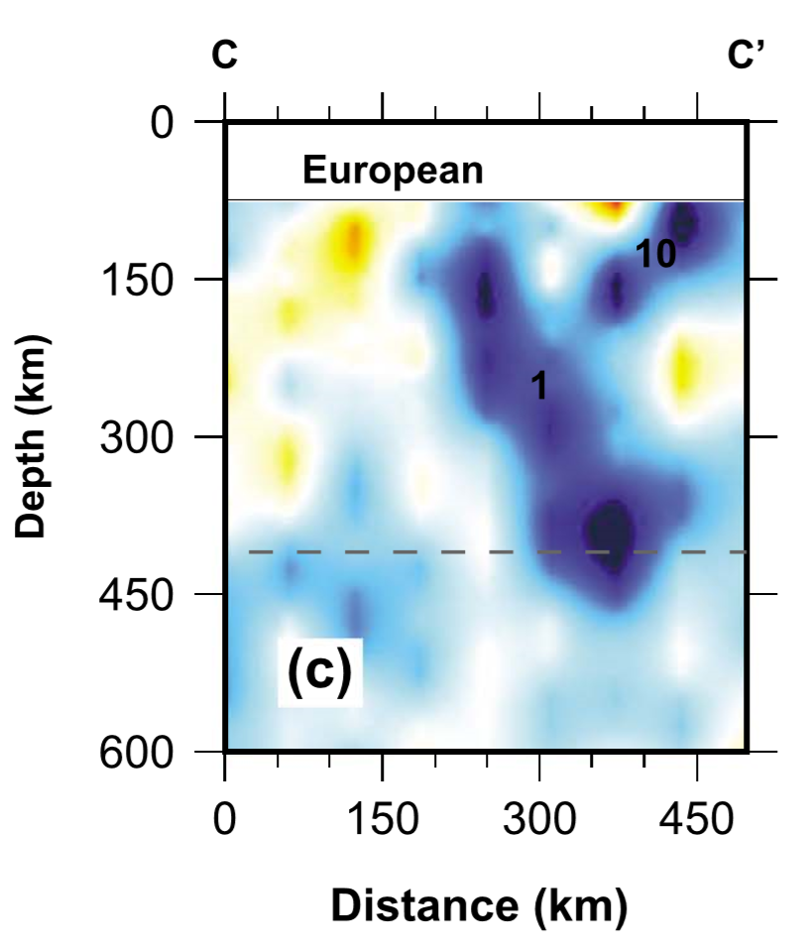
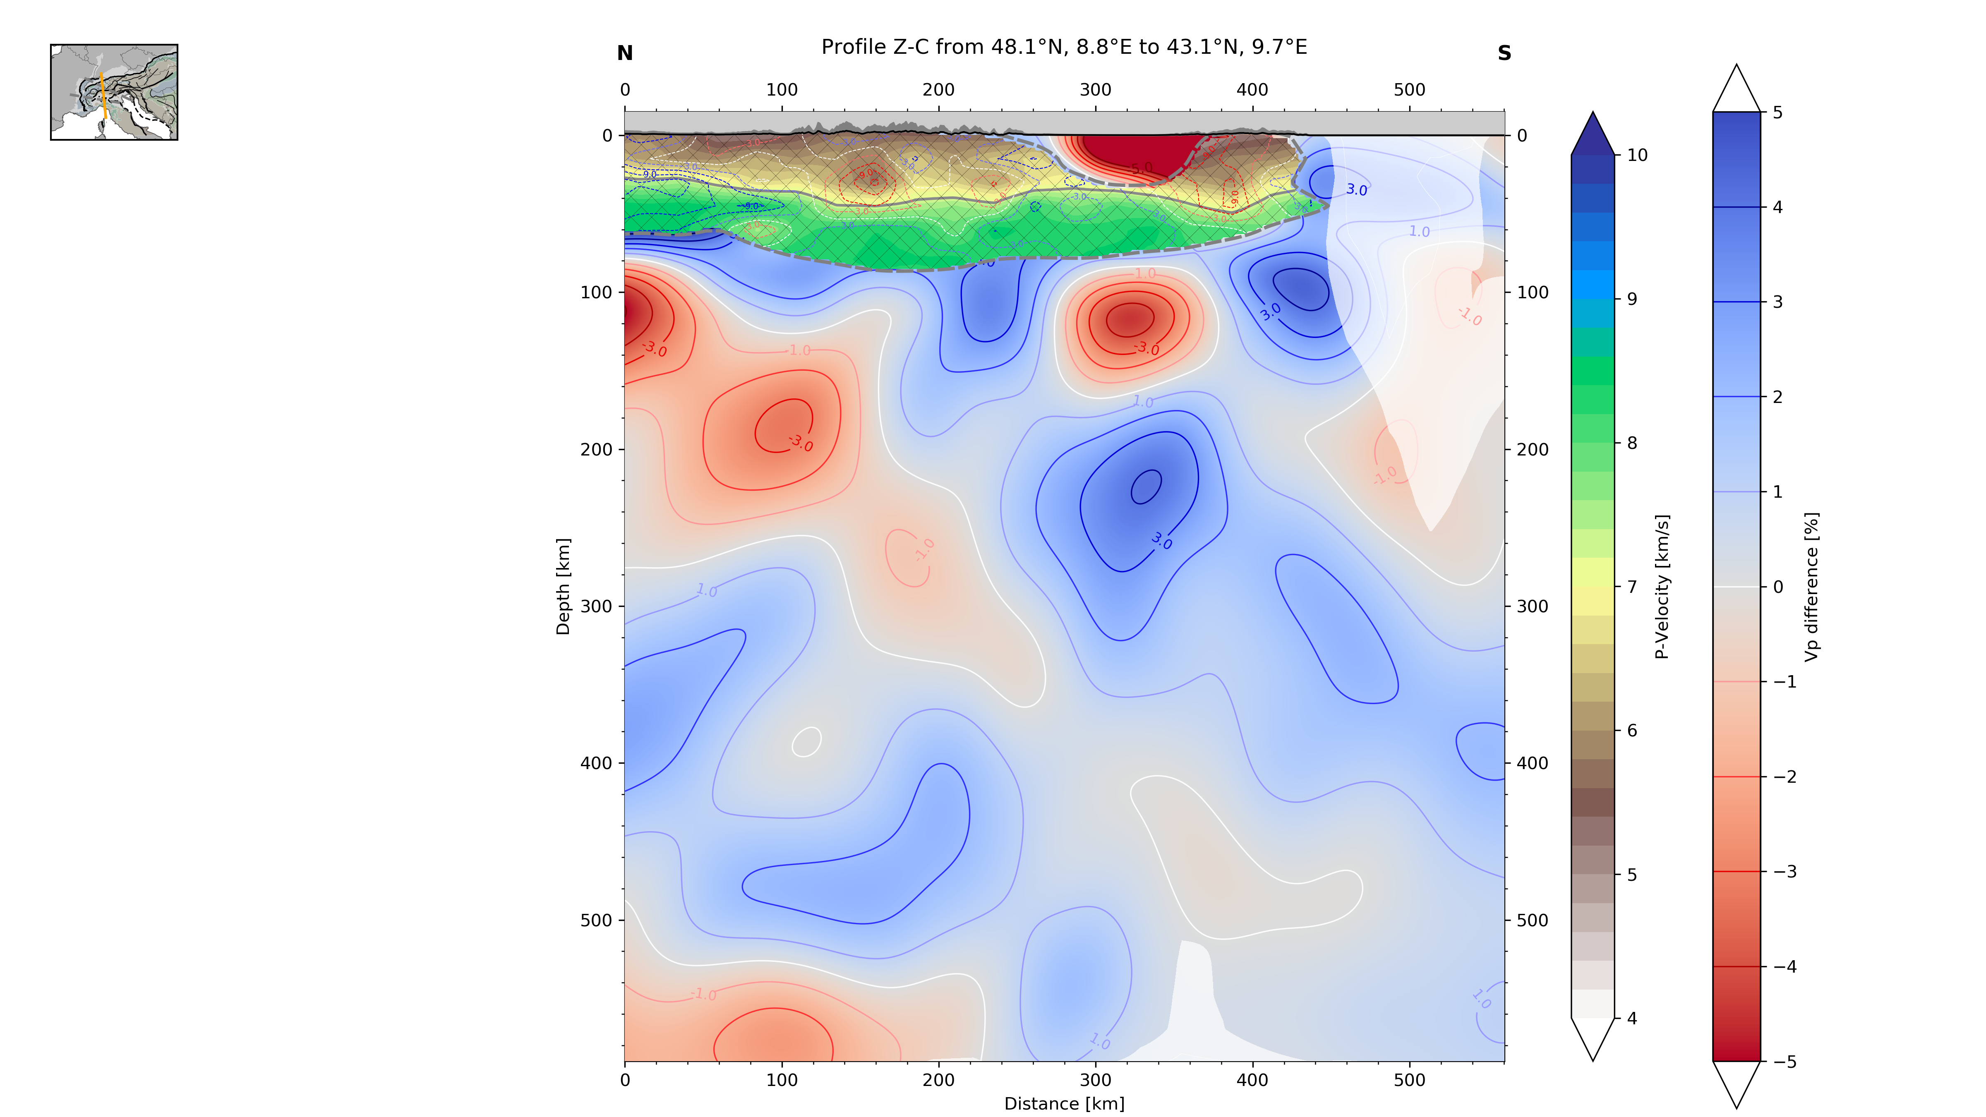
Comparison to other studies
Zhao et al. 2016, Slice A & C
Zhao et al. 2016
Slice A
Really good fit of different structures (asthenospheric upwelling, po plain anomaly)
Different inner structure of European lithospheric slab
No connection of lithospheric slab to crust in Zhao model
Slice C
Great agreement in velocity pattern
High velocity zone in Alps/Apennines transition zone more fractured, less steeply dipping
9
1
10
8
2
1
1
© Authors. All rights reserved

Slide 18
RESOLUTION ANALYSIS

Slide 19
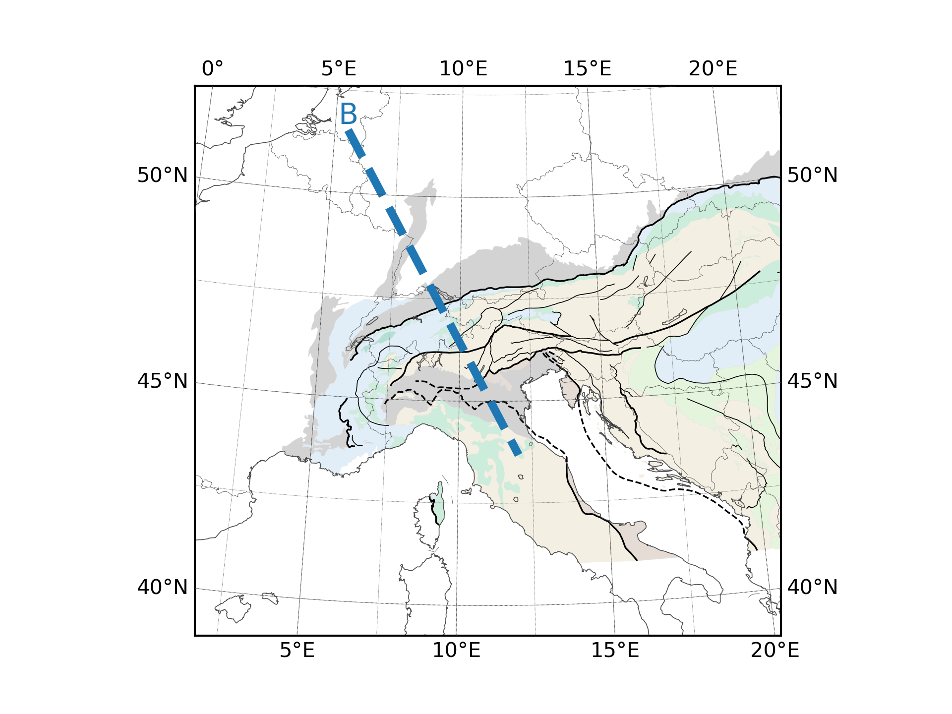
Resolution Analysis
Lippitsch (2003) Profile B, reversed slab orientation test
Dedicated analyses for different features:
Always take crustal model into account
Take original travel times and uncertainties
Forward modeling through crustal model
© Authors. All rights reserved

Slide 20
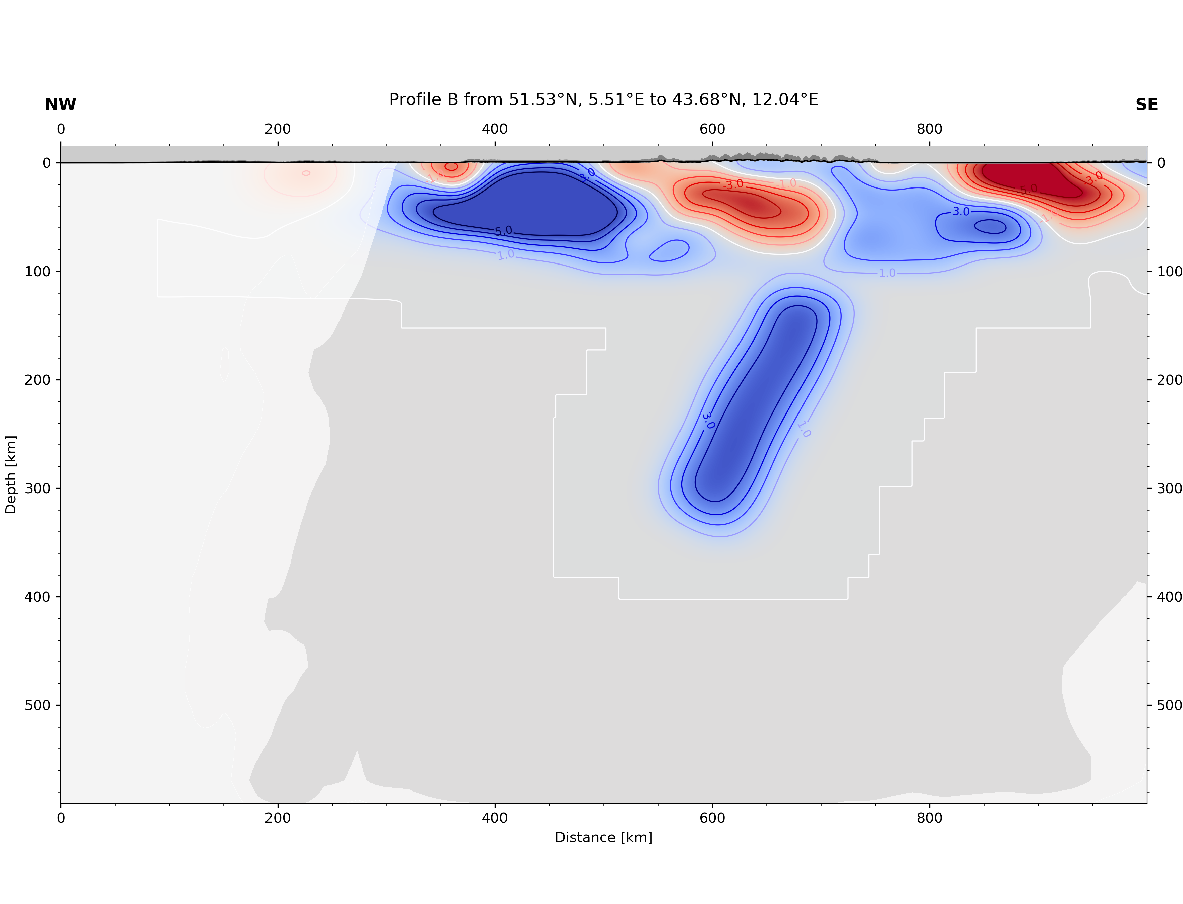
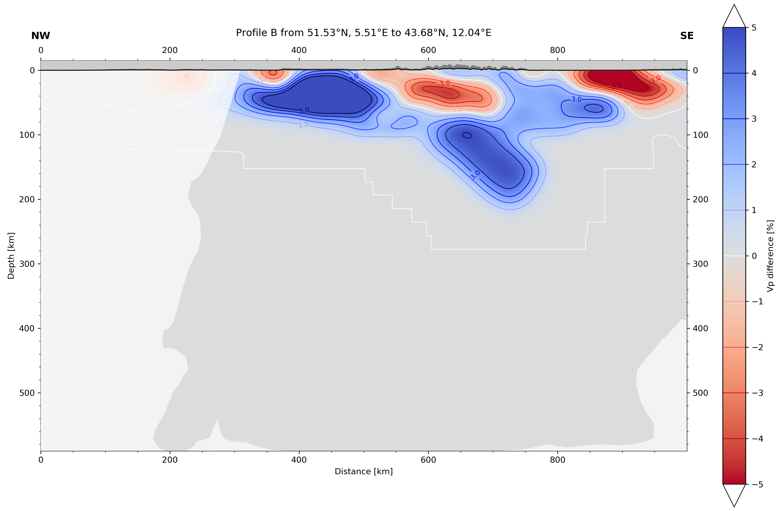
Resolution Analysis
Lippitsch (2003) Profile B, reversed slab orientation test
Dedicated analyses for different features:
Always take crustal model into account
Take original travel times and uncertainties
Forward modeling through crustal model
Synthetic testing:
Assume different slab geometries/orientation
Simulate through crustal model and synthetic slab anomaly (up to +5% vp increase)
Crustal model (T. Diehl 2009)
Crustal model (T. Diehl 2009)
Input slab
Input slab
© Authors. All rights reserved

Slide 21
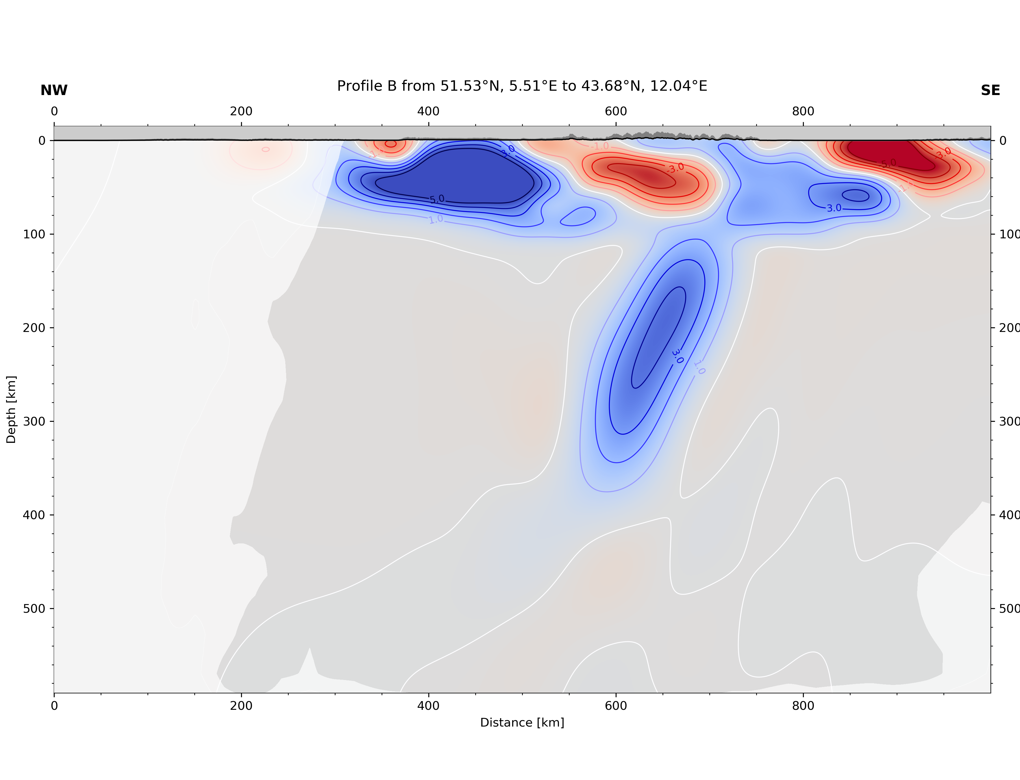
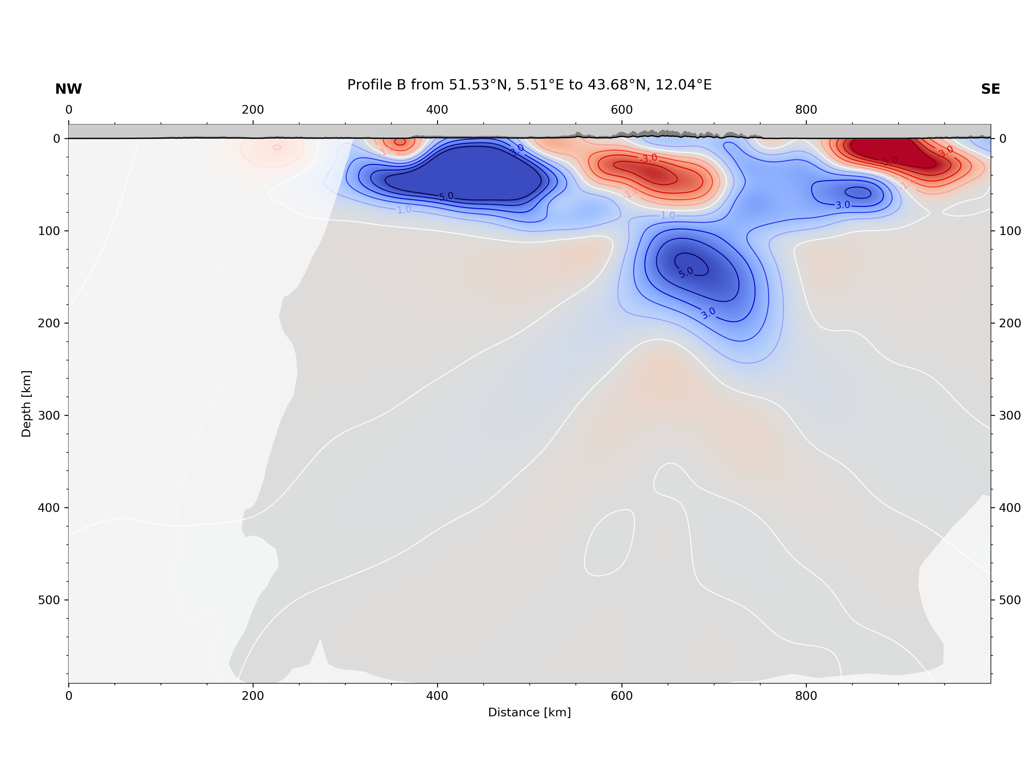
Resolution Analysis
Lippitsch (2003) Profile B, reversed slab orientation test
Specialized resolution tests for different features
Always simulate through crustal model
Use original source-receiver geometry and pick uncertainties for each phase
Synthetic testing:
Assume different slab geometries/orientation
Simulate through crustal model and synthetic slab anomaly (up to +5% vp increase)
Perform inversion and compare output to original model
Dipping direction clearly resolved, however depth smearing possible
Crustal model (T. Diehl 2009)
Crustal model (T. Diehl 2009)
Input slab
Input slab
Crustal model (T. Diehl 2009)
Crustal model (T. Diehl 2009)
smearing
smearing
Resolved slab
Resolved slab
© Authors. All rights reserved

Slide 22
References
AlpArray Seismic Network (2015): AlpArray Seismic Network (AASN) temporary component. AlpArray Working Group. Other/Seismic Network. doi:10.12686/alparray/z3_2015, http://www.alparray.ethz.ch/
Amante, C. and B.W. Eakins, 2009. ETOPO1 1 Arc-Minute Global Relief Model: Procedures, Data Sources and Analysis. NOAA Technical Memorandum NESDIS NGDC-24. National Geophysical Data Center, NOAA. doi:10.7289/V5C8276M
T. Diehl, S. Husen, E. Kissling, N. Deichmann, High-resolution 3-D P-wave model of the Alpine crust, Geophysical Journal International, Volume 179, Issue 2, November 2009, Pages 1133–1147, https://doi.org/10.1111/j.1365-246X.2009.04331.x
Wolfgang Friederich, Jörg Dalkolmo; Complete synthetic seismograms for a spherically symmetric earth by a numerical computation of the Green's function in the frequency domain, Geophysical Journal International, Volume 122, Issue 2, 1 September 1995, Pages 537–550, https://doi.org/10.1111/j.1365-246X.1995.tb07012.x
Hosseini, K. and Sigloch, K.: ObspyDMT: a Python toolbox for retrieving and processing large seismological data sets, Solid Earth, 8, 1047-1070, https://doi.org/10.5194/se-8-1047-2017, 2017.
L. Krischer, T. Megies, R. Barsch, M. Beyreuther, T. Lecocq, C. Caudron, J. Wassermann (2015)
L. Küperkoch, T. Meier, J. Lee, W. Friederich, EGELADOS Working Group, Automated determination of P-phase arrival times at regional and local distances using higher order statistics, Geophysical Journal International, Volume 181, Issue 2, May 2010, Pages 1159–1170, https://doi.org/10.1111/j.1365-246X.2010.04570.x
Lippitsch, R., Kissling, E., and Ansorge, J. ( 2003), Upper mantle structure beneath the Alpine orogen from high‐resolution teleseismic tomography, J. Geophys. Res., 108, 2376, doi:10.1029/2002JB002016, B8.
ObsPy: a bridge for seismology into the scientific Python ecosystem, Computational Science & Discovery, 8(1), 014003, DOI: 10.1088/1749-4699/8/1/014003
N. Rawlinson, M. Sambridge, Wave front evolution in strongly heterogeneous layered media using the fast marching method, Geophysical Journal International, Volume 156, Issue 3, March 2004, Pages 631–647, https://doi.org/10.1111/j.1365-246X.2004.02153.x
F. Schumacher, W. Friederich and S. Lamara, A flexible, extendable, modular and computationally efficient approach to scattering-integral-based seismic full waveform inversion, Geophysical Journal International 2016, 204 (2): 1100-1119 http://dx.doi.org/10.1093/gji/ggv505
Trabant, C., A. R. Hutko, M. Bahavar, R. Karstens, T. Ahern, and R. Aster (2012), Data Products at the IRIS DMC: Stepping Stones for Research and Other Applications, Seismological Research Letters, 83(5), 846–854, https://doi.org/10.1785/0220120032.
Zhao, L., et al. ( 2016), Continuity of the Alpine slab unraveled by high‐resolution P wave tomography, J. Geophys. Res. Solid Earth, 121, 8720– 8737, doi:10.1002/2016JB013310.
© Authors. All rights reserved

