Slide 1
Mechanisms for late 20th and early 21st Century decadal AMOC changes Alex Megann, Adam Blaker, Simon Josey, Adrian New and Bablu Sinha National Oceanography Centre, Southampton, UK EGU2020-1384
(c) Authors. All rights reserved.

Slide 2
Introduction
Smeed et al (2018) use observations from the RAPID array to infer that the AMOC at 26°N has declined by about 3 Sv since 2008.
Proxy data (e.g. Delworth et al, 2016) suggest that the AMOC was previously strengthening from the 1970s up to a maximum in the 1990s.
Can we use model simulations to identify a physical mechanism for the increase in the late 20th Century, and the decrease since then? Can we predict future AMOC changes with any skill?
Model description and experimental strategy
GO6 1/4° global NEMO v3.6 / CICE 5.2.1 configuration
Integrations supported under the NERC Atlantic Climate System Integrated Study (ACSIS) programme
To relate AMOC changes more robustly to changes in surface forcing, we use a range of surface forcing datasets to reduce uncertainty, and have integrated each from 1958 to as close as possible to present day: CORE2 (1958-2007); DFS5.2 (1958-2015); and JRA55 (1958-2018)

Slide 3
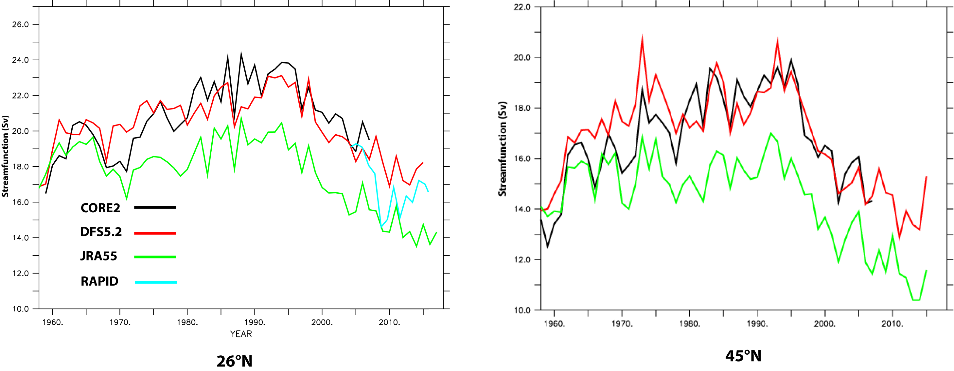
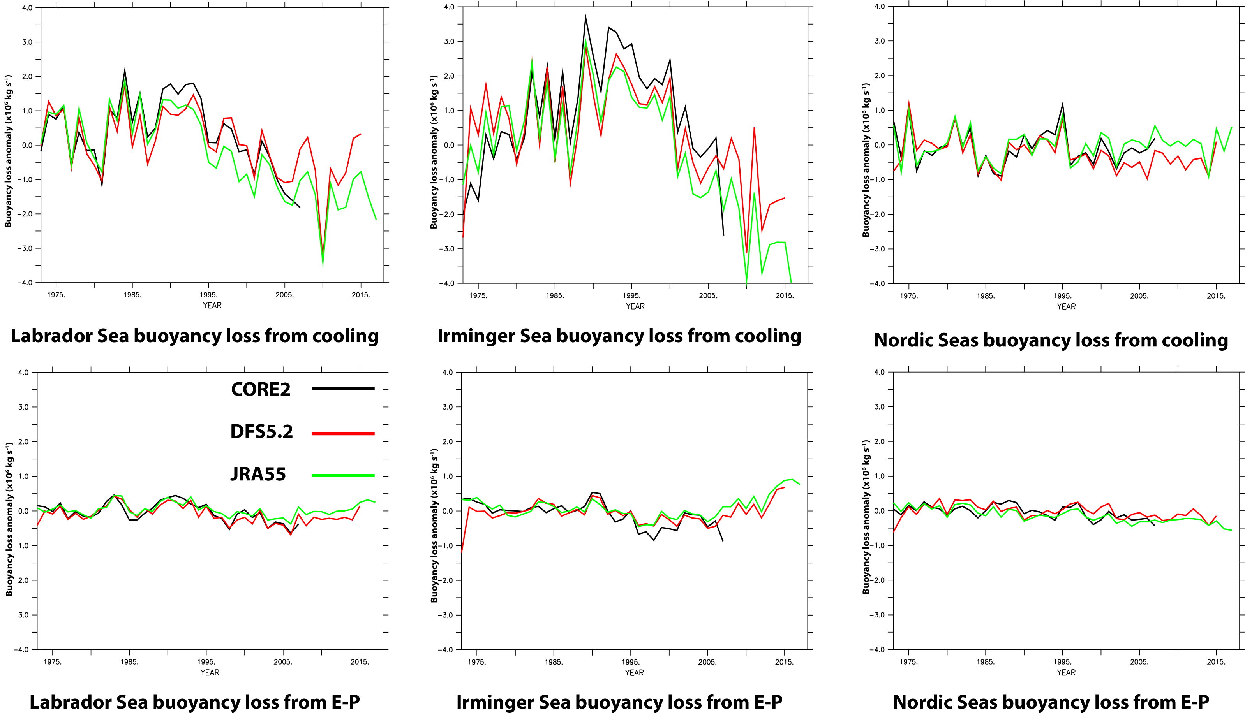
AMOC time evolution and surface forcing
Buoyancy loss through cooling from Irminger Sea shows similar time evolution to overturning at 45°N.
Lab Sea heat loss is about half the rate seen in Irminger Sea. and only later decline occurs.
FW fluxes have negligible contribution, as do fluxes in Nordic Seas.
AMOC indices at 26°N and 45°N
Regionally integrated buoyancy losses (in kg s⁻¹) in subpolar North Atlantic.

Slide 4
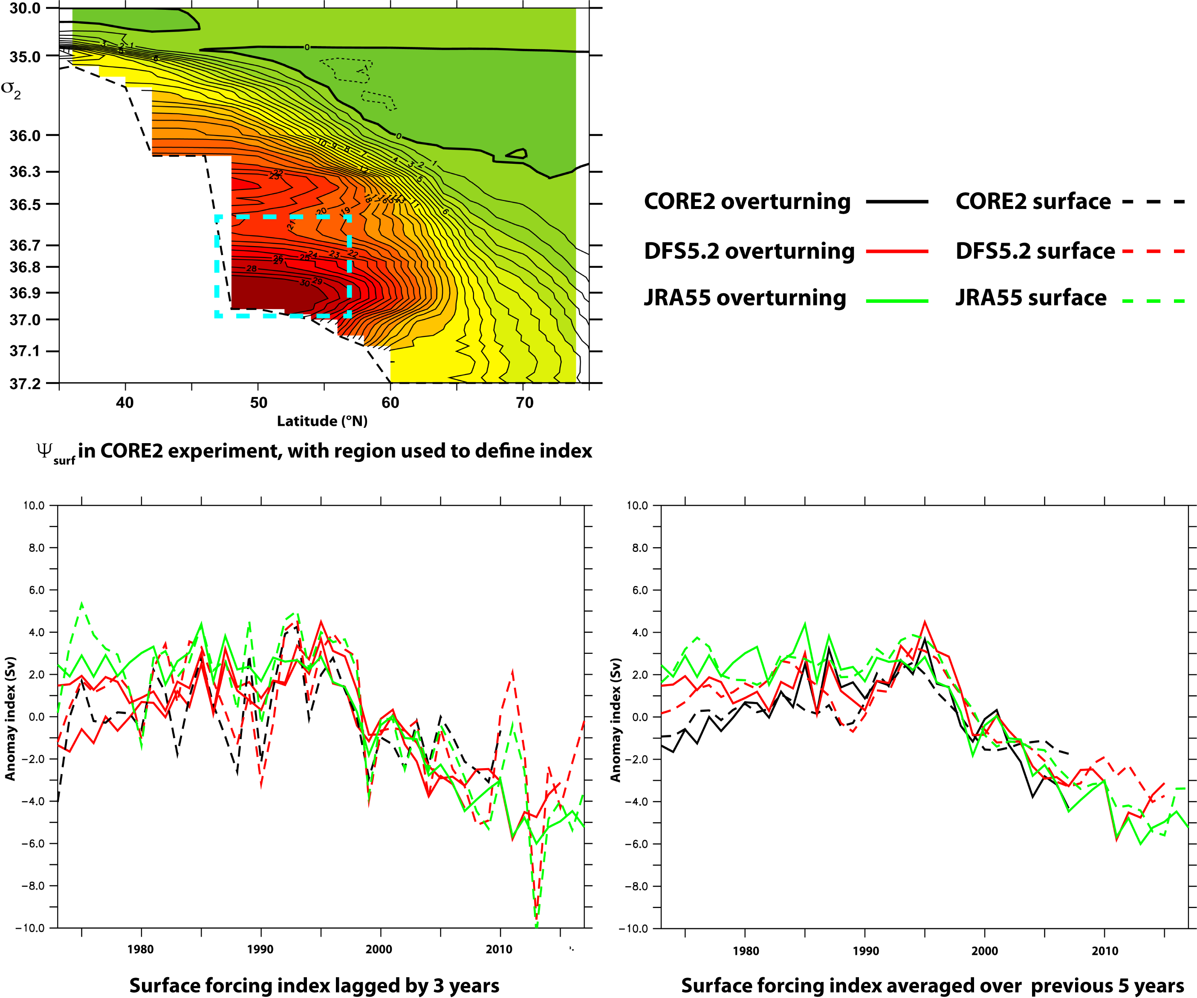
A surface forced circulation index
We define circulation indices T_{over} and T_{surf} as the means of the anomalies (w.r.t. the time mean from 1976) of annual mean overturning and surface-forced streamfunctions (as in e.g. Marsh, 2000; Grist et al, 2009), respectively, against σ₂ and latitude over the region shown below left.
The above authors showed that a surface-forced index from simulations has at least twice the interannual variability as the overturning index, as did Desbruyeres et al (2019) from observational data. We therefore define a surface-forced index T_{surf2}, respectively, in any year as the mean of T_{surf} over preceding 5 years.
Overturning and surface forced indices have similar overall decadal-scale time evolution, but T_{surf} has more interannual variation than T_{over}.
T_{surf2} represents a time-integrated cumulative surface forcing, and is a good predictor for the overturning strength.
We conclude that decadal changes in N. Atlantic overturning in our simulations are mainly forced by cooling in Irminger Sea over previous 3-5 years.

