Slide 1

ERE5.1 Constructional GeoMaterials: Resources, Properties, Uses, and Environmental Interactions
D737 | EGU2020-13887
Degradation of concrete with glass enriched recycled aggregate used to flooring an industrial warehouse
in Italy
Elena Marrocchino¹*, Negar Eftekhari¹, Chiara Telloli² and Carmela Vaccaro¹
¹ Department of Physics and Earth Sciences, University of Ferrara
² ENEA, Italian National Agency for New Technologies, Energy and Sustainable Economic Development Fusion and Technology for Nuclear Safety and Security Department Nuclear Safety, Security and Sustainability Division
* Elena Marrocchino mrrlne@unife.it

Slide 2
Aim of the project
Petrographic observations and SEM-EDS microanalysis were carried out to investigate samples of concrete containing different size glass particles from heavily degraded industrial floors in Emilia Romagna (North of Italy) two years after their realization, in order to define degradation effects affecting concrete material made with a mixed aggregate of natural rocks and recycled glass.
In two different kind of samples collected, one made with natural aggregates with carbonate rocks (concrete A-type) and another made with silico-carbonate rocks (concrete B-type), both added with waste of glass, alkali-aggregate reaction (AAR) and loss of physical-mechanical characteristics were observed.
Studied concretes are characterized by a mix composed by glass waste (20%) added to natural aggregate (80%) made by crushing rocks with silicate and carbonate composition.
Glass fragments considered in concrete samples of this study have a coarse grain and are breakable so they can develop a capillary porosity for cracking.

Slide 3
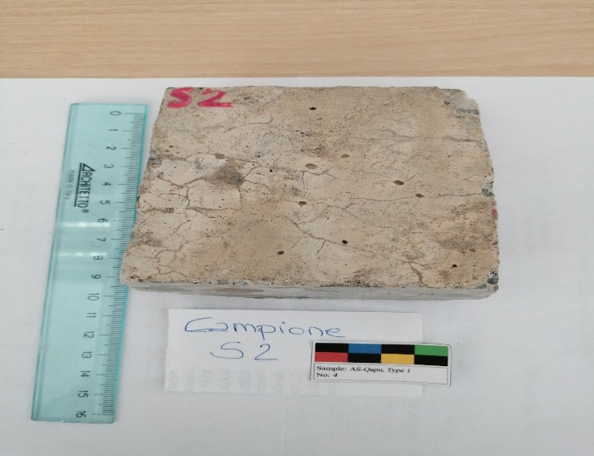
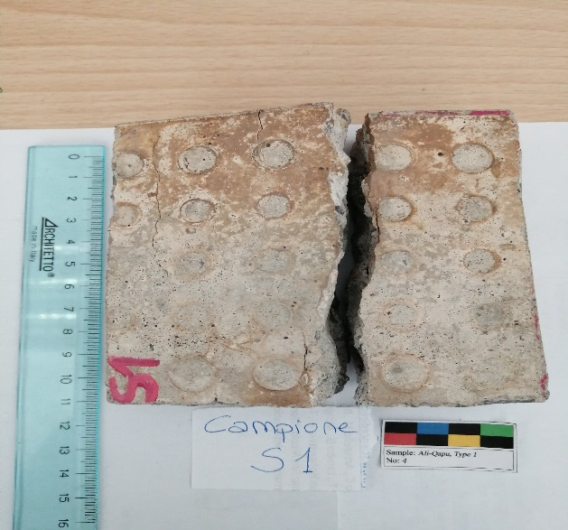
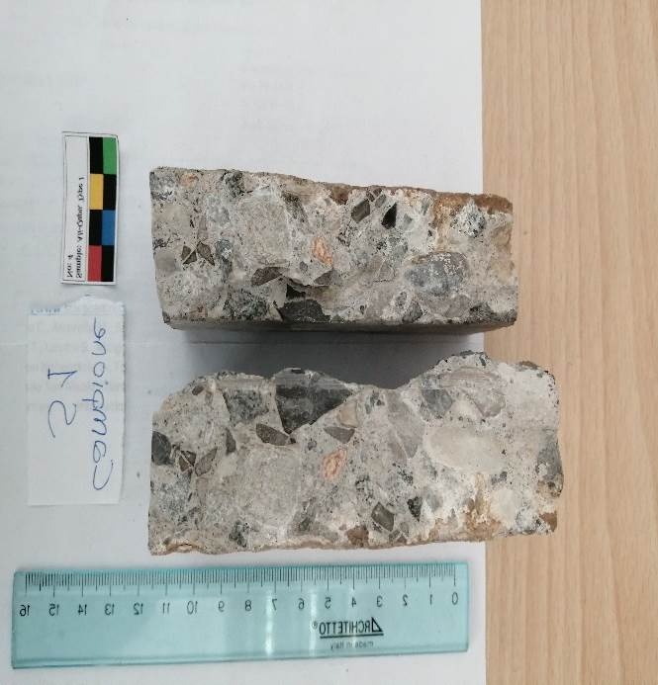
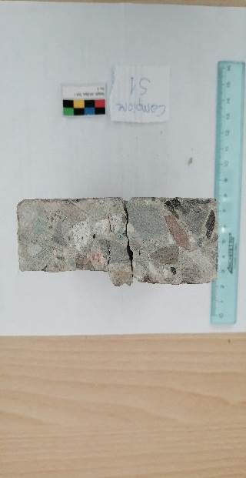
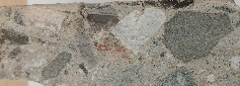
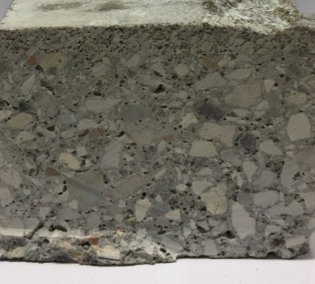
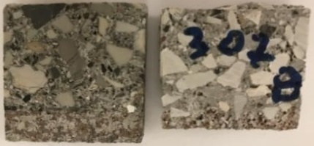
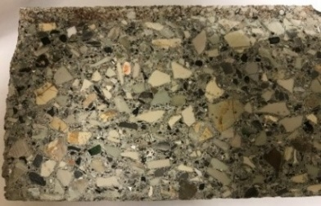
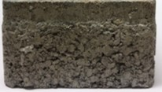
Two different type of concrete from courtyard of an industrial warehouse
in Emilia Romagna Region (Italy)
Mesoscopic scale observations of degradation distribution
A-type samples
collected in areas with presence of fracture and loss of cohesion
abundance of fine gravel fraction composed by natural rocks and significant presence of micro-gravel and sands (rich in coarse glass fragments).
B-type samples
collected in areas with well-preserved concrete
bimodal distribution of grain sizes with high percentage of fragments of natural rocks (fine and medium gravels) added with fine sandy aggregates and silt (rich in finely ground glass fragments)
7,00 cm
0. 5-0.70
cm

Slide 4
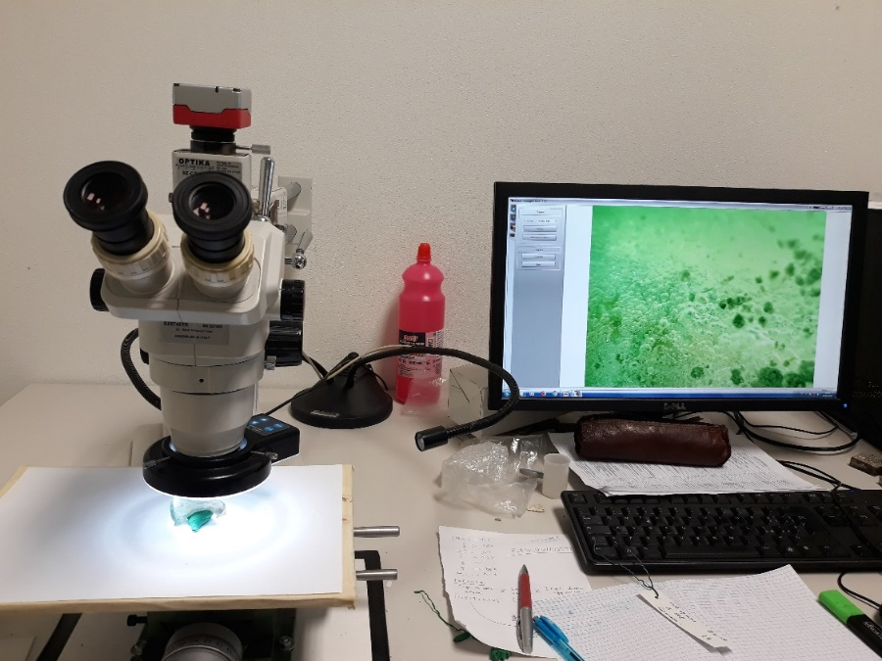
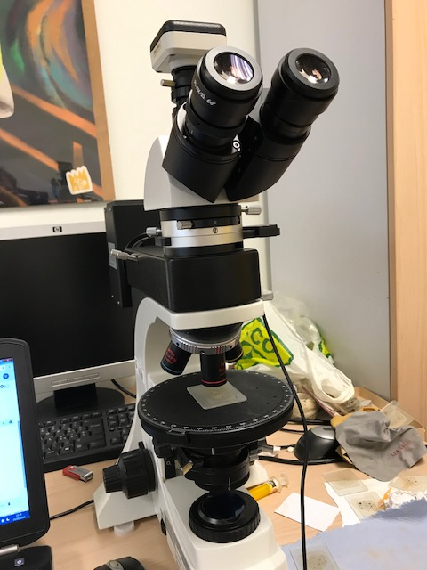
Analytical procedure performed at the Department of Physics and
Earth Sciences (University of Ferrara, Italy).
Mineralogical-petrographic investigations
Morphological-elemental analyses
On thin sections
Optical Transmitted Light Microscope
(OTLM)
Optika Mod. B500 POL I
Scanning Electron Microscopy equipped with an Energy Dispersive X-ray detector
(SEM-EDS)
SEM Zeiss EVO 40
With AZtec Oxford Instruments
On the sample surfaces
Stereomicroscope
Optika SZ6745TR

Slide 5
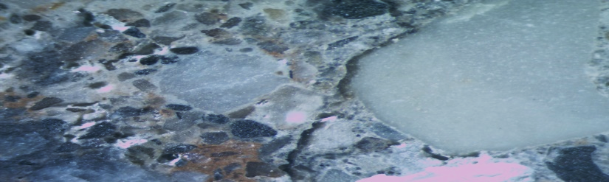
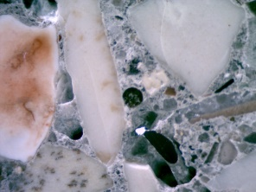
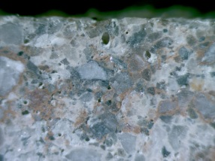
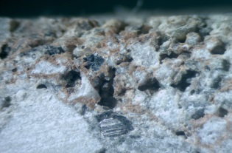
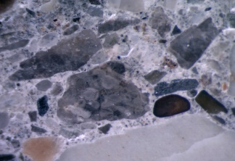
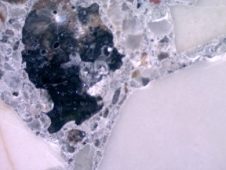
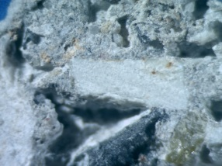
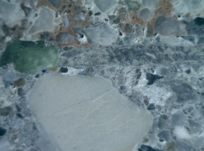
Steromicroscope investigations
A-type samples
Predominantly crushed carbonate natural aggregate mixed with coarse recycled glass
B-type samples
Less percentage of carbonate aggregate
silicate aggregate (quartzite and gneiss)
mixed with fine recycled glass
Components | Average of the modal analysis of single fractions
 | A-type A | B-type B
Silty (<62.5 µm) | 9% | 23%
Arenaceous (62.5 µm - 2.0 mm) | 22% | 29%
Fine conglomeratic ( 2.0 mm - 4.0 mm) | 27% | 14%
Coarse conglomeratic (> 4 mm) | 42% | 34%
Natural rocks/recycled glass waste ratio
80/20

Slide 6
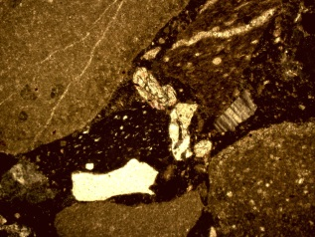
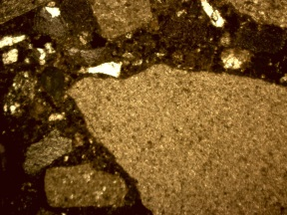
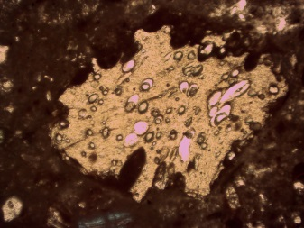
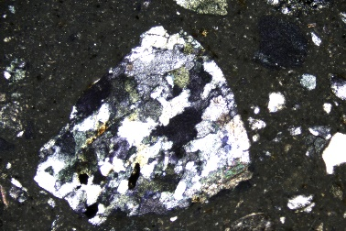
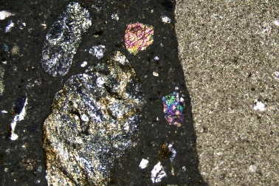
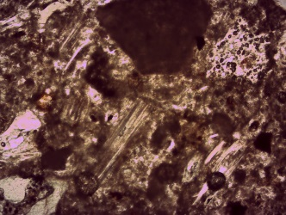
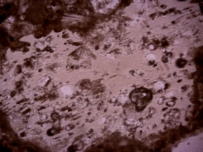
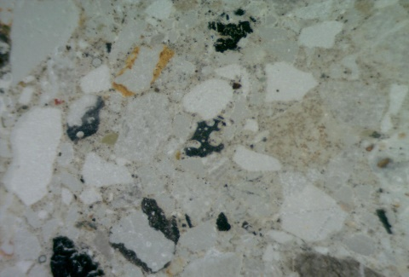
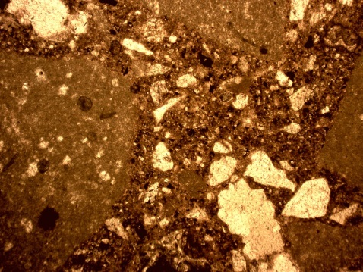
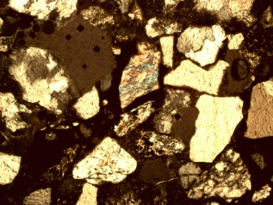
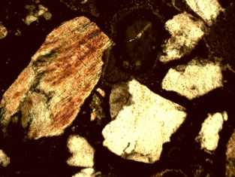
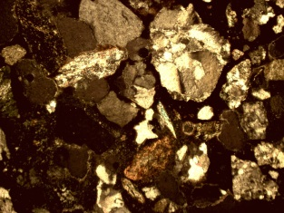
Thin sections OTLM observations
A-type samples
B-type samples
Mainly characterized by carbonate aggregates
with fragments of compact limestones with micritic calcite, rare silicate rocks fraction and coarse waste glass fragments.
Prevalence of silicate aggregates (metamorphic rocks and crystals of quartz and feldspar) with less carbonate and the silicate are, rich in fine glass waste.
A-type
A-type
A-type
B-type
5X NX
B-type
B-type
Calcite
5X NX
5X NX
Calcite
5X NX
5X NX
50X NX
A-type
B-type
B-type
10X NX
A-type aggregate
Large limestone clasts | 42%
Limestone granules medium-fine grains | 19%
Silicate grains | 14%
Femic minerals | 5%
Coarse glass fragments | 18%
Metal fragments | 2%
B-type aggregate
Micritic limestone clasts | 24%
Flint and sandstone clasts | 7%
Silicate (feldspars, plagioclase and quartz) together with metamorphic clasts | 48%
Fine waste glass faction and blast furnace slag | 18%
Calcite
10X NX

Slide 7
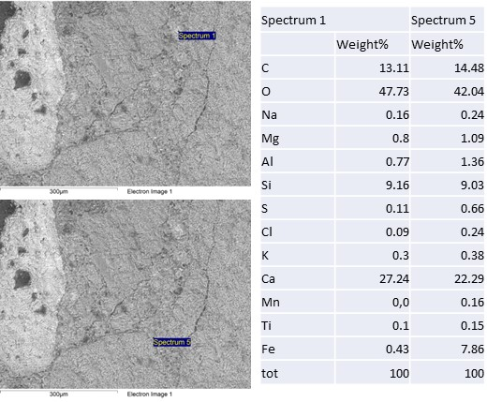
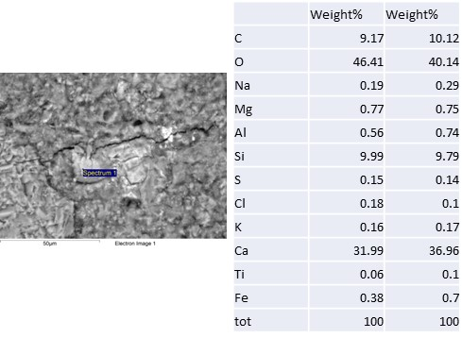
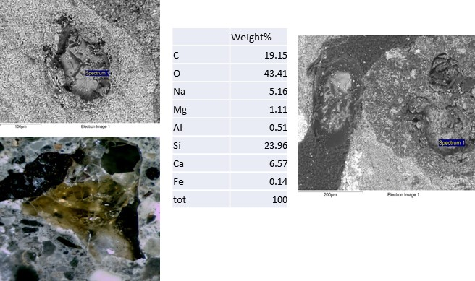
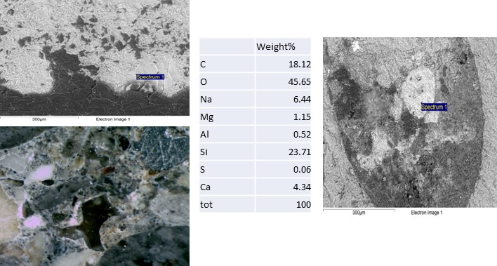
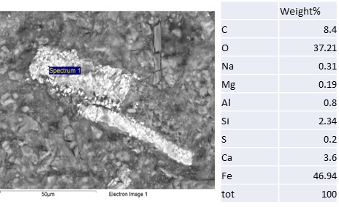
SEM-EDS observations
Glass particles may result in chemical processes in which it reacts with alkali hydroxides present in the concrete pore solution. The glass fraction aggregates were attacked by the alkali, forming hydrous alkali-calcium-silica gel, that incorporating water causes swelling, which leads to expansion and cracking of the concrete.
Examples of cement paste of both type of concrete mainly characterized by cryptocrystalline matrix with intense micro-fracturing
Since the surface layer was particularly rich in silica, it was the one most exposed to degradation by the action of the aqueous fluids enriched in the alkaline elements released by the glass.
In the samples of this work small metal slag percentage in the aggregate’s mixture does not exceed 2-3%. SEM observation have revealed the presence of a thin layer between cement paste and slag particles that could be responsible of swelling and fracturing.

Slide 8
Conclusion
Application of crushed recycled glass in concrete materials can offer significant economic and environmental benefits, but the major challenge in using glass aggregates in concrete is the deleterious alkali-silica reaction (ASR).
With concentrations of amorphous silica in the consumer glass around 70 wt %, these aggregates may react with cement alkalis and produce an ASR gel which, in the presence of moisture, expands and causes cracking and deterioration of concrete.
In this work, optical microscopic characterization and SEM-EDS microanalysis allow to explain the degradation as due to:
presence in alkali-rich silicate glass concrete which, by interaction with water, hydrated and transferred sodium to water;
presence of metals (iron, steel and copper wires) which oxidize and their swelling produced tensions in the concrete, fracturing it.
Moreover:
smooth surface of the waste glass decreases the adhesion force between glass surface cement;
addition of waste glass to natural aggregates produces an improvement in workability due to the non-absorbent nature of the glass;
in the short time inclusion of glass aggregates effectively improves the surface resistivity and the attack on sulphate but in the long time a secondary porosity for hydrolysis intervenes and the resistance decreased, and the carbonation rate increases.

Slide 9
References
Ben Haha M., Gallucci E., Guidoum A., Scrivener K.L. Relation of expansion due to alkali silica reaction to the degree of reaction measured by SEM image analysis. Cem. Concr. Res, 2007, 37 (8), pp 1206-1214.
Bisht K., Kabeer K.I. S.A., Ramana P.V. Gainful utilization of waste glass for production of sulphuric acid resistance concrete. Constr. Build. Mater, 2020, 235 117486
Belouadah M., Rahmouni Z. E. A., Tebba N. Influence of the addition of glass powder and marble powder on the physical and mechanical behavior of composite cement. Proc. Comp. Science, 2019, 158, pp. 366–375
Del Cura G., Garcés P, Garcı́a Alcocel E. Petrographical analysis of calcium aluminate cement mortars: Scanning electron microscopy and transmitted light microscopy. Cem. Concr. Res. 1999, 29 (12) pp 1881-1885.
He P., Zhang B., Lu J-X., Poon C S. A ternary optimization of alkali-activated cement mortars incorporating glass powder, slag and calcium aluminate cement. Constr. Build. Mater, 2020, 240 117983.
Hendi A., Mostofinejad D., Sedaghatdoost A., Zohrabi M., Naeimi N., Tavakolinia A., Mix design of the green self-consolidating concrete: Incorporating the waste glass powder. Constr. Build. Mater. 2019, 199, 369-384.
Kamali M., Ghahremaninezhad A. Effect of glass powders on the mechanical and durability properties of cementitious materials, Constr. Build. Mater. 2015, 98 pp. 407–416.
Mehta A., Ashish D. K. Silica fume and waste glass in cement concrete production: A review. Journal of Building Engineering 2020, 29, 100888.
Nassar R-U-D., Soroushian P. Strength and durability of recycled aggregate concrete containing milled glass as partial replacement for cement. Constr. Build. Mater. 2012, 29, pp 368-377.
Puppala, A., Sireesh, S., and Williammee, R. Sustainable reuse of limestone quarry fines and RAP in pavement base/subbase layers. J. Mater. Civ. Eng. 2012, 4.
Rajabipour F, Maraghechi H, Fischer G. Investigating the Alkali-Silica Reaction of Recycled Glass Aggregates in Concrete Materials. J Mater Civ Eng 2010, 22, pp. 1201-1208.
Ramyar K., Topal A. and Andic O. Effect of aggregate size and angularity on alkali–silica reaction. Cem. Concr. Res 2005, 35 (11),pp. 2165–2169.
Shayan A and Xu A. Value-added utilization of waste glass in concrete. Cement Concrete Res 2004, 34, pp. 81-89.
Šťastná A., Šachlová Š., Pertold Z., Přikryl R., Leichmann J. Cathodoluminescence microscopy and petrographic image analysis of aggregates in concrete pavements affected by alkali–silica reaction. Mat. Charact., 2012, 65, pp 115-125.
Vaitkevicius V, Serelis E, Hilbig H. The effect of glass powder on the microstructure of ultra-high performance concrete. Constr. Build. Mater., 2014, 68, pp. 102-109.
Waste Framework Directive 2008/98/EC. Directive 2008/98/EC of the European Parliament and of the Council of 19 November 2008 on waste and repealing certain Directives.
Yang H, Li Z, Rao M, Shao X. Study on Influence of Aggregate Combination and Inhibition Material of Alkali-silica Reaction in Fully-Graded Concrete. Material Science, 2020, 26 (3).
Zhao S., Fan J., Sun W. Utilization of iron ore tailings as fine aggregate in ultra-high performance concrete J. Constr. Build. Mater., 2014, 50, pp. 540-548
THANK FOR YOUR ATTENTION
* Elena Marrocchino mrrlne@unife.it
Department of Physics and Earth Sciences, University of Ferrara

