Slide 1
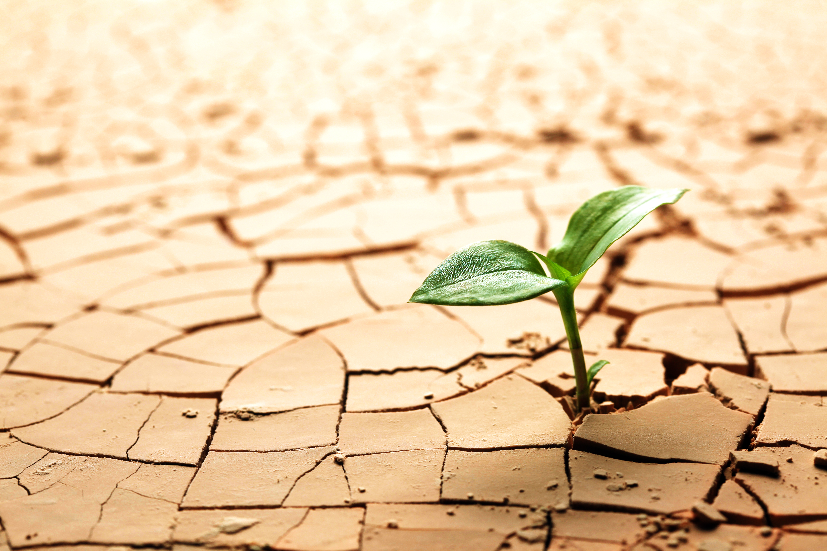

Study on the correlation between meteorological and agricultural drought based on drought indices in semi-arid area
Ruja Mansorian, Mohammad Zare, Guy Schumann
May 2020
From:http://www.wisegeek.com/what-are-the-different-types-of-xeriscape-plants.htm

Slide 2
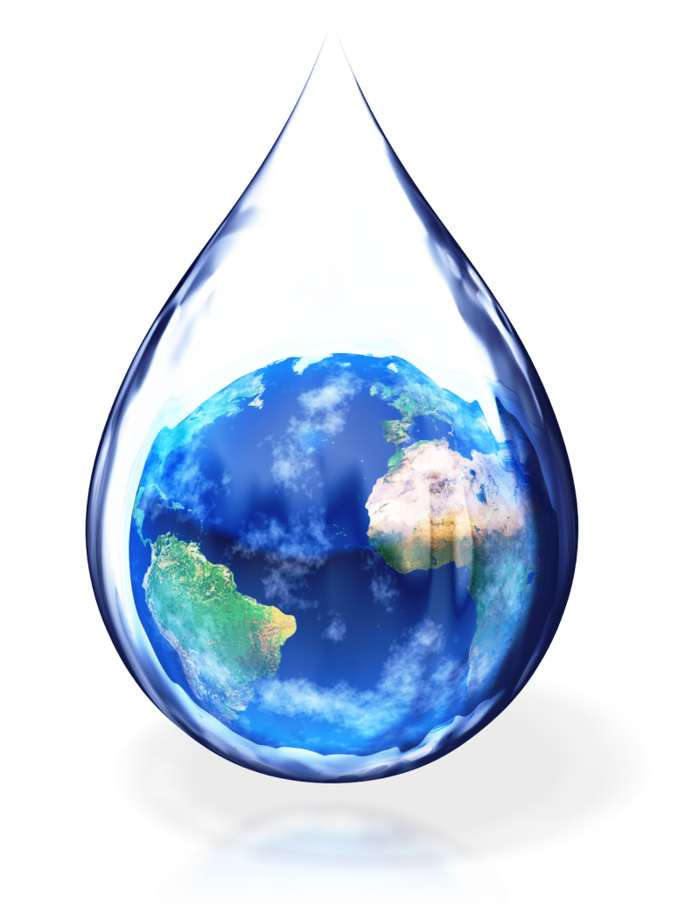
Introduction
From:http://content.presentermedia.com/files/clipart/00003000/3459/earth_water_drop_md_wm.jpg

Slide 3
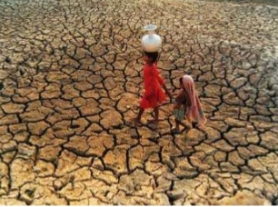
What is Drought?
A prolonged period of abnormally low rainfall, leading to a shortage of water (Oxford dictionary, 2016)
Drought is a protracted period of deficient precipitation resulting in extensive damage to crops, resulting in loss of yield(National drought mitigation center)
From:http://greenfieldgeography.wikispaces.com/Droughts

Slide 4
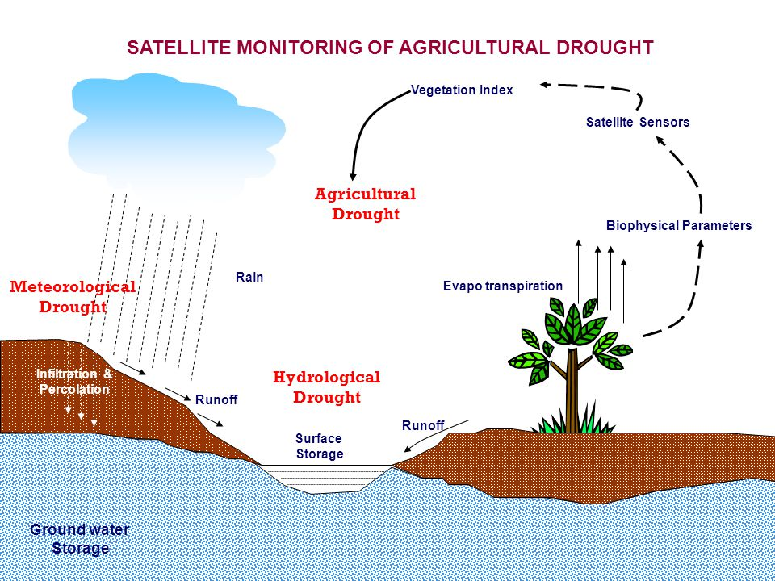
Droughts can be of three kinds
http://images.slideplayer.com/15/4801650/slides/slide_3.jpg

Slide 5
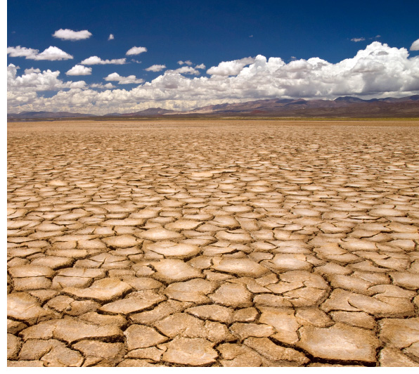
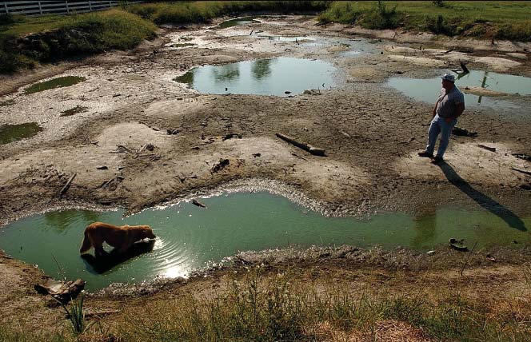
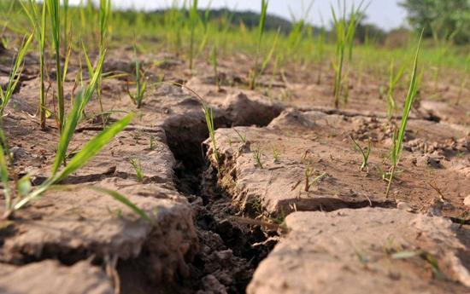
Meteorological drought
https://www.ametsoc.org/ams/assets/Image/aboutams/Insights/drought.jpg
Hydrological drought
Agricultural drought
http://pubs.usgs.gov/sir/2005/5053/pdf/images/report2_img_9.jpg
From:http://english.cntv.cn/program/china24/20130401/102035.shtml

Slide 6
The main objectives of study
The present study examines semi-arid region which agriculture is associated with rainfall and irrigation systems. The main objective is to investigate whether there is correlation between SPI with different time scales and agricultural drought indices (VCI) which will be calculated by Landsat 8 satellite images.
The positive correlation between two indices could be helpful to find a relation between meteorological and agricultural droughts i.e. it could be answered the following challengeable question
“how much the fluctuation of VCI is influenced by SPI fluctuation?

Slide 7
Literature review
Researcher | Year | Description
Kogan | 1997 | There is a good agreement between high NDVI (and/or VCI) and cultivation fields during time period of crop growth stage
Adamchuk and sharper | 2004 | In large scale area with insufficient sampling vegetation technique, remote sensing data could be a helpful tool for determining drought indices e.g. NDVI and VCI
Ozelkan et al. | 2016 | They studied on time lag effect between SPI and NDVI, the best correlations were obtained between spring SPI and summer NDVI, reflecting the crucial influence of spring watering on crop growth.

Slide 8
Study area

Slide 9
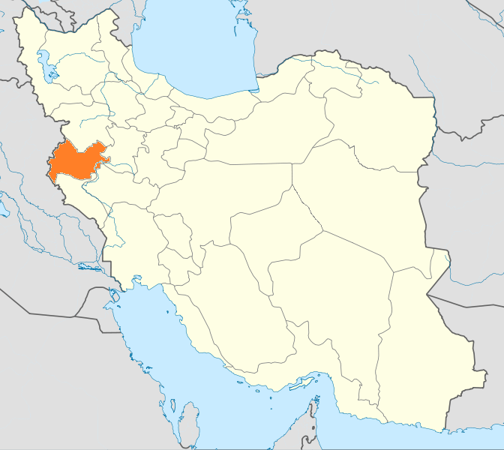
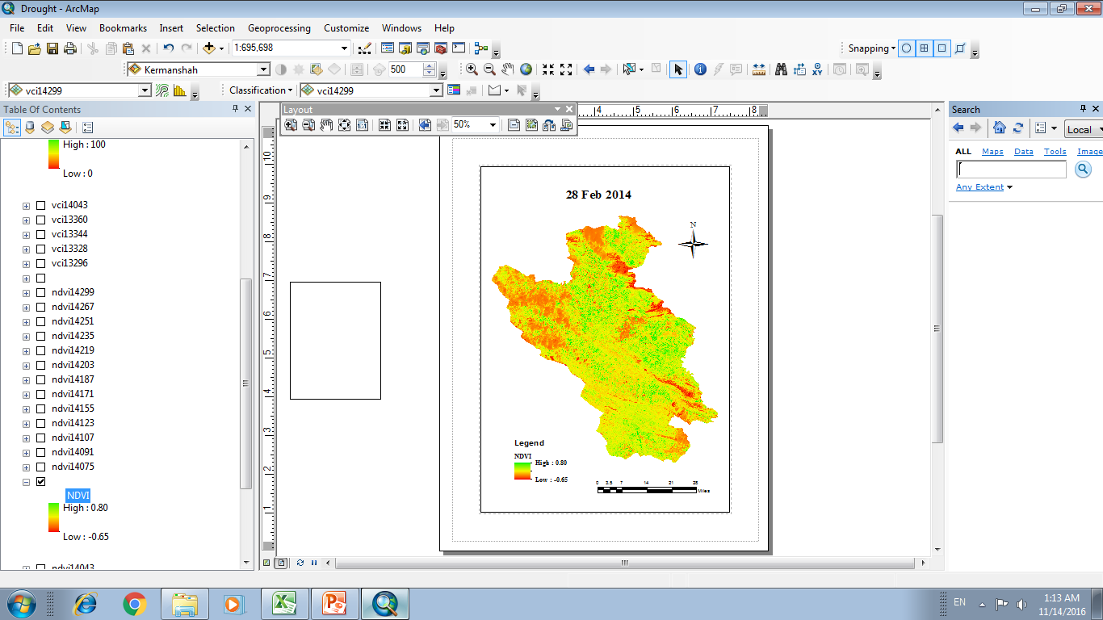
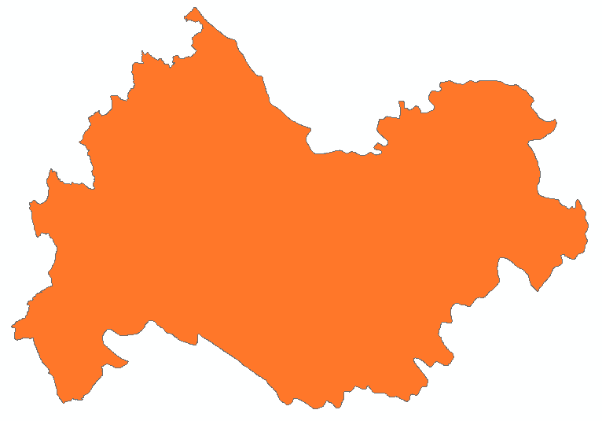
Iran
Area : 5647 km²
Longitude: 46º 59’15” E
Latitude: 34º 36’ 56 ” N
Mean rainfall: 434 mm/year
Meteorological station:
Elevation: 1318.5 m a.s.l.
Kermanshah Province

Slide 10
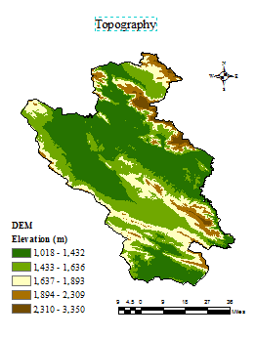
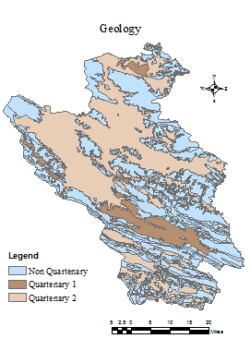
Min elevation:1108 m a.s.l.
Mean elevation: 1545 m a.s.l.
Max elevation:3350 m a.s.l.

Slide 11
Cultivation Pattern
Wheat, Barely, alfalfa, chickbeans, drybeans, maize are the most cultivated crops.
The water years started from October to September.
The first planting period started from 2nd Oct (wheat, barely)
The harvest time period begins from 2nd July (wheat, barely)
The most high demand months for irrigation water are June, July and August.
The study were done for two consequent water years 2013-14 and 2014-15

Slide 12
Material and Methods

Slide 13


SPI
SPI is the most common drought index, developed by McKee et al. (1993).
Long term precipitation data for a specific period is used for calculating the SPI
It is based on probability of precipitation for determined time scales
instead of the gamma (or any other parametric) distribution function, the empirical probability can be used to derive a non-parametric standardized index.(Farahmand and Aghakouchak, 2015) . The empirical probability is based on long term precipitation data. The median precipitation data will be equaled to the zero.

Slide 14
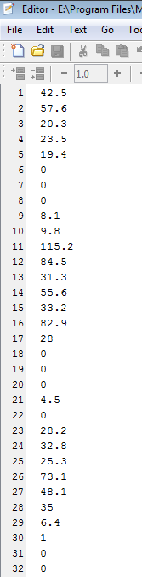
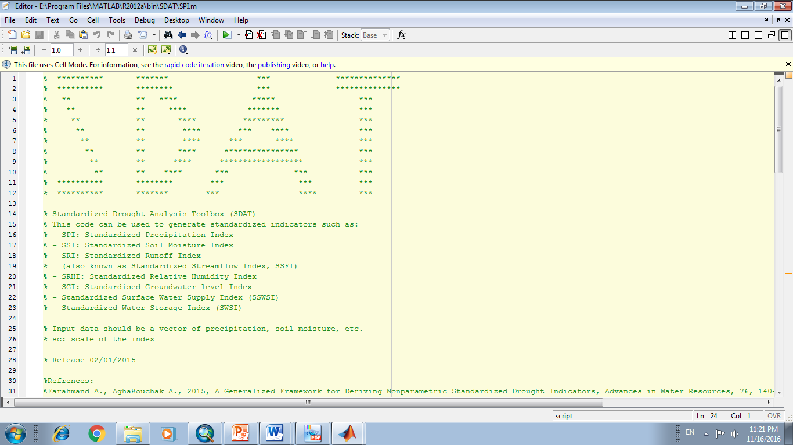
Farahmand A., AghaKouchak A., 2015, A Generalized Framework for Deriving Nonparametric Standardized Drought Indicators, Advances in Water Resources, 76, 140-145, doi: 10.1016/j.advwatres.2014.11.012 http://amir.eng.uci.edu/publications/15_Drought_Standardized_Index_AWR.pdf
The SDAT matlab code could be applied for SPI calculation

Slide 15
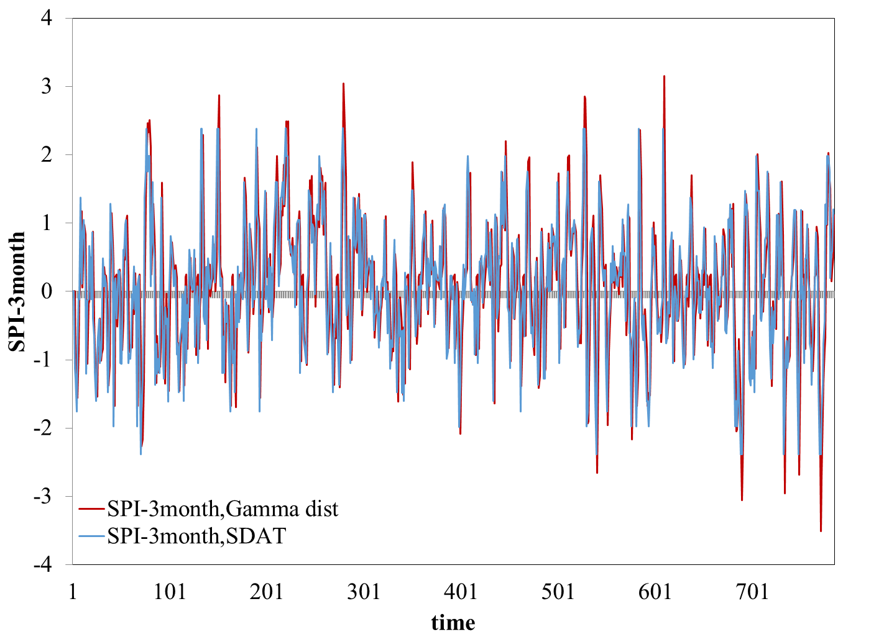
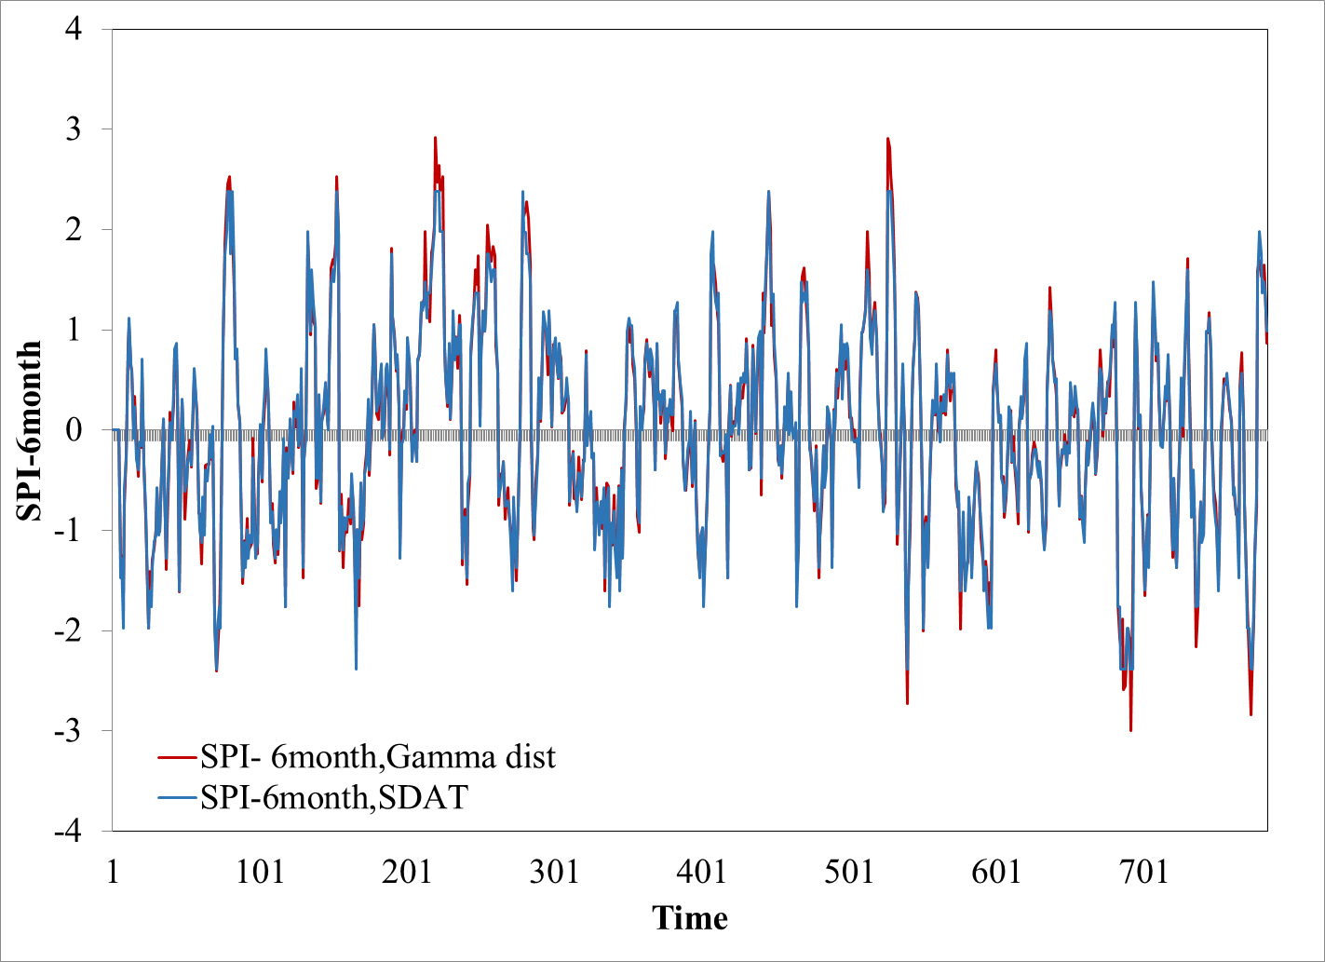
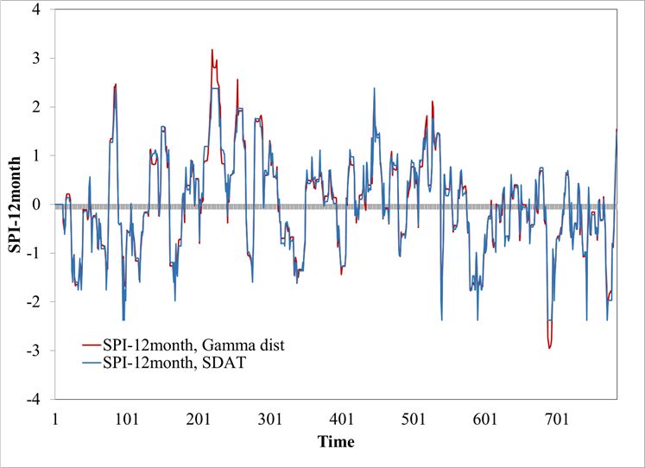
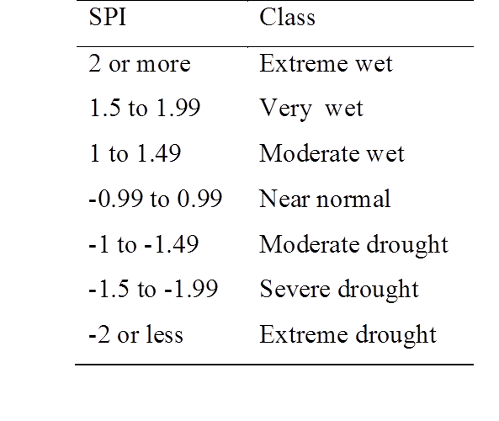
The difference between parametric and non-parametric SPI calculation

Slide 16
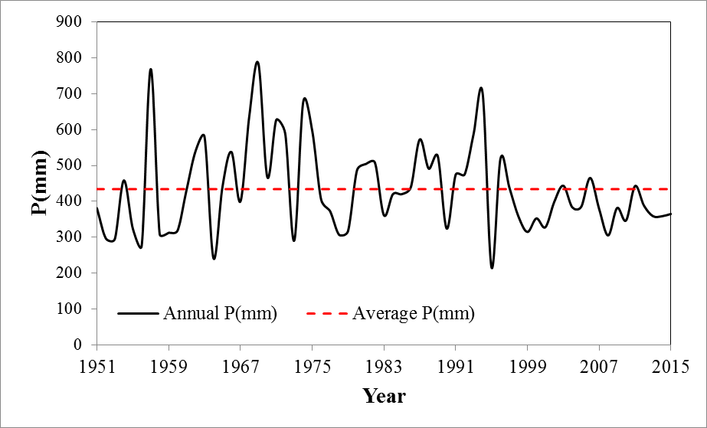
Precipitation in water year
2013-14: 384.5 mm
2014-2015: 245.26 mm
Using 780 months rainfall (from Jan 1951 to Dec 2015) , and SPI formulation the meteorological drought index calculated for different time scales(3,6,12 month)
The SPI values in water years 2013-2014 and 2014-2015 have been extracted from long term time series data in Kermanshah meteorological station.

Slide 17
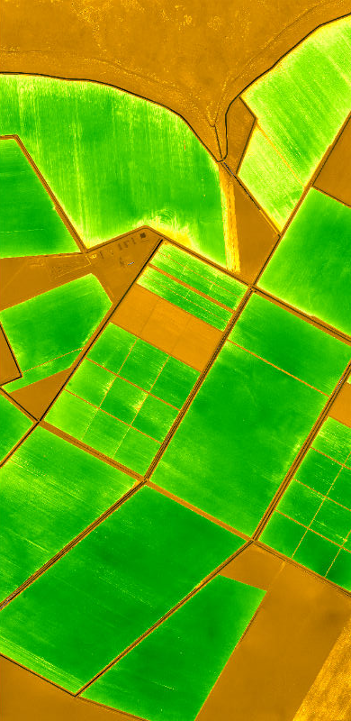
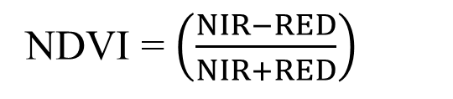
NDVI
NDVI = $\left(\frac{NIR−RED}{NIR+RED}\right)$
The most widely used vegetation index is NDVI which is calculated by remote sensing technology
NIR and RED bands of Landsat 8 images have been applied
NIR and RED bands reflection could detect vegetation cover better than the others.
NIR: 0.85-0.88 µm, RED: 0.64-0.67 µm
path/row: 167/36
Time period of overpass : every 16 days at 7:30 am.
USGS website : http://earthexplorer.usgs.gov
Thirty-four clear sky satellite images were selected from October 2013 to September 2015.
between -1 and +1
From:http://www.questuav.com/phpmedia/graphics/54b8af5f63a30e8851c16bb60e6ccf91.jpg

Slide 18
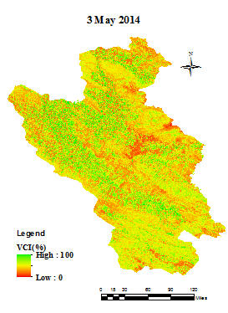
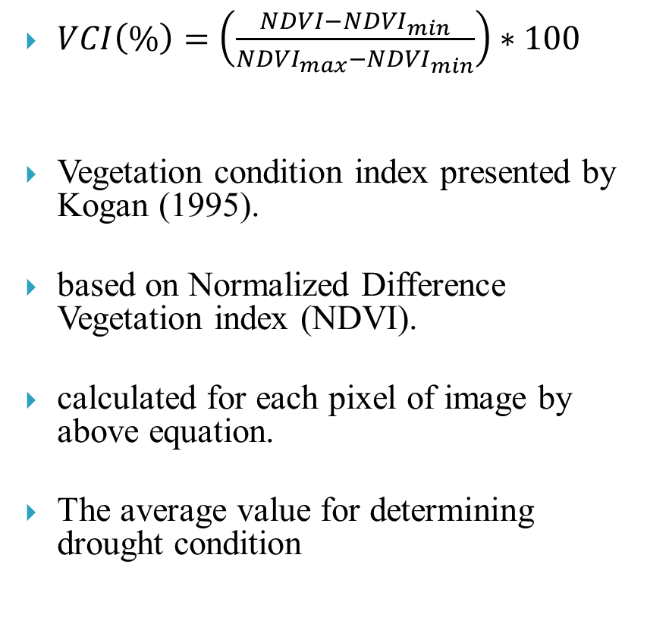
VCI
$VCI\left(\%\right)=\left(\frac{NDVI−{NDVI}_{min}}{{NDVI}_{max}−{NDVI}_{min}}\right)∗100$
Vegetation condition index presented by Kogan (1995).
based on Normalized Difference Vegetation index (NDVI).
calculated for each pixel of image by above equation.
The average value for determining drought condition

Slide 19
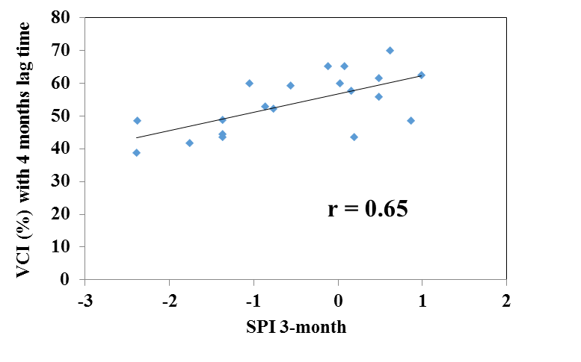
Correlation Coefficient
Measures the strength and the direction of a linear relationship between two indices.
The linear correlation between SPI with different time scales and VCI with lag time (one to twelve months) were calculated by above formula.

Slide 20
Results and discussion

Slide 21
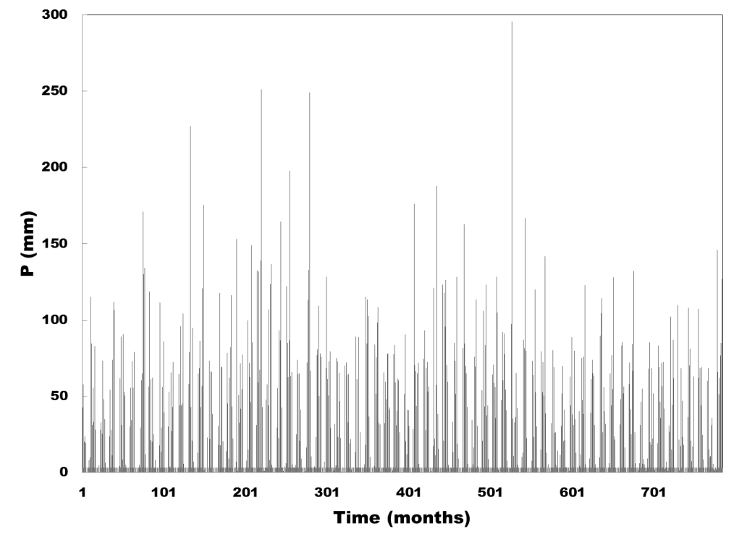
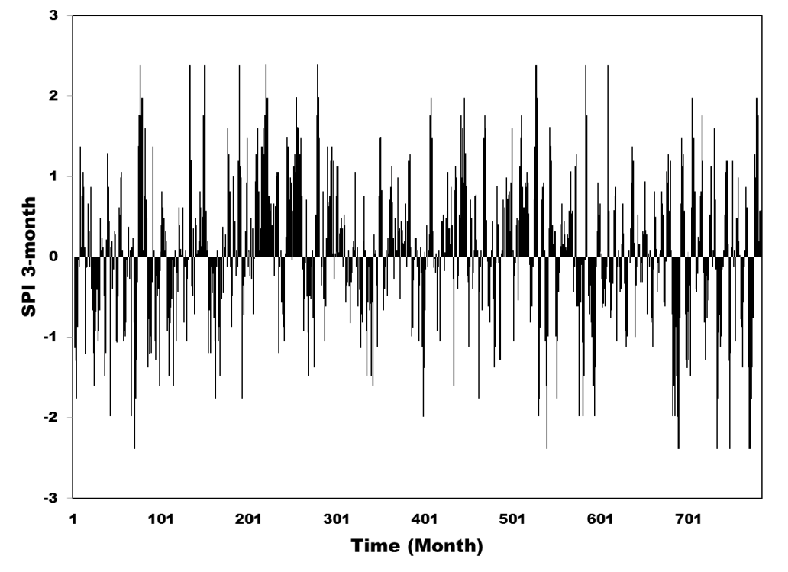
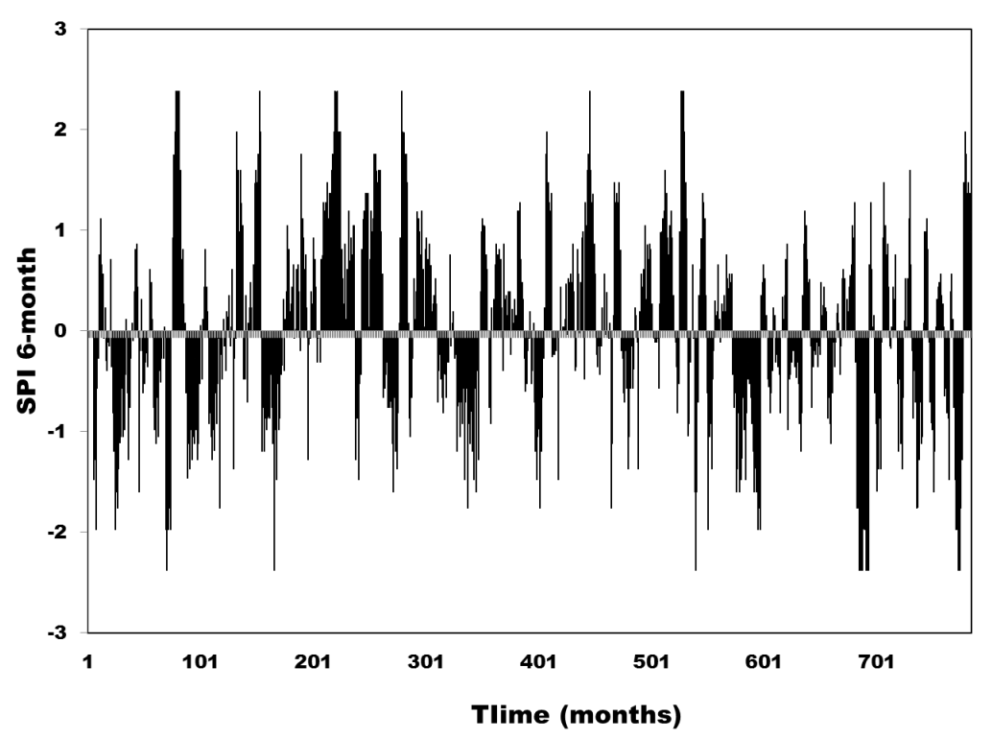
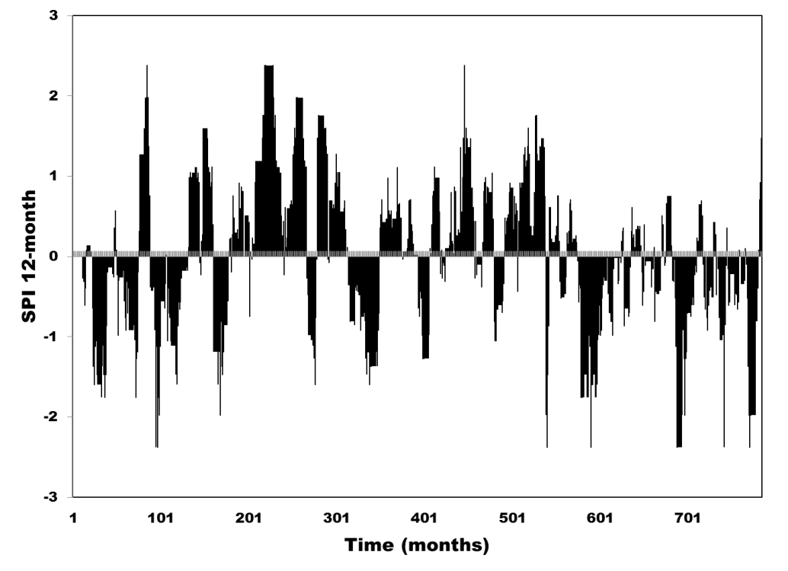

Slide 22
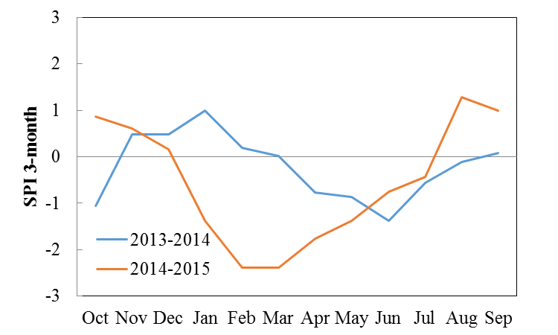
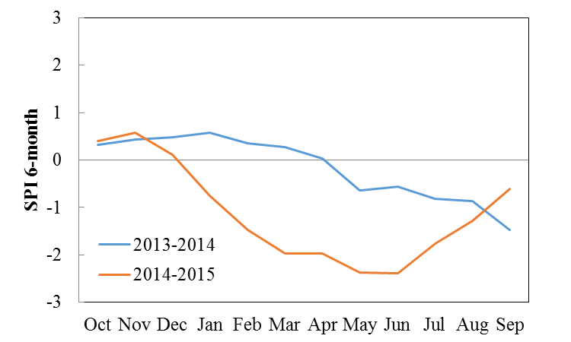
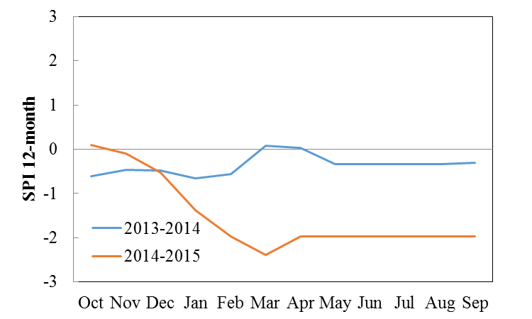

Slide 23
By advancements in technology and science the remote sensing data have been using for agricultural drought.
The spatial distribution of NDVI for clear sky images have been calculated during 2 years.
Based on NDVI calculations, vegetation cover in spring and summer month are more than other seasons.
For better understanding of vegetation cover condition the NDVI > 0.2 is extracted from NDVI maps.

Slide 24
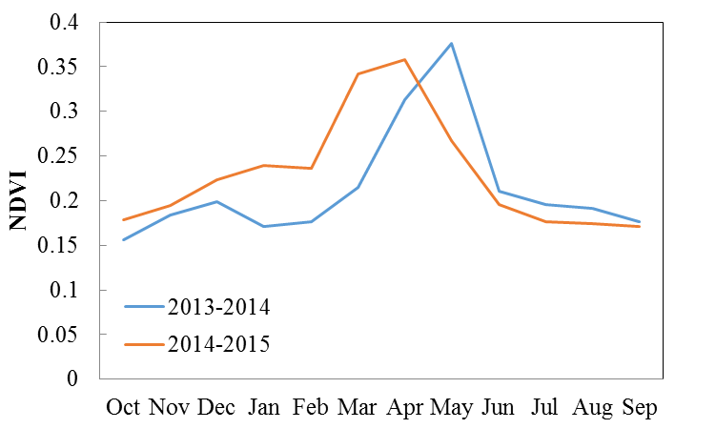
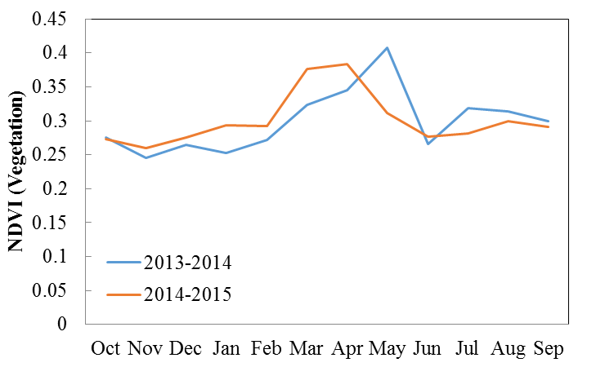
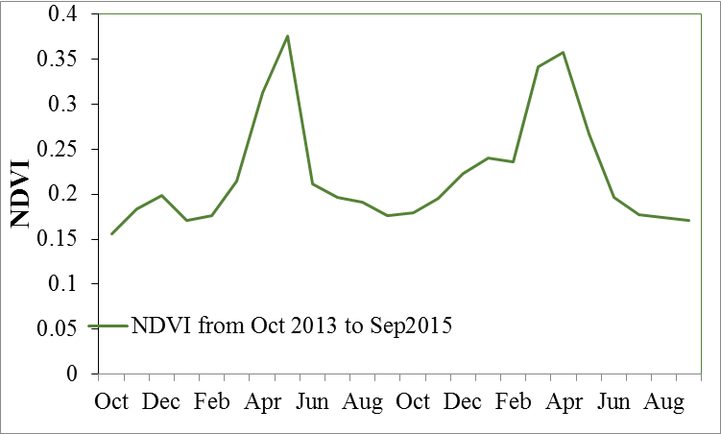

Slide 25
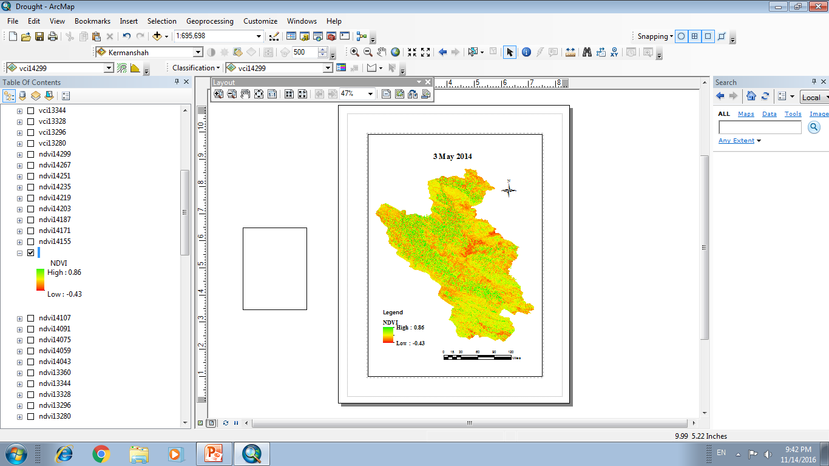
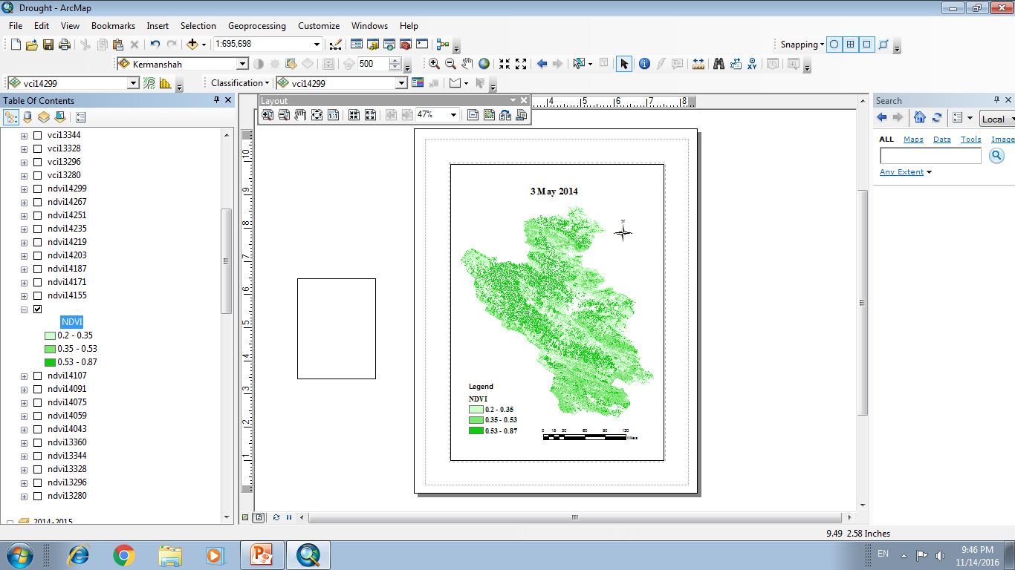
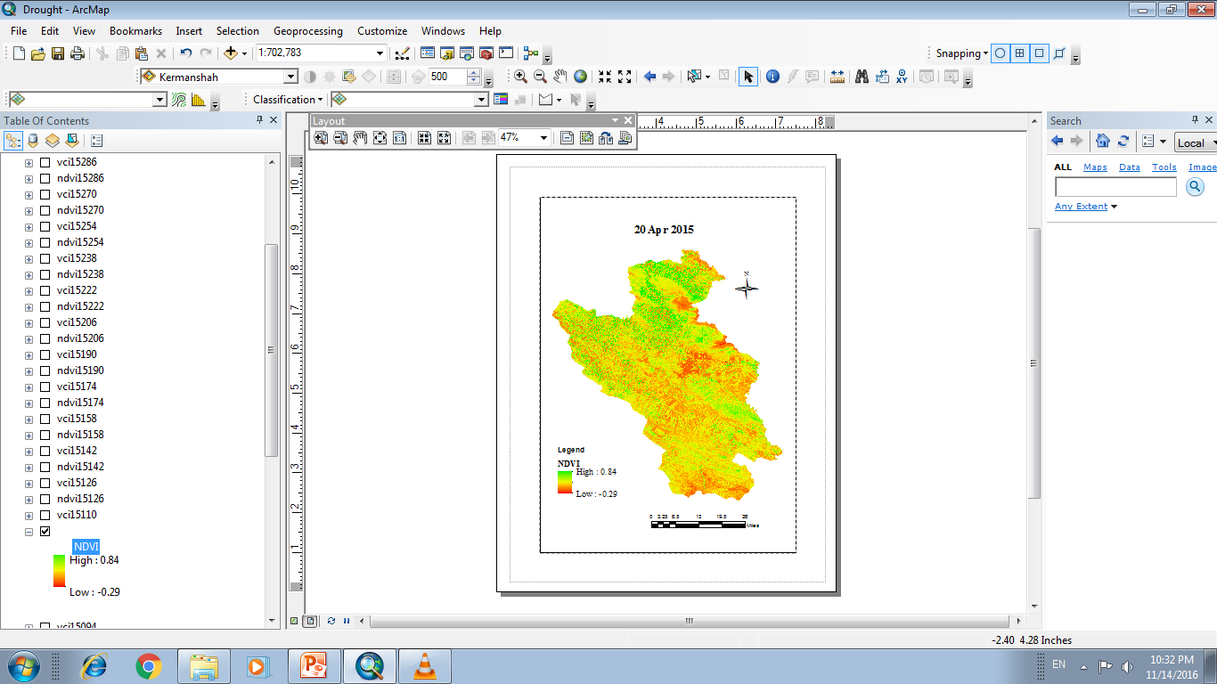
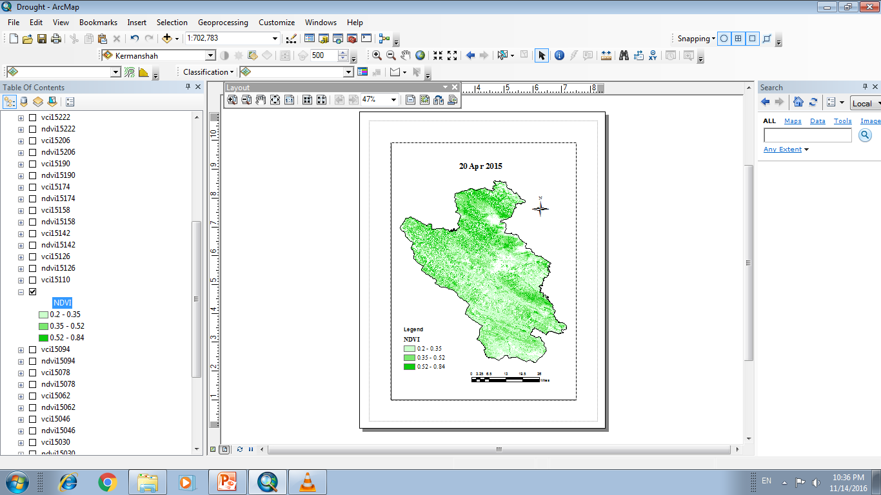
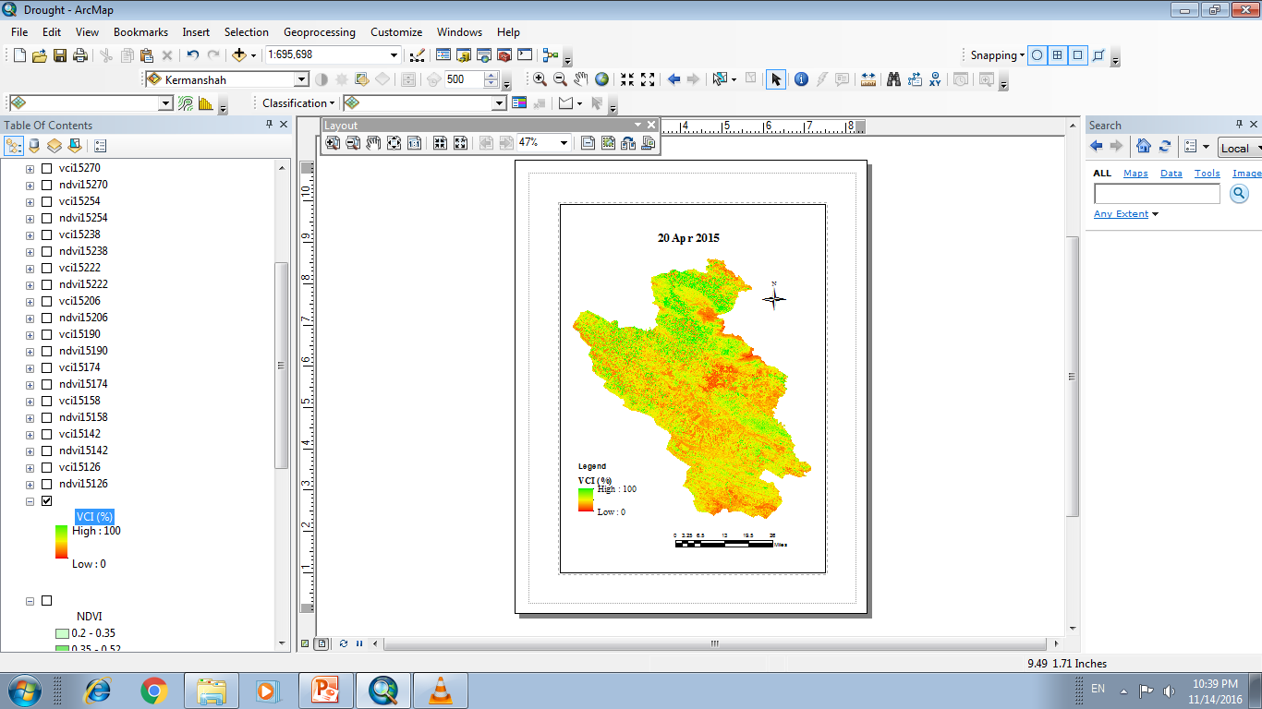

Slide 26
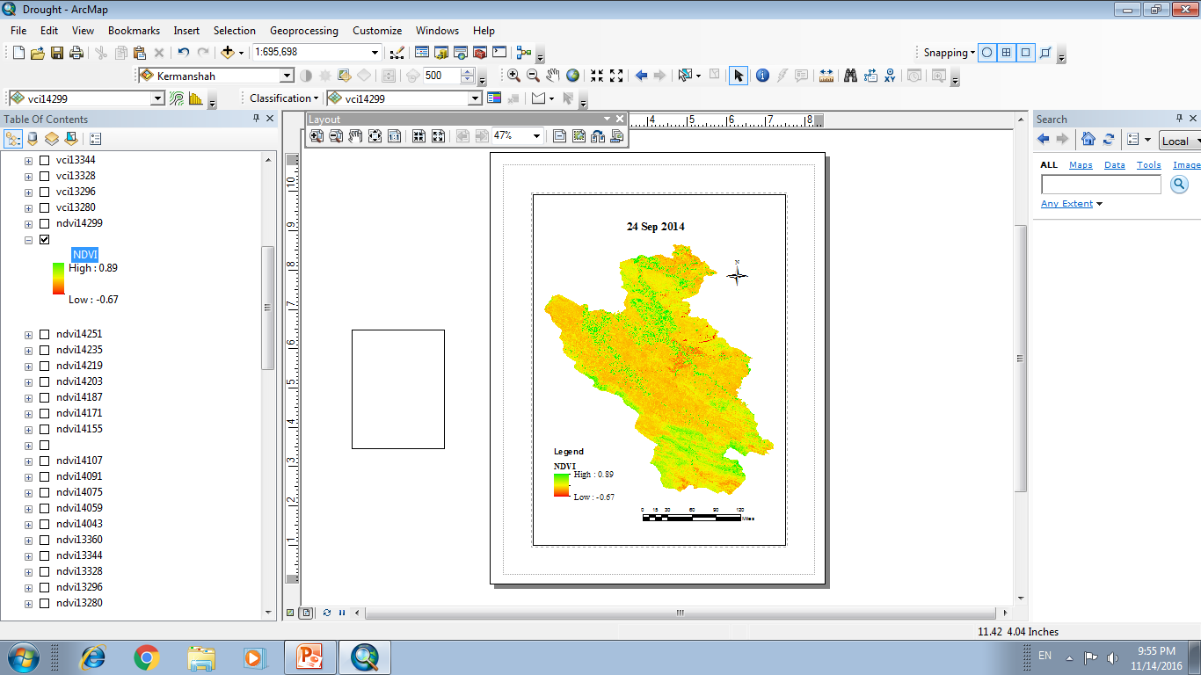
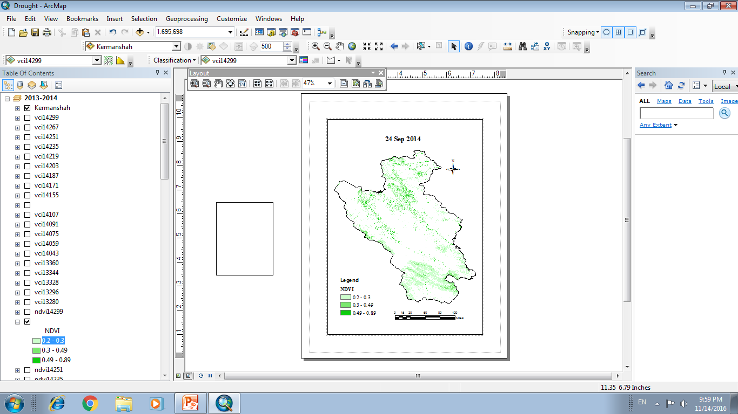
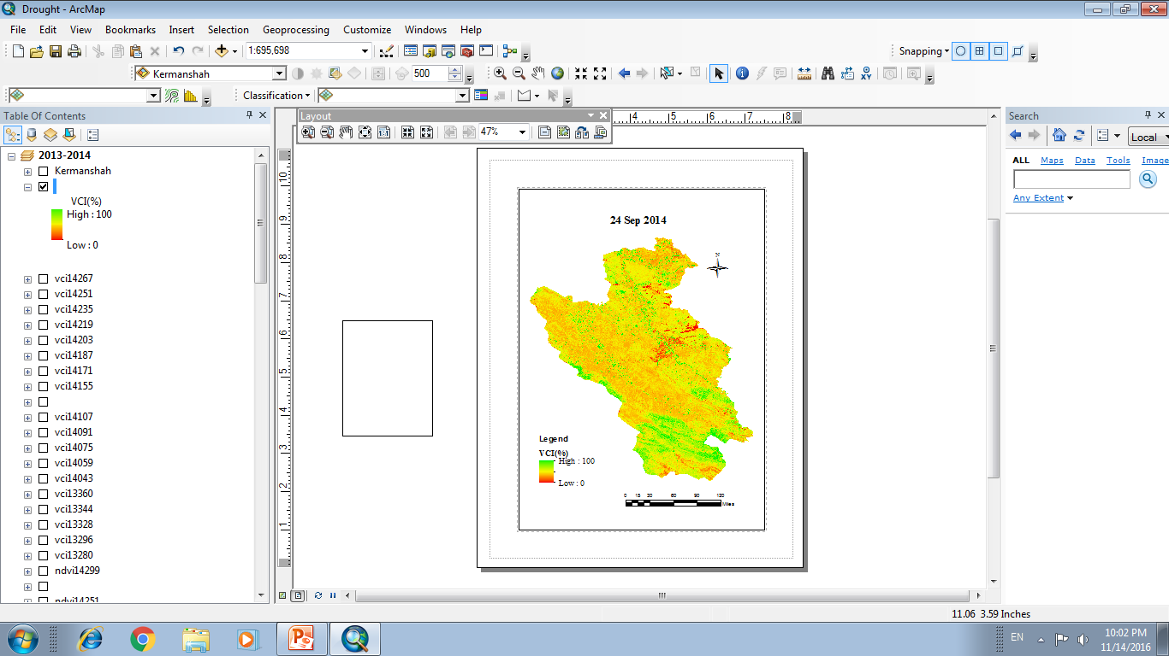
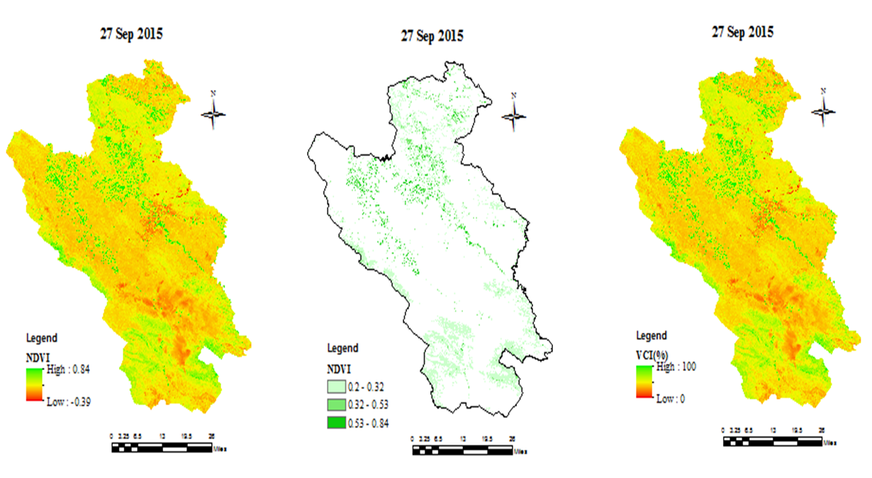

Slide 27
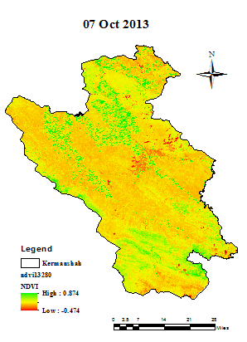
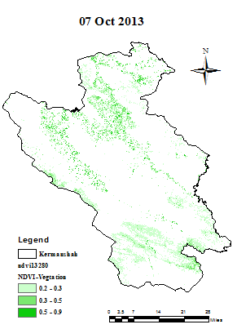
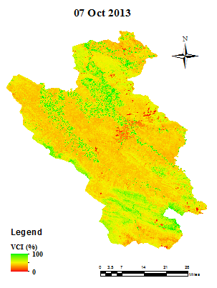
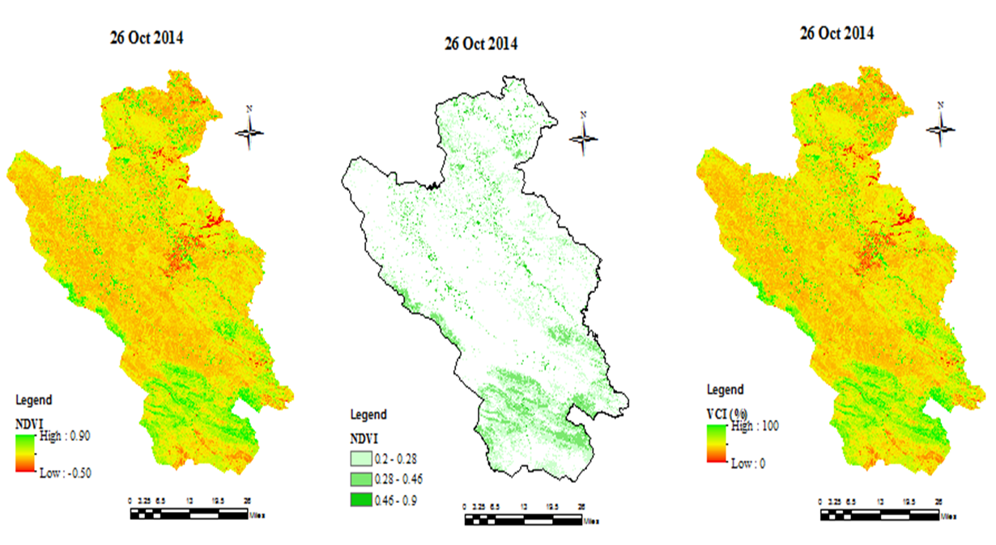
Despite of harvesting the product(which means the irrigation period were already finished) , the southern part of floodplain has natural vegetation cover.

Slide 28
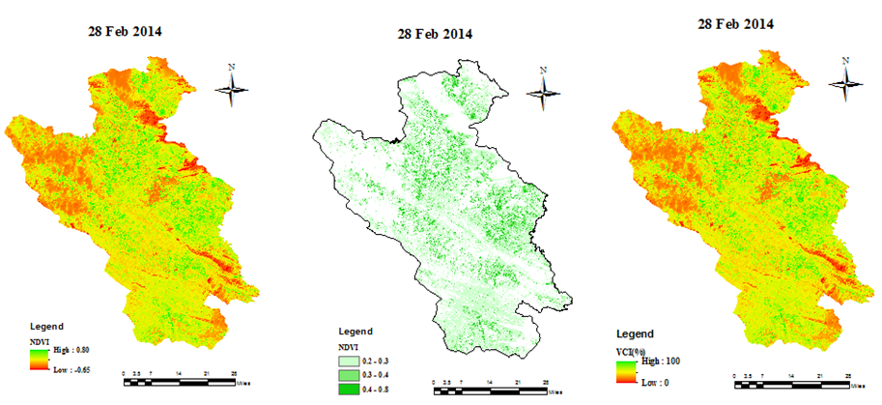
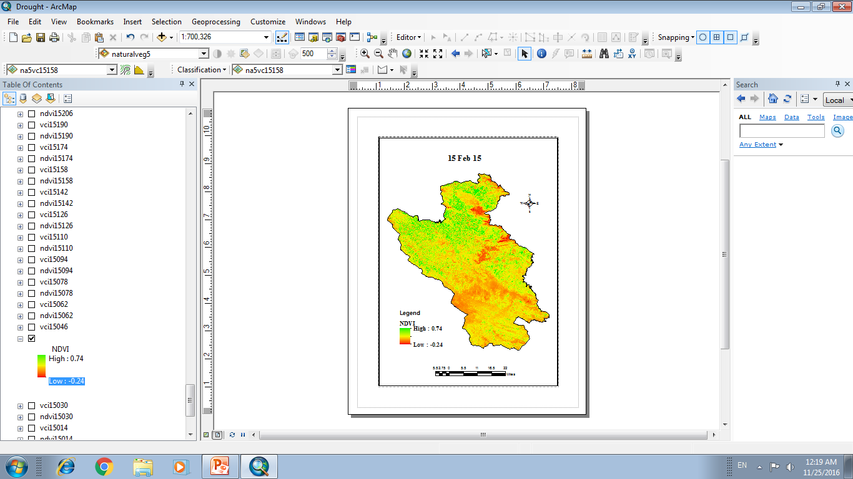
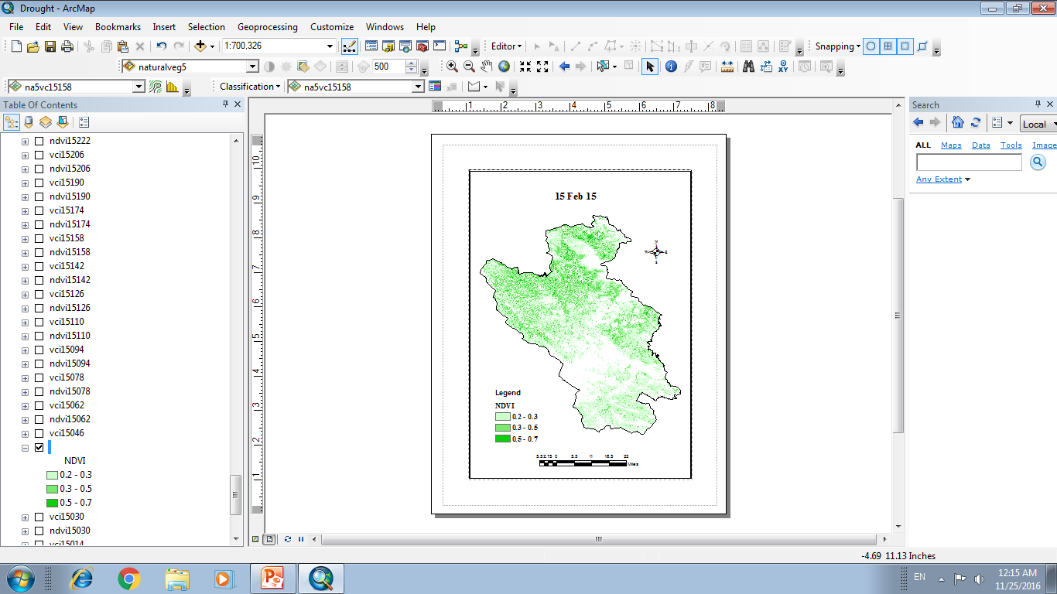


Slide 29


Vegetation condition index has been determined by NDVI values.

Slide 30



By comparing agricultural and natural vegetation cover the effect of irrigation was detected i.e. denser canopy is as a result of irrigation

Slide 31
Conclusion

Slide 32

The highest correlation occurred between SPI-3month and VCI with four months lag time

Slide 33

The highest correlation occurred between SPI-6month and VCI with two months lag time

Slide 34

The highest correlation occurred between SPI-12 month and VCI with four months lag time

Slide 35
The comparison were done not only for same time but also the lag time of precipitation effect on vegetation cover has been considered.
The VCI (which is based on NDVI) were calculated using NIR and Red bands of Landsat 8 stellate images for indicated years.
The correlation between SPI with different time scales and VCI with zero to 12 months lag time were calculated
The highest correlation between SPI-3,6 and 12 months time scales and VCI were occurred in 4, 2 and 4 months lag time, respectively.

Slide 36
Thanks for your attention!

