Slide 1



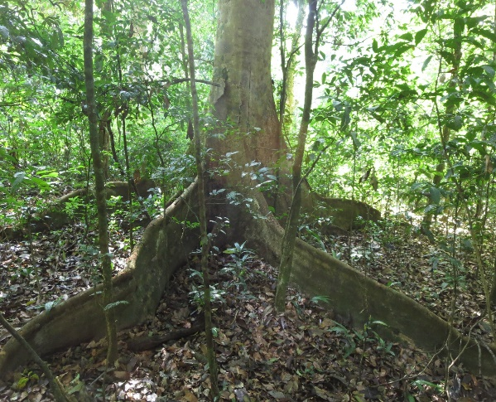
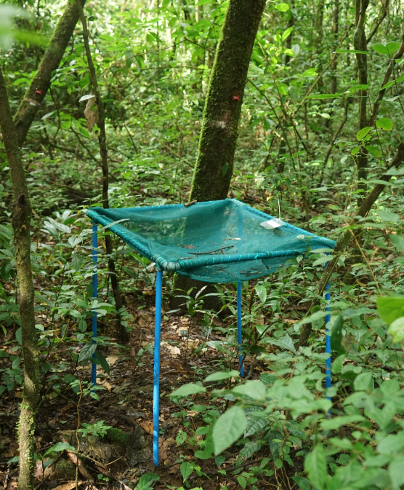
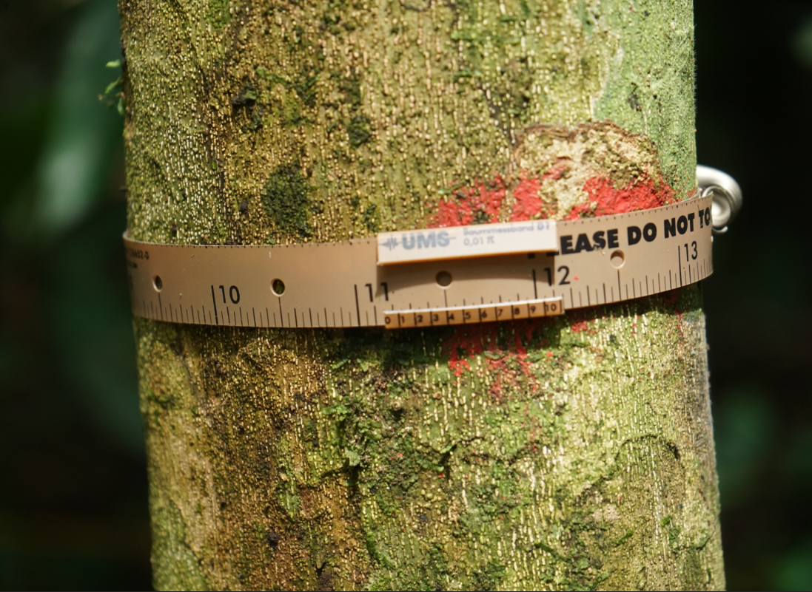

European Geoscience Union 2020
Early responses of elevated nutrient input on above-ground net primary production (ANPP) of a lower-montane tropical forest in Uganda
For audio, view in presentation mode
Raphael Manu¹, Marife D. Corre¹, Edzo Veldkamp¹ and Oliver van Straaten²
¹Soil Science of Tropical and Subtropical Ecosystems, University of Göttingen, Göttingen
²Northwest German Forest Research Institute, Göttingen
Correspondence: raphael.manu@uni-goetingen.de (PhD student)

Slide 2




Tropical forest ecosystems
  We established a large-scale in situ nutrient manipulation experiment to evaluate nutrient limitations on ANPP in an underrepresented tropical region (Africa)
Specific objective:
To evaluate the effects of elevated nutrient input on:
Tropical forest ecosystem
… different components of ANPP
  Stem diameter growth
  Litter production
  Above-ground woody biomass production
NK
K
NP
NPK
PK
N
P
Vitousek 1984; Tanner et al 1998; Sterner and Elser 2002; Kaspari et al. 2008; Wright et al. 2011; Powers et al. 2015
Introduction | Methods | Results | Conclusions
2

Slide 3
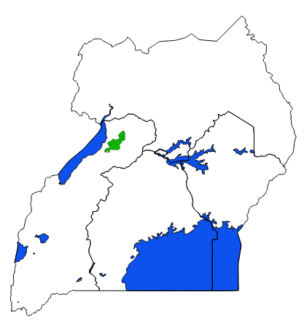

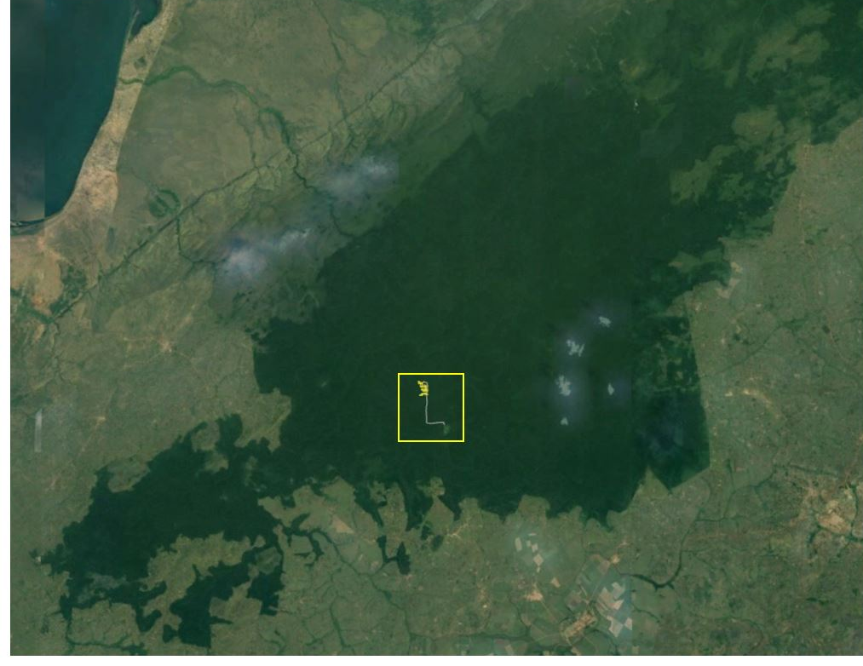
Location: Budongo Forest Reserve in Uganda
Location and site characteristics
Uganda
Semi-deciduous tropical rainforest
Elevation: 1100m a.s.l.
Annual rainfall: 1200 - 2200 mm
Temperature: 23-32 °C
Major dry season : Dec. – Feb.
Minor dry season : Jun. – Jul.
Soil type : Lixisols
Budongo Forest Reserve
Study population: trees with DBH ≥ 10 cm
Species richness = 94
Stem density (ha⁻¹) = 618 ± 13
Basal area (m² ha⁻¹) = 36.3 ± 1.1
Hamilton 1984; Babweteera 2012; FAO 2014
Introduction | Methods | Results | Conclusions

Slide 4
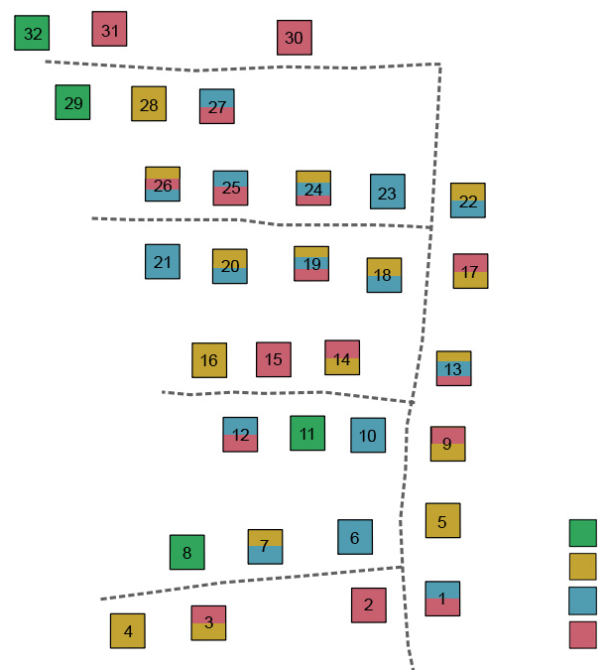
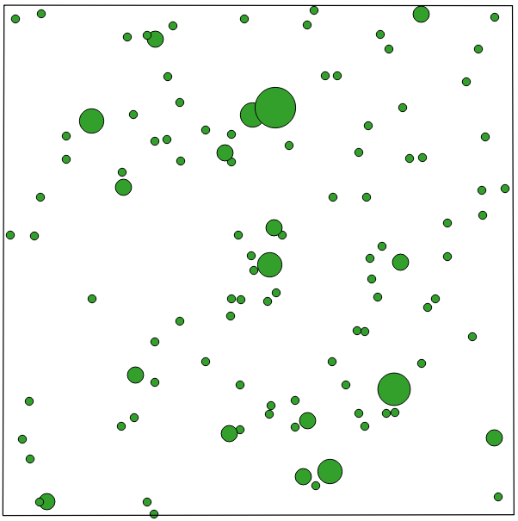
Plot design
32 plots (8 treatment × 4 replicate)
Plot size: 40 × 40 m
30 × 30 m
Dendrometer band installed on 20 selected trees in subplot
Control
N
K
P
Litter collector – 4 per plot (0.75 × 0.75 m)
Inputs: 125 kg N ha⁻¹yr⁻¹, 50 kg K ha⁻¹ yr⁻¹ and 50 kg P ha⁻¹yr⁻¹
Stem-mapped trees ≥ 10 cm dbh
Introduction | Methods | Results | Conclusions

Slide 5
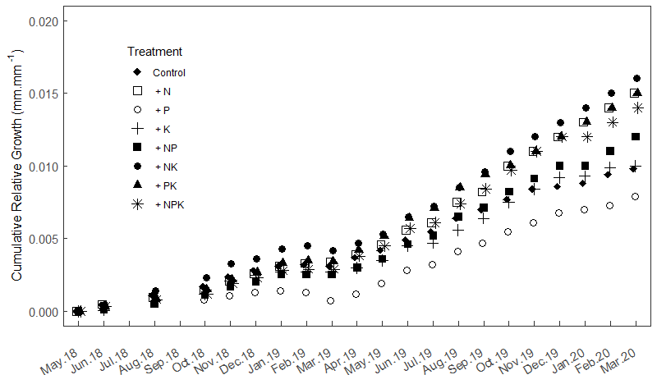
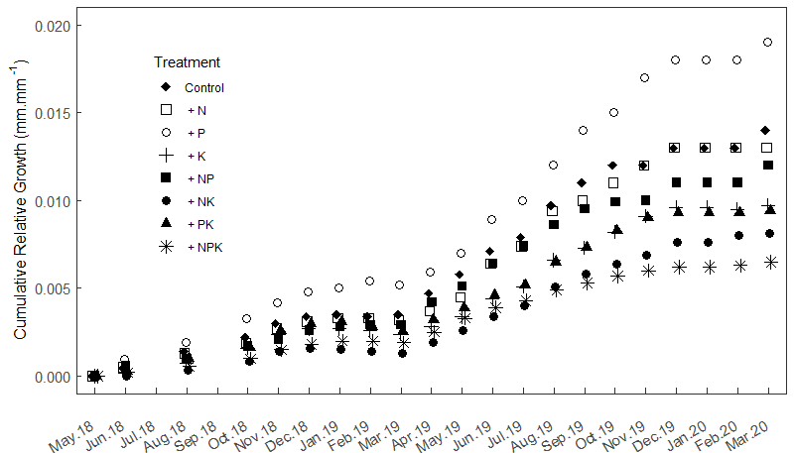
Tree-size response to nutrient addition
We observed no response in stem growth to nutrient addition based on tree size classes
10 – 30 cm dbh
B) > 30 cm dbh
Response of stem growth to nutrient addition by different tree size classes: A) 10 – 30 cm DBH (n = 4) and B) > 30 cm DBH (n = 4).
Introduction | Methods | Results | Conclusions

Slide 6
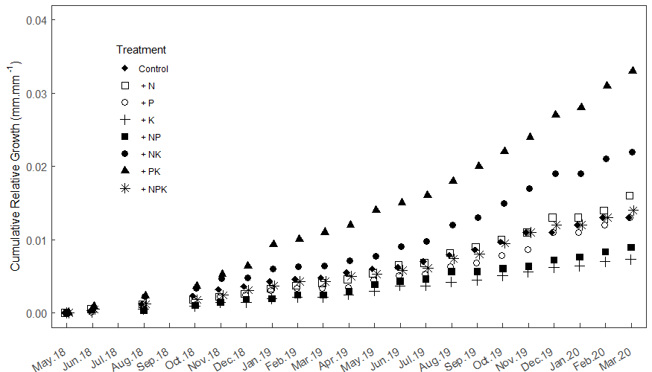
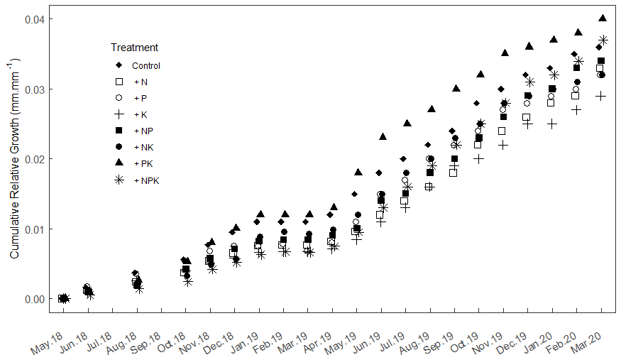
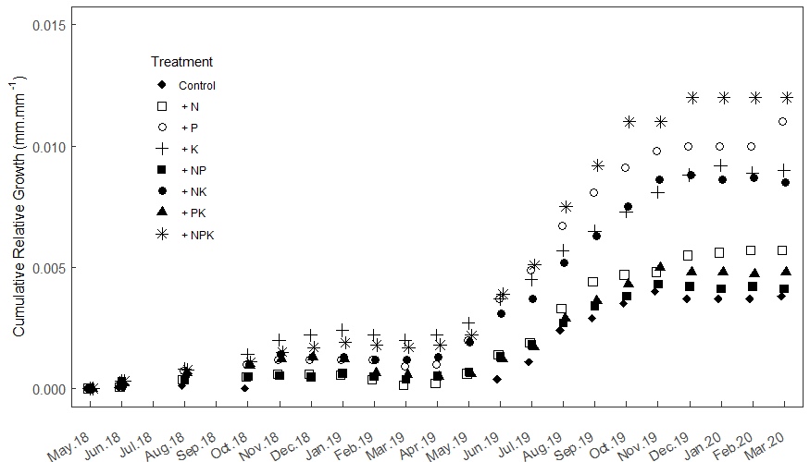
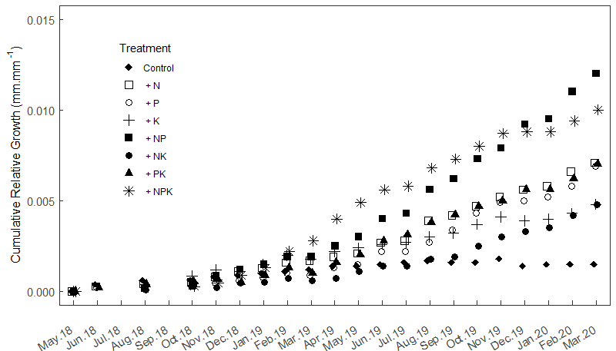
Species response in stem growth to nutrient addition
Different species responded differently to nutrient addition
Funtumia elastica
Cynometra alexandri
*
Celtis durandii
D) Celtis milbraedii
*
Presented here are four most dominant species present in at least three replicate plots of each treatment (individual trees were considered as experimental units) in our study site: A) Funtumia elastica (n = 10 - 23 trees), B) Cynometra alexandri (n = 3 - 10 trees), C) Celtis durandii (n = 5 - 11 trees) and D) Celtis mildbraedii (n = 9 - 15 trees). Asterisk indicate significance difference (p < 0.05) between the control and the given treatment
Introduction | Methods | Results | Conclusions

Slide 7
Leaf litter response to nutrient addition
Unlike the control, N- and P addition plots, K addition plots showed a delay in leaf shedding during the major dry season (grey-shades; Dec. – Feb.)
Generally, litter production showed seasonality with the highest in the major dry season (Dec. – Feb.)
 | Methods | Results | Conclusions

Slide 8
Leaf litter response to nutrient addition
Peaking of leaf litter production was four weeks later in all K addition plots than in control plots except in the NK addition plots (2 weeks). Possibilities are that:
Stomatal regulation by the presence of K allows gaseous exchange (evapotranspiration) which sustains photosynthesis during water-deficit conditions
The upregulation of K mitigates the early formation of reactive oxygen species in the leaf and activates the trees‘ stress resistance mechanism in the dry season
Introduction | Methods | Results | Conclusions

Slide 9
Response of above-ground net primary production to nutrient addition
A) Total fine-litterfall
B) Above-ground woody biomass
C) ANPP
Overall, we observed no significant response of litter fall, woody biomass and ANPP to nutrient addition (Fig. A, B and C resp.)
To our knowledge, total fine litter production lies at the upper end of the range reported for tropical montane forests (3.1–12.9 Mg ha⁻¹ yr⁻¹)
Introduction | Methods | Results | Conclusions

Slide 10
European Geoscience Union 2020
Conclusions
Within two years of nutrient addition:
We observed no significant response in stem growth based on tree sizes, however, different species responded differently to nutrient addition; Celtis durandii and Funtumia elastica increased in stem growth in K and PK addition plots respectively in contrast to N or P only
Litter production showed a strong seasonality with the highest litterfall recorded in the dry season (Dec. – Feb.)
Given the unique response pattern of leaf litter to K addition, we suggest that, the spectrum of biochemical functions triggered by up- or down regulation of K in the physiological processes responsible for tree growth and productivity should be explored in such a complex forest ecosystems
Overall, we observed no significant response of ANPP to nutrient addition
Further correspondence: raphael.manu@uni-goetingen.de (PhD student)
Introduction | Methods | Results | Conclusions
10

