Slide 2
The coastal areas of three nuclear power plants (NPP) in Tohoku region of Japan were impacted by the tsunami waves of the earthquake 11 March 2011. The overtopping of the tsunami protective dikes of Fukushima Daiichi NPP and inundation of the NPP site was followed by the nuclear accident with a large scale environmental contamination.
The site of the “sister” NPP Fukushima Daini at 10 km southward from Fukushima Daichi also was inundated by water which depths were of the same magnitude as at the Fukushima Daiichi site, however, quick reconstruction the emergency energy supply of the reactors has prevented a nuclear accident on this site. Onagawa NPP located at 115 km North-North-East from Fukushima Daiichi is the closest NPP to the epicenter of earthquake – source term of tsunami waves. The tsunami protection dike of this NPP was not overtopped. The situation at the Tohoku coast where the natural hazard - tsunami has triggered one of the largest environmental technogenic catastrophe is unique in the world history.

Slide 3
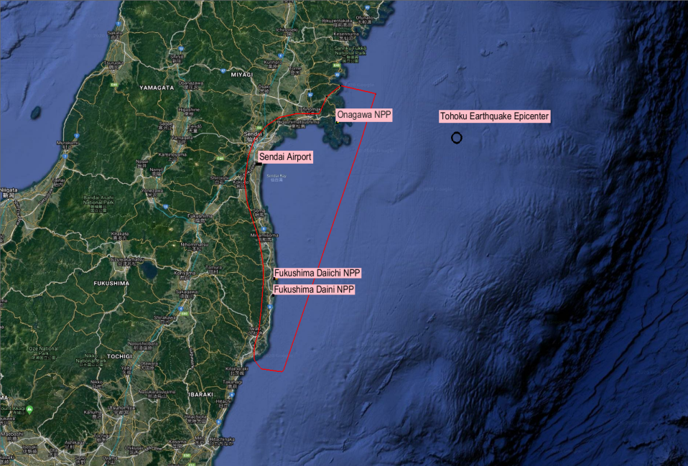
Sendai Bay. Modeled objects, Great Tohoku Earthquake 2011 epicenter, and model grid boundary (red)

Slide 4
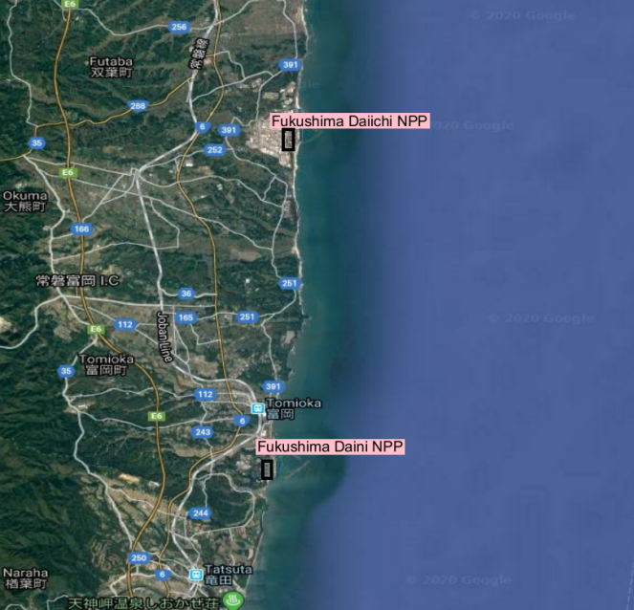
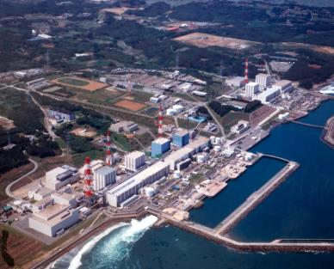
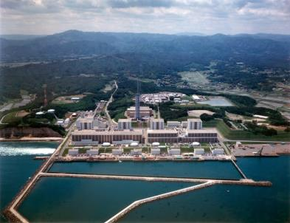
Fukushima Daiichi NPP and Fukushima Daini NPP

Slide 5
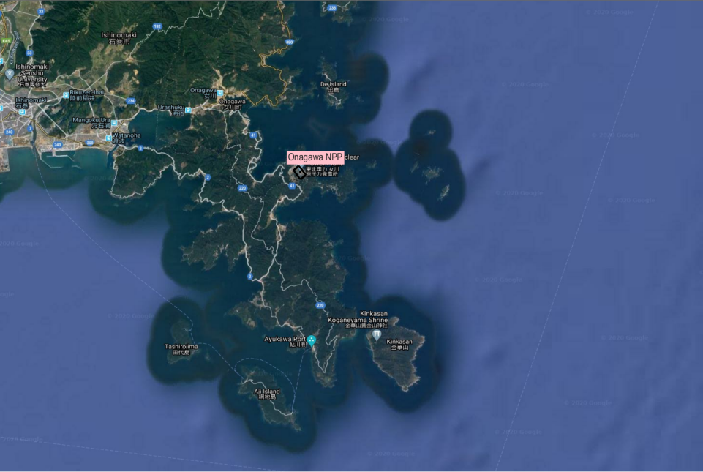
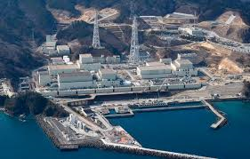
Onagawa NPP

Slide 6
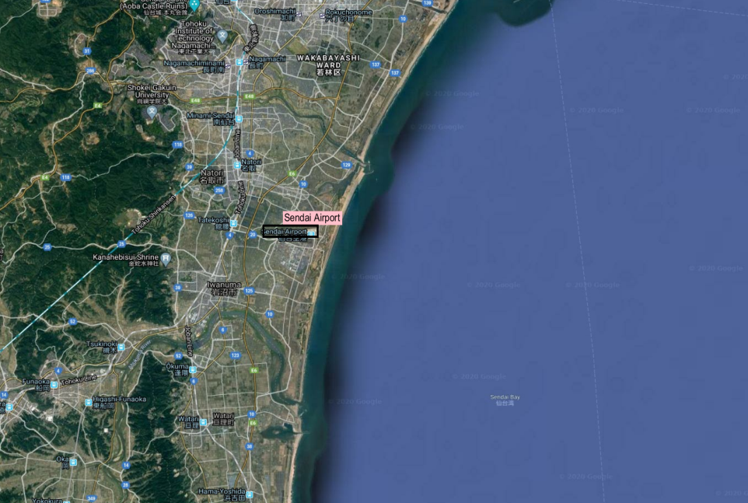
costa area at Sendai airport

Slide 7
To simulate the consequences of the radioactive contamination of the coastal waters at sediments at Fukushima Daiichi NPP we use the modelling system that includes the module of the numerical solution of the nonlinear shallow water equation (SWE). This module also can be used for the modeling of tsunami propagation and inundation of the coastal areas. The modeling of the tsunami propagation and coastal inundation of the areas of three NPPs was provived for the testing of our SWE module and analyses of the dynamics of tsunami inundation of three NPP sites

Slide 8
COASTOX-UN: Parallel 2D model of open flow hydrodynamics on unstructured grid
COASTOX_UN:
2D nonlinear shallow water equations in equidistant cylindrical projection or in rectangular coordinates depending from the size of the modeling area
Finite volume method
Unstructured mesh of triangular cells
Parallel implementation with Fortran and MPI with proven increasing of the computational performance with the increasing of the computational nodes
Coastox_UN is one of the models the coastal morphodynamic modeling system MORPHO
Tested in the a number of analytical tests and verified in a comparison with the data of laboratory experiments and field observations.
Applications: tsunami, tidal flow, waves driven nearshore currents , storm surge, morphodynamics, dam break, floods, 2-D hydrodynamics for radionuclide transport modeling
COASTOX _UN included as a part of the 2D module of radionuclide transport of Real Time Online Decision Support System RODOS.

Slide 9
Governing equations.
q_{x} and q_{y} (m²/s) are the components of the water discharges per unit width along the horizontal directions x and y

Slide 10
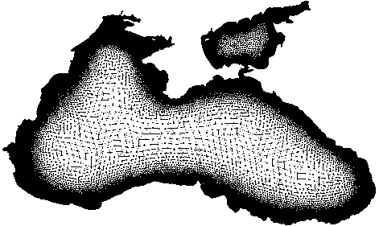
COASTOX-UN: Numerical scheme
COASTOX is run on unstructured triangular grids (example above).
The Shallow Water Equation system is integrated for each cell, flux theorem is used to replace volume with boundary values, we get an equation and it’s discretization:
Here U is the conserved values (mass, momentum) vector, F is corresponding advective flux.

Slide 11
COASTOX-UN: Numerical scheme
Equations:
y
B
Are solved by the explicit two-stage Runge-Kutta method of predictor-corrector type, using two different methods of flux calculation in the stages of the predictor and the corrector, thus achieving the second order in time and space.
Predictor stage: Godunov-type flux calculation scheme OR Roe methods of solving a Riemann problem.
Corrector stage: fluxes are computed directly using Riemann problem states in a downwind manner (E is locally rotated flux vector):
right cell
left cell
d_{R}
d_{L}
c_{R}
c_{L}
A
x
Local coordinate system
Corrector step guarantees second order in space.

Slide 12
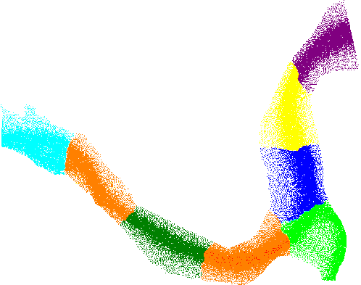
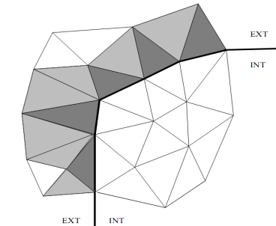
COASTOX-UN: parallelization approach
In parallelization for shared and distributed memory workstations the conventional domain decomposition approach with halo boundary structures and message-passing updating is employed using METIS graph partition library.
Each processor computes solution in it’s own subdomain. Continuity at boundary cells is achieved through hallo structures of fictitious elements, which mirror boundary conditions in border subdomains.
COASTOX sample grid partitioning using METIS library. (Upper)
Computational grid at the subdomain boundary (right). Arrows show compu-tational stencil, grey cells compose hallo structure.

Slide 13
Main differentiators- of COASTOX _UN in comparison with other software based on numerical solution of Shallow Water Equations:
A) Possibility to use in small and large areas due to the versions in cylindrical and Cartisian coordinates
B) High computational performance on multi –core/ multi- processors systems
C) Robust wetting drying algorithm
A) +B)+C) provide possibilities for the implementation of COASTOX_UN for the tsunami runup mapping for different earthquake scenarios that can request huge computational efforts in application for the long coastal areas ( e.g., Tohoku coast)

Slide 14
COASTOX-UN: model testing for tsunami applications

Slide 15
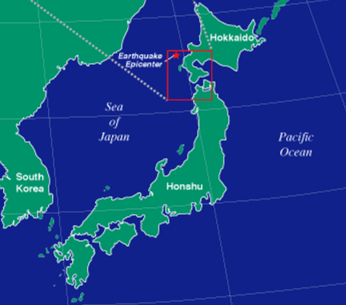
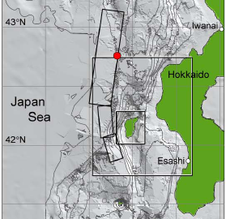
The numerical simulation of the Okushiri island inundation for the Hokkaido tsunami 1993
Japan Sea, the epicenter: 42.851N, 139.197E, M =7.6 (USGS)

Slide 16
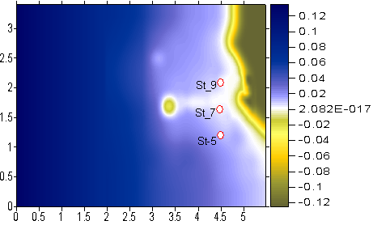
[Matsuyama, Tanaka, 2001] experiment (M:1/400), CRIEPI, Abiko, Japan
Fig.1. Bathymetry and topography data Fig.2. The offshore input
near v.Monai boundary data at d =13.5m

Slide 17
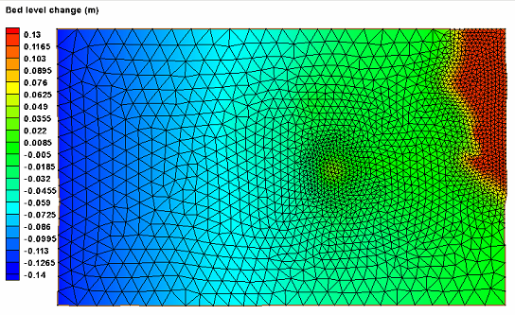
Okushiri Island mesh, Cartesian coordinates.

Slide 18
[Matsuyama, Tanaka, 2001] experiment (M:1/400), Abiko, Japan
The comparison of the water surface elevations calculated by COASTOX-UN with experimental data at gauge locations

Slide 19
[Matsuyama, Tanaka, 2001] experiment (M:1/400), Abiko, Japan
Inundation simulated by COASTOX-UN. White lines are depth contours

Slide 20
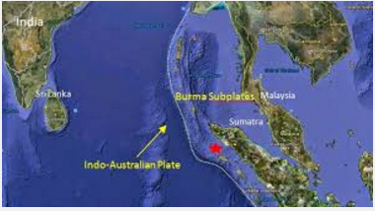
II. Modeling of Sumatra-Andaman tsunami 2004 by COASTOX-UN model
26.12.2004, Indian Ocean, epicenter is (3.09N, 94.26E)

Slide 21
Fault segments displacement calculated by [Okada, 1985] for [Grilli, 2007] data at t0 = 60, 272, 588, 913, 1273s
t= 2h. Water elevations simulated by COASTOX-UN
__ Satellite Jason-1 transect

Slide 22
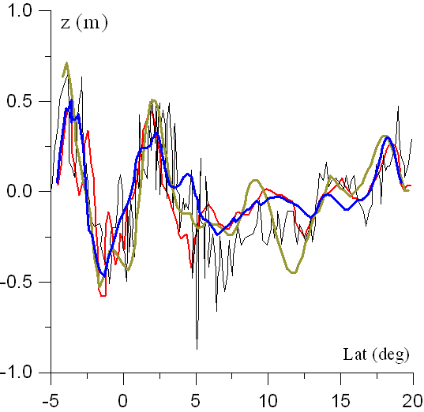
Comparison of the elevations with Jason 1 Satellite altimetry measured data (thin black line). COASTOX _UN (CPP)- blue, FUNWAVE(v.NSWE, Cartesian) – red, TUNAMI-N2 -NUS ([Dao, Tkalich, 2007], spherical coordinates) –green lines .

Slide 23
The comparison of sea levels calculated by COASTOX-UN (blue) with measured data (black)

Slide 24
Water surface elevation distribution near Western Thailand region

Slide 25
COASTOX_UN:
Modeling of Great Tohoku Earthquake Tsunami

Slide 26
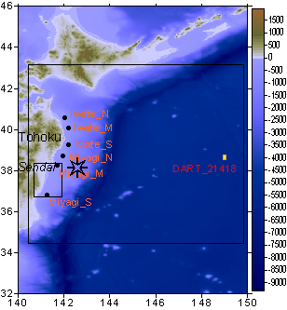
1
GPS gauges (orange) and DART (red) locations (Fuji,2011).

Slide 27
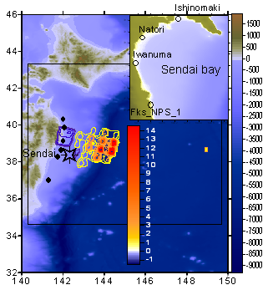
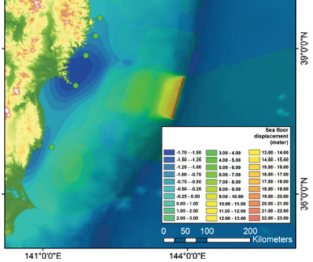
Initial water surface contour lines obtained by formulas [Okada, 1985] and based on slip distribution data [Fuji et al., 2011].
O – Sendai tide gauges [Muhari, Imamura, Suppasri, Mas, 2012]
Modeled seafloor displacement distribution
[Muhari, Imamura, Suppasri, Mas, 2012],
[Diposaptono et al., 2013]

Slide 28
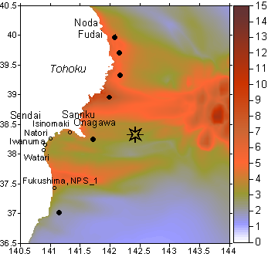
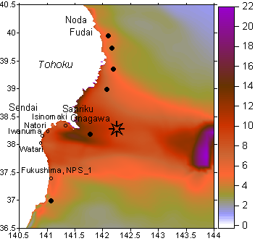
COASTOX UN - Tsunami maximum heights (m) in the water domain corresponded to tsunami source models [Fuji et al., 2011] (left panel) and [Muhari et al., 2012] (right panel).

Slide 29
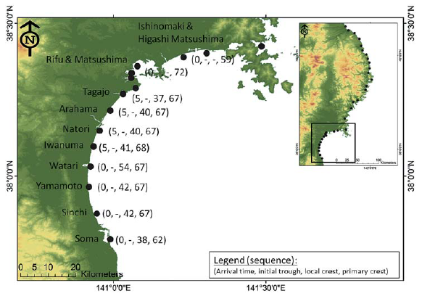
Sendai bay tide gauges locations [Muhari et al., 2012]

Slide 30
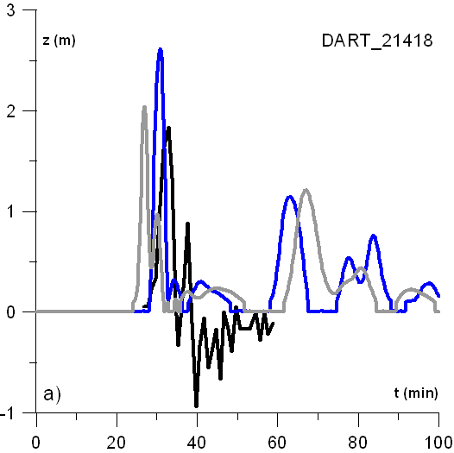
Tsunami heights simulated by COASTOX-UN for tsunami source model corresponded both to [Fuji et al., 2011] (grey line) and [Muhari et al.2012] (blue solid line).

Slide 31
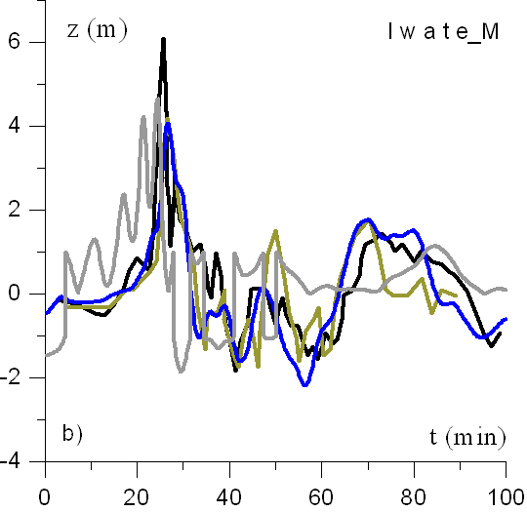
Tsunami heights simulated by COASTOX-UN for tsunami source model corresponded both to [Fuji et al., 2011] (grey line) and [Muhari et al.2012] (blue solid line).
TUNAMI-N2 simulated results [Muhari et al.2012] are denoted by green solid line.

Slide 32
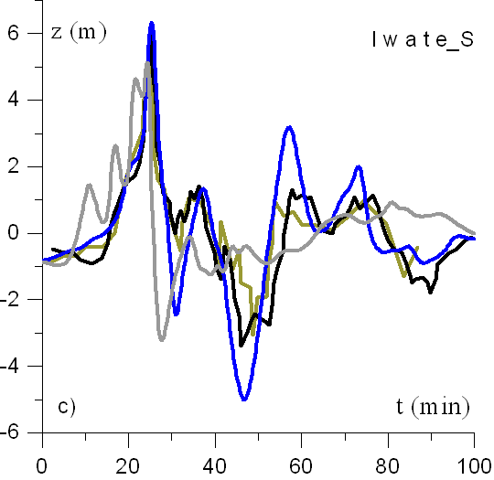
Tsunami heights simulated by COASTOX-UN for tsunami source model corresponded both to [Fuji et al., 2011] (grey line) and [Muhari et al.2012] (blue solid line).
TUNAMI-N2 simulated results [Muhari et al.2012] are denoted by green solid line.

Slide 33
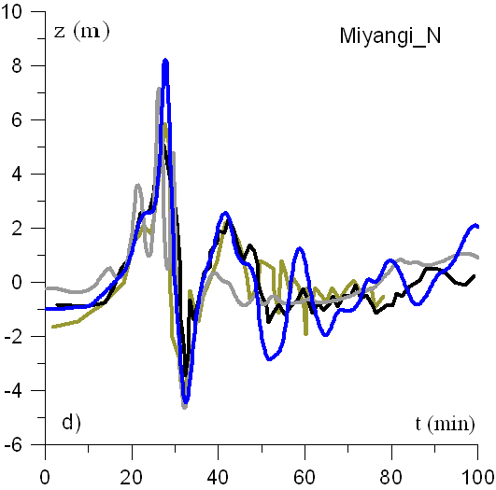
Tsunami heights simulated by COASTOX-UN for tsunami source model corresponded both to [Fuji et al., 2011] (grey line) and [Muhari et al.2012] (blue solid line).
TUNAMI-N2 simulated results [Muhari et al.2012] are denoted by green solid line.

Slide 34
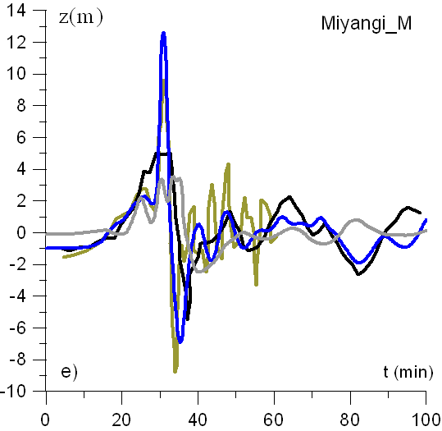
Tsunami heights simulated by COASTOX-UN for tsunami source model corresponded both to [Fuji et al., 2011] (grey line) and [Muhari et al.2012] (blue solid line).
TUNAMI-N2 simulated results [Muhari et al.2012] are denoted by green solid line.

Slide 35
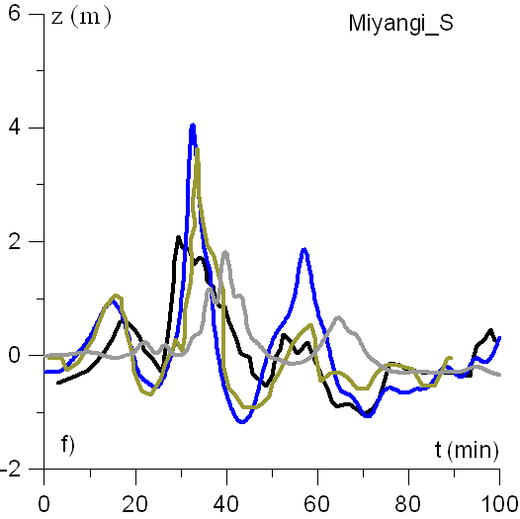
Tsunami heights simulated by COASTOX-UN for tsunami source model corresponded both to [Fuji et al., 2011] (grey line) and [Muhari et al.2012] (blue solid line).
TUNAMI-N2 simulated results [Muhari et al.2012] are denoted by green solid line.

Slide 36
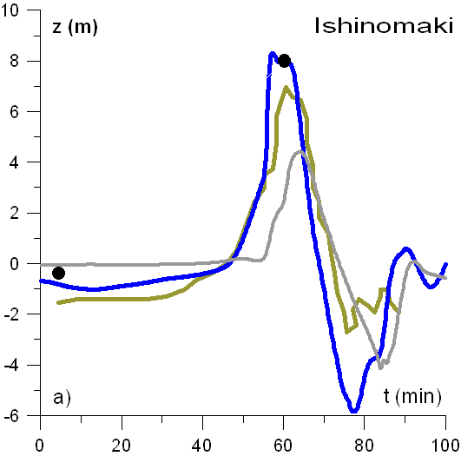
Tsunami heights simulated by COASTOX-UN for tsunami source model corresponded both to [Fuji et al., 2011] (grey line) and [Muhari et al.2012] (blue solid line).
TUNAMI-N2 simulated results [Muhari et al.2012] are denoted by green solid line. Data (•) are experimental data [Muhari et al., 2012] at tide gauges locations (slide 20).

Slide 37
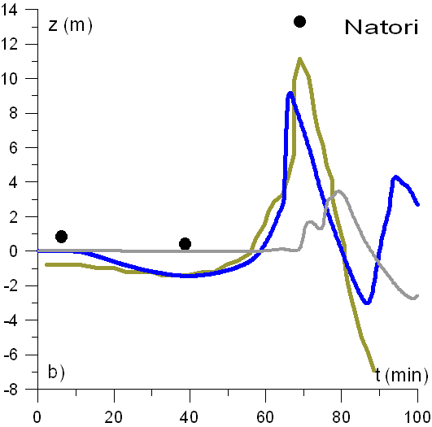
Tsunami heights simulated by COASTOX-UN for tsunami source model corresponded both to [Fuji et al., 2011] (grey line) and [Muhari et al.2012] (blue solid line).
Green solid line and (•) are TUNAMI-N2 simulated results and experimental data respectively [Muhari et al., 2012] at tide gauges locations (slide 20).

Slide 38
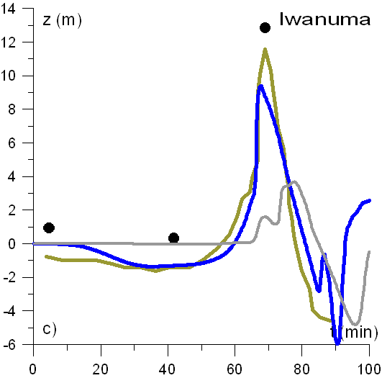
Tsunami heights simulated by COASTOX-UN for tsunami source model corresponded both to [Fuji et al., 2011] (grey line) and [Muhari et al.2012] (blue solid line).
Green solid line and (•) are TUNAMI-N2 simulated results and experimental data respectively [Muhari et al., 2012] at tide gauges locations (slide 20).

Slide 39
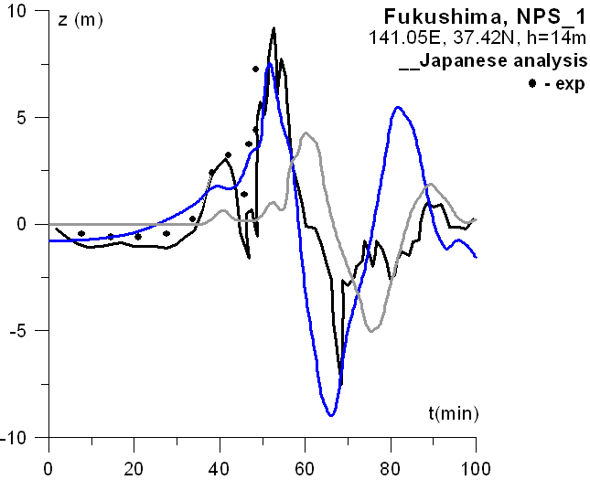
Tsunami heights simulated by COASTOX-UN.
Black solid line is Japanese analysis data, black points (• • •) are measured data [Gardner, 2013].

Slide 40
Tsunami runup in the area
Fukushima Daiichi NPP (FD-1) and Fukushima Daiini NPP (FD-2) protection walls were overtopped. The site of FD-1 was overtopped by flood height at 6.5 m , the site of FD-2 registered water maximum height was at 4.5 m ( TEPCO Fukushima Nuclear Accidents Investigation Report, Attachment, 2012) The nuclear accident at the flooded site of FD-2 was prevented through quick recovery of emergency power supply.
Protection walls at Onagawa NPP site has protected the NPP site, in situation of at 15 m height at the coast ( T.Sasagawa, R.Hirata, 2012).
The area of Sendai airport has been submerged.
The COASTOX -UN modeling results are presented in the next slides

Slide 41
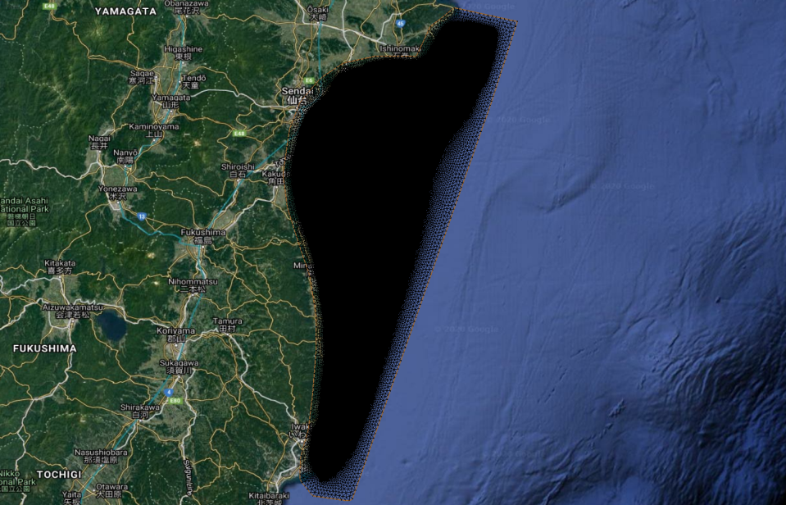
Sendai Bay mesh: 2 million cells, average size – 100 m.

Slide 42
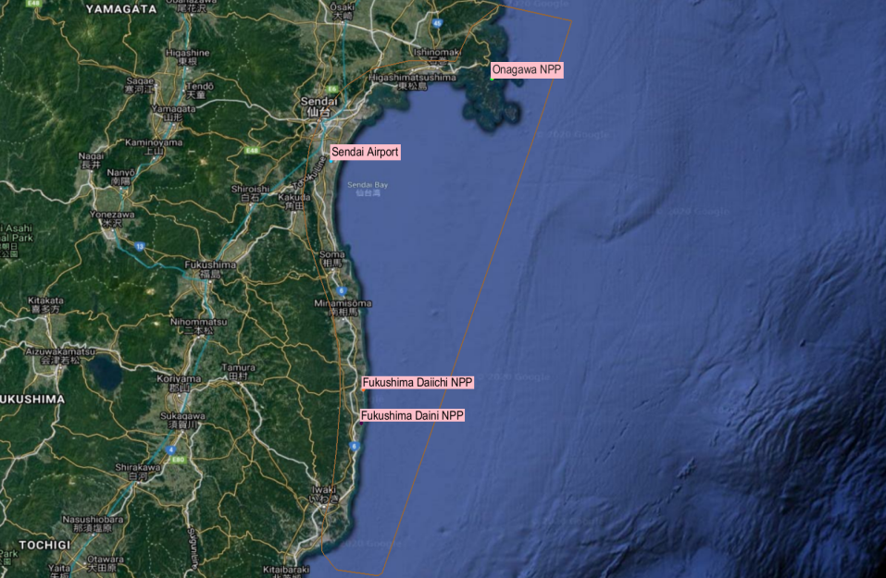
Sites of FD-1 , FD-2 , Onagawa NPP, Sendai Airport.

Slide 43
In the following slides, results for NPP sites and Sendai airport will be presented in the form of animations – low quality due to size restrictions :( – and graphs.
Animations will be present as a map of Water Displacement – change of water level from initial conditions (in meters).
Each site will be provided with a graph of Water Depth at measurement points indicated by color-coded dots:
Fukushima Daiichi – orange
Fukushima Daini - purple
Onagawa – green
Sendai Airport – cyan

Slide 44
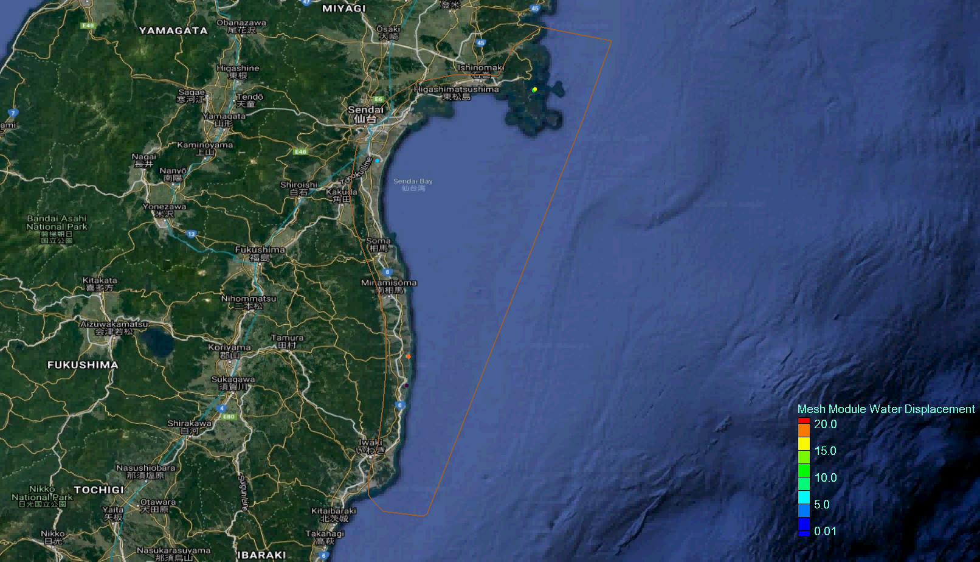
Sendai Bay, Water Elevation

Slide 45
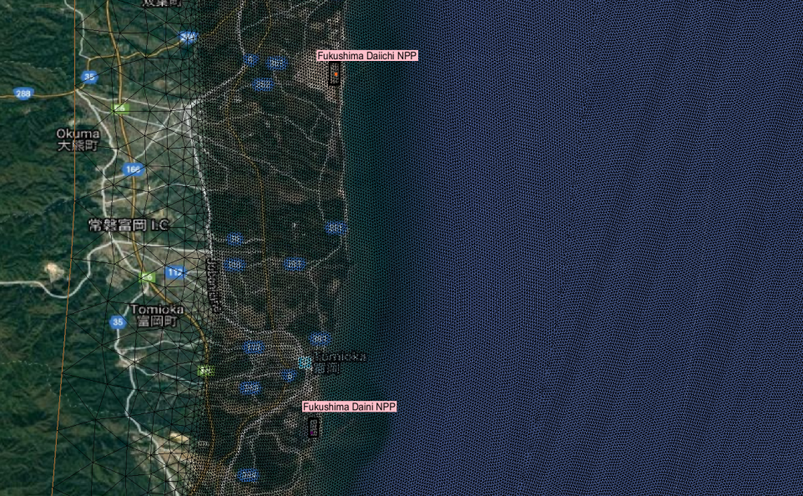
Grid near FD-1 and FD-2 . Cell size – 100 m.

Slide 46
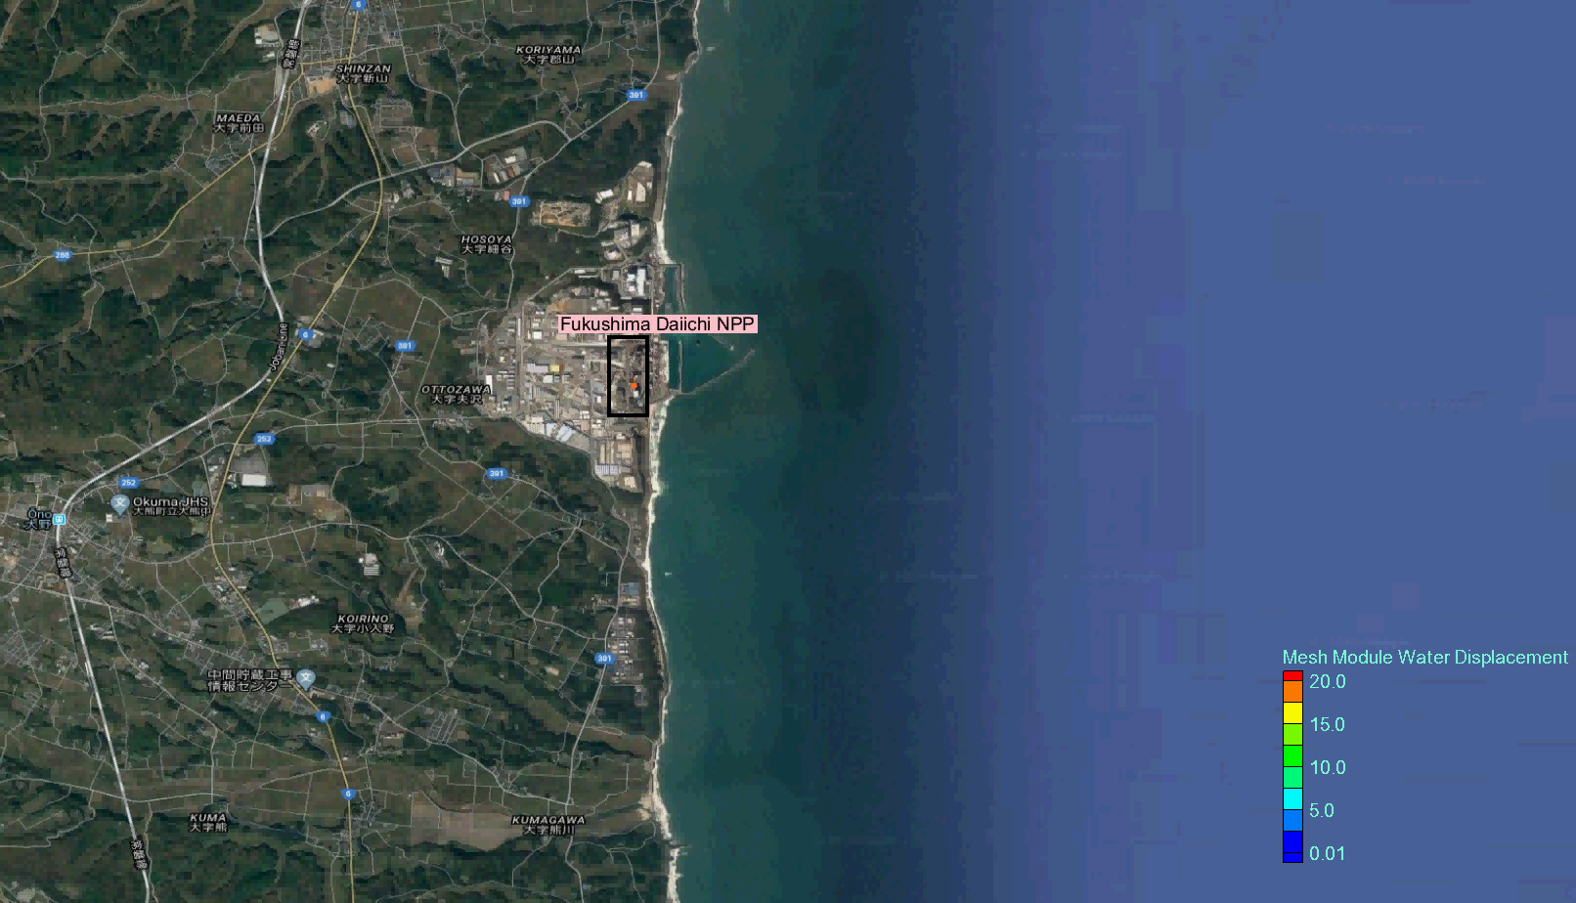
Fukushima Daiichi NPP site , Animation water elevation
red point, temporal dynamics of water depth presented below

Slide 47
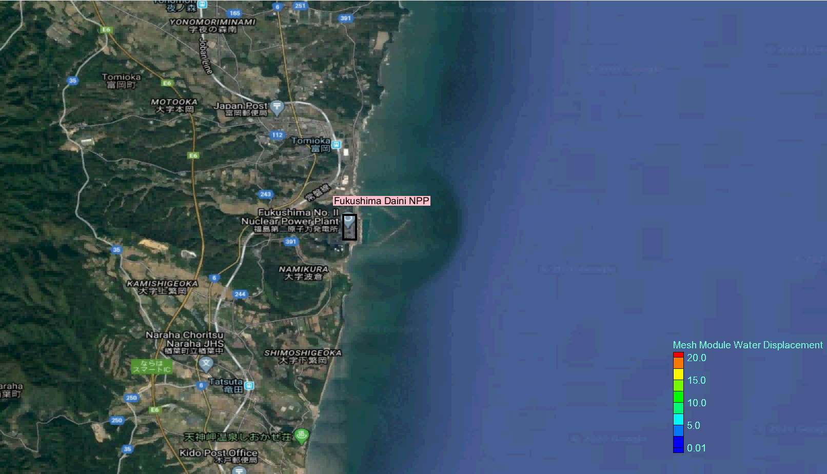
Fukushima Daiini NPP site , Animation water elevation

Slide 48
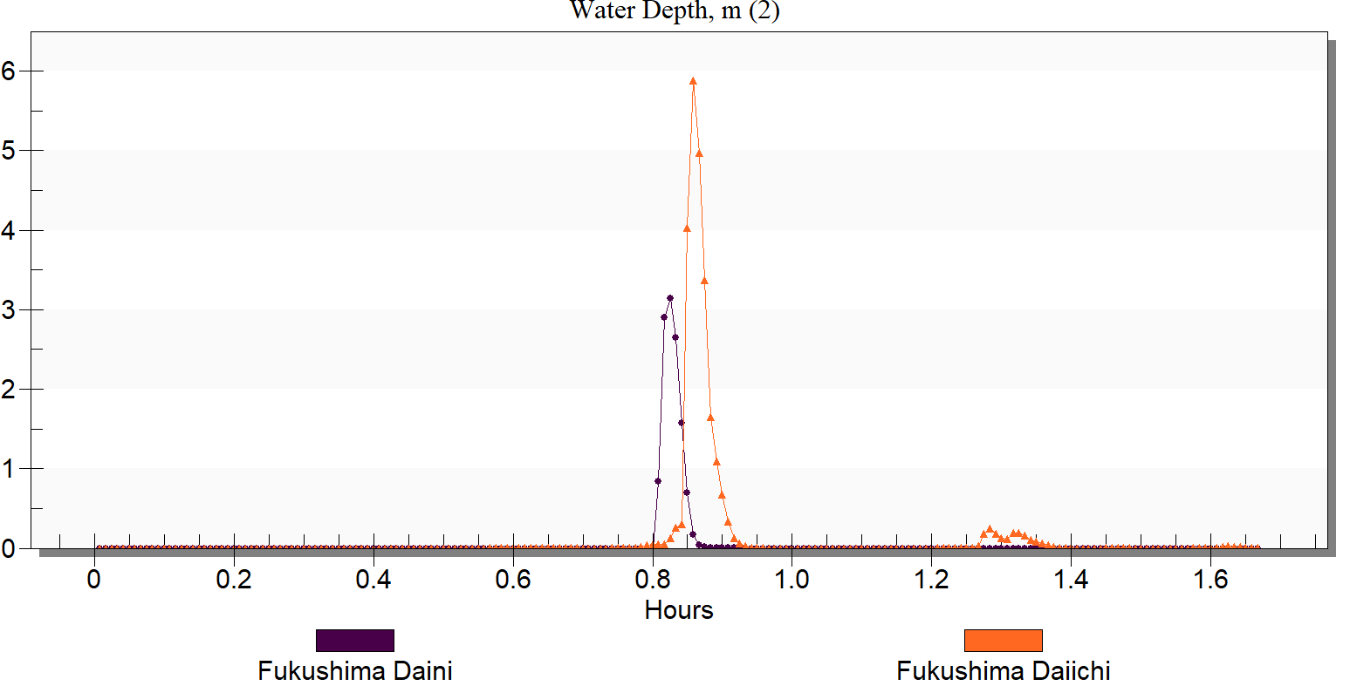
Time dynamics of Water Depth at measurement points, Fukushima Daiichi & Daini.

Slide 49
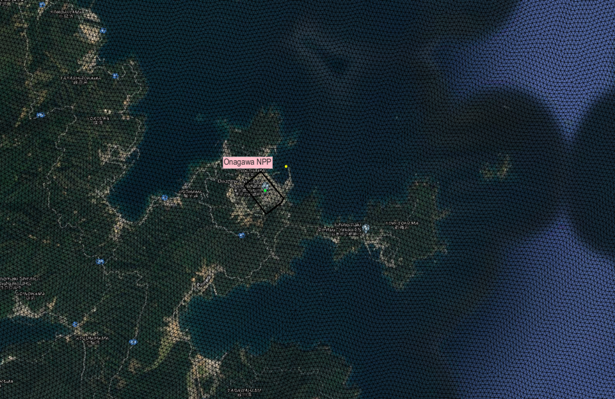
Grid at Onagawa NPP

Slide 50
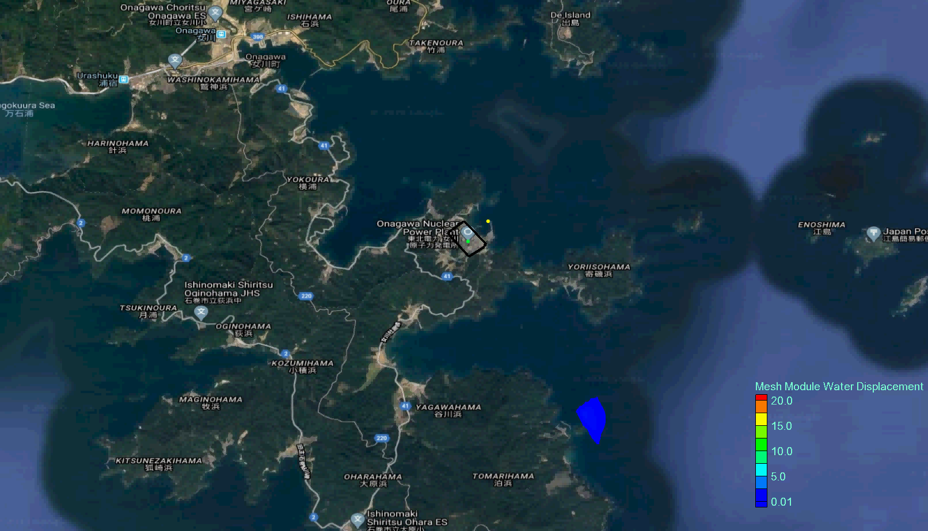
Onagawa NPP site , Water elevation

Slide 51
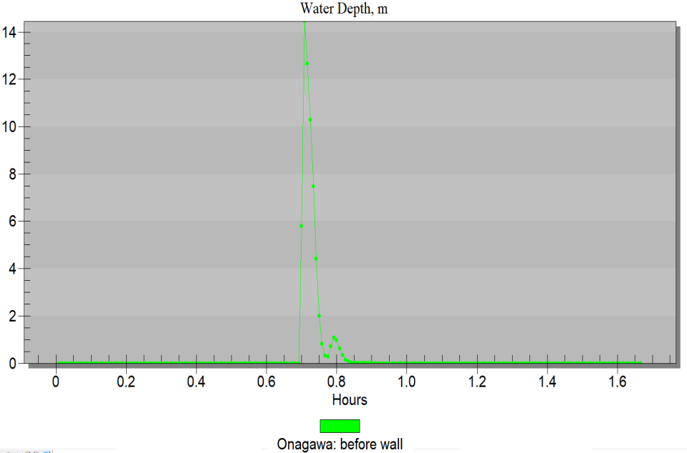
Time dynamics of Water Depth at measurement points, Onagawa NPP (behind protective barrier)

Slide 52
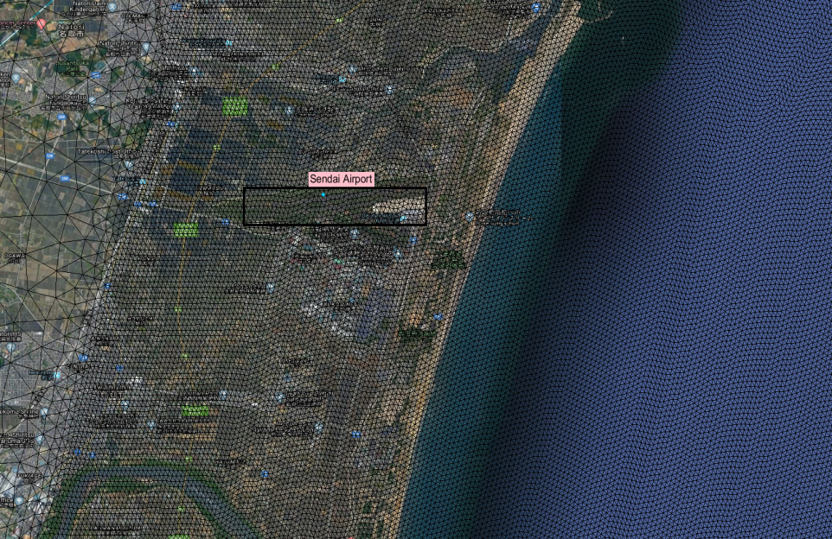
Mesh zoom near Sendai Airport.

Slide 53
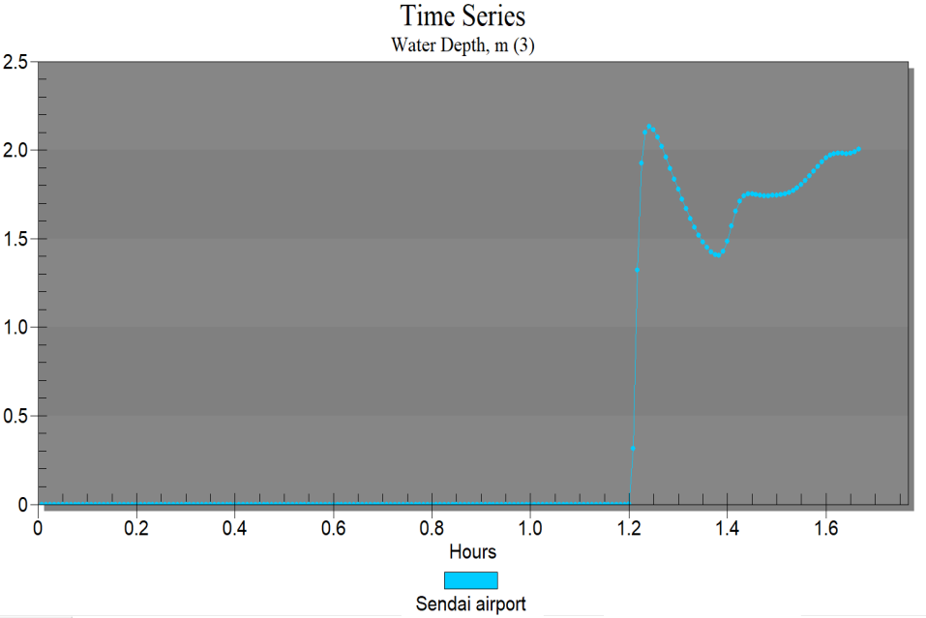
Time dynamics of Water Depth at measurement points, Sendai airport

Slide 54
Conclusions
COASTOX_UN numerical code based on the finite-volume solution of nonlinear SWE has demonstrated good efficiency fof the wetting-drying algorithm for modeling of the tsunami run-up at the sites of FD-1 , FD-2 and Onagawa NPPs: the modeling results of water height are in reasonable agreement with the recorder data.
Taking into account a large variability of the recorded data of the maximum water elevation at the FD-1 site and FD-2 site - more detailed analyses can be provided only using fine modeling grid and detailed site topography

