Slide 1
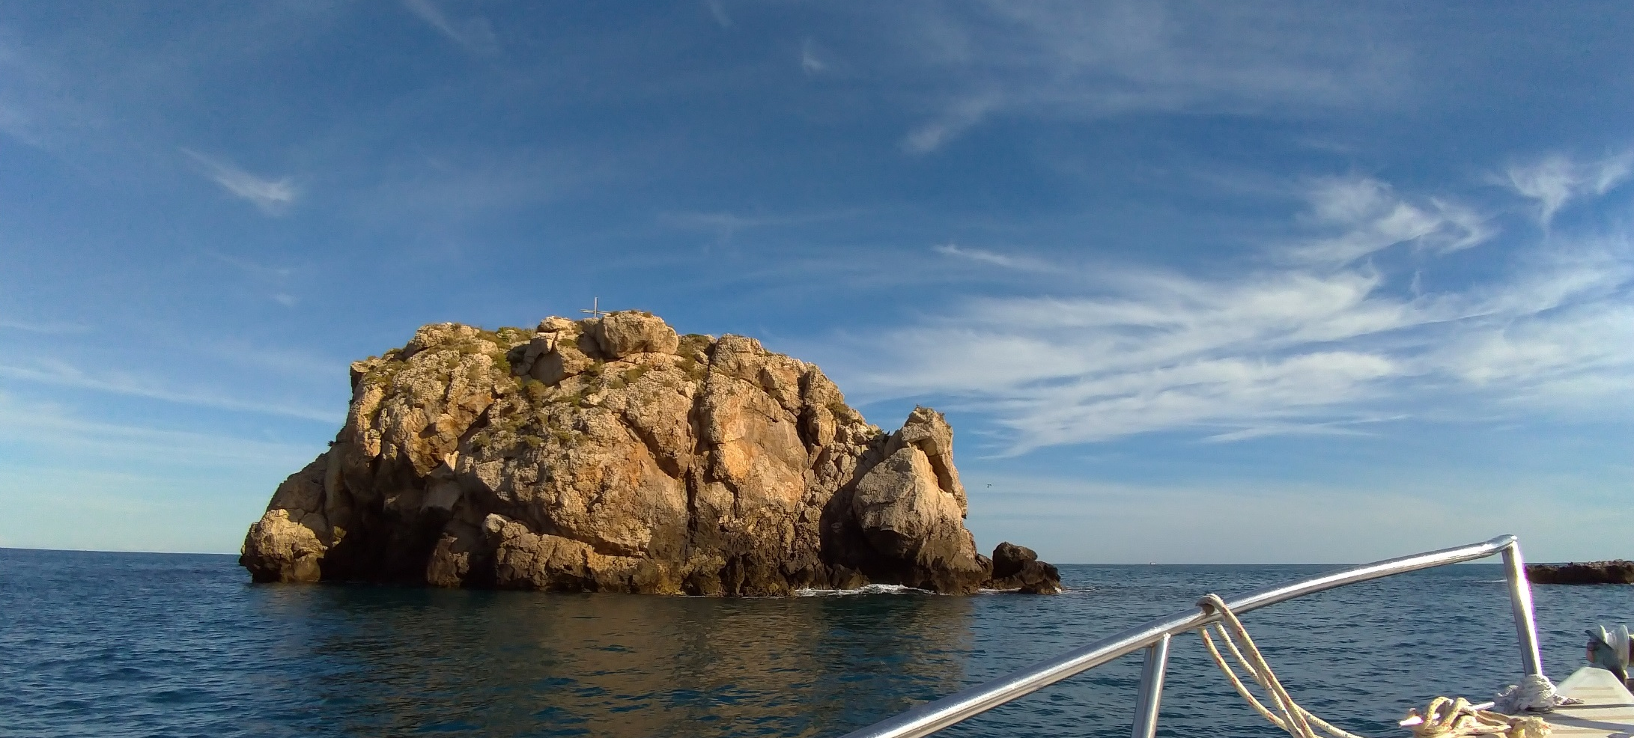
GEOMECHANICAL CHARACTERIZATION OF ROCK MASSES BY MEANS OF REMOTE SENSING TECHNIQUES
Lidia Loiotine^{1,2}, Marco La Salandra¹, Gioacchino Francesco Andriani¹, Giovanni Barracane¹, Marc-Henri Derron², Michel Jaboyedoff², Antonella Marsico¹, Mario Parise¹
1 Università degli Studi di Bari Aldo Moro, Dipartimento di Scienze della Terra e Geoambientali, Bari, Italy
2 Université de Lausanne, Institut des sciences de la Terre, Lausanne, Switzerland
Corresponding author: lidia.loiotine@uniba.it

Slide 2
Geomechanical characterization of rock masses by means of remote sensing techniques
AIM OF THE STUDY
Overcome the limits of conventional geomechanical and geostructural surveys for the characterization of rock masses (Barton et alii, 1974; Franklin et alii, 1988; Slob et alii, 2005; Poropat & Elmouttie, 2006) by means of remote sensing techniques (photogrammetry, Terrestrial Laser Scanning, Unmanned Aerial Vehicle).
Application of Structure from Motion techniques and management of point clouds for the geomechanical characterization within the framework of slope stability analyses.
NOTE: Due to the recent sanitary emergency, some planned activities had to be postponed. For this reason, during the confinement period, the study was focused on the advantages and limits of the applied technologies for a faster and more accurate structural analysis.
EGU General Assembly 2020

Slide 3
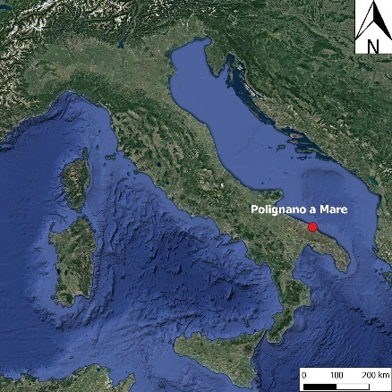
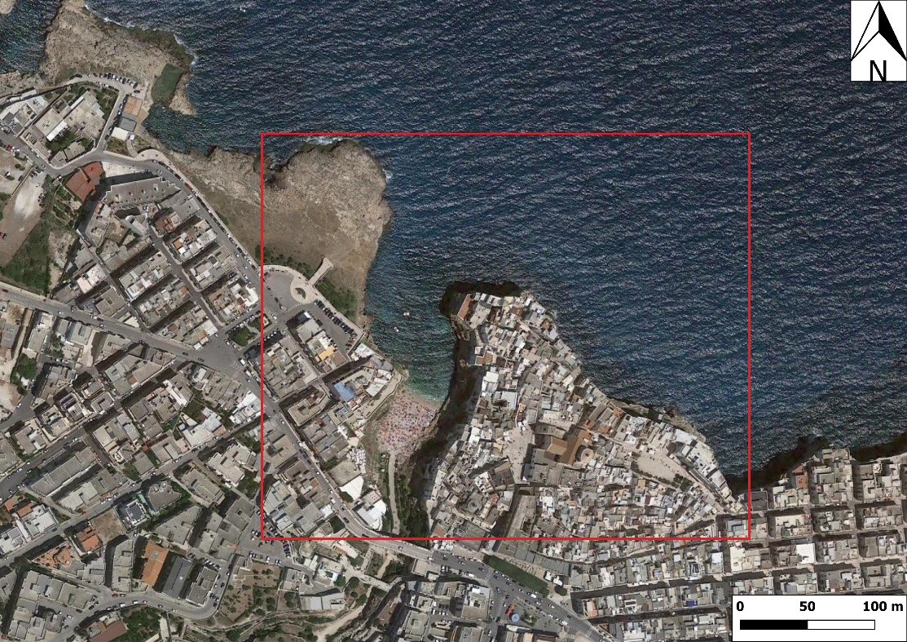
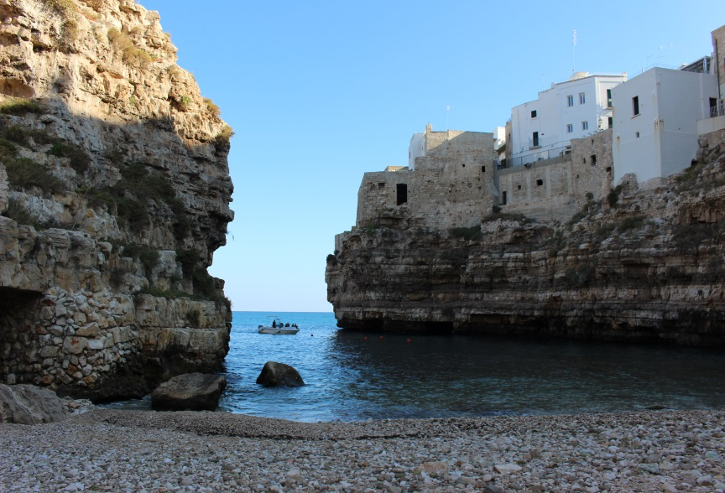
Geomechanical characterization of rock masses by means of remote sensing techniques
CHOICE OF THE CASE STUDY
Location: Lama Monachile (Polignano a Mare, Italy)
Cliff up to 20 m high made up of Calcarenite di Gravina Fm overlying Calcare di Bari Fm.
View of the complete stratigraphy.
Clearly visible discontinuities.
Possibility of performing conventional and remote sensing surveys by using the morphology of the site.
Social impact: presence of important historical buildings on the East side.
View of the East side of Lama Monachile
EGU General Assembly 2020

Slide 4
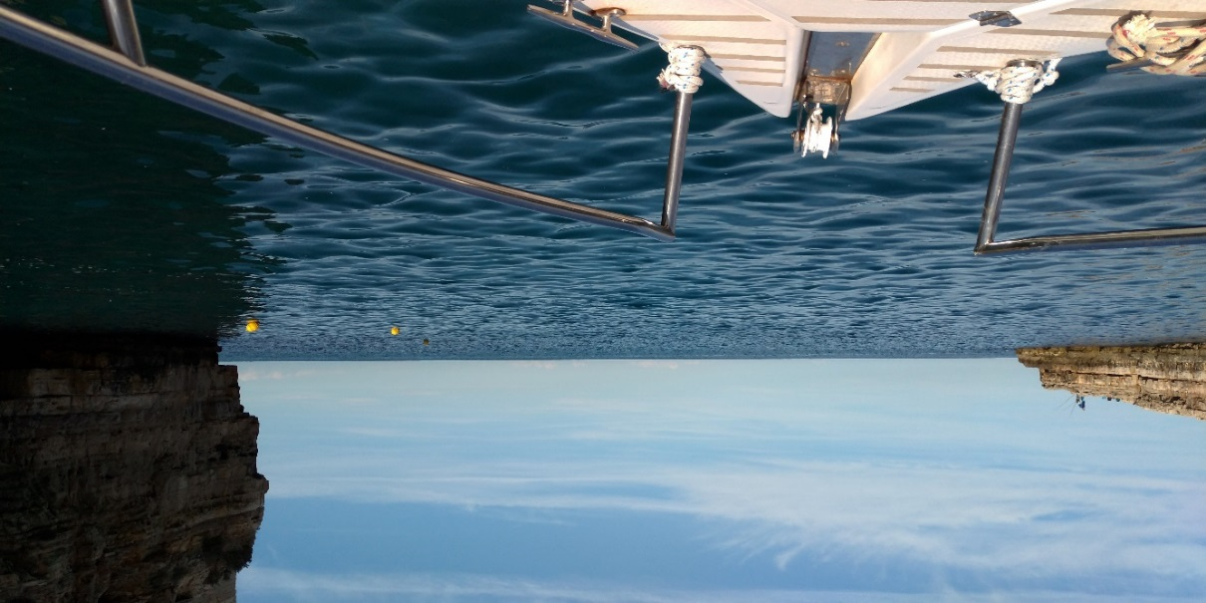
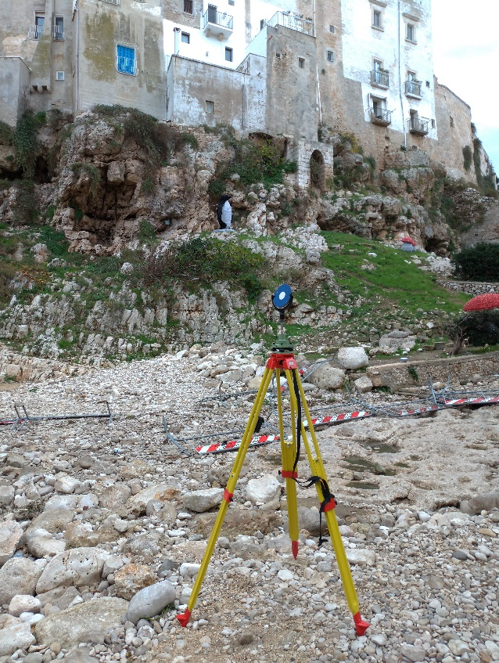
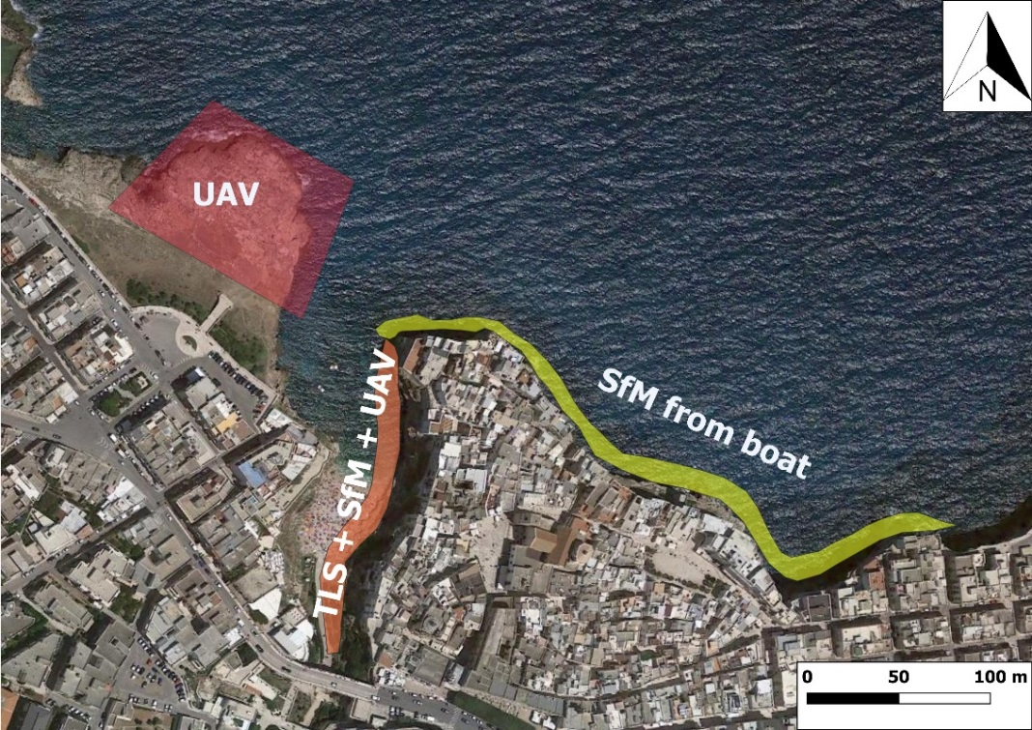
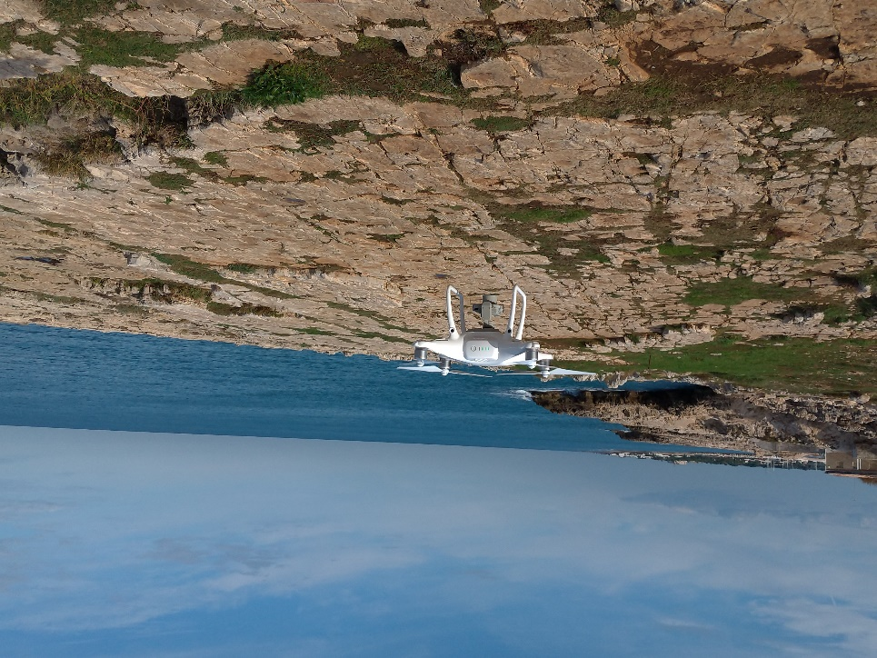
Geomechanical characterization of rock masses by means of remote sensing techniques
MATERIALS & METHODS
1. Acquisition
Photogrammetry: EOS Canon 100D
Terrestrial Laser Scanning:
Riegl VZ 400
Unmanned Aerial Vehicle: Phantom 4 Pro
EGU General Assembly 2020

Slide 5
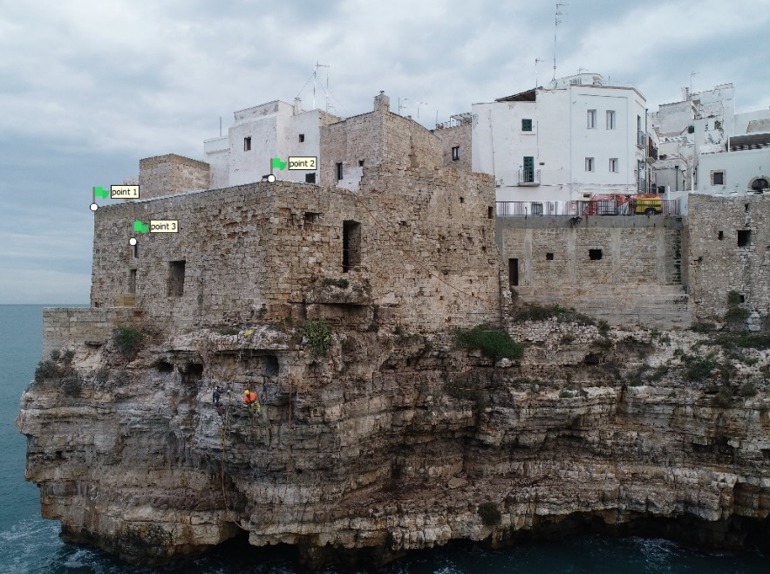
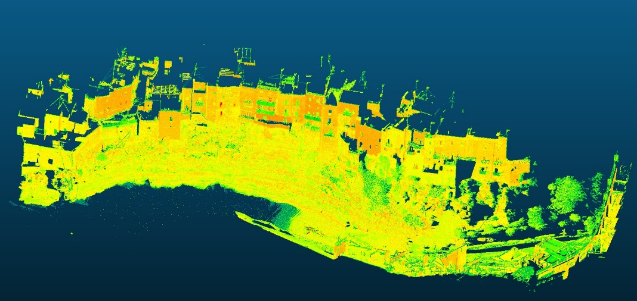
Geomechanical characterization of rock masses by means of remote sensing techniques
2. Processing
Subsampling,cleaning and georeferecing (WGS 84 UTM 33N) of the point cloud (PC) obtained by means of TLS technique
Structure from Motion (SfM) technique with Agisoft Metashape software
loading of photos
alignment and georeferencing
building of dense PCs + editing
building of meshes
generation of orthomosaics
EGU General Assembly 2020

Slide 6
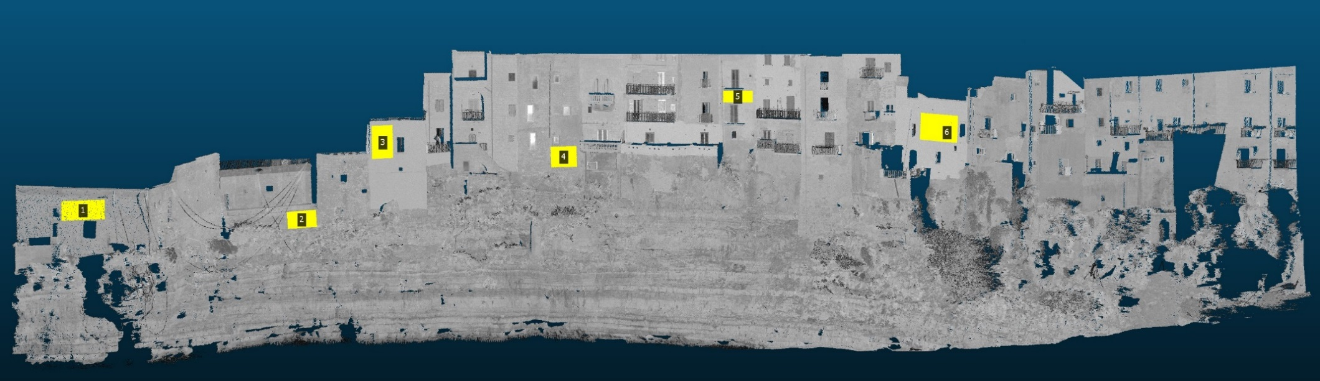
Geomechanical characterization of rock masses by means of remote sensing techniques
3. Assessment of the quality of the PCs with CloudCompare software
6 planes were fitted on each PC and the mean distance between a selected plane and the corresponding subset of the point cloud was calculated, as well as the statistical distribution (Gauss);
6 cross-sections perpendicular to the planes were drawn for each PC;
the PCs, at couples, were compared by activating the corresponding cross-sections and calculating the distances and statistics;
The PCs were compared at couples by using the Cloud to Cloud distance computation.
EGU General Assembly 2020

Slide 7
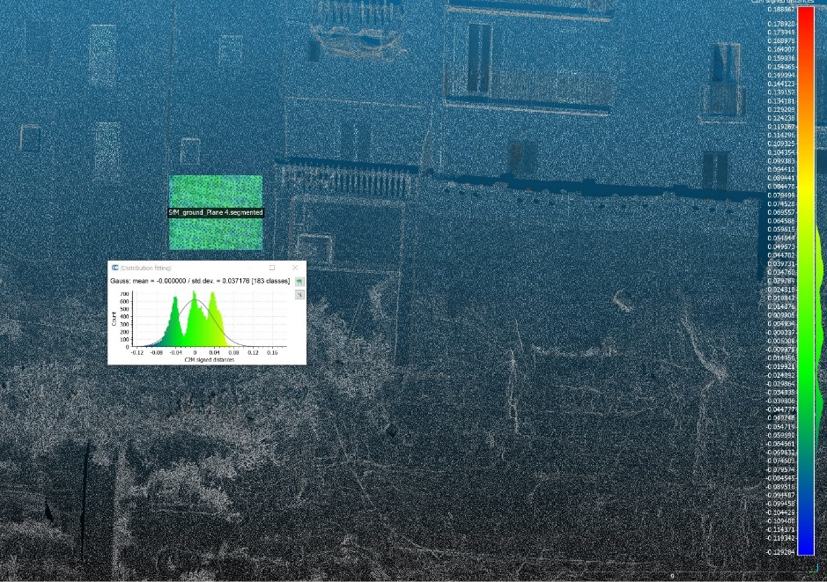
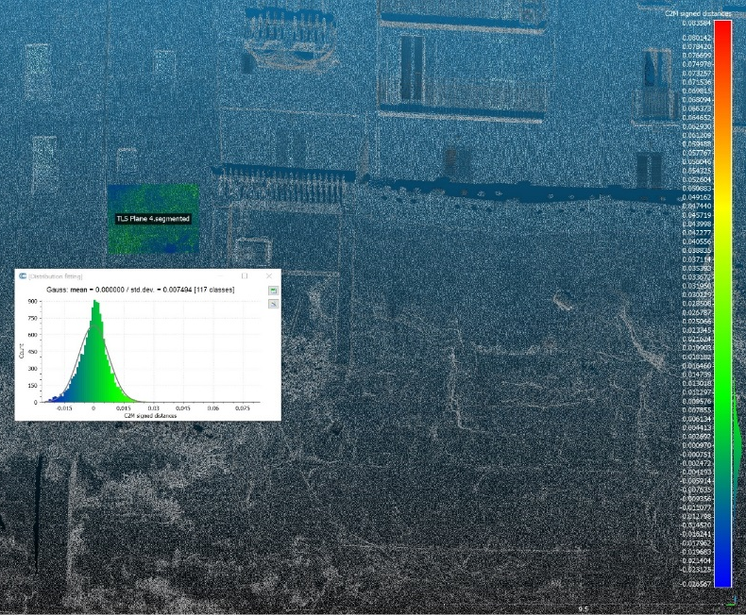
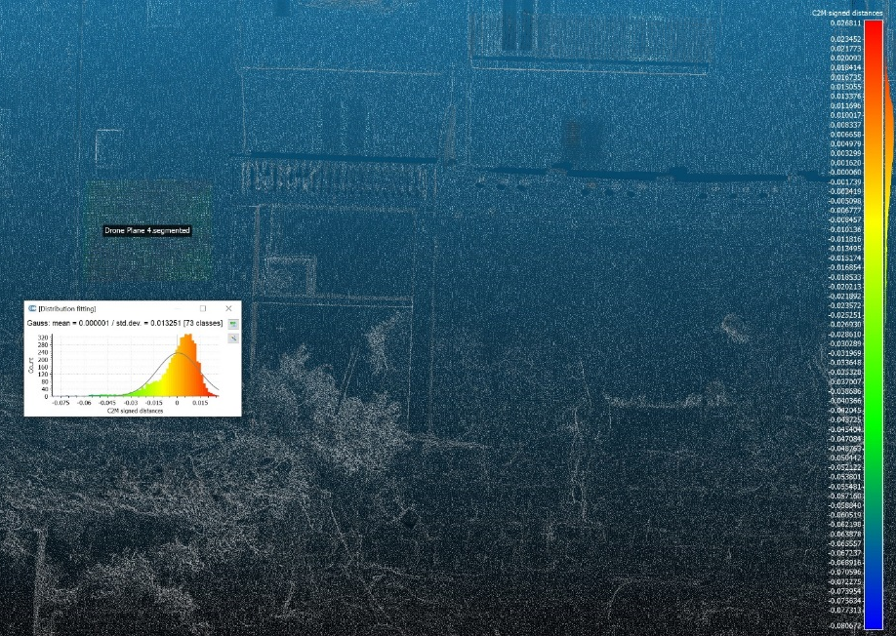
Geomechanical characterization of rock masses by means of remote sensing techniques
RESULTS
PC - digital camera
PC - TLS
PC - UAV
Mean distance = 0.000003 m
Standard deviation = 0.023340 m
Mean distance = 0.000000
Standard deviation = 0.007494 m
Mean distance = 0.000001 m Standard deviation = 0.013251 m
The PC obtained from photos taken manually has 3 peeks. This is related to considerable errors occurred during the application of the SfM technique.
On the contrary, the PCs obtained by means of TLS and UAV techniques are very accurate.
EGU General Assembly 2020

Slide 8
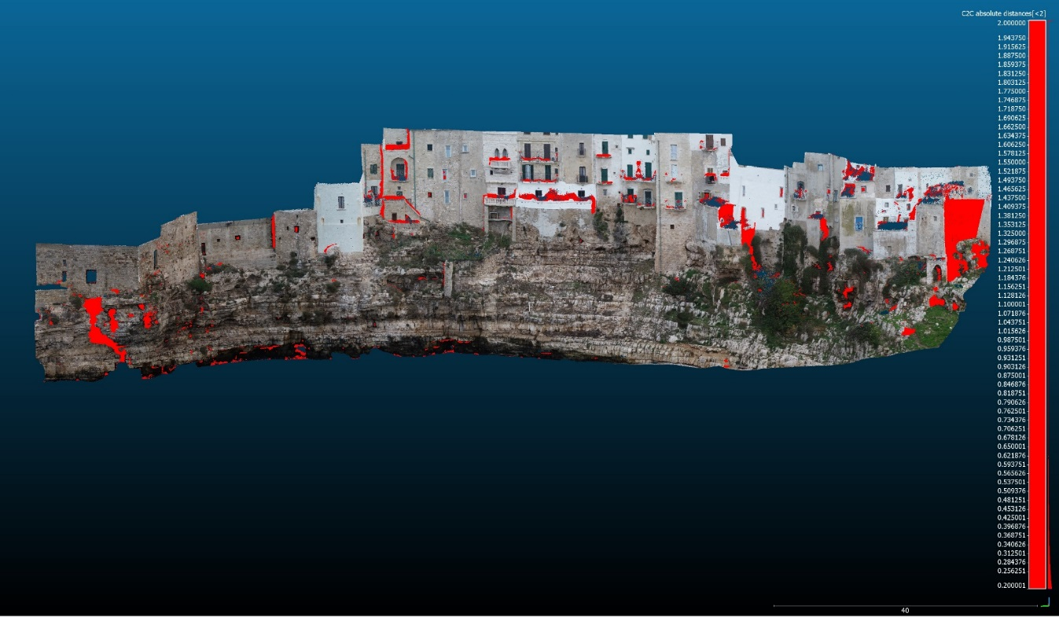
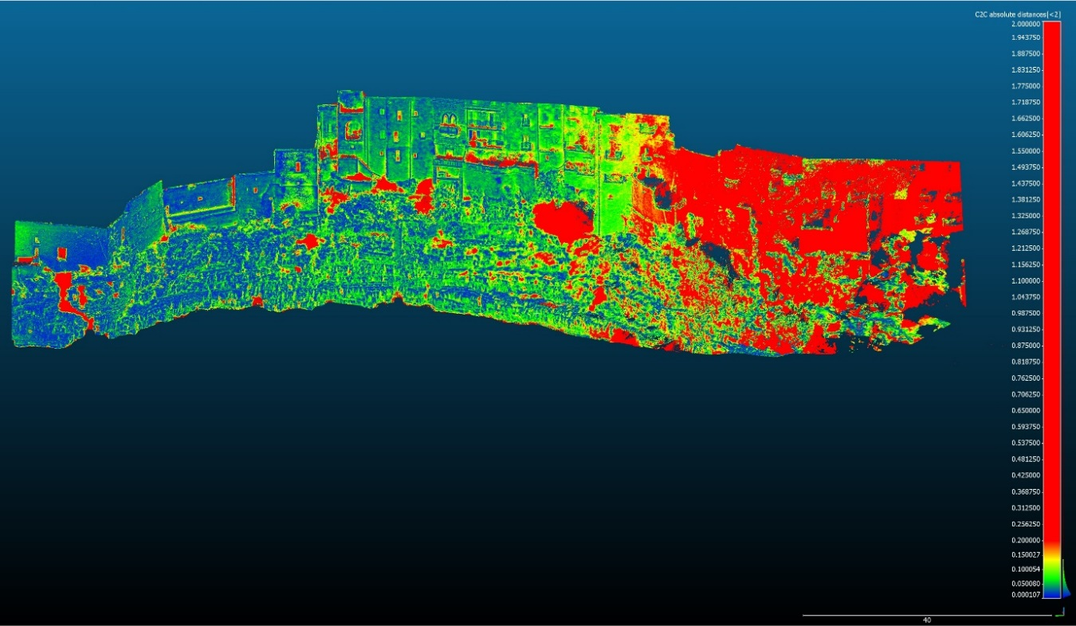
Geomechanical characterization of rock masses by means of remote sensing techniques
RESULTS
C2C distances: UAV (compared) -TLS (reference)
C2C distances: digital camera (compared) -TLS (reference)
Mean distance = 0.061185 Standard deviation = 0.112208 m
The red parts represent distances greater than 0.20 m
Mean distance = 0.118933 Standard deviation = 0.198242 m
The red parts represent distances greater than 0.20 m
EGU General Assembly 2020

Slide 9
Geomechanical characterization of rock masses by means of remote sensing techniques
FINDINGS
TLS and UAV techniques provided accurate models for the geostructural characterization of the case study, in contrast to the less reliable manual fotogrammetry.
The differences between the PCs of TLS and UAV methods are related to the presence of artifacts and vegetation. They are bot excellent tools for the characterization of rock masses.
TLS
PCs are more prone to the formation of shadow zones → more scans are needed.
The acquisition on outcrops facing the sea requires a dynamic system, which is rather complicated and expensive.
The RGB restitution is not enough accurate for the manual recognition of structures.
UAV
The authorizations for flying a drone are not always released.
A drone is capable of acquiring data with full coverage in different contexts: rock faces, plan areas and on the sea.
It is possible to create texturized meshes and more accurate orthophotos for the manual inspection of structures.
VS
EGU General Assembly 2020

Slide 10
Geomechanical characterization of rock masses by means of remote sensing techniques
Sometimes, one technique must be preferred to another depending on the morphology of the site. For example, if Lama Monachile had been narrower, the drone would not have been able to fly through it and return a complete model of the rock mass. In that case, the TLS technique would have been a good solution.
In complex areas, drones can lose the GPS signal and give distorted 3d models, as happened for Lama Monachile. The problem was largely solved during the SfM procedure by assigning to the photos some reference points, whose coordinates were taken from the PC of the TLS survey. With reference to the latter, few Ground Control Points and a GPS were sufficient to correctly georeference the PC obtained by the TLS technique.
The best results can be obtained by coupling the two methods. In fact, the geostructural analysis of the case study will be carried out:
1) by digitalizing the fracture systems on the ortophoto and applying statistical analyses;
2) by using semi-automatic procedures for the extraction of structures in rock masses. This will be done on the TLS point cloud because it is not affected by deformations.
EGU General Assembly 2020

Slide 11
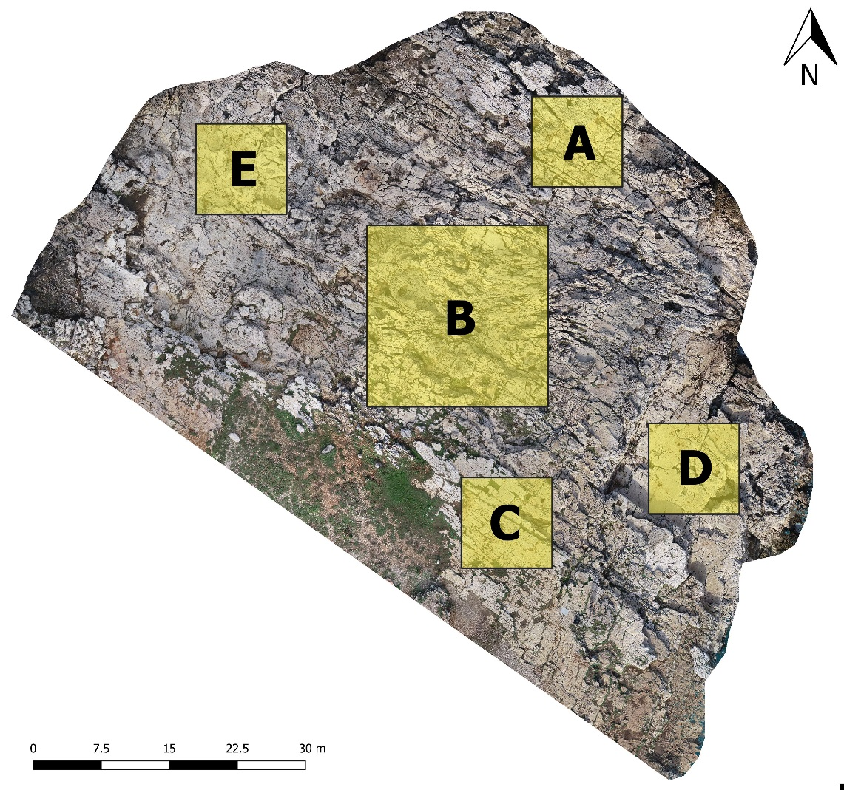
Geomechanical characterization of rock masses by means of remote sensing techniques
RECENT DEVELOPMENTS
The direct access to work stations was restricted because of the COVID-19 emergency → the analysis of the high resolution PCs was postponed.
In the meanwhile, the study was focused on the estimation and characterization of the fracture systems and on the identification of previous failures in the rock mass.
This was done by analyzing and processing the digital photos acquired by means of the UAV technique.
Concerning the identification of the fracture systems, an ortophoto of the plan area with a 0.005 m resolution was imported in a GIS software. 5 representative sub-areas were selected in different sectors of the rock mass and subjected to manual digitalization of the fractures.
EGU General Assembly 2020

Slide 12
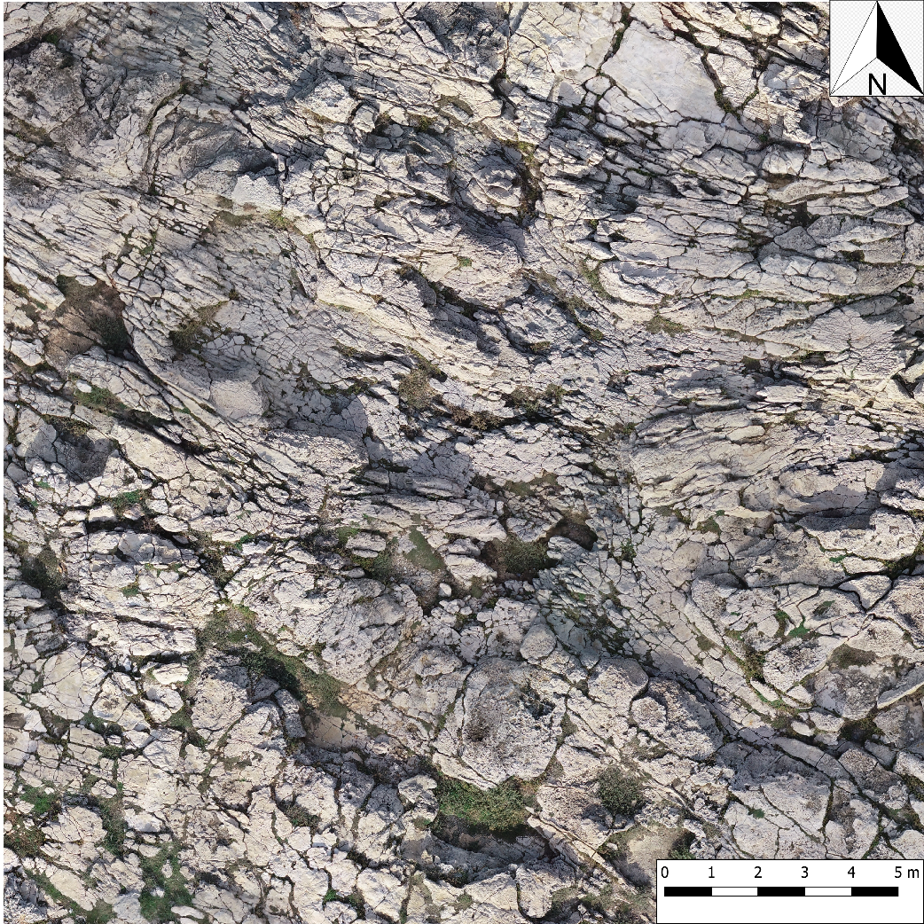
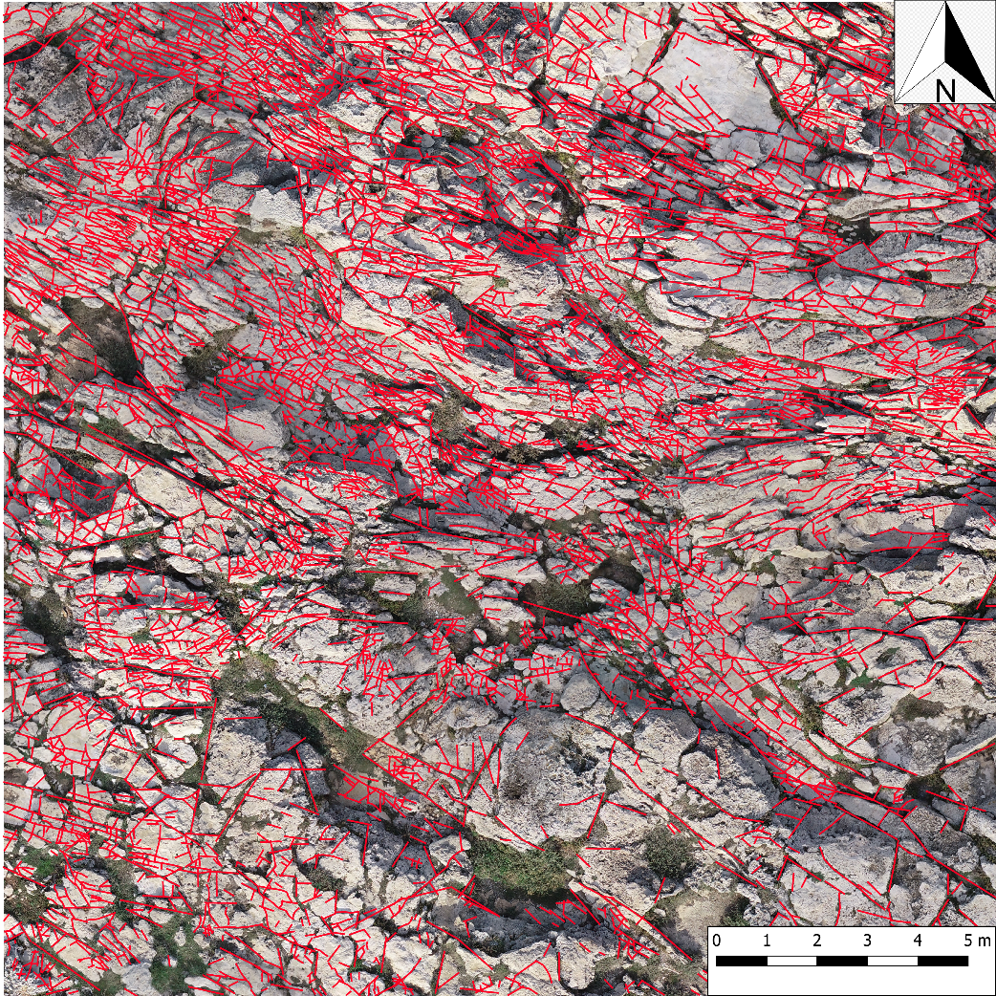
Geomechanical characterization of rock masses by means of remote sensing techniques
Example of manual digitalization on sub-area B (20x20 m²)
Number of traces: 5961 Number of segments: 9331
EGU General Assembly 2020

Slide 13
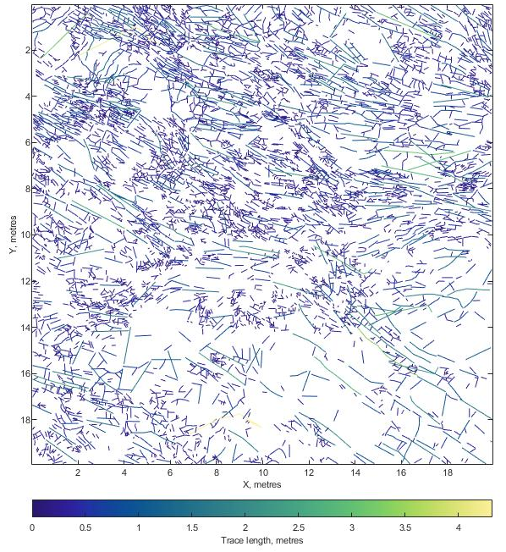
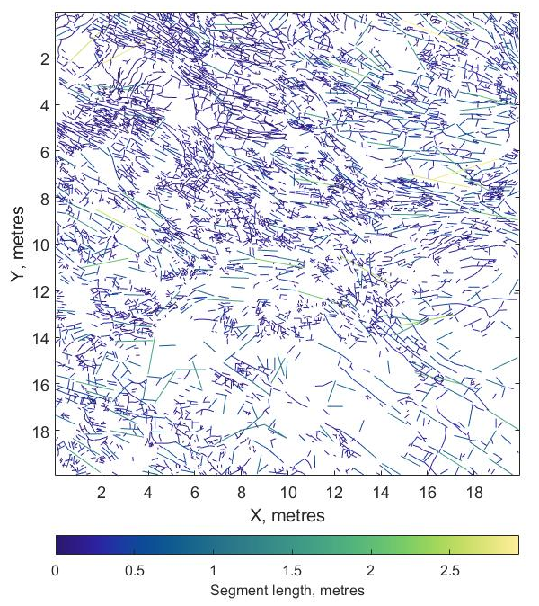
Geomechanical characterization of rock masses by means of remote sensing techniques
Subsequently, for each sub-area, the layer of the traces was converted to SVG format and imported in the FracPaQ software (Healy et alii, 2017) for the quantitative analysis of the fracture pattern.
Map of trace lengths
Map of segment lengths
Min. trace length | 0,02 m
Max. trace length | 4.32 m
Av. trace length | 0.31 m
Min. segment length | 0.00 m
Max. segment length | 2.94 m
Av. segment length | 0.20 m
EGU General Assembly 2020

Slide 14
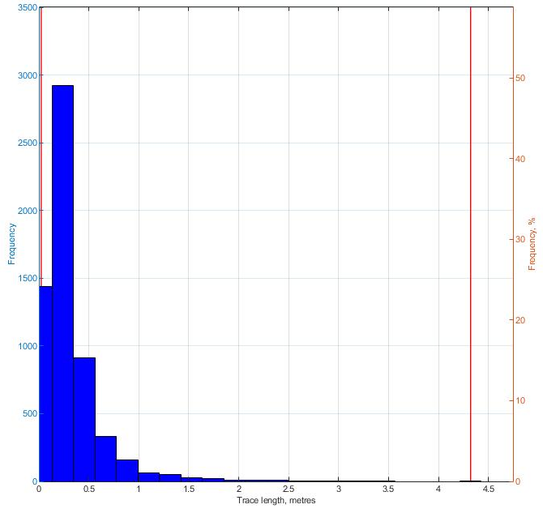
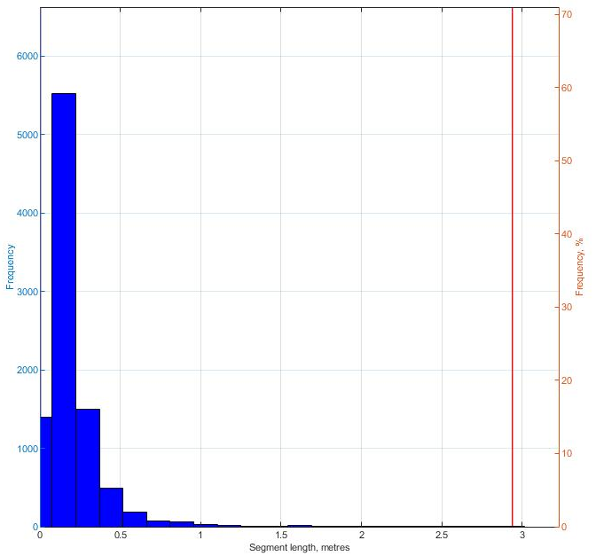
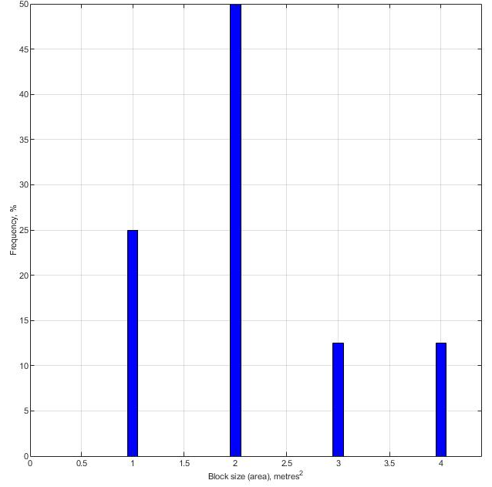
Geomechanical characterization of rock masses by means of remote sensing techniques
Histogram of trace lengths
Histogram of segment lengths
Histogram of block sizes
Note: block sizes are in m², since they were calculated through a 2D analysis.
Block volumes and shapes will be estimated by means of 3D analyses considering the spacing of discontinuity sets and the angles between them (Palmstrom, 2005).
EGU General Assembly 2020

Slide 15
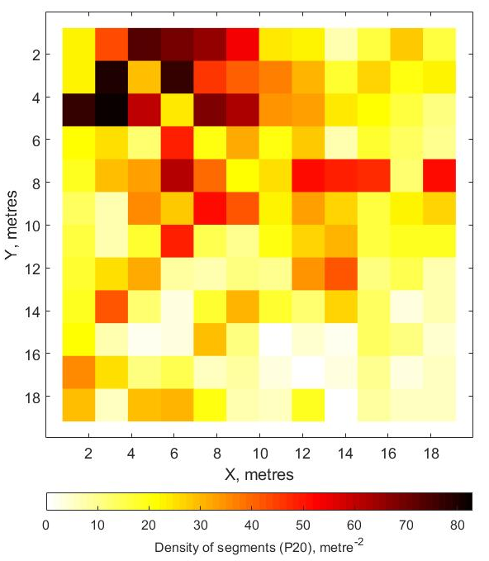
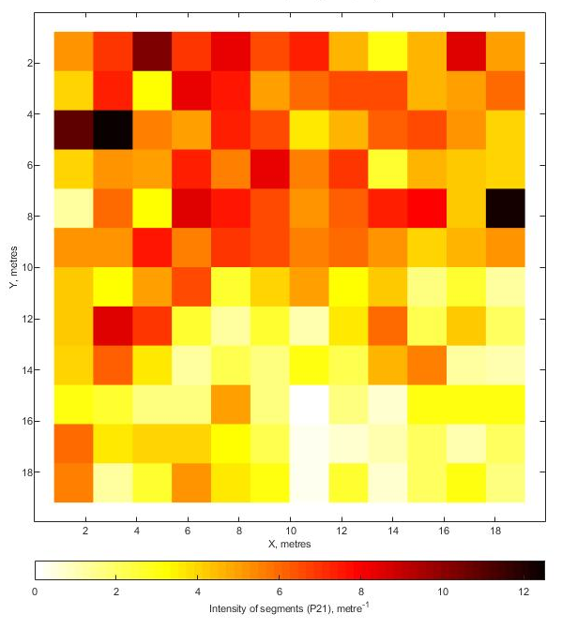
Geomechanical characterization of rock masses by means of remote sensing techniques
Estimated density of segments
Estimated intensity of segments
EGU General Assembly 2020

Slide 16
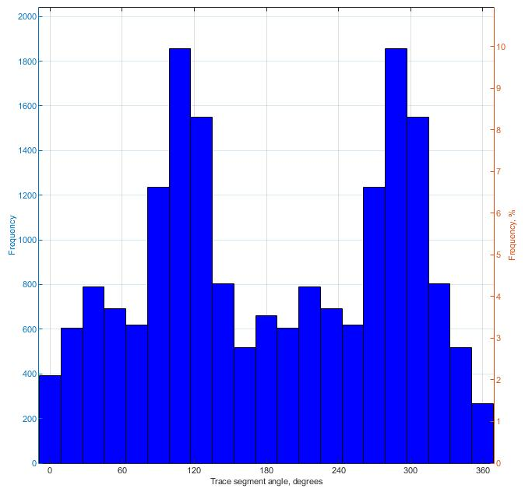
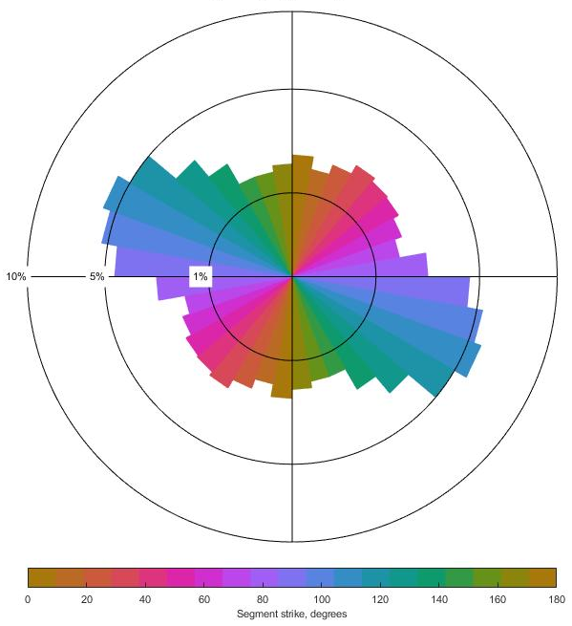
Geomechanical characterization of rock masses by means of remote sensing techniques
A random distribution of the segments, with major WNW-ESE and E-W trends, was estimated.
Histogram of angles
Rose diagram (equal area)
EGU General Assembly 2020

Slide 17
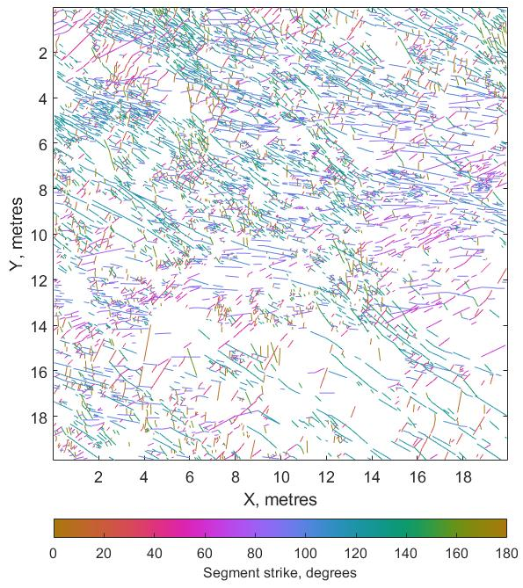
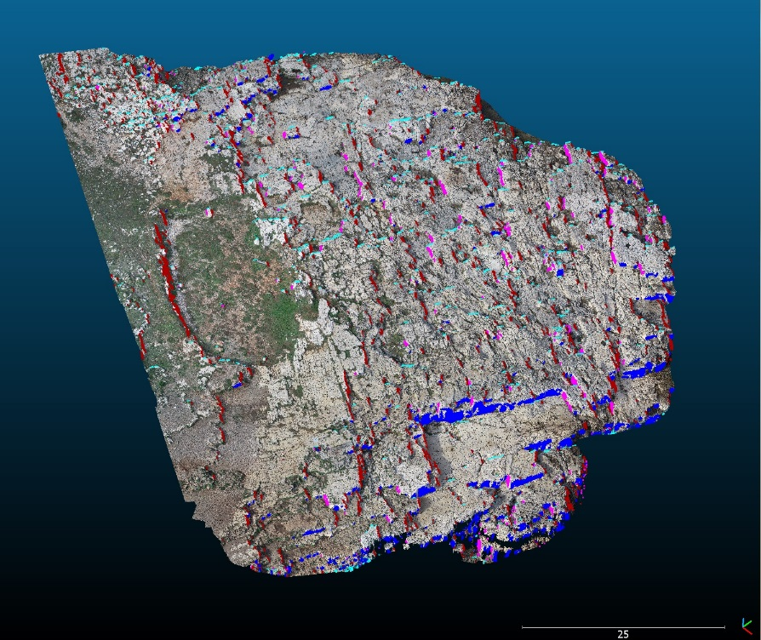
Geomechanical characterization of rock masses by means of remote sensing techniques
The discontinuity sets will be identified on the segment strike maps and individually imported in the MatterCliff software, for the evaluation of spacing, persistence and a detailed 2D statistical analysis of the spatial distribution.
The results will be compared and/or combined with the data obtained by means of semi-automatic procedures (i.e. Coltop3D software) (Jaboyedoff et alii, 2007; Matasci et alii, 2018) for the extraction of structures from PCs, in order to create a 3D model of the case study.
Eventually, relationships between fracture spacing, bed thickness and lithology will be estimated (Ladeira & Price, 1981).
Segment strike map
Approximate identification of the main discontinuity sets with Coltop3D
EGU General Assembly 2020

Slide 18
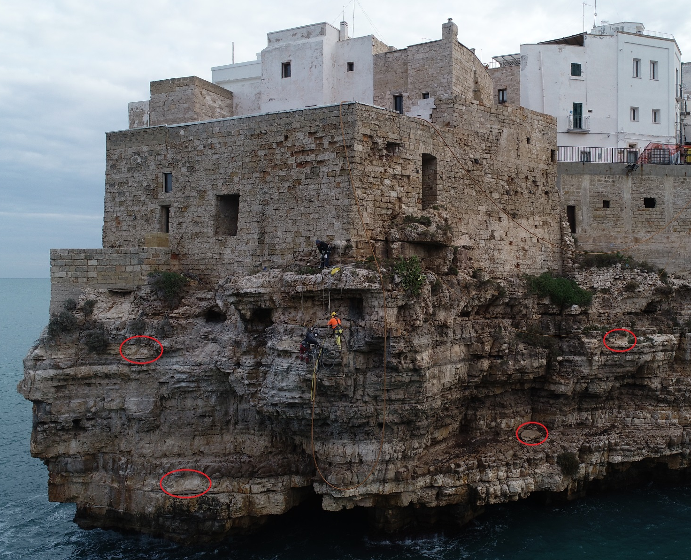
Geomechanical characterization of rock masses by means of remote sensing techniques
Previous failures in the rock mass were determined on the photos by identifying scars and deposits accumulated at the base of the cliff.
Note that some scars in the upper part of the cliff may have been intentionally caused by the urbanization of the area.
This will help in estimating future rockfall source areas, volumes involved and mechanisms of failure in a second phase of study, taking into account the physical and mechanical properties of the rock materials.
EGU General Assembly 2020

Slide 19
Geomechanical characterization of rock masses by means of remote sensing techniques
REFERENCES
Barton N., Lien R., Lunde J., 1974. Engineering classification of rock masses for the design of tunnel support. Rock Mechanics 6(4), 189-236.
Franklin J.A., Maerz N.H., Bennet C.P., 1988. Rock mass characterization using photoanalysis. Geotechnical and Geological Engineering 6 (2), 97-112. Poropat G. V., Elmouttie M. K., 2006. Automated structure mapping of rock faces. Proceedings of the Internation Symposium on Stability of Rock Slopes in Open Pit Mining and Civil Engineering Situations, 3-6.
Healy D., Rizzo R.E., Cornwell G.D., Farrell N.J.C., Watkins H., Timms N.E., Gomez-Rivas E., Smith M., 2017. FracPaQ: A MATLAB™ toolbox for the quantification of fracture patterns. Journal of Structural Geology, 95, 1-16.
Jaboyedoff M., Metzger R., Oppikofer T., Couture R., Derron M., Locat J., Turmel D., 2007. New insight techniques to analyze rock-slope relief using DEM and 3D-imaging cloud points: COLTOP-3D software. Rock Mechanics. Meeting Society's challenges and demands. Proceedings of the 1st Canada - U.S. Rock Mechanics Symposium, Vancouver, Canada, 27-61-78.
Ladeira F.L. , Price N.J., 1981. Relationship between fracture spacing and bed thickness. Journal of Structural Geology, 3 (2), 179-183.
Matasci B., Stock G.M., Jaboyedoff M., Carrea D., Collins B.D., Guérin A., Matasci G., Ravanel L., 2018. Assessing rockfall susceptibility in steep and overhanging slopes using three-dimensional analysis of failure mechanisms. Landslides, 15 (5) 859-878.
Palmstrom A., 2005. Measurements of and correlations between block size and rock quality designation (RQD). Tunnelling and Underground Space Technology.
Slob S., Van Knapen B., Hack R., Turner K., & Kemeny J., 2005. Method for Automated Discontinuity Analysis of Rock Slopes with Three-Dimensional Laser Scanning. Transportation Research Record, 1913(1), 187–194.
EGU General Assembly 2020

