Slide 1
Effect of decontamination on sediment discharge from mountain stream to river and cesium transfer in Yamakiya district
Fumiaki Makino¹, Yuichi Onda², Keisuke Taniguchi³, Slim Mitbaa⁴, Yoshifumi Wakiyama⁵, Hiroaki Kato², Shohei Kozuka¹, Sho Iwagami⁴
^{・1}University of Tsukuba, Japan
^{・2}Center for research in isotopes and environmental dynamics​
^{・3}Fukushima prefectural centre for enviromental creation
^{・4}Forest Research and Management Organization
^{・5}University of Fukushima, Japan

Slide 2
Introduction
On March 11, 2011, the TEPCO Fukushima Daiichi Nuclear Power Plant accident occurred. Due to the nuclear accident, ¹³⁷Cs was diffused into the atmosphere. Since ¹³⁷Cs that has landed on land is strongly fixed to soil particles, about 90% of it is distributed within 5 cm of the surface soil. Therefore, decontamination activities were conducted in Fukushima Prefecture from 2013 to 2015. Surface soil was stripped off in farmlands and forest floor litter was removed in forests. Due to the decontamination activities, much sediment flowed into the river.
Objective
Although decontamination activities have reduced air dose, the impact of transporting ¹³⁷Cs from forest areas to rivers has not been fully evaluated. In this study, based on long-term monitoring from 2011 to 2018, changes in river transport of ¹³⁷Cs in decontamination activities from forest areas to rivers were investigated.

Slide 3
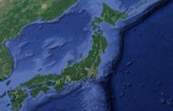
Study site Yamakiya district in Fukushima prefecture, Japan
Forest site
site1
site1
site3
site2
site2
Yamakiya district
http://josen.env.go.jp/en/progress/#special
 | Catchment area［km2］ | 137Cs inventory [kBq/m2] | Start measurement
Site1 Mt.Iboishi | 0.15 | 544 | Jun, 2011
Site2 Mt.Ishidaira | 0.1 | 298 | Jun, 2011
Site3 Mt.Setohachi | 0.048 | 759 | Dec, 2013
site3

Slide 4
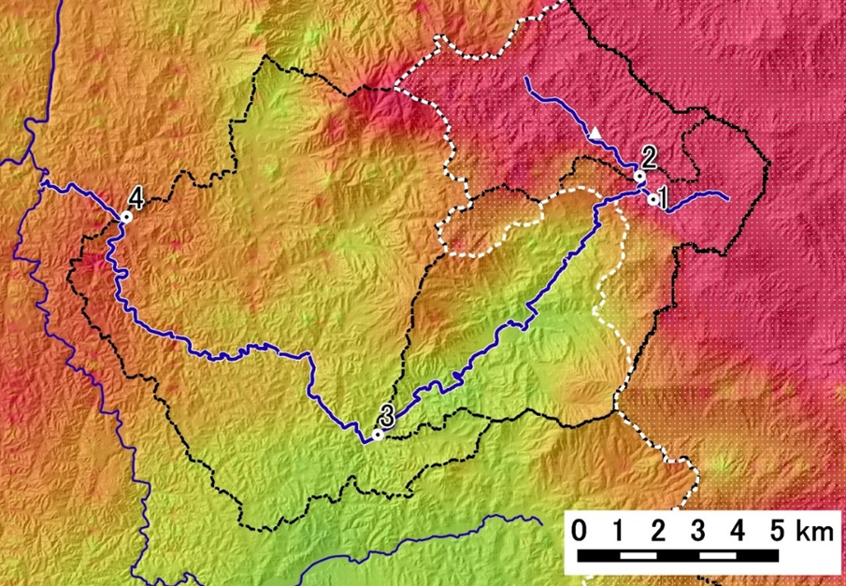
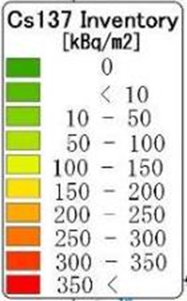
Study site Yamakiya district in Fukushima prefecture, Japan
River site
Site 1
Site 3
Site 2
Yamakiya district
Kuchibuto River
 | Watershed area［km2］ | 137Cs inventory [kBq/m2]
Site1 | 21.4 | 408
Site2 | 62.8 | 304
Site3 | 135 | 248

Slide 5
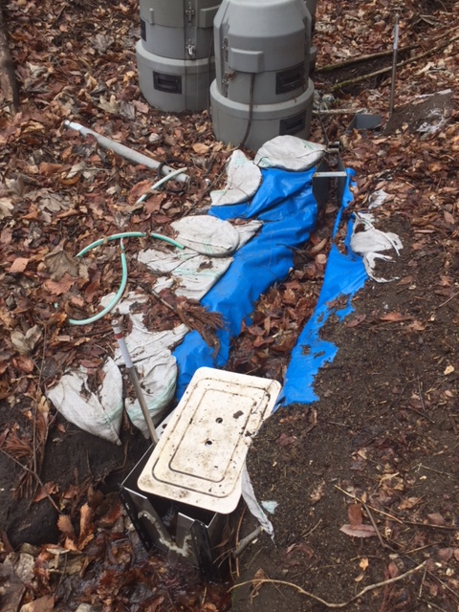
Sampling
Suspended sediment (SS) samplers were installed at the sites. Samples were collected once every few months. The samples were dried at 105℃ for 24 hours or lyophilized, and then measured for ¹³⁷Cs concentration [C (Bq kg⁻¹)]using a germanium semiconductor detector.
Calculation of SS and Cs-137 fluxes
-> Water level, turbidity data → Automatic monitoring (10-min. data)
-> Concentration of suspended solids (SS) [SSC (g/L)] and flow rate [Q (m3/s)] determined from turbidity data and water level data.
-> SS flux [Qss] Q × SSC
-> suspended ¹³⁷Cs flux C × Qss
installation

Slide 6
Results
Forest site
River site
Progress of
decontamination [%]
Rapid decline
Rapid decline
・As decontamination progresses, suspended cesium 137Cs concentration is decreasing.
・About one year after the ¹³⁷Cs concentration in the forest sites has declined, the ¹³⁷Cs concentration in the river sites has decreased. (Forest site Jun 2014, River site Sep 2015)

Slide 7
Decontamination map
name | Decontamination area[km2]
Farmland | 11.6
Forest | 2.51
Etcetera | 2.59
Total | 16.7
2013
2015
House
Park
institution
School
slope
Forest
Water
Farm land
road
2014
Decontamination was performed from 2013 to 2015 in the Yamakiya district.
Decontamination was carried out in earnest in 2013 and 2014. (2013 7.08km²、 2014 7.81km²)
The ratio of decontaminated area was 70% for farmland and 15% for forest.

Slide 8
Specific discharge in the largest rainfall of each year
2013
2015
Discussion
The impact of decontamination in forest areas appears in rivers about a year later.
Decontamination activities reduce air dose but tend to increase the specific flow to the river.
2014
2016
In 2013 and 2014, the specific flow rate was large at sites 2 and 3.
In 2015 and 2016, the site 1 specific flow rate was large.
From the graphs of 2013 and 2014, if decontamination is actively carried out in the upper stream of the river, the effects will appear in the middle and lower streams. When the decontamination activities settle down, the influence on the middle and lower reaches of the river will decrease.
Thank you for your attention!

