Slide 1
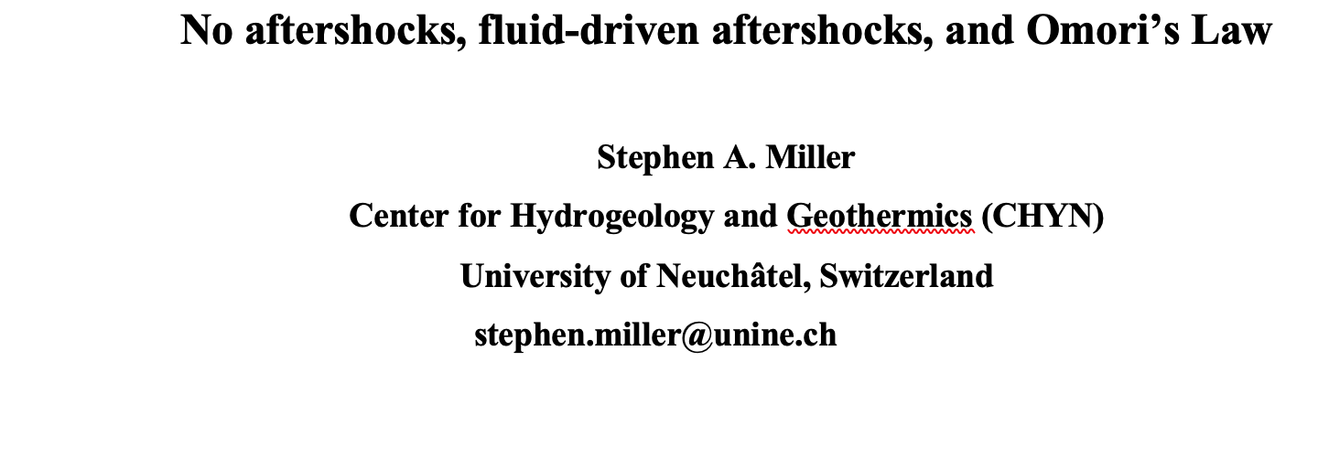
One aspect of earthquake physics not adequately addressed is why some earthquakes generate many thousands of aftershocks while other earthquakes generate few, if any, aftershocks. It also remains unknown why the empirical Omori Law, or one of its many variations, describes most aftershock sequences decaying at rates approximately as 1/time. In this work, I show that these two are linked, with a dearth of aftershocks reflecting the absence of high-pressure fluid sources at depth, while rich and long-lasting aftershock sequences reflect tapping high pressure fluid reservoirs that drive aftershock sequences. Using a physical model that captures the dominant aspects of permeability dynamics in the crust, I show that the model generates superior fits to observations than Omori’s Law, and find a functional relationship between aftershock decay rates and the tectonic ability to heal the co- and post-seismically generated fracture networks. These results can be used to interpret other observations such as seismic velocity recovery, attenuation and migration.

Slide 2
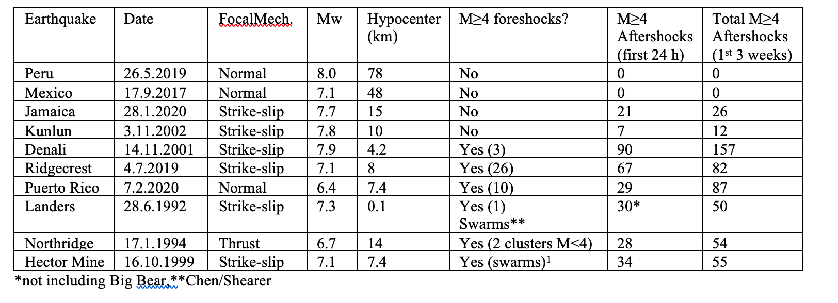
Comparison of different earthquakes and their aftershocks

Slide 3
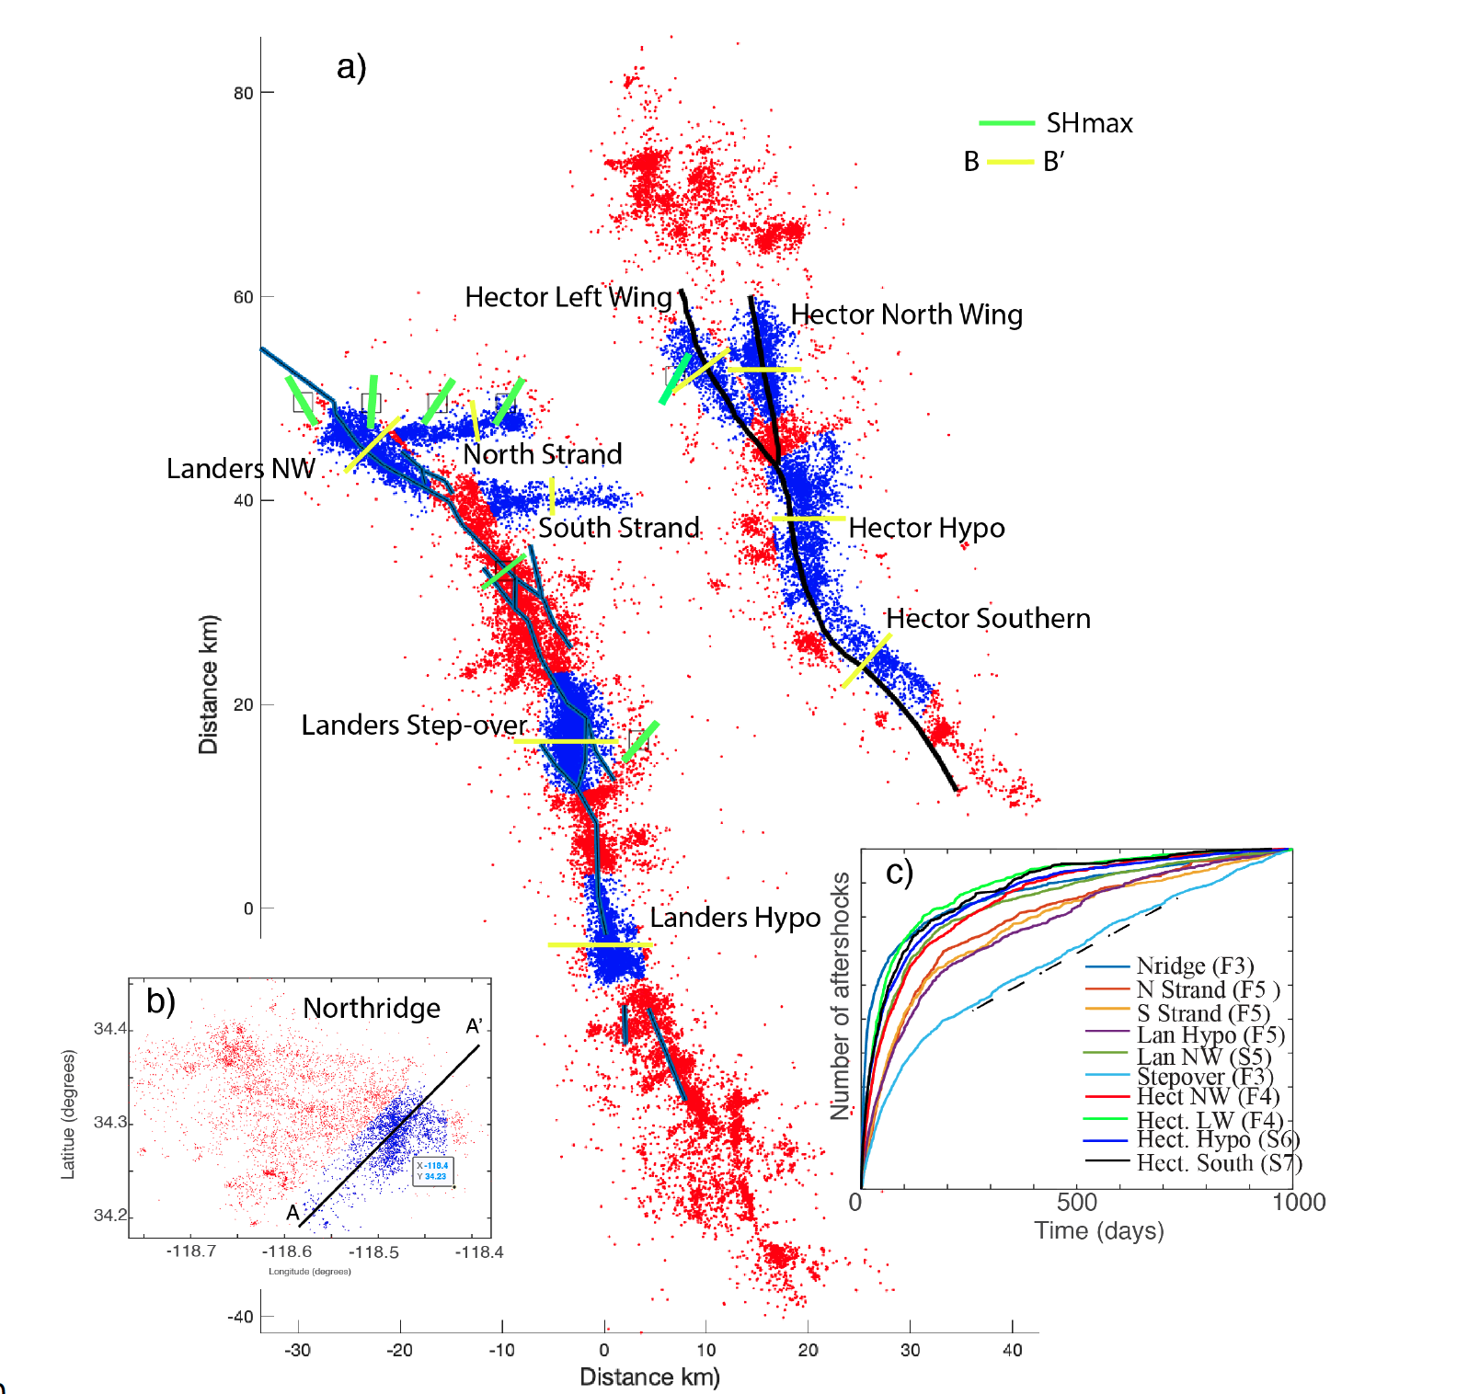
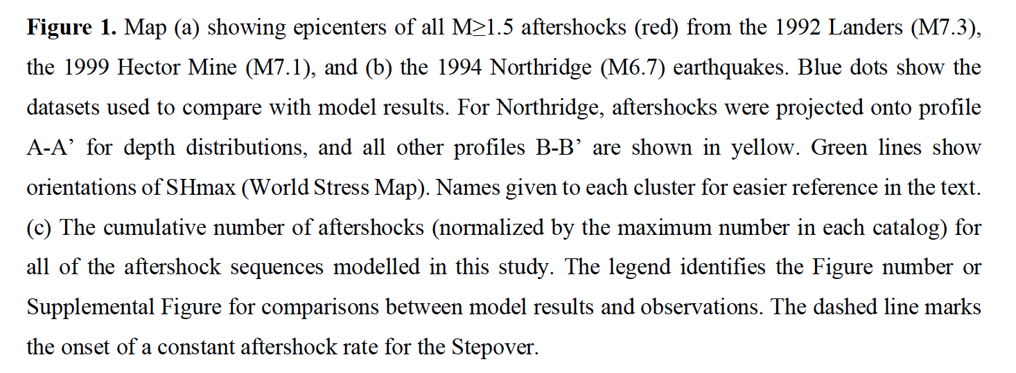

Slide 4
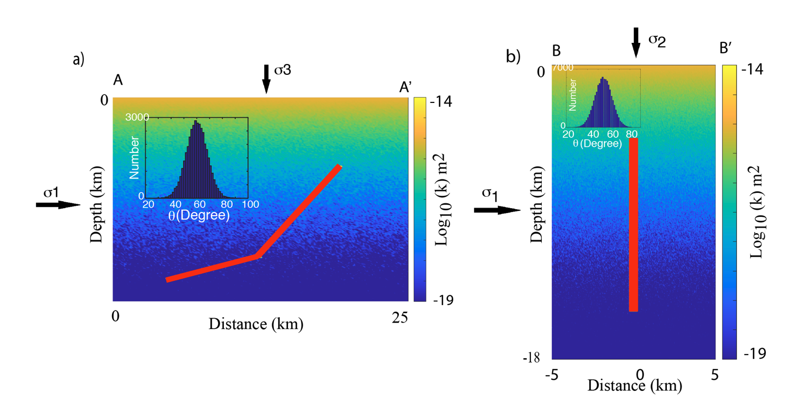

Slide 5
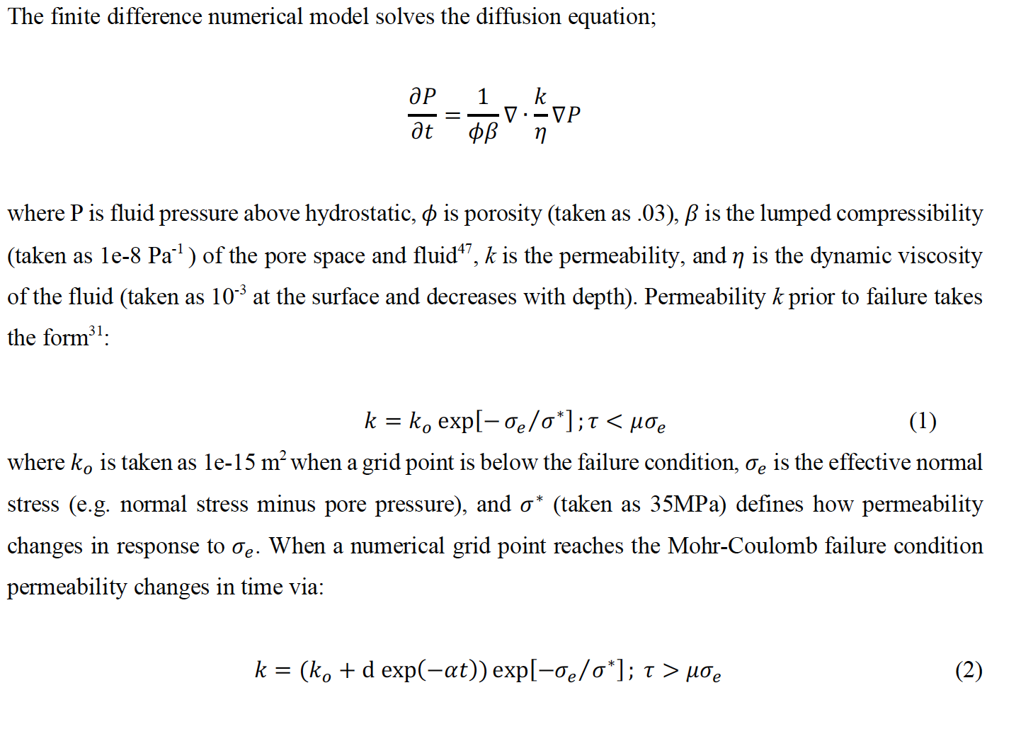

Slide 6
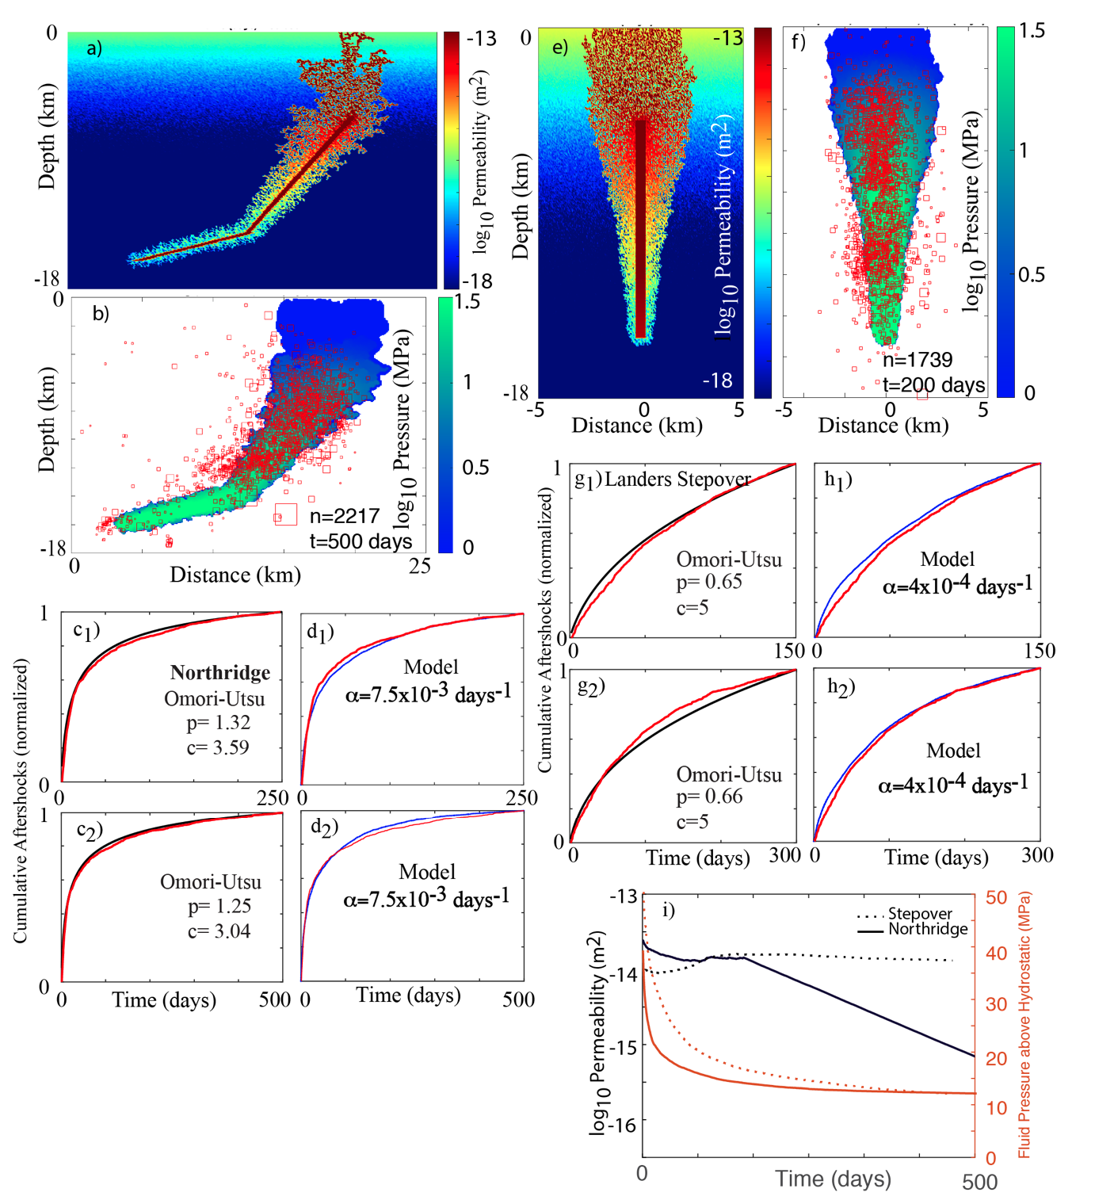
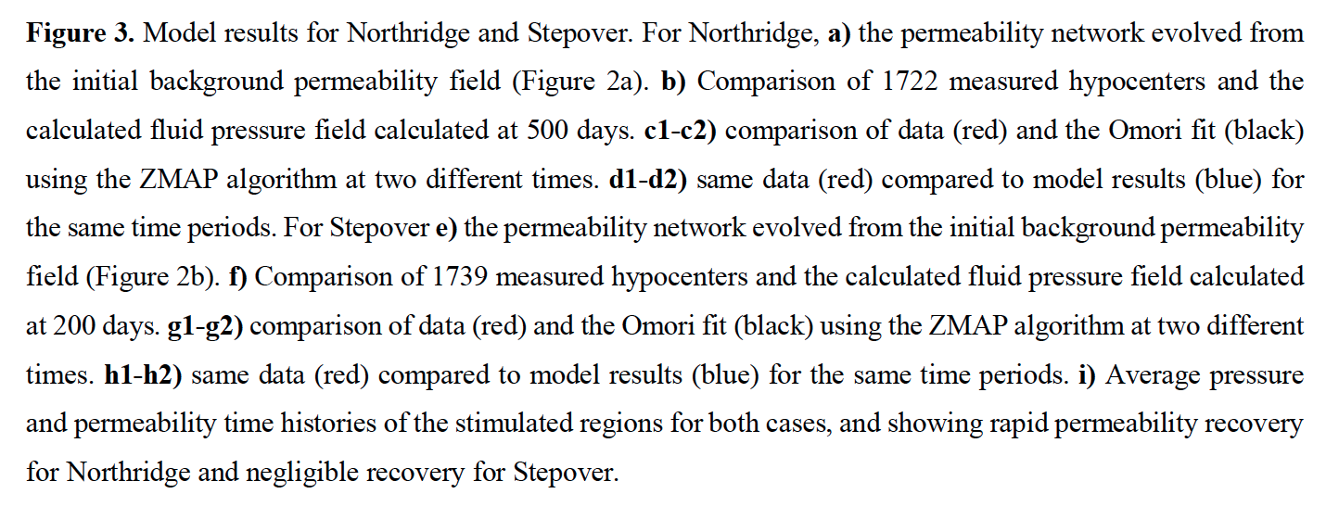

Slide 7
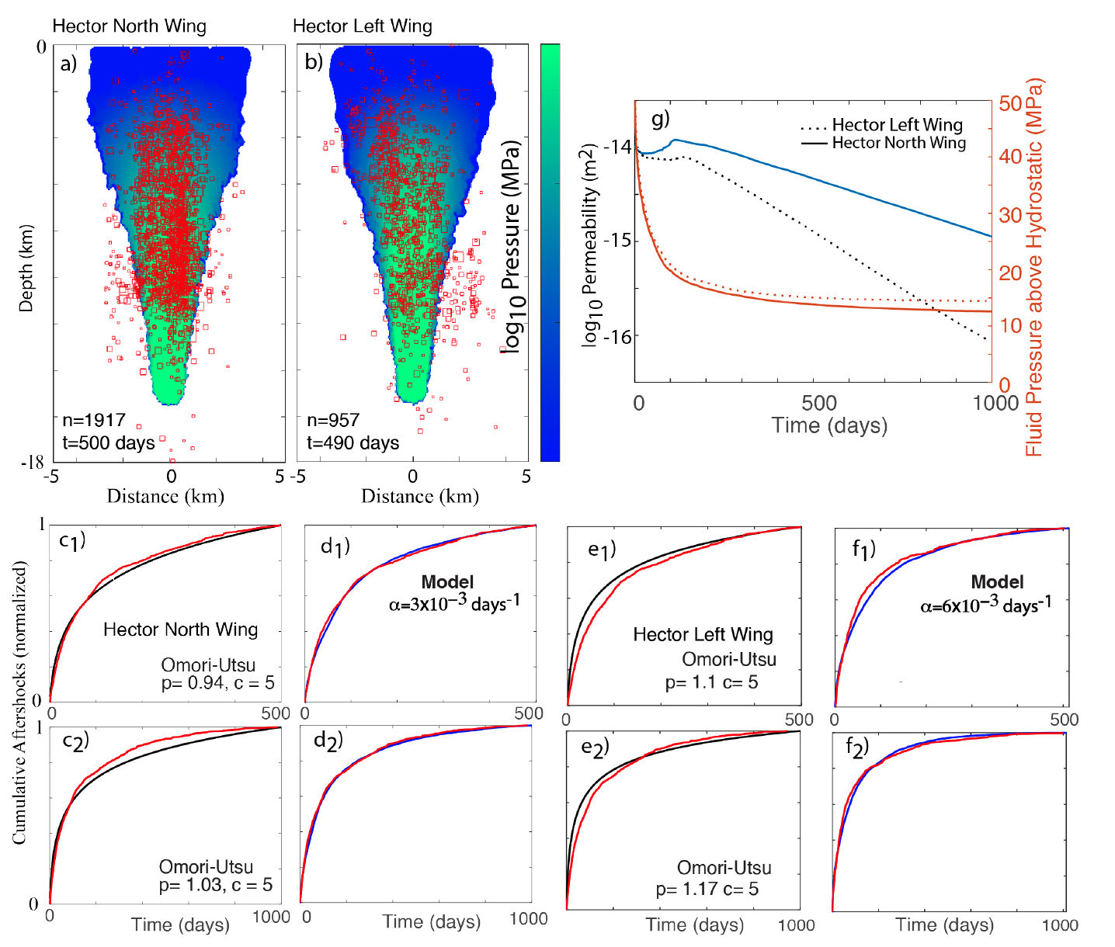
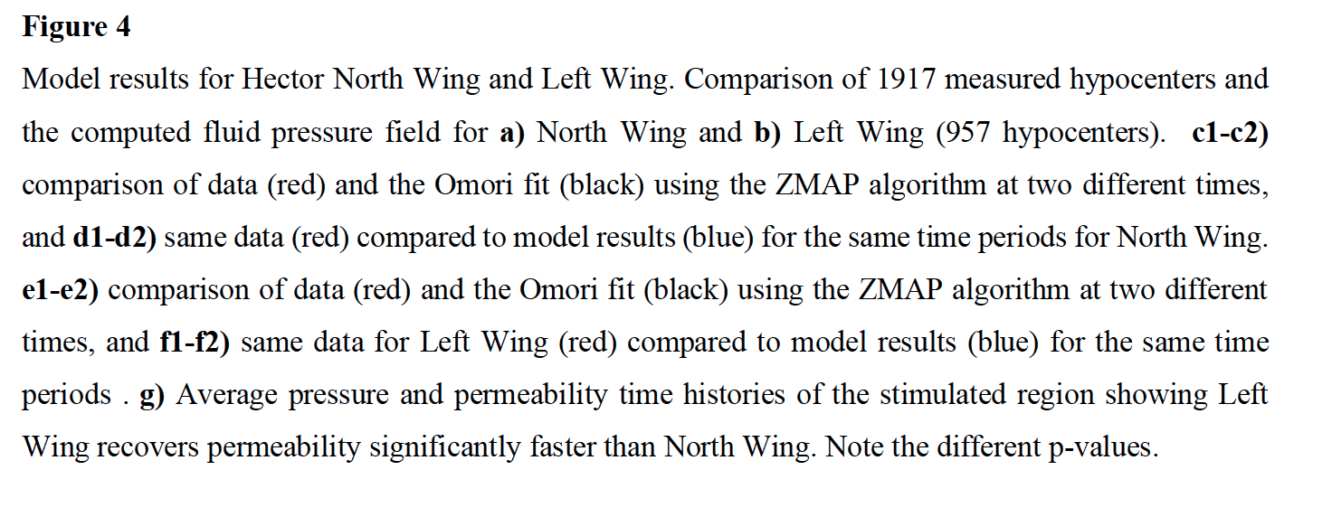

Slide 8
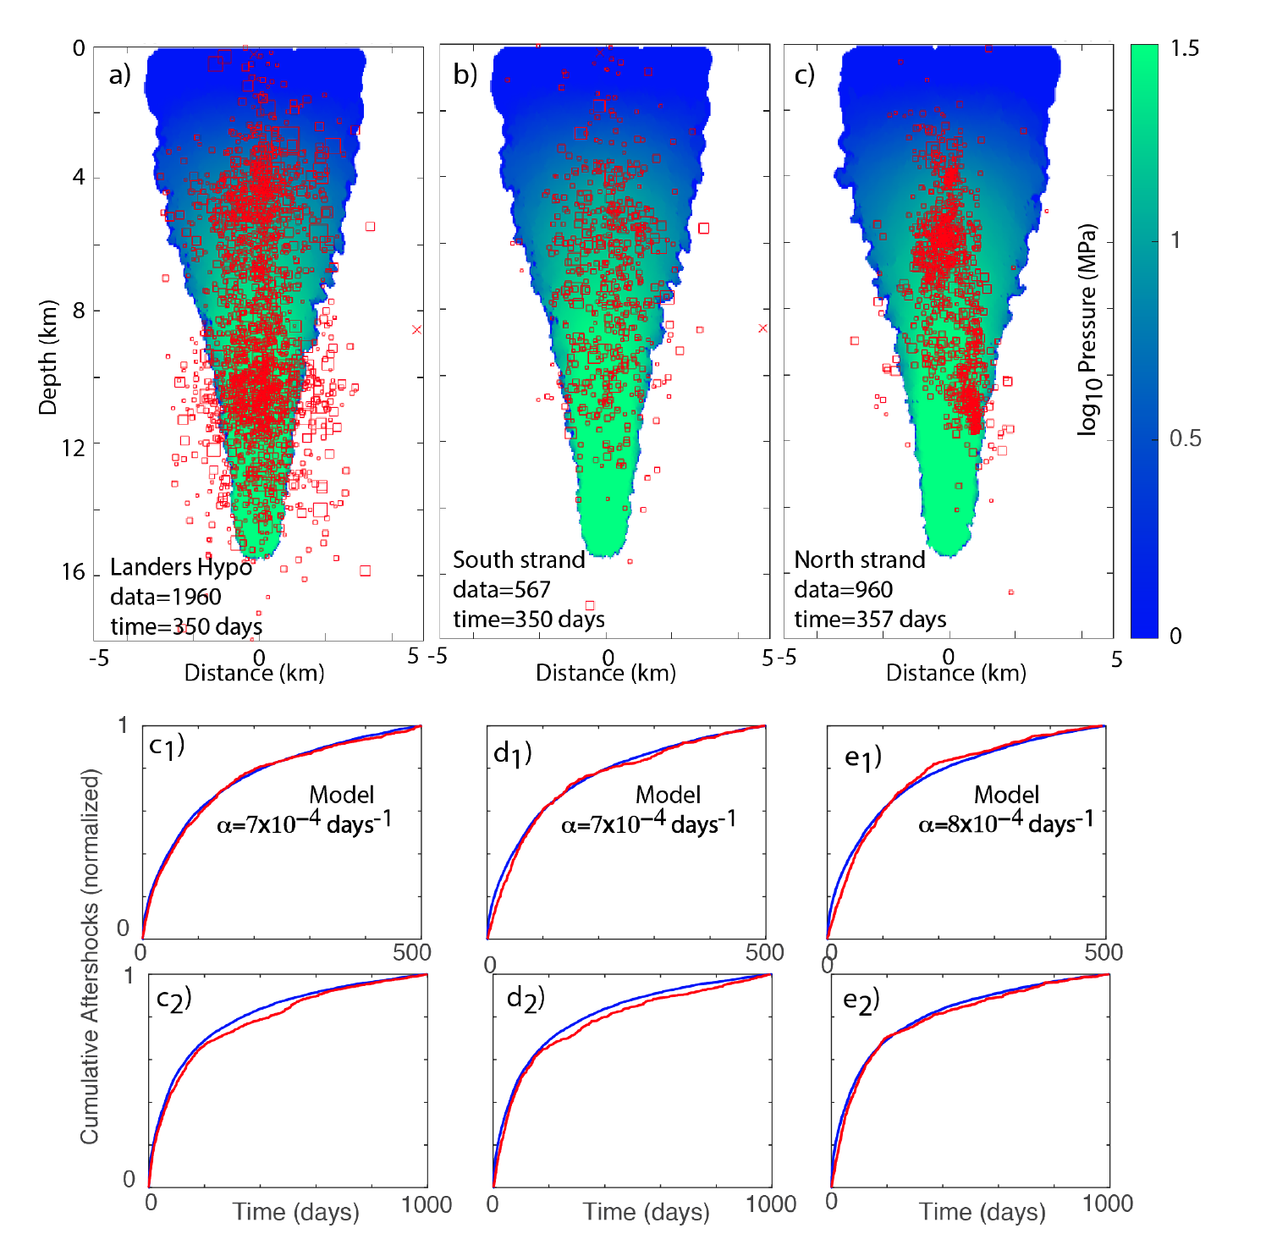

Slide 9
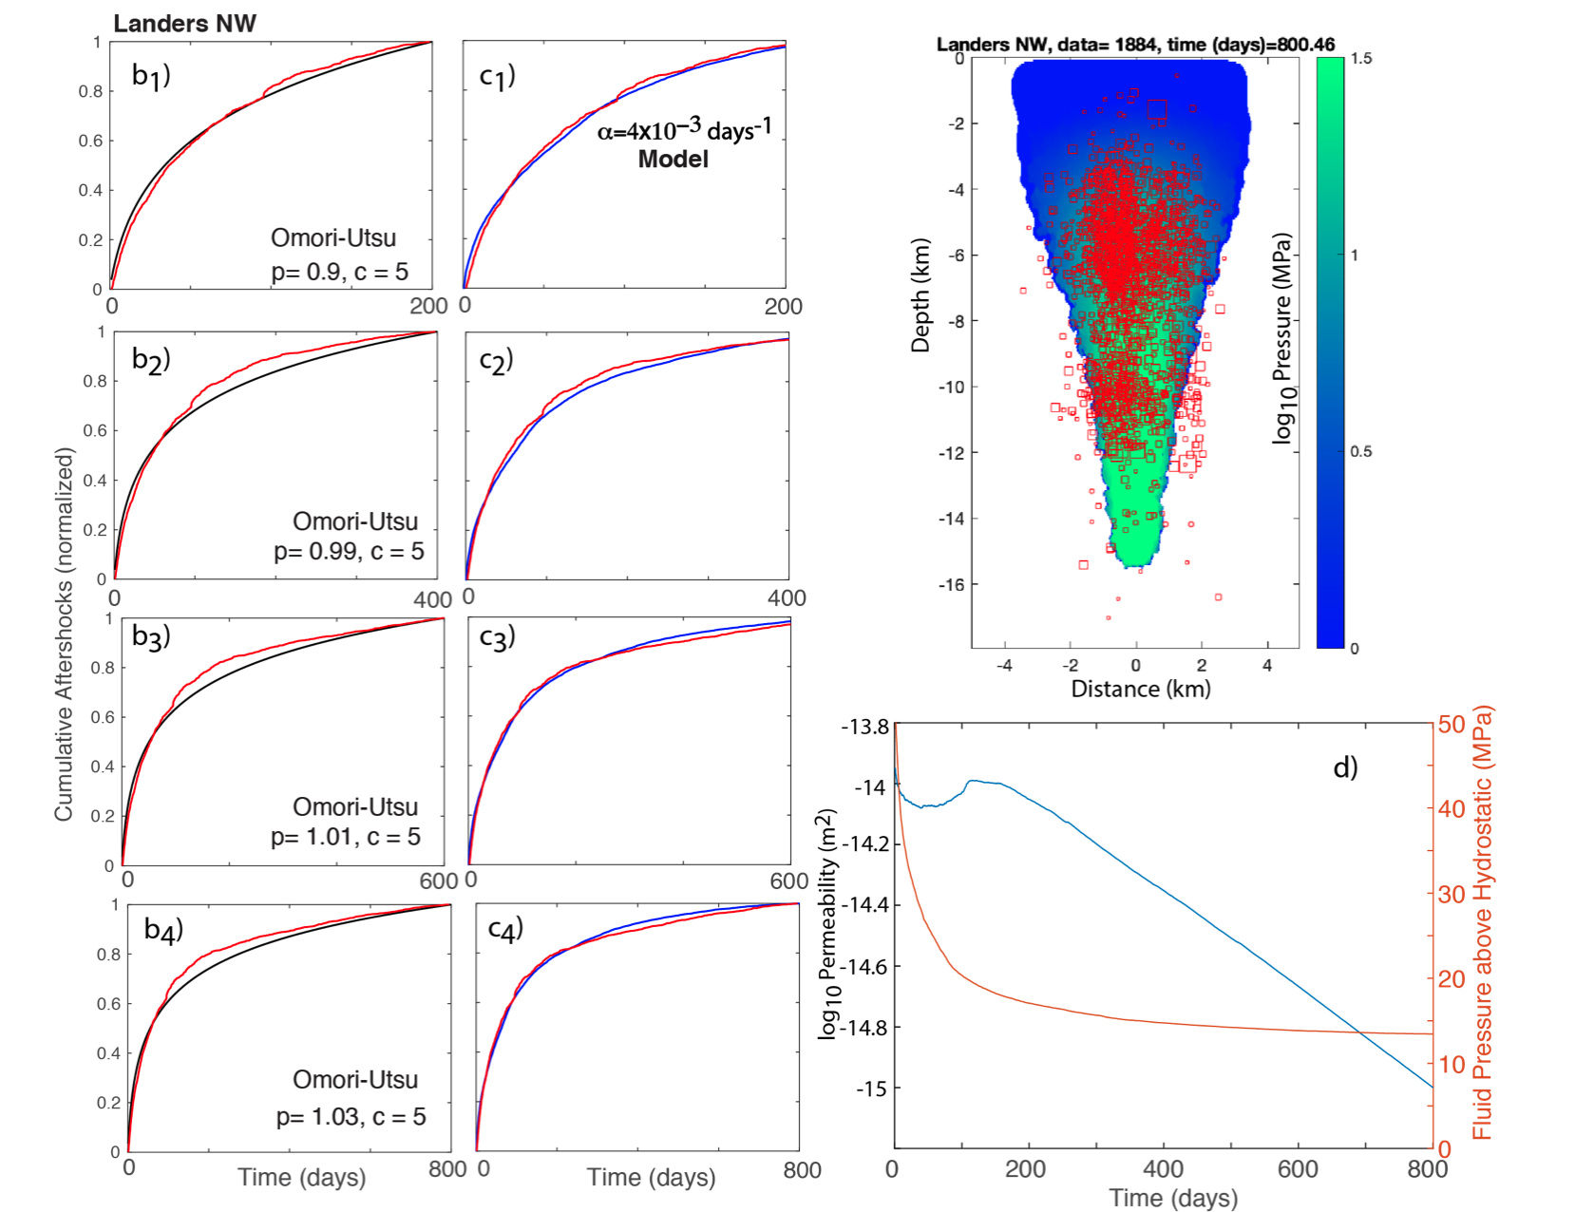

Slide 10
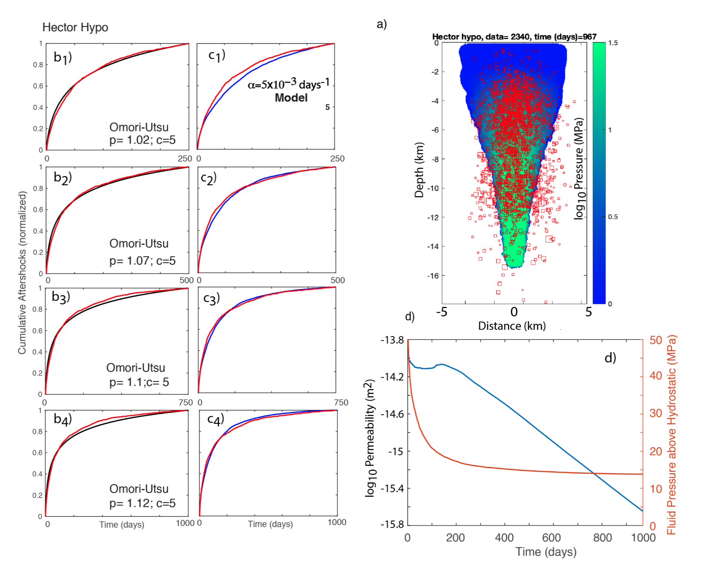

Slide 11
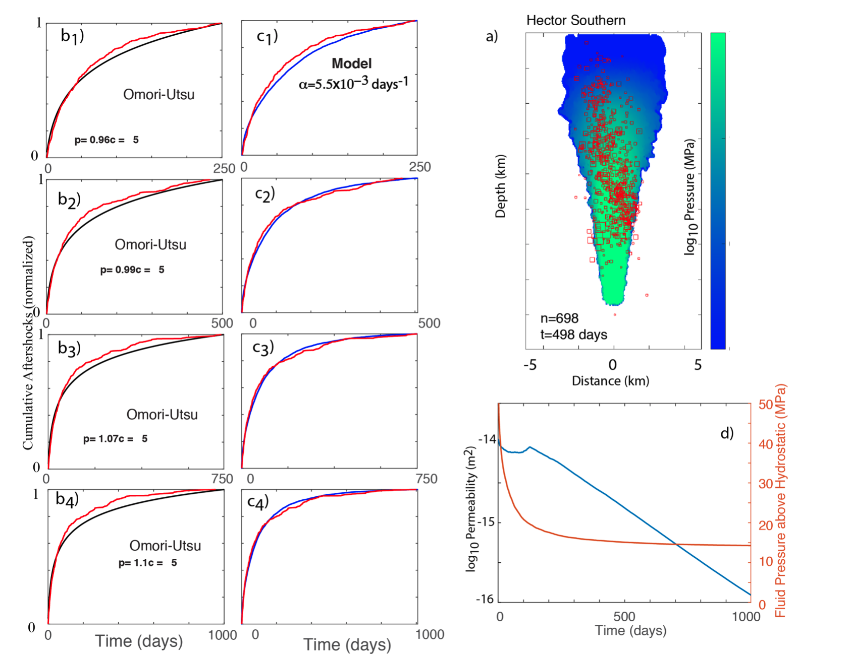

Slide 12
