Slide 1
Evolution of mechanical properties of lava dome rocks across the Soufrière Hills eruption, and application in discrete element models
Key Questions:
Did the mechanical properties of erupted volcanic rocks change across the 1995-2010 eruption?
Can the mechanical properties be linked to eruptive activity?
How can these properties be incorporated into numerical models?
Annotations show state of dome at end of each phase.
Extrusion rate across the Soufriere Hills eruption, with stars indicating major (>10⁷ m³) dome collapse.
Map of Montserrat, indicating sampling sites for temporally constrained rock samples. BRV = Belham River Valley

Slide 2
Microstructures and physical characteristics of samples
PHASE 1
PHASE 3
PHASE 4
PHASE 5
Rocks from Phase 5 have higher porosity and permeability, and are more friable in hand specimen
Highest crystallinity in samples from Phases 3 and 4
Low variability in componentry and mineralogical assemblage across all samples
Permeability vs. porosity, shown by eruptive phase
Mineral assemblage
Porosity
QEMSCAN (Quantitative Evaluation of Minerals by Scanning electron microscopy) analysis reveals microstructural, mineralogical and textural information of the samples.

Slide 3
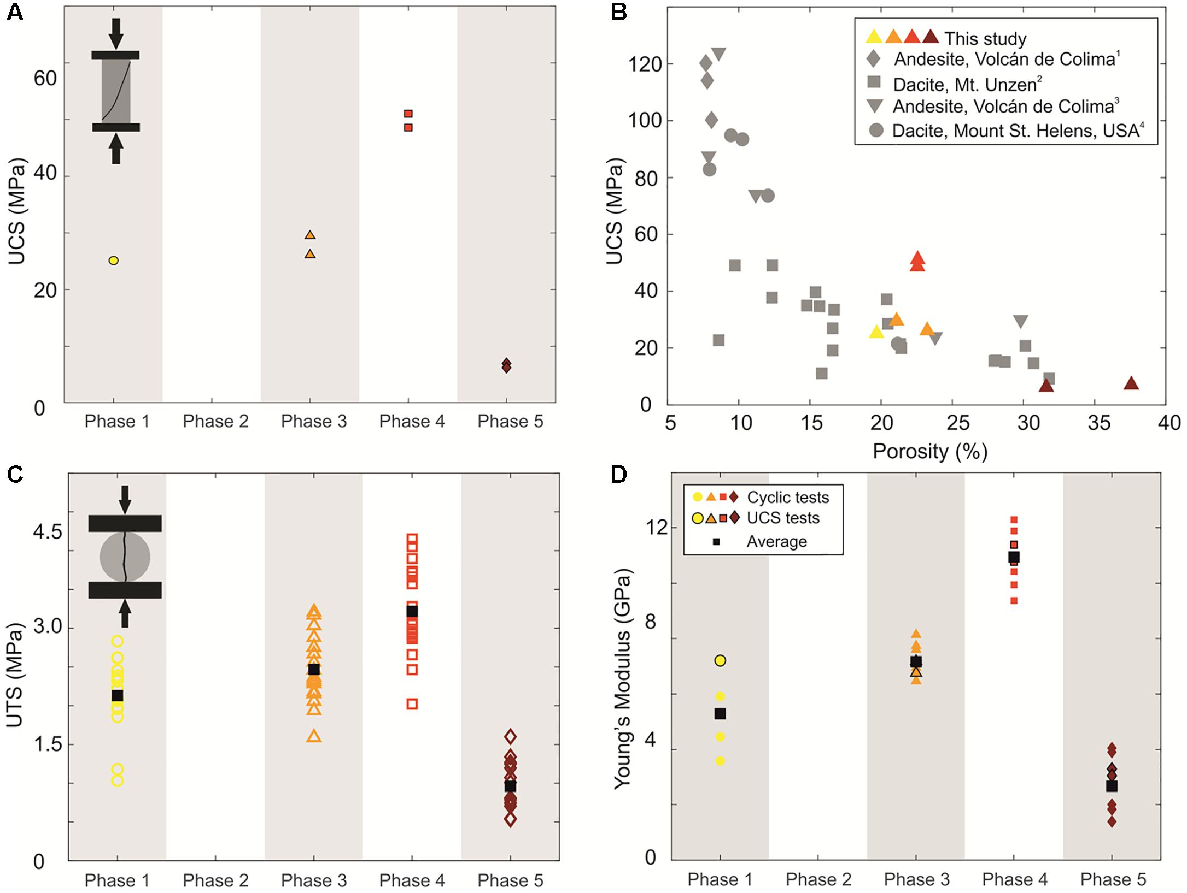
Mechanical characterisation – strength and Young’s Modulus
Limited uniaxial compressive strength (UCS) testing shows a general increase in strength from Phase 1 to Phase 3 to Phase 4, with a large decrease in strength in Phase 5
UCS peaks at 49.8 MPa in Phase 4, compared to only 6.6 MPa in Phase 5
UCS depends on porosity and fits alongside data from other volcanic rocks
The Brazilian tensile strength gives indirect uniaxial tensile strength (UTS), and shows the same trend as UCS
Young’s Modulus mirrors UCS trend, where less porous, stronger samples have a higher Young’s Modulus
UCS
UTS
Young’s Modulus
Full data tables available in Frontiers article

Slide 4
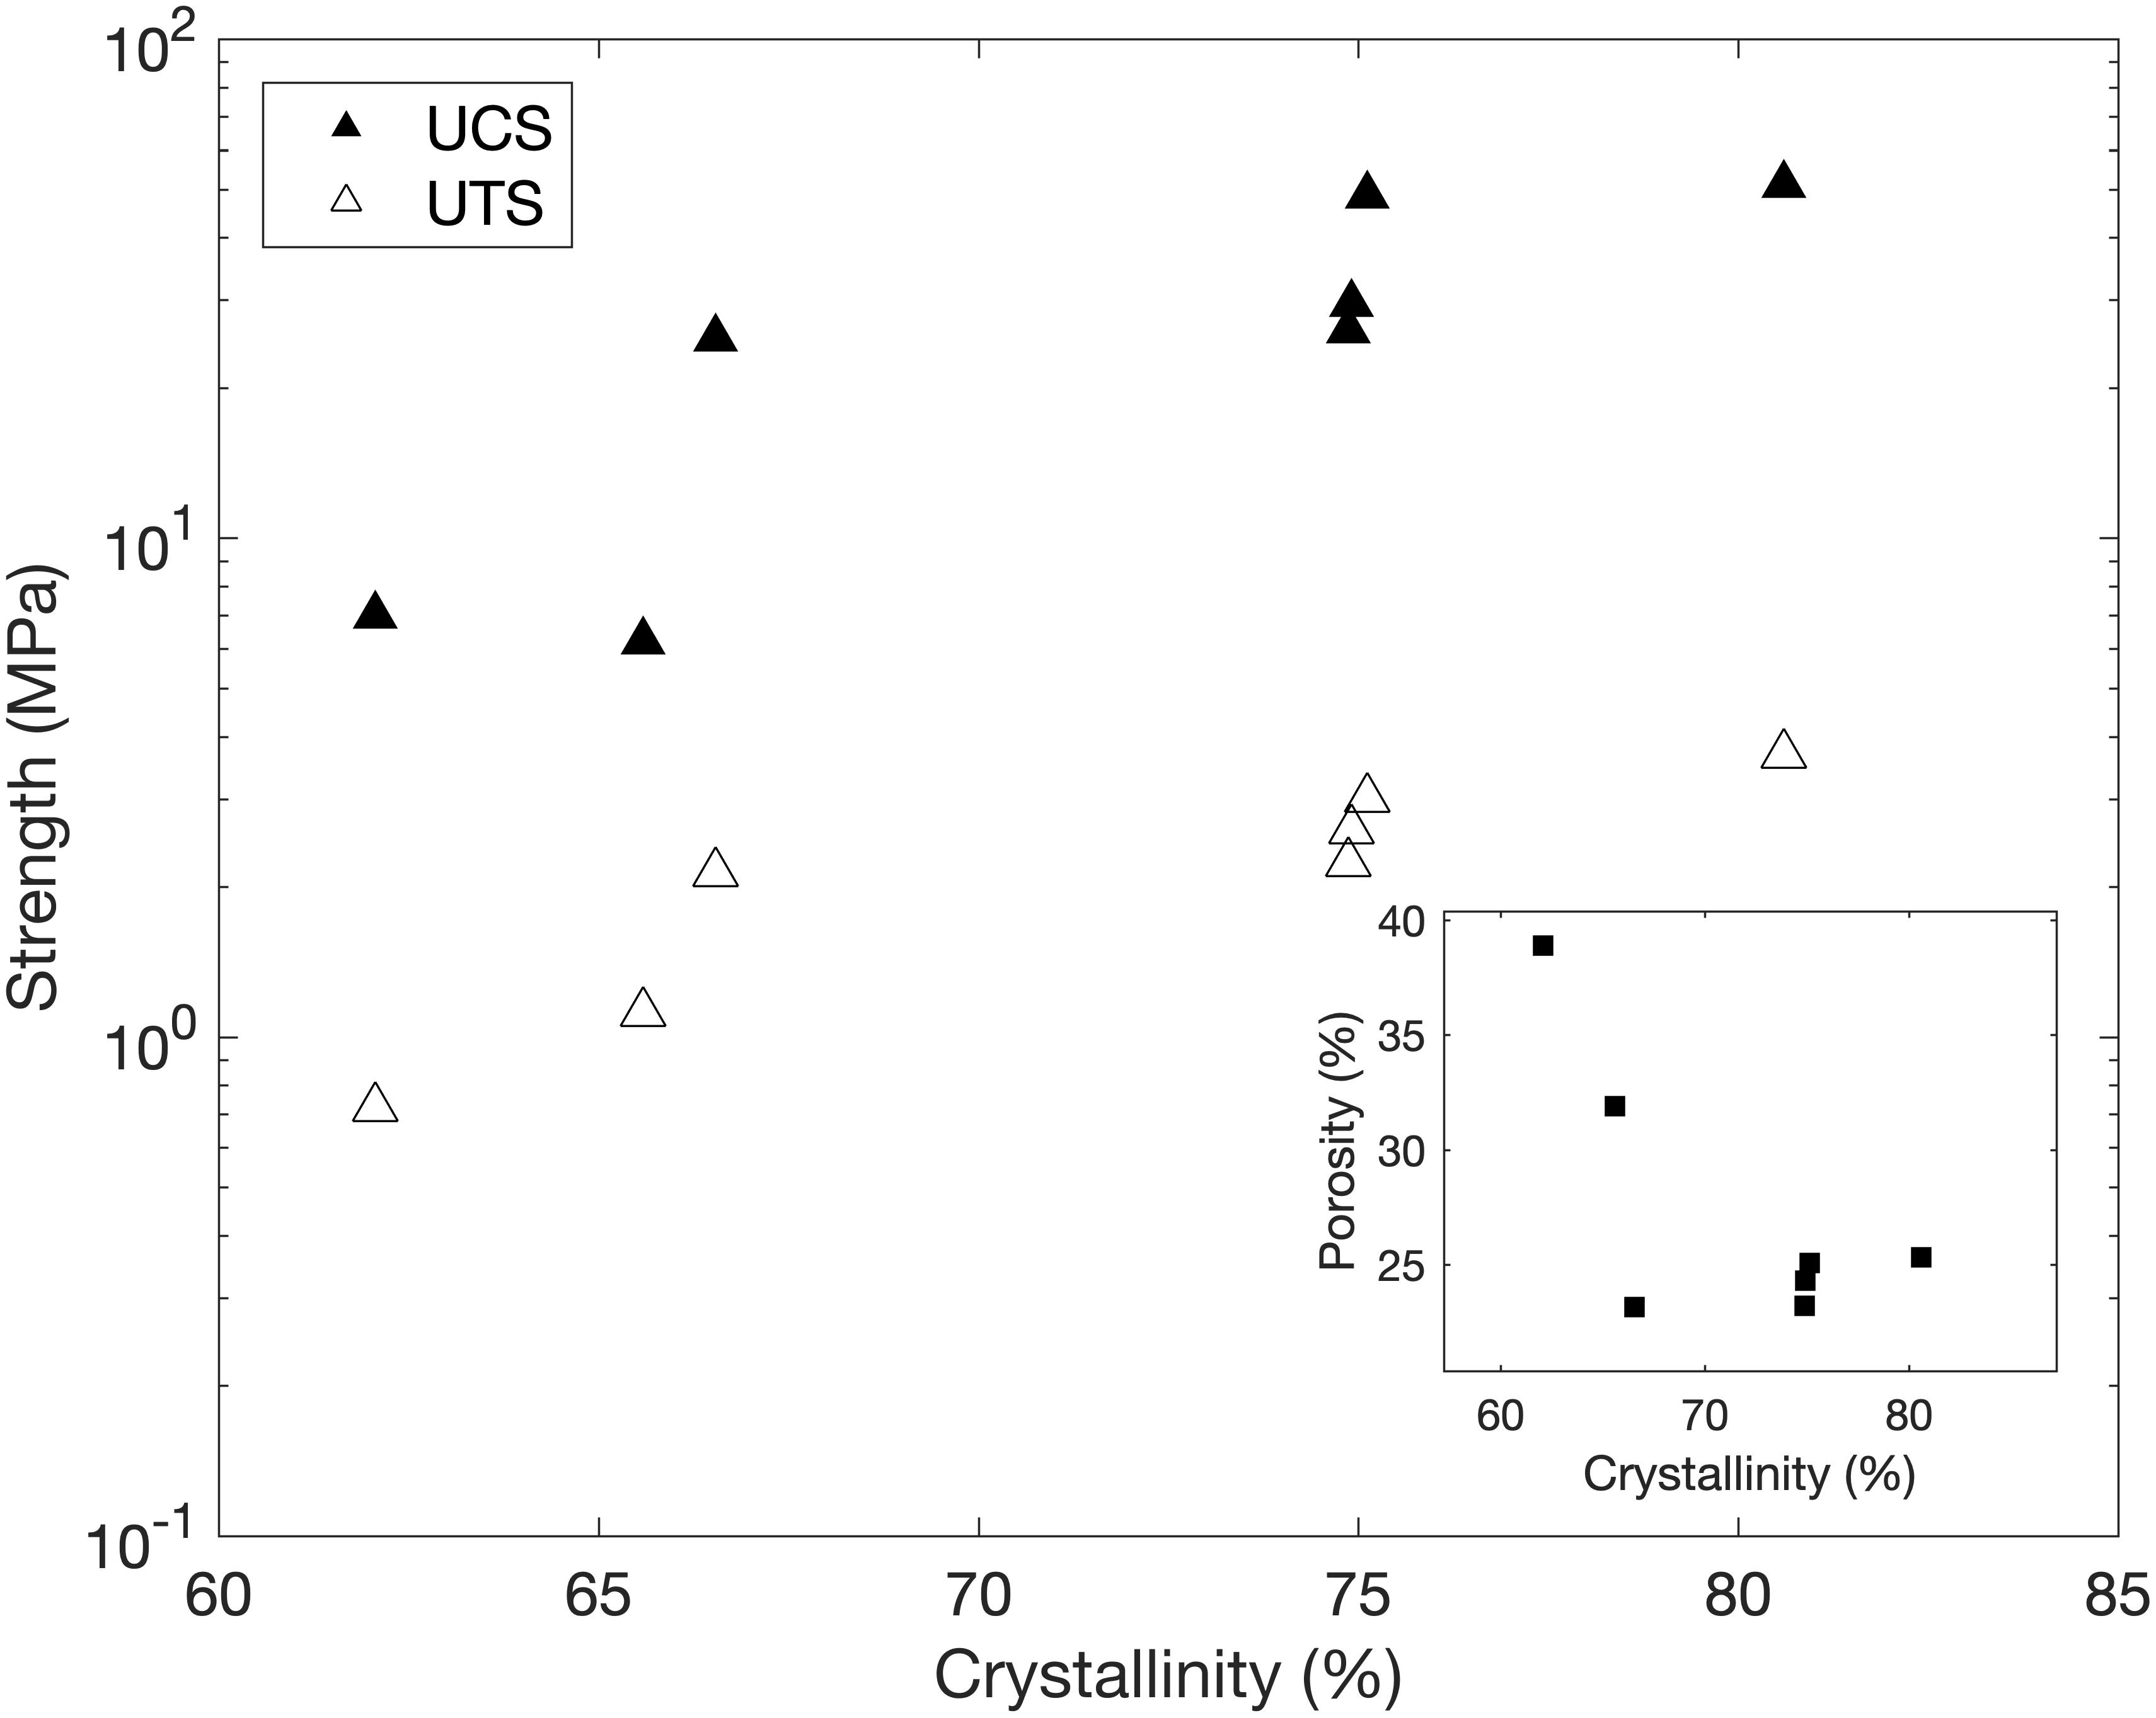
Relationship between physical and mechanical characteristics, and comments on eruptive activity
Co-variance of physical and mechanical properties
UCS and UTS vary by almost an order of magnitude, and show a non-linear decrease with increasing permeability and porosity
Stronger rocks show a higher UCS/UTS ratio, showing the importance of a non-constant UCS/UTS ratio in models to avoid overestimating overall dome stability
Pore connectivity is a controlling factor in mechanical behaviour, and therefore the strength captured here reflects textural heterogeneity, rather than fracturing during pyroclastic density current transport
Strength and porosity (inset) as a function of crystallinity
Comments on eruptive activity:
Highest rock strength in Phase 4 could reflect longer repose time, and therefore increased densification and crystallisation time caused by longer magma residence time at elevated temperatures
High permeability of Phase 5 samples could contribute to efficient dome outgassing, increasing dome stability
Permeability and Young’s Modulus as a function of the average ratio between uniaxial and tensile strength for each phase.

Slide 5
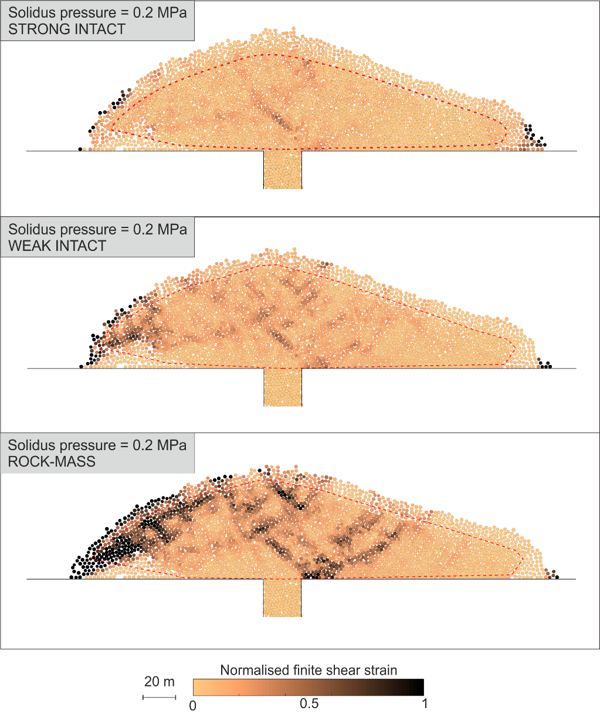
Considering strength variation using discrete element models
By calibrating a discrete element model with laboratory tests, we can consider three different strength scenarios to start to investigate the effect of strength heterogeneities:
Strong intact: highest observed strengths from Soufrière Hills, with an average UCS of 49.8 MPa from Phase 4.
Weak intact: lowest observed strengths from Soufrière Hills, with an average UCS of
6.6 MPa from Phase 5.
Rock-mass: the weakest rocks (Phase 5) upscaled. This corresponds to an average UCS of 1.3 MPa (20% of the weak intact properties).
Red dotted line – core/talus boundary
What impact does strength have on stability?
Higher strain accumulation seen in weaker dome
Higher volume of unstable material in weaker rocks for multiple modelled instability scenarios (i.e., gravitational collapse and internal pressure driven collapse)
The upscaling of properties shows a much more significant impact on the instability than the variability observed across the Soufrière Hills eruption
much higher strain accumulation in the weakest material

