Slide 1
Using the adjoint state variable for parameter estimation by inverse methods with parsimony.
F. Delay, P. Ackerer
Laboratory of Hydrology and Geochemistry of Strasbourg, France

Slide 2
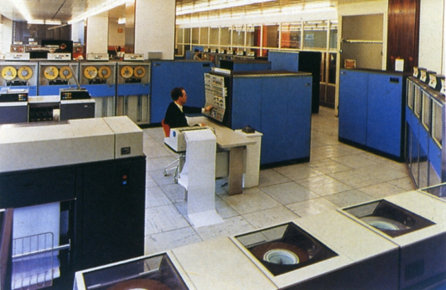

History:
Ideas and results from a 31 years old fellow
Emsellem, de Marsily, WRR, 1971
Objective functions with regularization/plausibility.
Local sensitivity analysis.
Scale issues regarding the estimated parameters.
Adaptive parameterization.
Four ideas in one paper …
Emsellem, de Marsily, Reply, WRR, 1972
The “small” computer
Already large delays in publishing.
Some researchers made some unfortunate comments …

Slide 3
Parameter estimation Algorithm
Gradient-based method for the minimization of an objective function
(typically sum of the quadratic differences between computed and measured variables).
Most of the codes are using the following iterative scheme:
Initialization:
Solve the forward problem y^{i} = y(p^{i})
Compute the objective function O^{i}
Compute the Jacobian matrix J^{i} and the Hessian H (or approximated)
(by sensitivity or adjoint state)
Compute updating parameter vector d
Update parameter vector p^{i+1 =} p^{i} + d
7. If convergence has been reached, then stop. Otherwise set i = i+1 and return to 2.

Slide 4
Gradient computation:
summary for np parameters
Discretized PDE:
Objective function:
Parameter increment:
Newton method
(np+1) systems to solve.
Good approximation of H(p).
‘Fast’ convergence.
First order uncertainty analysis.
Quasi-Newton method
2 systems to solve (state variable y + adjoint λ)
Iterative approximation of H(p).
‘Slow’ convergence.
Approximation
(BFGS)

Slide 5
Computation of the adjoint variable
Standard computation
Alternative computation
Mathematical model: PDE+BC+IC
Mathematical model: PDE+BC+IC
Numerical solution of the model
Numerical solution of the model
Ajoint state based on the discretized model
Mathematical model for the Ajoint
variable: PDE+BC+IC
Numerical solution of the model
Objective function gradient

Slide 6
Continuous adjoint variable formulation for flow and transport
Models for the state variables
Flow and transport in saturated porous material
Corresponding PDEs for the adjoint variables:
It is a backward computation over time and space (for advective transport)….
The RHS correspond to the derivatives of two objective functions with respect to the state variables

Slide 7
Numerical experiments
Estimation of K and S for saturated flow
Reference:problem solution
DAS-30: cell size=30m, 5210 cells
Standard adjoint computation (cell size: 30m)
CAS-30: cell size=30m, 5210 cells
Alternative adjoint computation (cell size: 30m)
CAS-60: cell size=60m, 1350 cells
Alternative adjoint computation (cell size: 60m)
.

Slide 8
Conclusion
The adjoint state can be computed in a efficient way and thus, reduces CPU time for parameter estimation.
The adjoint state is computed backward over time and requires specific boundary and initial conditions.
The adjoint variable can be computed in a non-intrusive way i.e. with a separate code.
It requires mapping between the mesh used for the direct problem and the mesh used for the adjoint computation. Mapping and coarser grids generate errors in the computed gradient that might affect the number of iterations of the minimization procedure.

