Slide 1
Intervening in interventions:
Exploring the implications of novel technologies through multidisciplinary lenses
Kelly Redeker¹, Eleanor Brown², Sally Brooks², Lynda Dunlop², Joshua Kirshner³, Richard Friend³, and Paul Walton⁴
¹- Department of Biology
²- Department of Education
³- Department of Environment and Geography
⁴- Department of Chemistry

Slide 2
STRIPES:
Social Transformative Research Informing Processes of Environmental Science: Co-production of knowledge in the Case of the Granbio Advanced Bio-refinery in Alagoas, Northeast Brazil.
Brazilian Partners
João Paulo Franco - LGE
Laboratório de Genômica e Expressão da Unicamp
Ana Cristina Zimmermann
University of Sao Paulo
Fernanda Veneu
Oswaldo Cruz Foundation
Redeker- Biology
Brown, Brooks, Dunlop- Education
Kirshner, Friend- Env & Geography
Walton- Chemistry

Slide 3
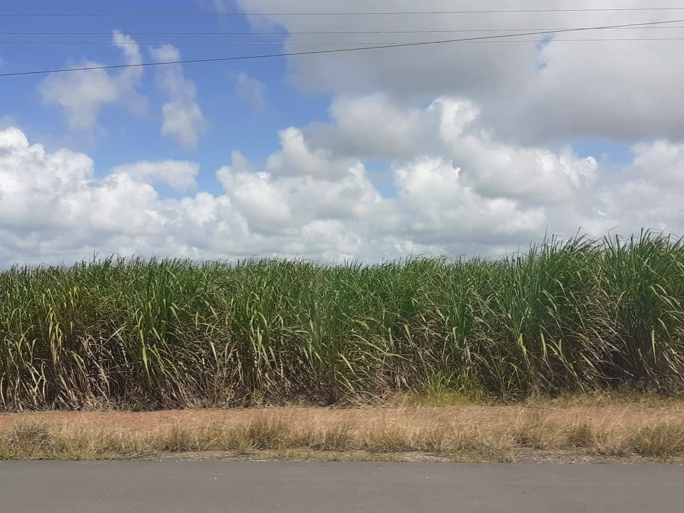
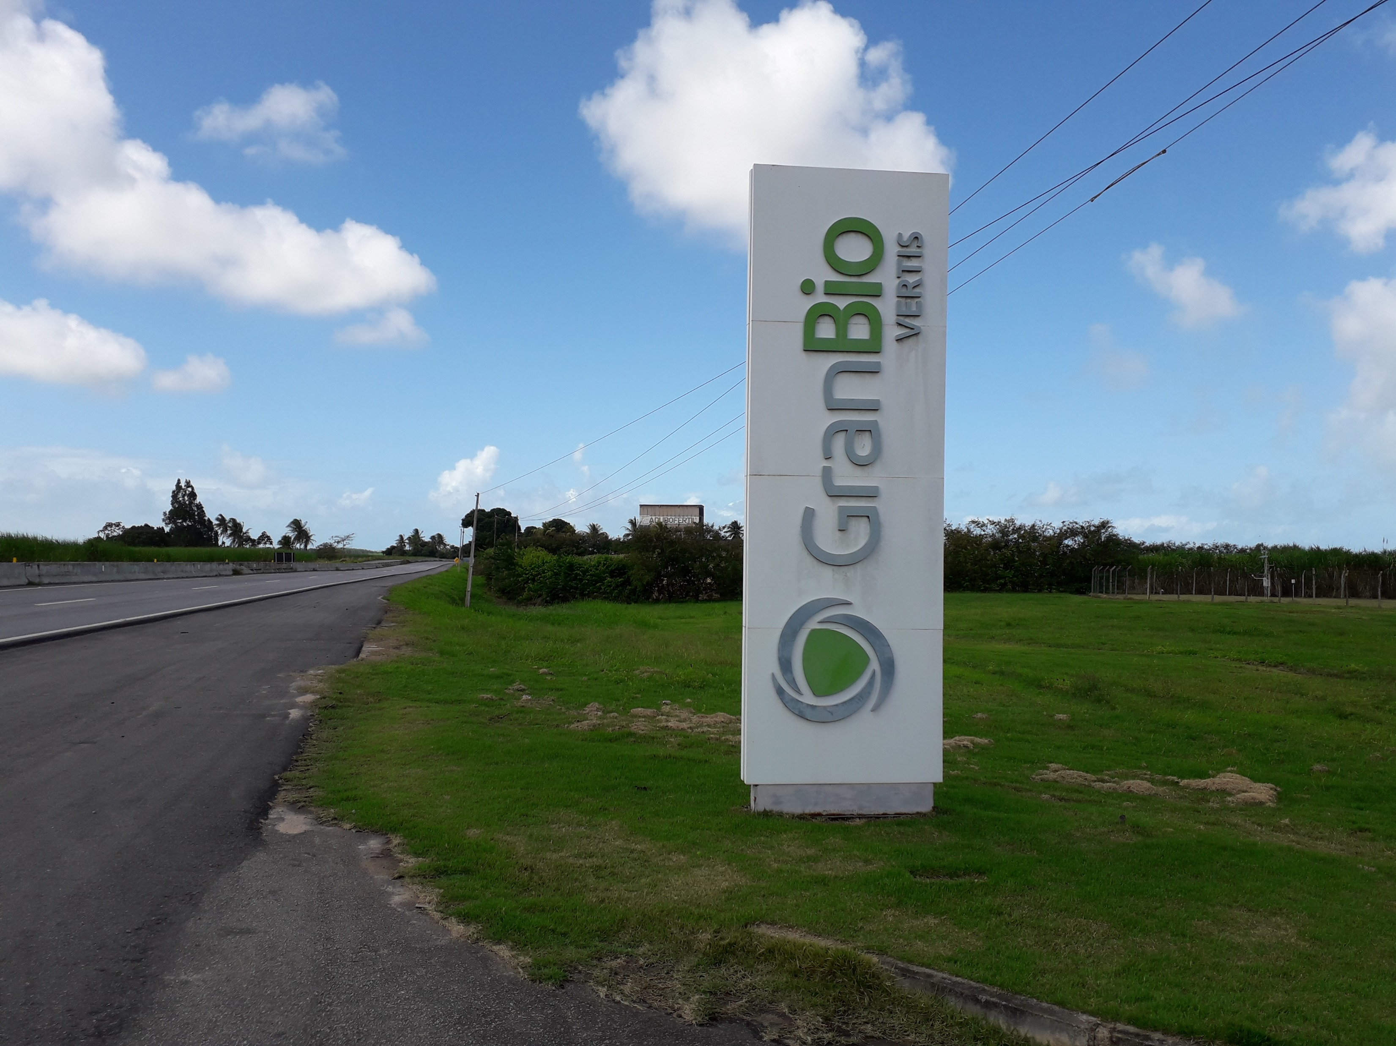
What is the project about?
Over the last few decades there have been a number of technologies and interventions that have been intended to produce more equitable, sustainable energy resources. These range from social interventions in how resources are managed to technological interventions that generate power through novel means.
However, a large subset of these interventions fail. Initial expectations of interventions are rarely tested and generally only over a limited subset of criteria (primarily economic or carbon neutrality).
We examine a promising new biotechnological intervention in energy production (production of biogas through residual crop waste) with GranBio in Alagoas, Brazil.
We will be exploring initial and ongoing community expectations of value and reduction in inequality through a broad range of lenses.

Slide 4
How do interventions progress?
What are the priorities for creating new technologies?
On what criteria are these priorities based?
A non-exhaustive list might include-
economic, carbon-neutral/climate change, resource availability, further environmental impact, gender impacts….
What are the criteria for implementation/continuation of these new technologies/interventions?
Are these the same criteria on which the creation was dependent?
Are these criteria held constant over time?
Can we identify useful intervention points in the research/implementation process that allow for more effective and equitable energy interventions?

Slide 5
Successful outcomes in this project rely upon useful interactions across disciplines
Key components of the interdisciplinary process that appeared to be necessary include:
start Early in the process!
provide sustained and open opportunities for interaction between researchers to develop effective communication across disciplines,
explicitly explore discipline-specific taken-for-granted assumptions and identify what individuals understand when talking about key terms and processes (in this case these included, for example, ‘sustainable’, ‘development’, ‘methodology’, ‘marginal land’ and ‘research outputs’),
create solidarity within the entire research community

Slide 6
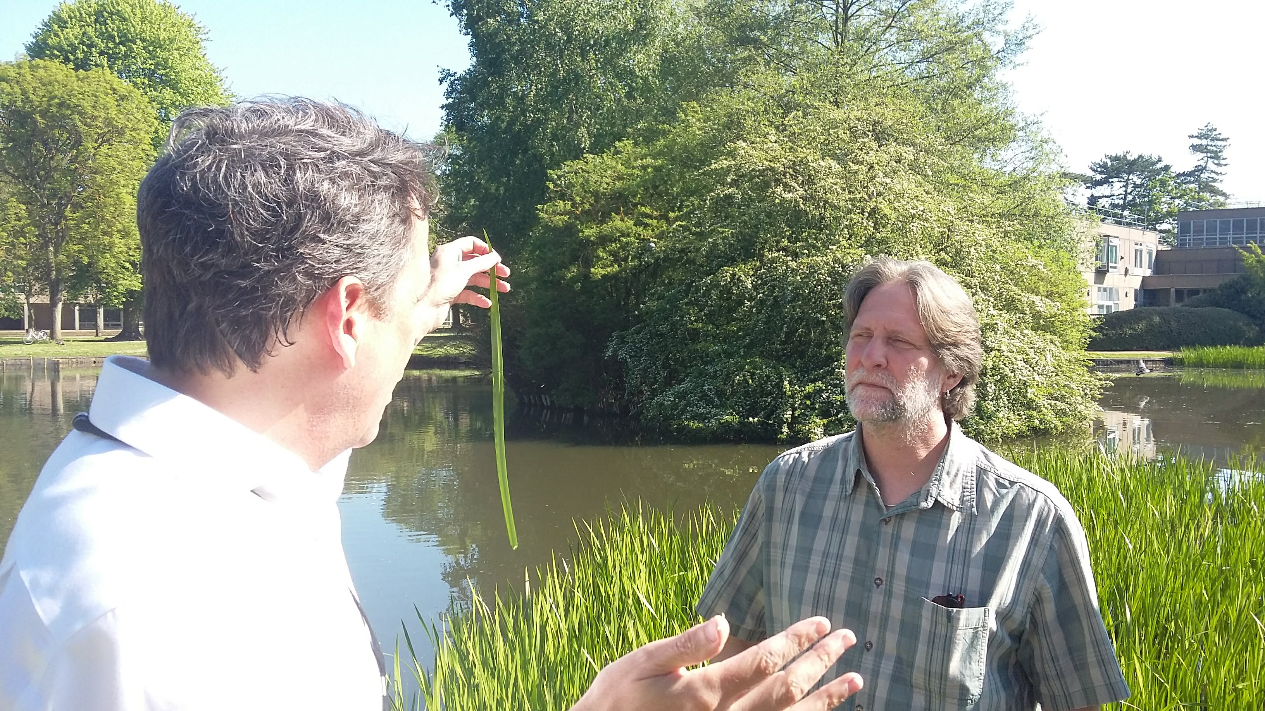
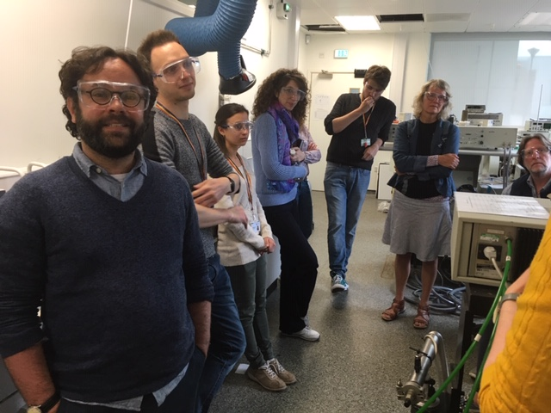
Successful outcomes in this project rely upon useful interactions across disciplines
Key components of the interdisciplinary process that appeared to be necessary include:
Start Early in the process!
provide sustained and open opportunities for interaction between researchers to develop effective communication across disciplines,
explicitly explore discipline-specific taken-for-granted assumptions and identify what individuals understand when talking about key terms and processes (in this case these included, for example, ‘sustainable’, ‘development’, ‘methodology’, ‘marginal land’ and ‘research outputs’),
create solidarity within the entire research community

Slide 7
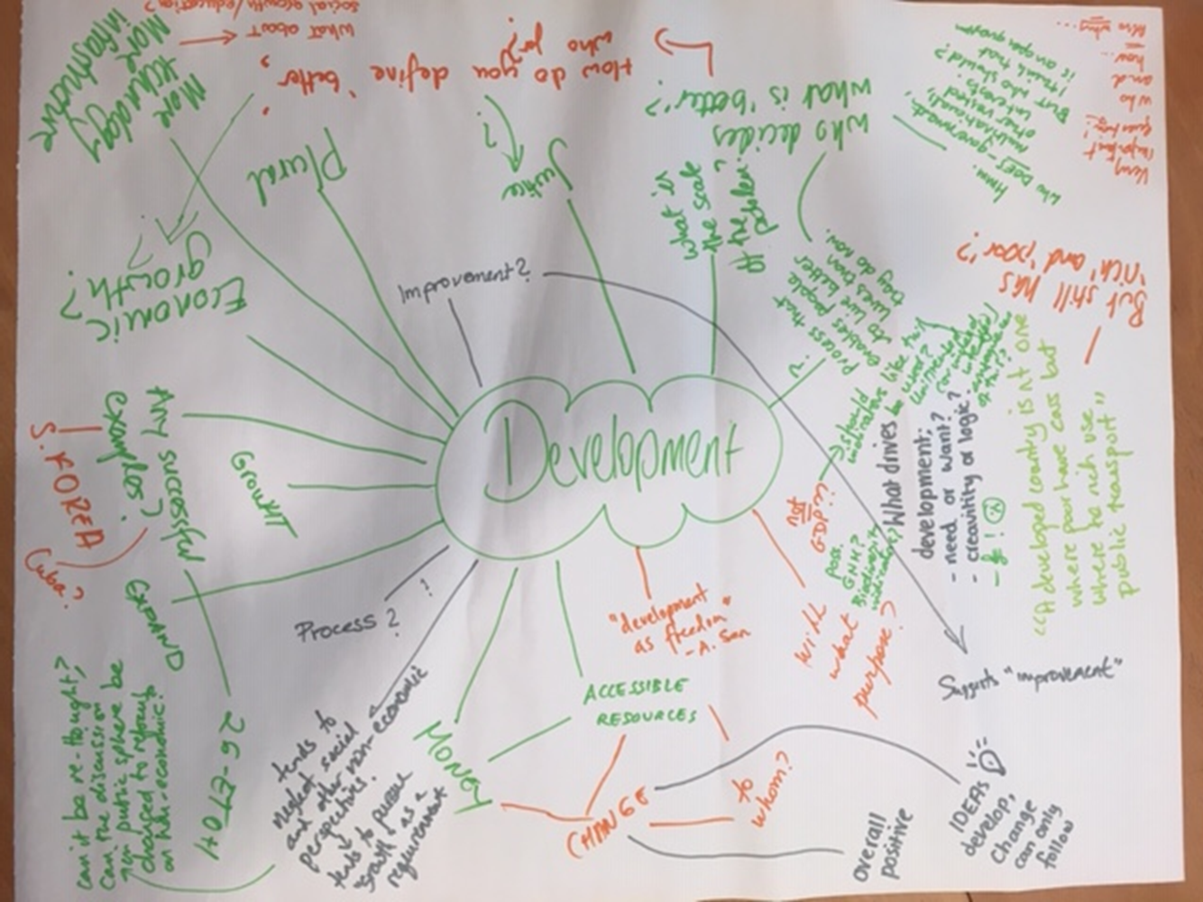
Successful outcomes in this project rely upon useful interactions across disciplines
Key components of the interdisciplinary process that appeared to be necessary include:
Start Early in the process!
provide sustained and open opportunities for interaction between researchers to develop effective communication across disciplines,
explicitly explore discipline-specific taken-for-granted assumptions and identify what individuals understand when talking about key terms and processes (in this case these included, for example, ‘sustainable’, ‘development’, ‘methodology’, ‘marginal land’ and ‘research outputs’),
create solidarity within the entire research community

Slide 8
Successful outcomes in this project rely upon useful interactions across disciplines
Key components of the interdisciplinary process that appeared to be necessary include:
start Early in the process!
provide sustained and open opportunities for interaction between researchers to develop effective communication across disciplines,
explicitly explore discipline-specific taken-for-granted assumptions and identify what individuals understand when talking about key terms and processes (in this case these included, for example, ‘sustainable’, ‘development’, ‘methodology’, ‘marginal land’ and ‘research outputs’),
create solidarity within the entire research community

