Slide 1
Analyses of Salt marsh Biogeomorphic Response to Sea Level Rise
Zhicheng Yang¹, Sonia Silvestri², Marco Marani³, and Andrea D’Alpaos¹,
1 Department of Geosciences, University of Padova, Padua, Italy
2 Department of Biological, Geological, and Environmental Sciences, University of Bologna, Bologna, Italy
3 Department ICEA, University of Padova, Padua, Italy
Contact: zhicheng.yang@phd.unipd.it； @ZhichengYang1

Slide 2
Outline
Introduction
Methods
Results
Conclusions
Z. Yang - Analyses of Salt marsh Biogeomorphic Response to Sea Level Rise

Slide 3
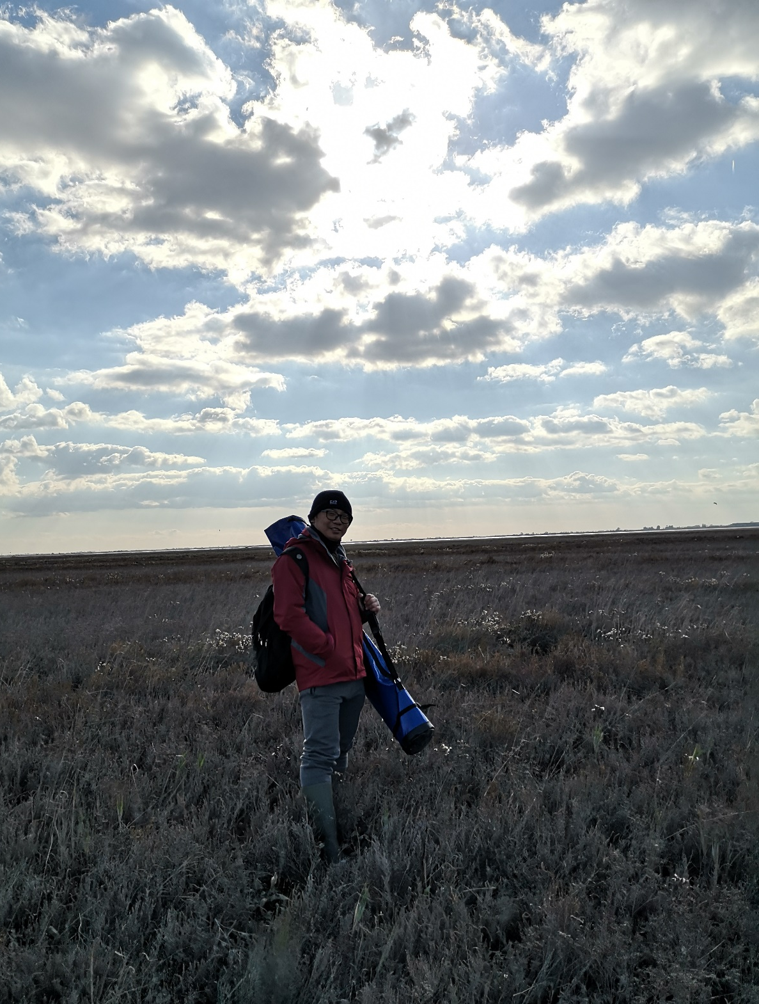
Salt marshes are critical but fragile ecosystems
It is argent to know how salt marsh elevation response to accelerated sea level rise (SLR) in low sediment concentration environments such as Venice lagoon.
How halophytic vegetation response to accelerated SLR is also still unclear.
So we conducted marsh elevation measurements and halophytic vegetation observations on a marsh between 2000 and 2019.
Z. Yang - Analyses of Salt marsh Biogeomorphic Response to Sea Level Rise
Introduction
Methods
Results
Conclusions

Slide 4
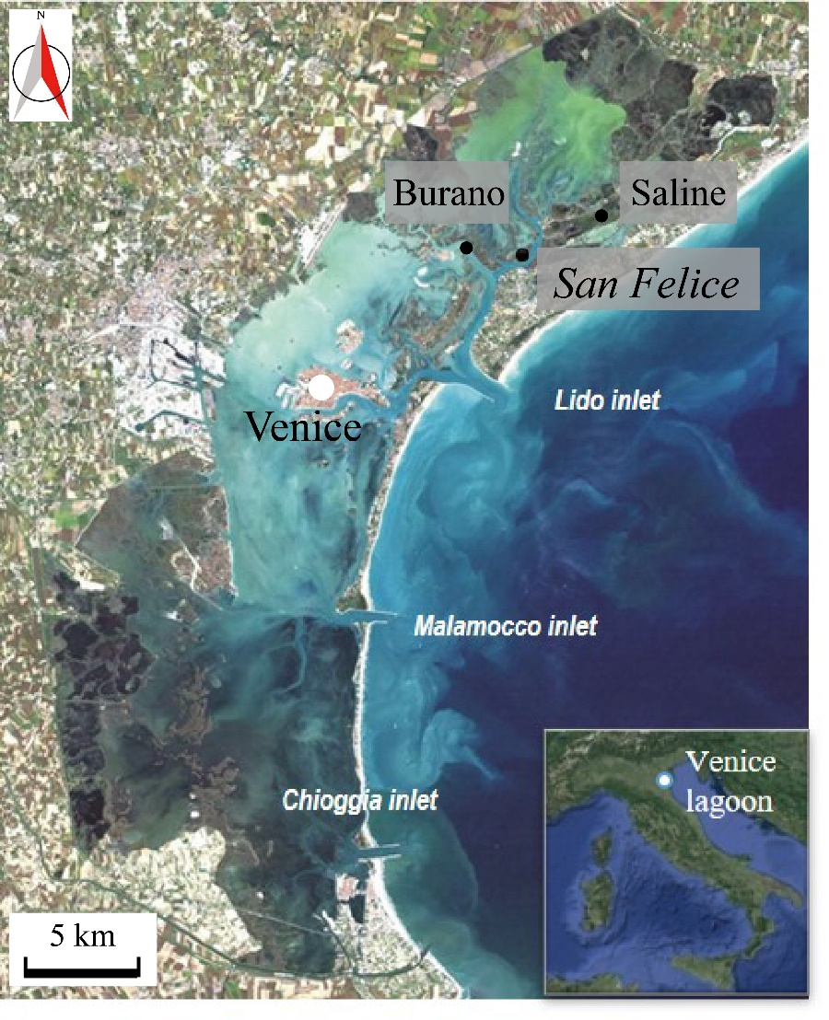
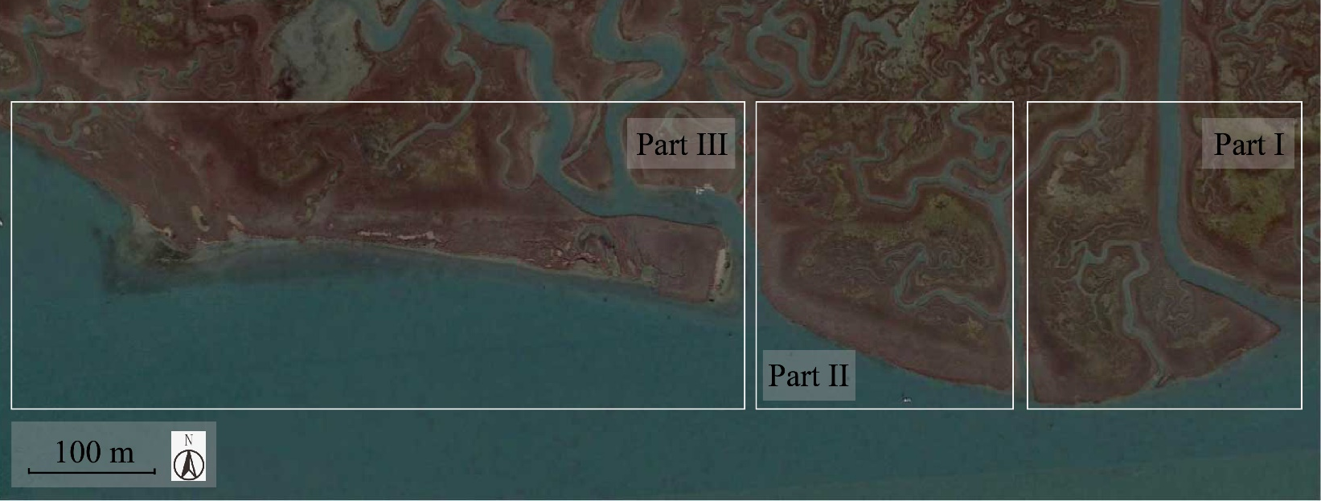
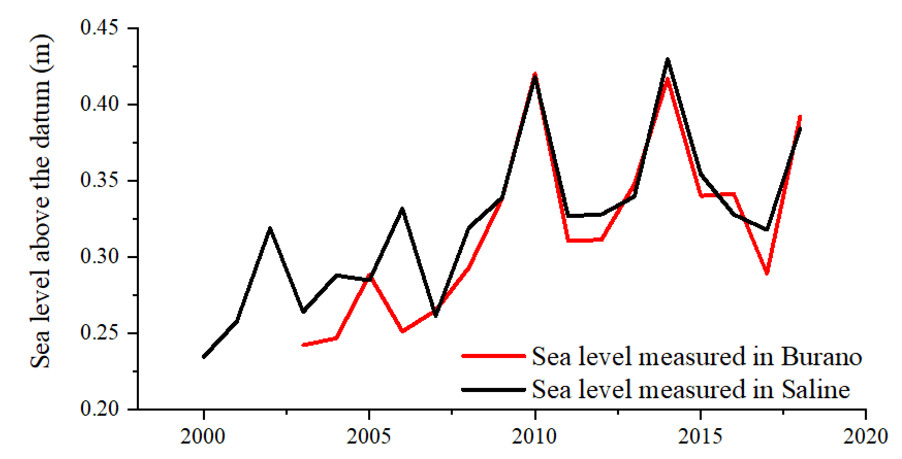
Area ≈ 550 km²
Mean water depth ≈ 1.5 m
Semi-diurnal micro-tidal regime
Surviving marshes about 47 km², they were 180 km² two centuries ago!
Period | Rate of SLR (mm/year)
 | Saline | Burano | Average
2000-2013 | 7.9 | 11.5 | 9.7
2013-2018 | -4 | -4.6 | -4.3
2000-2018 | 6.3 | 7.8 | 7.1
Main species:
Spartina maritima;
Sarcocornia fruticosa;
Limonium narbonense;
Inula crithmoides
Z. Yang - Analyses of Salt marsh Biogeomorphic Response to Sea Level Rise
Introduction
Methods
Results
Conclusions

Slide 5
1
The San Felice marsh lost elevation relative to MSL between 2000 and 2019. Because salt marsh accretion rates in different parts are lower than the RSLR.
Period | RSLR (mm/year) | Accretion rate (mm/yr)
 | Average | Part I | Part II | Part III
2000-2013 | 9.7 | 0.7 | -- | --
2013-2018 | -4.3 | 2.9 | -- | --
2000-2018 | 7.1 | 1.3 | 4 | 1.5
2
And the marsh accretion may be related to marsh boundary retreat.
Retreat rate (cm/yr)
Part I | 29
Part II | 39
Part III | 11
Z. Yang - Analyses of Salt marsh Biogeomorphic Response to Sea Level Rise
Introduction
Methods
Results
Conclusions

Slide 6
We can find the appearance of Salicornia and the dieback of Spartina !! This can be attributed to heatwave event (Strain et al., 2017).
1
Different halophytic vegetation species occupy their preferable elevations and can be characterized by their ecological niches.
2
The sequence of vegetation species with increasing soil elevation did not change during the observed 19 years.
Part | Period | SLR (mm/yr) | Vegetation migration rate (mm/yr)
 |  | Average | Spar | Lim | Sarc | Inu | Jun
Part I | 00-13 | 9.7 | 5.7 | 7.5 | -1.6 | 11.2 | …
 | 13-18 | -4.3 | 1.6 | 2.0 | 2.5 | 0.1 | …
 | 00-18 | 7.1 | 2.3 | 3.1 | 0.1 | 3.8 | …
Part II | 00-18 | 7.1 | 5.0 | 3.7 | 3.2 | 3.5 | …
Part III | 00-18 | 7.1 | 3.3 | 2.7 | 1.7 | 2.8 | 5.4
3
Vegetation migration rates is varied by different species.
Z. Yang - Analyses of Salt marsh Biogeomorphic Response to Sea Level Rise
Introduction
Methods
Results
Conclusions

Slide 7
The San Felice marsh lost elevation relative to MSL between 2000 and 2019: on average, salt marsh accretion rates in different parts are lower than the rate of sea level rise.
Different halophytic vegetation species are characterized by different ecological niches that slightly changed in time.
The sequence of vegetation species with increasing soil elevation did not change during the observed 19 years.
Vegetation migration rates can be characterized as a species-specific characteristic. Boundary species like Juncus and Inula are most sensitive to sea level changes, Limonium and Spartina are less sensitive to changes while Sarcocornia was characterized by delayed migration rates in response to sea level changes.
The dieback of Spartina and invasion of Salicornia are also observed in present study.
Z. Yang - Analyses of Salt marsh Biogeomorphic Response to Sea Level Rise
Introduction
Methods
Results
Conclusions

