Slide 1




D3043
Cloud, radiation, and surface heat flux simulations using Polar WRF with 3DVAR
Dae-Hui Kim¹, Hyun Mee Kim¹, and Jinkyu Hong¹
¹ Atmospheric Predictability and Data Assimilation Lab., Department of Atmospheric Sciences, Yonsei University
Contact: khm@yonsei.ac.kr / kdhui@yonsei.ac.kr
06 May 2020

Slide 2
Contents
1. Introduction
2. Methodology
3. Results
4. Summary
2-1. Model and data assimilation
2-2. Experimental setting
2-3. Observations
3-1. Surface radiation flux
3-2. Surface heat flux
3-3. Near surface variables

Slide 3
1. Introduction
A few observation campaigns have been performed to understand interactions between factors affecting atmospheric conditions of the Arctic. Based on these background knowledge, the Polar Weather Research and Forecasting (PWRF) model has been developed (Hines and Bromwich 2008).
In the Arctic, the cloud is an important factor affecting surface energy balance. Despite the development of cloud microphysics schemes in the PWRF, clouds over the Arctic region still have uncertainties.
In this study, the possibility of improving cloud simulations by using data assimilation (conventional observations and satellite radiance data) and its effects on the enhancement of the forecast accuracy of surface energy fluxes and meteorological variables are evaluated around the Svalbard with the PWRF model and three-dimensional variational (3DVAR) data assimilation system.
Performances of two microphysics schemes (WSM5 and 2-moment Morrison) are compared and evaluated to generalize the effect of data assimilation.

Slide 4
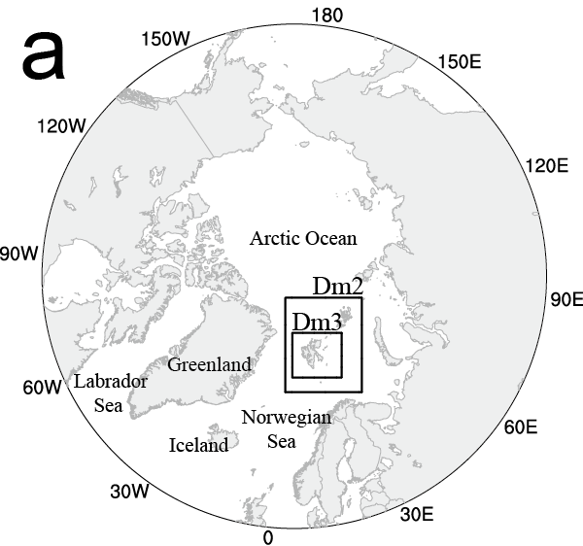
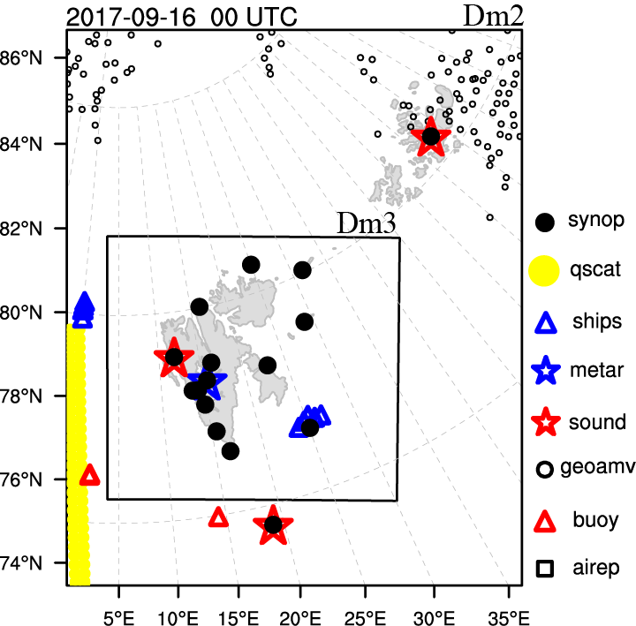
2-1. Model and data assimilation
Model |  | Polar WRF (v3.7.1) WRFDA (v3.8) 3DVAR
Period |  | 6 – 19 September 2017 (spin up: 5 days, 1–5 Sep.)
Resolution |  | 1 way nesting (15, 5, and 1.67 km)
Initial & boundary condition |  | ERA5 (0.25°x0.25°)
Background Error Covariance (BEC) |  | NMC method (for 1 month)
Parameterization schemes | Cumulus | Grell-Devenyi ensemble
 | Microphysics | WRF single-moment 5-class or Morrison 2-moment
 | Shortwave radiation | RRTMG
 | Longwave radiation | RRTMG
 | PBL | Mellor-Yamada-Janjic TKE
 | Land surface | Noah land surface model

Slide 5
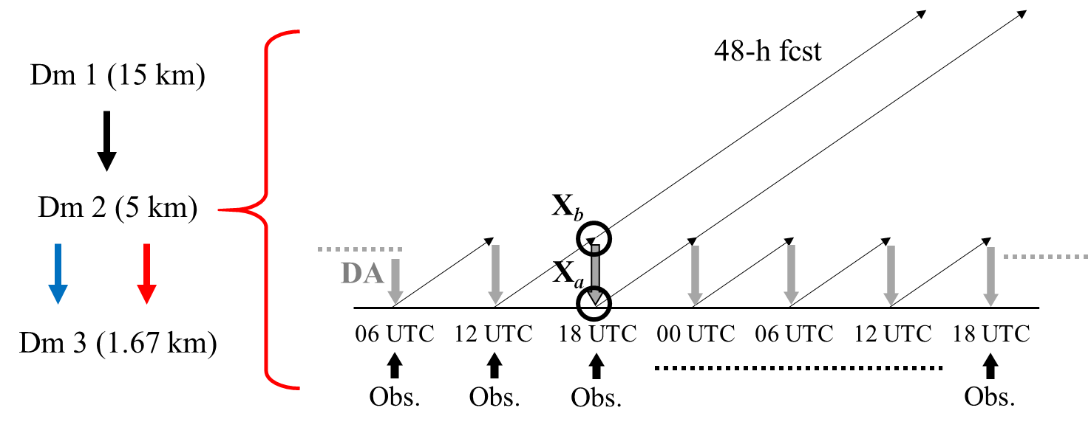
2-2. Experimental setting
EXP1 | WSM5 | Cold start
EXP2 |  | Warm start | Conventional obs.
EXP3 |  |  | Conventional obs. + Microwave radiance (AMSU-A, MHS)
EXP4 | Morrison 2-moment | Cold start
EXP5 |  | Warm start | Conventional obs. + Microwave radiance (AMSU-A, MHS)
The first 24-h forecasts from each analysis are excluded from the verification.
The 1 hourly time series for all experiments consist of 25–30 hour forecasts from 00, 06, 12, and 18 UTC.

Slide 6
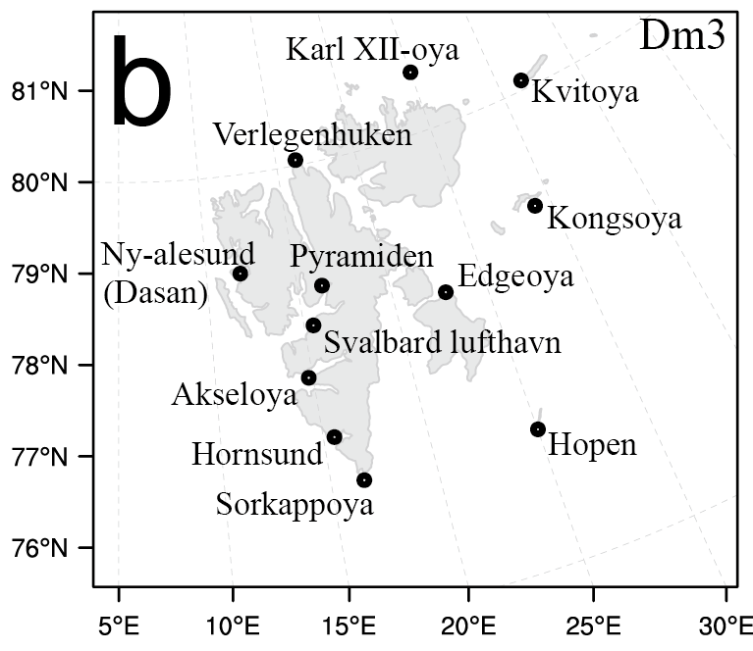
2-3. Observations
Hopen ( )
: Downward longwave / shortwave radiation flux
Ny-alesund (Dasan Station_Republic of Korea) ( )
: Upward sensible / latent heat flux
SYNOP stations ( )
: 10 m wind, 2 m temperature, sea level pressure
3-1. Surface radiation flux
3-2. Surface heat flux
3-3. Near surface variables

Slide 7
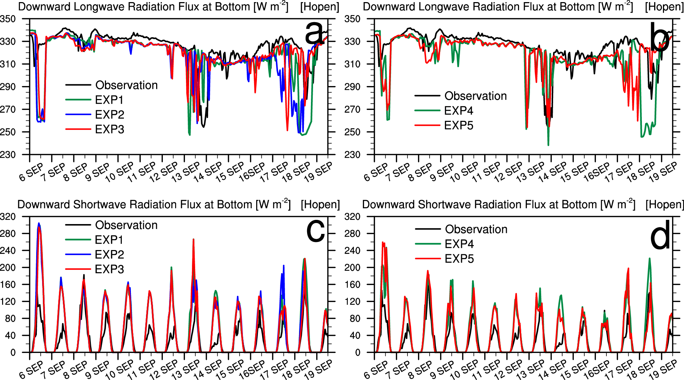
3-1. Surface radiation flux
Experiments |  | EXP1 | EXP2 | EXP3 | EXP4 | EXP5
Longwave | Bias | -8.15 | -7.81 | -5.52 | -8.41 | -5.81
 | RMSE | 21.14 | 22.09 | 18.45 | 20.25 | 16.79
Shortwave | Bias | 45.80 | 44.43 | 42.21 | 32.39 | 28.93
 | RMSE | 57.66 | 56.16 | 52.99 | 42.78 | 40.78
a. Time series (case 1)
better
: WSM5 Morrison
better
: WSM5 Morrison
Underestimation of the low level cloud
Shortwave radiation
Longwave radiation
(a) Case 1
2017091806
(a) Case 1
2017091806
> LW radiation
> SW radiation

Slide 8
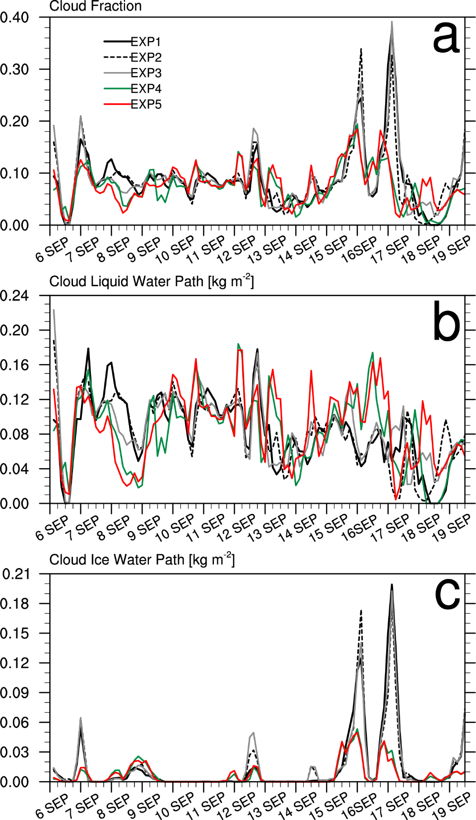
3-1. Surface radiation flux
b. Cloud fraction (case 1)
(a) Case 1
2017091806
Cloud fraction = 0.075 * CLWP + 0.17 * CIWP
The CF is determined mainly by the CLWP in summer.
The low CF values around 6, 13, and 17–18 SEP correspond to the underestimation of the downward longwave radiation fluxes.

Slide 9
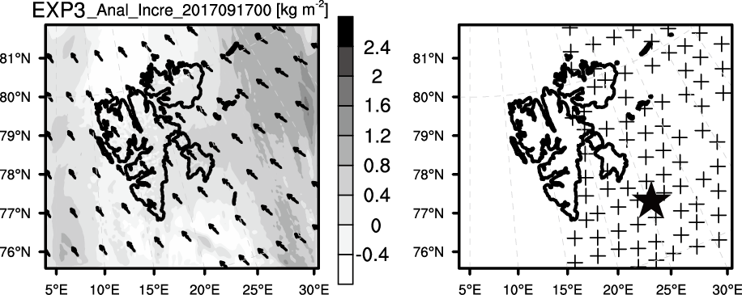
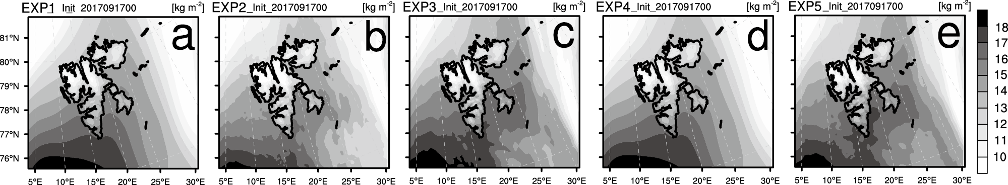
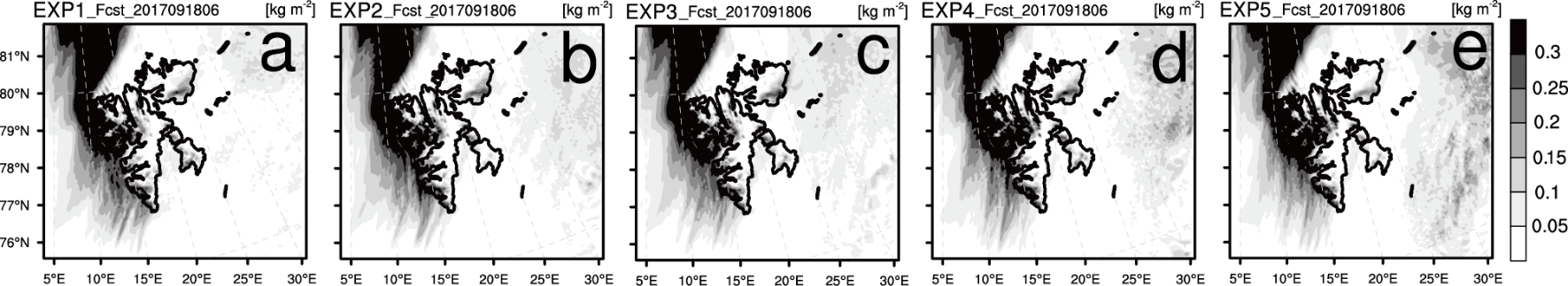
3-1. Surface radiation flux
c. Cloud simulation (case 1)
Integrated water vapor (20170917 00 UTC)
Cloud liquid water path (20170918 06 UTC)

Slide 10
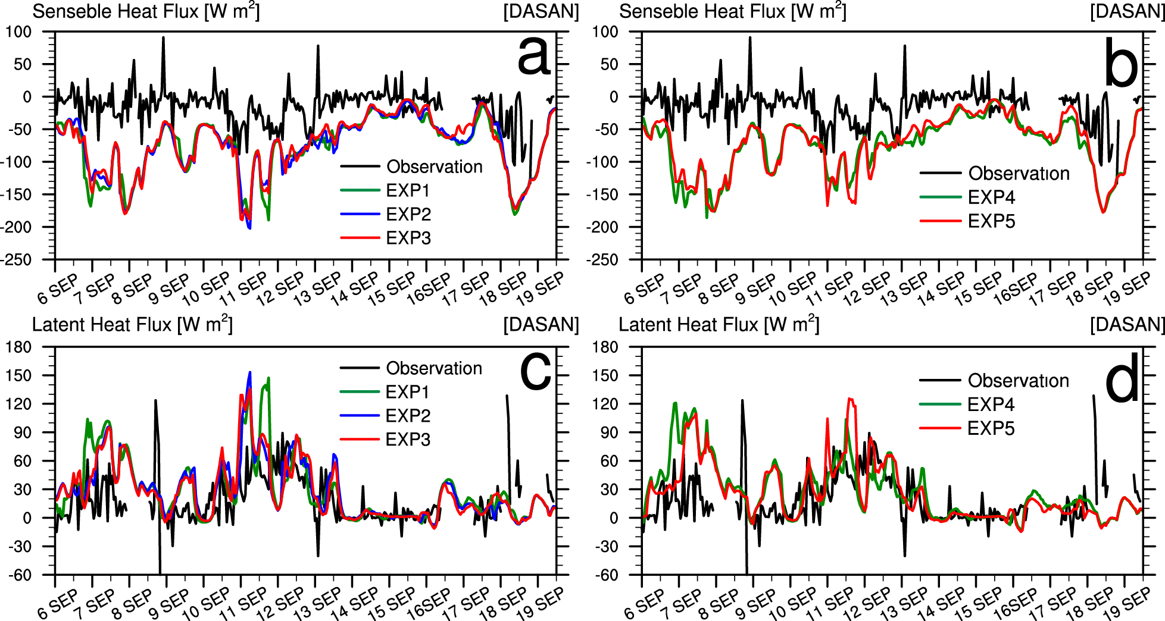
3-2. Surface heat flux
Experiments |  | EXP1 | EXP2 | EXP3 | EXP4 | EXP5
Sensible heat flux | Bias | -62.01 | -59.93 | -59.58 | -61.47 | -58.97
 | RMSE | 77.52 | 75.29 | 75.00 | 76.10 | 74.23
Latent heat flux | Bias | 11.39 | 10.22 | 10.22 | 10.42 | 8.74
 | RMSE | 39.26 | 35.68 | 36.20 | 36.77 | 35.63
a. Time series (case 2)
Underestimation of the low level cloud
Shortwave radiation
Longwave radiation
Surface
temp.
(b) Case 2
2017090618
> LW radiation
> SW radiation

Slide 11
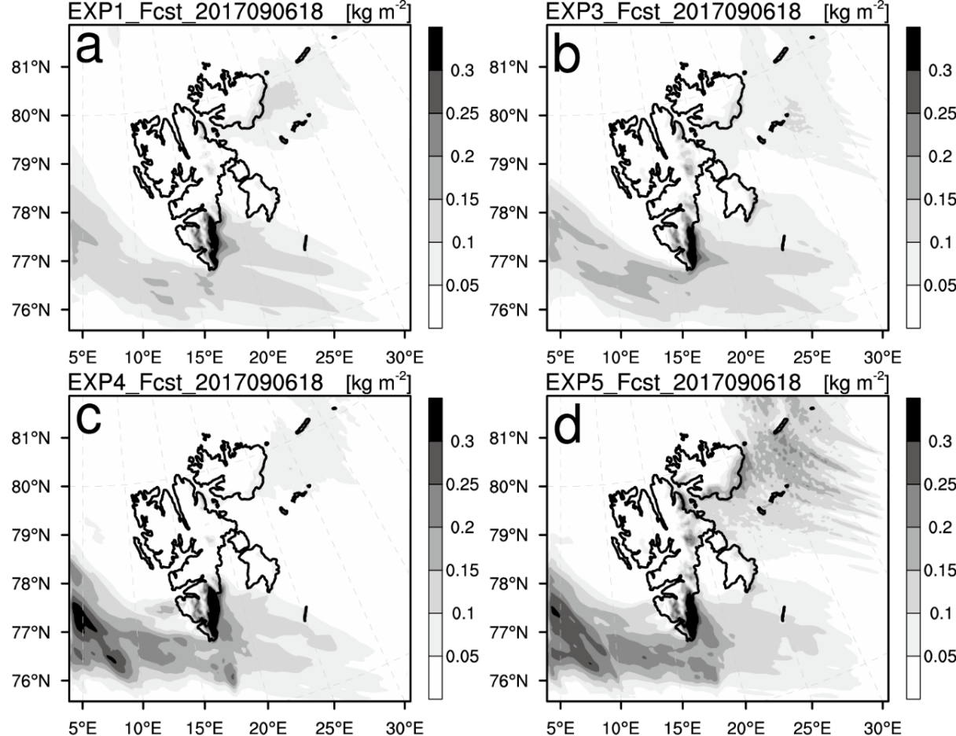
3-2. Surface heat flux
True
ERA5 reanalysis (20170906 18 UTC)
b. Cloud simulation (case 2)
Cloud liquid water path (20170906 18 UTC)
Region 2
Region 1
Wind
SNPP true color image (20170906 10 UTC)

Slide 12
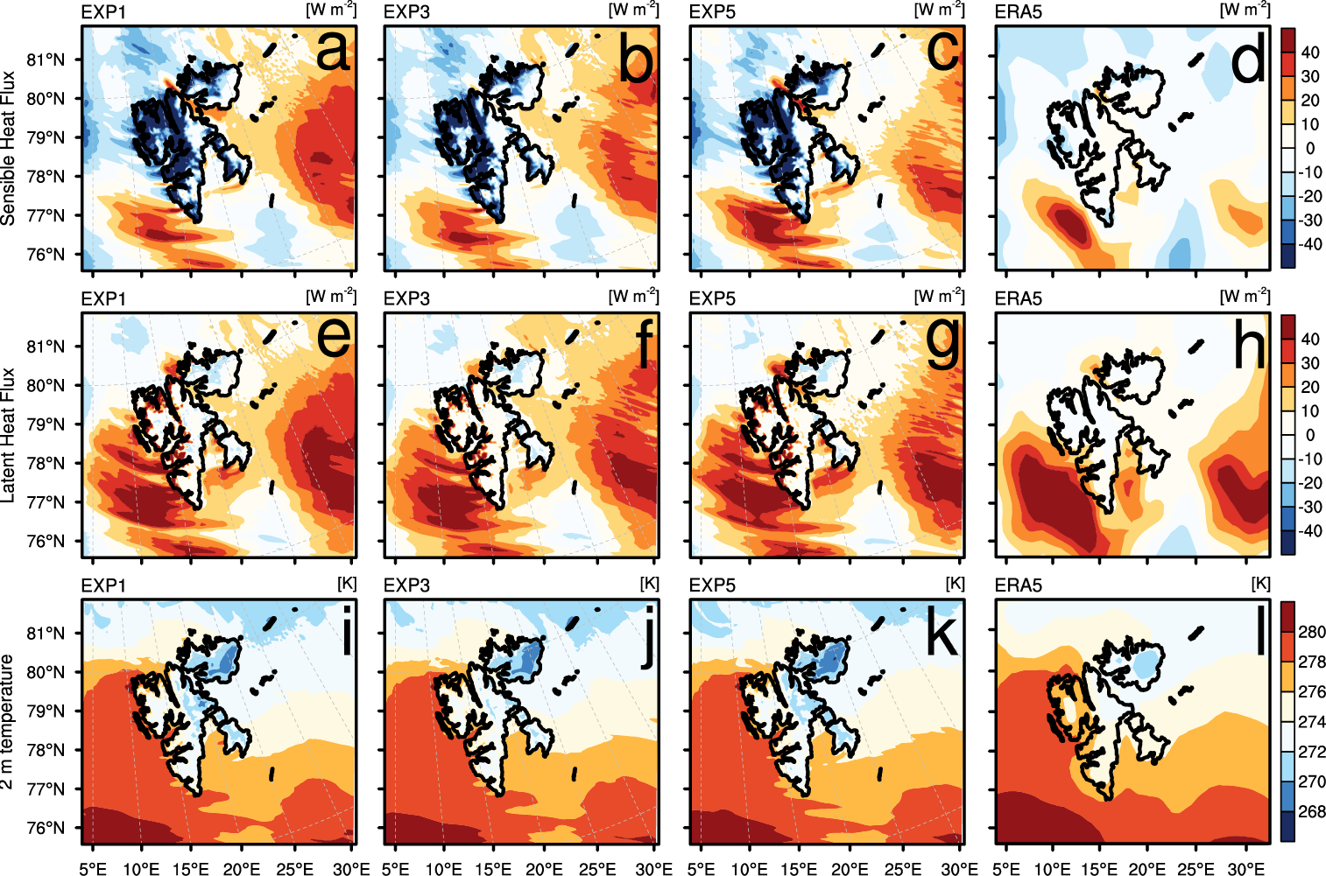
3-2. Surface heat flux
c. Flux field (case 2)
Shortwave radiation
Longwave radiation
> LW radiation
> SW radiation
Ocean Land
Albedo
Albedo
Heat content
Heat content
Temperature
Temperature

Slide 13
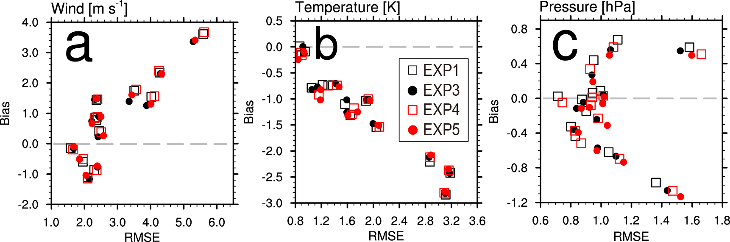
3-3. Near surface variables
a. Error statistics
 | Wind |  | Temperature |  | Pressure
 | Bias | RMSE | Bias | RMSE | Bias | RMSE
EXP1 | 0.834 | 2.901 | -1.233 | 1.814 | -0.053 | 1.010
EXP3 | 0.752 | 2.853 | -1.213 | 1.806 | -0.141 | 1.048
EXP4 | 0.855 | 2.935 | -1.249 | 1.849 | -0.128 | 1.047
EXP5 | 0.795 | 2.896 | -1.272 | 1.846 | -0.188 | 1.080
The negative bias of temperature is related to the underestimation of low level clouds.
The forecast error of the 10 m wind and 2 m temperature in the warm start was less than that in the cold start at most observation stations.
25–30 h forecast errors

Slide 14
4. Summary
When the cloud microphysics schemes in the PWRF have limitations, the possibility of complementing cloud simulations by using data assimilation was evaluated.
The forecasts of both cold and warm start experiments underestimated the amount of arctic clouds in summer. When satellite radiance data (AMSU-A and MHS) were assimilated, the distribution and quantity of water vapor became more realistic, which results in the improvement in cloud liquid water forecasts.
The improved forecast accuracy of clouds contributes to the decrease of forecast errors for radiation and heat fluxes.
The forecast error of the 10 m wind and 2 m temperature in the warm start was less than that in the cold start at most observation stations.
In conclusion, the data assimilation, especially assimilating satellite radiance data, could help to overcome the limitations of underestimated arctic clouds caused by microphysics schemes in the PWRF.

Slide 15
Thank you

