Slide 1
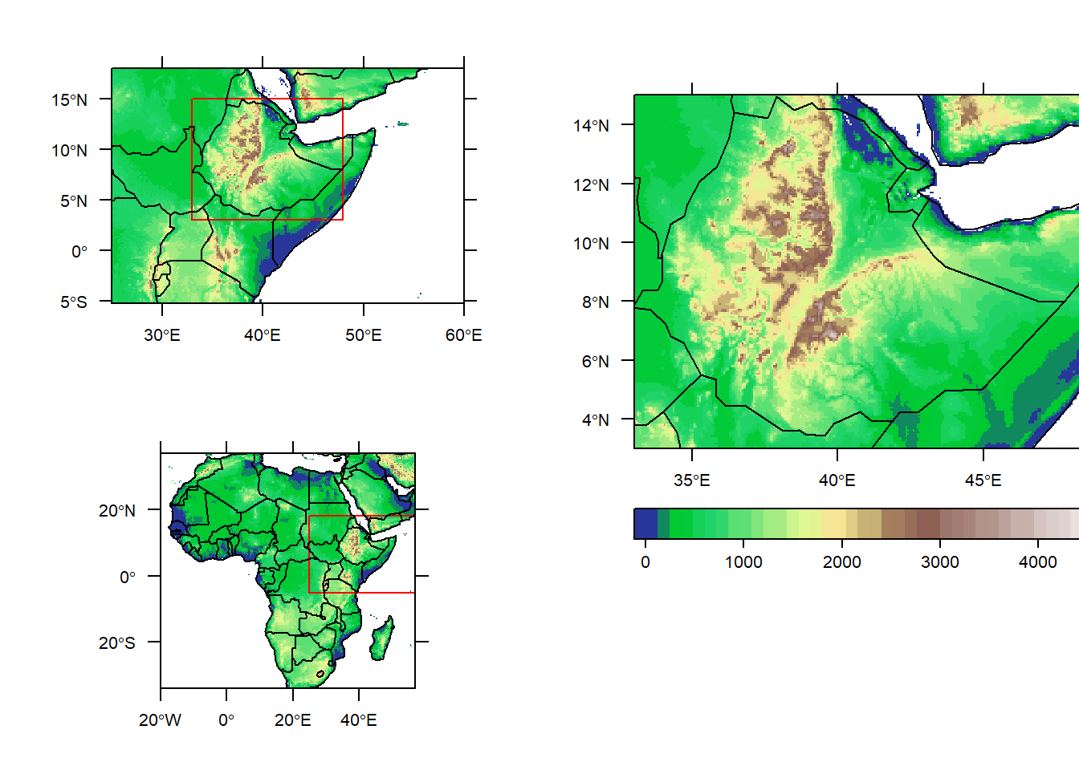
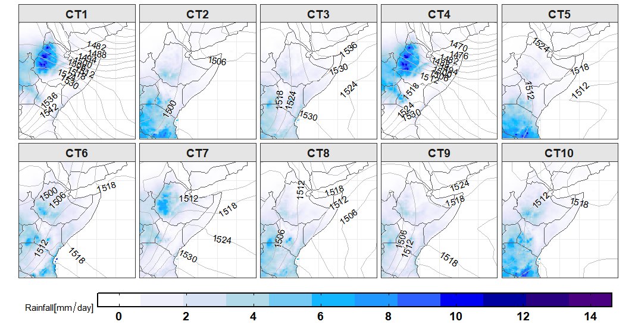
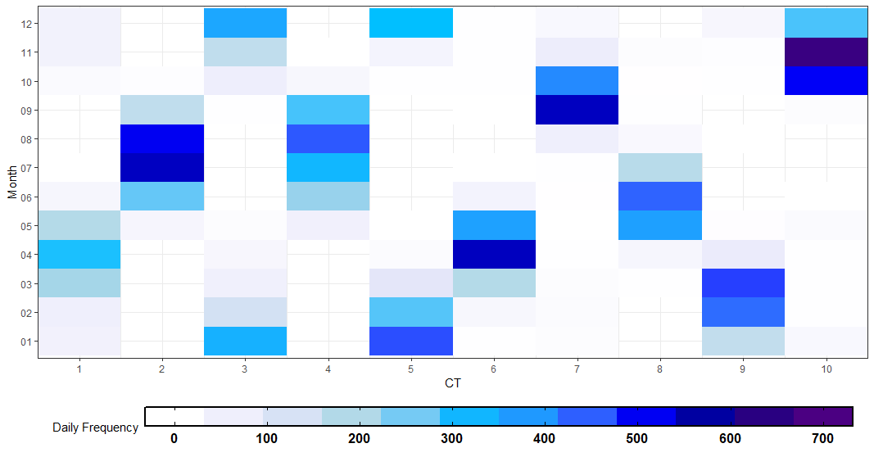
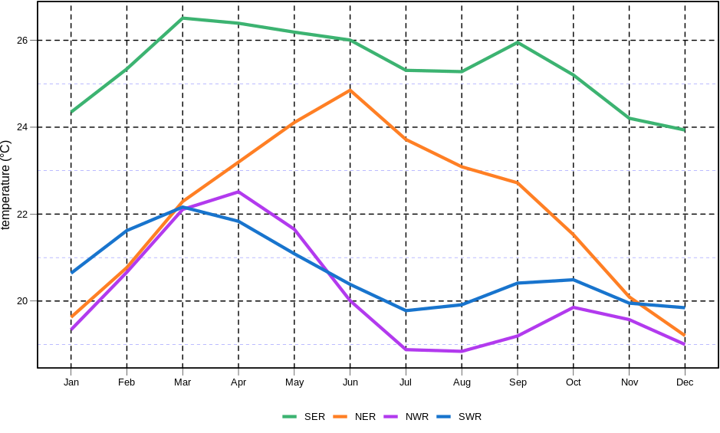
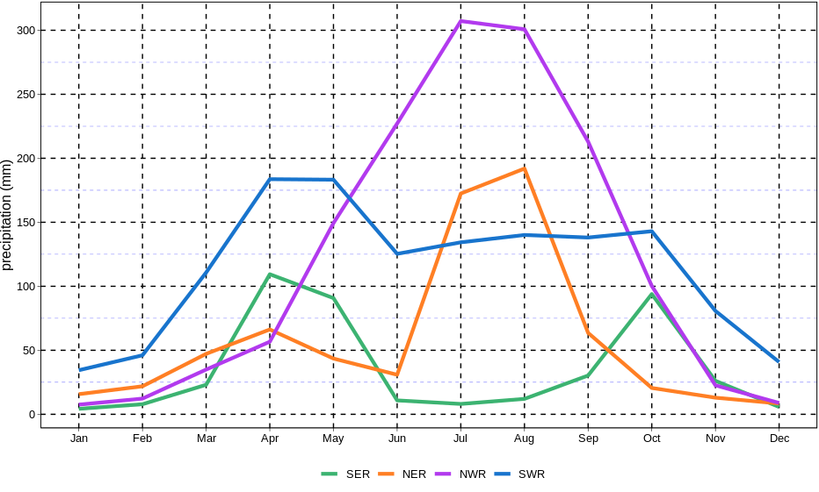
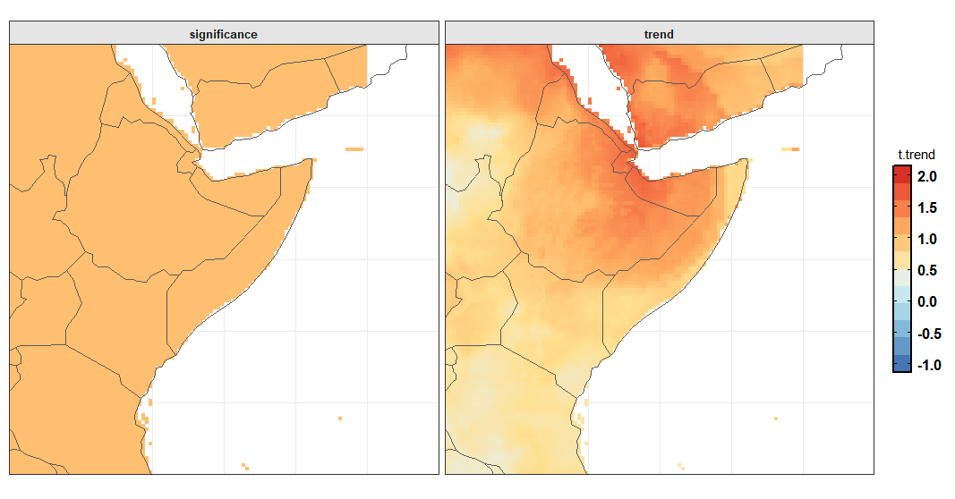
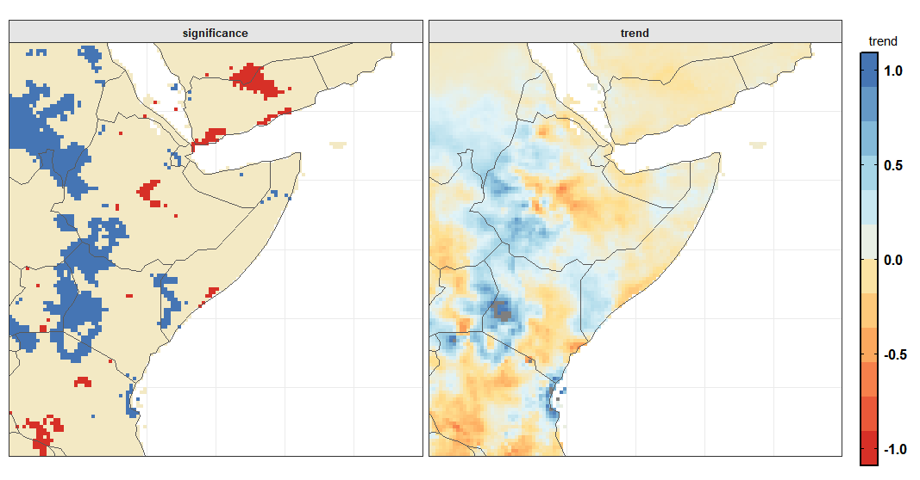
Synoptic Circulation Patterns and
Precipitation Regionalization over East Africa
Markos Ware*, Paolo Mori, Kirsten Warrach-Sagi, Mark Jury, Thomas Schwitalla,Volker Wulfmeyer
Institute for Physics and Meteorology, University of Hohenheim
I. Motivation
II. Methods
East Africa has a diverse climatic conditions modulated by synoptic, mesoscale and local feedback processes.
Subjective climatic regionalization's that introduce errors during clustering and delineation processes are in use.
Objective climatic regionalization is available over western Ethiopia (33°E–40°E and 3°N–15°N) only on summer season⁴.
We applied objective and automatic clustering technique on precipitation over East Africa considering all seasons.
We evaluated a seasonal cycle and trend in temperature and precipitation over respective regions.
Principal Component Analysis (PCA) was used to establish circulation types from daily mean sea level pressure.
Fig 1: Domain used in regionalization analysis
Using scree test we decided to maintain five principal components that explain 98% of the total variance.
Precipitation was regionalized into homogeneous climatic regions applying k-means clustering approach.
III. Results
a) Synoptic circulation types and climatology
b) Homogeneous climatic regions and their respective characteristics
Fig 2. Left: precipitation distributed over represent circulation types classified based on daily mean sea level pressure and contours lines represent sea level pressure distribution. Right: Seasonal cycle of respective circulation type.
Fig 4. Left: Seasonal cycle of long-term temperature over respective regions; Right: Seasonal cycle of long-term precipitation over respective region
Circulation types (CT1, CT4, and CT8) represented by low-pressure over the western part of the domain triggers precipitation over Ethiopian highlands.
IV. Summary and outlook
Climate regionalization is a pragmatic approach which can be utilized for climate, weather, hydrology, natural resources and hazards studies.
Ethiopia is clustered into four homogeneous regions, which explains 98% of the total variance of the precipitation over the region.
Seasonal forecast will be analyzed using these climatic sub-regions.
Fig 3. Left: trends in 2-m maximum temperature during 1983-2016 and Right: trends in precipitation during 1985-2018 over the study domain
The trend in precipitation is a non-significant over considerable parts of the region; however, trends in maximum temperature is significant across the region.
The 2-m maximum temperature increased up 2° C in some areas over the domain.
V. References
Lemus-Canovas M, Lopez-Bustins JA, Martin-Vide J, Royé D.( 2019). Environmental Modelling & Software. 118:114–19
Esteban P, Martin‐Vide J, Mases M. (2005; 2006). International Journal of Climatology. 26(11):1501–15
Souverijns N, Thiery W, Demuzere M, Lipzig NPMV. (2016). Environ. Res. Lett. 11(11):114011
Zhang Y, Moges S, Block P. (2016). J. Climate. 29(10):3697–3717
*Markos B. Ware, Garbenstraße 30, 70593 Stuttgart; markos.ware@uni-hohenheim.de

