Slide 1
EGU2020-14615
Seismic velocity changes across 10 years correlate the micro-seismicity evolution in the Irpinia Fault System (Southern Italy)
G. De Landro (1), R. Esposito (1), O. Amoroso (2) and A. Zollo (1)
(1) Dep. of Physics “E. Pancini”, Univ. of Naples “Federico II”, Italy
(2) Dep. of Physics “E.R. Caianiello” Univ. of Salerno, Fisciano (SA) Italy
email: grazia.delandro@gmail.com

Slide 2
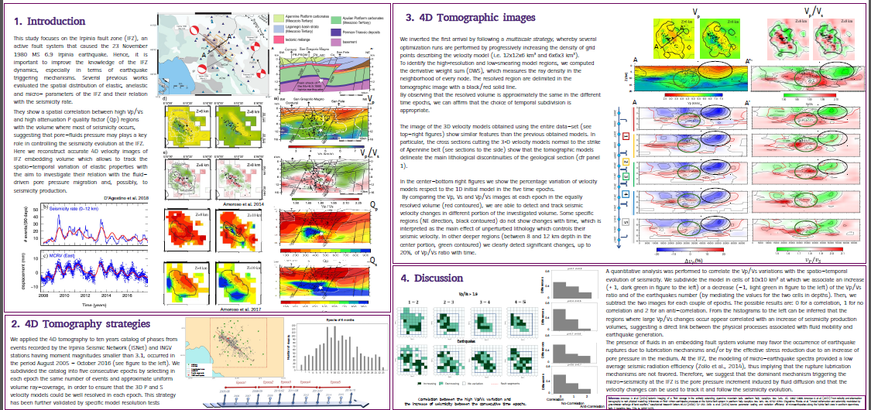
Seismic velocity changes across 10 years correlate the micro-seismicity evolution in the Irpinia Fault System (Southern Italy)
Click on the box of your interest…

Slide 3
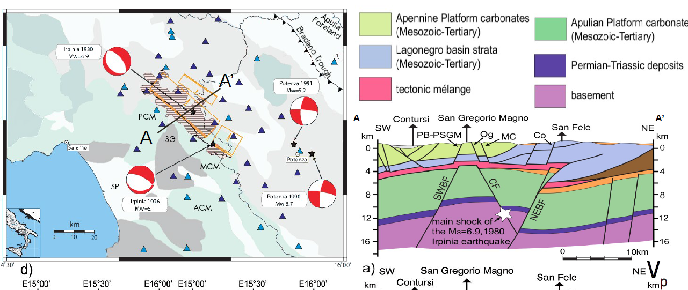
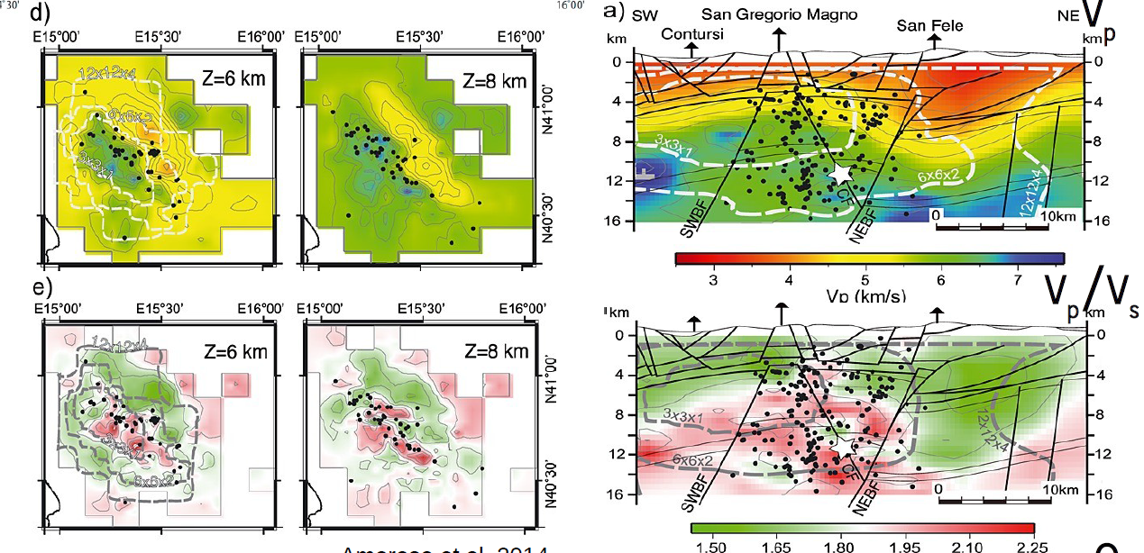
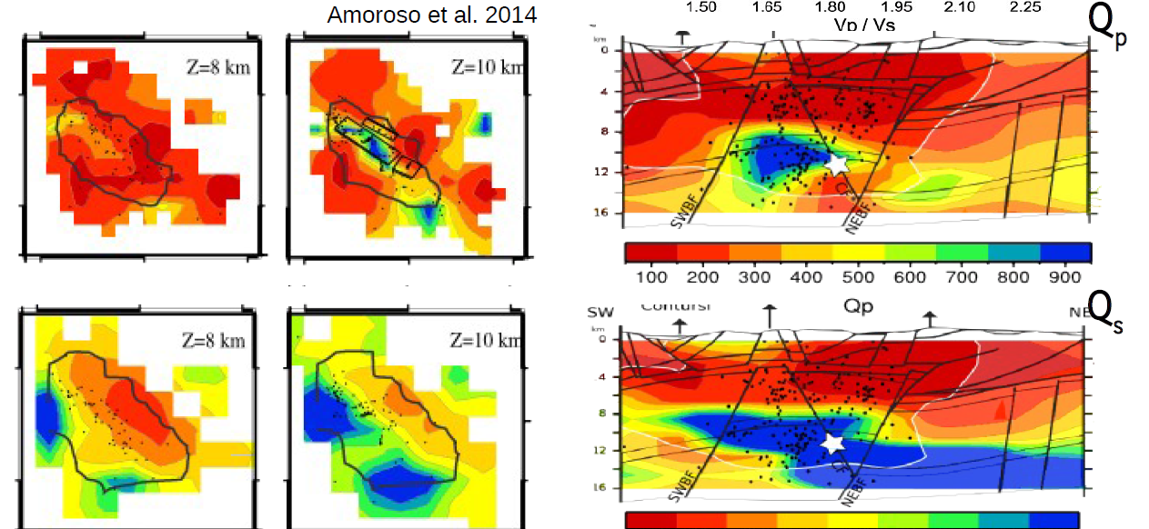
1. Introduction
This study focuses on the Irpinia fault zone (IFZ), an active fault system that caused the 23 November 1980 MS 6.9 Irpinia earthquake. Hence, it is important to improve the knowledge of the IFZ dynamics, especially in terms of earthquake triggering mechanisms.
Previous works showed a spatial correlation between high Vp/Vs and high attenuation P quality factor (Qp) regions with the volume where most of seismicity occurs, suggesting that pore-fluids pressure may plays a key role in controlling the seismicity evolution at the IFZ.
Here we reconstruct accurate 4D velocity images of IFZ embedding volume which allows to track the spatio-temporal variation of elastic properties with the aim to investigate their relation with the fluid-driven pore pressure migration and, possibly, to seismicity production.
Come back…
GRAZIA DE LANDRO, 8 MAY 2020

Slide 4
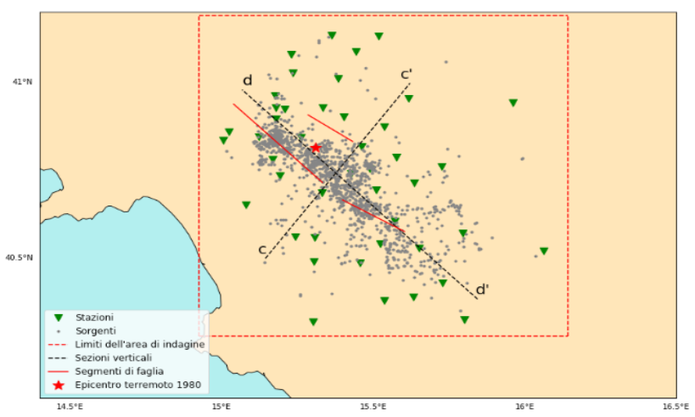
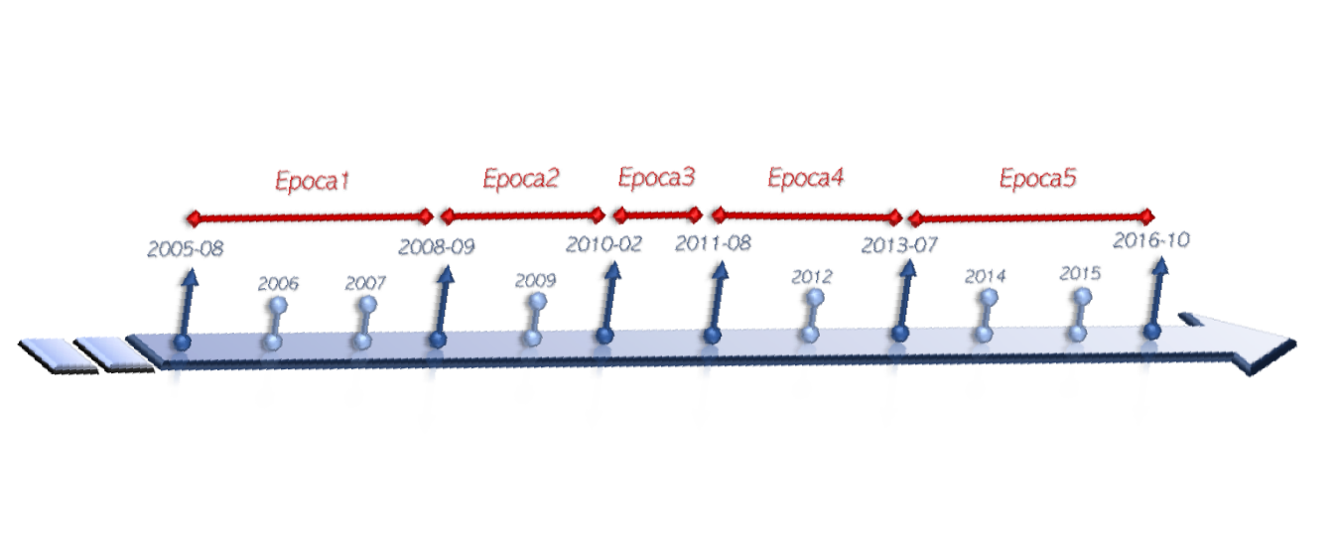
2. 4D Tomography strategies
We applied the 4D tomography to ten years catalog of phases from events recorded by the Irpinia Seismic Network (ISNet) and INGV stations (M<3.1), occurred in the period August 2005 - October 2016.
We subdivided the catalog into five consecutive epochs by selecting in each epoch the same number of events and approximate uniform volume ray-coverage, in order to ensure that the 3D P and S velocity models could be well resolved in each epoch.
We inverted the first arrival by following a multiscale strategy, (parameterization from 12x12x6 km³ to 6x6x3 km³).
Epochs of 6 months
Epochs of 9 months
Come back…
GRAZIA DE LANDRO, 8 MAY 2020

Slide 5
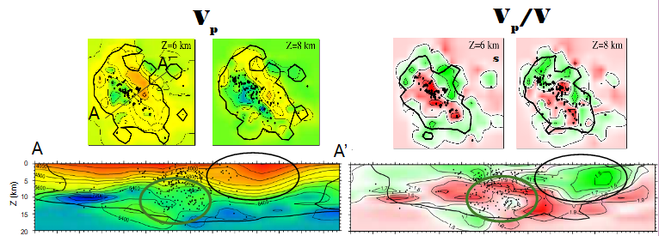
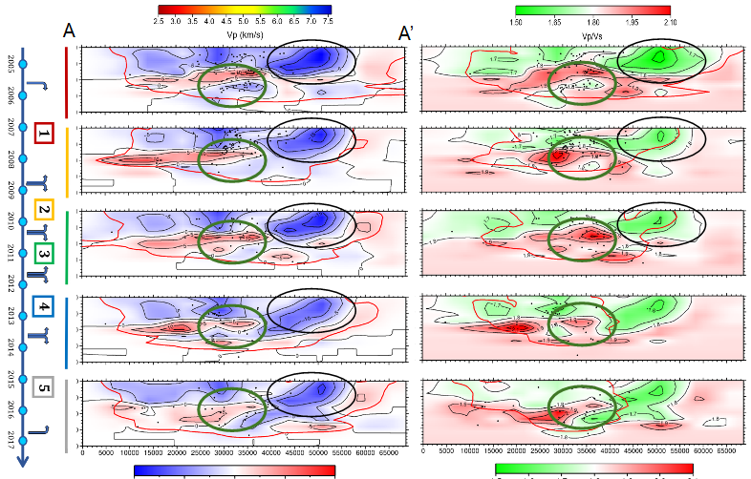
3. 4D Tomographic images
By observing that the resolved volume (delimited with black/red solid lines) is approximately the same in the different time epochs, we can affirm that the choice of temporal subdivision is appropriate.
The image of the 3D velocity models obtained using the entire data-set (see top-right figures) show that the tomographic models delineate the main lithological discontinuities of the geological section.
By comparing the Vp, Vs and Vp/Vs images at each epoch in the equally resolved volume (red contoured), we are able to detect and track seismic velocity changes in different portion of the investigated volume.
Some specific regions (NE direction, black contoured) do not show changes with time, which is interpreted as the main effect of unperturbed lithology which controls their seismic velocity.
In other deeper regions (between 8 and 12 km depth in the center portion, green contoured) we clearly detect significant changes, up to 20%, of Vp/Vs ratio with time.
Come back…
percentage variation of velocity models respect to the 1D initial model
GRAZIA DE LANDRO, 8 MAY 2020

Slide 6
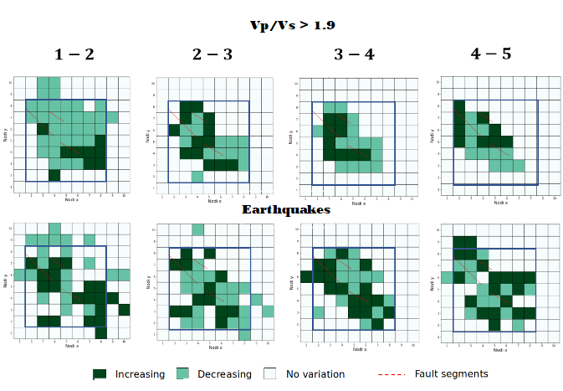
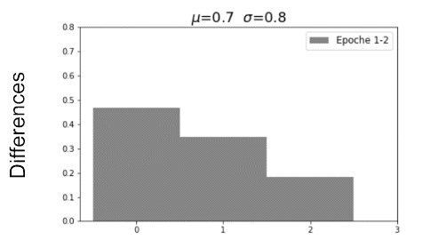
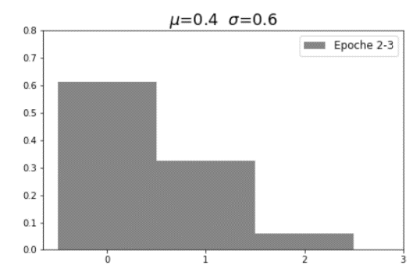
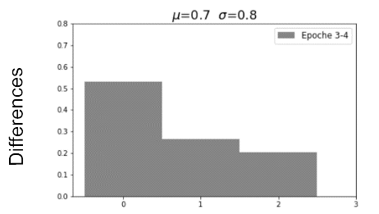
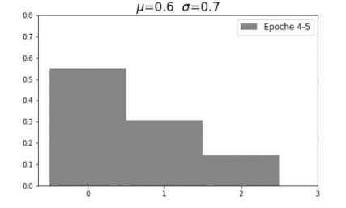
4. Discussion
We subdivide the model in cells of 10x10 km² at which we associate an increase or a decrease of the Vp/Vs ratio and of the earthquakes number. Then, we subtract the two images for each couple of epochs.
From the histograms to the left can be inferred that the regions where large Vp/Vs changes occur appear correlated with an increase of seismicity production volumes, suggesting a direct link between the physical processes associated with fluid mobility and earthquake generation.
The presence of fluids in an embedding fault system volume may favor the occurrence of earthquake ruptures due to an increase of pore pressure in the medium. Therefore, we suggest that the dominant mechanism triggering the micro-seismicity at the IFZ is the pore pressure increment induced by fluid diffusion and that the velocity changes can be used to track it and follow the seismicity evolution.
Come back…
GRAZIA DE LANDRO, 8 MAY 2020

Slide 7
References
Amoroso O. et al. (2014) Seismic imaging of a fluid storage in the actively extending Apennine mountain belt, southern Italy. Geophys. Res. Lett., 41, 3802-3809.
Amoroso O. et al. (2017) From velocity and attenuation tomography to rock physical modeling: Inferences on fluid-driven earthquake processes at the Irpinia fault system in southern Italy. Geophys. Res. Lett., 44, 6752-6760.
D'Agostino, Nicola, et al. (2018) Crustal deformation and seismicity modulated by groundwater recharge of karst aquifers.Geophysical Research Letters 45.22 : 12-253.
Zollo A. et al. (2014) Source parameter scaling and radiation efficiency of microearthquakes along the Irpinia fault zone in southern Apennines, Italy. J. Geophys. Res., 119, 4, 3256-3275.
Come back…
GRAZIA DE LANDRO, 8 MAY 2020

