Slide 1






Numerical assessment of chemical species infiltration in the
Prosecco area
Leonardo Costa ª, Mazzega Ciamp S. ª, Cardinali A. ^{b}, Carretta L. ^{b}, Dal Ferro N. ^{b}, Mencaroni M. ^{b}, Morari F. ^{b}, Salandin P. ª, Zanin G. ^{b}
ª Department of Civil, Environmental and Architectural engineering;
^{b} Department of Agronomy, Food, Natural resources, Animals and Environment
University of Padova, Italy
© Costa et al.
all rights reserved
Corresponding author: leonardo.costa.1@phd.unipd.it

Slide 2
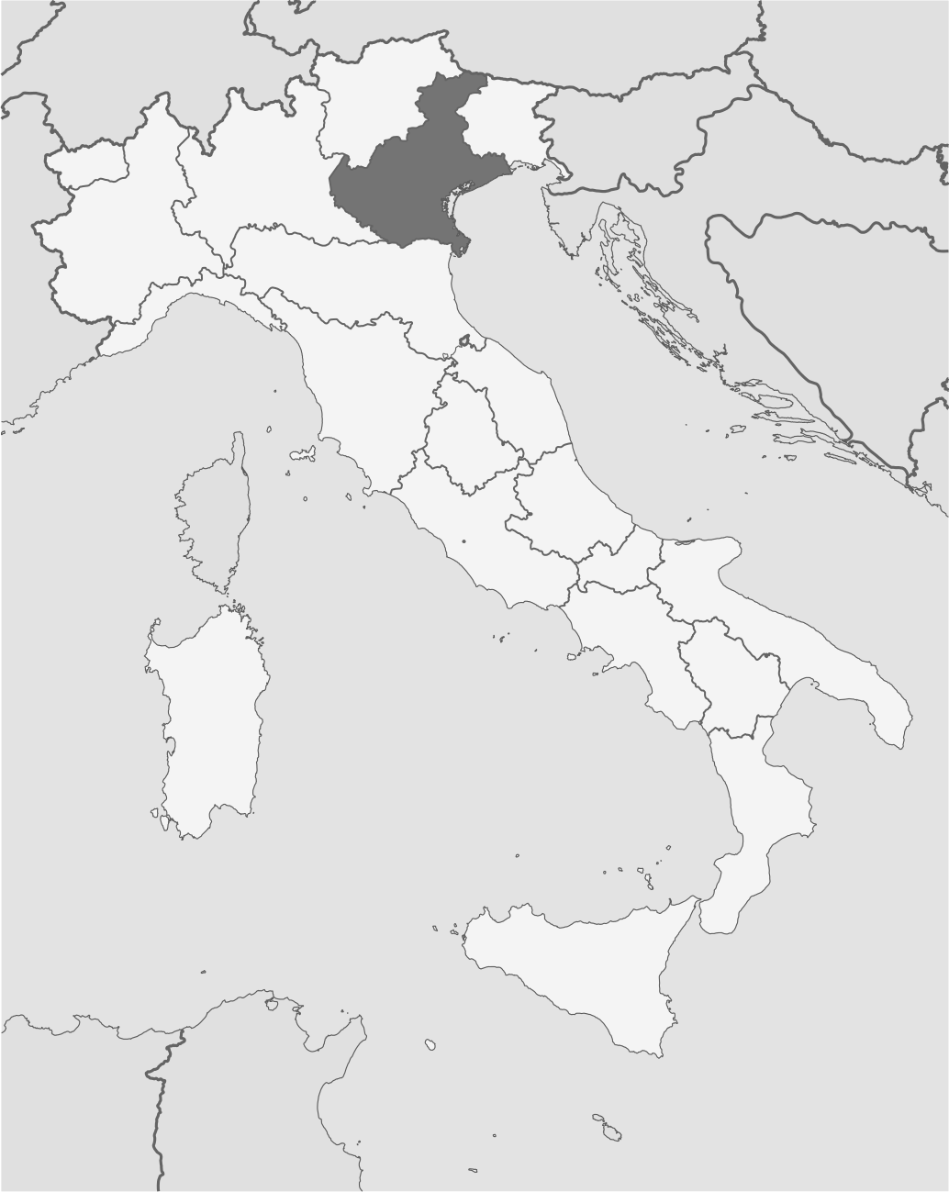
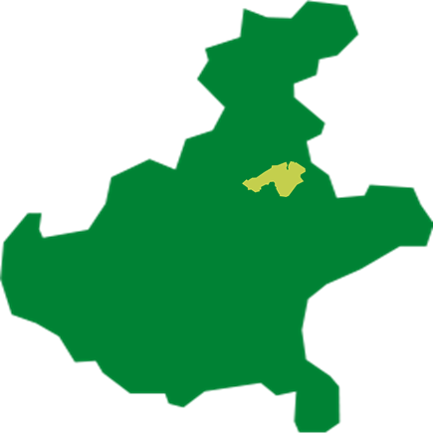
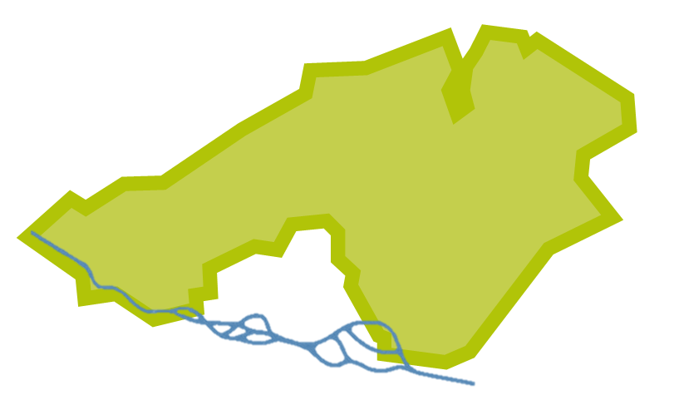



PROSECCO AREA
VENETO
D.O.C.G. PRODUCTION ZONE
TREVISO
VENEZIA
VALDOBBIADENE
ITALY
CONEGLIANO
PIAVE RIVER
en.wikipedia.org
www.prosecco.it/it/territorio/unesco/
© Costa et al.
all rights reserved
Introduction (1/3) - slide (1/19)

Slide 3
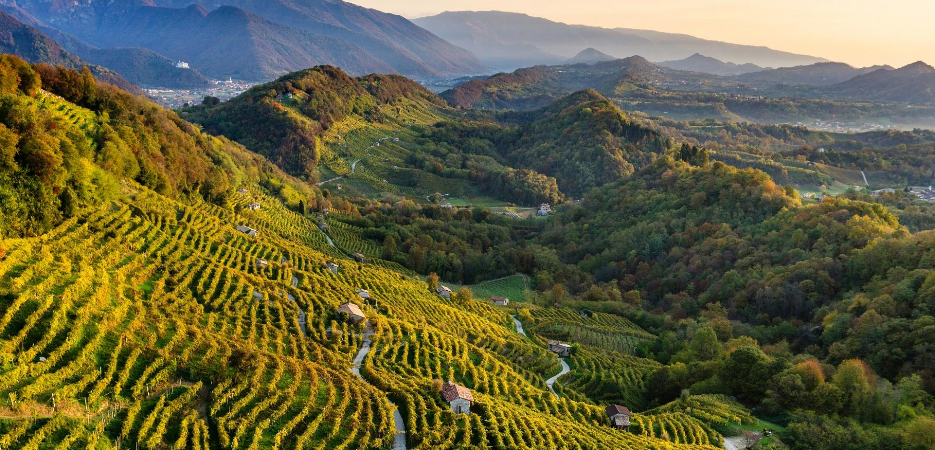
© Costa et al.
all rights reserved
Introduction (2/3) - slide (2/19)

Slide 4
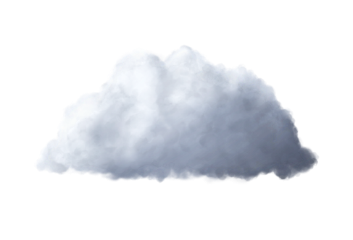

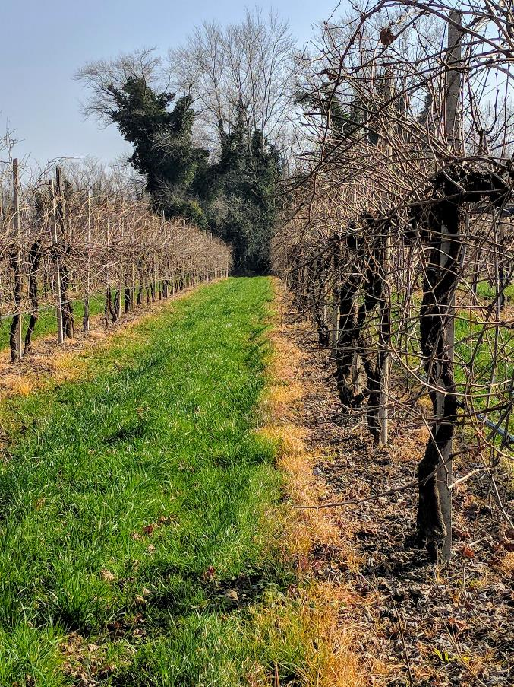
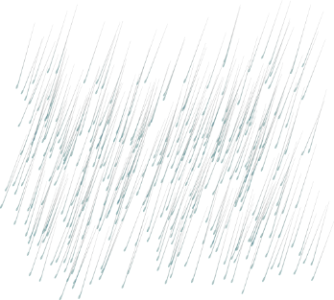
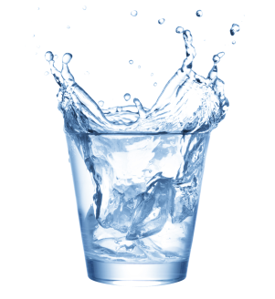
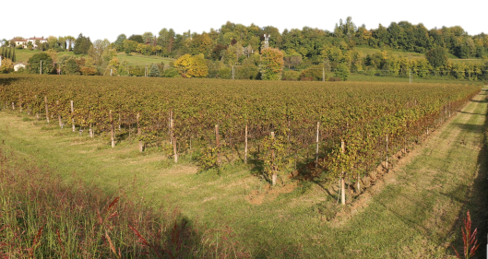




Contamination risks
Dispersion
Aquifer
x
Unsaturated Zone
Use of herbicide along the vineyards rows
z
© Costa et al.
all rights reserved
Introduction (3/3) - slide (3/19)

Slide 5
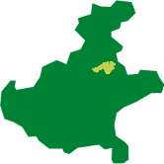
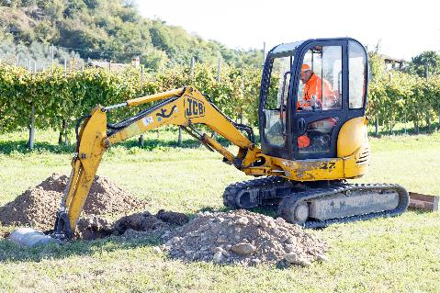

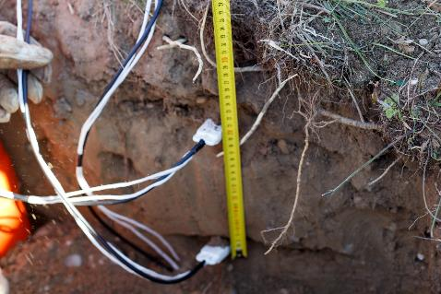
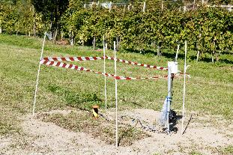
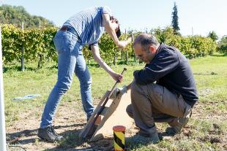

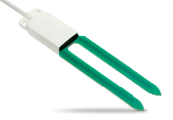
The SWAT project
Subsurface Water quality and Agricultural pracTices monitoring
2 monitoring installations, each of them subdivided in 2 parcels, were organized in October 2018 in 2 wells protection areas
SETTOLO SITE (VALDOBBIADENE)
Settolo North and Settolo South parcels
COLNÙ SITE (CONEGLIANO)
Colnù East and Colnù West parcels
Unconfined aquifers
water tables few meters underneath the surface
Capacitive sensors and porous cups were installed at
- 0,1 m, - 0,3 m, - 0,7 m ( x2 for each site )
© Costa et al.
all rights reserved
The SWAT project (1/4) slide (4/19)

Slide 6
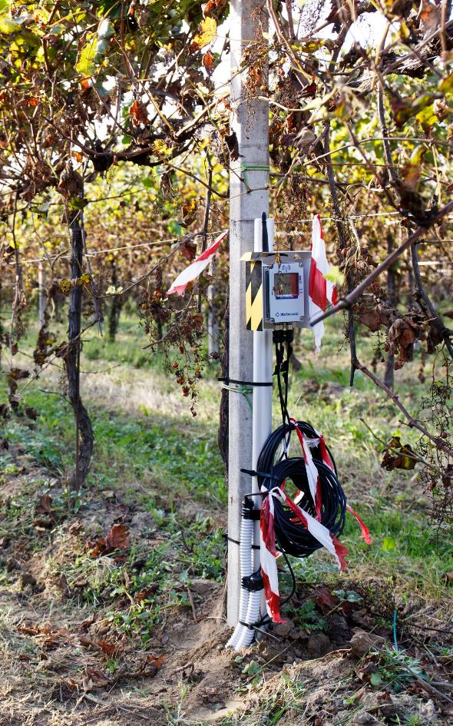
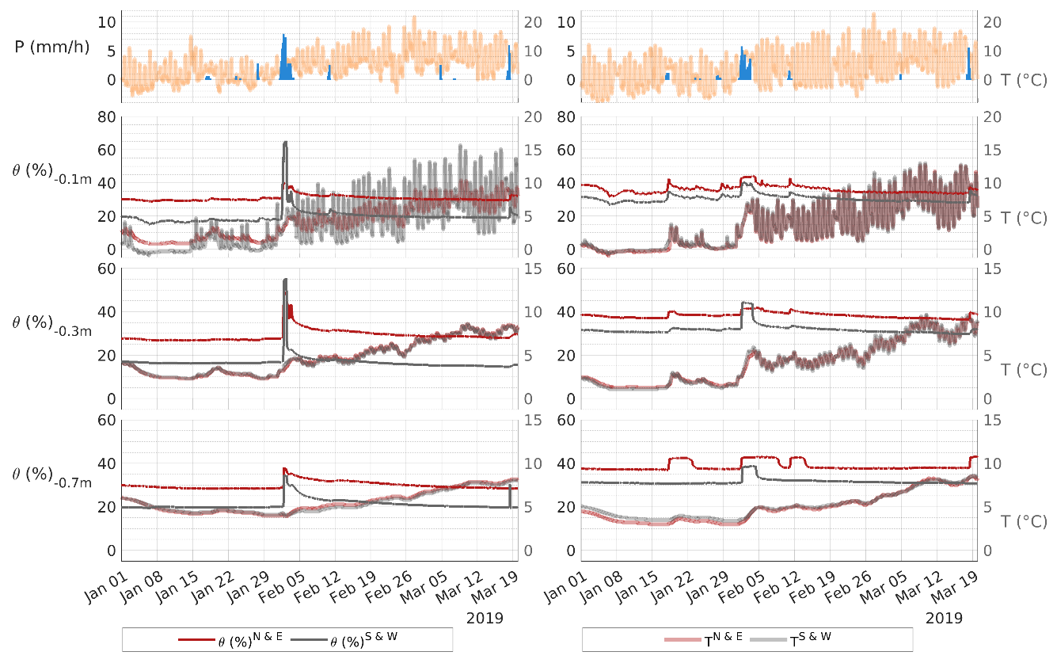
Capacitive sensors data logger and transmitter
Volumetric Water Content (θ) and Temperature (T) acquired by the capacitive sensors at Settolo (left) and Colnù (right) (Example: 10 weeks temporal window)
© Costa et al.
all rights reserved
The SWAT project (2/4) slide (5/19)

Slide 7
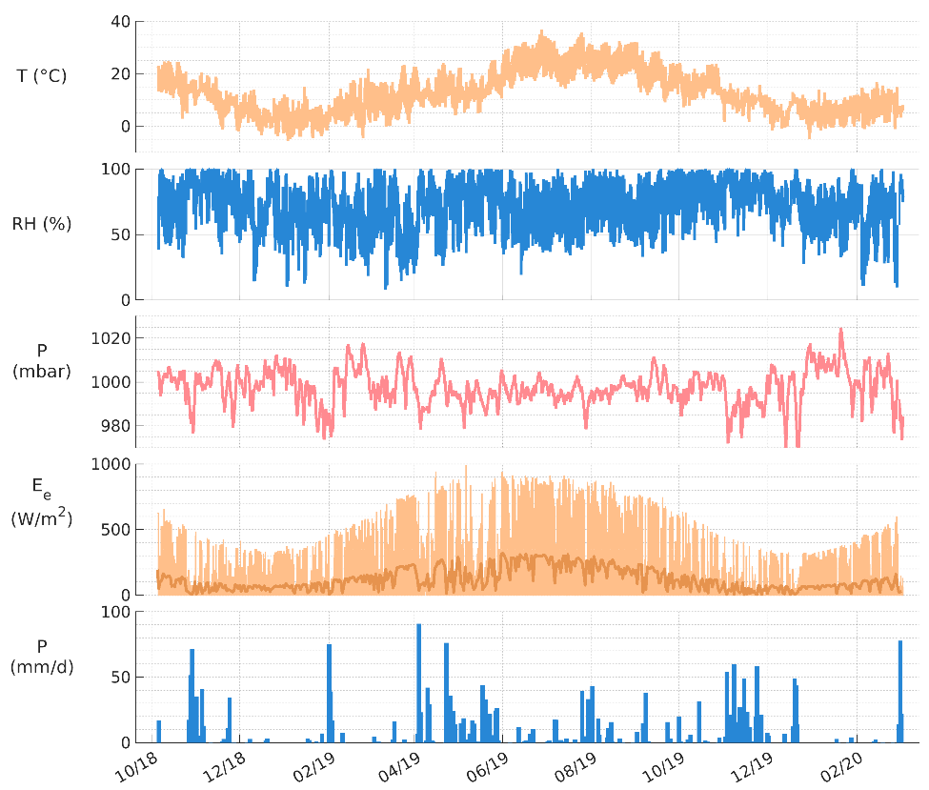
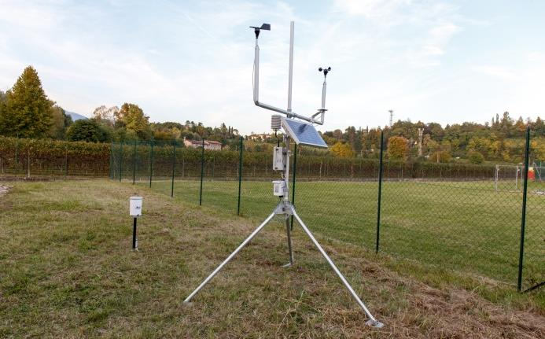
2 meteorological stations were installed (one for each experimental site)
var | description | unit
v_{w} | Wind velocity at 2 m | (m/s)
T_{w} | Wind temperature | (°C)
D | Wind direction | (degrees)
HYDROLICAL FORCING
and variables needed for
FAO PENMAN-MONTEITH EQUATION
for evapotranspiration modelling
Meteorological variables acquired at Settolo from October 2018 to April 2020
© Costa et al.
all rights reserved
The SWAT project (3/4) slide (6/19)

Slide 8
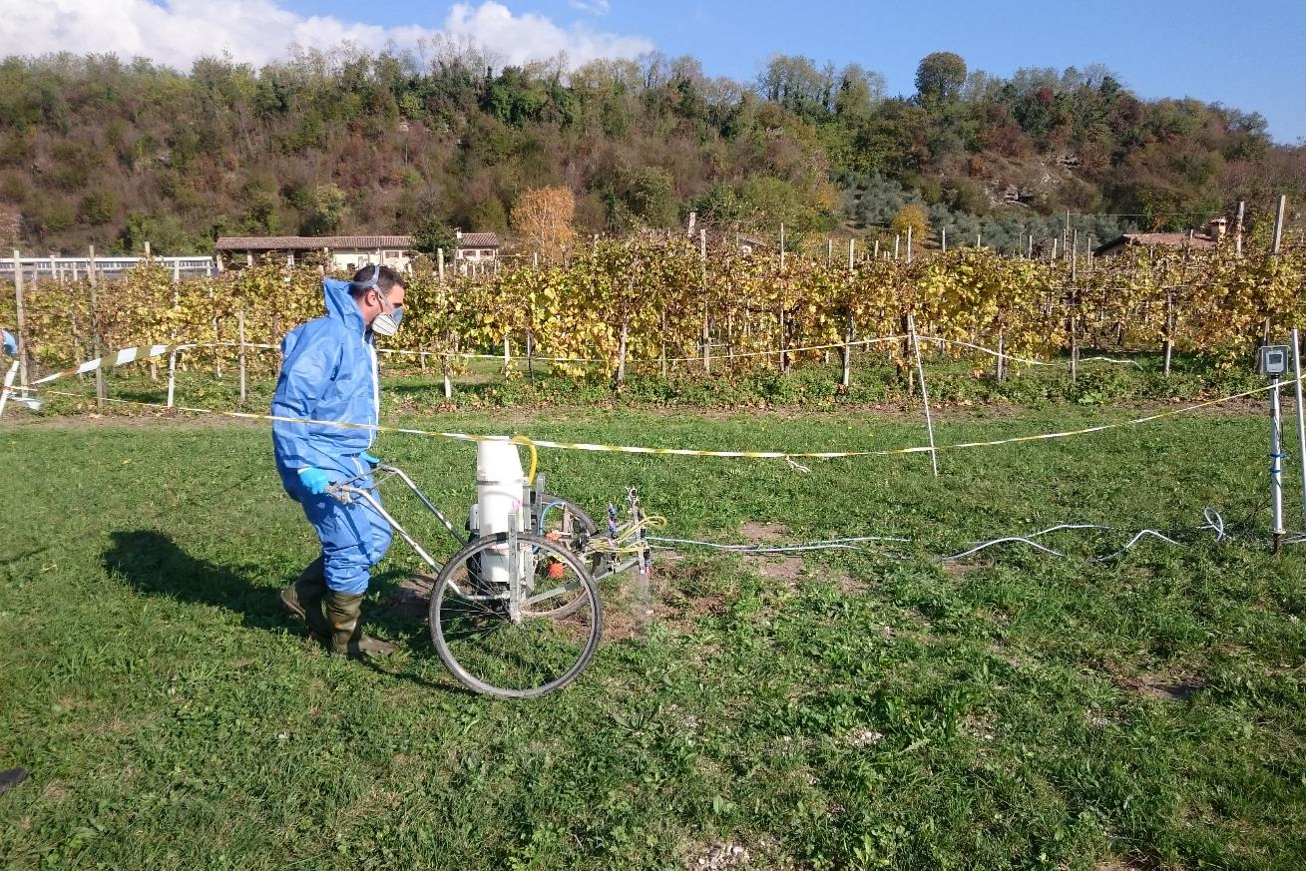
November 2018
A solution containing glyphosate (GLP) and potassium bromide (KBr) was applied on all the 4 site parcels
Soil Analysis
Chemical, Physical, Hydraulic properties
GLP and metabolite AMPA concetrations
Water Analysis
KBr
GLP and metabolite AMPA
concentrations
(Carretta et al. 2019)
© Costa et al.
all rights reserved
The SWAT project (4/4) slide (7/19)

Slide 9
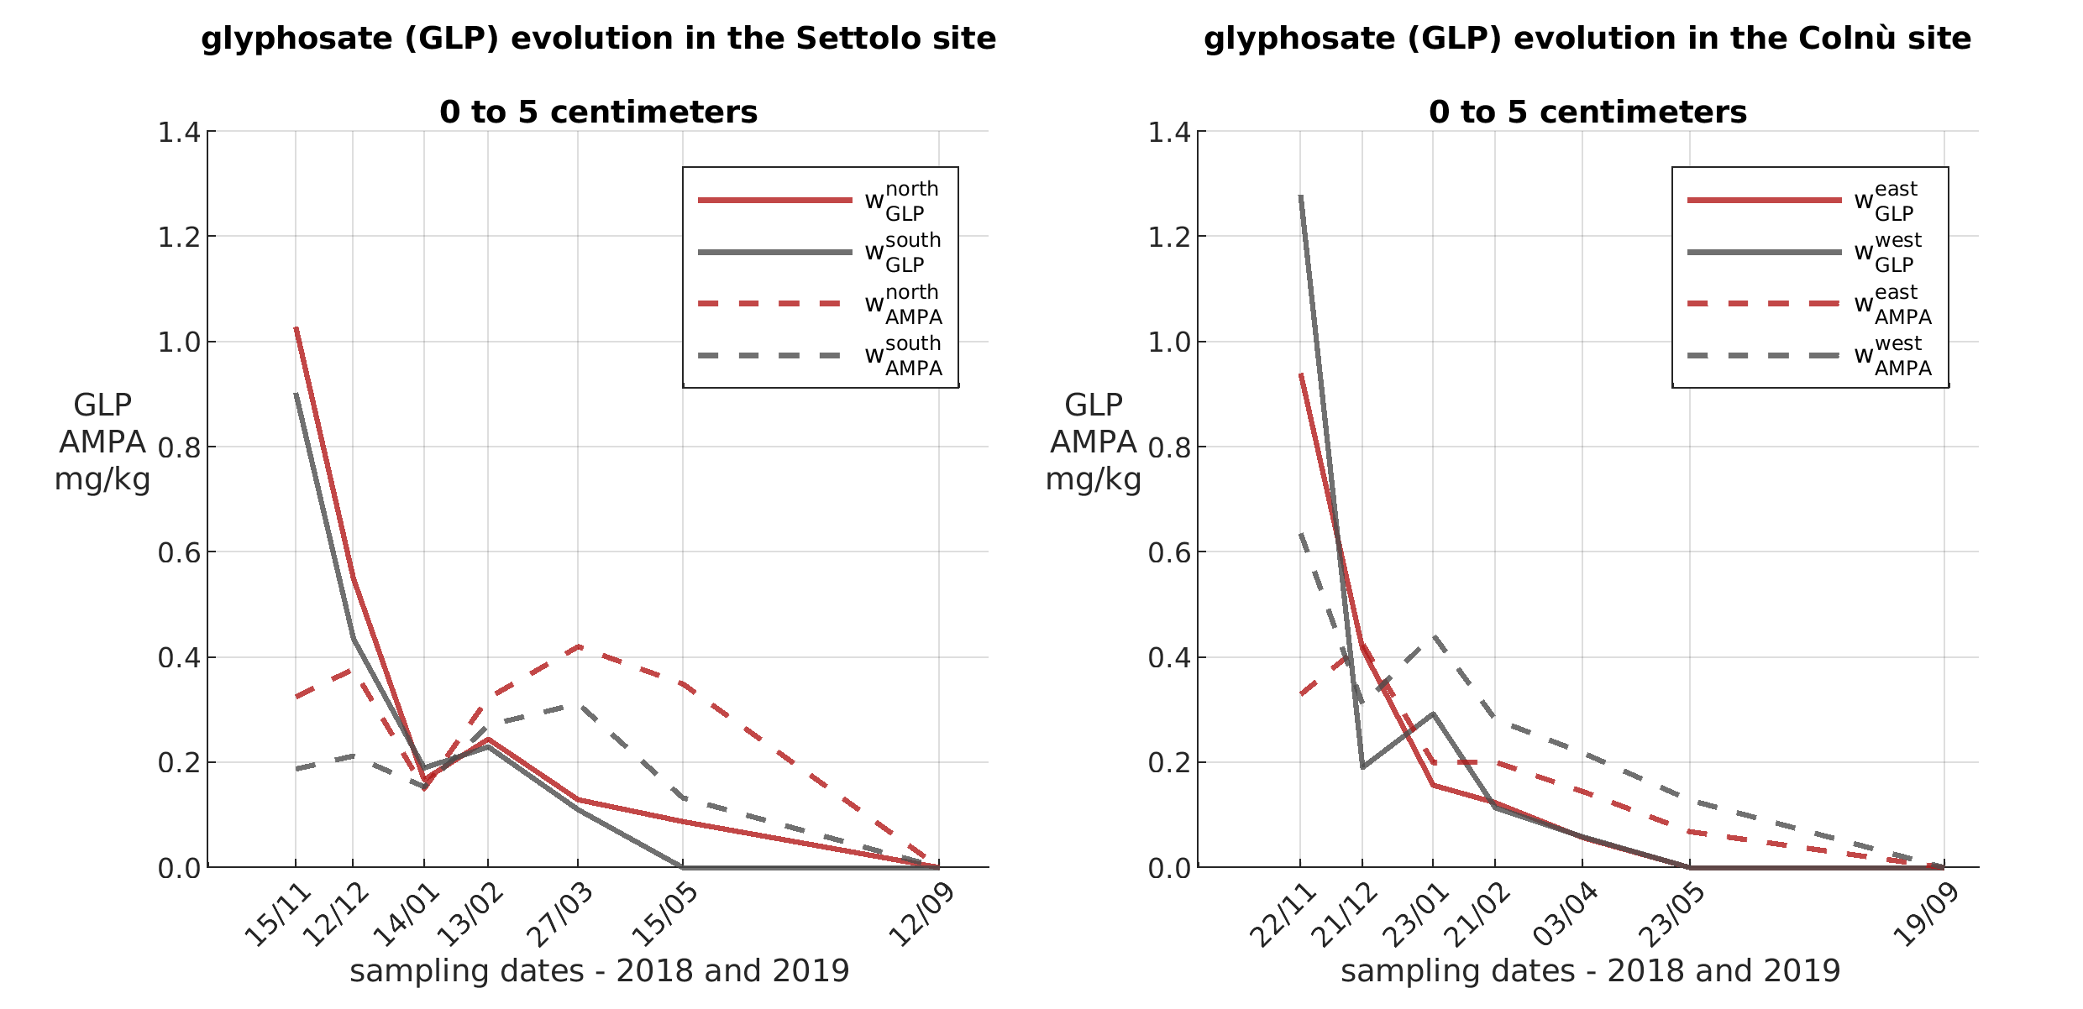
Soil Analysis
Results of GLP and AMPA analysis on top layer soil samples
© Costa et al.
all rights reserved
Data consistency (1/4) slide (8/19)

Slide 10
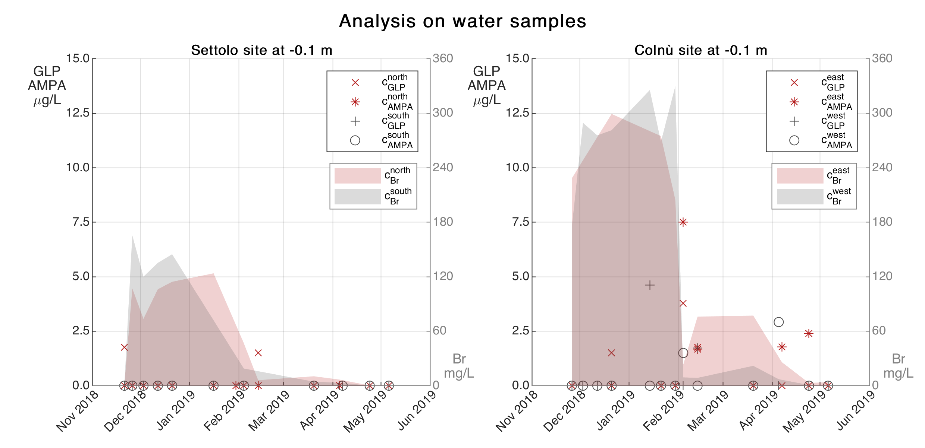
GLP and AMPA analysis on water samples
© Costa et al.
all rights reserved
Data consistency (2/4) slide (9/19)

Slide 11
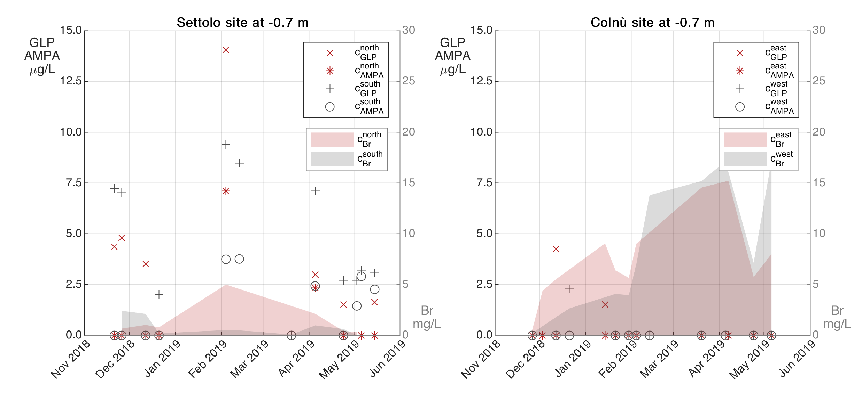
GLP and AMPA analysis on water samples: different infiltration process among different sites
© Costa et al.
all rights reserved
Data consistency (3/4) slide (10/19)

Slide 12
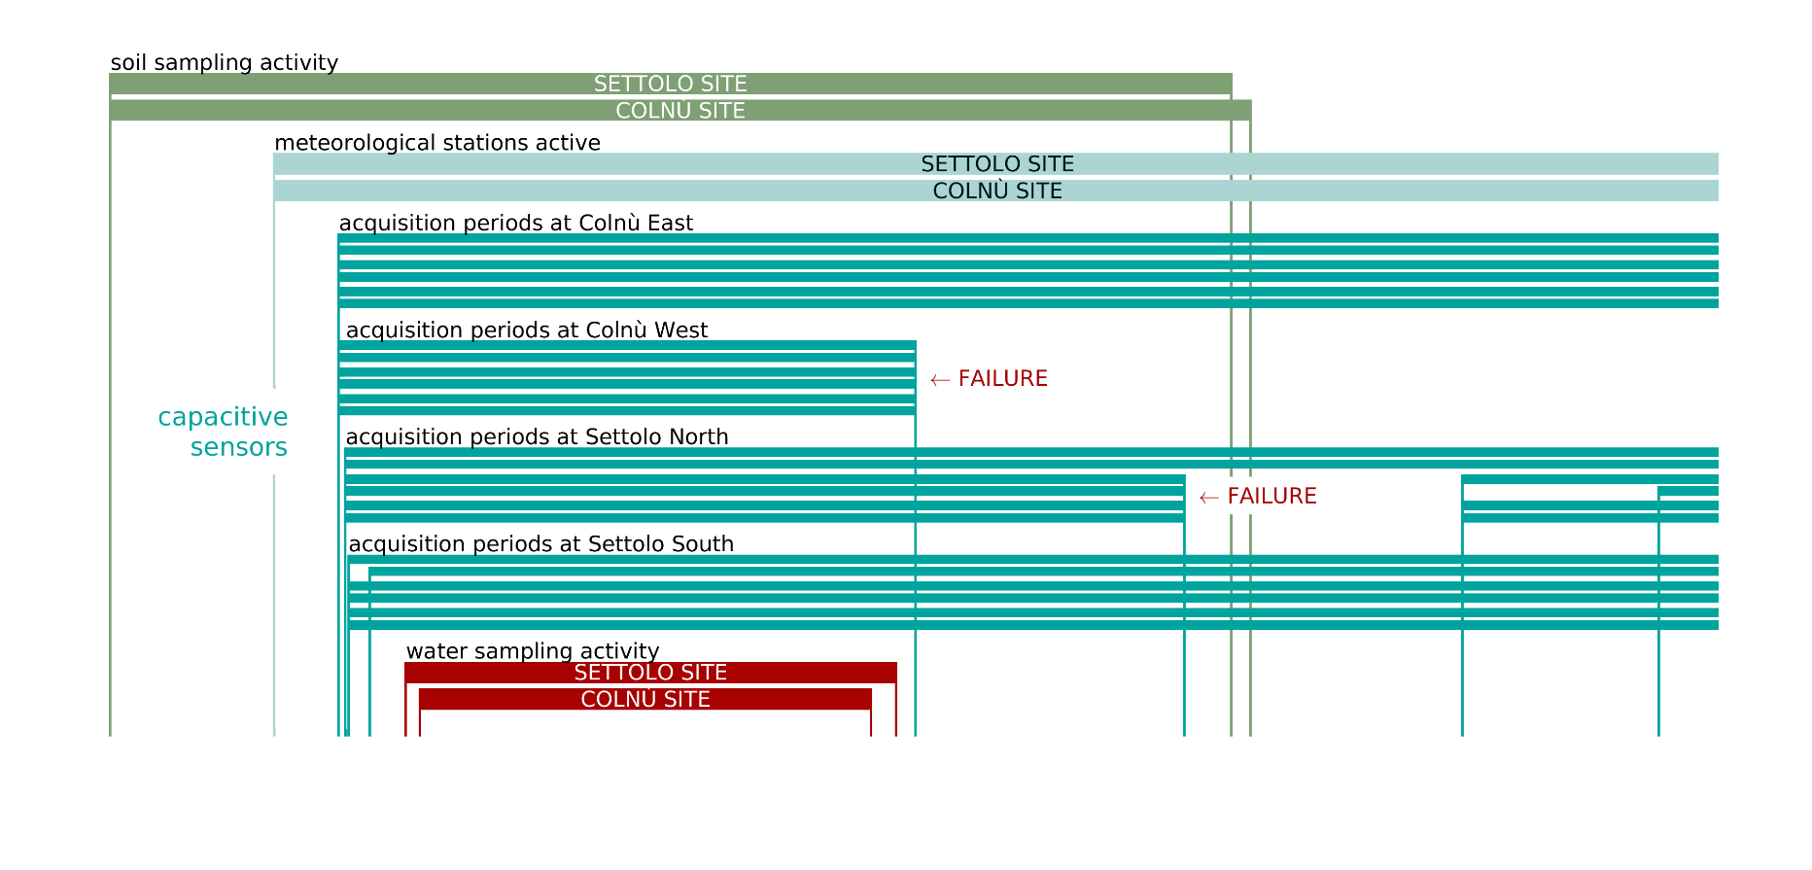
Periods of monitoring and sampling activity at the experimental sites
REPAIRING ACTIVITIES
© Costa et al.
all rights reserved
Data consistency (4/4) slide (11/19)

Slide 13



BRTSim 1D MULTIPHASE COMPUTATIONAL SOLVER (Maggi, 2015)
Mass balance
Hydrology
Chemical – Physical interactions
Bioreactive Transport Simulator finite volumes
$$n\frac{∂S_{β}}{∂t}=− div v_{β}$$
$$v_{β}=−k_{β}\frac{∂ψ}{∂z}$$
$$β=phase$$
Reaction equilibrium
Adsorption isoterms
Cellular metabolism
© Costa et al.
all rights reserved
1D model (1/2) slide (12/19)
Notes:
Estensione della legge di Darcy. Ipotesi mezzo poroso mezzo continuo. ipotesi i grani non si spostano. Kbeta=(krK)beta

Slide 14

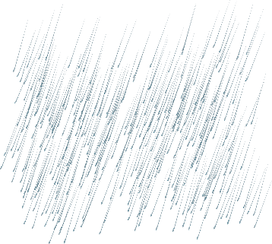


Calibration procedure for the hydraulic parameters of the infiltration process
first laboratory analysis
Domain geometry
(S = 25m² x D = 1m)
free-drainage boundary condition at the bottom
soil textures =
input data in ROSETTA
preliminary estimation of porosity n, permeability k and retention curve coefficients α and m (Van Genuchten,1980)
calibration (PEST)
(k_{cal}’ → α,m → k_{cal}”)
© Costa et al.
all rights reserved
1D model (2/2) slide (13/19)

Slide 15
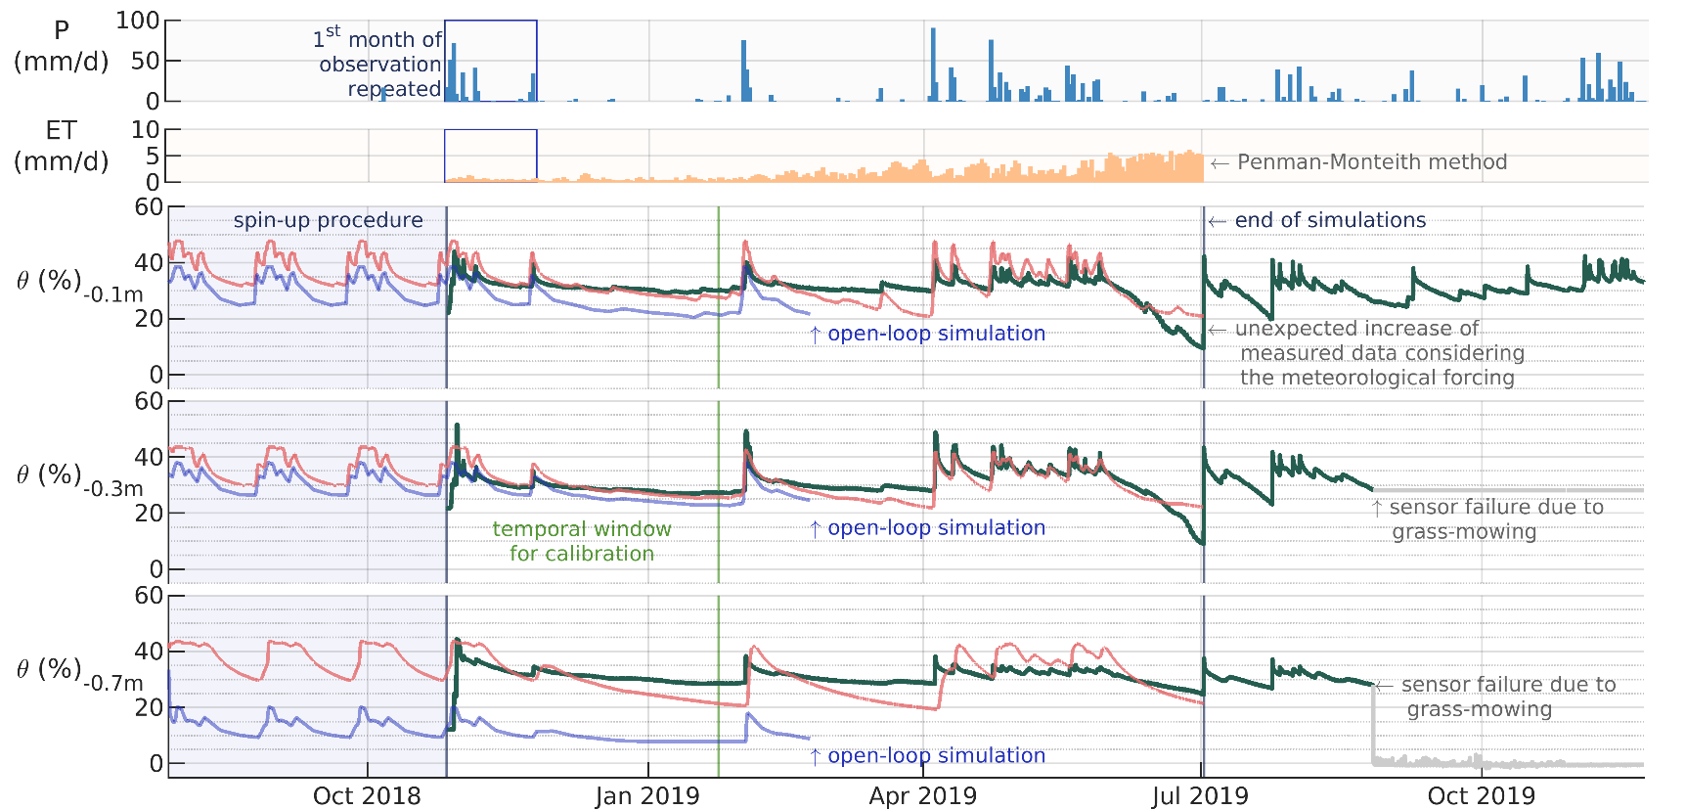
Open-loop simulation VS model calibrated using a 90 days temporal window (27/10/2018 to 24/01/2019)
© Costa et al.
all rights reserved
Results (1/4) slide (14/19)

Slide 16
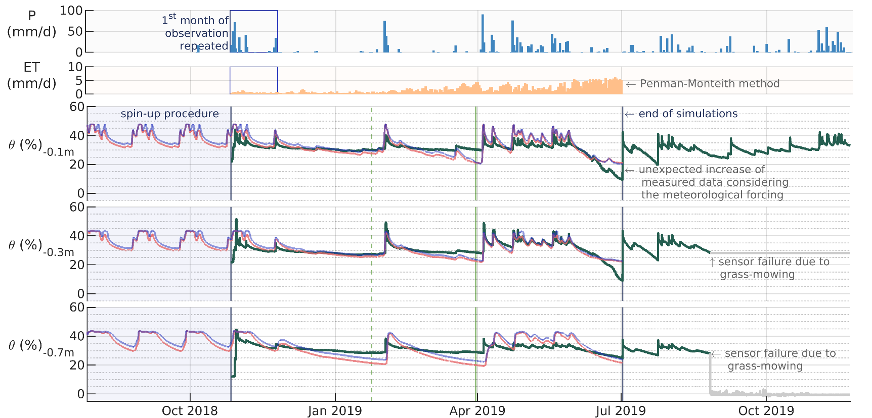
Comparison between different temporal window for calibration (90 days VS 153 days)
CAL 1
CAL 2
© Costa et al.
all rights reserved
Results (2/4) slide (15/19)

Slide 17
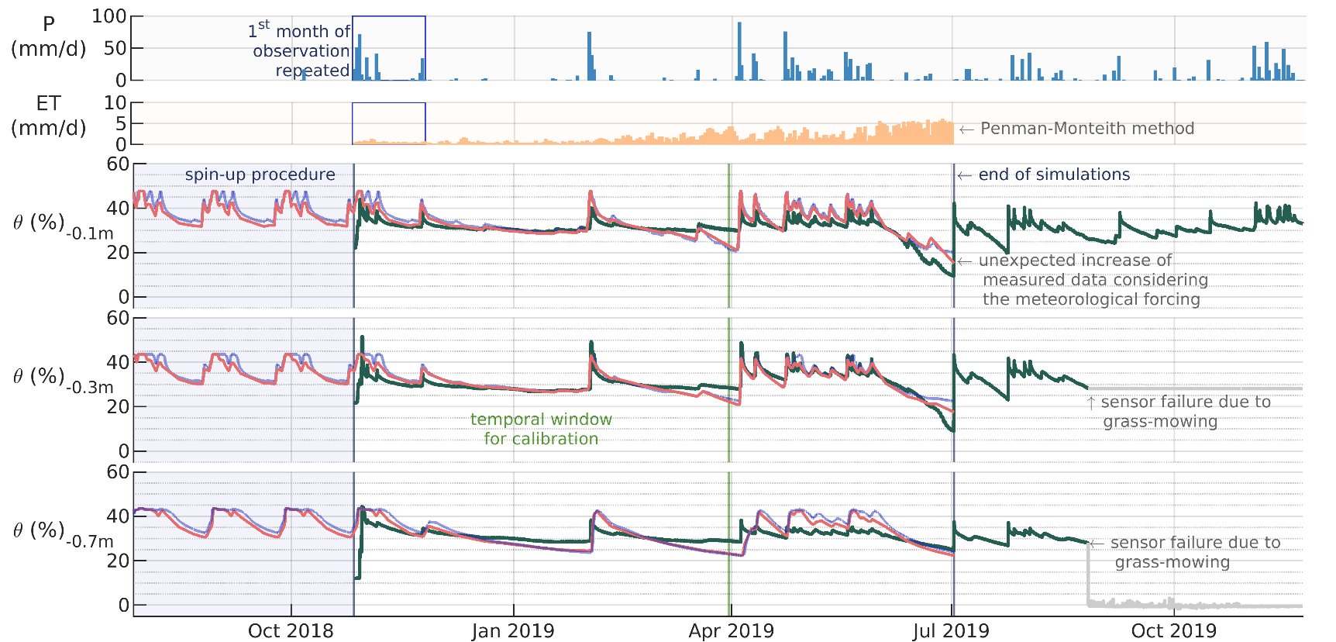
Comparison between different depths of influence of the active roots transpiration (10 cm VS 30 cm)
© Costa et al.
all rights reserved
Results (3/4) slide (16/19)

Slide 18
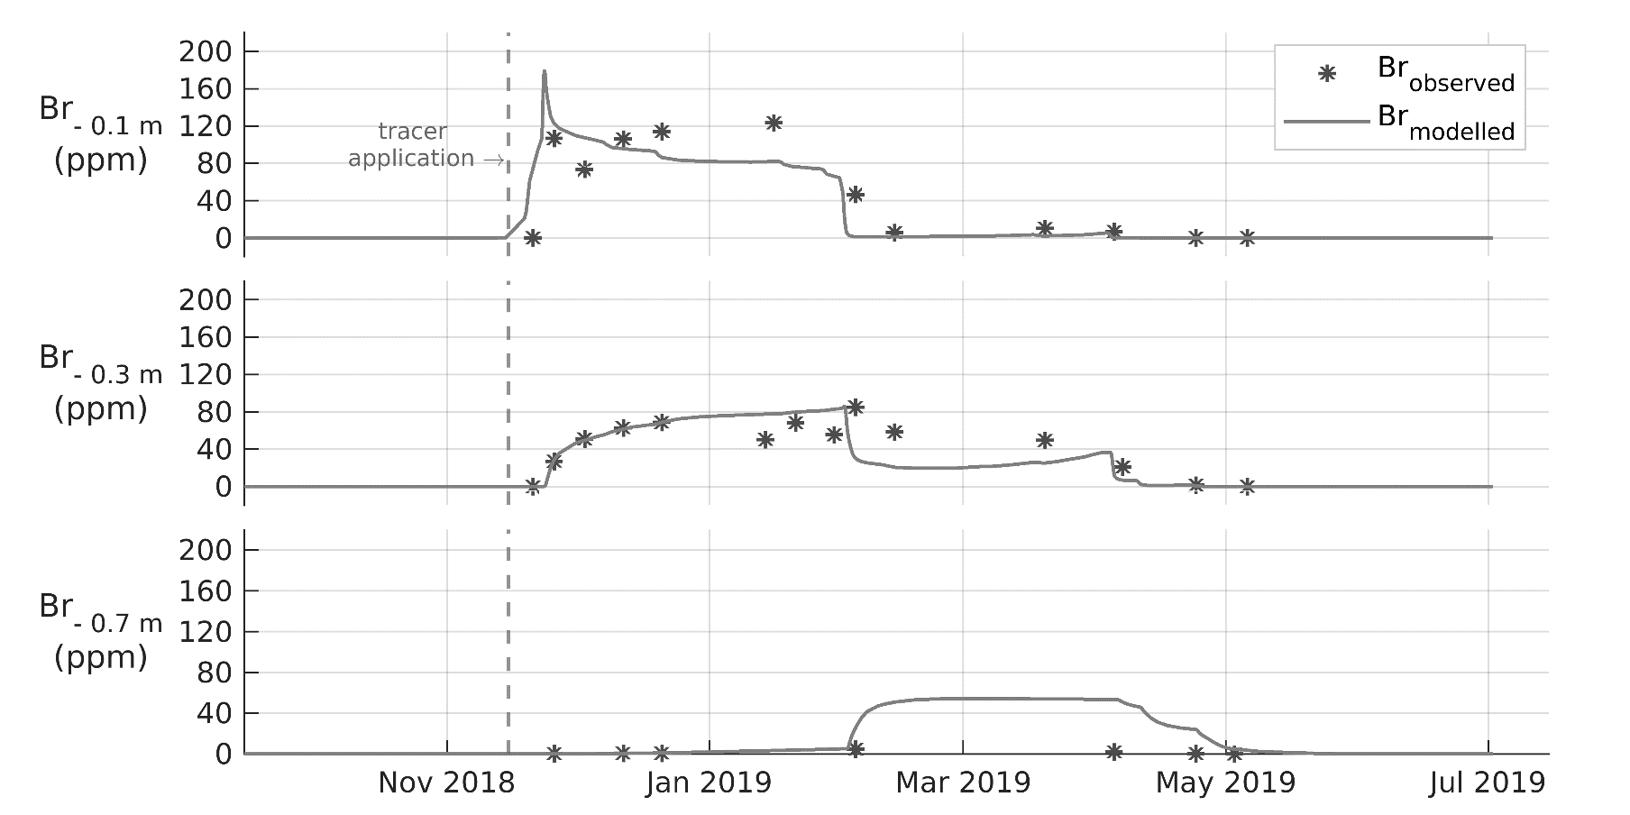
Results of tracer dispersion modelling using a dispersion coefficient of D = 1×10⁻⁰⁹ m²/s
© Costa et al.
all rights reserved
Results (4/4) slide (17/19)

Slide 19
TAKE-HOME MESSAGES
The one-dimensional modelling of the infiltration process achieves the best results in the upper layers of the soil (up to – 0.3 m).
The extension of the depth of influence of the active roots transpiration up to – 0.3 m increases the accuracy in simulating the soil volumetric water content in the periods subsequent to rainfall events
At greater depths the accuracy of the one-dimensional modelling of the infiltration process tends to be limited by the three-dimensional nature of the phenomenon.
© Costa et al.
all rights reserved
Conclusions (1/2) slide (18/19)

Slide 20
NEXT STEPS
Consider a more detailed time description of the meteorological forcing (rainfall and evapotranspiration): from daily to hourly
To extend the areal domain: from “punctual” to “areal” (based on the spatial heterogeneity of the infiltration process)
To consider a three-dimensional approach for the subsequent modelling of the glyphosate evolution
ACKNOWLEDGEMENTS
My acknowledgements go to Alto Trevigiano Servizi s.r.l. and Piave Servizi s.r.l. for supporting this research and to all the research group of the D. Tonini - Centre of Hydrology and of the DAFNAE and DICEA departments for the work done together
© Costa et al.
all rights reserved
Conclusions (2/2) slide (19/19)

