Slide 1
First Estimate of NO₂ in the upper troposphere from TROPOMI
UpTrop: Fundamental understanding of reactive nitrogen in the global upper troposphere
Project Tasks Relevant to this Call:
TROPOMI:
Assessment of cloud-slicing technique with synthetic GEOS-Chem observations
Validation of TROPOMI free tropospheric NO2 with Pandora measurements at high-altitude sites
Obtain cloud-sliced TROPOMI UT (450-180 hPa) NO2
Compare to NASA OMI UT NO2
NASA DC8:
Global UT reactive nitrogen abundance and composition determined with NASA DC8 aircraft observations since the 1990.
Global assessment of state-of-understanding by comparing GEOS-Chem and NASA DC8 reactive nitrogen
Holy Grail: find and address the problem
People:
Eloise Marais and collaborators Henk Eskes, Joanna Joiner, Sunny Choi, the Pandora network team.
Eloise A. Marais, Henk Eskes, Sungyeon Choi, Joanna Joiner, Alexander Cede
EGU General Assembly
7 May 2020
eloise.marais@le.ac.uk
http://maraisresearchgroup.co.uk/
Disclaimer: Results are preliminary and subject to change!

Slide 2
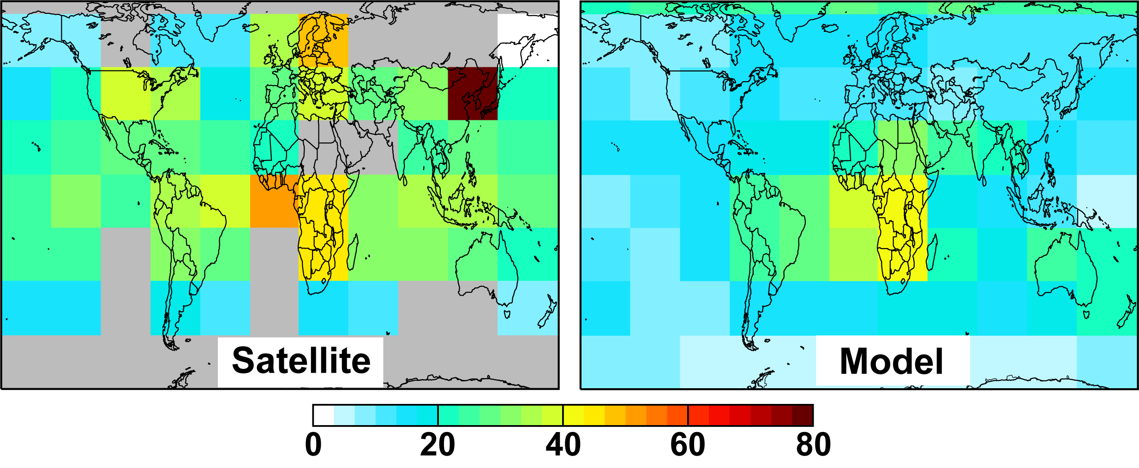
The Impact of Errors in the Upper Troposphere are Widespread
Small uncertainties in upper tropospheric NO_{x} induce large climate and air quality errors
Model NO₂ too low across the northern midlatitudes upper troposphere
errors in ozone production
Errors in tropospheric ozone radiative forcing
errors in satellite NO₂ retrievals
Uncertain global air quality constraints from satellites
[pptv]
[Marais et al., 2018]
Ozone is a powerful greenhouse gas (particularly in the upper troposphere)
Near-equivalent warming due to ozone and methane
ozone
-1 0 1 2 3
Radiative Forcing [W m⁻²]
[IPCC AR5, 2013]

Slide 3
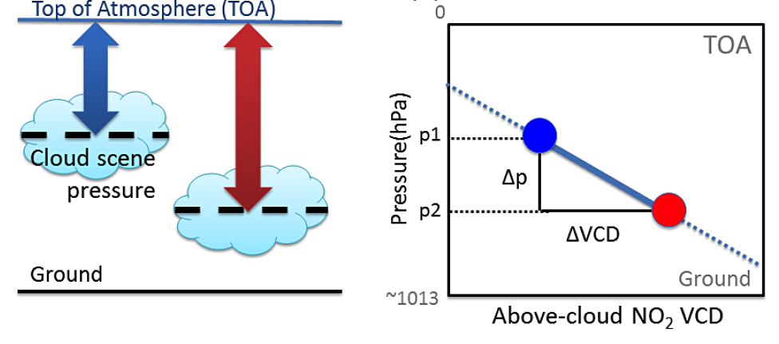
Obtain NO₂ in the Upper Troposphere (UT) with Cloud-Slicing
First applied by Ziemke et al. [2001] to TOMS ozone
Apply to partial NO₂ columns over optically thick clouds at different altitudes from 450 to 180 hPa for June 2019 to February 2020
Partial columns above thick clouds
Use cloud height variability to derive partial columns
p1
NO₂
p2
NO₂
Cloud
Atmosphere
Surface
[adapted from Choi et al., 2014]
NO₂ volume mixing ratio (VMR) between clouds at p1 and p2

Slide 4
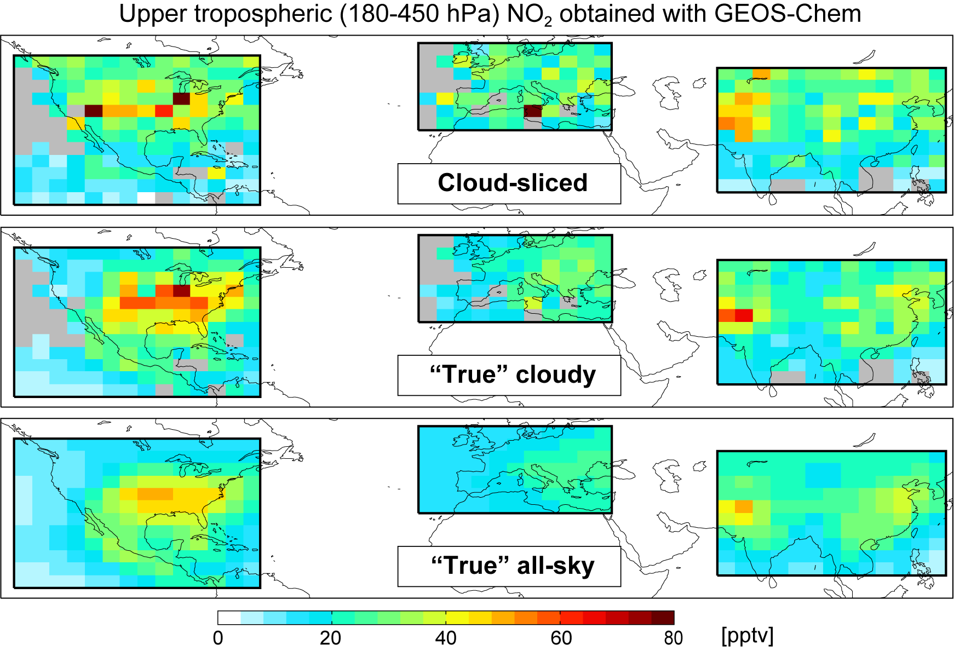
Synthetic Cloud-Slicing Experiment with GEOS-Chem
Test that cloud-sliced NO₂ reproduces the “truth” with synthetic data from GEOS-Chem
Use GEOS-Chem output at 0.5° × 0.3125° to obtain UT NO₂ at 4° × 5°.
Cloud-sliced and “true” cloudy scene UT NO₂ are spatially consistent (R = 0.66).
Regression slope for cloud-sliced versus “true” cloudy UT NO₂ is 0.92 ± 0.05 and the intercept is 2.3 ± 1.1 pptv.
Targeting cloudy conditions leads to 10% higher UT NO₂ than all-sky conditions.

Slide 5
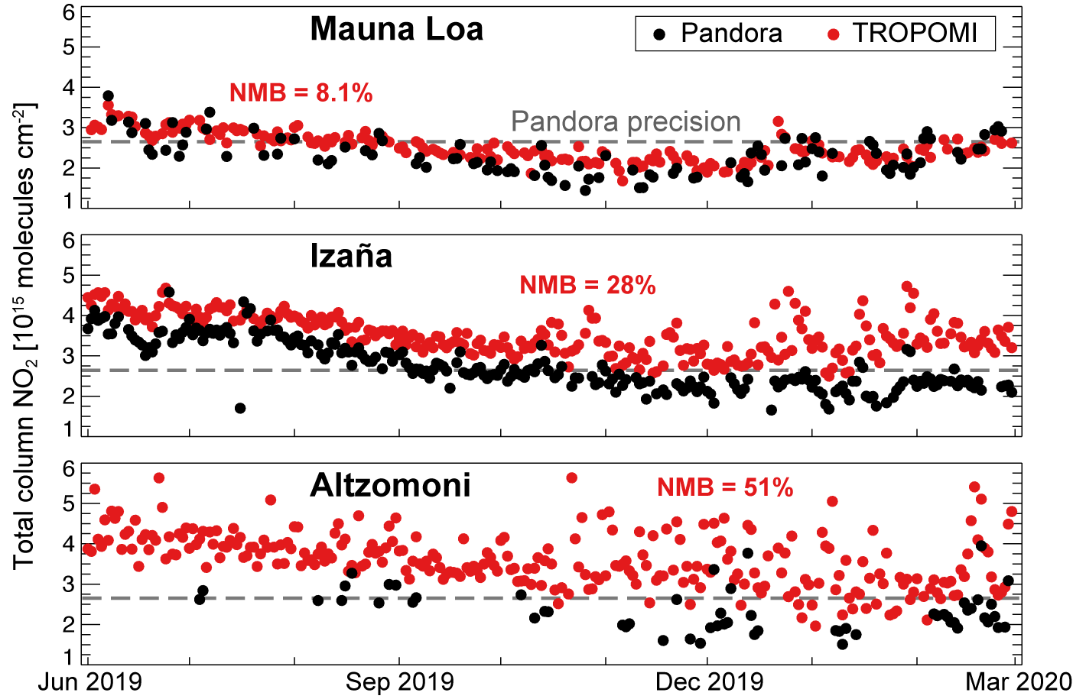
Evaluate TROPOMI against Pandora at High-Altitude Sites
Total column NO₂ time series at 3 Pandora long-term measurement stations
(3397 m)
Sample Pandora 30 min around TROPOMI overpass and TROPOMI within 20 km of Pandora site
TROPOMI normalized mean bias (NMB) for coincident observations is 8.1-51%
Temporal correlation at all sites (R > 0.7)
High bias in TROPOMI background NO₂ of 0.8-1.3 × 10¹⁵ molecules cm⁻²
Reported TROPOMI NO₂ stratospheric column is ~10%
(2373 m)
(3985 m)
[Pandora Data: https://www.pandonia-global-network.org/]

Slide 6
Evaluate TROPOMI Cloud Top Heights
Comparison of TROPOMI cloud top pressure products at different latitude bands
Compares TROPOMI NO₂ (FRESCO) and operational (DLR-OCRA) cloud product seasonal means at 2° × 2.5° for FRESCO clouds at 180 to 450 hPa
DLR-OCRA systematically lower clouds than FRESCO. Difference increases with latitude.
At poles (>65° N/S) DLR-OCRA range is <150-450 hPa; FRESCO range is 400-450 hPa

Slide 7
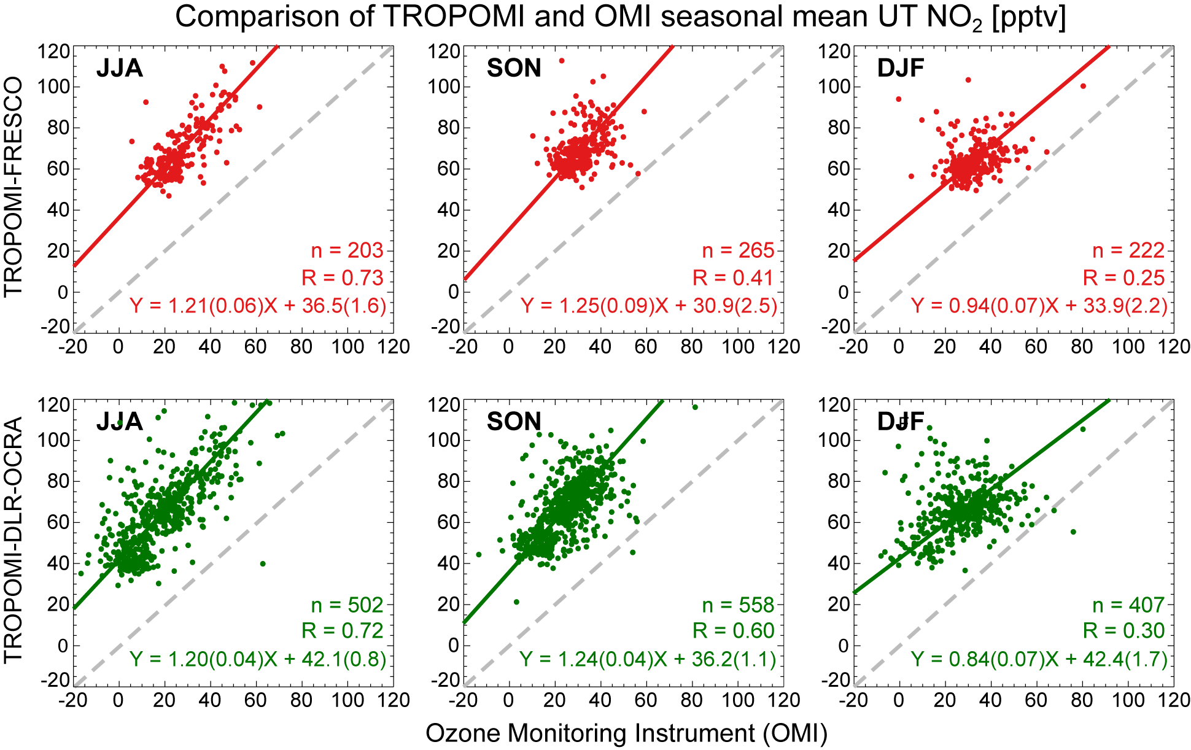
TROPOMI and OMI UT NO₂ Comparison
TROPOMI UT NO₂ [pptv] obtained with FRESCO clouds or DLR-OCRA clouds compared to OMI UT NO₂
OMI product obtained at 8° × 5° by S. Choi and J. Joiner. Details in Choi et al. [2014] & Marais et al. [2018]
Values are correlation and regression statistics.
DLR-OCRA cloud product yields greater data density and spatial consistency with OMI product.
TROPOMI positive intercept consistent with bias expect from Pandora comparison and supports upper troposphere as source of bias in column

Slide 8
Concluding Remarks of Preliminary Results
Positive bias in TROPOMI NO₂ of 8-51% compared to Pandora, likely due to underestimate in free tropospheric a priori NO₂ leading to underestimate in air mass factor.
Synthetic cloud-sliced NO₂ in the upper troposphere (UT) from GEOS-Chem partial columns broadly reproduces the spatial distribution of “true” UT NO₂ obtained under cloudy conditions in summer.
Preferentially selecting very cloudy scenes for cloud-slicing leads to a 10% higher NO₂ than is obtained under all-sky conditions from GEOS-Chem.
The different TROPOMI cloud products yield similar TROPOMI UT NO₂, but with greater spatial coverage with DLR-OCRA than with FRESCO-S due to more dynamic cloud height range in the UT from DLR-OCRA.
TROPOMI and OMI UT NO₂ have similar spatial distribution and variance, but TROPOMI positive bias of 30-40 pptv supports upper (and perhaps also free) troposphere as source of bias in the column.
Increasing GEOS-Chem NO₂ mixing ratios in the upper troposphere by a factor of 2 to obtain synthetic partial columns also yields cloud-sliced UT NO₂ that is 30-40 pptv more than the “truth”.
Questions? Contact Eloise Marais (eloise.marais@le.ac.uk)

Slide 9
References
Choi et al., First estimates of global free-tropospheric NO₂ abundances derived using a cloud-slicing technique applied to satellite observations from the Aura Ozone Monitoring Instrument (OMI), ACP, 14, 10565–10588, doi:10.5194/acp-14-10565-2014, 2014.
Myhre et al. (IPCC, AR5), Anthropogenic and Natural Radiative Forcing. In: Climate Change 2013: The Physical Science Basis. Contribution of Working Group I to AR5 in the IPCC [Stocker et al. (eds.)]. Cambridge University Press, Cambridge, UK and NY, NY, US, 2013.
Marais et al., Nitrogen oxides in the global upper troposphere: interpreting cloud-sliced NO₂ observations from the OMI satellite instrument, ACP, 18, 17017–17027, doi:10.5194/acp-18-17017-2018, 2018.
Ziemke et al., “Cloud slicing”: A new technique to derive upper tropospheric ozone from satellite measurements, JGR, 106, 9853–9867, doi:10.1029/2000jd900768, 2001.

