Slide 1
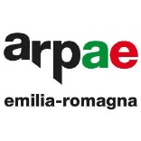
WMO Hydrological Observing System (WHOS) broker: implementation progress and outcomes
Enrico Boldrini (1), Paolo Mazzetti (1), Stefano Nativi (1),
Mattia Santoro (1), Fabrizio Papeschi (1),
Roberto Roncella (1), Massimiliano Olivieri (1),
Fabio Bordini (2), and Silvano Pecora (3)
National Research Council of Italy
Regional Agency for Prevention, Environment and Energy of
Emilia-Romagna, Italy
(3) Po River Basin District Authority
EGU General Assembly 2020 Mon, 04 May, 08:30–10:15 | D894

Slide 2
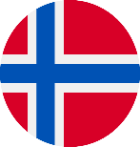
WHOS
WMO commission for Hydrology
WMO Commission of Hydrology (CHy) providing guidance to WMO Member countries in operational hydrology, including capacity building, NHSs engagement and coordination of WHOS implementation
National Hydrological Services (NHS) willing to publish their data to the benefit of a larger audience
Hydrologists, decision makers, app and portal authors willing to gain access to world-wide hydrological data
Heterogeneous software tools
Heterogeneous publication systems
?
Only data publishers and consumers implementing the same standards interact (e.g. same service protocol + metadata + data model)
How to improve interoperability?
Hydrology modelers, decision makers, scientists
Data providers, e.g. National Hydrological Services (NHS)

Slide 3
WHOS
ESSI-Lab of CNR-IIA responsible for the WHOS broker component: a software framework in charge of enabling interoperability by mediation of standard service protocols, metadata and data models amongst the distributed heterogeneous systems belonging to data providers (e.g. data publishing services) and data consumers (e.g. web portals, libraries and apps),
WMO commission for Hydrology
Hydrology modelers, decision makers, scientists
WHOS broker
Interoperability enabler
Data providers, e.g. National Hydrological Services (NHS)

Slide 4
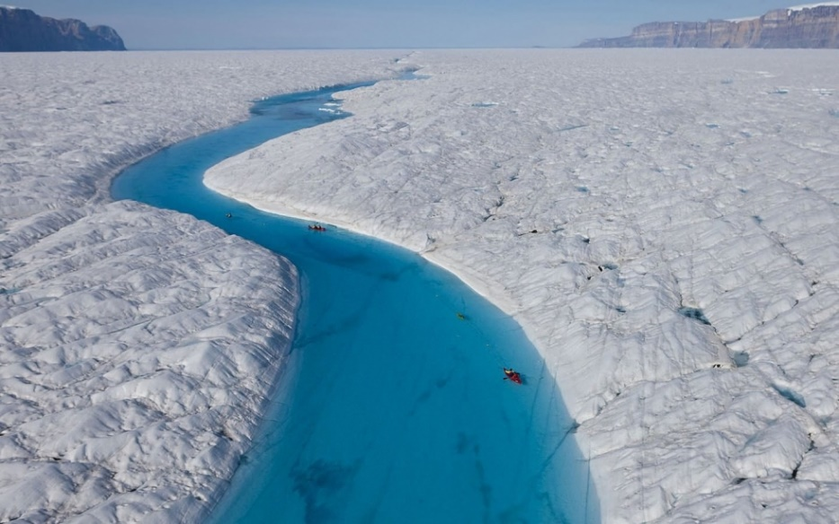
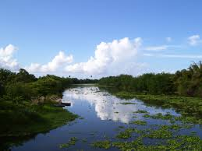
WHOS pilots
Two WMO regional programmes have been targeted to benefit from WHOS, operating as successful applications for others to follow:
WHOS-Plata
(La Plata river basin)
WHOS-Arctic
(Arctic rivers)

Slide 5
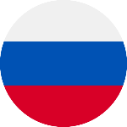
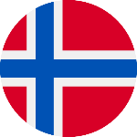
WHOS-Arctic
WMO commission for Hydrology
52North Helgoland
U.S.A.
Jupyter notebooks
Water level /
Discharge
Russia
CUAHSI Hydro
Desktop
Canada
R WaterML package
Iceland
Norway
& more …
Denmark
Finland
Hydrology modelers, decision makers, scientists
WHOS broker
Interoperability enabler
Data providers, e.g. National Hydrological Services (NHS)

Slide 6
WHOS-Plata
WMO commission for Hydrology
52North Helgoland
Argentina hydro /
meteo data
Jupyter notebooks
Bolivia
meteo data
CUAHSI Hydro
Desktop
Brazil hydro /
meteo data
Radar data
R WaterML package
Paraguay meteo data
HRC PROHMSAT forecasting and early warning system
Uruguay hydro /
meteo data
COSMO data
Hydrology modelers, decision makers, scientists
WHOS broker
Interoperability enabler
Data providers, e.g. National Hydrological Services (NHS)

Slide 7
CUAHSI HydroDesktop demo
HydroDesktop is a GIS enabled desktop application that search, download, visualize, and analyze hydrologic and climate data from a central service implementing WaterML based WaterOneFlow protocol, such as the one provided by WHOS-broker.
PLAY

Slide 8
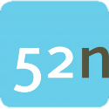
52 North Helgoland demo
52North Helgoland is a web based OGC SOS client that can connect to WHOS using Observation & Measurement based OGC SOS v.2.0.0 protocol
PLAY

Slide 9
National Water Institute of Argentina (INA) portal demo
wmlclient_wc is a Node.js client that can be used through a REST API or through a web GUI. It connects to WHOS through CUAHSI WOF protocol.
INA develops it and publishes it in a dedicated portal.
PLAY

Slide 10
WHOS broker JS API demo
In order to simplify the development of applications and clients (in particular web portals) making use of WHOS, WHOS broker JS API high level client-side Open APIs (Application Program Interface) have been designed and developed in JavaScript online documentation available
PLAY

Slide 11
Jupyter Notebook demo
The R WaterML library is a software package made by Jiri Kadlec that can be used by developers to access to WHOS functionalities within their R applications. Check out this sample Colaboratory notebook
PLAY

Slide 12
Thank you!
Graphics by Freepik, Becris, Skyclick, Good Ware: https://www.flaticon.com/
Questions?
enrico.boldrini@cnr.it
paolo.mazzetti@cnr.it

