Slide 1
Using Sentinel-1 and -2 satellite time series to monitor crop phenology at the parcel level
Raphaël D’ANDRIMONT, Guido LEMOINE and Marijn VAN DER VELDE
EGU – 8 May 2020
Notes:
JRC → Food Security Unit

Slide 2
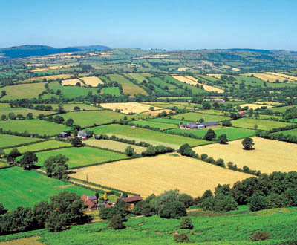
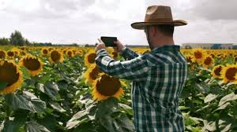
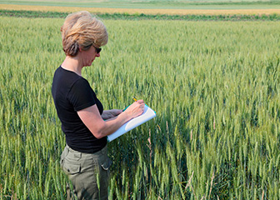
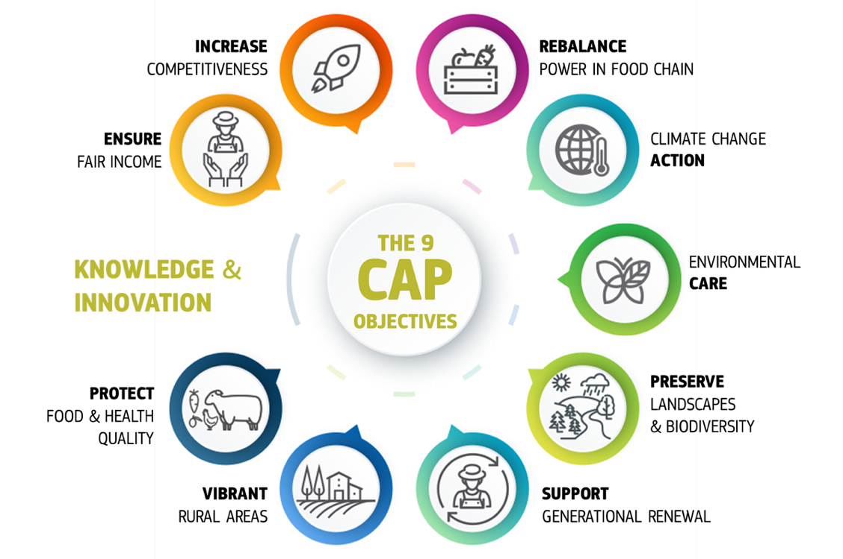
Data integration and connecting communities from local to continental scale to monitor agriculture
The EU’s Common Agricultural Policy (CAP)
Shaping our landscape
€58,537,967,000 in 2018*
Authorities
Farmers
Connect
Communities
Citizens
Notes:
In the Digital Rural Landscape Lab, we are working on heterogeneous data integration to monitor agriculture.
In EU, almost 60 bn euro per year (1867.37 euro/sec) are spent to help c.a 7 000 000 farmers make optimum, sustainable, environmentally and climate positive use of 48% of the EU’s land to provide food (along with fibre and fuel) for all EU citizens. The Commission needs to have systems to assure performance (i.e. the CAP actually does protect biodiversity etc.) and assure fair and accountable expenditure (i.e. the money really does go to farmers who are farming on real farmland, and that each farmer gets their fair share).
CAP Monitoring – shift from control to monitoring, simplify and automate provision of evidence (e.g. geo-tagged images)
Sentinel satellites observations – complement frequent and high resolution observations
Exploit the data continuum - opportunity for farmers, citizens, and authorities to consider novel ways of information exchange

Slide 3
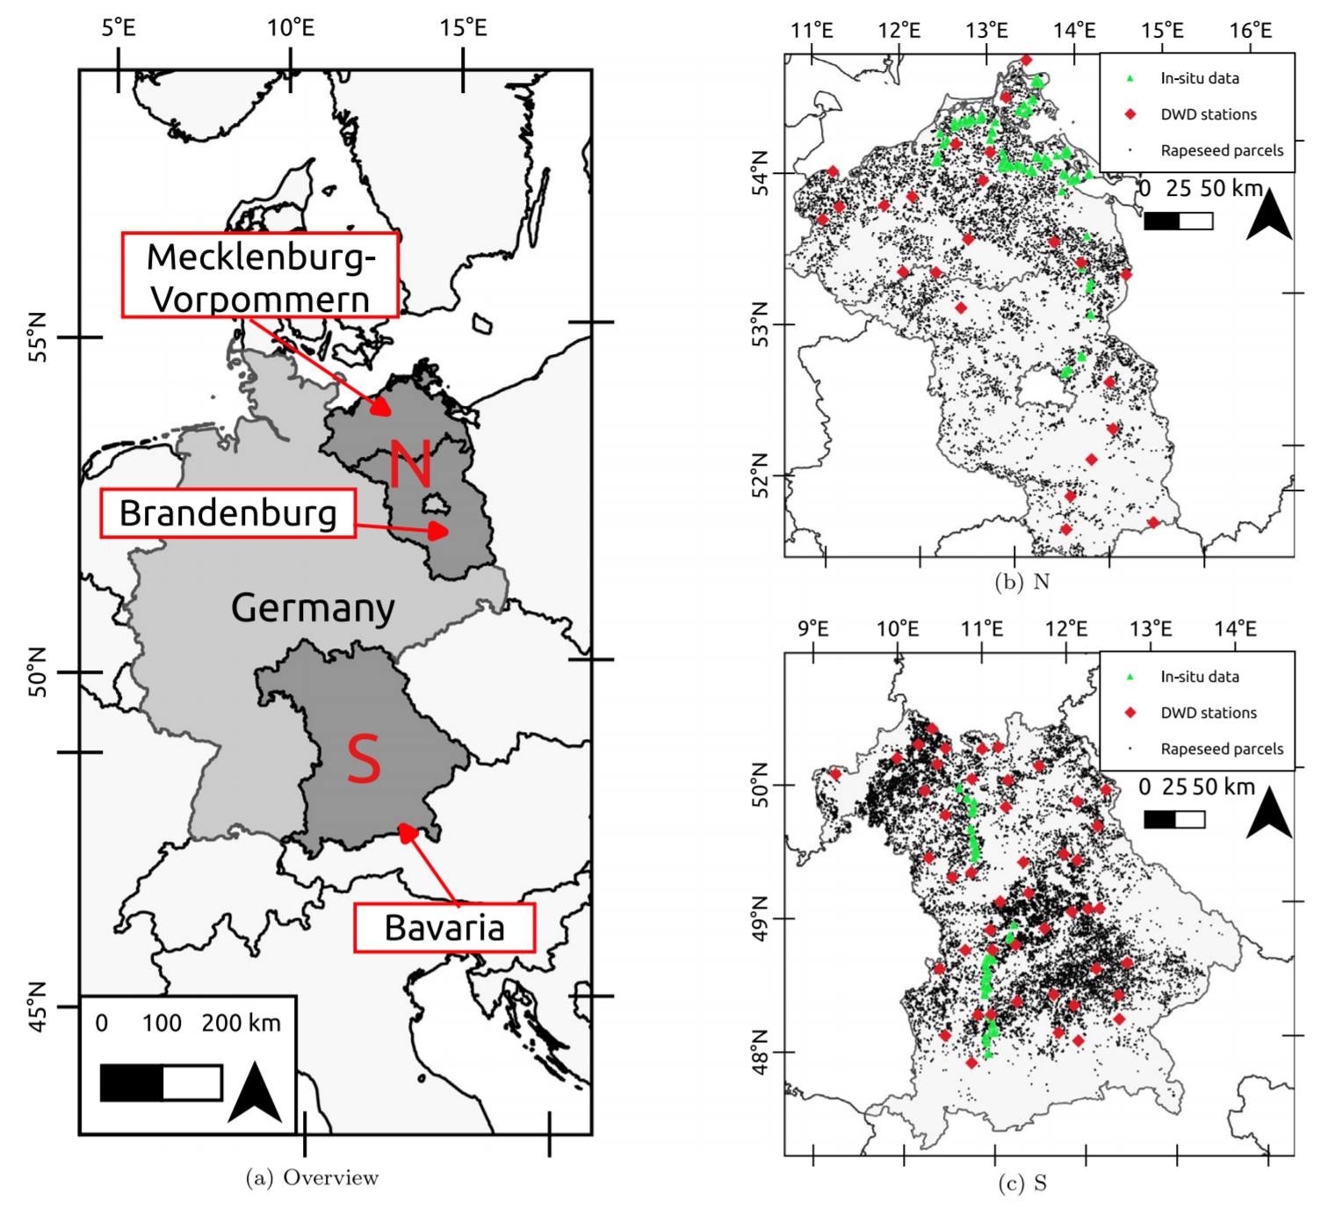
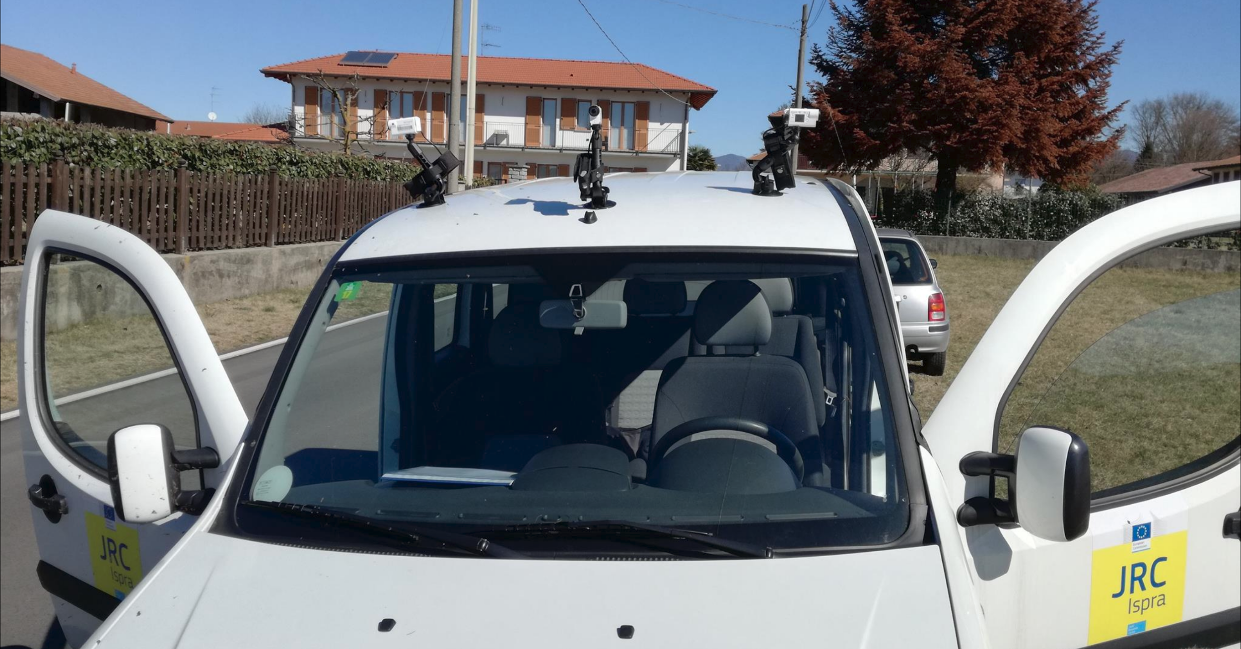
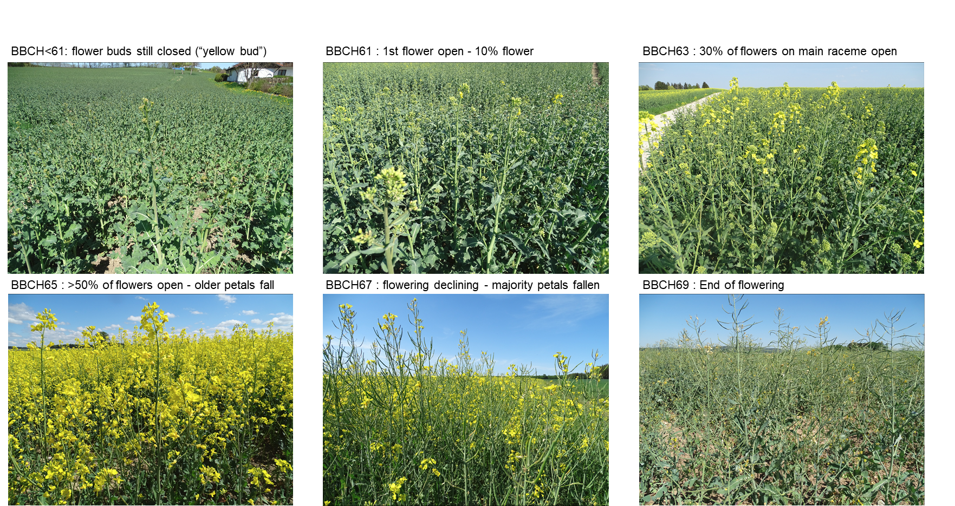
Can we accurately detect the peak of rapeseed flowering with S1 and S2 time-series at parcel level?
Study site and in-situ data
Photo collection with roof cameras
Close-up photos to identify BBCH stage
d’Andrimont, R., Taymans, M., Lemoine, G., Ceglar, A., Yordanov, M. and van der Velde, M., 2020. Detecting flowering phenology in oil seed rape parcels with Sentinel-1 and-2 time series. Remote sensing of environment, 239, p.111660.
Notes:
more than 200.000 images

Slide 4
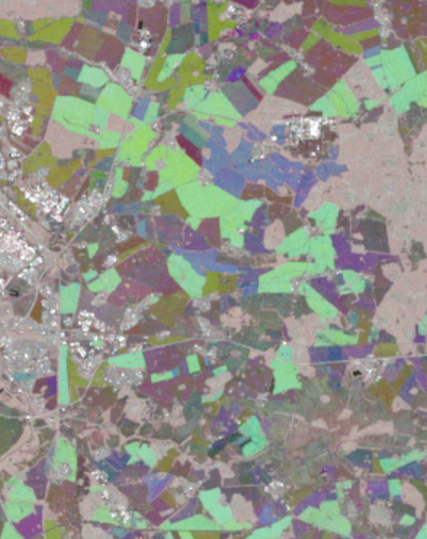
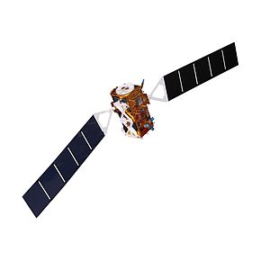
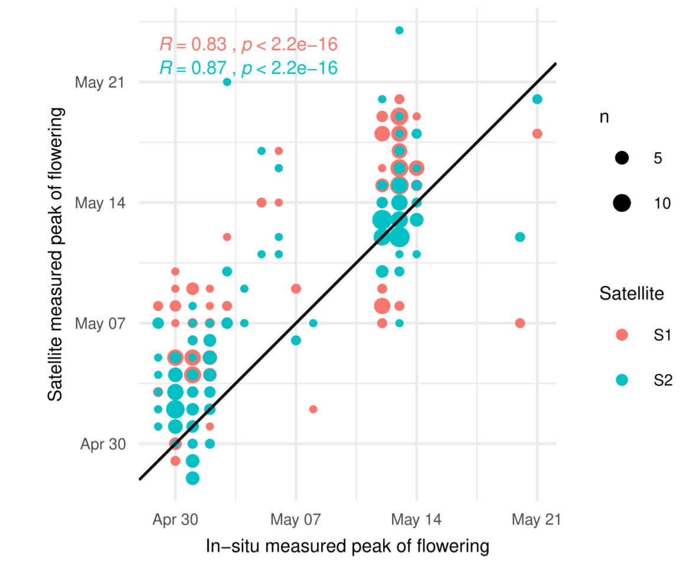
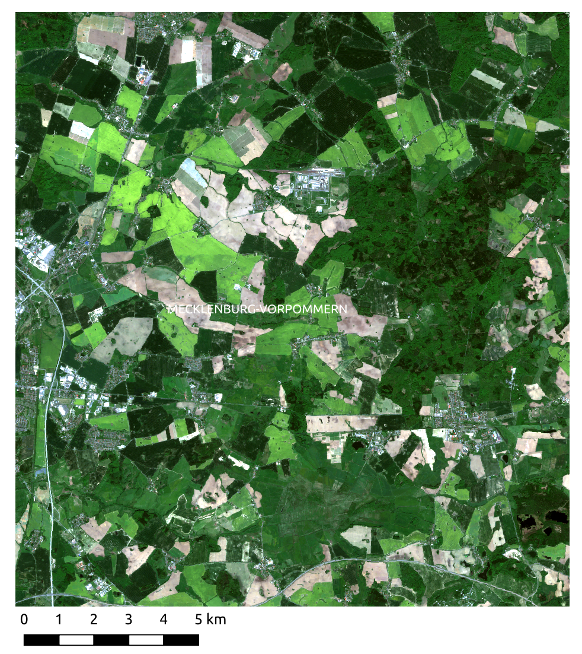
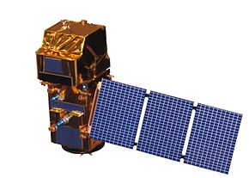
Satellite time series detected parcel flowering date with an accuracy of 1 to 4 days combining Sentinel-1 & -2
Sentinel-1 : structure and morphology
VV drop during flowering
Parcel in-situ and Sentinels
Sentinel-2 : yellow index
NDYI peak during flowering
d’Andrimont, R., Taymans, M., Lemoine, G., Ceglar, A., Yordanov, M. and van der Velde, M., 2020. Detecting flowering phenology in oil seed rape parcels with Sentinel-1 and-2 time series. Remote sensing of environment, 239, p.111660.
Structure & morphology

Slide 5
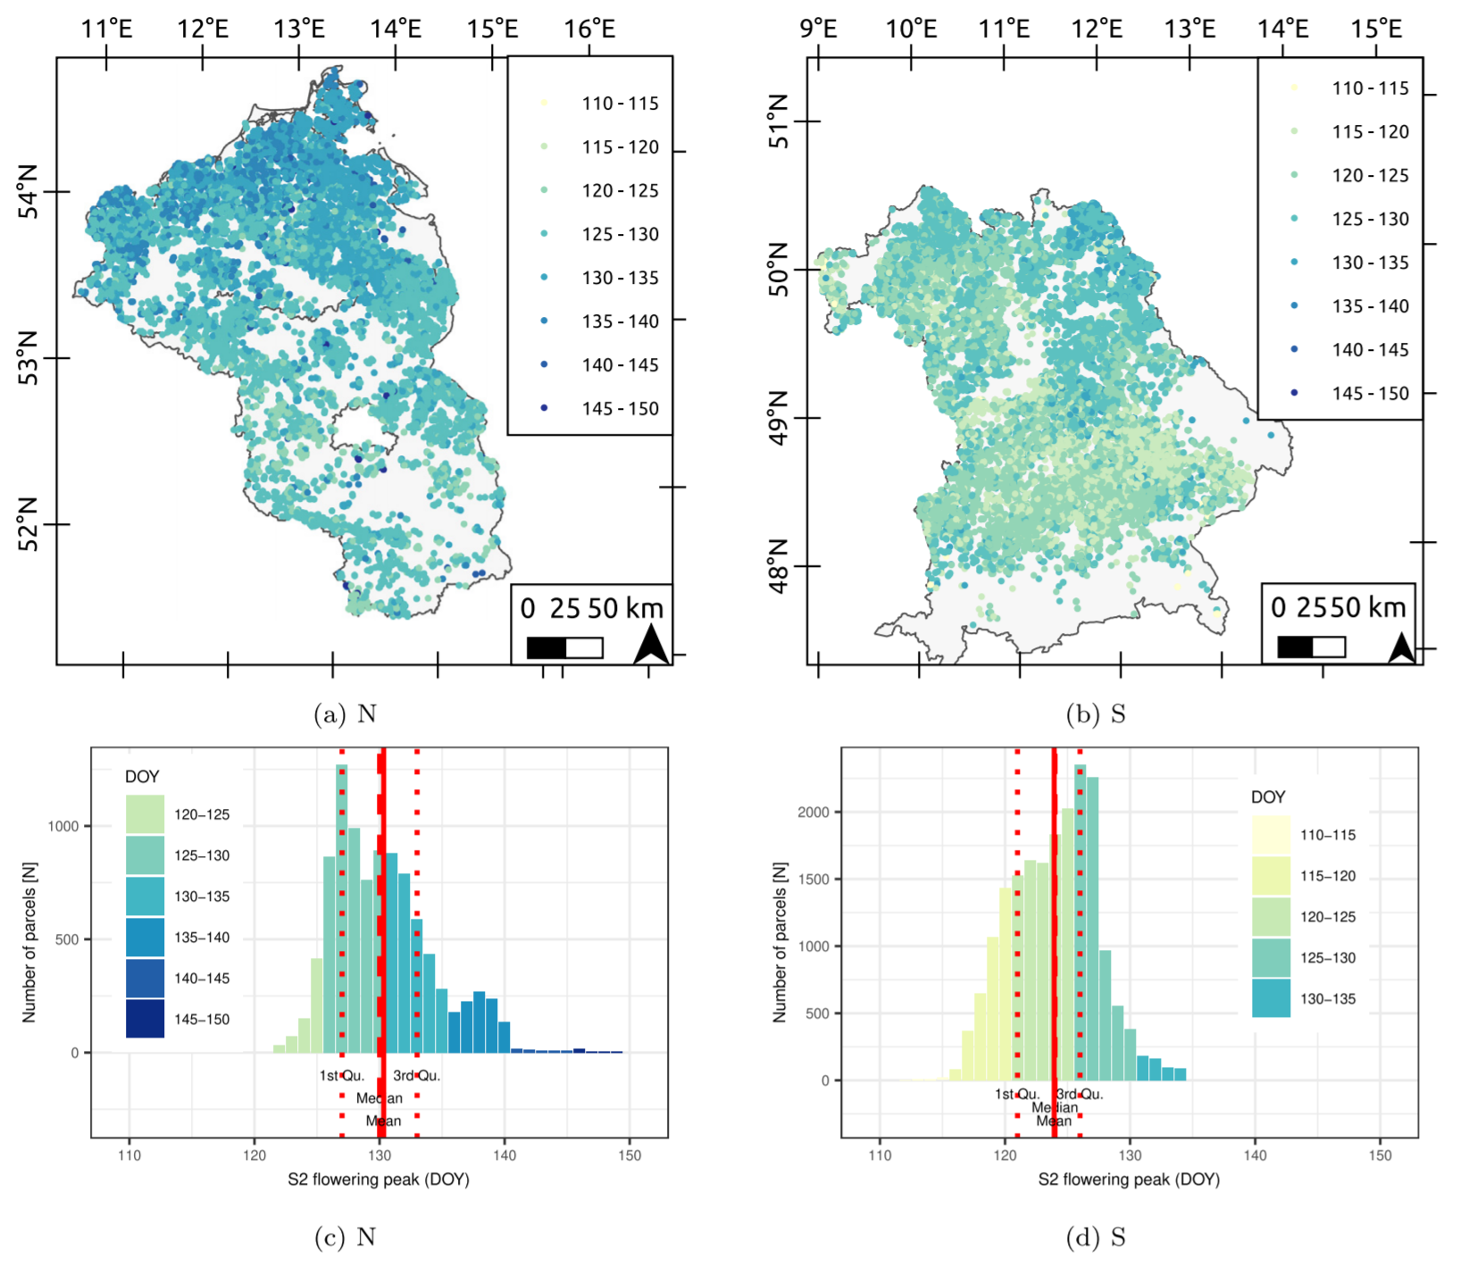
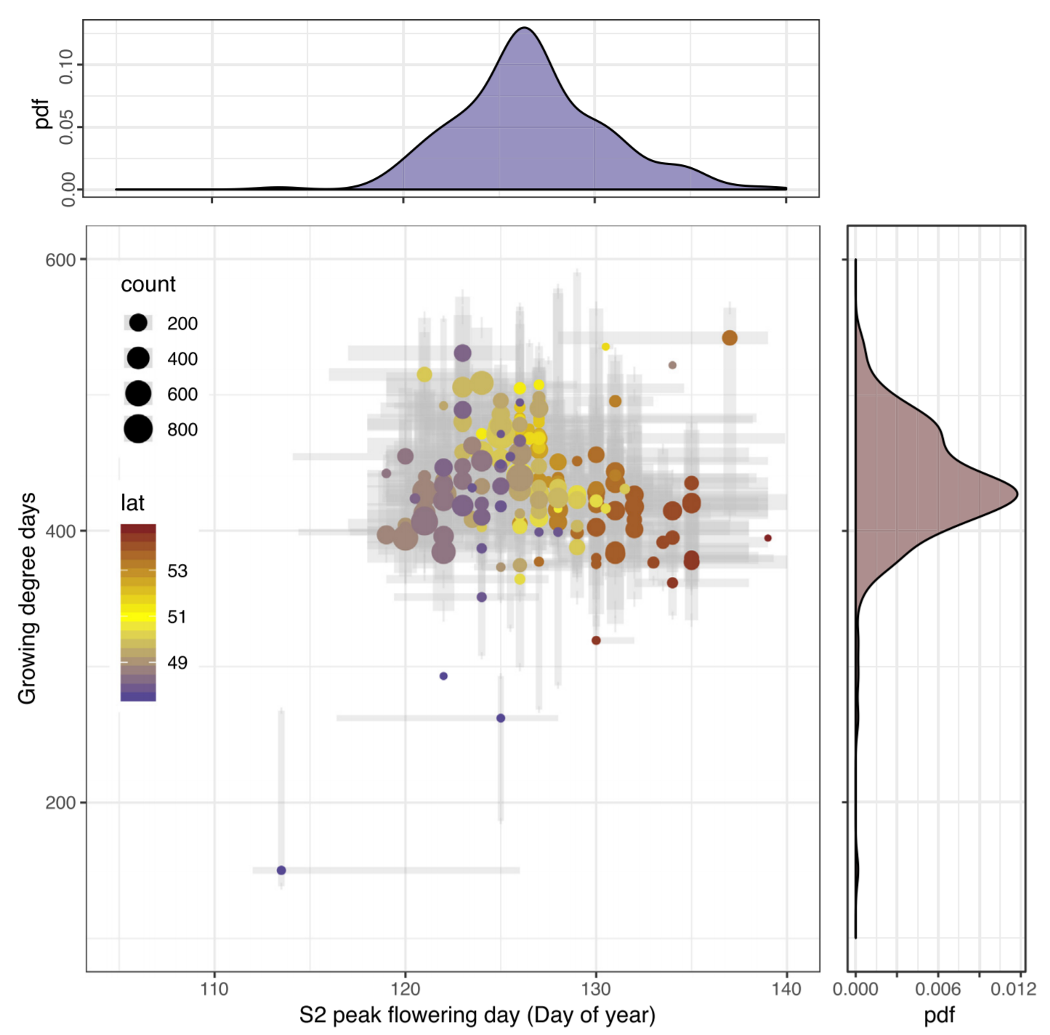
Mapping at regional scale shows expected climatic gradient in flowering from South to North
Parcel flowering peak (DOY) at regional level level
Crop model-relevant thermal time to flowering based on satellite observations.
25-km aggregation
and thermal time
d’Andrimont, R., Taymans, M., Lemoine, G., Ceglar, A., Yordanov, M. and van der Velde, M., 2020. Detecting flowering phenology in oil seed rape parcels with Sentinel-1 and-2 time series. Remote sensing of environment, 239, p.111660.
Notes:
Mapping at regional scale shows expected climatic gradient in flowering
Crop model-relevant thermal time to flowering based on satellite observations.

Slide 6
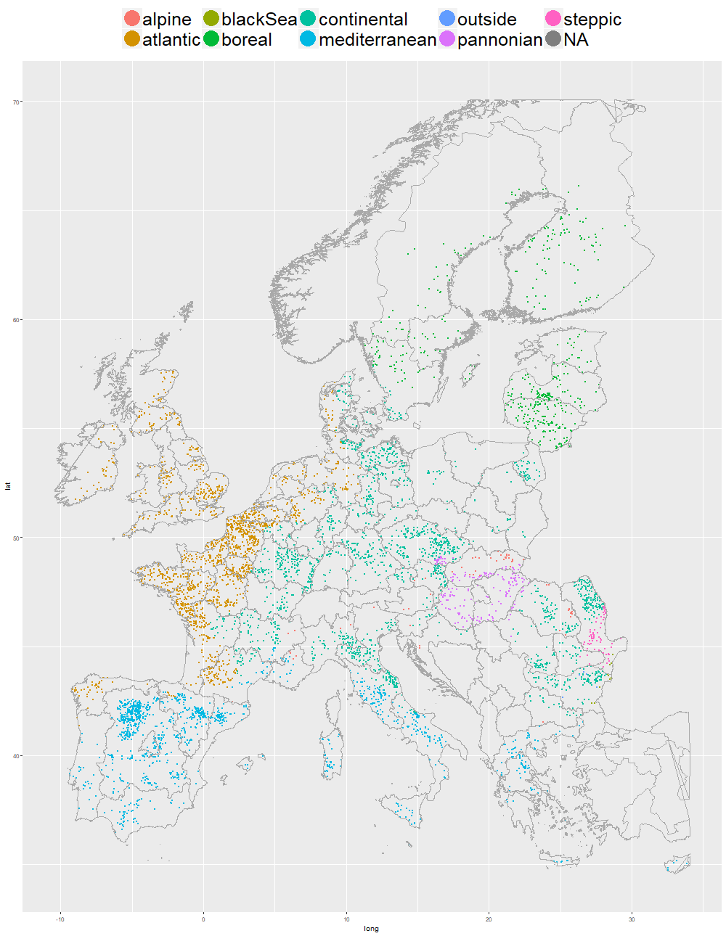
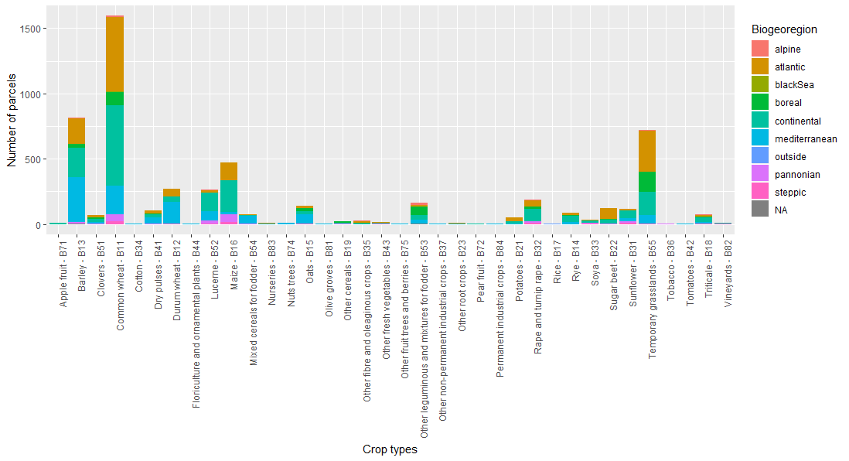
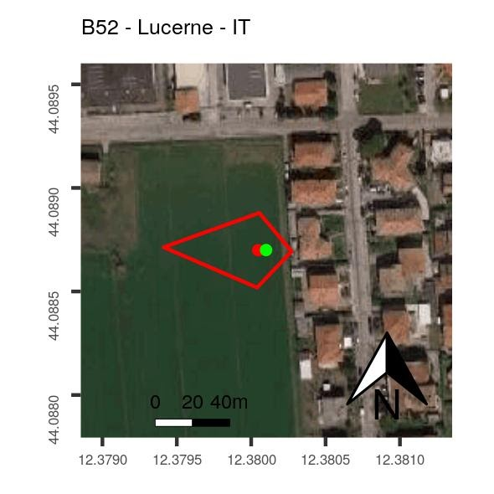
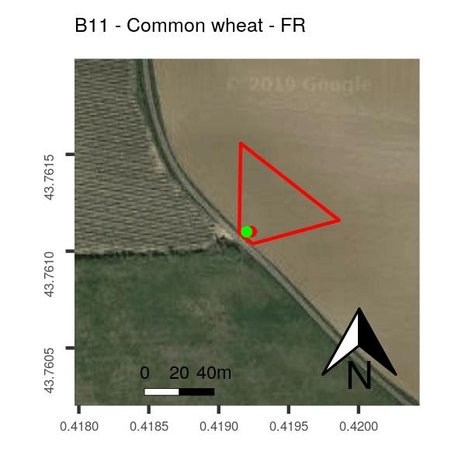
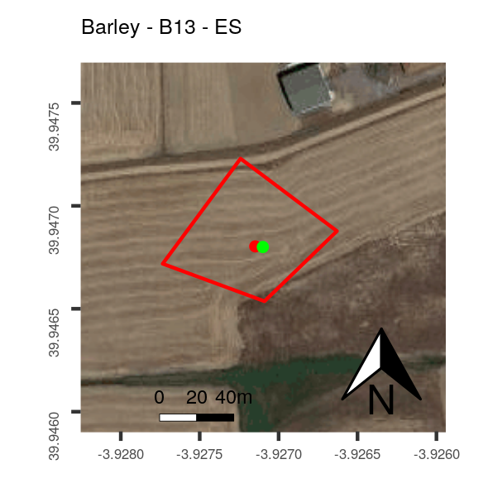
LUCAS in-situ observations could be used to extract satellite time series to study phenology
EU28
In-situ data from LUCAS Copernicus 2018
LUCAS Copernicus component is a pilot to provide in-situ data for training and validation algorithm for remote sensing data
Exact location of the observation (VS theoretical for normal LUCAS)
Pure Land Cover extent within 50 m from the points (N, E, S, W)
63,364 LUCAS points surveyed with the Copernicus requirements
Cleaning and construction of polygons
Examples of LUCAS Copernicus polygons
6,905 Polygons in 30 crop types
d’Andrimont, R., Verhegghen, A., Meroni, M., Lemoine, G., Strobl, P., Eiselt, B., van der Velde, M. LUCAS Copernicus 2018: Earth Observation relevant in-situ data on land cover throughout the European Union. (Ongoing study)
Notes:
d’Andrimont, R., Verhegghen, A., Meroni, M., Lemoine, G., Strobl, P., Eiselt, B., van der Velde, M. LUCAS Copernicus 2018: Earth Observation relevant in-situ data on land cover throughout the European Union. (Ongoing study)

Slide 7
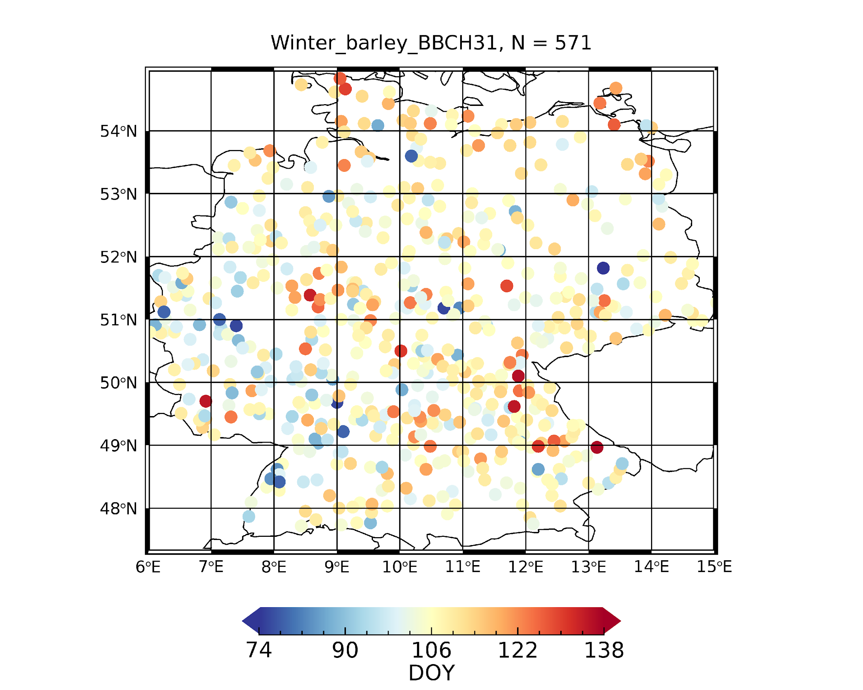
Satellite time series are used to obtain Land Surface Phenology and compared with in-situ data
Sentinel-1 Cross Ratio (VH/VV)
Sentinel-2 NDVI
In-situ early stem elongation (BBCH 31)
Satellite time series fitting provides Land Surface Phenology metrics (start, peak and end of the season)
Δ
Satellite Start of season (SOS)
In-situ start of season
Δ is the difference in days between the average timing of the LSP metric and BBCH stage
Meroni, M., d’Andrimont, R., Vrieling, A., Fasbender, D., Lemoine, G., Rembold, F., Seguini, L., Verhegghen A. Comparing land surface phenology of major European crops as derived from SAR and optical data of Sentinel-1 and -2. (Ongoing study)

Slide 8
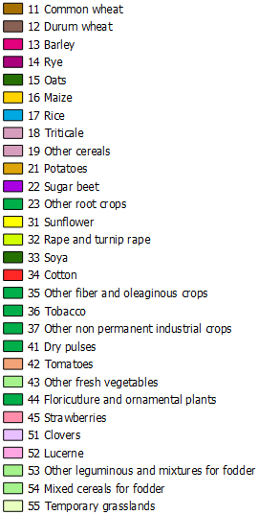
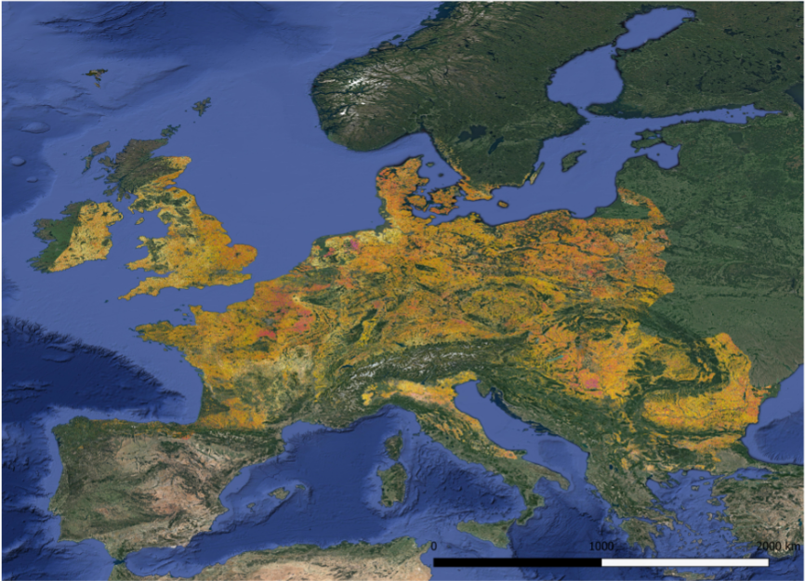
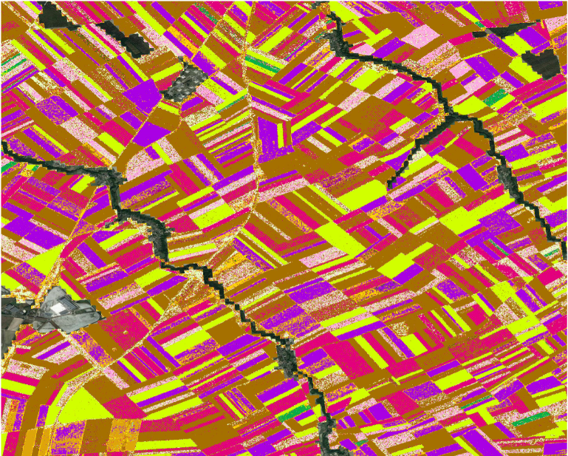
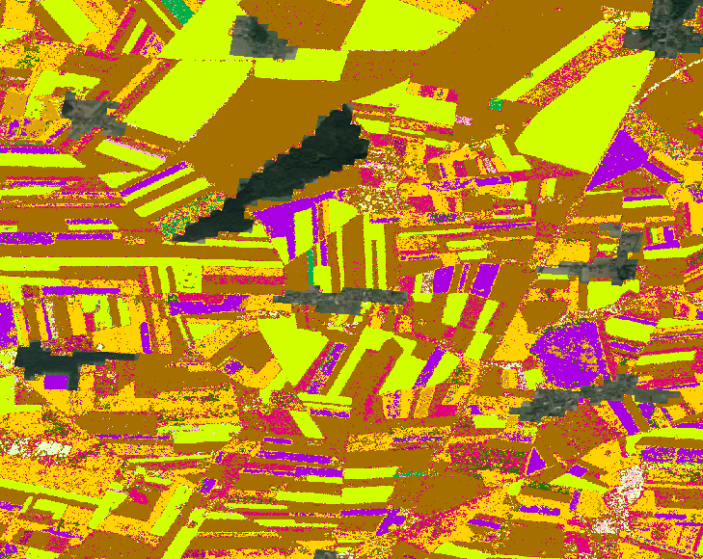
Crop type mapping could contribute to scale crop parcel phenology retrieval at continental scale
1
2
1
2
2018 map at 10m
with S1 data (01-03 to 31-08)
d'Andrimont, R., Verhegghen, A., Lemoine, G., Strobl, P., van der Velde M. A Sentinel-1 based European crop parcel map using 2018 in-situ LUCAS Copernicus observations
Notes:
drimont, R., Verhegghen, A., Lemoine, G., Strobl, P., van der Velde M. A Sentinel-1 based European crop parcel map using 2018 in-situ LUCAS Copernicus observations

Slide 9
Conclusions
Recent satellite constellations such as the Copernicus Sentinels are able to provide detailed spatial (10 m) and temporal information (<5 day)
This information is suited for parcel crop phenology retrieval
High quality in-situ data is still the holy grail
Research needs to better integrate heterogeneous data stream (field observations, satellite data, street-level photos, crowdsourcing, administrative data)

Slide 10
Thank you
Raphaël D’ANDRIMONT
raphael.dandrimont@ec.europa.eu
Twitter: @rdandrimont
© European Union 2020
Unless otherwise noted the reuse of this presentation is authorised under the CC BY 4.0 license. For any use or reproduction of elements that are not owned by the EU, permission may need to be sought directly from the respective right holders.
Notes:
Update/add/delete parts of the copy right notice where appropriate.
More information: https://myintracomm.ec.europa.eu/corp/intellectual-property/Documents/2019_Reuse-guidelines%28CC-BY%29.pdf

