Slide 1
Using standards to model delayed mode sensor processes
Alexandra Kokkinaki, Justin Buck, Emma Slater, Julie Collins, Raymond Cramer, and Louise Darroch
The British Oceanogrpahic Data Centre, National Oceanography Centre, UK

Slide 2
Objectives
As part of the EU ENVRIplus project, our work aims at capturing the delayed mode, data curation process taking place at the National Oceanography Centre’s British Oceanography Data Centre (BODC).
FAIR: Unique URIs, standards and controlled vocabularies, Model: The delayed mode process commencing from the submitted originators input and ending by the archived and published dataset.

Slide 3
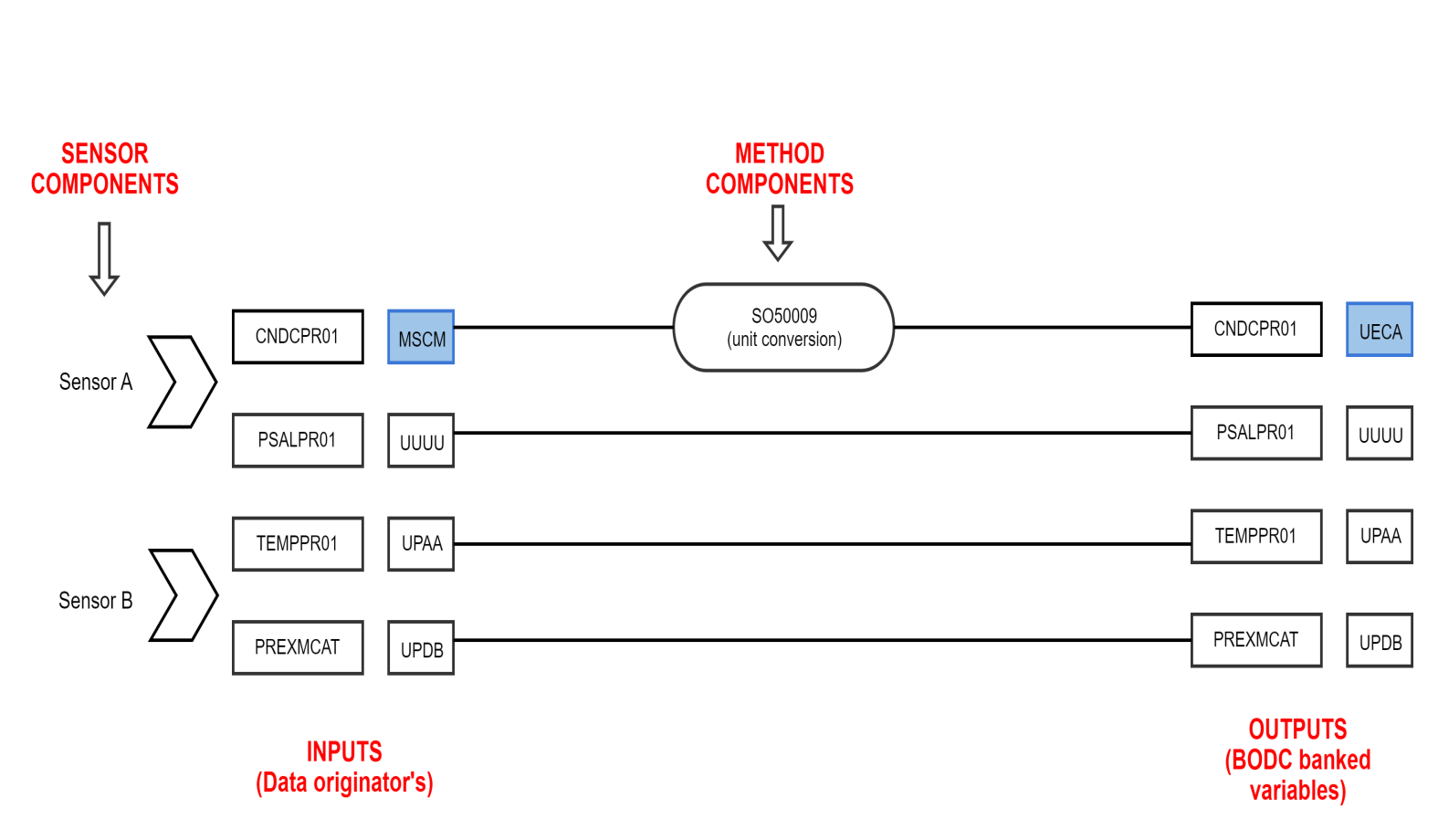
BODC ingestion process

Slide 4
Delayed Mode Process in BODC
Search for a link with this colour
ERDDAP
NVS vocabularies
Unique URIs
OGC SWE sensorML
(SWE Marine Profiles)
52North SOS
OGC SWE O&M
Delayed Mode Process

Slide 5
OGC SWE – SWE Marine profiles
Enhance semantic interoperability
Communicate and understand
SWE Marine Profiles
NERC Vocabulary Server (NVS)
Property definitions
SensorML Events: Collection W03
SensorML Capabilities: Collection W04
SensorML Characteristics: Collection W05
SensorML Classifications: Collection W06
SensorML Identifications: Collection W07
SensorML Contacts: Collection W09
SWE O&M: Collection W09
SWE Data interface types: W10
Property values
Observable property: Collections P01, P07
Instrument Type: Collection L05
Platform Type: Collection L06
Platform/device models: Collections L22, B76
Roles: Collections G04, C86
Feature of Interest: Collection C19
Manufacturer: Collections L35, C75
Kokkinaki, A., Darroch, L., Buck, J. and Jirka, S. (2016) http://ceur-ws.org/Vol-1762/Kokkinaki.pdf

Slide 6
Aggregate process
A physical system is a physical process that consists of multiple components that can be both physical and non-physical. In addition to listing the components within the ComponentList element, a PhysicalSystem can explicitly define the flow of data throughout the system, using the ConnectList element. Components can be defined inline within the PhysicalSystem description or referenced externally using the xlink:href attribute as shown in the example below. A connection Link maps between the data source and the data destination, and can thus describe the flow of data between various components or between components and the systems inputs, outputs, and parameters.

Slide 7
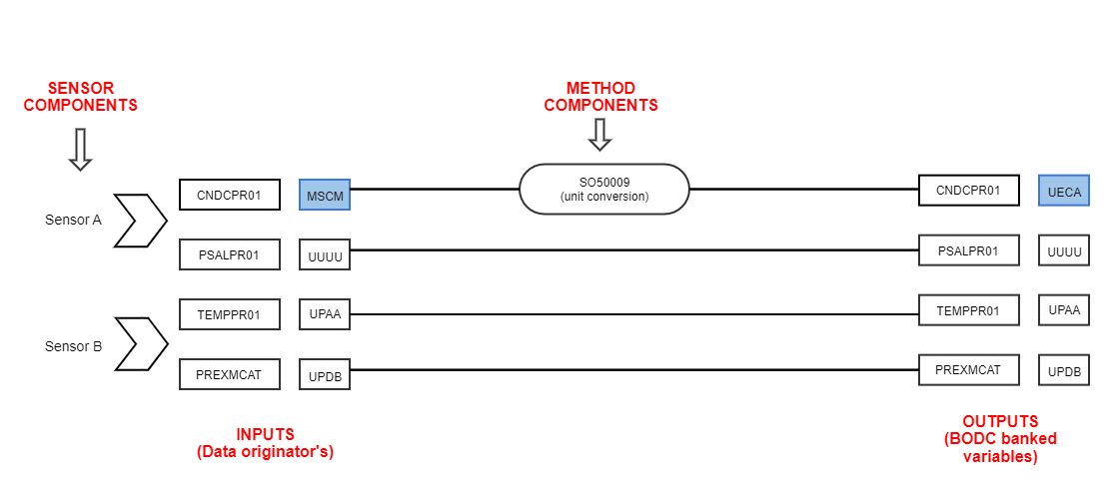
Search for a link with this colour
Each element iin the diagram is a hyperlink idntified by a unique URI.
BODC parameter semantic model data processing entity descriptions

Slide 8
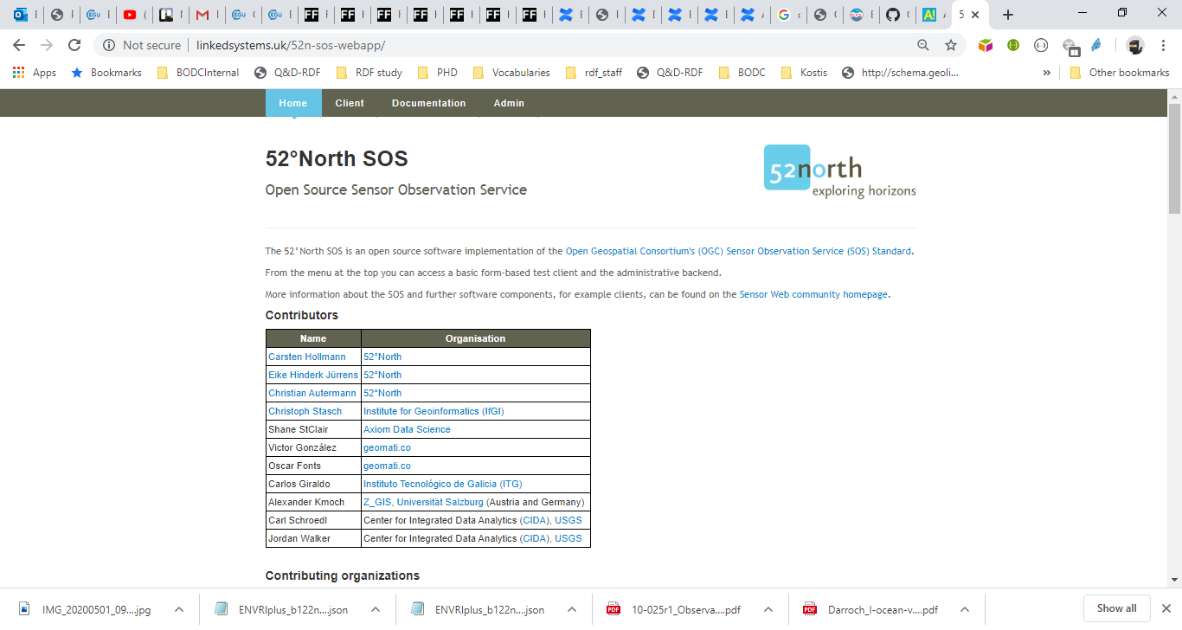
SWE Marine Profiles

Slide 9
https://dev.linkedsystems.uk/delmodesys/instance/ SLSYS_SOC080077C_61300 /current/
<sml:PhysicalSystem ………..>
<sml:outputs>
<sml:OutputList>
<sml:output name="SLSYS_SOC080077C_61300">
<swe:DataRecord>
<swe:field name="InSituCond">
<swe:Quantity definition="http://vocab.nerc.ac.uk/collection/P01/current/CNDCPR01/">
<swe:uom xlink:href="http://vocab.nerc.ac.uk/collection/P06/current/UECA" />
</swe:Quantity>
</swe:field>
<swe:field name="InSituCond">
<swe:Quantity definition="http://vocab.nerc.ac.uk/collection/P01/current/CNDCPR01/">
<swe:uom xlink:href="http://vocab.nerc.ac.uk/collection/P06/current/MSCM" />
</swe:Quantity>
</swe:field>
<swe:field name="P_sal">
<swe:Quantity definition="http://vocab.nerc.ac.uk/collection/P01/current/PSALPR01/">
<swe:uom xlink:href="http://vocab.nerc.ac.uk/collection/P06/current/UUUU" />
</swe:Quantity>
</swe:field>
<swe:field name="Pres_Mcat_interp">
<swe:Quantity definition="http://vocab.nerc.ac.uk/collection/P01/current/PREXSINT/">
<swe:uom xlink:href="http://vocab.nerc.ac.uk/collection/P06/current/UPDB" />
</swe:Quantity>
</swe:field>
<swe:field name="Temp">
<swe:Quantity definition="http://vocab.nerc.ac.uk/collection/P01/current/TEMPPR01/">
<swe:uom xlink:href="http://vocab.nerc.ac.uk/collection/P06/current/UPAA" />
</swe:Quantity>
</swe:field>
</swe:DataRecord>
</sml:output>
</sml:OutputList>
</sml:outputs>
</sml:output>
</sml:OutputList>
</sml:outputs>
Notes:
Delayed mode process modelled as a Physical system here showing outputs

Slide 10
https://dev.linkedsystems.uk/delmodesys/instance/ SLSYS_SOC080077C_61300 /current/
<sml:components>
<sml:ComponentList>
<sml:component name="TOOL0022_2933" xlink:title="TOOL0022_2933" xlink:href="http://linkedsystems.uk/system/instance/TOOL0022_2933/current/" />
<sml:component name="MTHD_SOC080077C_61300_CNDCPR01" xlink:title="MTHD_SOC080077C_61300_CNDCPR01" xlink:href="http://linkedsystems.uk/procmodel/instance/MTHD_SOC080077C_61300_CNDCPR01/current/" />
</sml:ComponentList>
</sml:components>
Notes:
Continued from Delayed mode process here showing components

Slide 11
https://dev.linkedsystems.uk/delmodesys/instance/ SLSYS_SOC080077C_61300 /current/
<sml:connections>
<sml:ConnectionList>
<sml:connection>
<sml:Link>
<sml:source ref="components/MTHD_SOC080077C_61300_CNDCPR01/outputs/CNDCPR01" />
<sml:destination ref="outputs/SLSYS_SOC080077C_61300/CNDCPR01" />
</sml:Link>
</sml:connection>
<sml:connection>
<sml:Link>
<sml:source ref="components/TOOL0022_2933/outputs/CNDCPR01" />
<sml:destination ref="inputs/MTHD_SOC080077C_61300_CNDCPR01/CNDCPR01" />
</sml:Link>
</sml:connection>
<sml:connection>
<sml:Link>
<sml:source ref="components/TOOL0022_2933/outputs/PSALPR01" />
<sml:destination ref="outputs/SLSYS_SOC080077C_61300/PSALPR01" />
</sml:Link>
</sml:connection>
<sml:connection>
<sml:Link>
<sml:source ref="components/TOOL0022_2933/outputs/PREXSINT" />
<sml:destination ref="outputs/SLSYS_SOC080077C_61300/PREXSINT" />
</sml:Link>
</sml:connection>
<sml:connection>
<sml:Link>
<sml:source ref="components/TOOL0022_2933/outputs/TEMPPR01" />
<sml:destination ref="outputs/SLSYS_SOC080077C_61300/TEMPPR01" />
</sml:Link>
</sml:connection>
</sml:ConnectionList>
</sml:connections>
Notes:
Continued from Delayed mode process here showing data flow via connections

Slide 12
https://dev.linkedsystems.uk/procmodel/instance/MTHD_SOC080077C_61300_CNDCPR01/current/
<sml:SimpleProcess gml:id="MTHD_SOC080077B_98100_CNDCPR01">
<gml:description>Simple process for SOC080077B_98100_CNDCPR01</gml:description>
<gml:identifier codeSpace="uniqueID">MTHD_SOC080077B_98100_CNDCPR01</gml:identifier>
<sml:typeOf xlink:title="_A_Type_for_Process_Model" xlink:href="http://dev.linkedsystems.uk/system/instance/prototype/MTHD/" />
<sml:inputs>
<sml:InputList>
<sml:input name="MTHD_SOC080077B_98100_CNDCPR01">
<swe:DataRecord>
<swe:field name="InSituCond">
<swe:Quantity definition="http://vocab.nerc.ac.uk/collection/P01/current/CNDCPR01/">
<swe:uom xlink:href="http://vocab.nerc.ac.uk/collection/P06/current/MSCM" />
</swe:Quantity>
</swe:field>
</swe:DataRecord>
</sml:input>
</sml:InputList>
</sml:inputs>
<sml:outputs>
<sml:OutputList>
<sml:output name="SLSYS_SOC080077B_98100">
<swe:DataRecord>
<swe:field name="InSituCond">
<swe:Quantity definition="http://vocab.nerc.ac.uk/collection/P01/current/CNDCPR01/">
<swe:uom xlink:href="http://vocab.nerc.ac.uk/collection/P06/current/UECA" />
</swe:Quantity>
</swe:field>
</swe:DataRecord>
</sml:output>
</sml:OutputList>
</sml:outputs>
</sml:SimpleProcess>
Notes:
The method that converts units encoded in sensorML as a simple process showing inputs and outputs

Slide 13
GetObservation request for a delayed mode process
Out of band observation
GetObservation response
"resultTime" : "0004-06-16T00:00:00.000Z",
"result" : {
"href" : "https://linkedsystems.uk/erddap/tabledap/ENVRIplus_b122nnnn.json?depth%2Clongitude%2Clatitude%2CPOSITION_SEADATANET_QC%2Ctime%2CTIME_SEADATANET_QC%2CPREXMCAT%2CPREXMCAT_SEADATANET_QC&time%3E=2003-11-17&time%3C=2004-06-18"
}
Observation result:
O&M: out of band
Link to ERDDAP
Notes:
The data

Slide 14
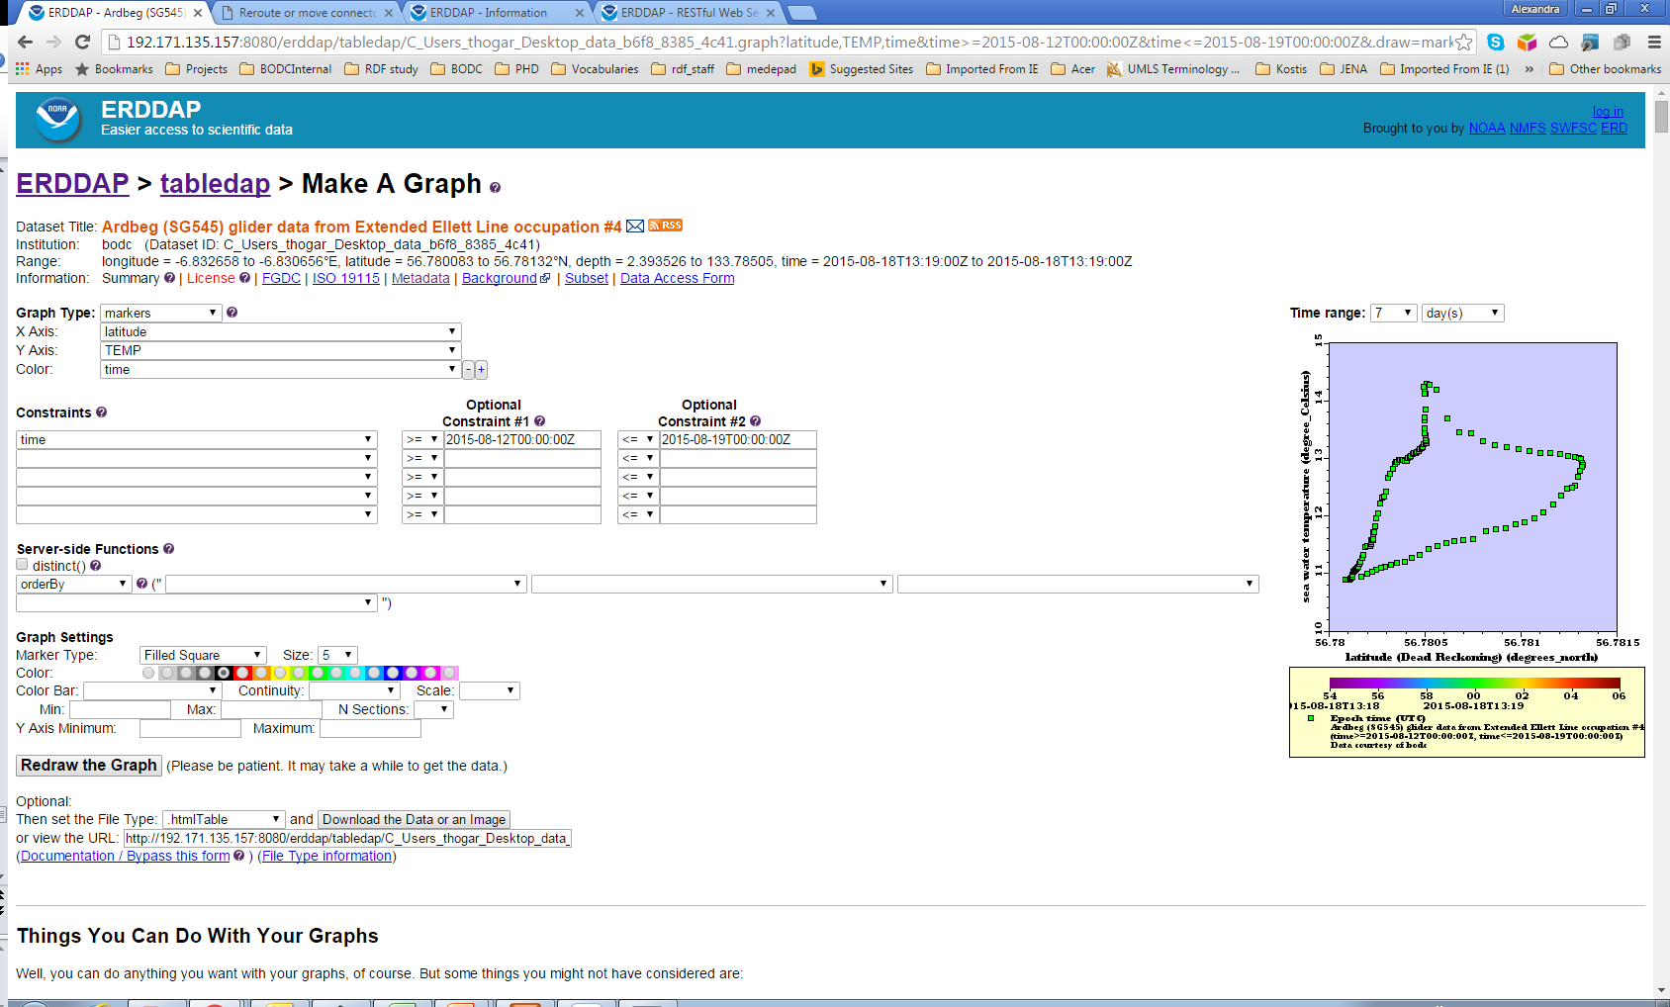
ERDDAP
https://linkedsystems.uk/erddap/
Notes:
ERDDAP

