Slide 1
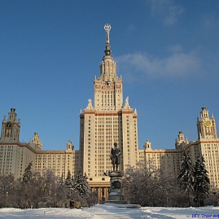

The main types of river channel bedforms movement
Olga Borisova
Institute of Geography, Russian Academy of Sciences
Aleksey Sidorchuk
Moscow State University

Slide 2
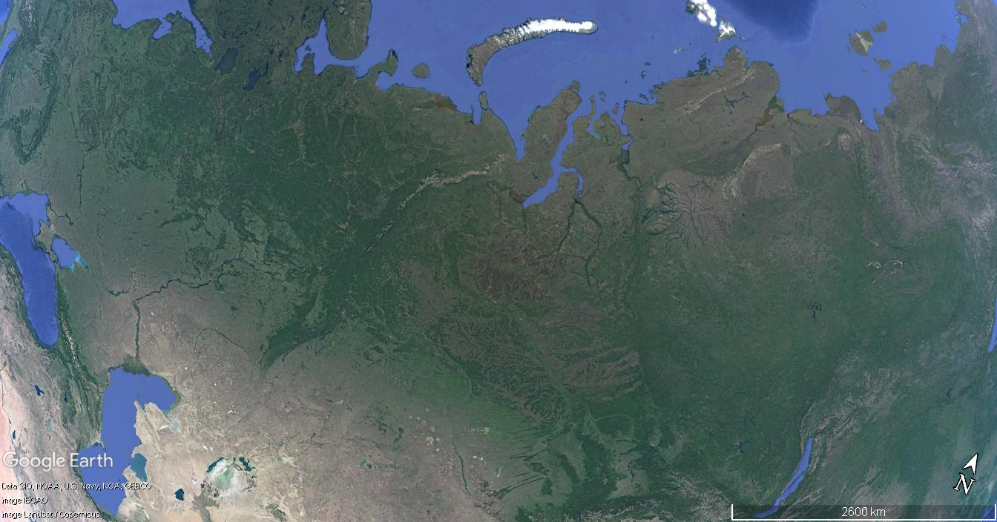
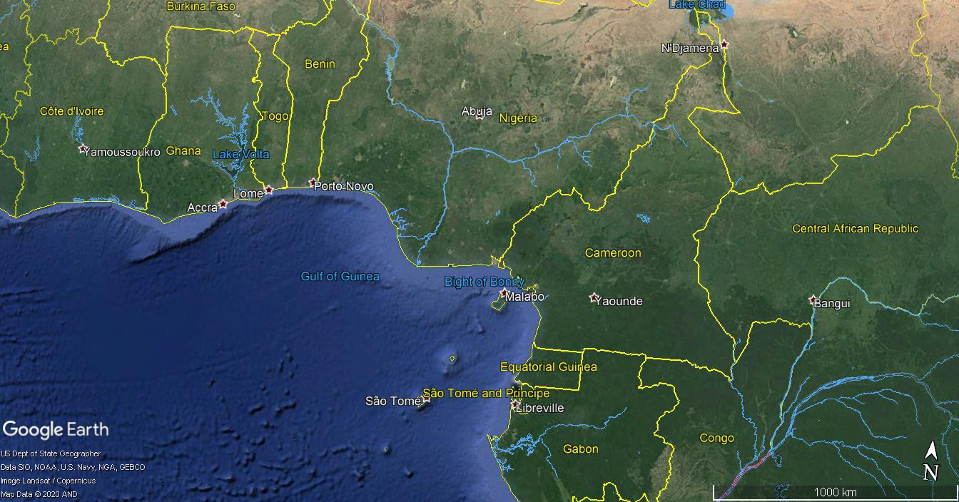
The examples are from:
Vychegda River
Yenisei River
Volga River
Lena River
Ob River
Niger River
Terek River

Slide 3
The main characteristics of the river channel bedforms
Hierarchical structure
Stochasticity of morphology and dynamics
Two main modes of movement: active and passive

Slide 4
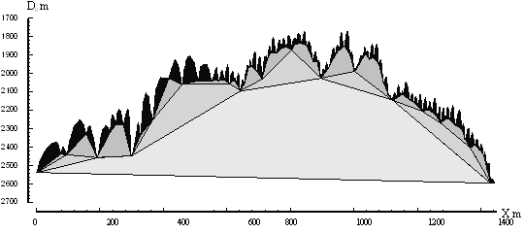
General terms
All dune-like alluvial features in the river channel – sand waves
(although some are not of sand but of gravel, cobbles and boulders)
The smallest (first order) sand waves with wavelength and amplitude
changing with flow depth and velocity – megaripples
Second order sand waves often, but not necessarily, covered by megaripples – dunes_1
Third order sand waves often covered by dunes_1 and megaripples, but not necessarily – dunes_2
Usually, the larger sand waves in the hierarchy
(mezoforms) are called bars
They also can be of several orders and are
usually covered by smaller bedforms
(microforms)

Slide 5
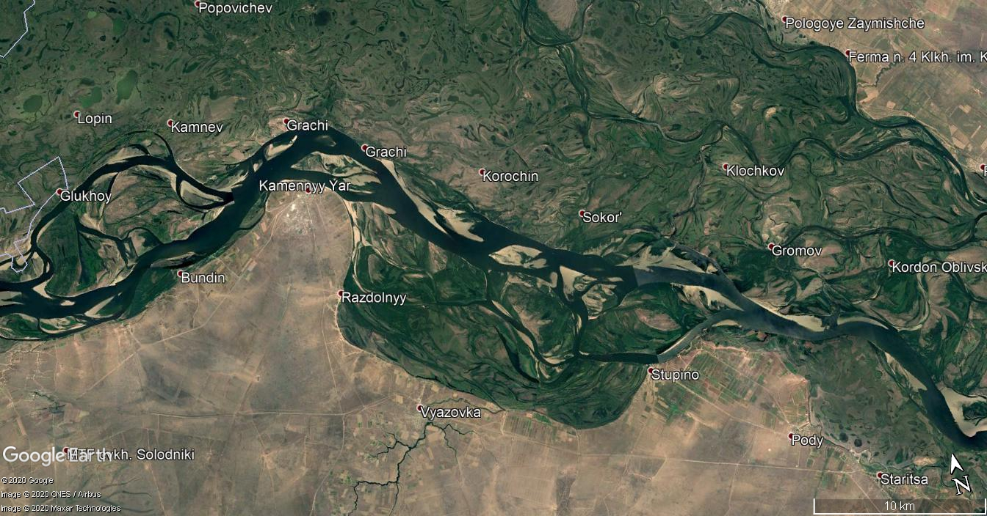
The lower Volga River

Slide 6
Hierarchical structure
The lower Volga River
Bedforms in the river channel are usually organised into hierarchical complexes, where smaller bedforms move along the surface of larger ones.
Dunes of the first order (dunes_1) on the dunes of second order (dunes_2) in side-scan sonar image

Slide 7
Stochasticity of morphology
The lower Volga River
Probability density functions
Sand waves wavelength
Sand waves amplitude
Dunes_1 Dunes_2 Bars_1

Slide 8
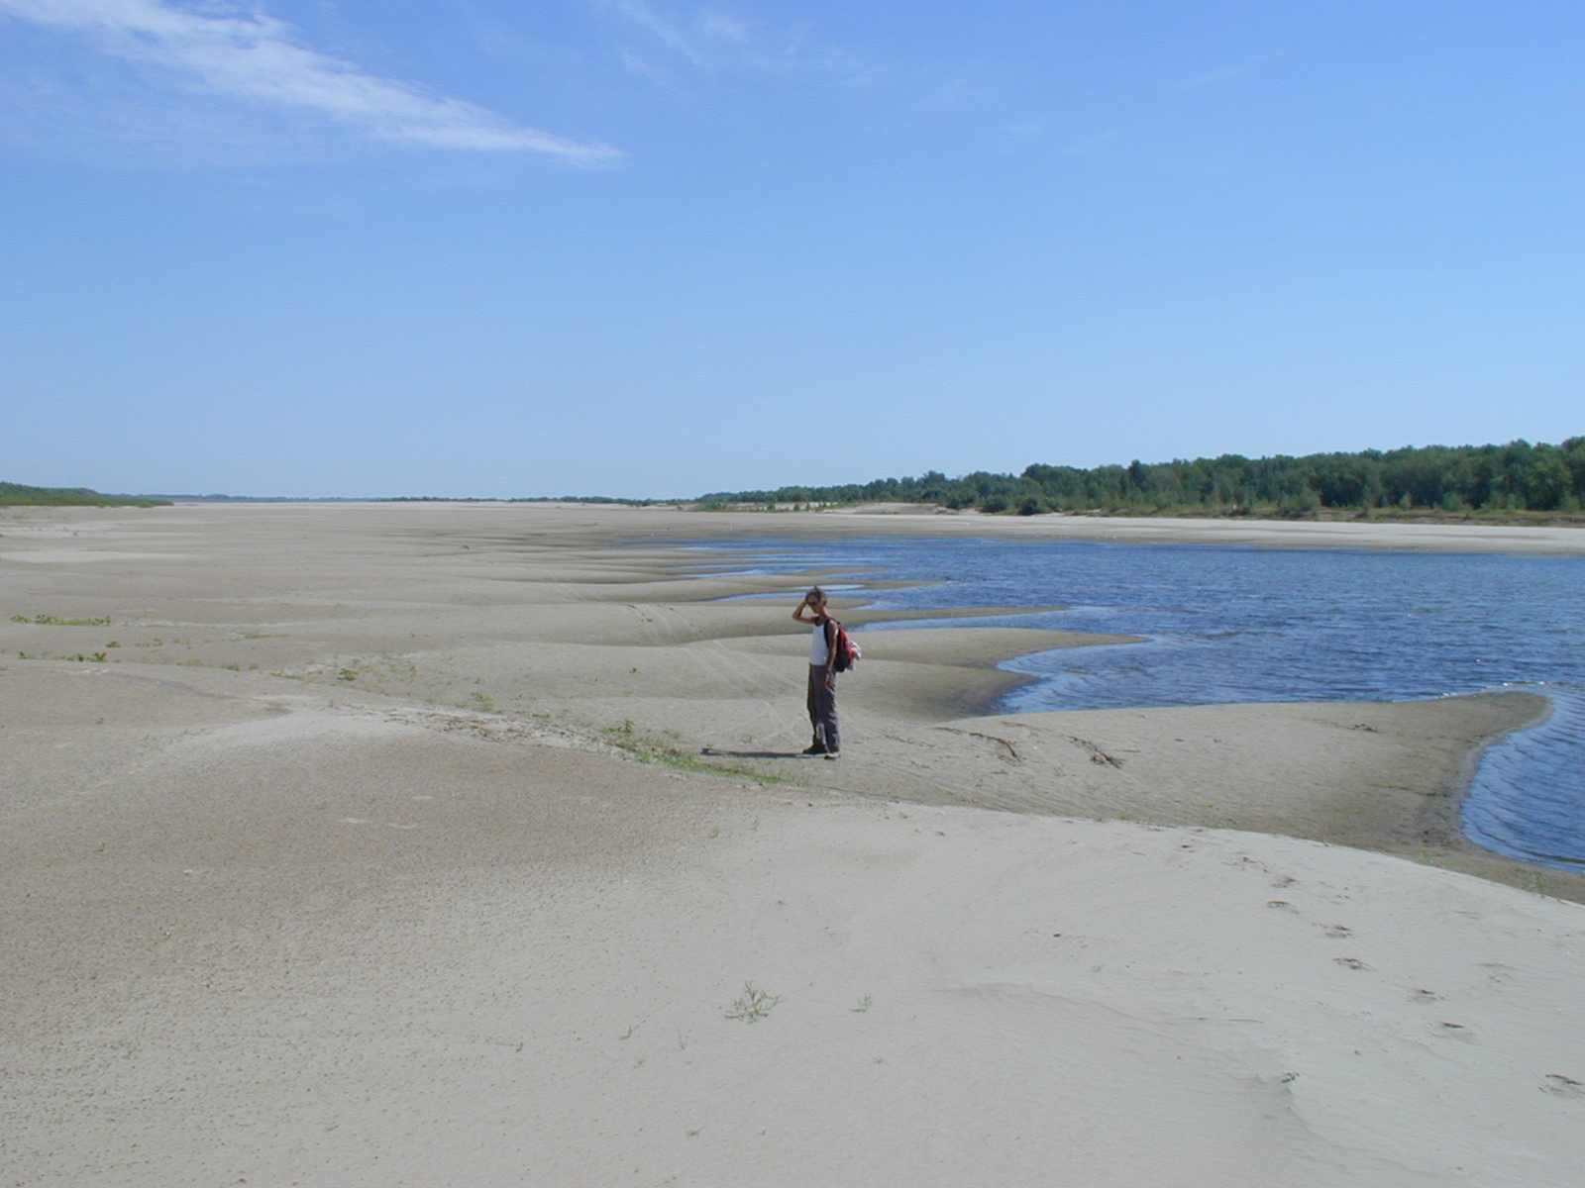
The lower Volga River
Photo by J. de Kramer

Slide 9
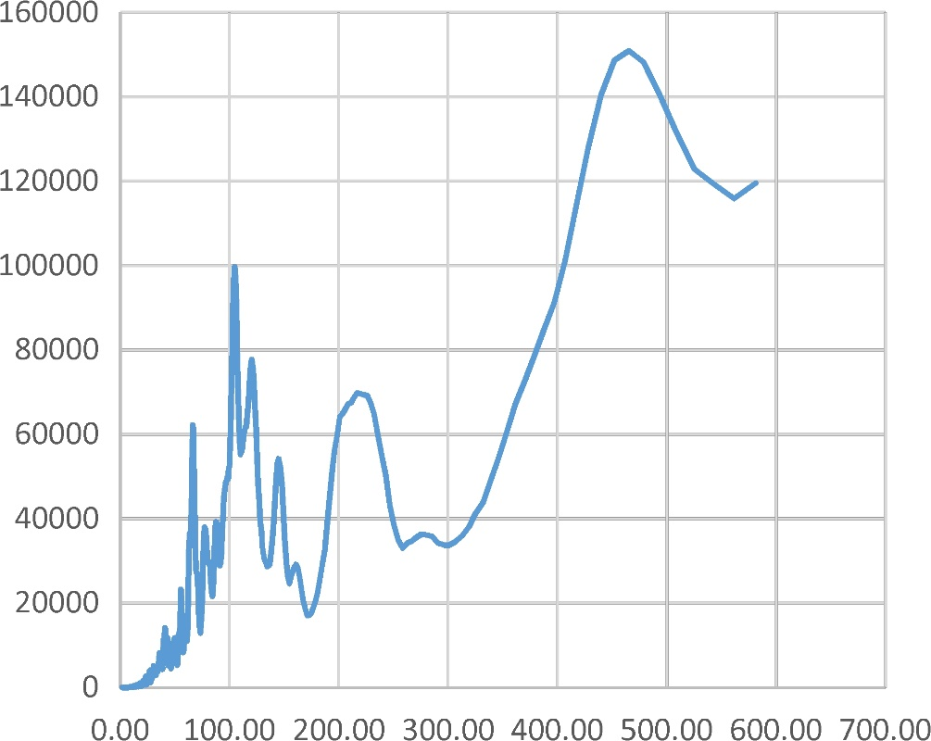
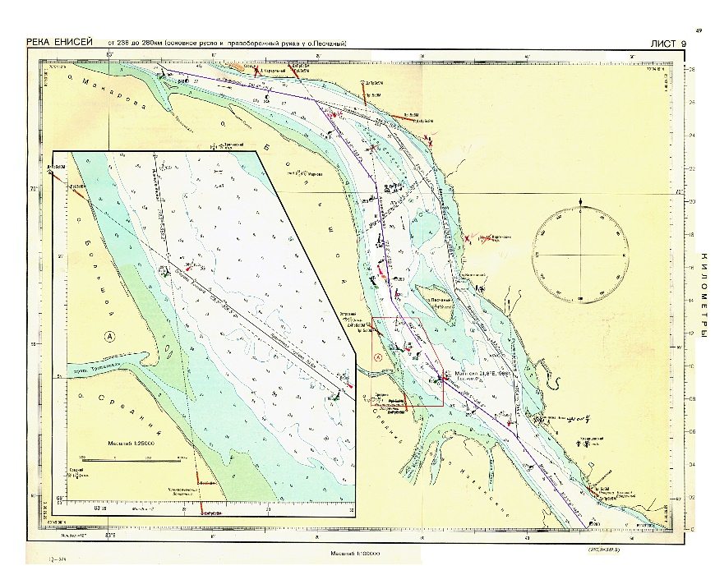
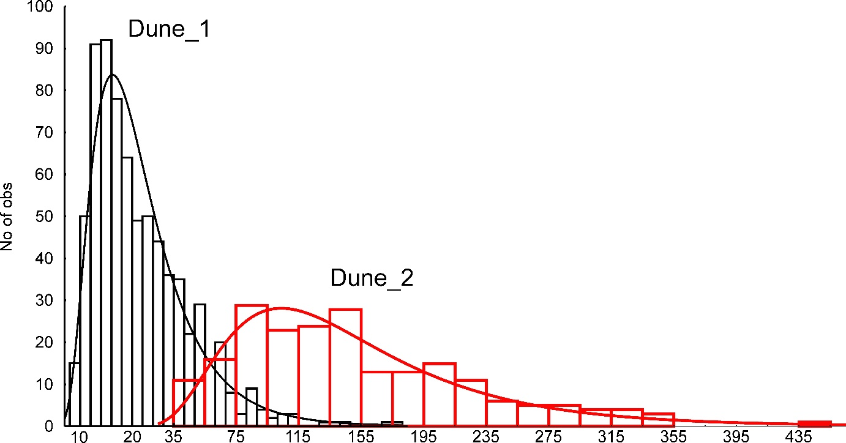
Stochasticity of morphology
Spectral density function
The lower Yenisei River
Bars_1
Dunes_1
Dunes_2
Wavelenth, m
Wavelenth, m
Probability density function

Slide 10
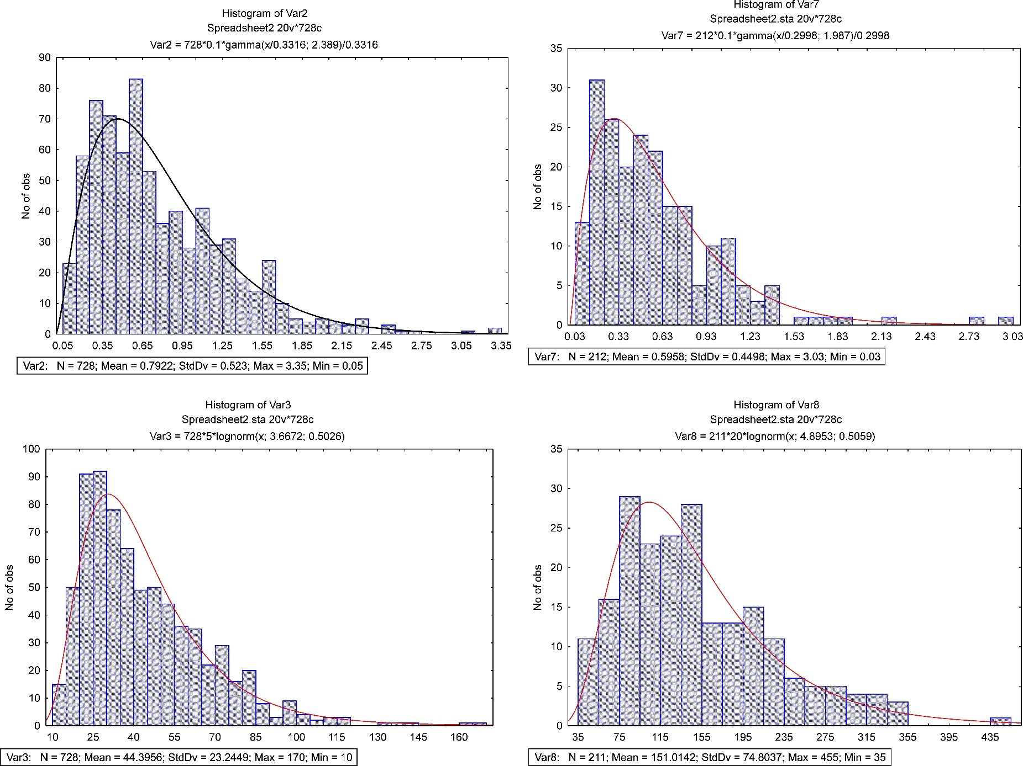
Stochasticity of morphology
The lower Yenisei River
Probability density functions
Sand waves wavelength
Sand waves amplitude
Dunes_1 Dunes_2

Slide 11
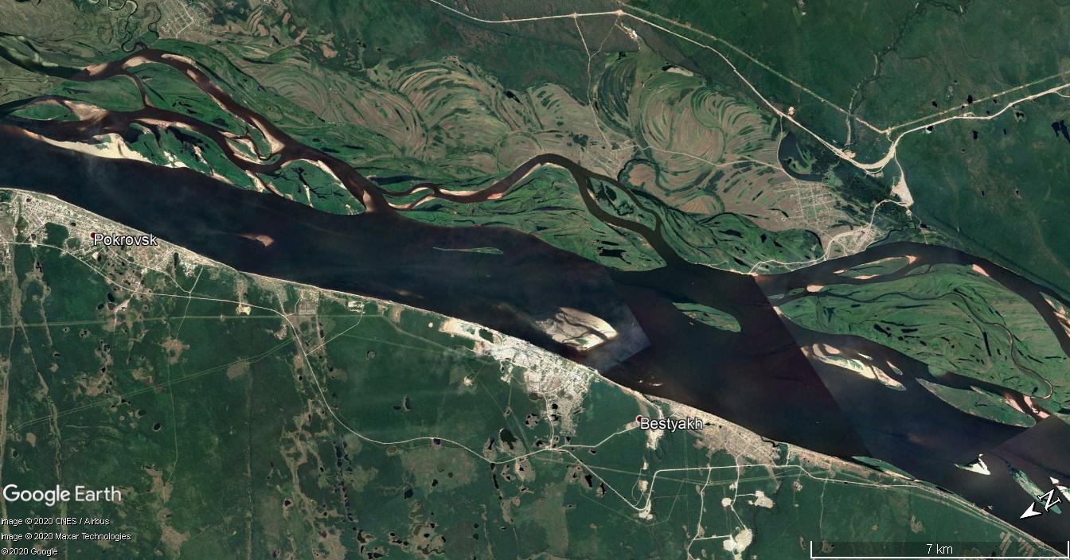
The Lena River
Observation
site

Slide 12
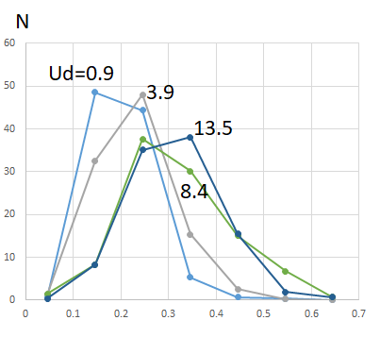
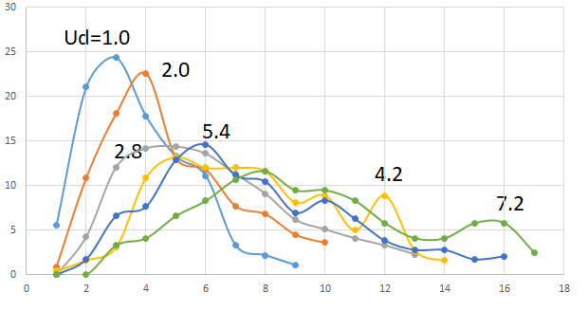
Stochasticity of morphology
The Lena River
Megaripple amplitude h and wavelength L probability density functions at different specific discharges Ud m2/s
N
h m
L m

Slide 13
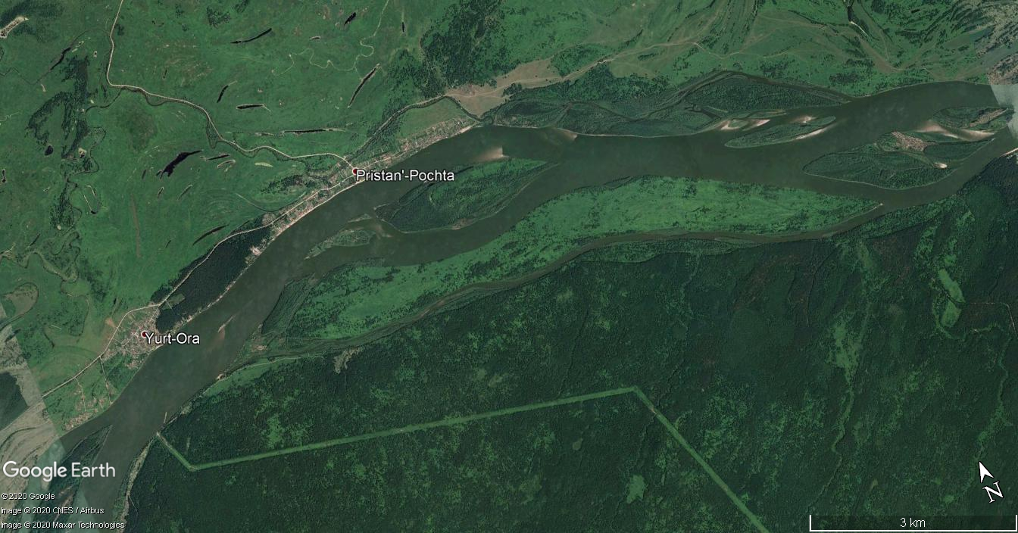
The Ob’ River
Observation
site

Slide 14
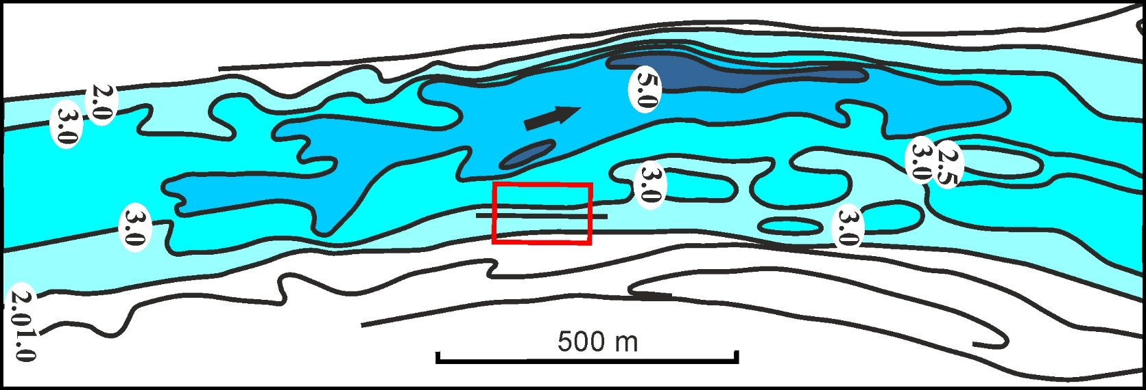
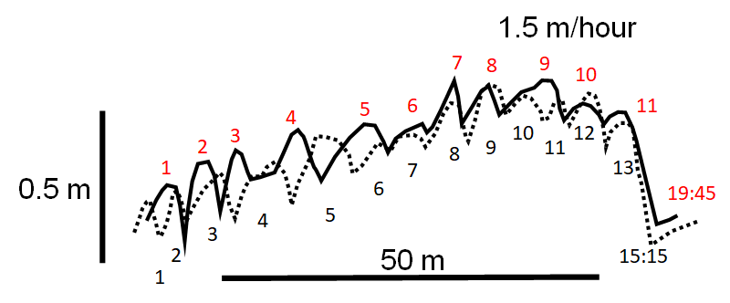
Two main modes of movement: active and passive
Active megaripples on passive dunes
The Ob’ River
15:15
15:45
16:15
16:45
The celerity of passive dunes is 0.2-0.4 m/hour; that of megaripples 1.5 m/hour
50 m
18:50
Orsko-Borsky
shallows,
August 7, 1993
19:15
19:45
20:15

Slide 15
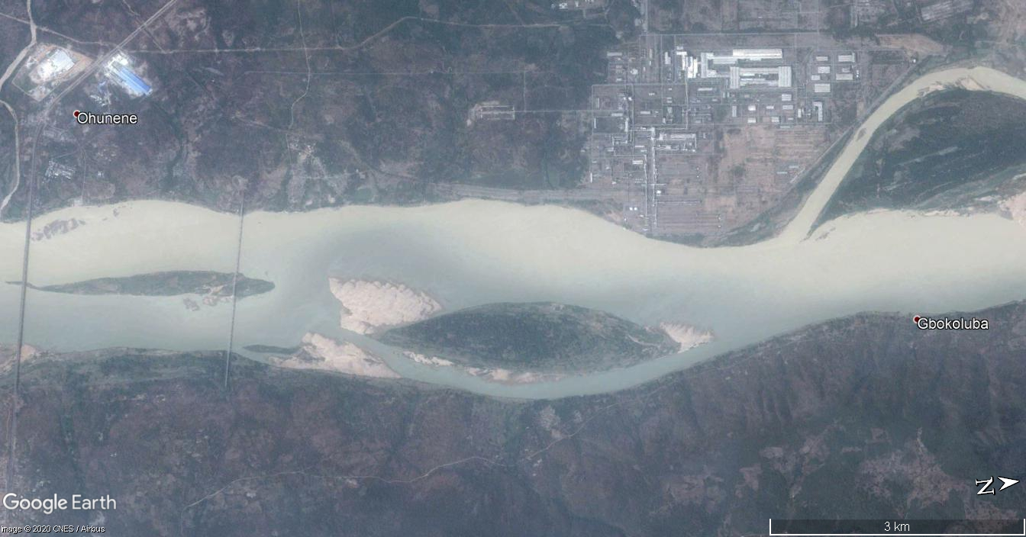
The Niger River
Observation
site

Slide 16
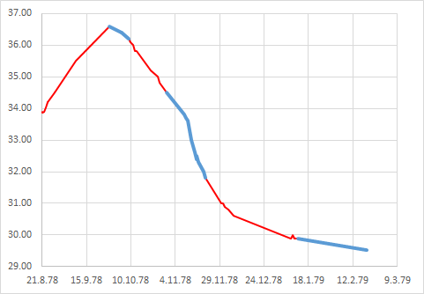
Two main modes of movement: active and passive
The Niger River near Ajaokuta
23.09-09.10.1978
Water level, m asl.
Active bedforms are three-dimensional, symmetrical, with gentle slopes. They move without significant change in shape, since all parts of their surface move at the same speed.
date
30 m asl
25 m asl

Slide 17
Two main modes of movement: active and passive
The Niger River near Ajaokuta
28.10-23.11.1978
Water level, m asl.
Passive bedforms are two-dimensional, asymmetric, with steep leeward slope. Their tops move faster than theirhollow so that the bedform is skewing.
Water level, m asl.
date
Transformation of active dunes into passive ones
m

Slide 18
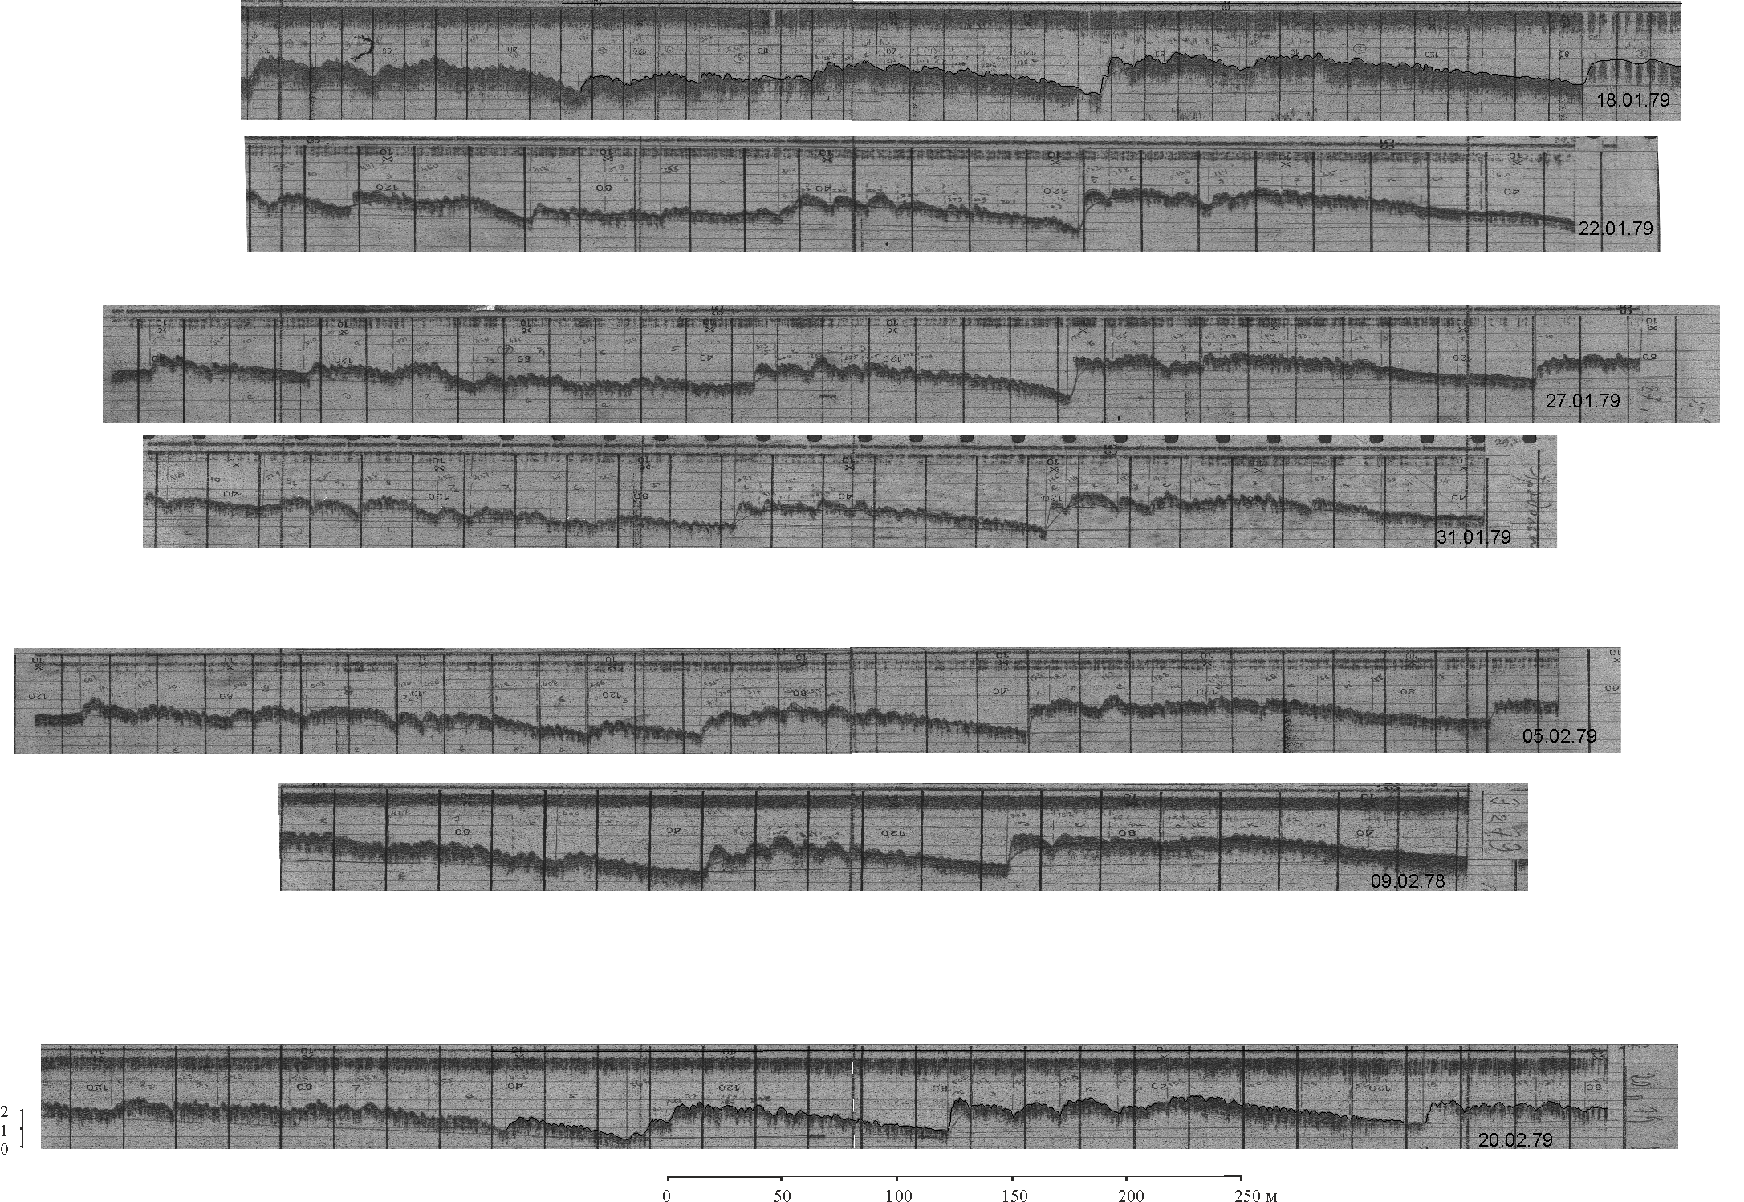
Two main modes of movement: active and passive
The Niger River near Ajaokuta
18.01-20.02.1979
Water level, m asl.
date
A new generation of active dunes appears on the surface of passive
dunes

Slide 19
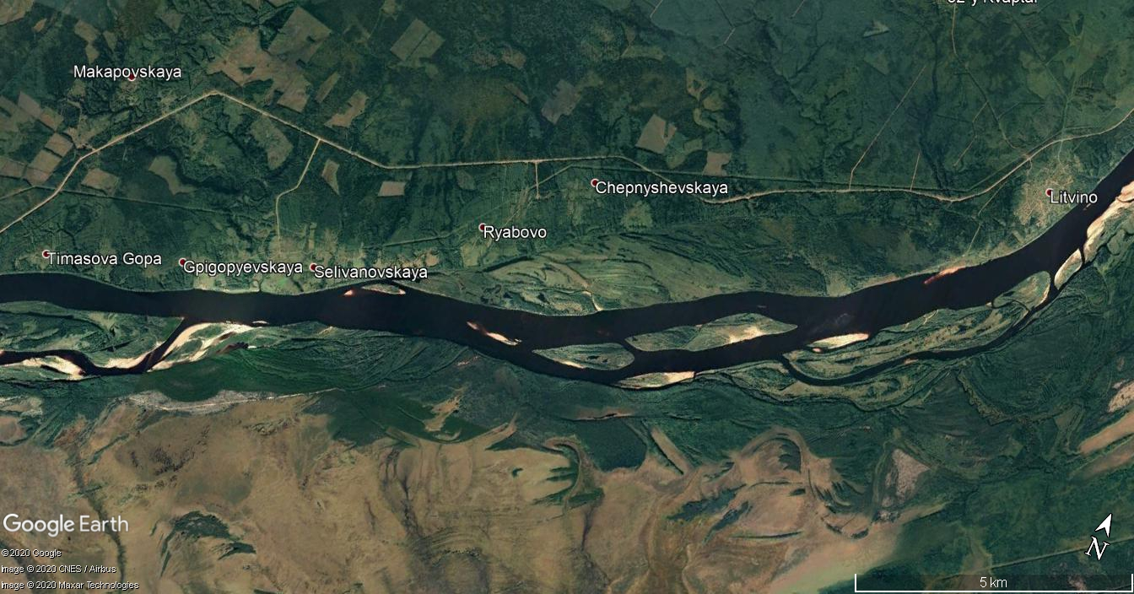
The Vychegda River
Observation
site

Slide 20
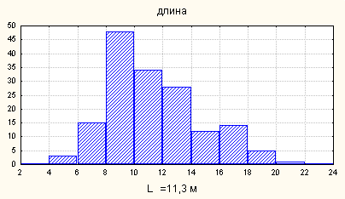
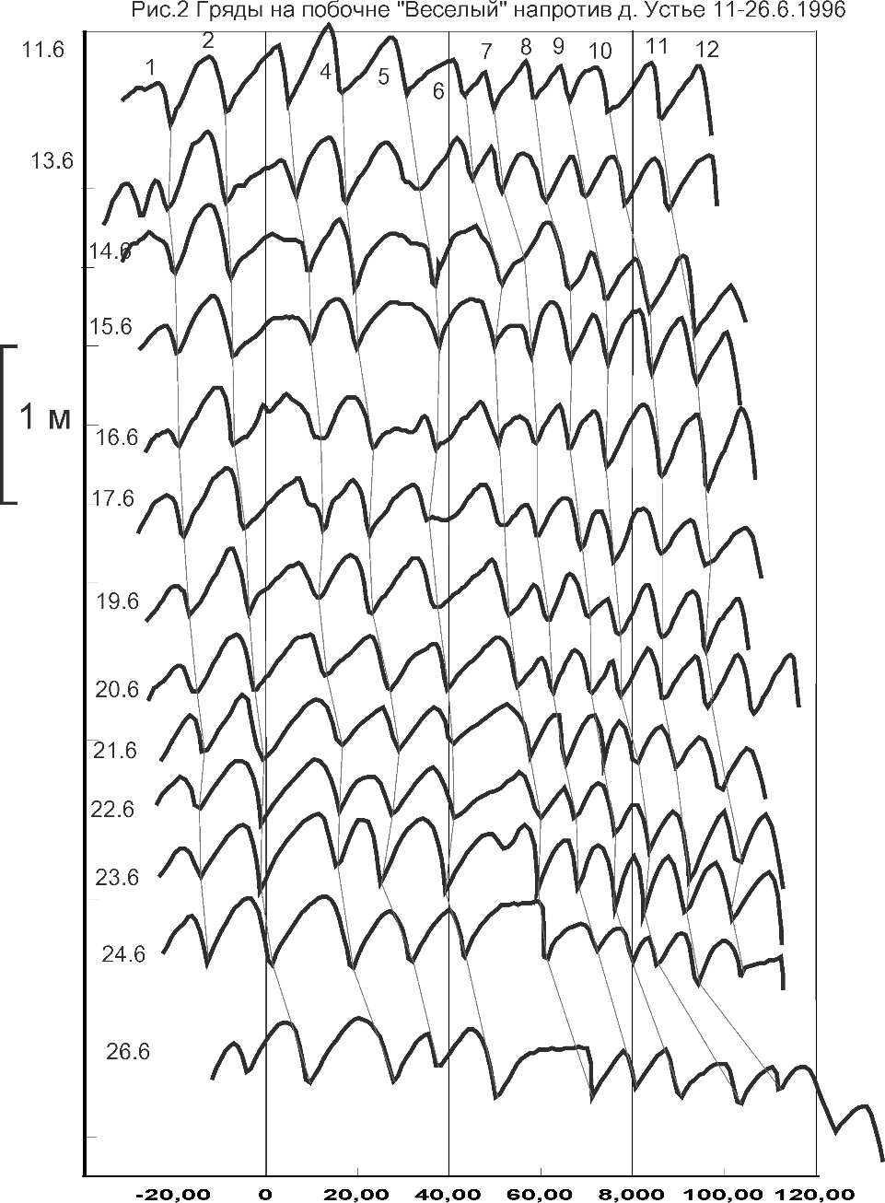
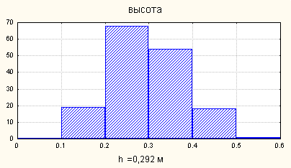
Two main modes of movement: active and passive
The Vychegda River
Active dunes on the bar
Dune wavelength
Dune amplitude

Slide 21
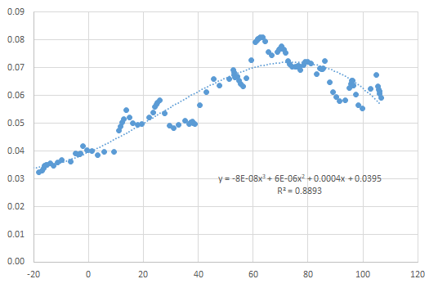
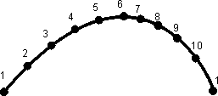
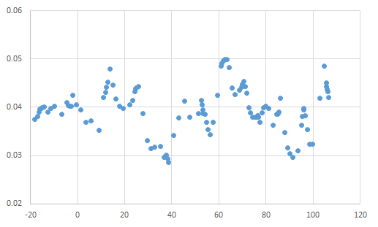
The Vychegda River
Dune celerity by points along the bar, m/hour
Points on the dune
Dune celerity by points (detrended)
along the bar, m/hour
Distance along the bar, m

Slide 22
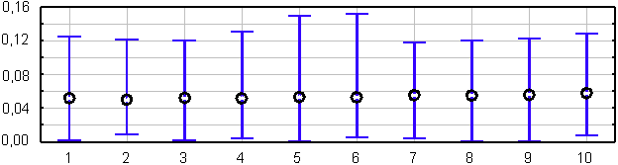
Histograms of dune
celerity by points
The Vychegda River
Points on the dune
Detrended dune celerity by points: means and max/min, m/hour, showing a general stability of active dunes shape

Slide 23
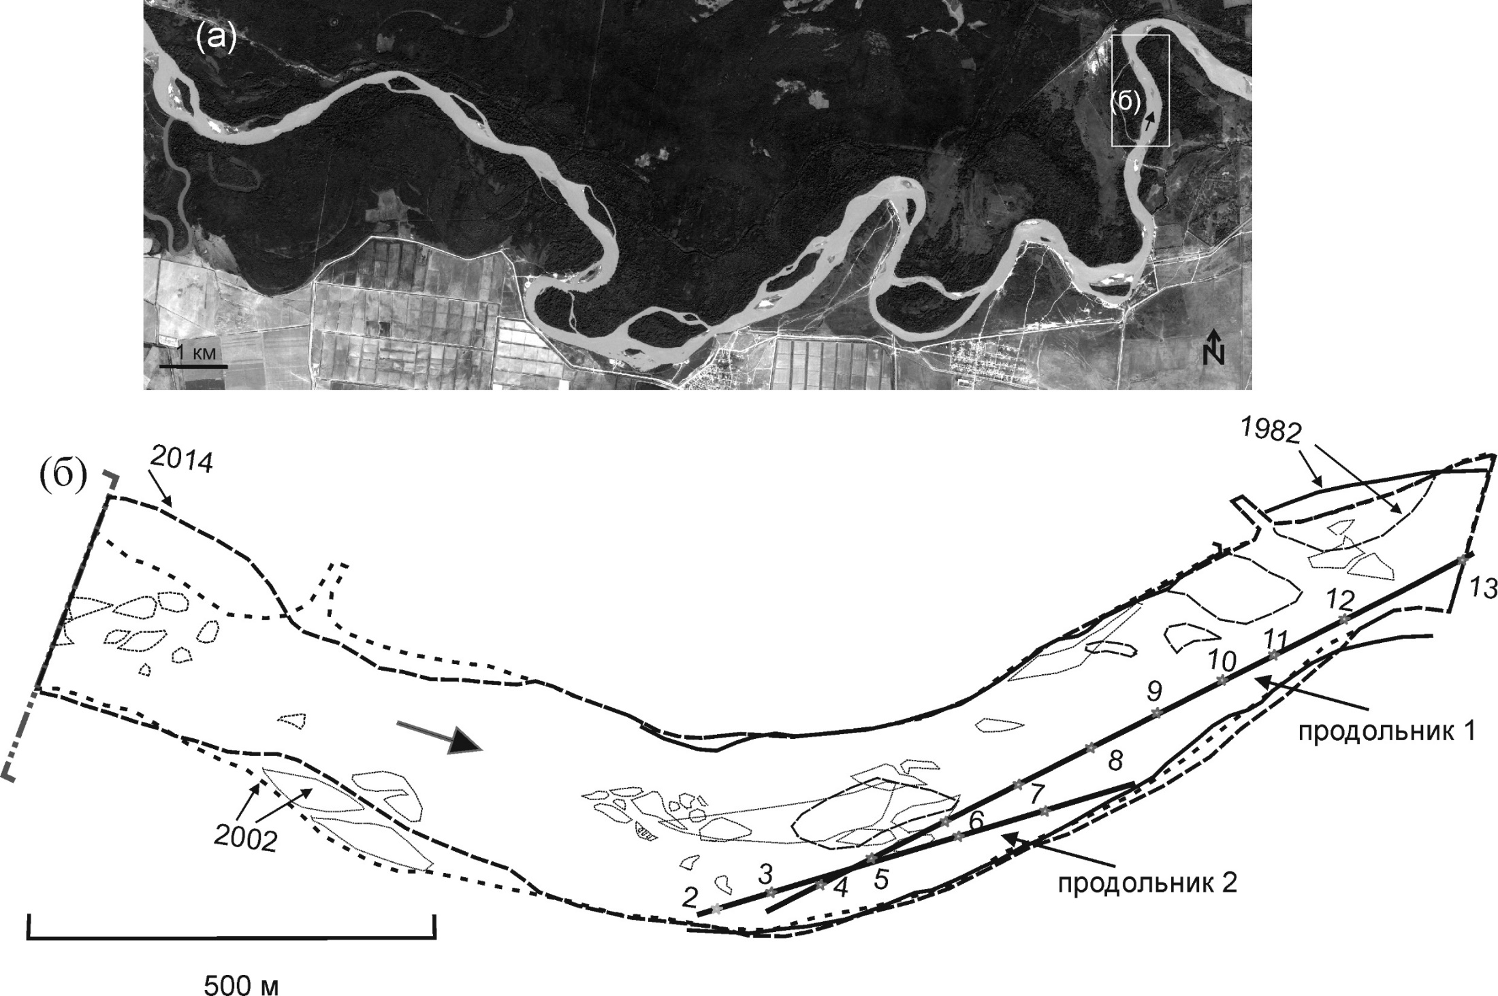
The Terek River
A stable section
of the Terek River
channel
long profile 1
long profile 2

Slide 24
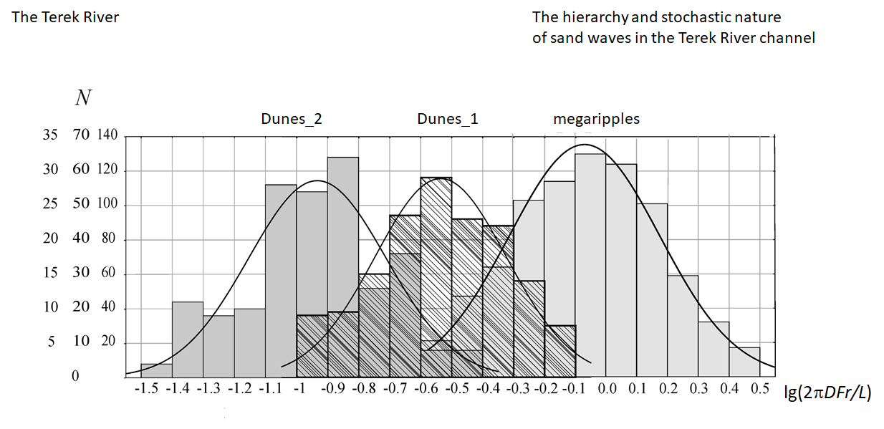

Slide 25
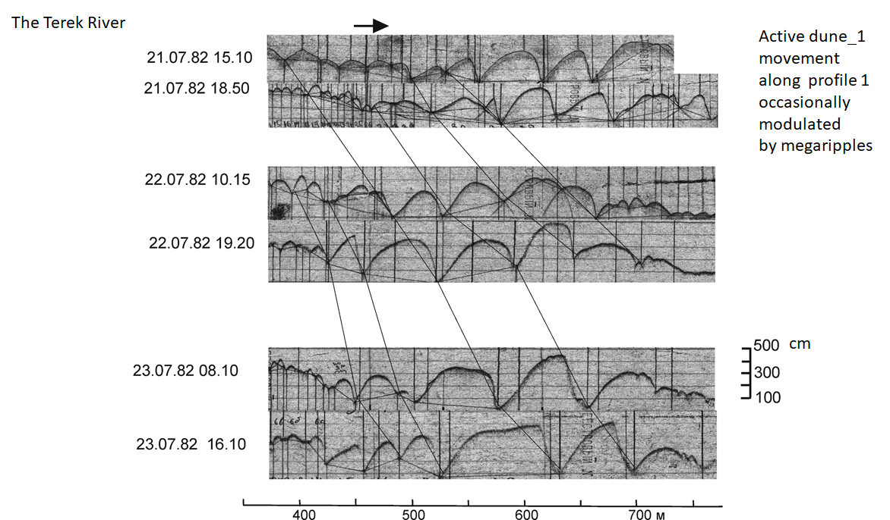

Slide 26
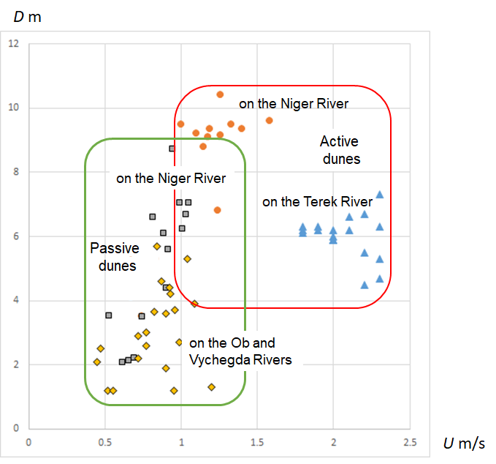
The flow depth-velocity diagram
with the areas of existence of
active and passive dunes
with active megaripples

Slide 27
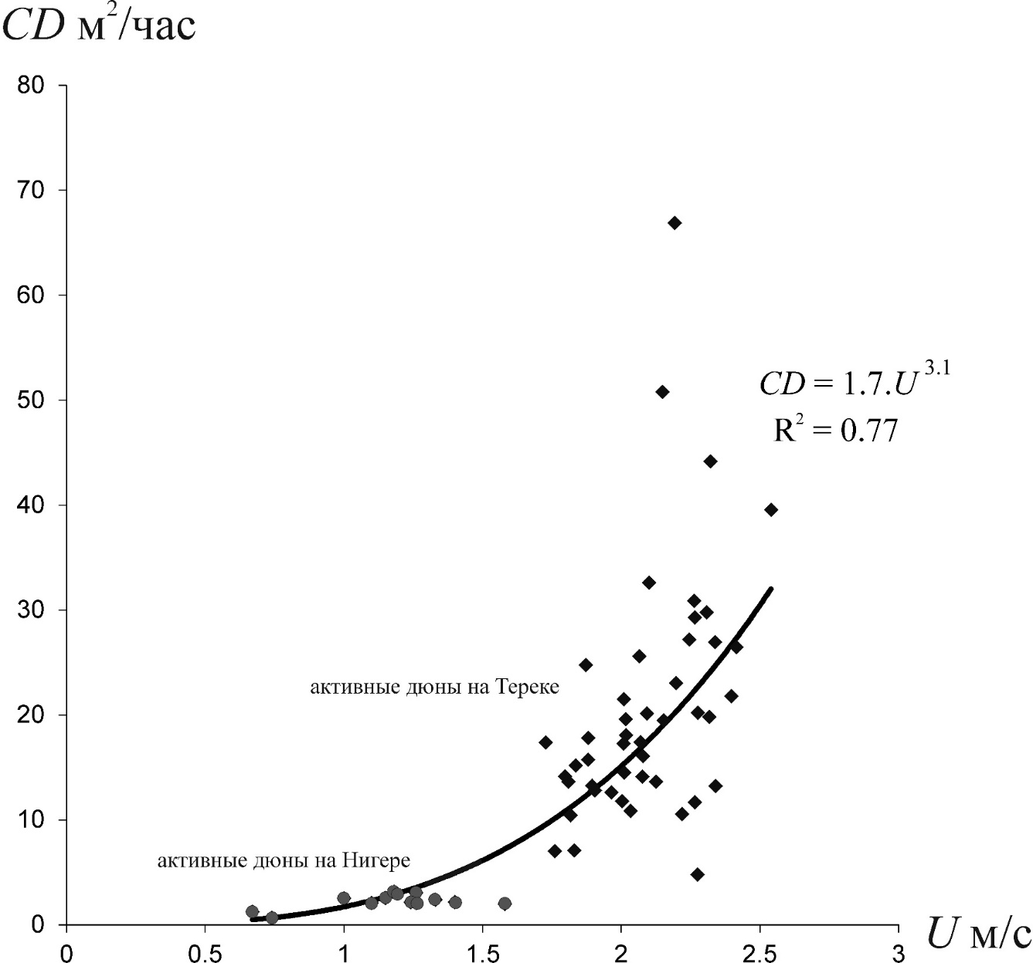
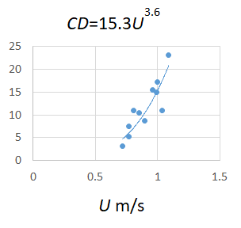
Passive dunes celerity C
as the function of flow depth D
and velocity U
The Niger, Ob and Vychegda Rivers
m²/hour
Active dunes_1 celerity C
as the function of flow depth D and velocity U
CD=2.8U
3.4
Active megaripples celerity C
as the function of flow depth D
and velocity U
Ob and Lena Rivers
Terek River
Niger River
m/s

Slide 28
The remaining questions
Hierarchical structure of the sand wave system can be found on the majority of large and medium-size rivers, and even in the large experimental flumes. An existence of the megaripple - bar pairs was explained theoretically using the small perturbation method (Sidorchuk, 1996). An existence of the pair megaripple - dune, although it is the most common one, still has no theoretical explanation.
Stochasticity of morphology and dynamics of sand waves, presumably, is caused by the stochastic nature of the river flow turbulence. The typical form of probability density functions for the morphological and dynamic characteristics of the dunes is close to asymmetric gamma-function or lognormal function, although the flow turbulence is described by symmetrical normal distribution. This phenomenon still requires the theoretical explanation
The two main modes of sand waves movement, active and passive, often are not distinguished. An active mode is common for megaripples even during the low water levels, but the active dunes movement can be detected only during the high floods or in rapid flows. With the decrease of water level and flow velocity the active dunes rapidly transform into passive ones. The larger sand waves are usually in the passive mode of movement. This phenomenon requires further investigation and theoretical explanation.

Slide 29
A few papers
Sidorchuk A. Y. Morphology of dune-like relief in rivers // Water Resources. — 2020. — Vol. 47, no. 1. — P. 65–76
Alekseevskii N. I., Sidorchuk A. Y. Morphology and dynamics of active bed forms in the Terek R. channel // Water Resources. — 2017. — Vol. 44, no. 2. — P. 226–236.
Sidorchuk, A. Evaluating bedload transport rate in a river bed taking into account data on the active and passive bed-forms dynamics // Water Resources. — 2015. — Vol. 42, no. 1. — P. 38–51.
Sidorchuk A.Y. Bed-form dynamics In the Nizhne-sheshurovskii shallows of the Vychegda River// Russian Meteorology and Hydrology— 2000. — no. 4. — P. 62–69.
Sidorchuk A. The structure of river bed relief // Coherent flow structures in open channels. — Wiley Chichester, UK, 1996. — P. 397–421.
Zaitsev A.A., Kirik O.M., Lodina R.V., Sidorchuk A.Yu., Chalov R.S. Channel changes on the Lena River in the transition of confined channel to wide floodplain//Water Resources — 1991 — № 6 — P. 22-30.

