Slide 1

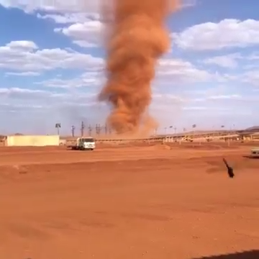
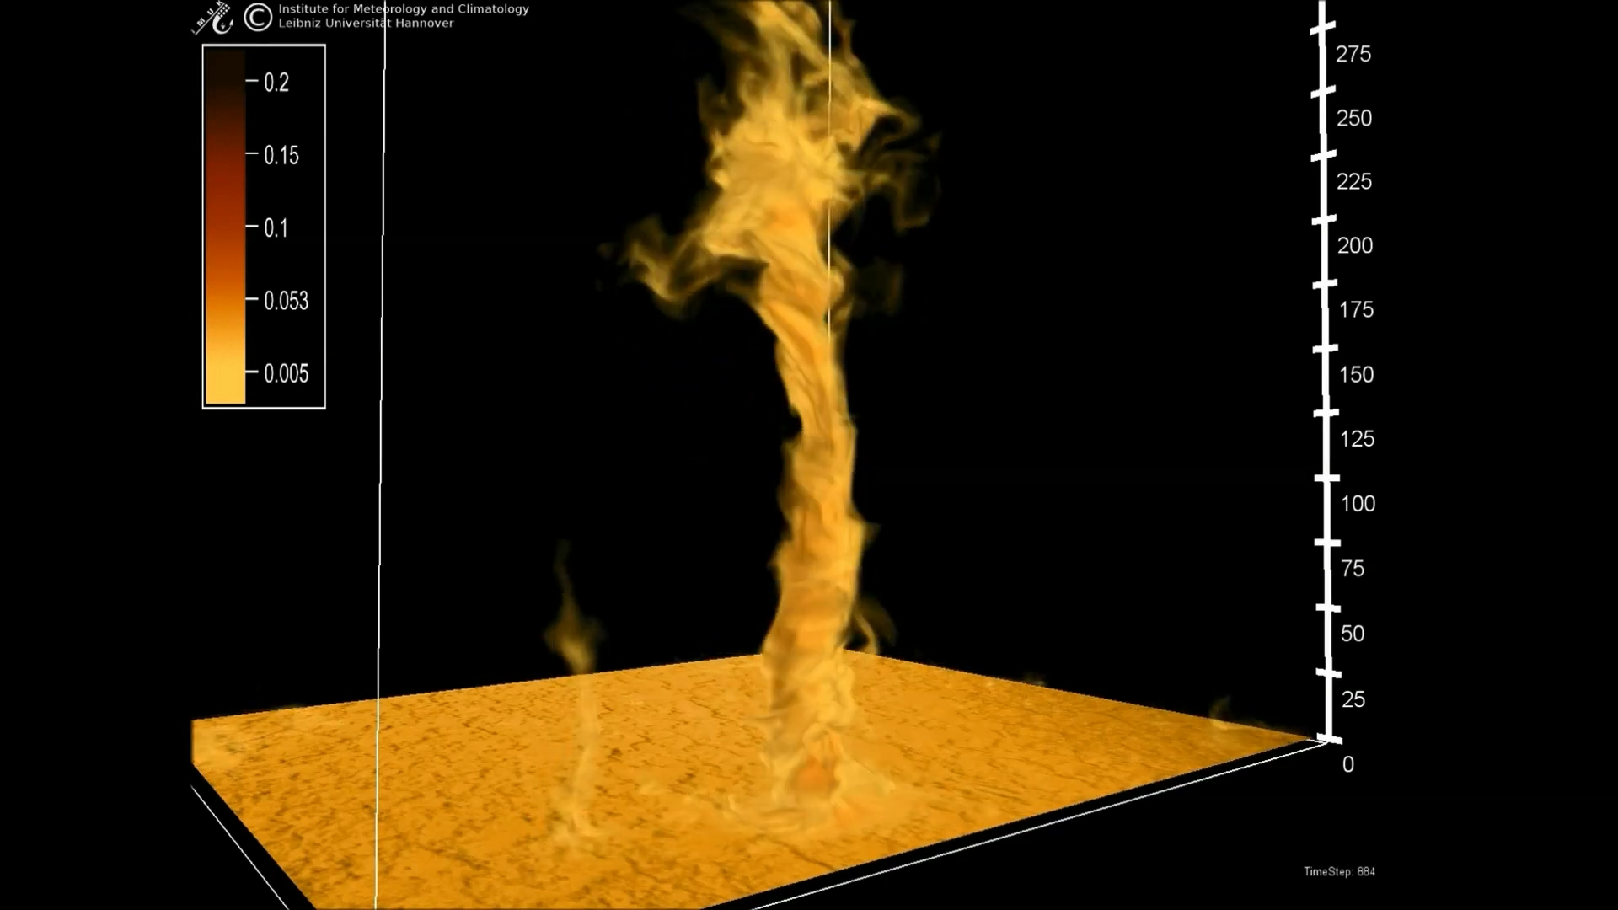

Genesis and Features of Dust Devil-Like Vortices in Convective Boundary Layers – A Numerical Study Using LES and DNS
youtube.com: Dust Devil in Pilbara, Australia.
youtube.com: Dust Devil simulated with the numerical model PALM.
M.Sc. Sebastian Giersch, April 20, 2020 - EGU2020 - Session AS2.1

Slide 2
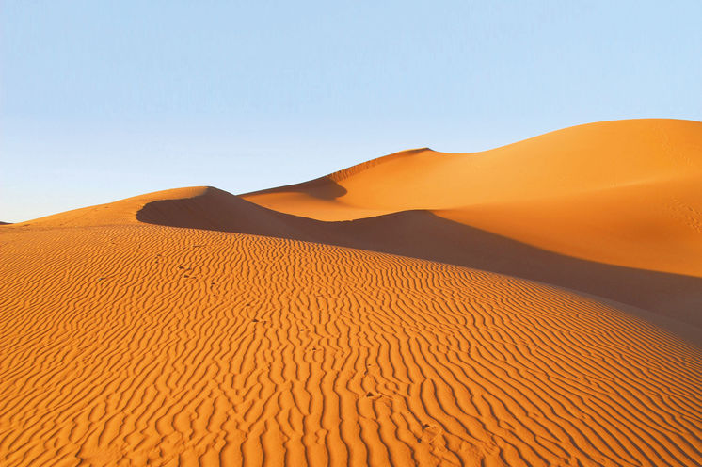

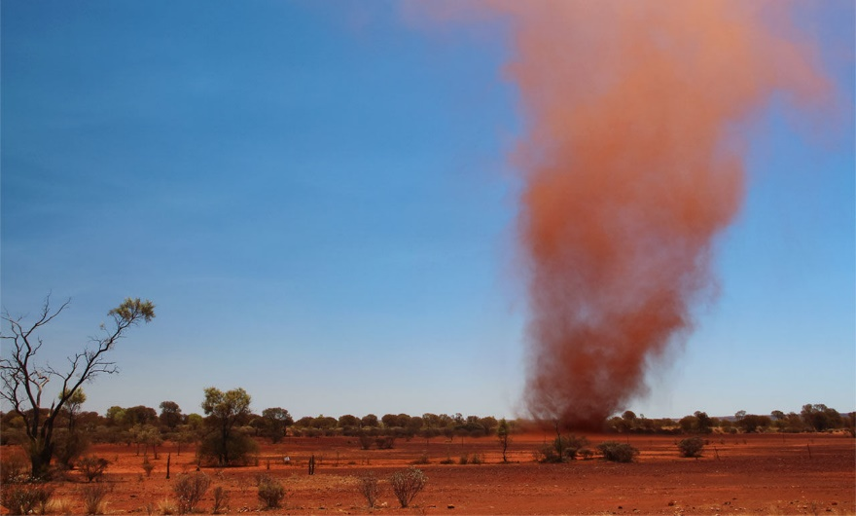


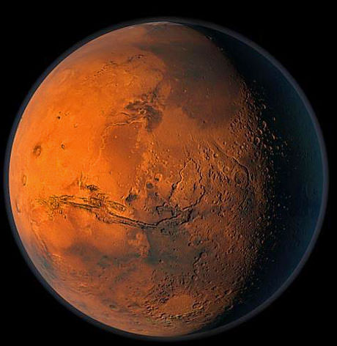

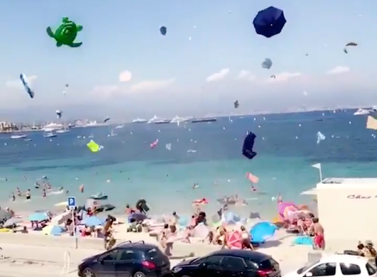
General Motivation
A definition: Dust Devils are organized, convective vortices with vertical axes which are made visible by entrained dust or other particles.
Source: sciencemag.org
Source: perrypedia.de
2. Influence on cloud formation
3. Influence on radiation budget
1. Aerosol emission into the atmosphere
Visually impressive and dynamically interesting
Dust devils are relevant for weather and climate considerations
Influence on Martian climate and future explorations
Source: devonlive.com
Source: mensjournal.com
Hazard for light aircrafts and human beings

Slide 3
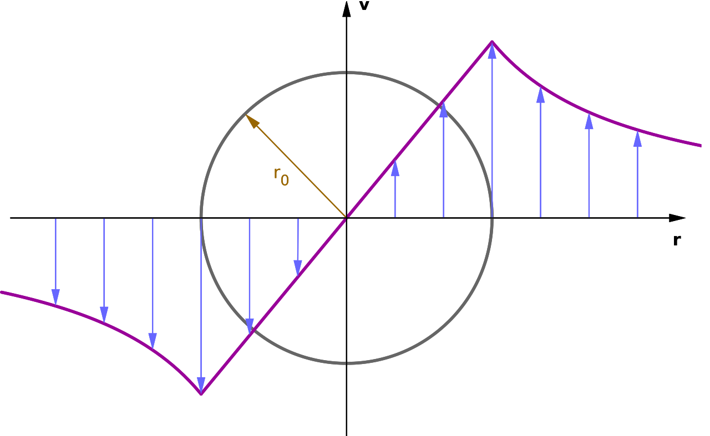
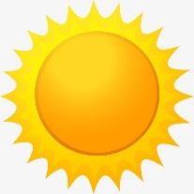
Dust Devils – A Sketch
Rankine vortex (Wikipedia):
V_{tan}
Genesis during strong insolation that triggers convection & under dry atmospheric conditions
Core with minimum in pressure and maximum in vertical vorticity (vorticity = curl of the flow velocity vector)
Radial inflow of near-surface warm air toward the center → warm core
Tangential velocity profile like a Rankine vortex
Vertical velocity maximum next to the center
Mean motion with ambient wind
HOT
Sketch of a dust devil (adapted from Renno et al. (1998)).

Slide 4
Dust Devil Investigations using Large-Eddy Simulation (LES)
A numerical definition: Dust Devils are organized, convective vortices with vertical axes reaching certain pressure drop and vorticity thresholds.
Key problem: Simulated values of core pressure drops (see right Table) are ~ 1 order of magnitude smaller compared to observed range (~ 250 – 450 Pa (Sinclair, 1973)).
Key method: Investigation of the effects of grid spacing, background wind, and surface heterogeneities on the simulated vortex strength with high-resolution LES of the convective boundary layer (Model: PALM).
Key finding: Observed core pressures can be reproduced by using a high spatial resolution of 2 m, a model setup with moderate background wind and a spatially heterogeneous surface heat flux.
For more information: S. Giersch et al. (2019): Toward Large‐Eddy Simulations of Dust Devils of Observed Intensity: Effects of Grid Spacing, Background Wind, and Surface Heterogeneities, J. Geophys. Res. Atmos., DOI: 10.1029/2019JD030513.
Giersch et al. (2019)
306
Simulated values of maximum core pressure drops (adapted from Spiga et al. (2016)).

Slide 5
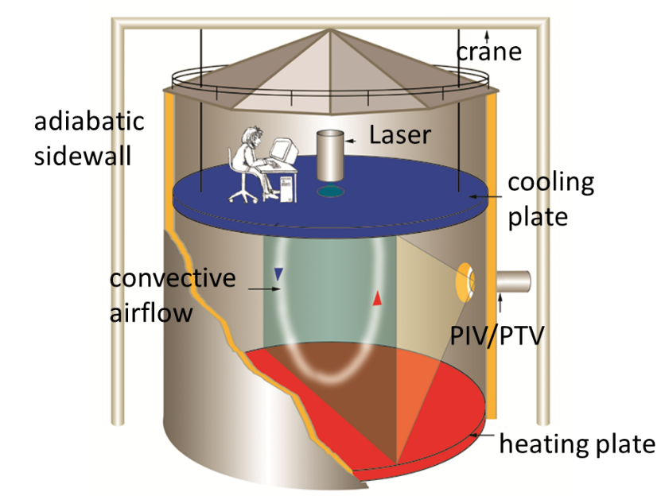
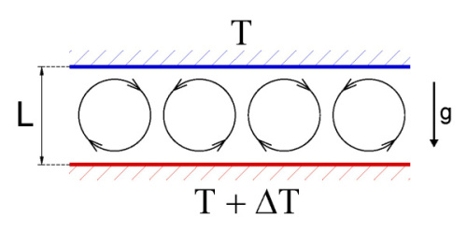
Dust Devil Investigations using Direct Numerical Simulation (DNS)
Key problem/motivation:
  Dust devil-like structures can not be resolved completely with LES, especially close to the ground, and are affected by boundary conditions (Monin–Obukhov similarities) in an unknown way.
  DNS results of dust devils allow us a direct comparison to experimental results obtained in the Barrel of Ilmenau (see right) - a large-scale experimental facility to investigate turbulent convection (https://www.tu-ilmenau.de/en/barrel-of-ilmenau/)
Key method: Investigation of the influence of the Rayleigh number (10⁹ ≤ Ra ≤ 10¹¹), the aspect ratio (2 ≤ A ≤ 4) and the velocity boundary conditions (no-slip vs. free-slip) on dust devil-like structures in Rayleigh–Bénard convection between to plates with DNS (Model: PALM).
Source: euhit.org
H
Source: isibrno.cz

Slide 6
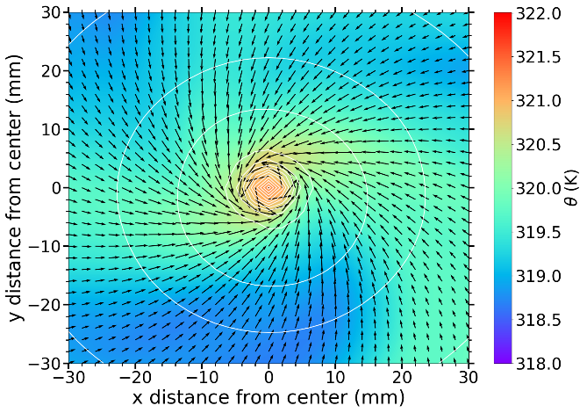
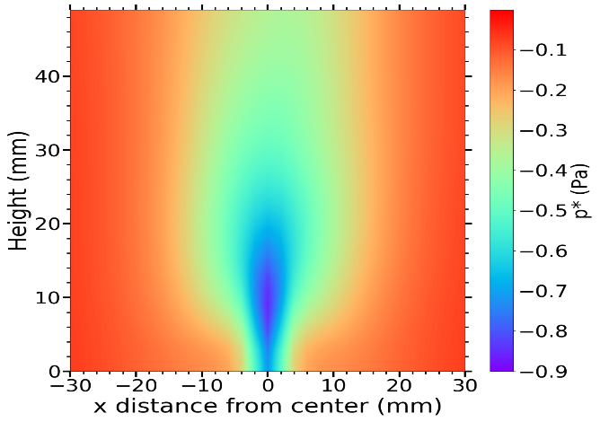


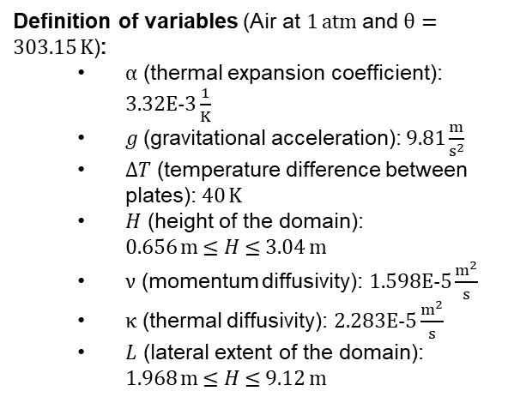
Dust Devil Investigations using Direct Numerical Simulation (DNS)
Key findings:
  The higher the Rayleigh number the larger the number of detected dust devils, the dust devils’ strength, and the translation speed the lower lifetimes.
  Aspect ratios between 2 to 4 only effect the number of detected dust devils and the total maximum values (e. g., maximum recorded pressure drop).
  Surface friction increases radial velocities & updrafts of the vortices, lifetimes and the dust devil’s strength but it lowers the translation speeds, the total number of detected dust devils and their lifetime-averaged horizontal & tangential velocities.
  The 3D structure is very similar to the one derived from LES data.
10⁹ ≤ Ra $=\frac{α g ∆T H3}{ν κ}$ ≤ 10¹¹
A = $\frac{L}{H}$
Definition of variables (Air at 1 atm and $θ=$ 303.15 K):
  $α$ (thermal expansion coefficient): 3.32E-3 $\frac{1}{K}$
  $g$(gravitational acceleration): 9.81 $\frac{m}{s^{2}}$
  $∆T$ (temperature difference between plates): 40 K
  $H$ (height of the domain): 0.656 m ≤ $H$ ≤ 3.04 m
  $ν$ (momentum diffusivity): 1.598E-5 $\frac{m^{2}}{s}$
  $κ$ (thermal diffusivity): 2.283E-5 $\frac{m^{2}}{s}$
  $L$ (lateral extent of the domain): 1.968 m ≤ $H$ ≤ 9.12 m
Near surface temperature distribution around a dust devil within the horizontal plane.
Near surface pressure drop distribution around a dust devil within the vertical plane.

Slide 7


Summary & Outlook
Summary - Key points:
First LES simulations producing dust devil-like structures of observed intensity were performed.
Grid spacings of 2 m, heat flux heterogeneities, and moderate background winds increase the strength of simulated dust devils via LES significantly.
First DNS simulations of dust devil-like structures for Rayleigh numbers up to 10¹¹ were performed (Publication with the title “S. Giersch and Raasch, S.: Genesis and Features of Dust Devil-Like Vortices in turbulent Rayleigh–Bénard convection – A numerical study using DNS“ is in progress).
Dust devil-like structures simulated via DNS are strongly effected by Rayleigh number and surface friction. The aspect ratio show only a weak influence on the dust devils’ statistics.
The time-averaged 3D structure of dust devils is very similar between LES and DNS simulations.
Outlook:
Comparison: Experiment vs. numerical Simulation
Further open questions:
initial development/vorticity origin,
maintenance,
and amount of dust/heat release
Source: euhit.org
Source: hlrn.de

Slide 8
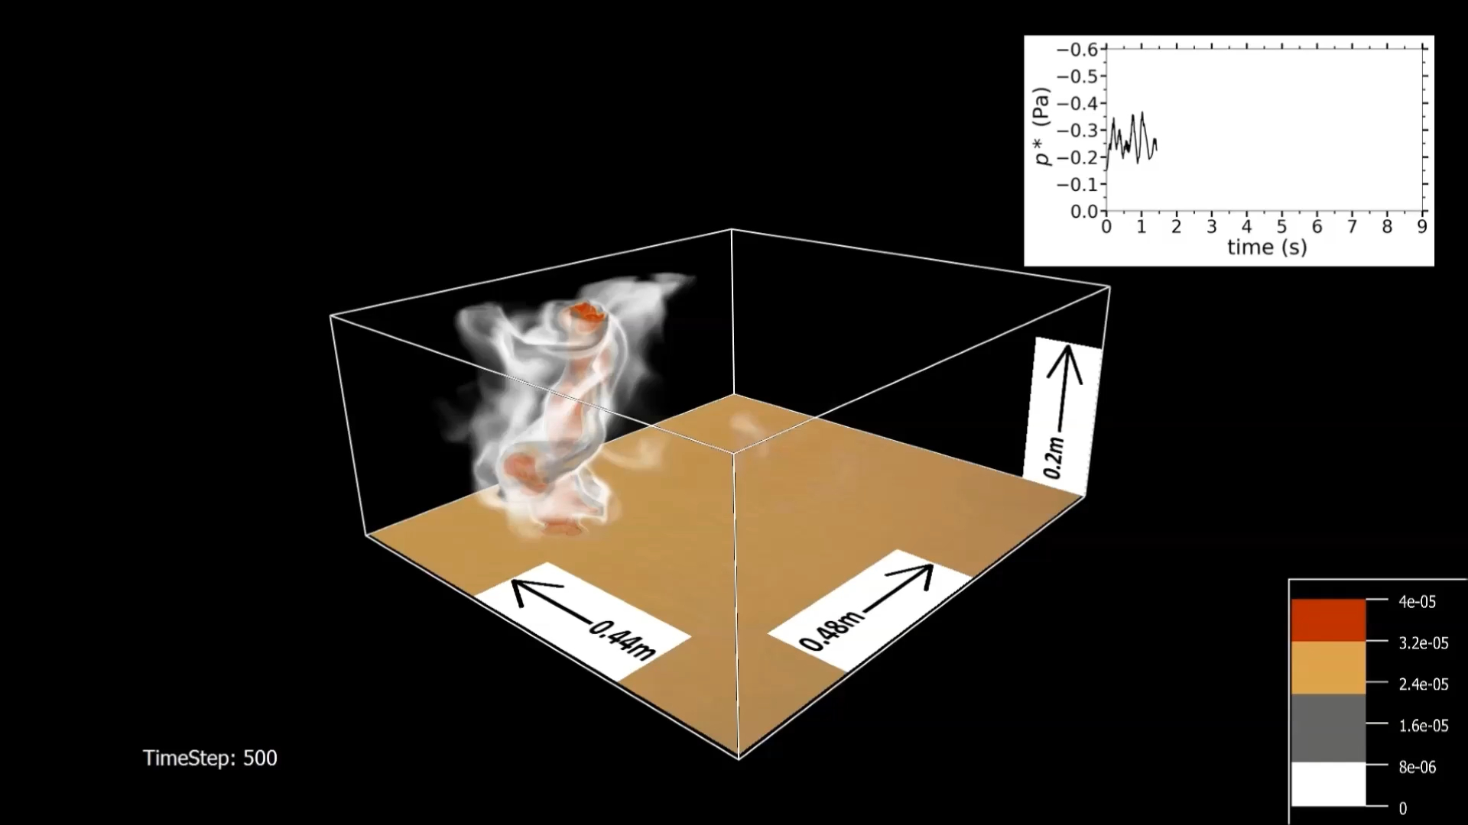
Summary & Outlook
Video of a dust devil-like structure for Rayleigh 10⁹, A=3 visualized through dust emission (arbitrary units):

