Slide 1
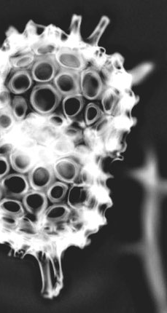
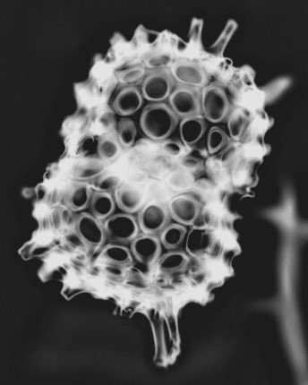
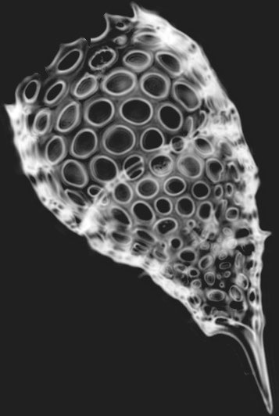



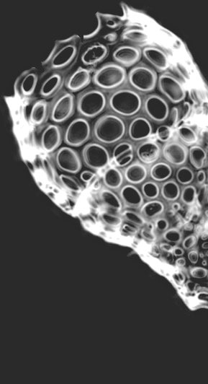



EGU 2020
A new automated radiolarian image acquisition, processing and identification workflow
Martin Tetard¹, Ross Marchant^{1,2}, Giuseppe Cortese³, Yves Gally¹, Thibault de Garidel Thoron¹, Luc Beaufort¹.
¹ Aix Marseille Univ, CNRS, IRD, Coll France, INRAE, CEREGE, Aix-en-Provence, France.
² School of Electrical Engineering and Robotics, Queensland University of Technology, Brisbane, Australia
³ GNS Science, Lower Hutt, New Zealand.

Slide 2
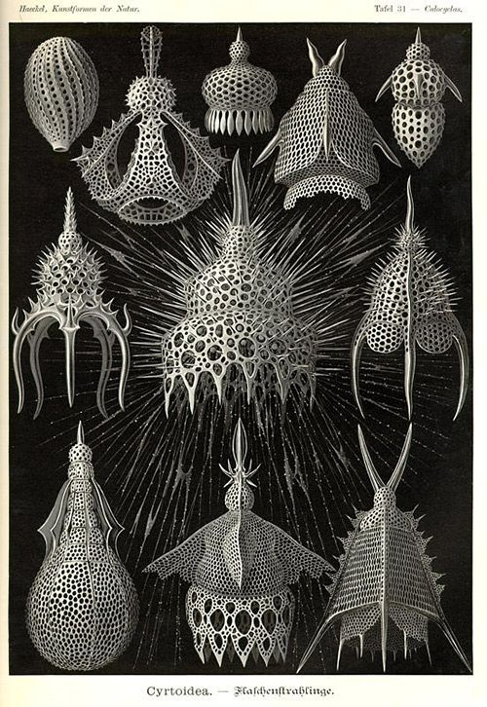
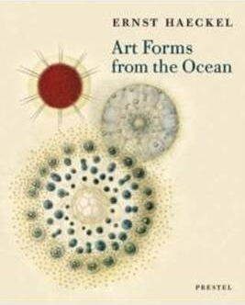
Just a reminder
Marine planktic micro-organisms,
Siliceous shell,
50-500 µm,
Known since the Cambrian (540 Ma),
Presence / Absence, abundance of some species are used as tracers,
Very useful for productivity and temperature reconstructions, for tracking water masses, and for biostratigraphical studies.
« Recent technological advances in image acquisition, processing, and recognition now enable automated procedures, from microscopic slide field-of-view acquisition to taxonomic identification. »
Step 1: slide preparation
However, their investigation requires:
a significant taxonomical knowledge (identification can be biased between operators),
time, as about 300 specimens per sample need to be counted for reliable analyses.

Slide 3
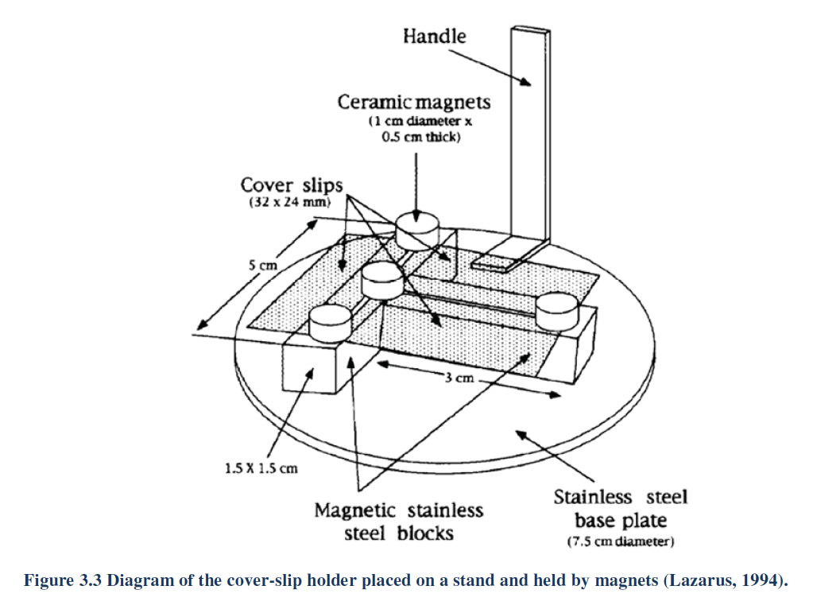
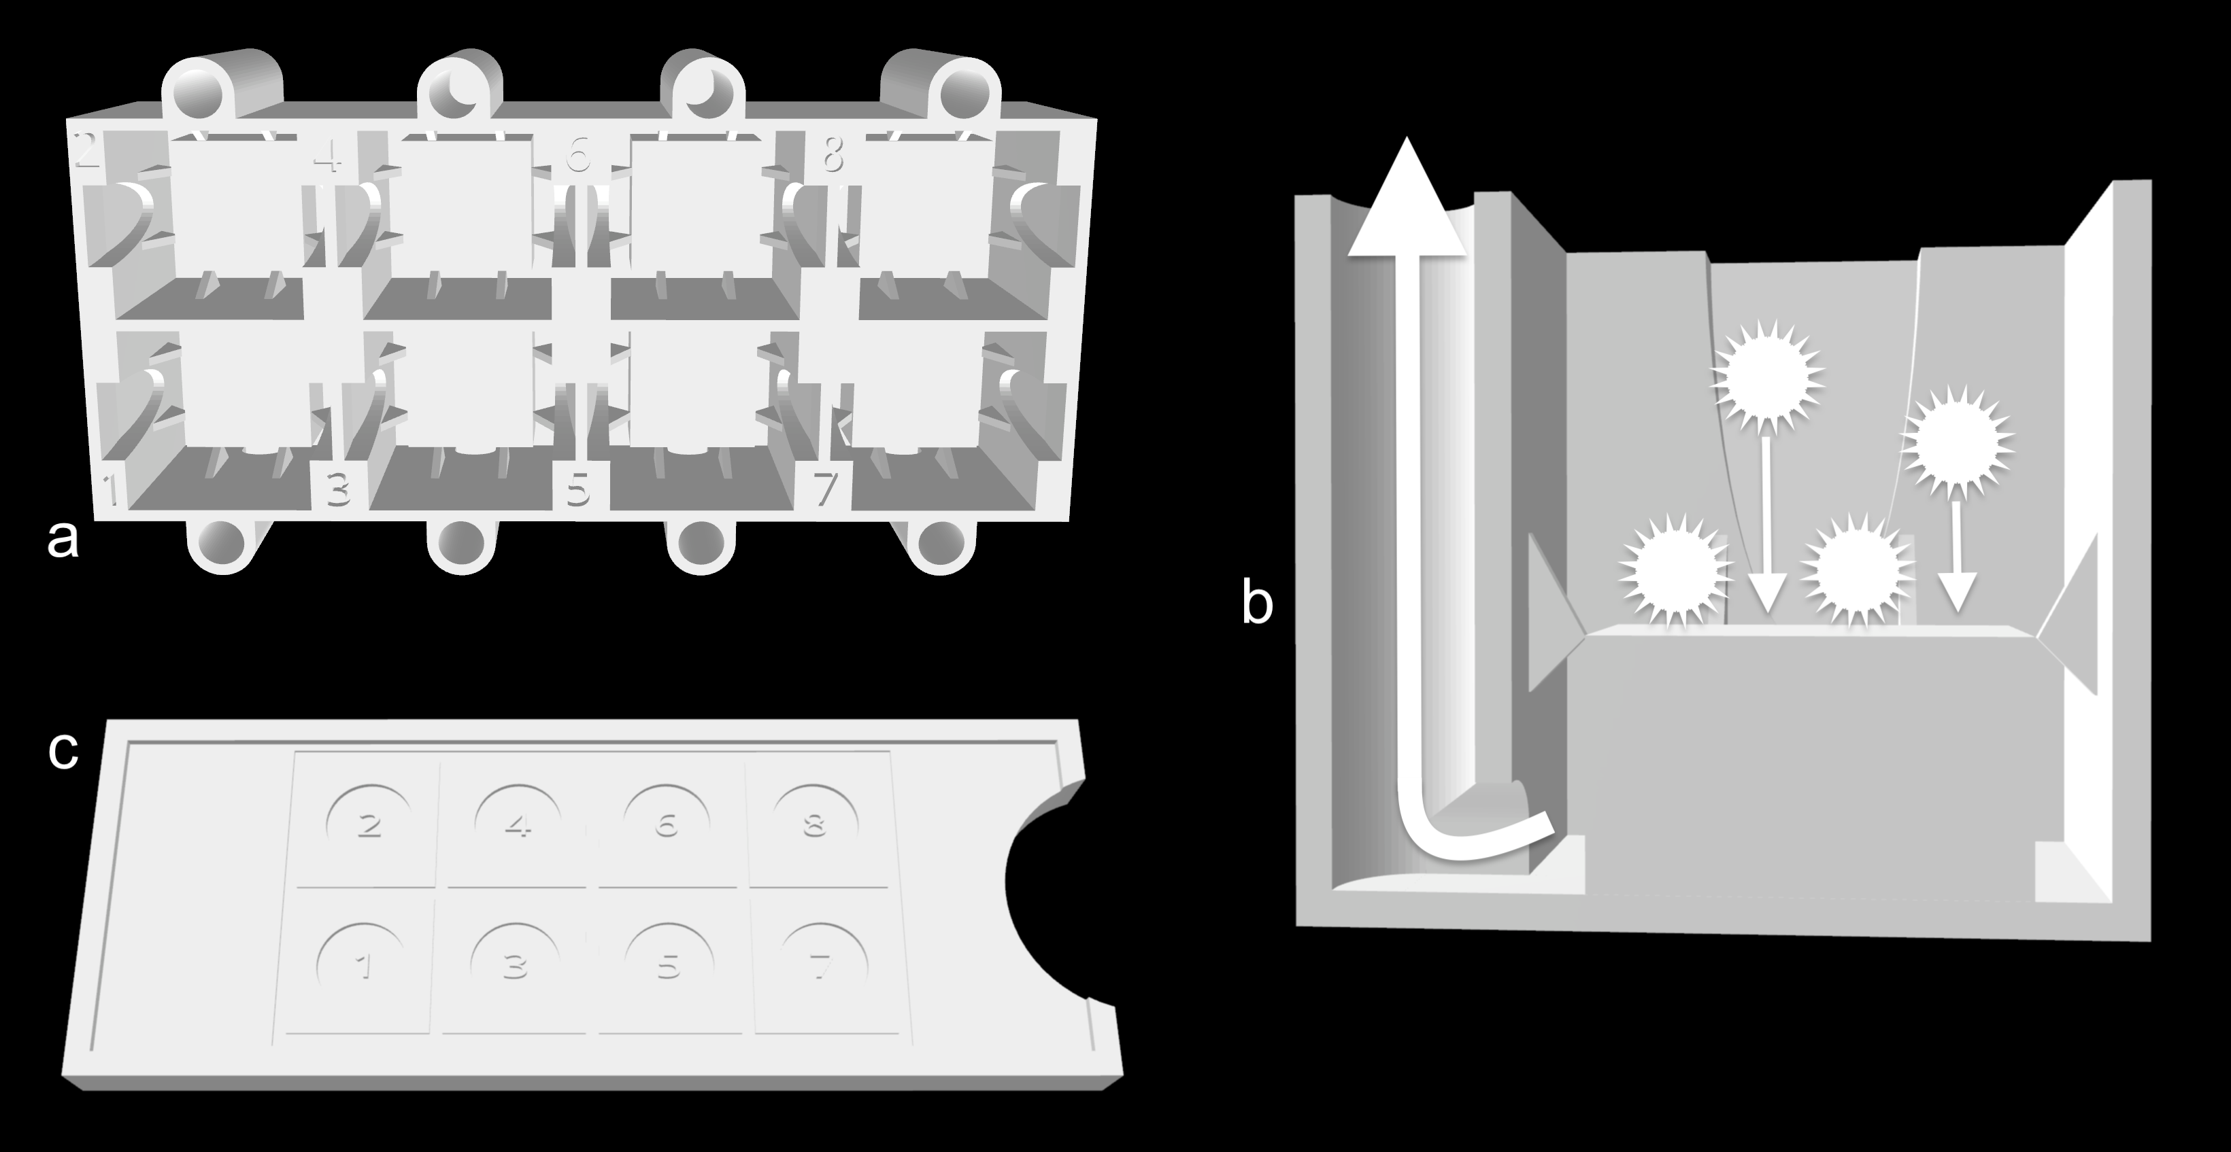
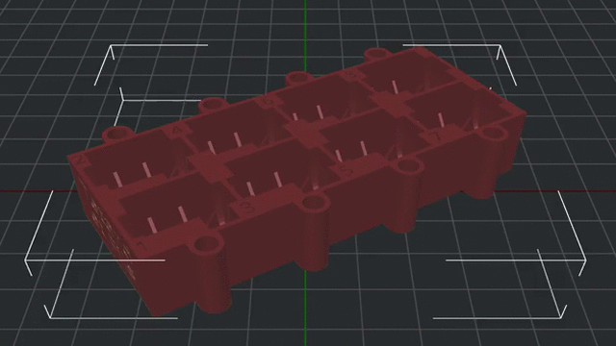
A new random settling protocol
Original protocol for radiolarian slides preparation.
Main issues:
-Lots of loss,
-Large cover slides.
New protocol for slide preparation.
Advantages:
-Minimise the loss of material,
-very fast tu use and clean,
-1 sample per tank = 8 samples per system (and per slide).
Step 2: image acquisition
Diagram of the cover-slip holder placed on a stand into a beaker = 1 sample per system (Lazarus, 1994).
Step 1: slide preparation
3D printed decanter for random settling of particles on cover slides.
Cross-section of a tank.
3D printed slide guide for mounting cover slides.

Slide 4

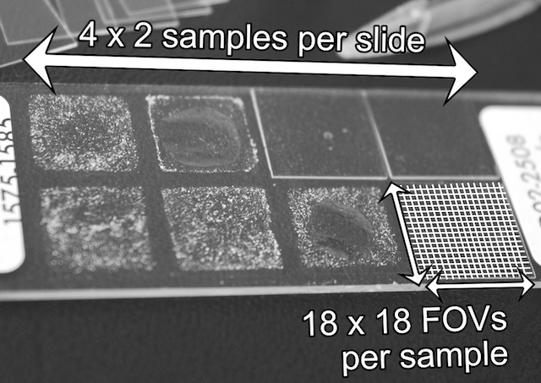
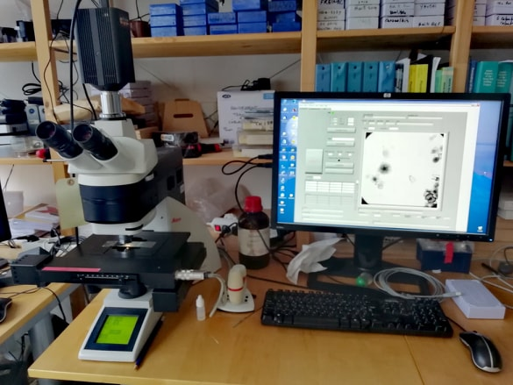
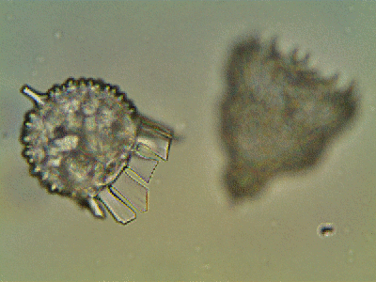
A new automated acquisition
1 slide = 8 cover slides (= 8 samples, after Beaufort et al. (2014) ),
1 sample = 324 fields of view (FOVs).
Step 2: image acquisition
www.microbehunter.com
1 FOV = hyperfocus of 15 images acquired by incrementally stepping through the slide (step size: 10 µm).

Slide 5
Step 3: image stacking

Slide 6

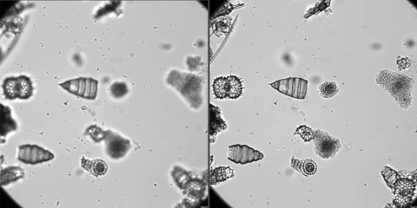
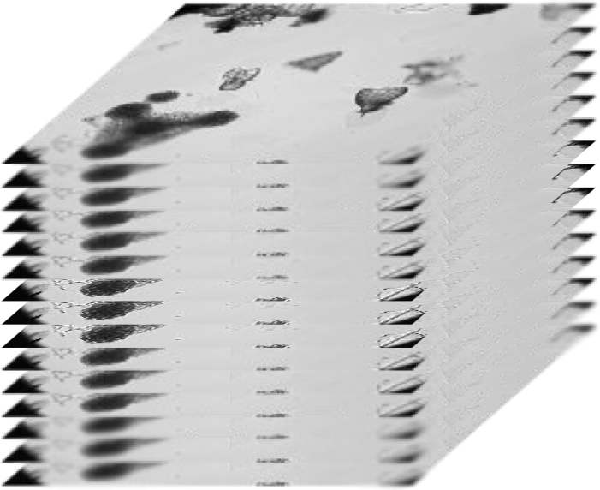

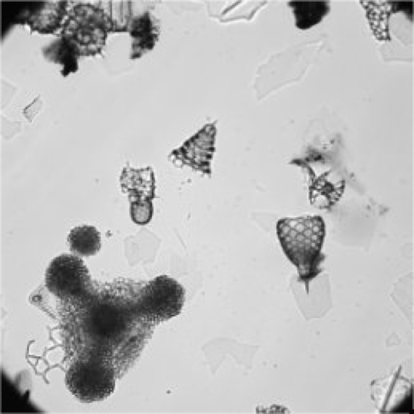
A new automated FOVs stacking
Stack of 15 original FOVs
Step 4: image processing and segmentation
Step 3: image stacking
For each FOV, the 15 mages are then automatically stacked using a depth map on Helicon Focus, The focally stacked FOV is saved send for image processing.
Stacked FOV

Slide 7

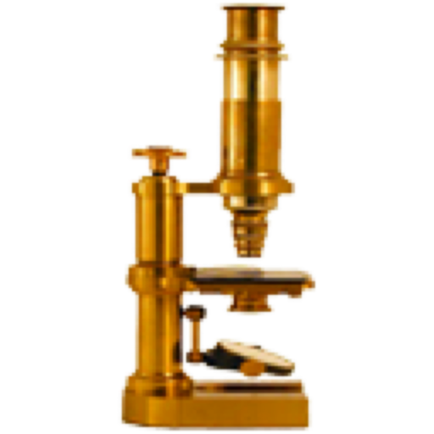
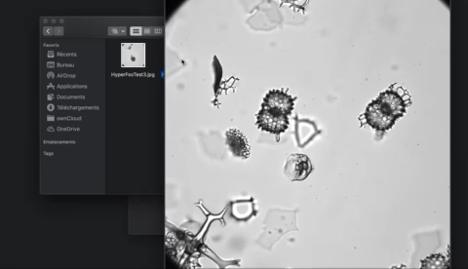
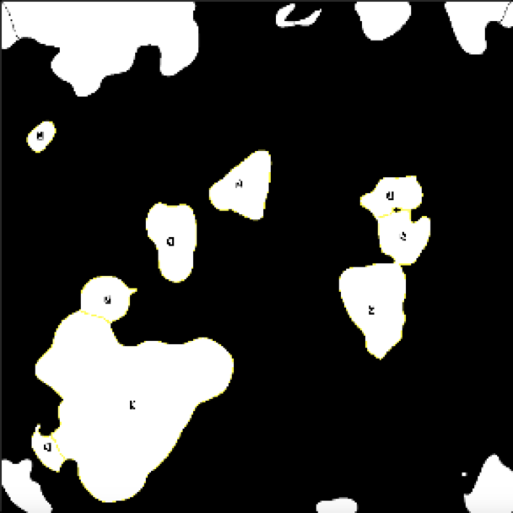
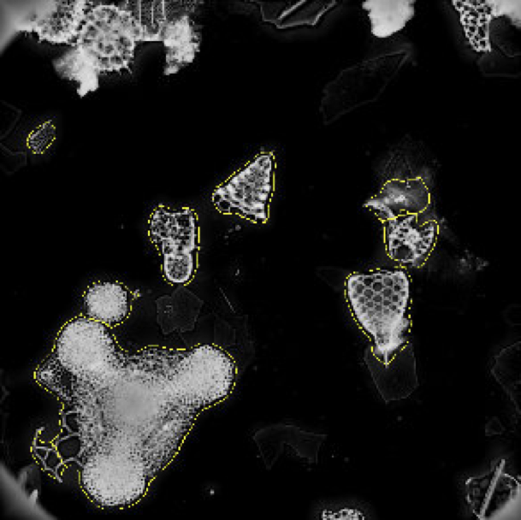
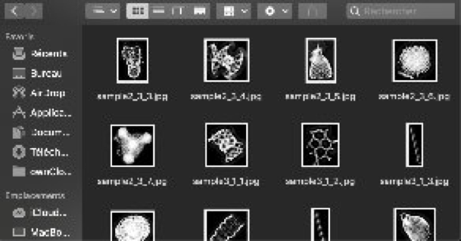
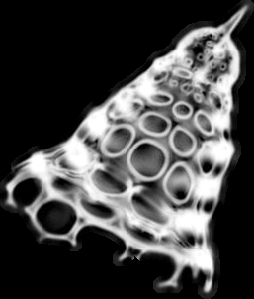
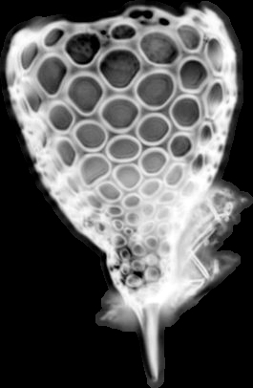
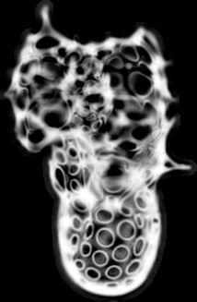
A new automated segmentation
Stacked FOV
Defining ROIs
Step 4: image processing and segmentation
  Automated image processing, segmentation, and vignettes export.
Applying ROIs on inversed stacked FOV
Vignette for each specimen
1 sample = ~ 2000 - 3000 vignettes,
1 slide = ~ 20000 vignettes.

Slide 8
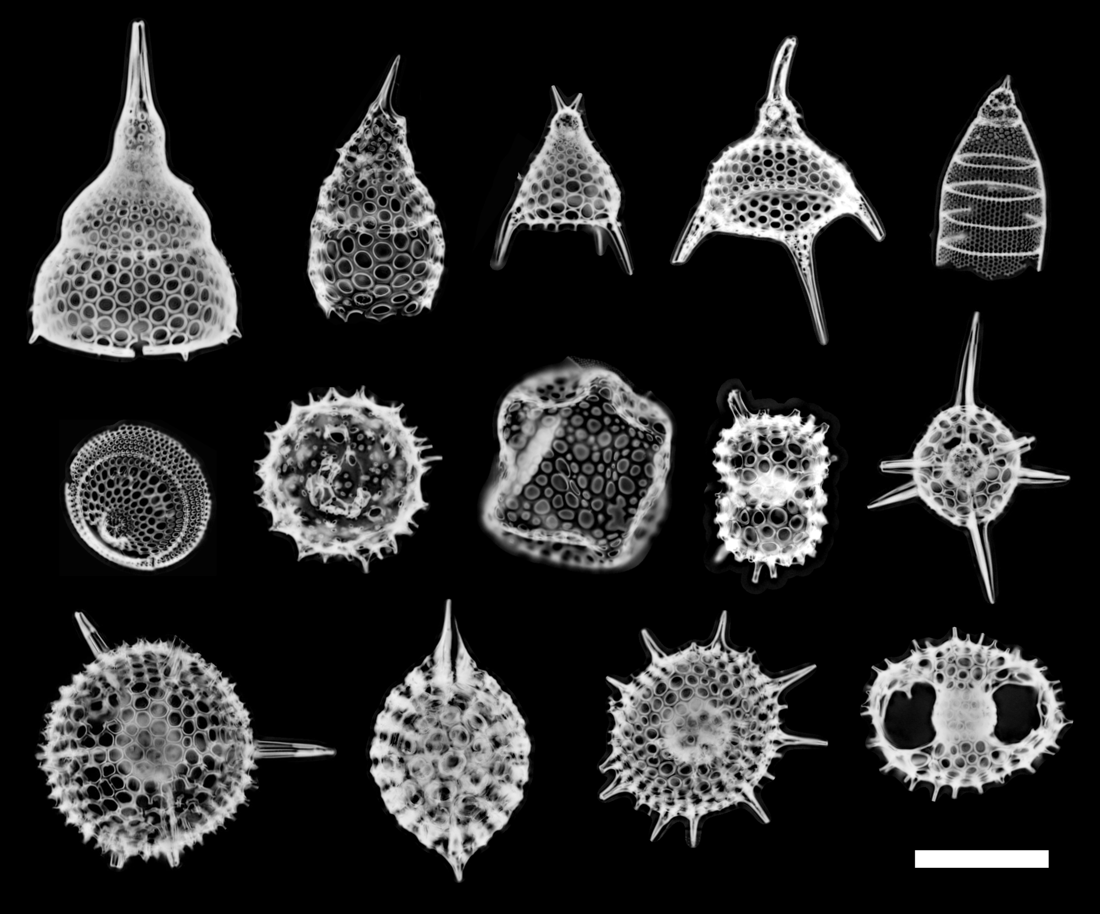
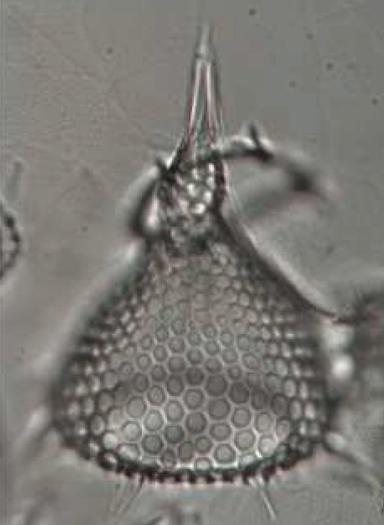
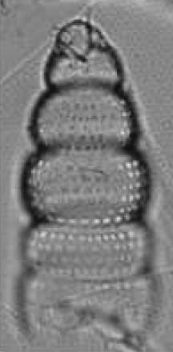
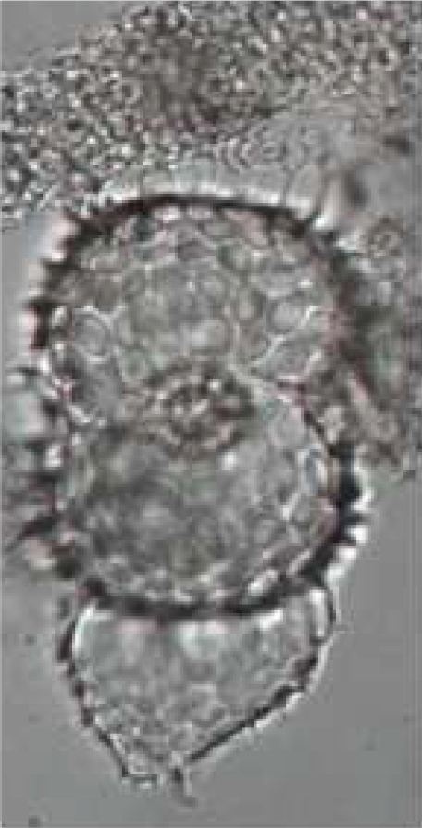
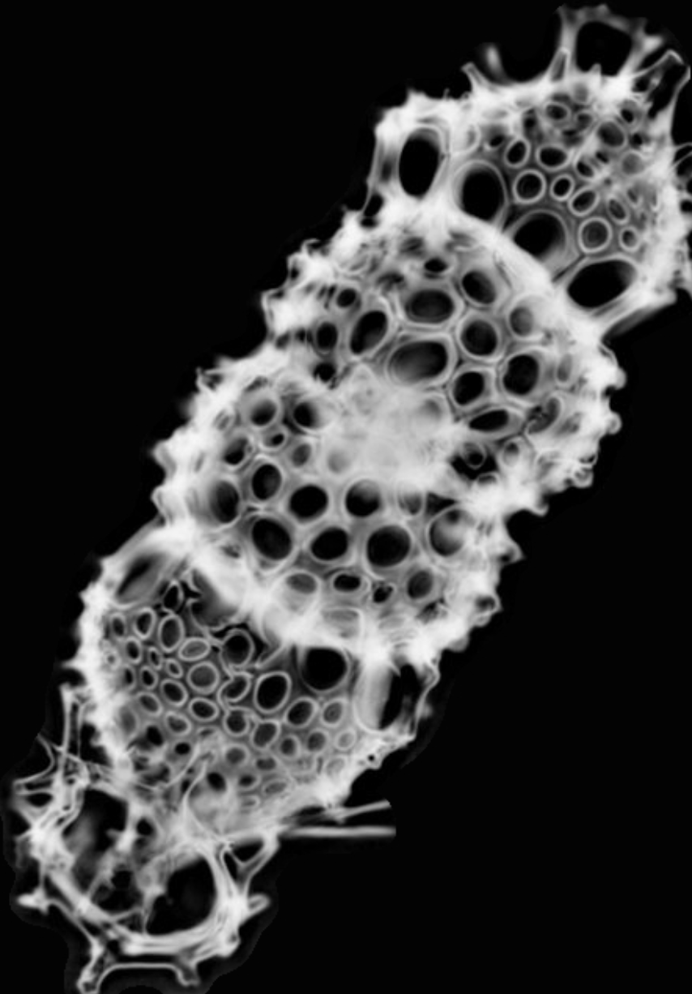
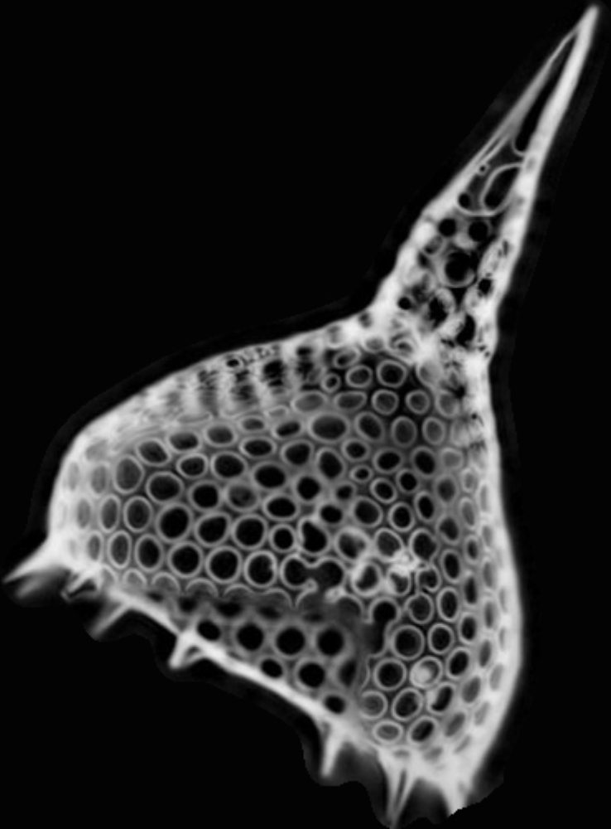
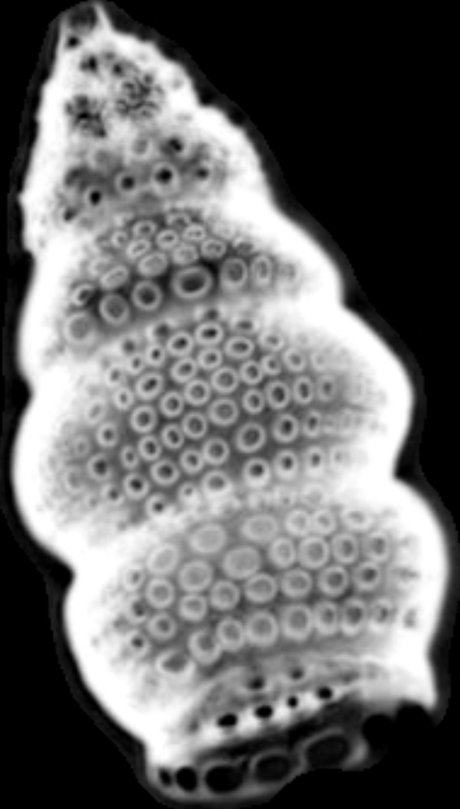
A new automated segmentation
Step 5: image recognition
Anthocyrtidium ophirense
Botryostrobus auritus-australis
Didymocyrtis tetrathalamus tetrathalamus
Few examples of radiolarian specimens after the automated image processing and segmentation. Scale bars 100 µm

Slide 9
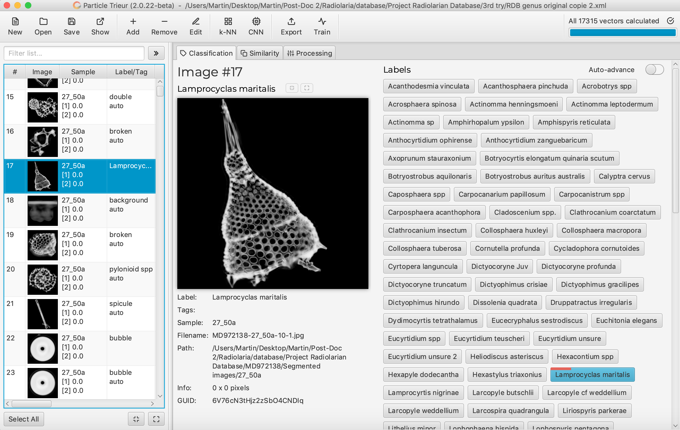
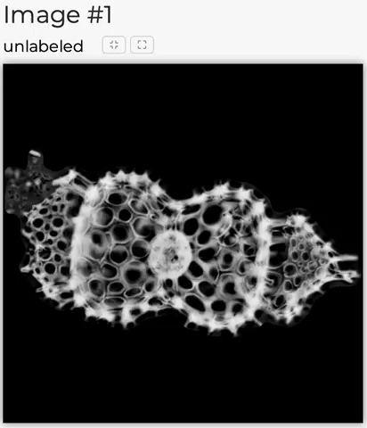
A new automated recognition
« Convolutional Neural Networks (CNNs) enable Deep Learning approaches for classifying images of different microfossil taxa. »
Step 5: image recognition
Particle_trieur, a software developed at CEREGE (Marchant et al., 2020) is used to built a database and classify each image.

Slide 10
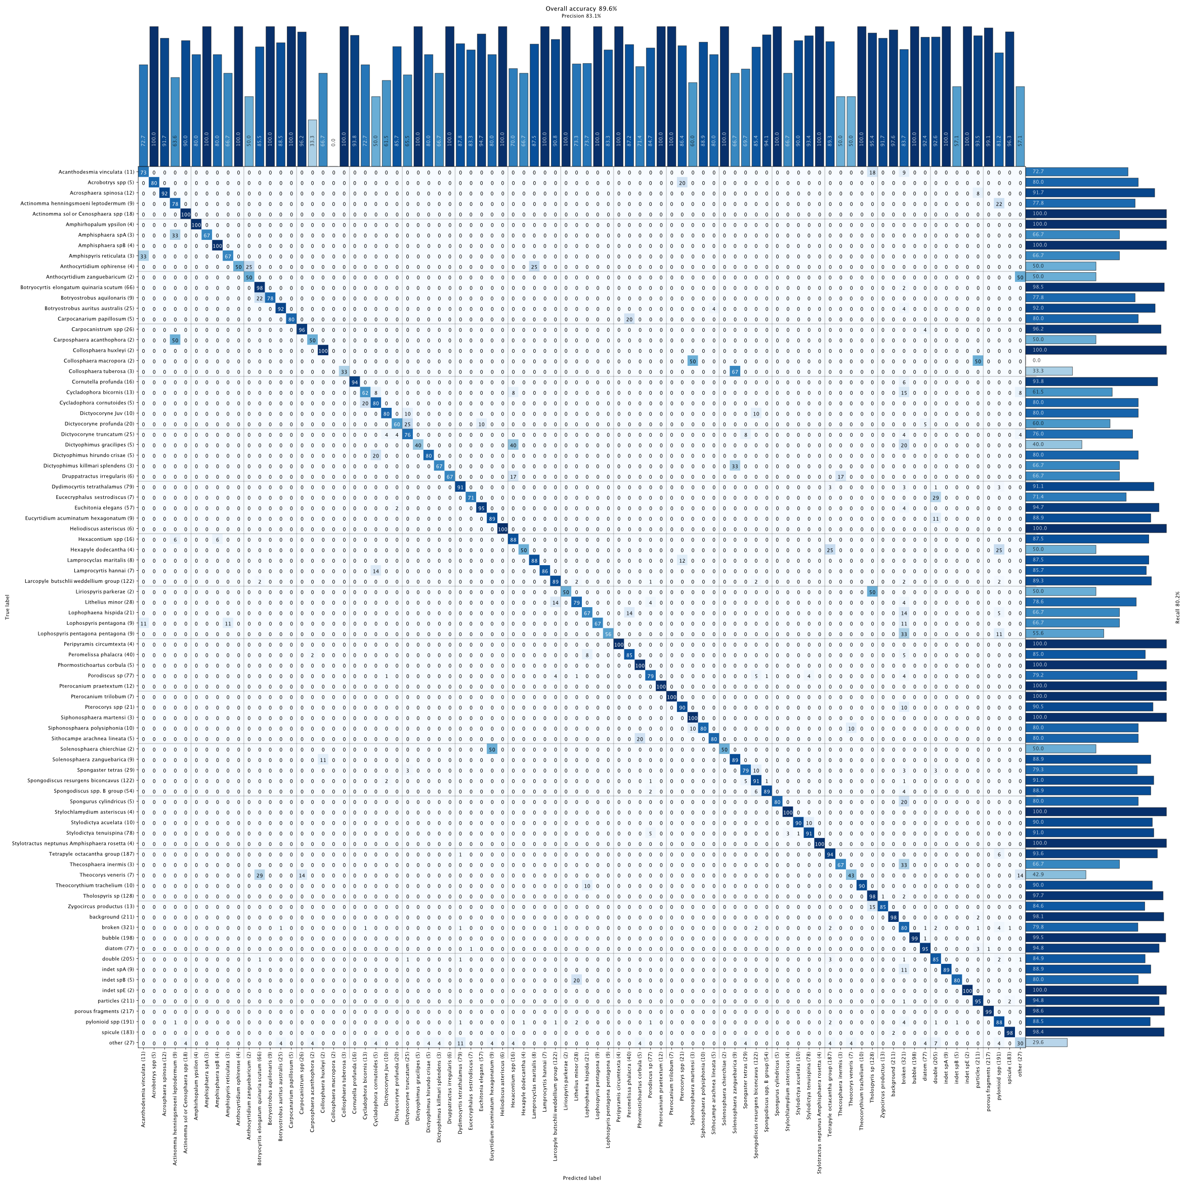

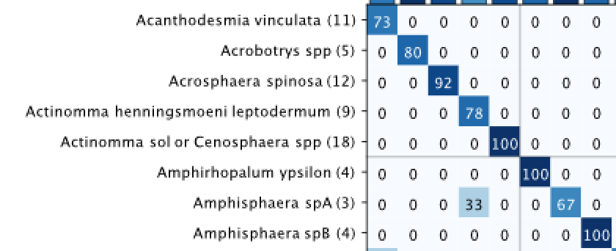
Database
Currently 17.065 images, recovered from West Pacific Warm Pool samples,
112 classes in total, 84 trained classes (as classes with less than 10 images are fused into a single one),
Overall accuracy of 90 %.
« Convolutional Neural Networks (CNNs) enable Deep Learning approaches for classifying images of different microfossil taxa. »
Step 6: Image storage and census counts
Example of recognition scores for a few radiolarian classes.
Confusion matrix for the trained CNN (based on resnet50).

Slide 11
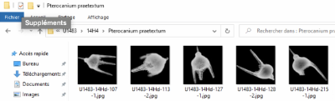



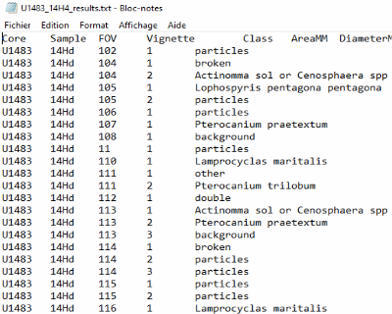

Automated counts and image storage
The trained CNN automatically returns images identification.
3 kinds of results are automatically exported:
(1) Identified individual images are saved into folder corresponding to their assigned classes and samples.
(2) Census data and (3) morphometric measurements are also automatically saved for each sample and core.
Step 6: Image storage and census counts

Slide 12
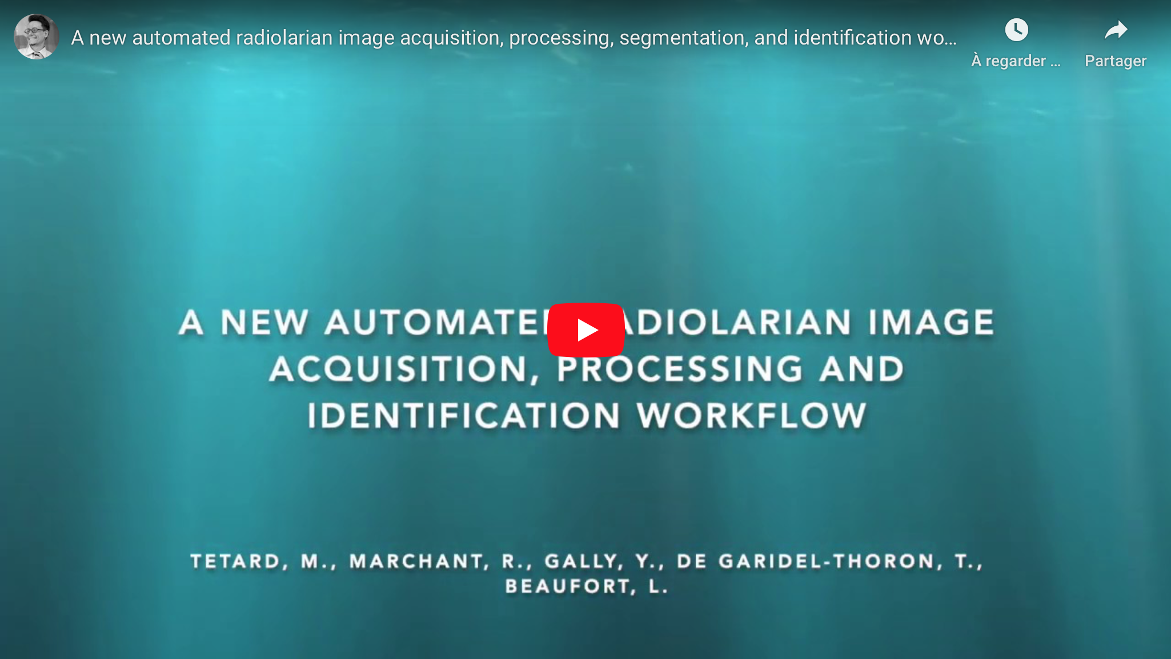

Operational workflow
https://www.youtube.com/watch?v=4U66wgLoVPg&feature=emb_title

Slide 13
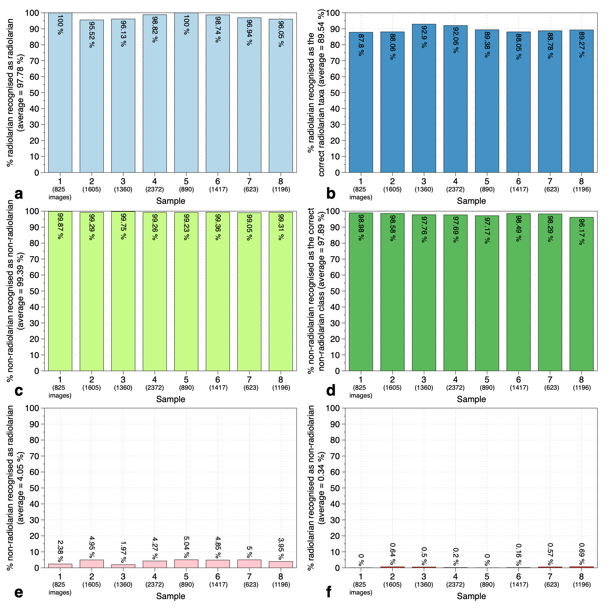
Accuracy of the CNN on random samples
8 new random samples (10.288 images) from the WPWP were prepared, and processed according to the described protocol.
Vignettes were automatically identified and manually checked to test the accuracy of this new recognition workflow.
In average:
98 % of radiolarian images were actually recognised as radiolarians (a),
90 % of radiolarians were identified as the correct radiolarian taxa (b),
99 % of the non-radiolarian images were recognised as non-radiolarian (c),
98 % non-radiolarian images were assigned to the correct class (d),
4 % were radiolarian false positives (non-radiolarian images among radiolarians, e),
0.3 % were non-radiolarian false positives (radiolarian images among rnon-adiolarians, f).

Slide 14


Autoradio database
Conclusion
A new automated radiolarian workflow was developed and consists of a sequence of 6 steps:
1: A new microscopic slide preparation protocol that decreases the loss of material,
2: Automated microscope image acquisition of slides bearing up to 8 samples at different focal depths,
3: Automated stacking of each batch of fields of view (FOV) images,
4: Automated FOV image processing and segmentation to generate individual images for every radiolarian specimen,
5: Automated radiolarian recognition using a CNN,
6: Automated export of census data and morphometric measurements per sample, and storage of radiolarian images.
https://autoradiodatabase.wordpress.com/database/

